Slide 1
ANALYSIS OF COVID-19 IMPACT ON STOCK PRICE
EE0005 GROUP PROJECT
MEMBERS: Calamur Muralidaran Arun Rameshwar Seenivasagan Haresh Sivaramakrishnan Hemang Venkatesh Pratul

Slide 2
PROJECT
Area of analysis:
COVID-19 Cases in USA Companies listed under S&P500 Index
Objective:
Predict the stability of a stock price of a company and analyse behaviour of stock market in the COVID-19 pandemic.
Application:
As a personal investor, if another wave of cases were to hit, which stocks should one be wary of experiencing drastic change, and to thus avoid losses by appropriately buying and selling.

Slide 3
Stock Market Price – Time Series Data ❌
Instead analysed using stock price at key dates:
Start of wave of cases, peak of wave of cases, end of wave of cases.

Slide 4
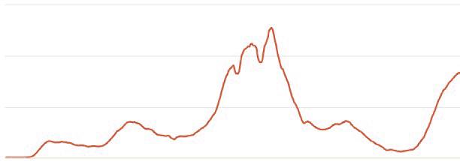
COVID-19 Daily Cases in USA
WAVE 1
WAVE 2
WAVE 3
WAVE 4 (ONGOING)
Only WAVE 1 & WAVE 3 analysed. The other waves were not considered due to:
Wave 2 – Other political movements influence present at that time.
Wave 4 – Ongoing

Slide 5
Sample stock data obtained for
each company. Eg: Apple Inc
DATES
WAVE 1 | Start | 15/3/2020
 | Peak | 10/4/2020
 | End | 10/5/2020
WAVE 3 | Start | 10/9/2020
 | Peak | 1/1/2021
 | End | 20/2/2021
66.45 USD
65.99 USD
85.24 USD
113.90 USD
129.92 USD
129.92 USD
Above are week average
around that data

Slide 6
Formula Used
‘CLASS’ variable – RESPONSE variable created by us.
Will be predicted using other company aspects as PREDICTORS.
Values:
1 – Volatile. Stock price likely to change.
0 – Observed to have been stable.

Slide 7
Formula Used
% change during Wave 1 cases rise: (65.99-66.45)/(66.45)=0.69%
% change during Wave 1 cases decrease: (85.24-65.99)/(65.99)=29.17%
Average Wave 1 change (with more weightage to change during rise)
=AVG(0.69,0.69,29.17)=10.18%
__
Similar % calculated for Wave 3 = 9.377%
__
AVERAGE CHANGE = AVG(10.18,9.377) = 9.78%
Sample stock data obtained for
each company. Eg: Apple Inc
66.45 USD
65.99 USD
85.24 USD
113.90 USD
129.92 USD
129.92 USD

Slide 8
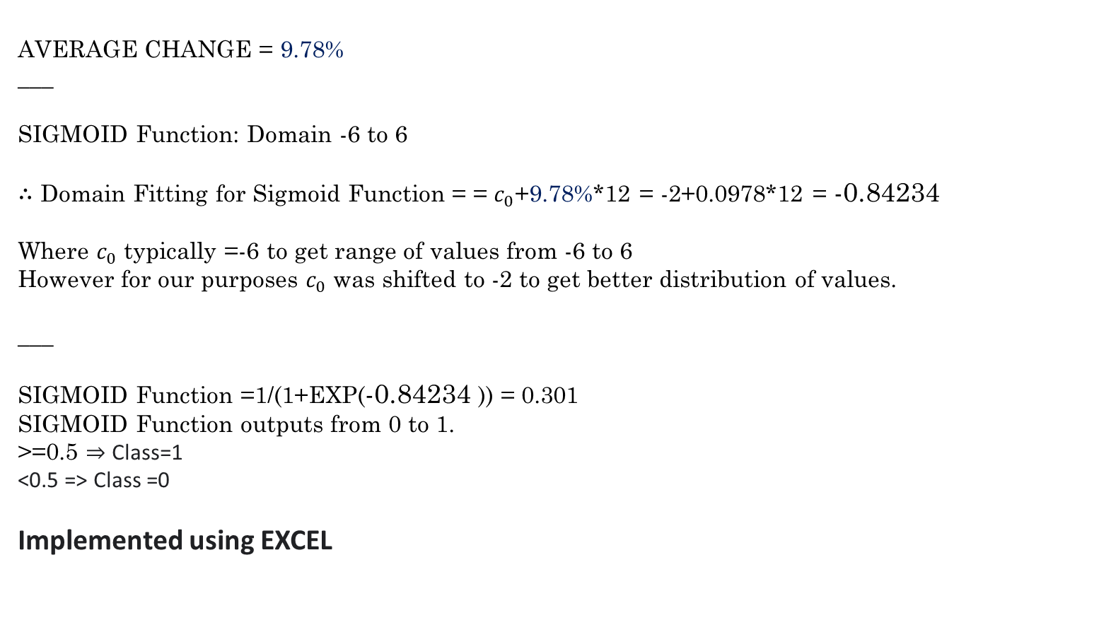
Formula Used

Slide 9
To obtain our data we used yfinance API to download data from Yahoo Finance
We thus obtained the following attributes for each company to use as PREDICTORS:
sector city industry priceToBook bookValue
shortRatio revenuePerShare operatingMargins forwardEps
heldPercentInstitutions heldPercentInsiders marketCap
profitMargins volume totalDebt totalCash beta totalCashPerShare
enterpriseValue floatShares numberOfAnalystOpinions
Notes:
Include how many attributes

Slide 10
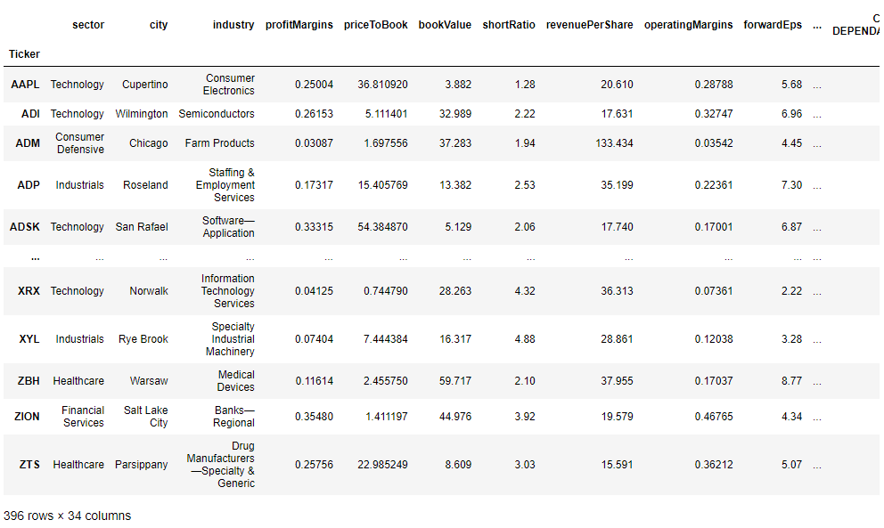
Combined with our CLASS output following was the final dataset created by us:
Lack of data for 100 companies ⇒ Our dataset size was around 400 Companies

Slide 11
It is thus a CLASSIFICATION problem for predicting either 0 or 1,
(depicting stability during wave of COVID-19 cases)
from other company attributes.

Slide 12
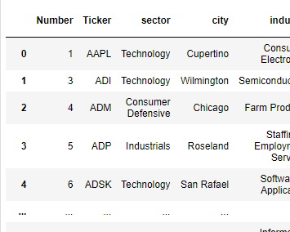
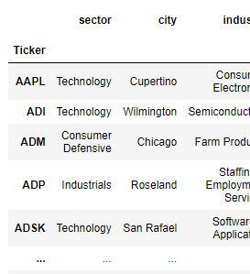

DATA CLEANING
After downloading data, duplicate columns were present which were dropped.
Eg: Volume.1 , profitMargins.1
Some companies had to be dropped because of too many missing values for some features.
Columns were re-indexed with company names for accessibility.

Slide 13
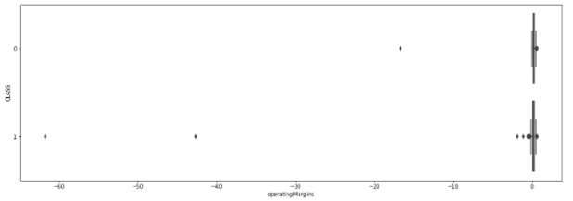
DATA PRE-PROCESSING
To utilize ‘Sector’ a categorical variable we used One-Hot Encoding that creates separate columns for each sector which can contribute to classification trees.
For some variables, far outliers and prescence of too many outliers affected data.
Thus we used Robust Scaler to make the data useable and to adjust the scale of response variables.

Slide 14
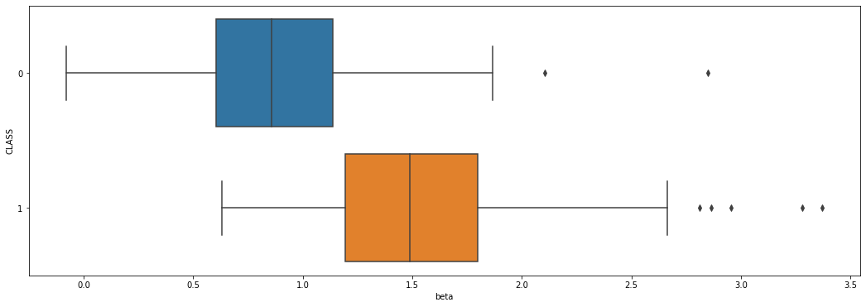
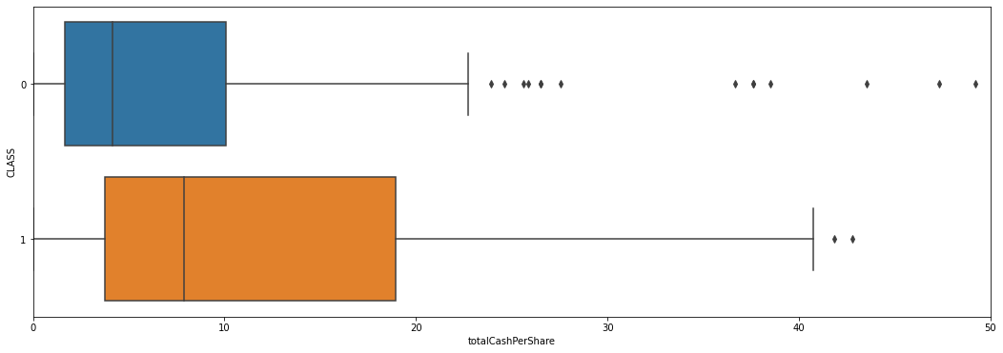
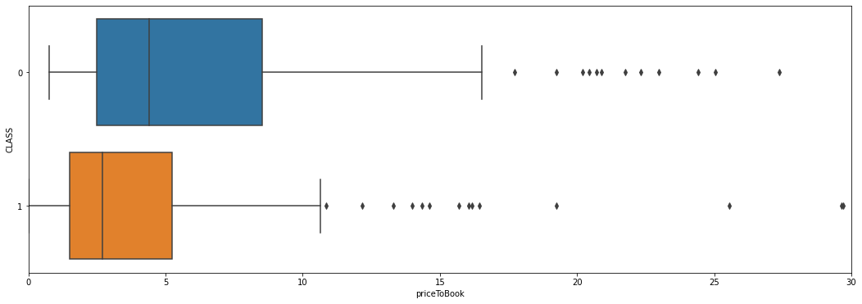
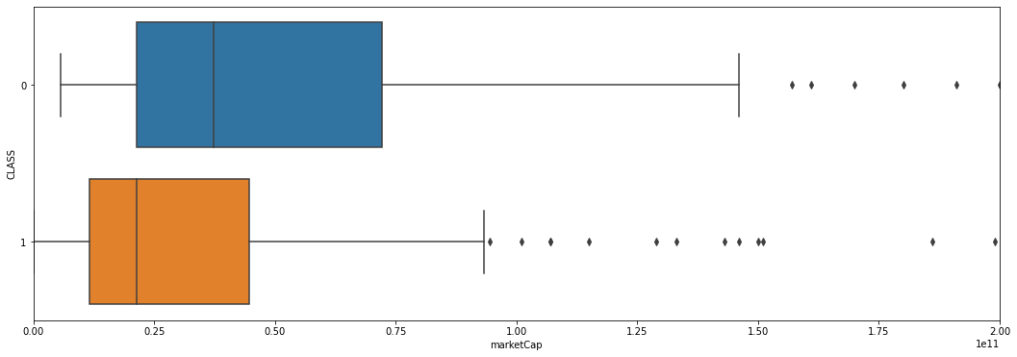
EXPLORATORY ANALYSIS
By visualizing boxplots we identified that good response variables are present for classification
The variable ‘beta’ appeared to have the best partitions for classification.

Slide 15
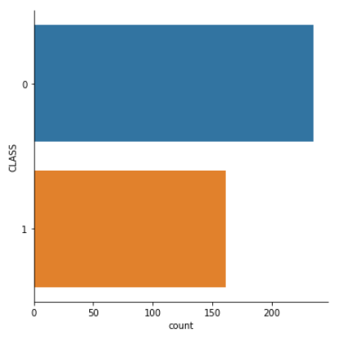
Our CLASS response variable has the following categorical plot.

Slide 16
COVID Behaviour
We observed that for around half of the companies, the stock price fell during the first wave rise in cases and then rose back when cases fell.
The other half of companies had their stock price increase throughout.
During the 3rd wave, most companies had their stock price increase.

Slide 17
ML Models
Dataset was randomly split, with 20% size for Test set.
We tested the following ML models for classification, all as multivariate:
Logistic Regression
Naïve Bayes Method
Random Forest Classifier
XGBoost

Slide 18
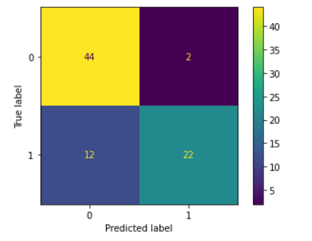
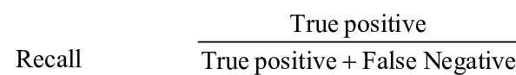
ML Model – Logistic Regression
Logistic regressions measures the relationship between the categorical dependent variable and one or more independent variables by estimating probabilities using a logistic function.
Confusion Matrix for test set:
ACCURACY: 73.8% | RECALL: 64.71%

Slide 19
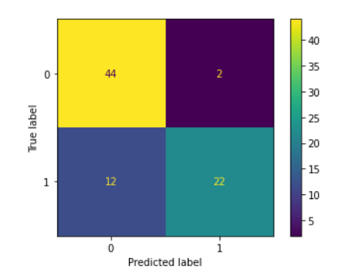
ML Model – Naive Bayes Method
A classification technique based on Bayes' Theorem with an assumption of independence among predictors. It assumes that the presence of a particular feature in a class is unrelated to the presence of any other feature.
Confusion Matrix for test set:
ACCURACY: 82% | RECALL: 64.71%

Slide 20
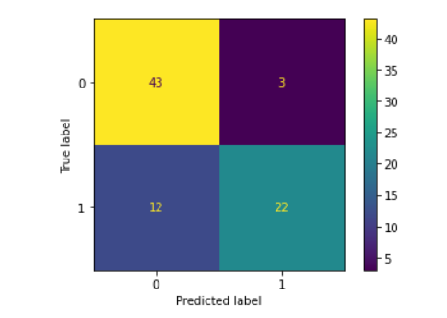
ML Model – Random Forest Classifier
A random forest builds multiple decision trees and merges them together to get a more accurate and stable prediction. Each individual tree in the random forest spits out a class prediction and the class with the most votes becomes our model’s prediction
Confusion Matrix for test set:
ACCURACY: 81% | RECALL: 64.71%

Slide 21
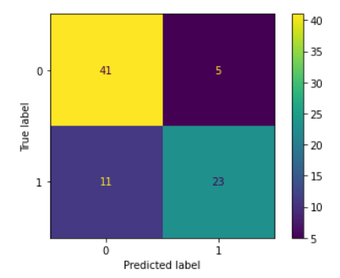
ML Model – XGBoost
XGBoost is an implementation of gradient boosted decision trees designed for speed and performance.
Confusion Matrix for test set:
ACCURACY: 78.7% | RECALL: 64.71%

Slide 22
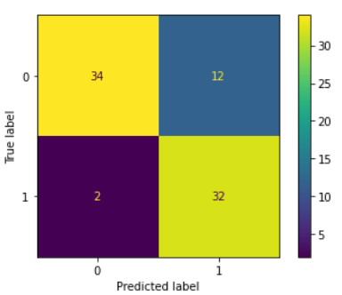
ML Model- XGBoost with Hyper Parameter Tuning
We Hyper Parameter Tuned XGBoost using RandomizedSearchCV, to reduce the false negatives.
This method was tested on the XGBoost ML model and improved the recall , thus lowering the number of false negatives.
ACCURACY: 82.50% | RECALL: 94.12%
Aimed to reduce False Negative Rate as it is riskier to falsely classify a company as stable (0)

Slide 23
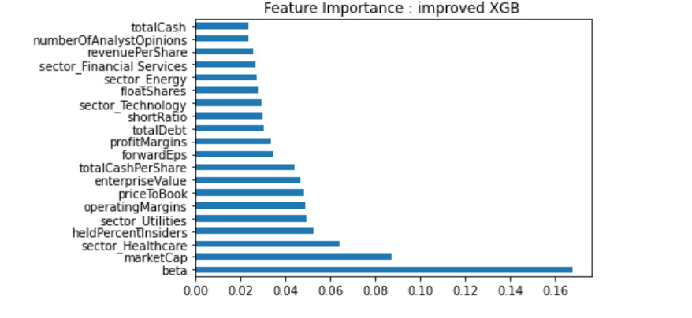
Results from Improved XGB
Using the Improved XGB we can note a relation that makes sense i.e companies of sectors that have a relation to COVID. These are the Health Care and Utilities sectors. They were shown to be stable.

Slide 24
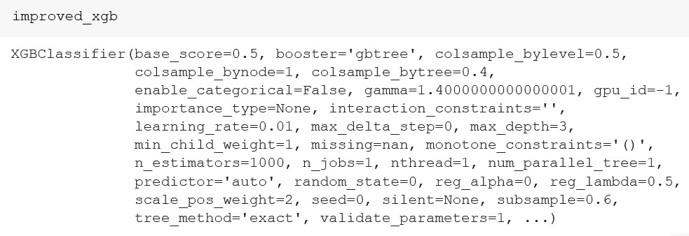
Parameters from Hyper Parameter Tuning

Slide 25
ML Model – Summary Pt 1
Models Summary before Hyperparameter Tuning :
Models Summary after Hyperparameter Tuning :
Logistic regression: 0.74 f1 score:0.68 recall: 0.65
naive bayes: 0.82 f1 score:0.76 recall: 0.65
Random forest: 0.81 f1 score:0.75 recall: 0.65
XGBOOST: 0.78 f1 score:0.71 recall: 0.65
Logistic regression: 0.7375 f1 score: 0.68 recall: 0.6471
naive bayes: 0.8250 f1 score: 0.76 recall: 0.6471
Random forest: 0.8125 f1 score: 0.75 recall: 0.6471
XGBOOST: 0.7750 f1 score: 0.71 recall: 0.6471
Hyperparameter tuned XGBOOST: 0.8250 f1 score: 0.82 recall: 0.9412

Slide 26
ML Model – Summary Pt 2
All the ML Models on average had accuracies around 70-80%.
The ML Model – Naïve Bayes had the highest accuracy with 82.5%
The ML Models had a recall of around 64.71% while XGBoost with Hyper Parameter Tuning had 94.12%
Uni-variate classification with variable ‘beta’ had a high accuracy as well as compared to multi-variate classification.

Slide 27
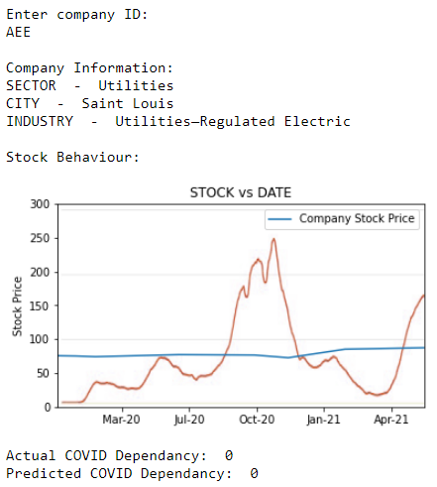
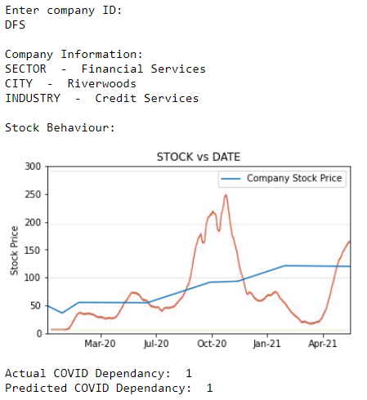
CONCLUSION
Code can be used to plot and visualize statistics for a selected company.
Company with stable stock
Company with dependent stock
____
COVID Daily Cases in USA

Slide 28
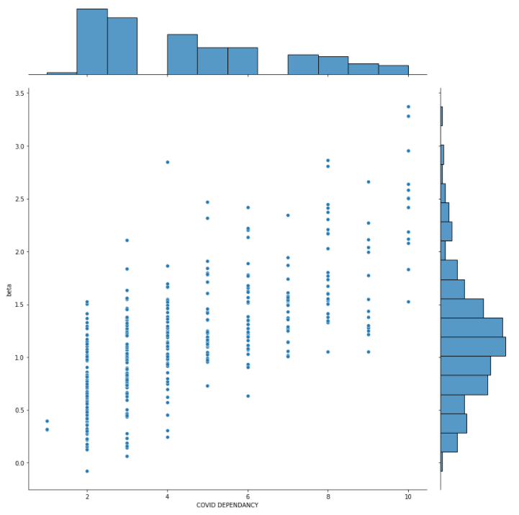
The variable ‘beta’ had a very high linear correlation (~0.8) with our class!
BETA vs AVG %CHANGE(Scale 1-10) (before split into classes of <5 as 0,>=5 as 1)

Slide 29
BETA defined by Yahoo Finance as
“how volatile a stock is in relation to the broader stock market over time. A stock with a high beta indicates it’s more volatile than the overall market and can react with dramatic share-price changes amid market swings.”
Variable is computed by comparing covariance of a company with variance of a market, monthly, over the past 5 years.
By analysing just 6 stock prices at key dates, we indirectly discovered a good predictor for BETA.

Slide 30
Inference Hypothesis: The COVID Pandemic affects a companies stock price based on it’s relation with the rest of the market.
However certainly, CORRELATION != CAUSATION And further research required into why the variables are correlated.

Slide 31
CONCLUSION
We came up with a problem of analysing COVID-19 impact on Stock Prices.
We defined and formulated the variable ‘CLASS’ to analyse volatility.
We performed EDA and analysed the box plots to identify good classification variables for decision trees.
We created our own dataset using yfinance API and cleaned the data to create the final dataset with one hot encoded sectors.
We tested different ML Models for our classification problem.
We learnt new methods of One Hot Encoding, Naïve Bayes, XGBoost, Random Forest Classifier, and hyperparameter tuning.
The ML Models had a good accuracy of around 70-80%
For the future we wish to explore more features, bigger datasets and other countries/regions.

Slide 32
CONTRIBUTIONS
Arun Rameshwar
EDA, Presentation, testing linear relationships and whether regression is possible, Data cleaning
Seenivasagan Haresh:
Dataset Creation [Predictors], Data pre-processing, ML Model [XGBoost], Hyperparameter tuning
Sivaramakrishnan Hemang:
EDA, ML Models [Logistic Regression, Naïve Bayes, Random Forest Classfier]
Venkatesh Pratul:
Problem Ideation & Guidance, Dataset Creation [Response], Plots, ‘Code as a Tool’, Presentation

