Slide 1


REACT-ENABLED ANAYTICS FOR
HEALTHCARE OPTIMIZATION

Slide 2
TEAM MEMBERS
01
HARESH M - 210701066
02
HAYAGREEVAN V - 210701080
03
JEYAPRIYAN M - 210701097

Slide 3
ABSTRACT
This project introduces an advanced analytics platform empowered by React JS to revolutionize healthcare optimization. By integrating real-time data collection and interactive user interfaces, this project provides healthcare professionals with actionable insight and aids them making well-informed decisions, allocate resources, and actively manage risks. to process and analyze vast amounts of healthcare data swiftly and accurately. Through its React-enabled architecture, the platform ensures a responsive and intuitive user experience, allowing healthcare professionals to interact with complex datasets effortlessly.

Slide 4
INTRODUCTION
The healthcare industry is undergoing a profound transformation driven by advancements in technology and the growing need for efficient, data-driven decision-making processes.
In this dynamic landscape, this project emerges as a pivotal solution designed to address the multifaceted challenges faced by the healthcare industry.
By harnessing the power of React-enabled analytics, this project aims to optimize healthcare delivery, improve patient outcomes, precisive diagnostics and enhance operational efficiency.
This project leverages state-of-the-art data analytics and visualization tools to provide healthcare professionals with real-time insights and predictive analytics.
This platform integrates seamlessly with existing healthcare systems, offering a comprehensive suite of features that include real-time data collection, machine learning algorithms, and interactive user interfaces.

Slide 5
LITERATURE REVIEW
Healthcare organizations increasingly rely on healthcare analytics, using technologies like Hadoop and Spark, to support evidence-based decision-making.
The healthcare sector has significantly benefited from advancements in information technology (IT), transforming clinical practices and improving efficiency. Tools such as Advanced Data Visualization, Presto, Hive, Hadoop, and cloud computing enable efficient data handling and real-time analytics, leading to better decision-making and patient outcomes
The review noted a growing trend in systematic secondary studies at the intersection of data analytics and healthcare. Challenges such as data interoperability and privacy concerns underscored the need for robust computational infrastructure and ethical frameworks. Multidisciplinary collaboration between medical and technical experts emerged as crucial for effective implementation.

Slide 6

LITERATURE REVIEW
Multidisciplinary collaboration across fields like Mathematics, Statistics, and Computer Science is driving innovative solutions for complex healthcare challenges. This special issue underscores the importance of analytical approaches and solution methodologies for data-intensive healthcare applications.
The research applies a systems thinking approach, merging practitioner perspectives with academic literature to address healthcare informatics complexities.

Slide 7
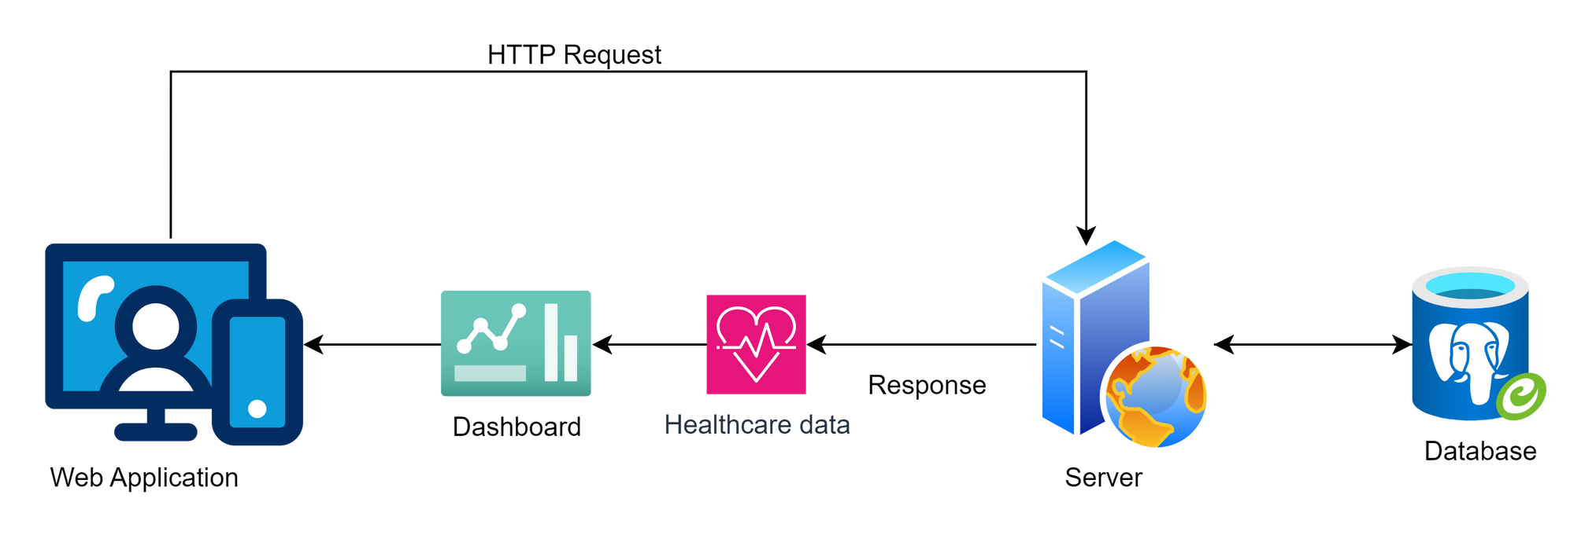
ARCHITECTURE DIAGRAM

Slide 8
TECH STACK
CLIENT TECHNOLOGIES
FRONTEND LIBRARY : React JS
STYLING LIBRARY : TailwindCSS
DATA VISUALIZATION : Chart JS
SERVER TECHNOLOGIES
SERVER SIDE RUNTIME ENVIRONMENT : Node JS
SERVER : Express
DATABASE DRIVER MODULE : PG
DATABASE
DATABASE MANAGEMENT SYSTEM : PostgreSQL

Slide 9
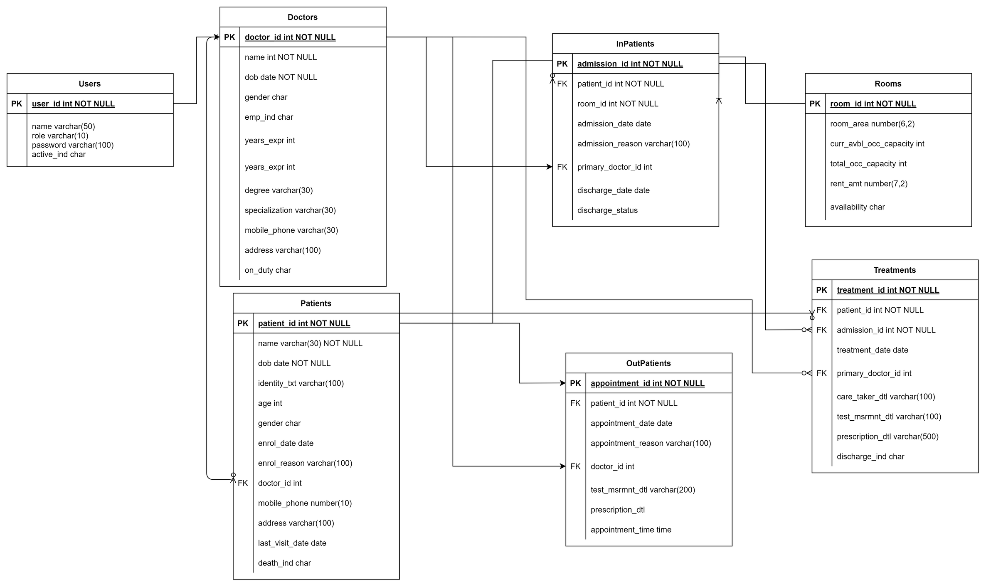
DATABASE SCHEMA - ENTITY RELATIONSHIP DIAGRAM

Slide 10
MODULES
DASHBOARD
Aggregates and presents critical data in an easily digestible format, using real-time data visualization tools powered by Chart.js.
DOCTOR DATABASE
Maintains comprehensive and up-to-date profiles of all medical practitioners associated with the hospital. This module captures essential details including personal information, contact details, specializations, qualifications, years of experience, and professional certifications.
PATIENT ROOM ALLOCATION
The room allocation module in this project is designed to efficiently manage the assignment and utilization of hospital rooms. This module automates the process of allocating rooms to patients based on various criteria such as medical needs, room availability, and patient preferences.

Slide 11
INPATIENT ADMISSION
Streamlines the process of admitting patients for inpatient care, ensuring a smooth and efficient transition from outpatient to inpatient status. It captures and stores detailed patient information, including medical history, admission reason, attending physician, and any special requirements. The module facilitates real-time tracking of bed availability and occupancy rates, helping to optimize bed utilization and reduce wait times.
APPOINTMENTS FOR OUTPATIENTS
Facilitates the scheduling and management of appointments for patients seeking outpatient care. It captures essential patient information, including personal details, medical history, and preferred appointment times.
TREATMENTS HISTORY
Captures and organizes detailed information about each treatment, including medications prescribed, procedures performed, diagnostic tests ordered, and therapeutic interventions given. It integrates with other modules, such as the patient information module, to maintain a complete patient profile that includes medical histories, allergies, and ongoing treatments.

Slide 12
PATIENT DISCHARGE HANDLING
By automating and optimizing the discharge process, this module enhances patient safety, improves bed turnover rates, and reduces hospital readmissions. It also supports effective communication and collaboration among healthcare providers, ensuring continuity of care and improving overall patient experience and satisfaction.

Slide 13
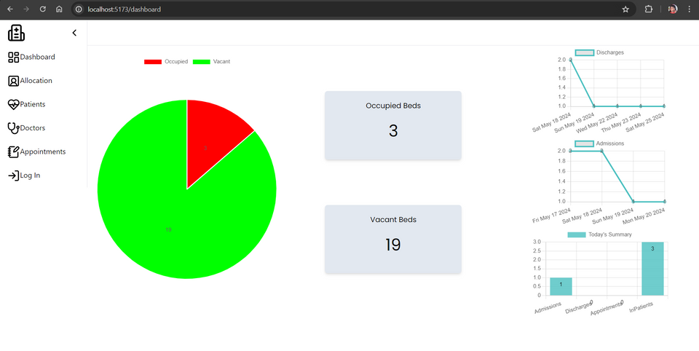
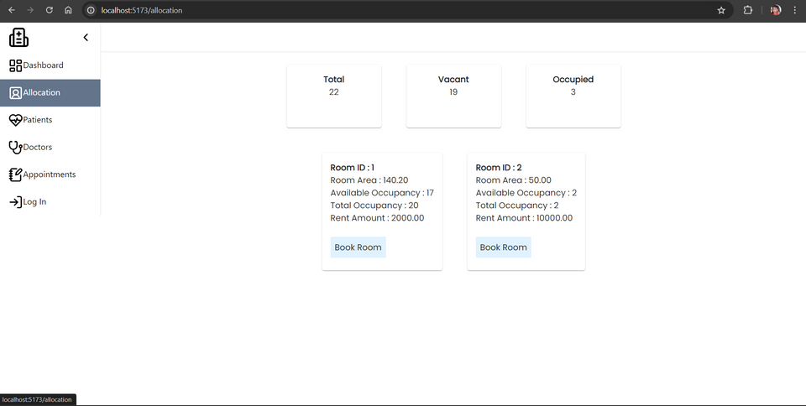
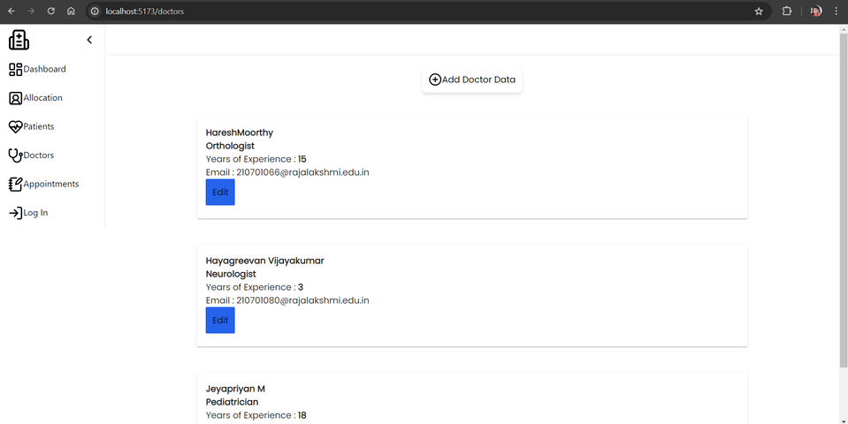
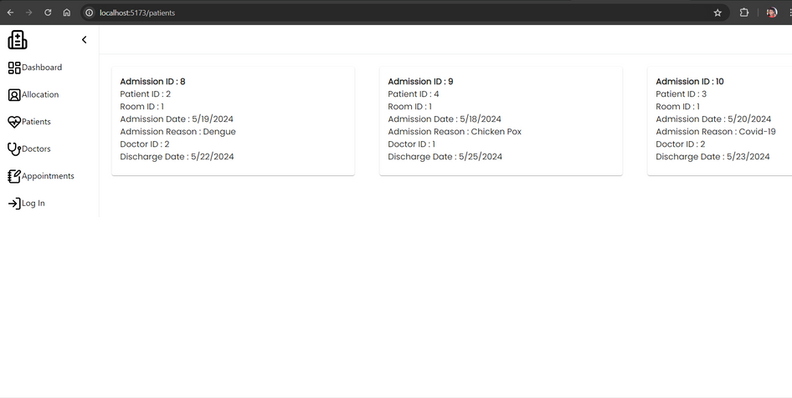
OUTPUT - SCREENSHOTS
Dashboard
Room Allocation Page
Doctors Page
InPatients Page

Slide 14
CONCLUSION
This project delivers a robust and integrated software solution that enhances operational efficiency, improves patient care quality, and supports informed decision-making within the hospital infrastructure. .
Real-time analytics and reporting capabilities enable hospital administrators to make data-driven decisions based on critical metrics like patient admissions, resource utilization, and clinical outcomes.
Overall, the system aims to optimize resource management, improve communication and coordination among healthcare teams, and enhance patient satisfaction by ensuring efficient and effective healthcare delivery.

Slide 15
FUTURE ENHANCEMENT
Additionally, incorporating Internet of Things (IoT) devices for patient monitoring, strengthening cybersecurity measures, implementing machine learning for clinical decision-making, and developing a patient portal for health information access would further enhance patient care and operational efficiency.
Ensuring interoperability with external systems such as electronic health records and pharmacies would facilitate seamless data exchange and improve care continuity, making the system adaptable to future healthcare needs.

Slide 16
REFERENCES
Miah, S. J., Gammack, J., & Hasan, N. (2019, December 26). Methodologies for designing healthcare analytics solutions: A literature analysis. Health Informatics Journal, 26(4), 2300–2314. https://doi.org/10.1177/1460458219895386
Kelley, J. M., Kraft-Todd, G., Schapira, L., Kossowsky, J., & Riess, H. (2014, April 9). The Influence of the Patient-Clinician Relationship on Healthcare Outcomes: A Systematic Review and Meta-Analysis of Randomized Controlled Trials. PLoS ONE, 9(4), e94207. https://doi.org/10.1371/journal.pone.0094207
Taipalus, T., Isomöttönen, V., Erkkilä, H., & Äyrämö, S. (2022, December 9). Data Analytics in Healthcare: A Tertiary Study. SN Computer Science, 4(1). https://doi.org/10.1007/s42979-022-01507-0
Yang H, Kundakcioglu OE, Zeng D. Healthcare data analytics. Inf Syst e-Bus Manag. 2015;13(4):595–7. https://doi.org/10.1007/s10257-015-0297-0
Strang, K. D., & Sun, Z. (2019, July 2). Hidden big data analytics issues in the healthcare industry. Health Informatics Journal, 26(2), 981–998. https://doi.org/10.1177/1460458219854603

