Slide 1

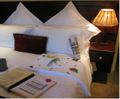
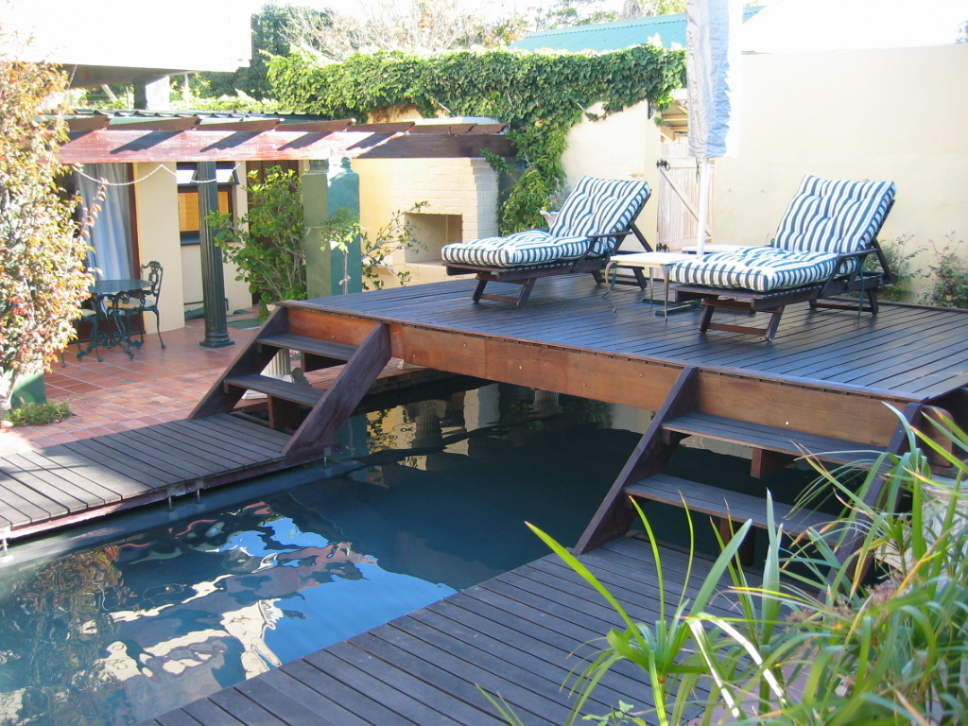
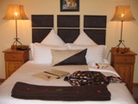

Harfield Guest
Villa
Boutique B &B

Slide 2
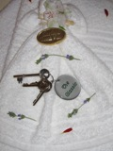
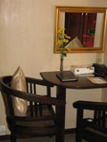
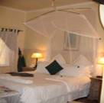
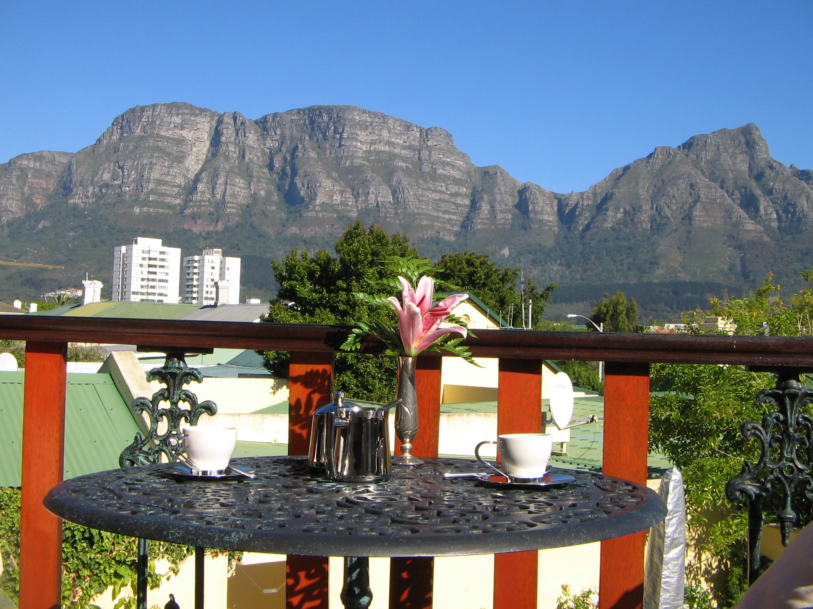
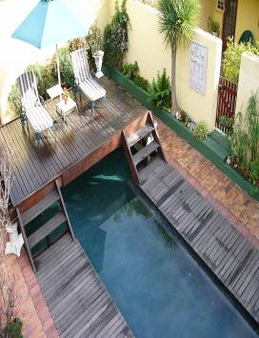
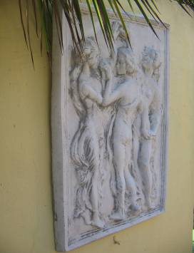
Cape Towns Best Kept Secret…
Harfield Guest Villa
Boutique B & B
…Spectacular views

Slide 3
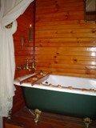
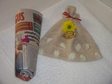
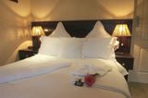
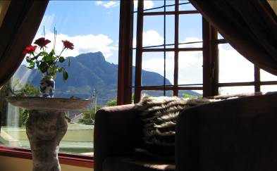
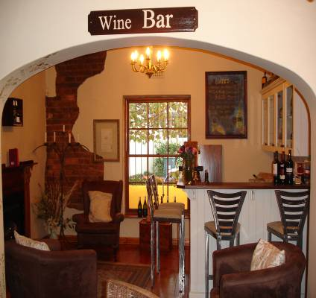
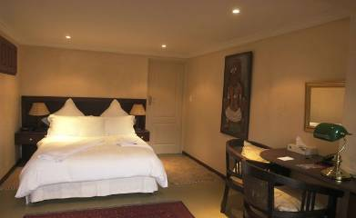
…
Harfield Guest Villa
Boutique B & B
With amazing quality

Slide 4
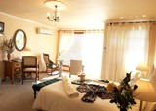
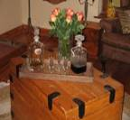

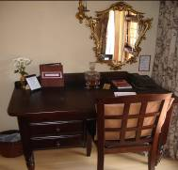
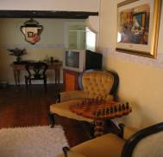
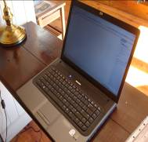
Harfield Guest Villa
Boutique B & B
Corporate -Rates
Please enquire about our fantastic frequent travel rate!!!!
It is Ideal for companies! To qualify for the rate, the company is required to use 30 nights annually at Harfield.
To avoid disappointment during the high season, try and book at least 2 weeks prior to
arrival.
Please note that it is non commissionable.

Slide 5
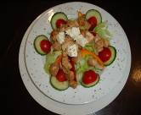
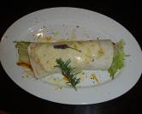
Dinner Menu
Harfield Guest Villa
Boutique B & B
Starters
Fresh garden salad
Tuna Salad
Soup of the day
Main Course
Chicken Fettuccine
An exotic Sweet Chilli Chicken wrap
Extravagant Deep Sea Delight
Grilled Hake
Beef fillet done to your perfection served with a variety of roast vegetables, rosemary roasted
Potatoes and a creamy mushroom sauce
Desserts
Vanilla ice cream served with chocolate sauce
Malva Pudding-”African style”
French Delight-Come and find out

Slide 6
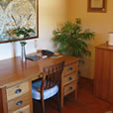
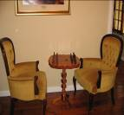
Unique services
Harfield Guest Villa
Boutique B & B
      High Speed ADSL wireless internet connection
      Clothing Storage (for the regular corporate guest)
      24Hour reception (advise on late check-in)
      A la Carte Dinner Menu available
      Laundry Service
      Privacy and security
      Express Check-in and Check-out
      Coffee bar
      Wine Selection and bar
      Bill Back Services

Slide 7

Harfield Guest Villa
Boutique B & B
Local Attractions
    V&A Waterfront 15km
    Cape Town International Convention Centre____14km
    Kirstenbosch Botanical Gardens 4km
    Beaches 15km
    Table Mountain Cable Way 15km
    Newlands Cricket and Rugby Stadium 1km
    UCT 5km
    Claremont/Newlands Commercial District 1km
    Constantia Winelands 8km
    Cavendish Shopping 1km
    Local Restaurants 200m
    Famous Restaurants (Constantia Uitsig, Ginja) 8-10km

Slide 8
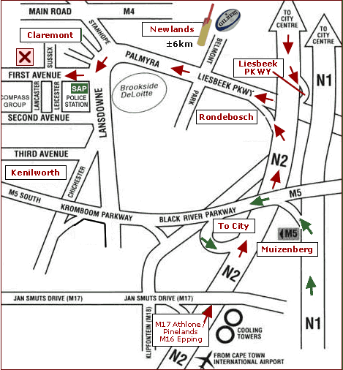
Harfield Guest Villa
Boutique B & B
Contact us:
Tel: 021 683 7376
Email: info@harfield.co.za
Visit: www.harfield.co.za
Physical Address:
26 First Avenue
Harfield Village
Claremont
Cape Town, South Africa
Sit back, relax
and enjoy yourself while we ensure your
experience is unforgettable in the best possible way!

