Slide 1
Data Science : Business Visualization
B. TECH IN DATA SCIENCE
Harshil Gandhi
M.Tech – Data Science
SAS – Consulting Team

Slide 2
What is Data Science/Data Mining/Analytics ?
Data Mining / Data Science
Statistics
Technology (R/SAS/PYTHON etc.)
Domain Knowledge (Marketing/Finance/Operations/Banking etc.)
Applications of subject?

Slide 3
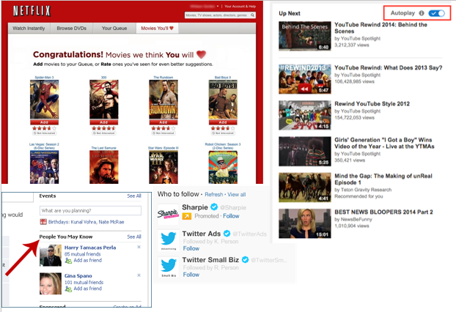
Real Time Applications
Recommender System
Internet giants like Amazon, Twitter, Google Play, Netflix, Linkedin, imdb and many more uses this system to improve user experience.
The recommendations are made based on previous search results for a user.

Slide 4



Speech Recognition Applications
Google Voice (Google Allo)
SIRI
CORTANA

Slide 5

Gaming
EA Sports, Zynga, Sony, Nintendo, Activision-Blizzard have led gaming experience to the next level using data science.
Games are now designed using machine learning algorithms which improve / upgrade themselves as the player moves up to a higher level.
In motion gaming also, your opponent (computer) analyzes your previous moves and accordingly shapes up its game.

Slide 6
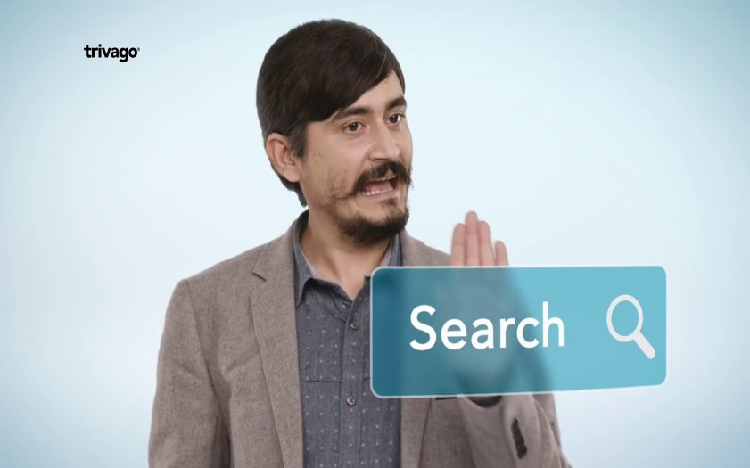






Smarter Websites
Price Comparison Website
Vacation/Movie Planning
Food Ordering

Slide 7
Data – As a Career?
What’s the Trend?
https:///www.analyticsvidhya.com/blog/2015/09/ultimate-data-scientists-world-today
Data is the new oil for industrial revolution : Mukesh Ambani
https://www.jio4gplan.com/data-is-the-new-oil-for-industrial-revolution-mukesh-ambani/

Slide 8
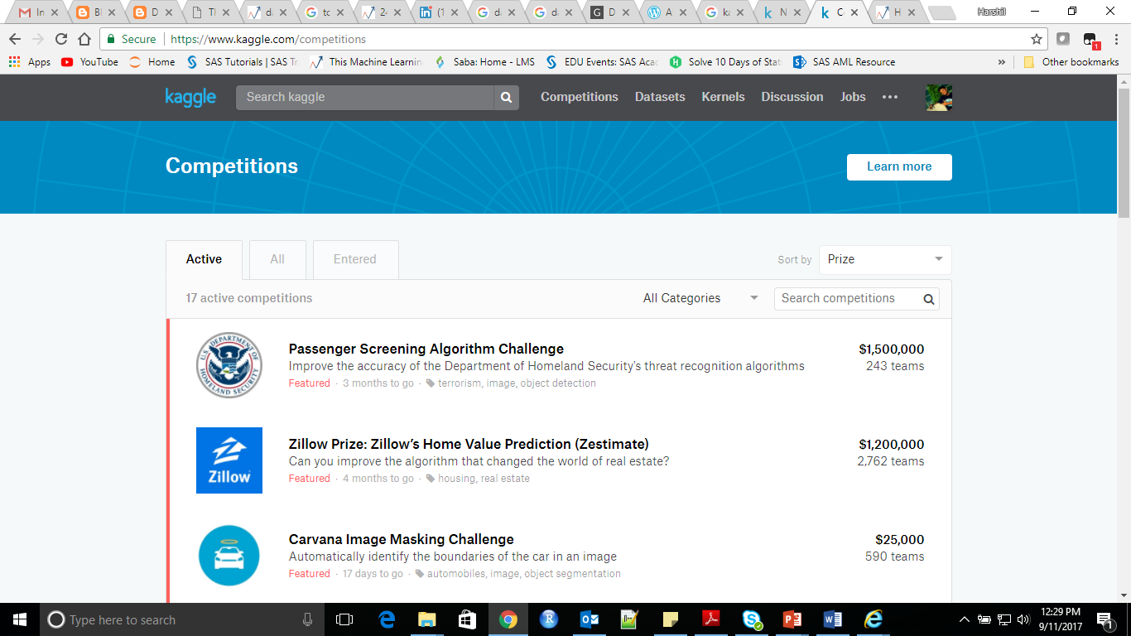
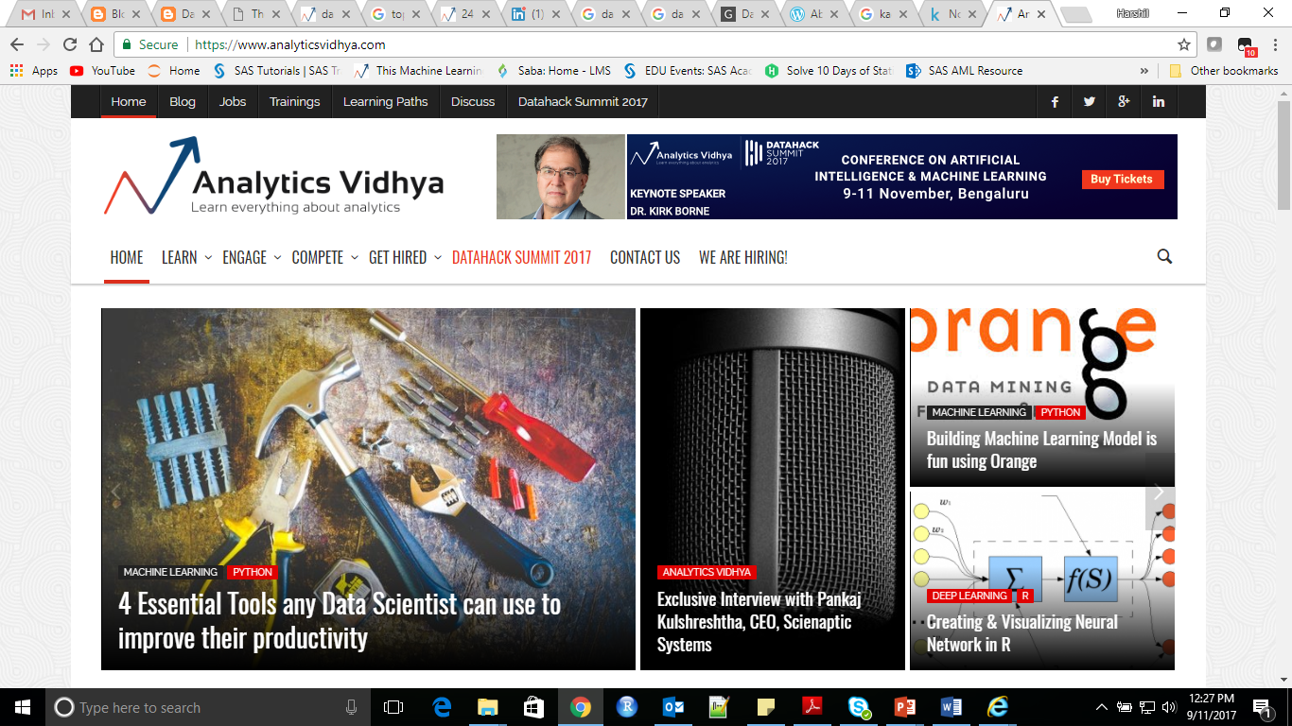
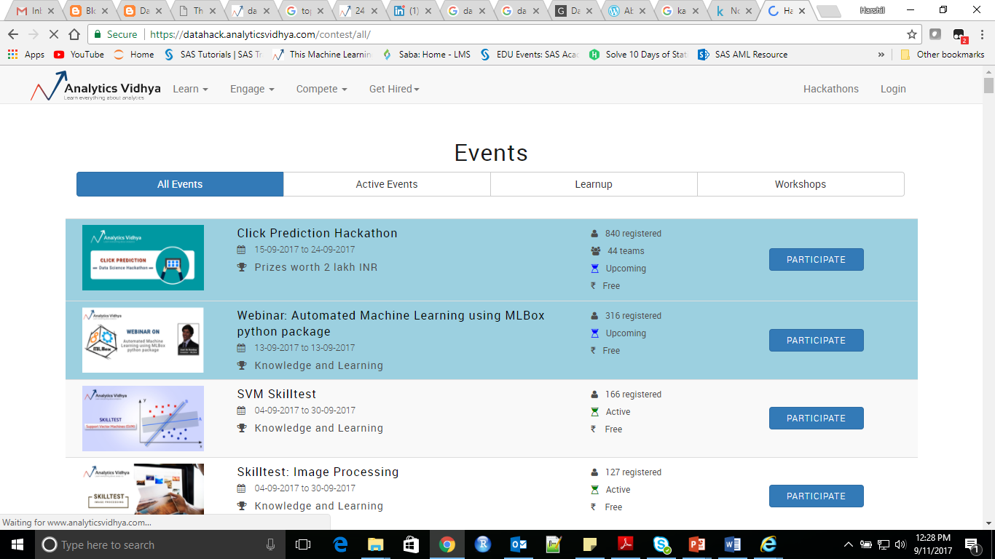
Popular Websites
Kaggle : https://www.kaggle.com/
Analytics Vidhya : https://www.analyticsvidhya.com/

Slide 9

Reference Book and Material
An Introduction to Statistical Learning with Applications in R
http://www-bcf.usc.edu/~gareth/ISL/

Slide 10
Business Visualization
Objectives:
Use of Visual analytics is the science of analytical reasoning facilitated by interactive visual interfaces.
Use of visual analytics tools and techniques to synthesize information and derive insight from massive, dynamic, ambiguous, and often conflicting data
Data representations and transformations that convert all types of conflicting and dynamic data in ways that support visualization and analysis
Outcomes:
Analytical reasoning techniques that enable users to obtain deep insights that directly support assessment, planning, and decision making
Techniques to support production, presentation, and dissemination of the results of an analysis to communicate information in the appropriate context to a variety of audiences.

Slide 11
Unit | Description | Duration
1 | Introduction to data and its visualization | 02
2 | Defining the Research and Development Agenda for Visual Analytics | 02
3 | The Science of Analytical Reasoning Build upon theoretical foundations of reasoning, sense-making, cognition, and perception to create visually enabled tools to support collaborative analytic reasoning about complex and dynamic problems. | 02 02
4 | Visual Representations and Interaction Technologies Develop a new suite of visual paradigms that support the analytical reasoning process. Create a science of visual representations based on cognitive and perceptual principles that can be deployed through engineered, reusable components. Visual representation principles must address all types of data, address scale and information complexity, enable knowledge discovery through information synthesis, and facilitate analytical reasoning. | 04 02 04
5 | Data Representations and Transformations Develop both theory and practice for transforming data into new scalable representations that faithfully represent the content of the underlying data Create methods to synthesize information of different types and from different sources into a unified data representation so that analysts, first responders, and border personnel may focus on the meaning of the data | 04 02 04
 | Production, Presentation, and Dissemination Tools : SAS Visual Analytics, Tableau | 02
Total |  | 30

Slide 12
Assessment – 50 Marks
Half semester Presentation – 20 Marks
To Demonstrate Visualization Skills
Case Study and Presentation -30 Marks
To Demonstrate Business/Data Understanding + Visualization Skills

Slide 13
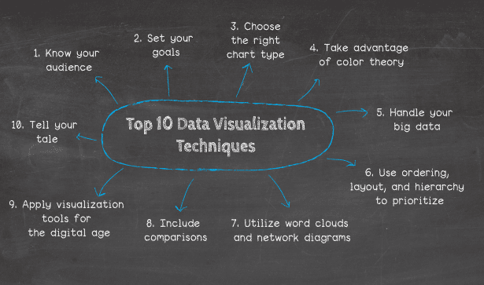

Slide 14
Visualization Tools
SAS Visual Analytics
Tableau
D3.JS
QlikView
Sisense
FusionCharts
Microsoft Power BI
Plot.ly
Carto
And Many More…!

