Slide 1
Tableau

Slide 2
What is Tableau?
Tableau is a Data Visualization tool that is widely used for Business Intelligence but is not limited to it.
It helps create interactive graphs and charts in the form of dashboards and worksheets to gain business insights.
And all of this is made possible with gestures as simple as drag and drop!

Slide 3
Introduction
Tableau is a Business Intelligence tool for visually analyzing the data.
Users can create and distribute an interactive and shareable dashboard, which depict the trends, variations, and density of the data in the form of graphs and charts.
Tableau can connect to files, relational and Big Data sources to acquire and process data.
The software allows data blending and real-time collaboration, which makes it very unique.
It is used by businesses, academic researchers, and many government organizations for visual data analysis.
It is also positioned as a leader Business Intelligence and Analytics Platform in Gartner Magic Quadrant.

Slide 4
Tableau Features
Speed of Analysis
Self-Reliant
Visual Discovery
Blend Diverse Data Sets
Architecture Agnostic
Real-Time Collaboration
Centralized Data

Slide 5
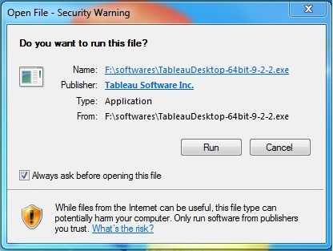
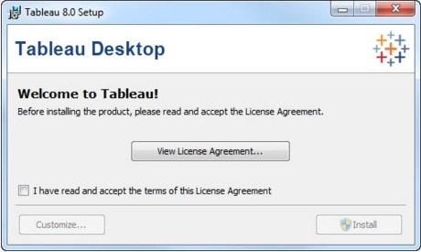
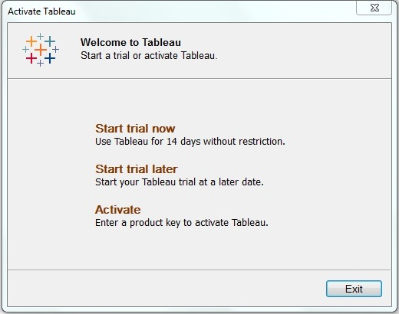
Installation https://www.tableau.com/products/desktop/download

Slide 6
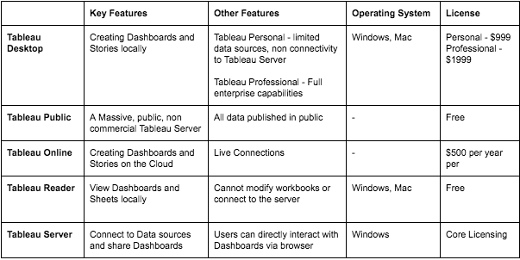
Tableau Products

Slide 7
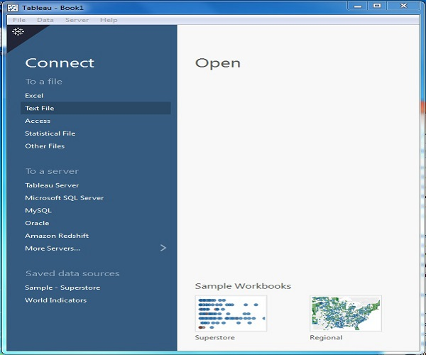
Welcome Screen

Slide 8
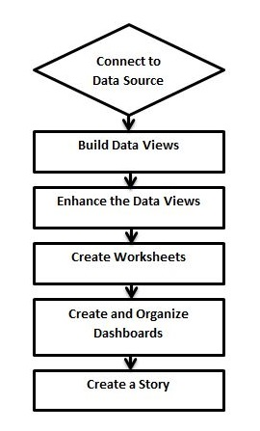
Design Flow

Slide 9
Connect
Connect to Data Source
Tableau connects to all popular data sources. It has inbuilt connectors which take care of establishing the connection, once the connection parameters are supplied. Be it simple text files, relational sources, SQL sources or cloud data bases, Tableau connects to nearly every data source.
Build
Build Data Views
After connecting to a data source, you get all the column and data available in the Tableau environment. You classify them as dimensions and measures, and create any hierarchy required.
Enhance
Enhance the Views
The views created above needs to be enhanced further by the use of filters, aggregations, labeling of axes, formatting of colors and borders, etc.
Create
Create Worksheets
Create different worksheets to create different views on the same or different data.
Create and Organize
Create and Organize Dashboards
Dashboards contain multiple worksheets which are linked. Hence, the action in any of the worksheet can change the result in the dashboard accordingly.
Create
Create a Story
A story is a sheet that contains a sequence of worksheets or dashboards that work together to convey information. You can create stories to show how facts are connected, provide context, demonstrate how decisions relate to outcomes, or simply make a compelling case.

Slide 10
Data Type
Data Type | Description | Example
STRING | Any sequence of zero or more characters. They are enclosed within single quotes. The quote itself can be included in a string by writing it twice. | 'Hello' 'Quoted' 'quote'
NUMBER | These are either integers or floating points. It is advised to round the floating point numbers while using them in calculations. | 3 142.58
BOOLEAN | They are logical values. | TRUE FALSE
DATE & DATETIME | Tableau recognizes dates in almost all formats. But in case we need to force Tableau to recognize a string as date, then we put a # sign before the data. | "02/01/2015" "#3 March 1982"
As a data analysis tool, Tableau classifies every piece of data into one of the four categories namely - String, Number, Boolean and datetime.
Once data is loaded from the source, Tableau automatically assigns the data types.
Contrarily, you can also change some of the data types if it satisfies the data conversion rule. The user has to specify the data type for calculated fields.

Slide 11
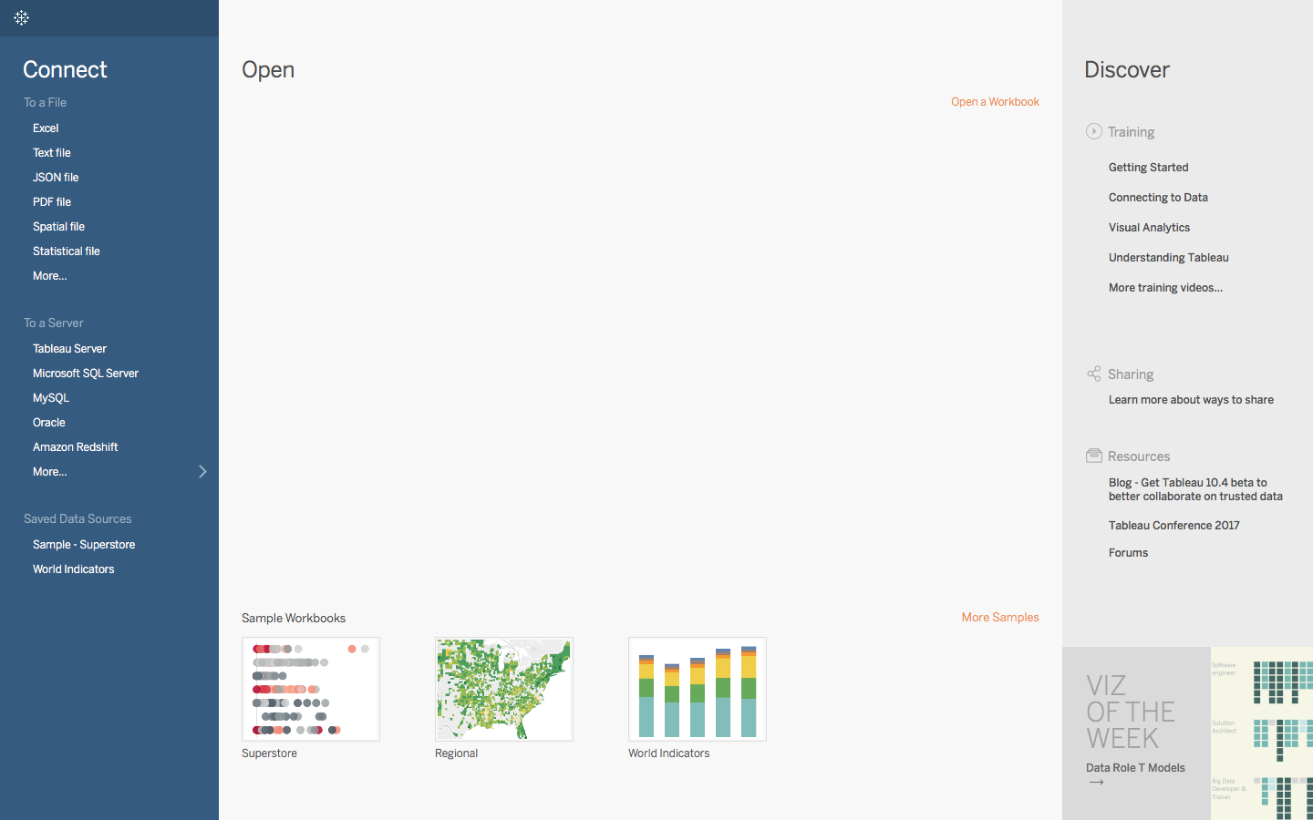
Connect To Data

Slide 12
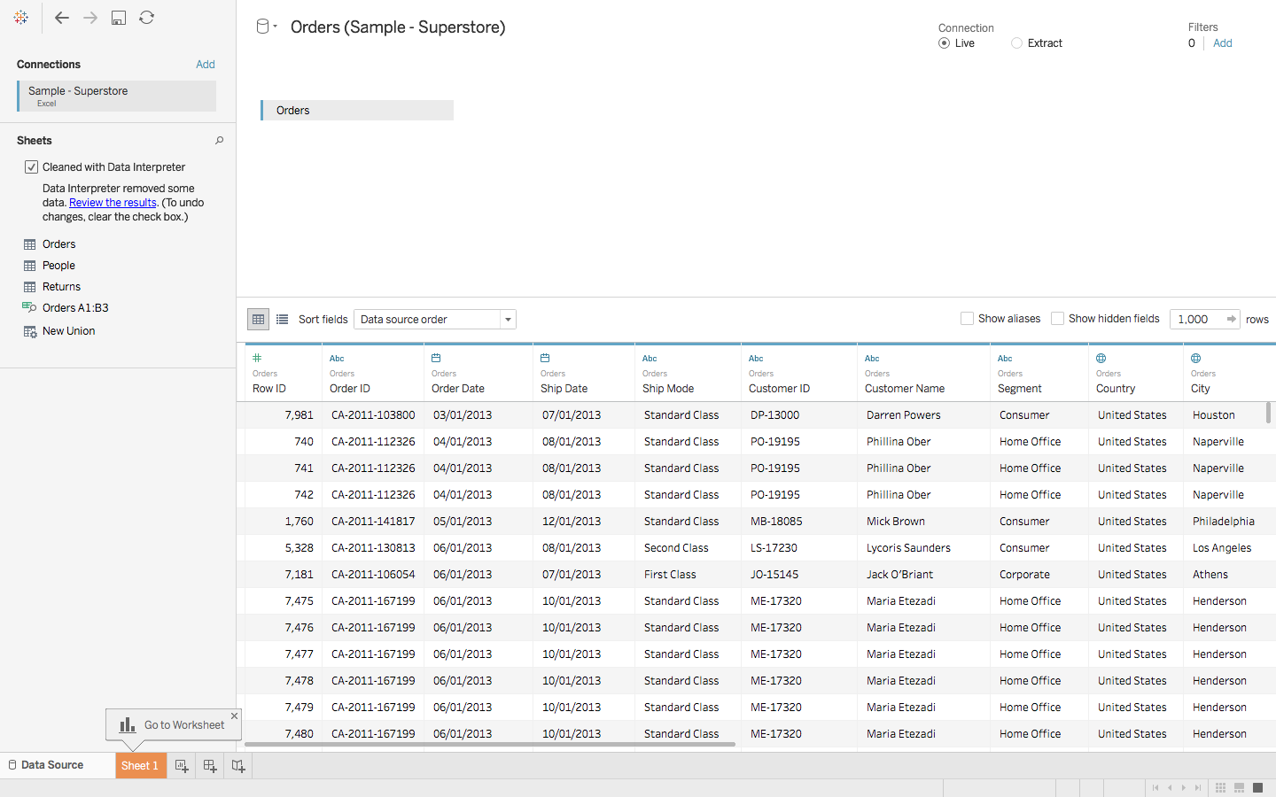
Import the Data

Slide 13
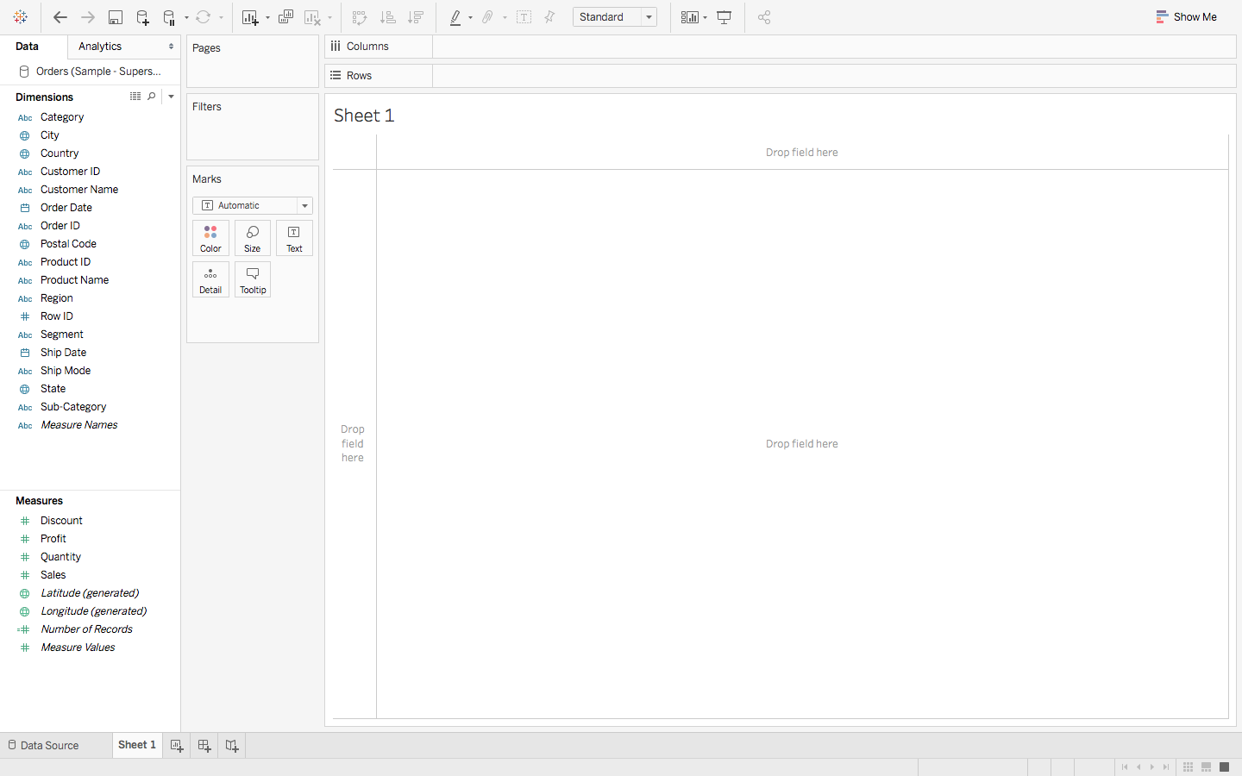
Worksheet

Slide 14
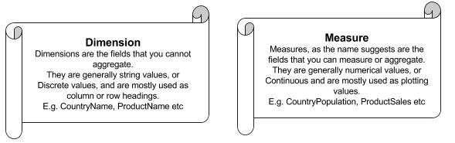
Dimensions and Measures

Slide 15
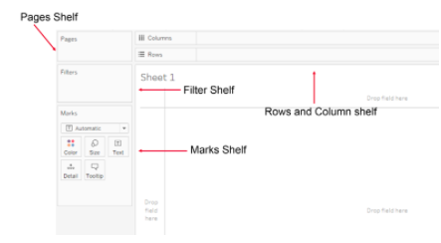
Shelves

Slide 16
Rows and Columns : Represent the x and y – axis of your graphs / charts. Filter : Filters help you view a strained version of your data. For example, instead of seeing the combined Sales of all the Categories, you can look at a specific one, such as just Furniture. Pages : Pages work on the same principle as Filters, with the difference that you can actually see the changes as you shift between the Paged values. Marks : The Marks property is used to control the mark types of your data. You may choose to represent your data using different shapes, sizes or text.
And finally there is Show Me, the brain of Tableau!

Slide 17
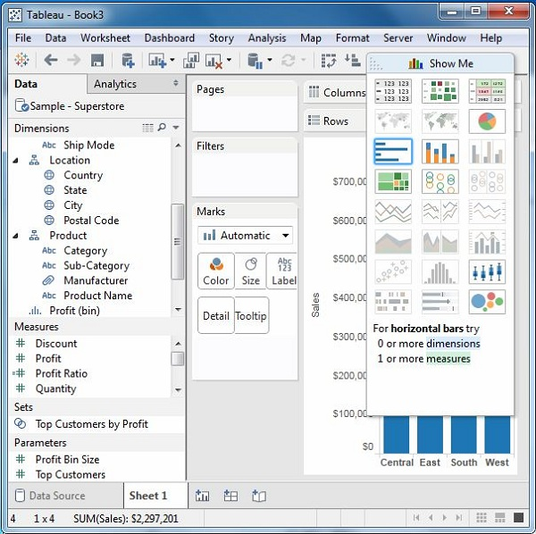
Tableau - Show Me
It can be used to apply a required view to the existing data in the worksheet.
Those views can be a pie chart, scatter plot, or a line chart.
Whenever a worksheet with data is created, it is available in the top right corner as shown in the following figure.
Some of the view options will be greyed out depending on the nature of selection in the data pane.

Slide 18
Chart Types
1) Bar Chart
2) Line Chart
3) Pie Chart
4) Crosstab
5) Scatter Plot
6) Bubble Chart
7) Bullet Graph
8) Box Plot
9) Tree Map
10) Bump Chart
11) Gantt Chart
12) Histogram
13) Motion Charts
14) Waterfall Charts

Slide 19
Bar Chart
A bar chart represents data in rectangular bars with the length of the bar proportional to the value of the variable.
Tableau automatically produces a bar chart when you drag a dimension to the Row shelf and measure to the Column shelf.
We can also use the bar chart option present in the Show Me button.
If the data is not appropriate for bar chart, then this option will be automatically greyed out.

Slide 20
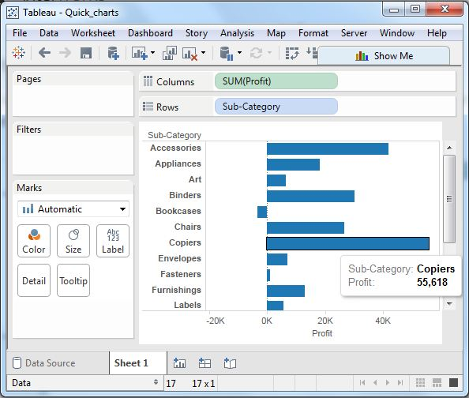
Simple Bar Chart

Slide 21
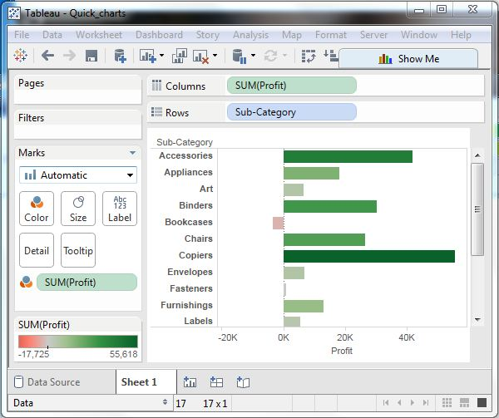
Bar Chart with Color Range

Slide 22
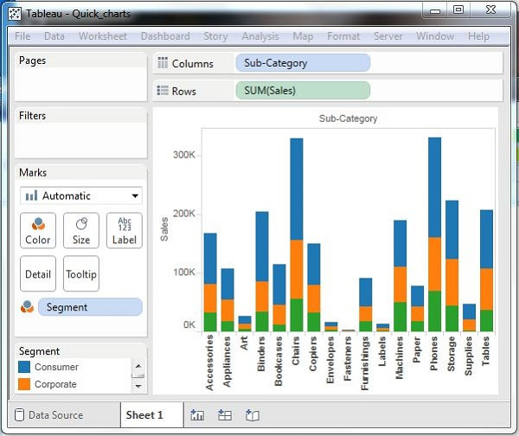
Stacked Bar Chart

Slide 23
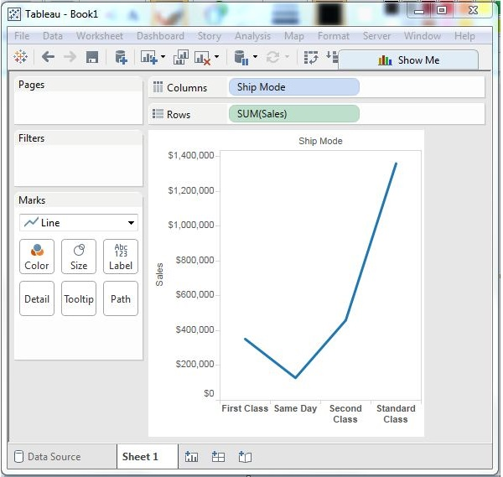
Line Chart
In a line chart, a measure and a dimension are taken along the two axes of the chart area.
The pair of values for each observation becomes a point and the joining of all these points create a line showing the variation or relationship between the dimensions and measures chosen.

Slide 24
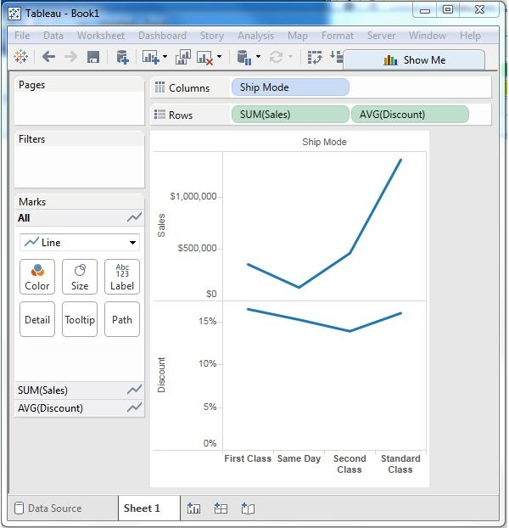
Multiple Measure Line Chart

Slide 25
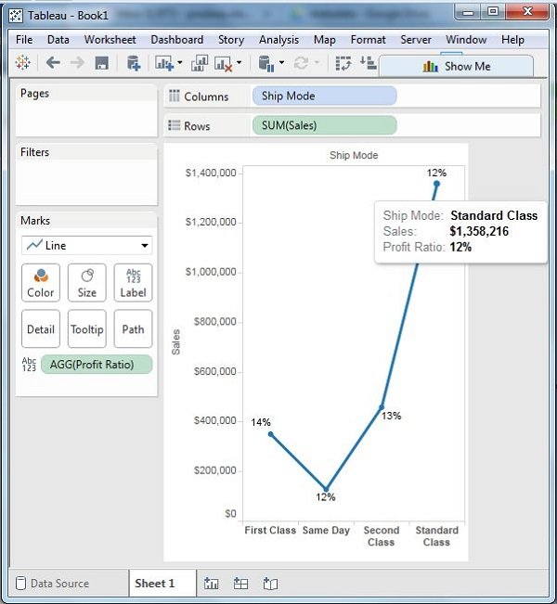
Line Chart with Label

Slide 26
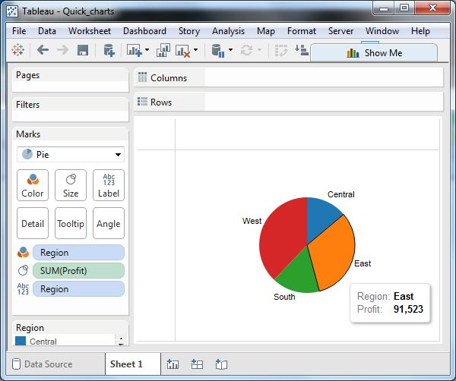
Pie Chart
A pie chart represents data as slices of a circle with different sizes and colors.
The slices are labeled and the numbers corresponding to each slice is also represented in the chart.
You can select the pie chart option from the Marks card to create a pie chart.

Slide 27
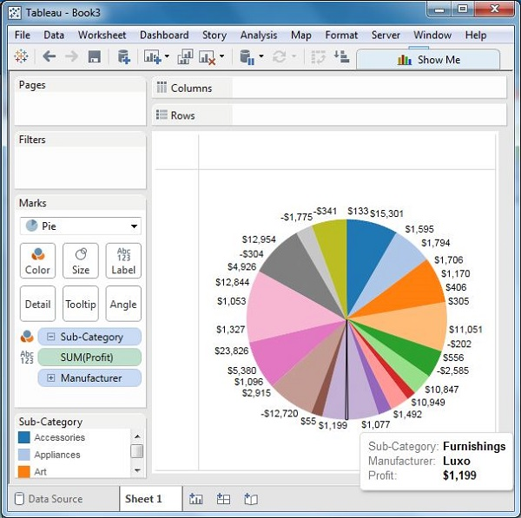
Drill-Down Pie Chart

Slide 28
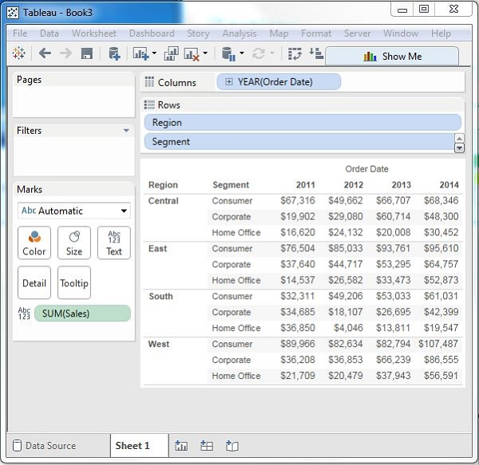
CrossTab
A crosstab chart in Tableau is also called a Text table, which shows the data in textual form.
The chart is made up of one or more dimensions and one or more measures.
This chart can also show various calculations on the values of the measure field such as running total, percentage total, etc.

Slide 29
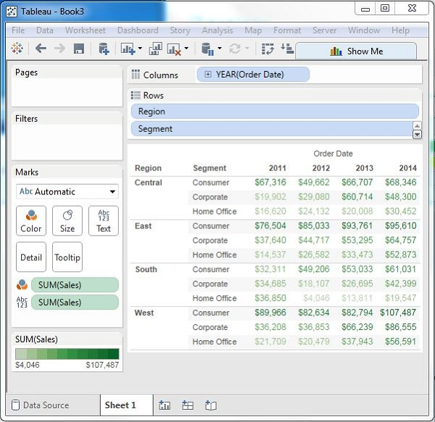
Crosstab - Color Encoded

Slide 30
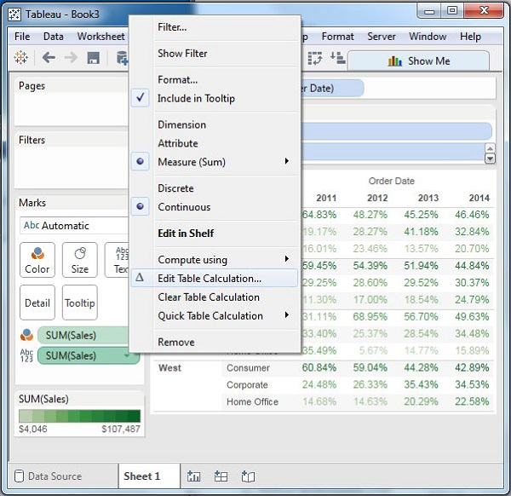
Crosstab with Row Percentage

Slide 31
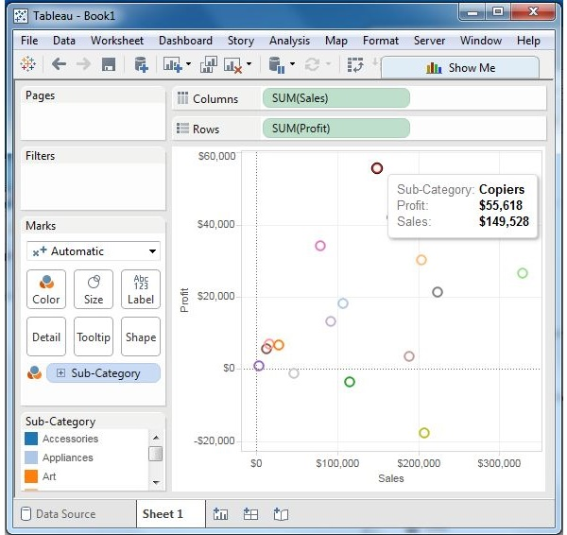
Scatter Plot
As the name suggests, a scatter plot shows many points scattered in the Cartesian plane.
It is created by plotting values of numerical variables as X and Y coordinates in the Cartesian plane.
Tableau takes at least one measure in the Rows shelf and one measure in the Columns shelf to create a scatter plot.
However, we can add dimension fields to the scatter plot which play a role in marking different colors for the already existing points in the scatter graph.

Slide 32
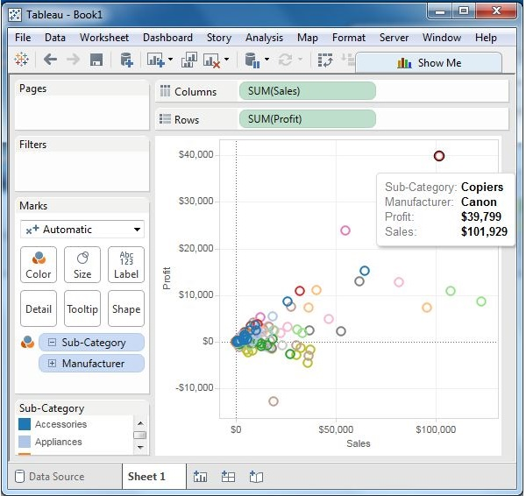
Scatter Plot - Color Encoded

Slide 33
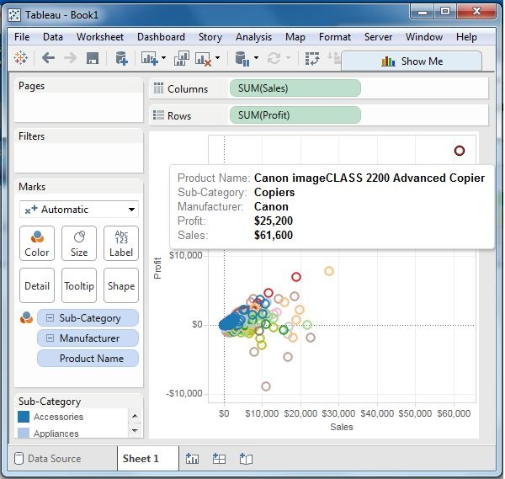
Drill-Down Scatter Plot

Slide 34
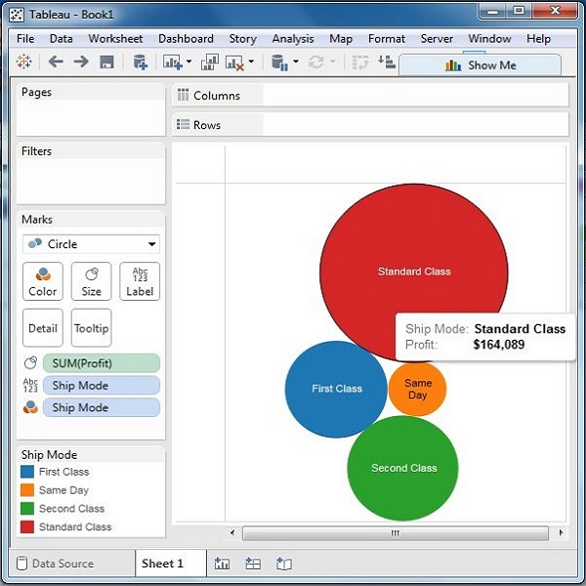
Bubble Chart
Bubble charts display data as a cluster of circles.
Each of the values in the dimension field represents a circle whereas the values of measure represent the size of those circles.
As the values are not going to be presented in any row or column, you can drag the required fields to different shelves under the marks card.

Slide 35
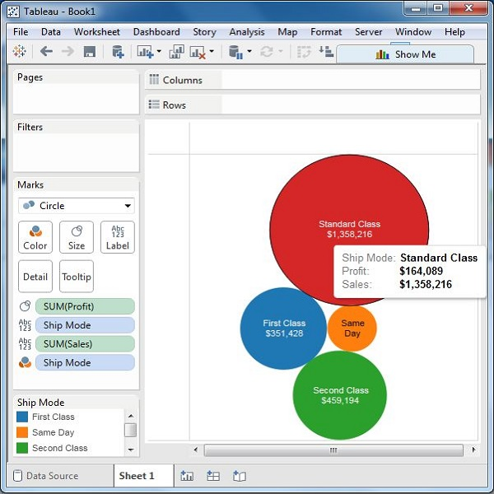
Bubble Chart with Measure Values

Slide 36
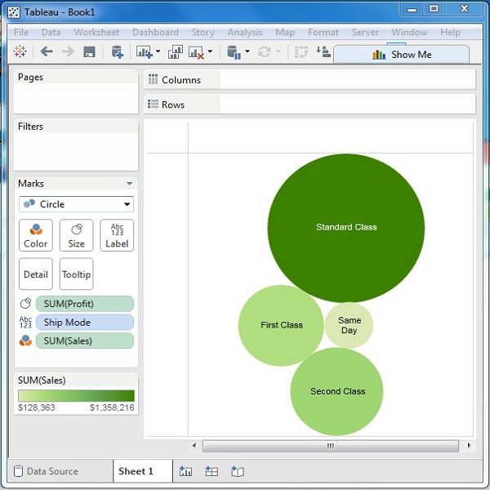
Bubble Chart with Measure Colors

Slide 37
Bullet Graph
A bullet chart is a variation of Bar chart.
In this chart, we compare the value of one measure with another measure in the context of finding the variation in the first measure within a range of variations in the second measure.
It is like two bars drawn upon one another to indicate their individual values at the same position in the graph.
It can be thought of as combining two graphs as one to view a comparative result easily.

Slide 38
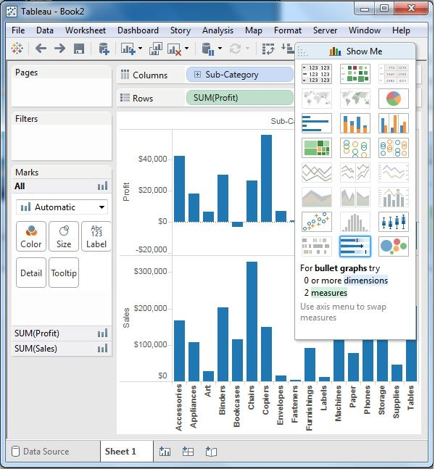
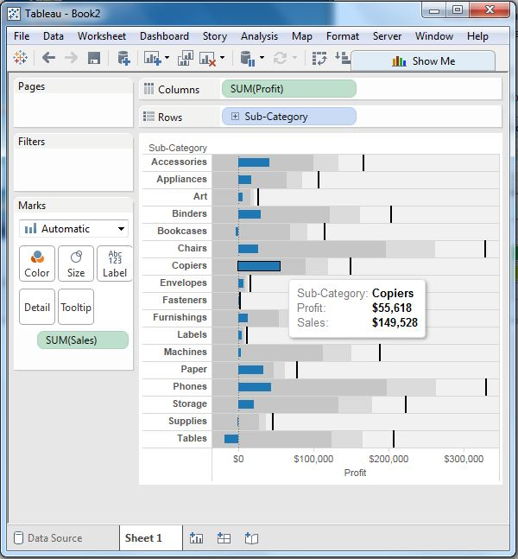
Steps
Step 1 − Drag and drop the dimension Sub-Category from the data pane into the column shelf.
Step 2 − Drag and drop the measures Profit and Sales to the Rows shelf.
Step 3 − Drag the sales measure to the Marks card. Using Show Me, choose the bullet graph option. The following chart shows the bullet graph.

Slide 39
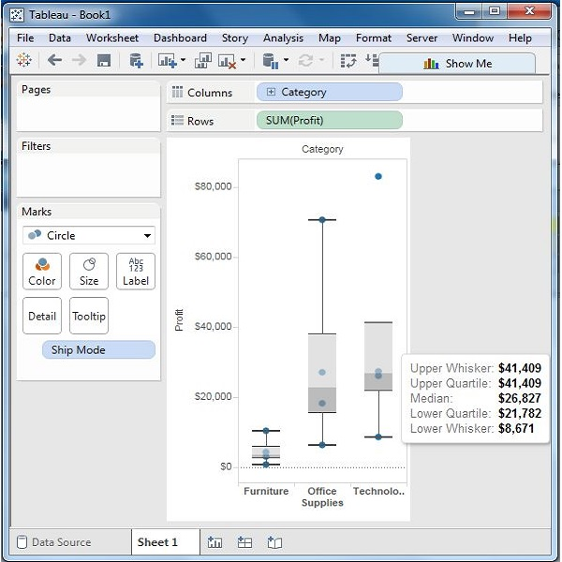
Boxplot
The box plots are also known as a box-and-whisker plots. They show the distribution of values along an axis.
Boxes indicate the middle 50 percent of the data which is, the middle two quartiles of the data's distribution.
The remaining 50 percent of data on both sides is represented by lines also called whiskers, to display all points within 1.5 times the interquartile range, which is all points within 1.5 times the width of the adjoining box, or all points at the maximum extent of the data.

Slide 40
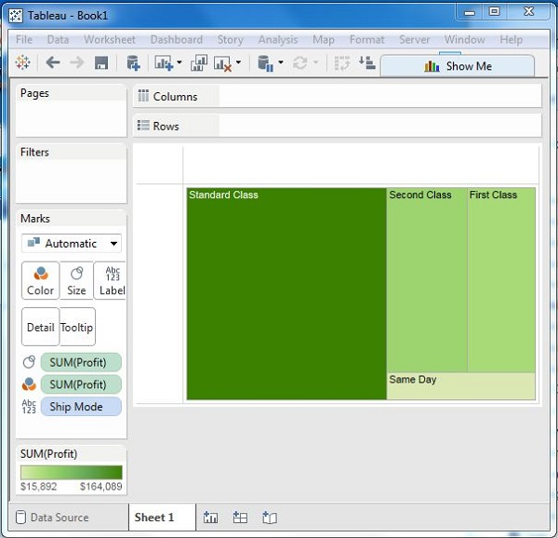
Tree Map
The tree map displays data in nested rectangles.
The dimensions define the structure of the tree map and measures define the size or color of the individual rectangle.
The rectangles are easy to visualize as both the size and shade of the color of the rectangle reflect the value of the measure.

Slide 41
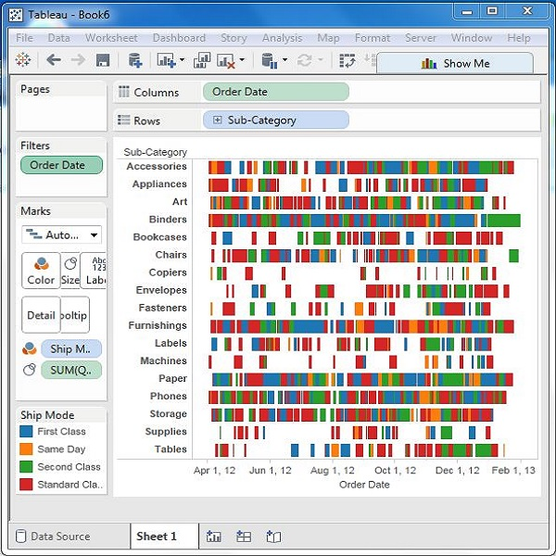
Gantt Chart
A Gantt chart shows the progress of the value of a task or resource over a period of time. It is extensively used in project management and other types of variation study over a period of time. Thus, in Gantt chart, time dimension is an essential field.
The Gantt chart takes at least a dimension and a measure in addition to the time dimension.

Slide 42
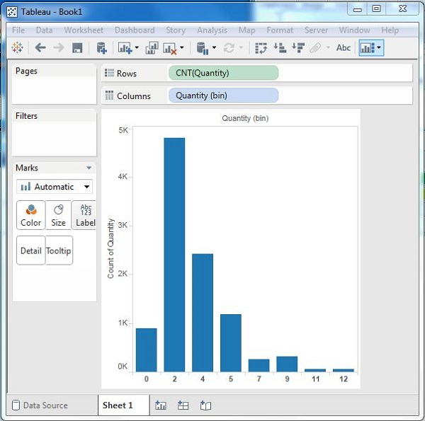
Histogram
A histogram represents the frequencies of values of a variable bucketed into ranges.
Histogram is similar to bar chart but it groups the values into continuous ranges.
Each bar in histogram represents the height of the number of values present in that range.
Tableau creates a histogram by taking one measure. It creates an additional bin field for the measure used in creating a histogram.

Slide 43
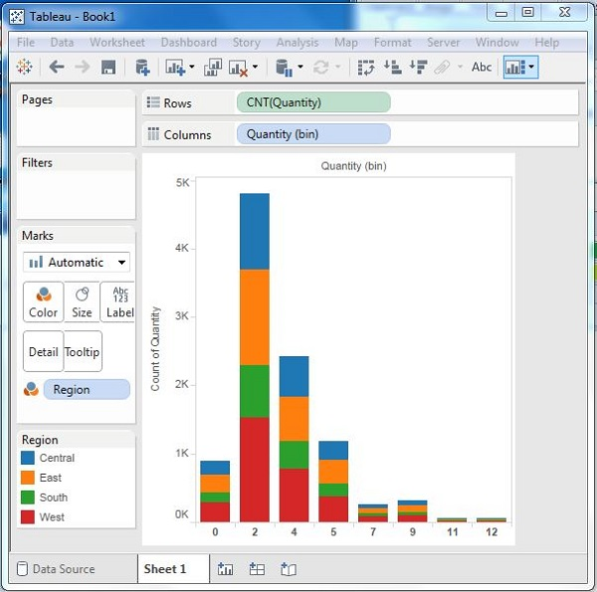
Histogram with Dimension
This will create a stacked histogram. Each bar will have stacks representing the values of the dimension.

Slide 44
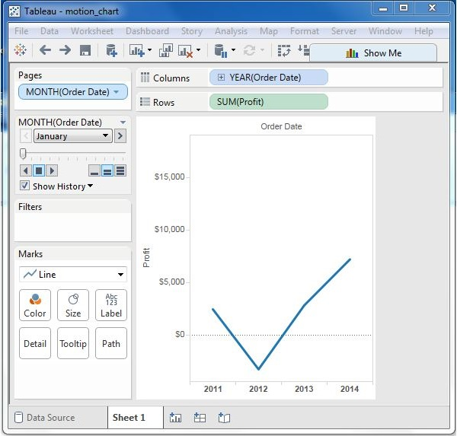
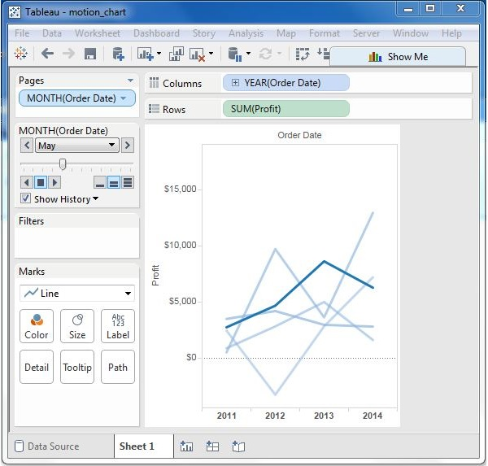
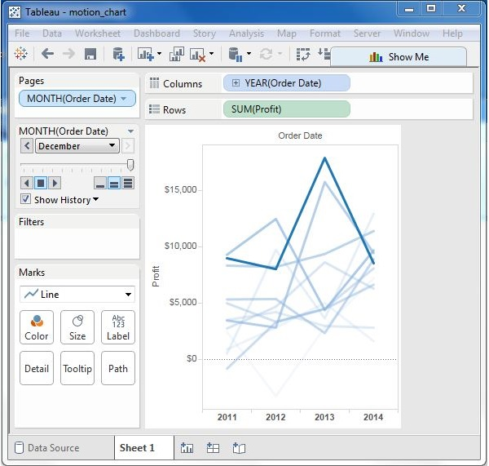
Motion Charts
Motion charts show data using the X and Y-axes, displaying changes over time by showing the movement of data points within the defined space as well as changes in the color of the lines.
The main advantage of motion chart is to view the entire trail of how the data has changed over time and not just a snapshot of the data.

Slide 45
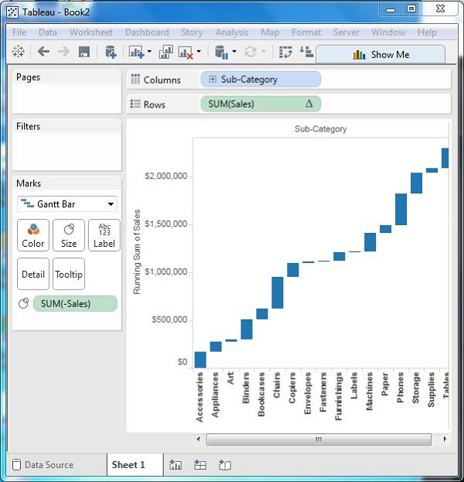
Waterfall Chart
Waterfall charts effectively display the cumulative effect of sequential positive and negative values.
It shows where a value starts, ends and how it gets there incrementally. So, we are able to see both the size of changes and difference in values between consecutive data points.
Tableau needs one Dimension and one Measure to create a Waterfall chart.

Slide 46
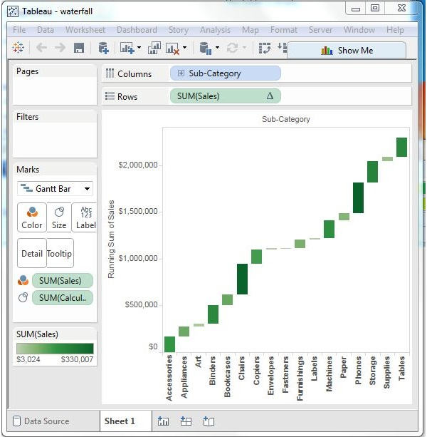
Waterfall Chart with Color
Give different color shades to the bars in the chart by dragging the Sales measure to the Color shelf under the Marks Card.
You get the following waterfall chart with color.

Slide 47
Design Case Study..!

Slide 48
Functionalities
Filters
Drill Down and Drill Up
Trend Line
Forecasting
Clusters

