Slide 1
Habit Calendar 001b
Installation and everyday use
Ubuntu laptop and Android phone
Version 1.1.1 · harharhari · GPL-3.0-only
Notes:
Use a disposable rsn-test-vault for all first-use exercises. This tutorial includes manual installation on both devices, optional Obsidian Sync and a maintainer publication appendix.
Plugin behaviour: version 1.1.1 source and repository documentation.

Slide 2
The monthly calendar
One named calendar for every enabled habit.
Monday starts the week. Earlier dates in the current month remain editable.
Click or tap a date to cycle unmarked, green, pink, then unmarked.
Schedules are not part of this version. You choose every mark manually.
Habit Calendar 001b 1.1.1
02
Notes:
Plugin behaviour: version 1.1.1 source and repository documentation.

Slide 3
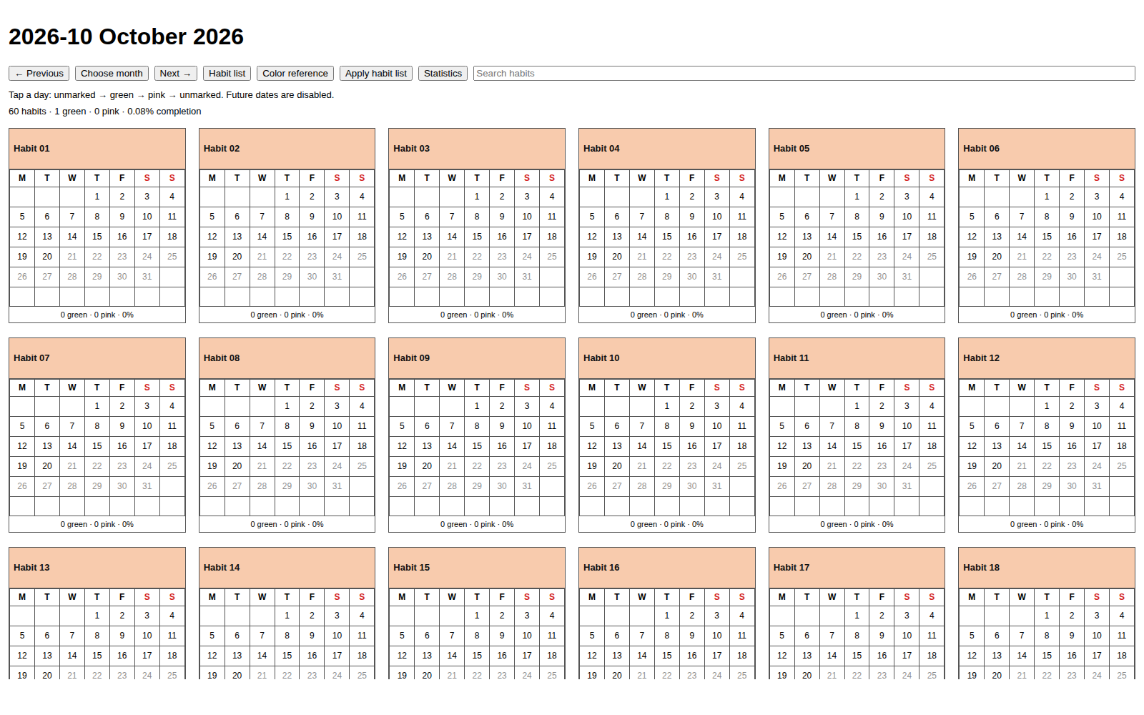
Desktop layout
Wide desktop views show six calendars per row.
Search filters the visible habit names.
Previous, Choose month and Next open monthly views.
Browser-rendered example; Obsidian APIs mocked
03
Notes:
Browser-rendered example with mocked Obsidian APIs and generic habits. This is not an Ubuntu Obsidian screenshot.
Plugin behaviour: version 1.1.1 source and repository documentation.

Slide 4
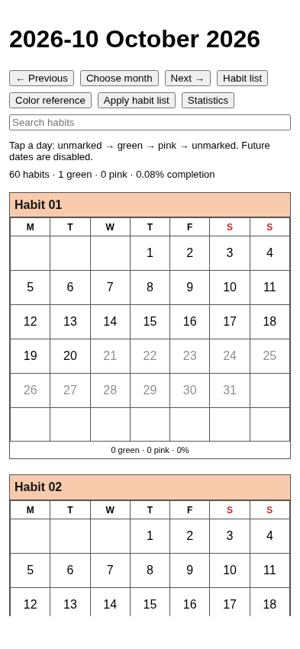
Android layout
One calendar per row.
Scroll vertically through all habits.
Tap a day to change its mark.
Use the same commands as on your laptop.
Browser-rendered example; Obsidian APIs mocked
04
Notes:
Browser-rendered mobile viewport, not an Android device screenshot. The maintainer separately reports working Android phones.
Plugin behaviour: version 1.1.1 source and repository documentation.

Slide 5
Requirements and test vault
Obsidian installed on both devices. The manifest declares version 1.7.2 or later.
A separate vault named rsn-test-vault for the first trial.
An Android file manager that can show hidden files for manual installation.
Normal use needs no Node.js or Python. Sync is optional.
Habit Calendar 001b 1.1.1
05
Notes:
The declared minimum is based on API compatibility checks; the exact minimum app version has not been tested on devices. Ubuntu 24.04.3 is user-confirmed. The user assumes latest Obsidian and Android; exact versions/models remain unrecorded.
Official source: https://docs.obsidian.md/Plugins/Getting%20started/Build%20a%20plugin
Plugin behaviour: version 1.1.1 source and repository documentation.

Slide 6
GitHub release downloads
Open harharhari/rsn-habit-tracker-obsidian-plugin on GitHub, then Releases.
Select release tag 1.1.1 and expand Assets.
Download the four loose files, installation ZIP and SHA256SUMS into one folder.
Use the attached installation ZIP. The automatic Source code ZIP needs a developer build.
Habit Calendar 001b 1.1.1
06
Notes:
Repository: https://github.com/harharhari/rsn-habit-tracker-obsidian-plugin/releases/tag/1.1.1 . The link works only after the maintainer publishes the release and your account has access. A private repository requires authorized access. The six asset names are main.js, manifest.json, styles.css, hex-color-list.md, habit-calendar-001b-1.1.1.zip, SHA256SUMS.
Plugin behaviour: version 1.1.1 source and repository documentation.

Slide 7
Download verification
On Ubuntu, open a terminal inside the release download folder.
Run: sha256sum -c SHA256SUMS
Expect five OK results, covering four loose files and the ZIP.
Stop if a file is missing or a checksum fails. Download matching assets again.
Habit Calendar 001b 1.1.1
07
Notes:
Keep the release checksum with release downloads. The repository root checksum describes source files instead. The checksum file cannot hash itself. Checksums detect corruption and mismatches but are not a signature proving publisher identity.
Plugin behaviour: version 1.1.1 source and repository documentation.

Slide 8
Ubuntu installation: files
1. Open rsn-test-vault once in Obsidian, then close the app.
2. In Files, press Ctrl+H to show hidden files. Open the vault’s .obsidian folder.
3. Create plugins if needed. Extract the installation ZIP.
4. Copy its habit-calendar-001b folder into .obsidian/plugins/.
Habit Calendar 001b 1.1.1
08
Notes:
The final path must be <vault>/.obsidian/plugins/habit-calendar-001b/main.js. Do not create habit-calendar-001b/habit-calendar-001b/main.js. A custom configuration folder replaces .obsidian if you have explicitly configured one.
Official source: https://docs.obsidian.md/Plugins/Getting%20started/Build%20a%20plugin
Plugin behaviour: version 1.1.1 source and repository documentation.

Slide 9
Ubuntu installation: first opening
1. Reopen the correct vault in Obsidian.
2. Open Settings, then Community plugins. Allow community plugins.
3. Enable Habit Calendar 001b and verify version 1.1.1.
4. Press Ctrl+P. Run Habit Calendar 001b: Open current month.
Habit Calendar 001b 1.1.1
09
Notes:
A new installation starts with an empty editable habit table. Controls should appear even before calendars exist. The old Habit Calendar 001 must stay disabled when using the same data. Restart Obsidian after changing the manifest.
Official source: https://docs.obsidian.md/Plugins/Getting%20started/Build%20a%20plugin
Plugin behaviour: version 1.1.1 source and repository documentation.

Slide 10
Android installation: vault location
1. Install the official Obsidian app and create or open rsn-test-vault.
2. For manual file copying, choose device storage and note the real folder location.
3. Open the vault once. Force-stop Obsidian using Android Settings.
4. Transfer verified files from Ubuntu, or download the same release on the phone.
Habit Calendar 001b 1.1.1
10
Notes:
Example location: Internal storage/Documents/Obsidian/rsn-test-vault. Actual names vary by phone. App-private storage is inaccessible to the ordinary manual file-copy workflow. Android may request file access for device storage. Do not uninstall Obsidian as an upgrade step.
Official source: https://obsidian.md/help/android
Plugin behaviour: version 1.1.1 source and repository documentation.

Slide 11
Android installation: plugin files
1. Enable Show hidden files in your file manager.
2. Inside the vault, create .obsidian/plugins/habit-calendar-001b/.
3. Copy main.js, manifest.json, styles.css and hex-color-list.md directly into it.
4. Reopen Obsidian, enable community plugins and enable Habit Calendar 001b.
Habit Calendar 001b 1.1.1
11
Notes:
Alternatively extract the ZIP and copy its enclosed folder into .obsidian/plugins. Do not copy a second nested folder. LICENSE and NOTICE can remain if using the ZIP. ZIP and SHA256SUMS are not runtime files.
Plugin behaviour: version 1.1.1 source and repository documentation.

Slide 12
Android installation: first opening
Open the command palette from the mobile ribbon or menu.
Run Habit Calendar 001b: Open current month.
Expect a title such as 2026-10 October 2026.
A monthly Markdown note renders its calendar in Reading view; Source mode shows code.
Habit Calendar 001b 1.1.1
12
Notes:
The direct command opens the interactive view. If the plugin is absent, check the selected vault, folder nesting, hidden configuration folder and filenames. If the version is old, replace the correct files and restart. If no habits exist, continue to the habit-list exercise.
Plugin behaviour: version 1.1.1 source and repository documentation.

Slide 13
The three-column habit list
Use Habit list to open Habit Tracker/habit-tracker-list.md.
Add Walking with Y and #90EE90. Add Reading with Y and #ADD8E6.
Add Yoga with N and #FFDAB9, then save.
Y includes a calendar when applied. N excludes it. Keep automatic habit-ID comments.
Habit Calendar 001b 1.1.1
13
Notes:
Copy the complete starter table from examples/habit-tracker-list.md in the repository. Headers are Habit, Generate calendar, Header color. Edit in Source mode. The plugin inserts stable habit IDs; preserve them when renaming or moving existing rows.
Plugin behaviour: version 1.1.1 source and repository documentation.

Slide 14
The replacement warning
The warning appears after a meaningful habit-list change.
Yes clears every current-month mark and applies the new list.
No preserves displayed calendars and marks. Your edited list remains saved.
Use Apply habit list to reconsider a change previously declined.
Habit Calendar 001b 1.1.1
14
Notes:
Exact warning: “The current months entries will be overwritten and there would be loss of data”. Choose Yes for the new empty practice month. Later, never use Yes simply to troubleshoot a blank view. A color-only edit also resets all current marks when accepted. Closing the dialog behaves as No.
Plugin behaviour: version 1.1.1 source and repository documentation.

Slide 15
Daily marking exercise
Tap today in Walking once: green means activity completed.
Tap again: pink is your manual not-done mark.
Tap a third time: the date has no color.
Mark an earlier current-month date, restart Obsidian and confirm the mark persists.
Habit Calendar 001b 1.1.1
15
Notes:
Future dates are disabled. Previous months are read-only. No schedule runs in the background, and blank dates do not automatically become pink. Use the Statistics button to compare counts after restart.
Plugin behaviour: version 1.1.1 source and repository documentation.

Slide 16
Colors and custom shades
Open Color reference and switch to Reading view for swatches.
Choose a six-digit code such as #ADD8E6 and copy it yourself into the habit list.
To add a shade, append My lavender with #B8A9E8 and an empty third cell.
Changing the color reference alone never changes an existing calendar.
Habit Calendar 001b 1.1.1
16
Notes:
Source-mode row: | My lavender | #B8A9E8 | | . The editable vault reference has 147 CSS3 named colors. Its third column renders the actual shade. Applying a header-color change through the habit list requires the same destructive confirmation.
Plugin behaviour: version 1.1.1 source and repository documentation.

Slide 17
Habit maintenance
Rename the visible label while retaining the hidden habit ID.
Move whole table rows to reorder calendars.
Add a row, change Y to N, or delete a row to alter the next applied catalog.
Batch changes deliberately. Every accepted catalog change resets all current marks.
Habit Calendar 001b 1.1.1
17
Notes:
Practice No first, then Apply habit list and Yes in the disposable vault. Verify unchanged habits also lose current marks. The plugin saves a recovery snapshot under System/Backups but provides no one-click undo.
Plugin behaviour: version 1.1.1 source and repository documentation.

Slide 18
Statistics without schedules
Completion is green days divided by elapsed calendar days.
Example: 6 green days after 10 days gives 60% for that habit.
Pink and blank dates break streaks. Streaks stay within one month.
Historical reports keep their saved as-of date and totals.
Habit Calendar 001b 1.1.1
18
Notes:
The simple denominator counts elapsed dates, not a custom schedule. A frozen report whose last update was before month-end retains that earlier as-of date. Do not assume historical percentages were recalculated to the last day of the month.
Plugin behaviour: version 1.1.1 source and repository documentation.

Slide 19
New months and frozen history
A new month appears while Obsidian is open or on the next opening.
The new month uses the current habit list and starts with blank marks.
Previous months keep their saved calendars and statistics.
Late synced marks remain excluded from frozen history.
Habit Calendar 001b 1.1.1
19
Notes:
Even a list change declined in the previous month can be used for the next month. Default timezone is Asia/Kolkata in Habit Tracker/System/config.md. Keep it consistent across devices. There is no Android background scheduler. The optional Linux helper is documented in SETUP-AND-USAGE.md.
Plugin behaviour: version 1.1.1 source and repository documentation.

Slide 20
Optional Obsidian Sync
Connect both local vaults to the same remote vault. Matching names alone do not connect them.
On each device, enable the installed and active community plugin sync options.
Include Habit Tracker and its Records, Statistics and System folders.
Wait for downloads, then restart Obsidian to load plugin changes.
Habit Calendar 001b 1.1.1
20
Notes:
Obsidian Sync is an optional paid service. Configure sync preferences separately on each device. For remembered plugin settings, include community plugin settings where offered. See ANDROID-rsn-test-vault.md for the complete sequence. Independent manual copies do not synchronize automatically.
Official source: https://help.obsidian.md/sync/settings
Plugin behaviour: version 1.1.1 source and repository documentation.

Slide 21
Safe work across devices
Finish syncing before a habit-list reset on the primary laptop.
Let that reset reach Android before adding new marks there.
Sync before month rollover so pending activity can reach the saved report.
Avoid simultaneous offline resets. Keep a separate backup.
Habit Calendar 001b 1.1.1
21
Notes:
The runtime uses revision-tagged records. Old-generation marks cannot resurrect data after a reset. Simultaneous resets can discard another revision, and late historical marks are excluded by design. Neither this plugin nor GitHub supplies a sync service.
Plugin behaviour: version 1.1.1 source and repository documentation.

Slide 22
Upgrade without losing history
Back up and finish syncing, then close or force-stop Obsidian.
Replace main.js, manifest.json, styles.css and the plugin-folder hex-color-list.md.
Keep plugin data.json and the entire vault Habit Tracker folder.
Restart and verify the version. Updating code alone requires no habit-list reset.
Habit Calendar 001b 1.1.1
22
Notes:
data.json holds plugin preferences including remembered decisions. Habit Tracker holds your list, custom color reference, records, monthly notes, statistics and snapshots. There are two hex-color-list.md files: replace the packaged plugin copy and preserve your editable vault copy.
Plugin behaviour: version 1.1.1 source and repository documentation.

Slide 23
Troubleshooting
Plugin missing: check vault, directory nesting and exact filenames.
Controls visible but no calendars: check Y rows and whether list changes were declined.
Blank view: run Open current month and try the note in Reading view.
Report the app version, plugin version, phone/OS, steps and exact error text.
Habit Calendar 001b 1.1.1
23
Notes:
Do not delete Habit Tracker or accept a reset to investigate a blank screen. To inspect Android errors, enable USB debugging and use Chrome chrome://inspect/ on the laptop. The official mobile-development page covers this workflow.
Official source: https://docs.obsidian.md/Plugins/Getting%20started/Mobile%20development
Plugin behaviour: version 1.1.1 source and repository documentation.

Slide 24
Maintainer: repository and release
Upload repository/ contents to the GitHub repository root, including hidden files.
README.md, LICENSE and manifest.json belong at that root.
Attach each of the six release-assets files separately to tag 1.1.1.
Keep the personal habit list and test vault outside the public repository.
Habit Calendar 001b 1.1.1
24
Notes:
Use FILE-LOCATIONS.md in the outer delivery for the exact local-to-GitHub mapping. The source checksum and release checksum are different files. GitHub Actions validates pushes but does not publish. Do not replace a published binary silently; use a new version for changed code.
Plugin behaviour: version 1.1.1 source and repository documentation.

Slide 25
Maintainer: acceptance tests
Run npm ci --ignore-scripts, npm run check and npm run test:helper.
Download the published release into a fresh folder and verify its checksums.
Test installation, marking, restart, Yes/No changes, colors and frozen history on both devices.
Record exact versions and outcomes in TEST-RESULTS-TEMPLATE.md.
Habit Calendar 001b 1.1.1
25
Notes:
37 JavaScript and 6 Python tests pass. Browser desktop/mobile scenarios are separate from device testing. The user reports Ubuntu 24.04.3 and Android success, but exact app/phone versions and all-checklist results remain unrecorded. Test the declared minimum or revise the compatibility claim before submission.
Plugin behaviour: version 1.1.1 source and repository documentation.

Slide 26
Maintainer: Community submission
Make the intended public repository and matching normal release available.
Sign in at community.obsidian.md and connect GitHub.
Go to Plugins, New plugin. Enter the repository URL and owner, then submit.
Resolve review errors and publish the listing. Confirm installation from the app’s Community browser.
Habit Calendar 001b 1.1.1
26
Notes:
Review the developer policies and maintenance commitment before submitting. The current directory-based workflow replaces old pull-request tutorials. Source: https://docs.obsidian.md/Plugins/Releasing/Submit%20your%20plugin
Account and form instructions: https://docs.obsidian.md/community-directory/set-up-and-claim
Review controls: https://docs.obsidian.md/community-directory/manage-entry
Official source: https://docs.obsidian.md/Plugins/Releasing/Submit%20your%20plugin
Plugin behaviour: version 1.1.1 source and repository documentation.

Slide 27
Maintainer: review and updates
The directory checks manifest, release assets, source and build verification.
Use Review branch for a preview scan when the entry management page offers it.
Fix issues in a new version and release. Local lint does not grant acceptance.
For future versions, publish matching release assets and monitor new review results.
Habit Calendar 001b 1.1.1
27
Notes:
Reference: https://docs.obsidian.md/community-directory/manage-entry . See docs/GITHUB-AND-COMMUNITY-RELEASE.md for step-by-step publication, official sources, test gates and future-release guidance.
Official source: https://docs.obsidian.md/community-directory/manage-entry
Plugin behaviour: version 1.1.1 source and repository documentation.

Slide 28
Reference files
docs/INSTALL-DOWNLOAD.md: detailed installation and upgrades.
docs/TUTORIAL.md: practice exercises and history behaviour.
docs/GITHUB-AND-COMMUNITY-RELEASE.md: testing and submission.
docs/DESIGN-DECISIONS.md: confirmed choices and remaining questions.
Habit Calendar 001b 1.1.1
28
Notes:
The repository includes a generic starter and 60-habit example. Personal 71-habit data is excluded. Official documentation was checked on 21 October 2026. The PowerPoint describes version 1.1.1; refer to current release notes for later versions.
Plugin behaviour: version 1.1.1 source and repository documentation.

