Slide 1
rsn habit calendar one b
Windows, Ubuntu and Mac
Android, iPhone and iPad
Version 1.1.5 · harharhari · GPL-3.0-only
Notes:
Use a disposable rsn-test-vault for all first-use exercises. This tutorial includes manual installation on both devices, optional Obsidian Sync and a maintainer publication appendix.
Plugin behaviour: version 1.1.5 source and repository documentation.

Slide 2
The monthly calendar
One named calendar for every enabled habit.
Monday starts the week. Earlier dates in the current month remain editable.
Click or tap a date to cycle unmarked, green, pink, then unmarked.
Schedules are not part of this version. You choose every mark manually.
rsn habit calendar one b 1.1.5
02
Notes:
Plugin behaviour: version 1.1.5 source and repository documentation.

Slide 3
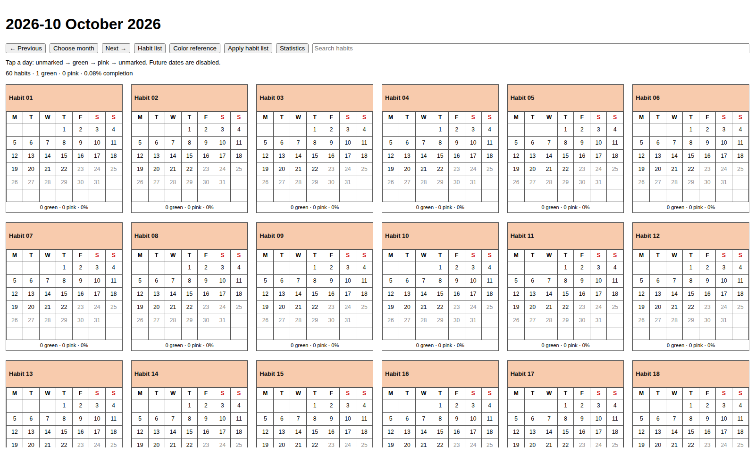
Desktop layout
Wide desktop views show six calendars per row.
Search filters the visible habit names.
Previous, Choose month and Next open monthly views.
Browser-rendered example; Obsidian APIs mocked
03
Notes:
Browser-rendered example with mocked Obsidian APIs and generic habits. This is not an Ubuntu Obsidian screenshot.
Plugin behaviour: version 1.1.5 source and repository documentation.

Slide 4
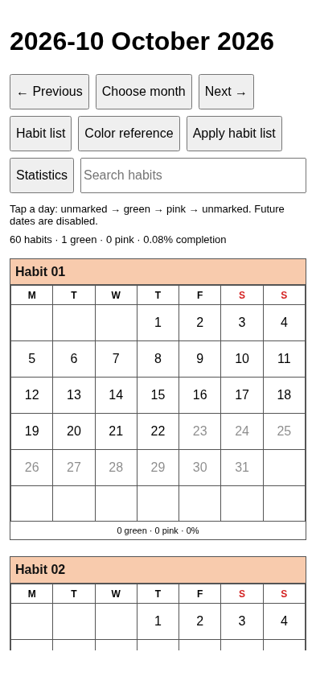
Phone and tablet layout
One calendar per row.
Includes iPad in landscape.
Tap a day to change its mark.
Scroll vertically through all habits.
Browser-rendered example; Obsidian APIs mocked
04
Notes:
Browser-rendered phone viewport with mocked Obsidian APIs. This is not an actual mobile app screenshot. Native device acceptance for 1.1.5 remains pending.

Slide 5
Requirements and test vault
Install Obsidian and create rsn-test-vault for first-use exercises.
Targets: Windows 11, Ubuntu 24.04.3 and current Apple/Android systems.
Manual Android setup needs an accessible vault and a file manager with hidden files.
Normal use needs no Node.js or Python. Obsidian Sync is optional.
rsn habit calendar one b 1.1.5
05
Notes:
All targets use the same plugin bundle. Latest means stable at testing time. Record exact device, OS and Obsidian versions. 1.1.1 was reported working on Ubuntu/Android. 1.1.5 native device acceptance remains pending. The manifest retains 1.7.2 as an API floor, not a tested-device claim. Official source: https://docs.obsidian.md/Plugins/Getting%20started/Build%20a%20plugin

Slide 6
GitHub release downloads
Open harharhari/rsn-habit-tracker-obsidian-plugin on GitHub, then Releases.
Select release tag 1.1.5 and expand Assets.
Download main.js, manifest.json and styles.css into one folder.
The color starter is embedded. Source code ZIP links require a developer build.
rsn habit calendar one b 1.1.5
06
Notes:
See docs/INSTALL-DOWNLOAD.md and docs/CHECKSUMS.md. Normal plugin use does not require GitHub CLI, npm or Python. The optional six-file manual kit is separate from Community release attachments.

Slide 7
Download provenance
The maintainer workflow attests the files built from the reviewed tag.
With GitHub CLI, verify each downloaded file against the repository.
Check the verification result’s source commit and workflow.
Local handoff files have checksums; they are not described as attested.
rsn habit calendar one b 1.1.5
07
Notes:
See docs/INSTALL-DOWNLOAD.md and docs/CHECKSUMS.md. Normal plugin use does not require GitHub CLI, npm or Python. Commands: gh attestation verify main.js --repo harharhari/rsn-habit-tracker-obsidian-plugin; repeat for manifest.json and styles.css. https://docs.github.com/en/actions/how-tos/secure-your-work/use-artifact-attestations/use-artifact-attestations

Slide 8
Checksum verification
Use docs/RELEASE-ASSET-SHA256SUMS from the exact version tag.
Ubuntu: sha256sum -c RELEASE-ASSET-SHA256SUMS
Mac: shasum -a 256 -c RELEASE-ASSET-SHA256SUMS
Windows: use the PowerShell loop in docs/CHECKSUMS.md.
rsn habit calendar one b 1.1.5
08
Notes:
See docs/INSTALL-DOWNLOAD.md and docs/CHECKSUMS.md. Normal plugin use does not require GitHub CLI, npm or Python. Place the three downloaded assets and the checksum file together. Expect three OK results. The optional manual kit has its own SHA256SUMS and five payloads. Stop on any mismatch.

Slide 9
Windows 11: plugin files
1. Open rsn-test-vault once, then close Obsidian.
2. In File Explorer, enable Hidden items and File name extensions.
3. Create .obsidian/plugins/rsn-habit-calendar-one-b/ inside the vault.
4. Copy main.js, manifest.json and styles.css directly into that folder.
rsn habit calendar one b 1.1.5
09
Notes:
See docs/INSTALL-DOWNLOAD.md and docs/CHECKSUMS.md. Normal plugin use does not require GitHub CLI, npm or Python.

Slide 10
Windows 11: first opening
1. Reopen rsn-test-vault in Obsidian.
2. Under Settings, Community plugins, enable rsn habit calendar one b.
3. Verify version 1.1.5. Press Ctrl+P and run Open current month.
4. Add generic habits using the later practice exercise. Wide panes show six calendars per row.
rsn habit calendar one b 1.1.5
10
Notes:
Use the complete command rsn habit calendar one b: Open current month. Calendar controls appear even when the habit list is empty. Restart after changing manifest.json.

Slide 11
Ubuntu installation: files
1. Open rsn-test-vault once in Obsidian, then close the app.
2. In Files, press Ctrl+H to show hidden files. Open the vault’s .obsidian folder.
3. Create plugins/rsn-habit-calendar-one-b/ if needed.
4. Copy the three downloaded plugin files directly into that folder.
rsn habit calendar one b 1.1.5
11
Notes:
See docs/INSTALL-DOWNLOAD.md and docs/CHECKSUMS.md. Normal plugin use does not require GitHub CLI, npm or Python.

Slide 12
Ubuntu installation: first opening
1. Reopen the correct vault in Obsidian.
2. Open Settings, then Community plugins. Allow community plugins.
3. Enable rsn habit calendar one b and verify version 1.1.5.
4. Press Ctrl+P. Run rsn habit calendar one b: Open current month.
rsn habit calendar one b 1.1.5
12
Notes:
A new installation starts with an empty editable habit table. Controls should appear even before calendars exist. The old Habit Calendar 001 must stay disabled when using the same data. Restart Obsidian after changing the manifest.
Official source: https://docs.obsidian.md/Plugins/Getting%20started/Build%20a%20plugin
Plugin behaviour: version 1.1.5 source and repository documentation.

Slide 13
Mac: plugin files
1. Open rsn-test-vault once, then quit Obsidian.
2. In Finder, press Command+Shift+period to reveal hidden files.
3. Create .obsidian/plugins/rsn-habit-calendar-one-b/ inside the vault.
4. Copy main.js, manifest.json and styles.css directly into that folder.
rsn habit calendar one b 1.1.5
13
Notes:
See docs/INSTALL-DOWNLOAD.md and docs/CHECKSUMS.md. Normal plugin use does not require GitHub CLI, npm or Python.

Slide 14
Mac: first opening
1. Reopen the same vault. Enable rsn habit calendar one b under Community plugins.
2. Confirm version 1.1.5. Press Command+P to open the command palette.
3. Run rsn habit calendar one b: Open current month.
4. Test marking, restart and a narrow split pane before using personal data.
rsn habit calendar one b 1.1.5
14
Notes:
The same bundle supports all target platforms. Actual Mac acceptance remains pending. Use docs/PLATFORM-TESTING.md and record the exact OS and app versions.

Slide 15
Android installation: vault location
1. Install the official Obsidian app and create or open rsn-test-vault.
2. For manual file copying, choose device storage and note the real folder location.
3. Open the vault once. Force-stop Obsidian using Android Settings.
4. Transfer verified files from Ubuntu, or download the same release on the phone.
rsn habit calendar one b 1.1.5
15
Notes:
Example location: Internal storage/Documents/Obsidian/rsn-test-vault. Actual names vary by phone. App-private storage is inaccessible to the ordinary manual file-copy workflow. Android may request file access for device storage. Do not uninstall Obsidian as an upgrade step.
Official source: https://obsidian.md/help/android
Plugin behaviour: version 1.1.5 source and repository documentation.

Slide 16
Android installation: plugin files
1. Enable Show hidden files in your file manager.
2. Inside the vault, create .obsidian/plugins/rsn-habit-calendar-one-b/.
3. Copy main.js, manifest.json and styles.css directly into it.
4. Reopen Obsidian, allow community plugins and enable rsn habit calendar one b.
rsn habit calendar one b 1.1.5
16
Notes:
See docs/INSTALL-DOWNLOAD.md and docs/CHECKSUMS.md. Normal plugin use does not require GitHub CLI, npm or Python. Manual Android copying needs an accessible device-storage vault.

Slide 17
Android installation: first opening
Open the command palette from the mobile ribbon or menu.
Run rsn habit calendar one b: Open current month.
Expect a title such as 2026-10 October 2026.
A monthly Markdown note renders its calendar in Reading view; Source mode shows code.
rsn habit calendar one b 1.1.5
17
Notes:
The direct command opens the interactive view. If the plugin is absent, check the selected vault, folder nesting, hidden configuration folder and filenames. If the version is old, replace the correct files and restart. If no habits exist, continue to the habit-list exercise.
Plugin behaviour: version 1.1.5 source and repository documentation.

Slide 18
iPhone and iPad: Sync preparation
1. Install 1.1.5 in the desktop rsn-test-vault and confirm it works.
2. Connect that local vault to an Obsidian Sync remote vault.
3. Enable installed and active community plugin sync, plus plugin settings if wanted.
4. Wait for upload completion. Keep this vault outside iCloud Drive.
rsn habit calendar one b 1.1.5
18
Notes:
Obsidian Sync is a separate optional paid service. The plugin does not provide sync. On every device configure Sync preferences separately. Official sources: https://help.obsidian.md/sync/settings and https://help.obsidian.md/sync-notes

Slide 19
iPhone and iPad: Sync opening
1. Install the official Obsidian app and sign in. Choose the same remote Sync vault.
2. Enable the matching plugin sync options on this device. Allow community plugins.
3. Wait for files to arrive, restart Obsidian, and enable rsn habit calendar one b.
4. Verify 1.1.5 and run Open current month. Expect one calendar per row, even on iPad.
rsn habit calendar one b 1.1.5
19
Notes:
Use an on-device local vault connected to Sync, not Store in iCloud. Verify the vault is linked to the same remote ID, not merely the same name. If a restart is needed, close and reopen the app without uninstalling it. Official sources: https://help.obsidian.md/ios and https://help.obsidian.md/sync/settings

Slide 20
Apple alternative: iCloud setup
1. On iPhone or iPad, create rsn-test-vault in Obsidian with Store in iCloud enabled.
2. On a Mac with the same Apple Account, locate iCloud Drive/Obsidian/rsn-test-vault.
3. Keep that folder downloaded and open it as a vault in Obsidian on the Mac.
4. Close Obsidian before copying plugin files into this vault.
rsn habit calendar one b 1.1.5
20
Notes:
This is a separate Apple-only alternative. Do not add Obsidian Sync to the same vault. Keep downloaded where supported in Finder. Use the Obsidian app-created iCloud folder, not an unrelated folder with the same name. Official source: https://help.obsidian.md/sync-notes

Slide 21
Apple alternative: manual plugin copy
1. On the Mac, reveal hidden files with Command+Shift+period.
2. Copy the three plugin files into the iCloud vault’s matching plugin folder.
3. Wait for iCloud transfer. Reopen Obsidian on each Apple device and enable it.
4. Verify 1.1.5 and persistence. Keep this vault separate from Obsidian Sync.
rsn habit calendar one b 1.1.5
21
Notes:
See docs/INSTALL-DOWNLOAD.md and docs/CHECKSUMS.md. Normal plugin use does not require GitHub CLI, npm or Python. Full path: .obsidian/plugins/rsn-habit-calendar-one-b/. The normal iOS Files app cannot reliably expose .obsidian; use Mac-assisted copying or Obsidian Sync. https://help.obsidian.md/sync-notes

Slide 22
The three-column habit list
Use Habit list to open Habit Tracker/habit-tracker-list.md.
Add Walking with Y and #90EE90. Add Reading with Y and #ADD8E6.
Add Yoga with N and #FFDAB9, then save.
Y includes a calendar when applied. N excludes it. Keep automatic habit-ID comments.
rsn habit calendar one b 1.1.5
22
Notes:
Copy the complete starter table from examples/habit-tracker-list.md in the repository. Headers are Habit, Generate calendar, Header color. Edit in Source mode. The plugin inserts stable habit IDs; preserve them when renaming or moving existing rows.
Plugin behaviour: version 1.1.5 source and repository documentation.

Slide 23
The replacement warning
The warning appears after a meaningful habit-list change.
Yes clears every current-month mark and applies the new list.
No preserves displayed calendars and marks. Your edited list remains saved.
Use Apply habit list to reconsider a change previously declined.
rsn habit calendar one b 1.1.5
23
Notes:
Exact warning: “The current months entries will be overwritten and there would be loss of data”. Choose Yes for the new empty practice month. Later, never use Yes simply to troubleshoot a blank view. A color-only edit also resets all current marks when accepted. Closing the dialog behaves as No.
Plugin behaviour: version 1.1.5 source and repository documentation.

Slide 24
Daily marking exercise
Tap today in Walking once: green means activity completed.
Tap again: pink is your manual not-done mark.
Tap a third time: the date has no color.
Mark an earlier current-month date, restart Obsidian and confirm the mark persists.
rsn habit calendar one b 1.1.5
24
Notes:
Future dates are disabled. Previous months are read-only. No schedule runs in the background, and blank dates do not automatically become pink. Use the Statistics button to compare counts after restart.
Plugin behaviour: version 1.1.5 source and repository documentation.

Slide 25
Colors and custom shades
Open Color reference and switch to Reading view for swatches.
Choose a six-digit code such as #ADD8E6 and copy it yourself into the habit list.
To add a shade, append My lavender with #B8A9E8 and an empty third cell.
Changing the color reference alone never changes an existing calendar.
rsn habit calendar one b 1.1.5
25
Notes:
Source-mode row: | My lavender | #B8A9E8 | | . The editable vault reference has 147 CSS3 named colors. Its third column renders the actual shade. Applying a header-color change through the habit list requires the same destructive confirmation.
Plugin behaviour: version 1.1.5 source and repository documentation.

Slide 26
Habit maintenance
Rename the visible label while retaining the hidden habit ID.
Move whole table rows to reorder calendars.
Add a row, change Y to N, or delete a row to alter the next applied catalog.
Batch changes deliberately. Every accepted catalog change resets all current marks.
rsn habit calendar one b 1.1.5
26
Notes:
Practice No first, then Apply habit list and Yes in the disposable vault. Verify unchanged habits also lose current marks. The plugin saves a recovery snapshot under System/Backups but provides no one-click undo.
Plugin behaviour: version 1.1.5 source and repository documentation.

Slide 27
Statistics without schedules
Completion is green days divided by elapsed calendar days.
Example: 6 green days after 10 days gives 60% for that habit.
Pink and blank dates break streaks. Streaks stay within one month.
Historical reports keep their saved as-of date and totals.
rsn habit calendar one b 1.1.5
27
Notes:
The simple denominator counts elapsed dates, not a custom schedule. A frozen report whose last update was before month-end retains that earlier as-of date. Do not assume historical percentages were recalculated to the last day of the month.
Plugin behaviour: version 1.1.5 source and repository documentation.

Slide 28
New months and frozen history
A new month appears while Obsidian is open or on the next opening.
The new month uses the current habit list and starts with blank marks.
Previous months keep their saved calendars and statistics.
Late synced marks remain excluded from frozen history.
rsn habit calendar one b 1.1.5
28
Notes:
Even a list change declined in the previous month can be used for the next month. Default timezone is Asia/Kolkata in Habit Tracker/System/config.md. Keep it consistent across devices. There is no Android background scheduler. The optional Linux helper is documented in SETUP-AND-USAGE.md.
Plugin behaviour: version 1.1.5 source and repository documentation.

Slide 29
Month selection on every platform
Choose month opens the same Month dropdown and Year field on all devices.
Select February and enter 2028 to inspect a leap-year month.
Use Open, or press Enter in the Year field with a keyboard.
Years must be 1970–9999. Choosing a month never makes historical dates editable.
rsn habit calendar one b 1.1.5
29
Notes:
The portable controls avoid browser differences in input type month. A future month can be viewed, but future dates remain disabled. Historical views are read-only.

Slide 30
Optional Obsidian Sync
Connect every local vault to the same remote vault. Matching names alone do not connect them.
On each device, enable installed and active community plugin sync options.
Include the entire Habit Tracker folder, including Records, Statistics and System.
Wait for downloads, then restart Obsidian to load plugin changes.
rsn habit calendar one b 1.1.5
30
Notes:
Obsidian Sync is an optional paid service. Enable community plugin settings as well to transfer remembered plugin decisions. Configure sync preferences separately on each device. Keep local Sync vaults outside iCloud and other sync folders. Official source: https://help.obsidian.md/sync/settings

Slide 31
Safe work across devices
Finish syncing before a habit-list reset on the primary laptop.
Let that reset reach other devices before adding marks there.
Sync before month rollover so pending activity reaches the saved report.
Avoid simultaneous offline resets. Keep a separate backup.
rsn habit calendar one b 1.1.5
31
Notes:
The runtime uses revision-tagged records. Old-generation marks cannot resurrect data after a reset. Simultaneous resets can discard another revision, and late historical marks are excluded by design. Neither this plugin nor GitHub supplies a sync service.
Plugin behaviour: version 1.1.5 source and repository documentation.

Slide 32
Upgrade to version 1.1.5
From 1.1.3 or 1.1.4: close Obsidian, back up the vault and keep the same plugin folder.
Replace main.js, manifest.json and styles.css with matching 1.1.5 files.
Preserve data.json and the entire Habit Tracker folder, including custom colors.
Only old habit-calendar-001b installations need the identity migration guide.
rsn habit calendar one b 1.1.5
32
Notes:
See docs/INSTALL-DOWNLOAD.md and docs/CHECKSUMS.md. Normal plugin use does not require GitHub CLI, npm or Python. The next two migration slides apply only to the old identity. Version 1.1.5 preserves the saved format and does not require a calendar reset.

Slide 33
Migration: activation and checks
Enable rsn habit calendar one b and confirm version 1.1.5. Keep the old plugin off.
Open current month. Compare existing marks, statistics and history with the backup.
Reassign hotkeys and command shortcuts to the new plugin name.
If a pending habit-list edit prompts for replacement, choose No until you intend a reset.
rsn habit calendar one b 1.1.5
33
Notes:
Command IDs now use rsn-habit-calendar-one-b as prefix. Existing habit-calendar code blocks and the internal view type remain compatible. Do not activate both plugins because they share data and registrations. No record migration/reset is required. See docs/MIGRATION-1.1.3.md.

Slide 34
Migration: phones and tablets
With Obsidian Sync, finish the desktop migration while other devices are idle.
Sync installed/active plugin lists and plugin settings to transfer data.json.
On each device, wait for transfer, restart, and verify the old plugin is off and 1.1.5 is on.
With iCloud, copy files and settings on the Mac, then verify each Apple device.
rsn habit calendar one b 1.1.5
34
Notes:
Configure Sync preferences separately on each device. Do not combine Sync and iCloud on one vault. Preserve Habit Tracker, and never accept a reset merely to resolve a sync problem. Optional Linux users must disable the old habit-calendar-001b.timer before enabling the renamed timer. Sources: docs/MIGRATION-1.1.3.md; https://help.obsidian.md/sync/settings

Slide 35
Troubleshooting
Plugin missing: check vault, directory nesting and exact filenames.
Controls visible but no calendars: check Y rows and whether list changes were declined.
Blank view: run Open current month and try the note in Reading view.
Report the app version, plugin version, phone/OS, steps and exact error text.
rsn habit calendar one b 1.1.5
35
Notes:
Do not delete Habit Tracker or accept a reset to investigate a blank screen. To inspect Android errors, enable USB debugging and use Chrome chrome://inspect/ on the laptop. The official mobile-development page covers this workflow.
Official source: https://docs.obsidian.md/Plugins/Getting%20started/Mobile%20development
Plugin behaviour: version 1.1.5 source and repository documentation.

Slide 36
Maintainer: source and release files
Upload repository/ contents at the GitHub root, including hidden .github files.
Delete old src/core.js and src/plugin-source.js. Upload the .ts replacements.
Keep only main.js, manifest.json and styles.css as release attachments.
The optional ZIP, color file and checksums stay in the separate manual kit.
rsn habit calendar one b 1.1.5
36
Notes:
See docs/FILES-TO-PUSH.md, REVIEW-RESPONSE-1.1.5.md and GITHUB-AND-COMMUNITY-RELEASE.md. Main embeds the color reference. Do not upload private lists, vaults, node_modules or generated build folders.

Slide 37
Update the existing GitHub repository
Keep the repository, history, tags and previous releases. Do not delete everything.
Copy repository/ contents into the source root, including hidden .github files.
Delete only the superseded src/core.js and src/plugin-source.js source files.
Review a branch/PR, run all three OS checks, then merge the complete update.
rsn habit calendar one b 1.1.5
37
Notes:
See docs/DEPLOYMENT-UPDATE-GUIDE.md sections B–D. Review accidentally uploaded generated/wrapper folders before removing duplicates. Preserve unique material and unrelated work. Do not commit the outer handoff folders. If 1.1.5 is already published, commit documentation updates without moving its tag or replacing binaries.

Slide 38
Manual kit: GitHub Actions artifacts
The workflow uploads the kit automatically; do not commit manual-downloads/.
Open Actions → Build and review → the successful run for your intended commit.
Under Artifacts, download habit-calendar-test-kit-Linux and extract it.
Verify SHA256SUMS. Extract the inner plugin ZIP or copy the three program files.
rsn habit calendar one b 1.1.5
38
Notes:
See docs/DEPLOYMENT-UPDATE-GUIDE.md section E. Windows and macOS kits are also available. Do not mix files from different runs. Signed-in repository read access is needed. Artifacts expire (90 days by default); this is a testing route, not the primary permanent public download. The kit ZIP is not automatically attested. https://docs.github.com/en/actions/how-tos/manage-workflow-runs/download-workflow-artifacts

Slide 39
Optional permanent manual downloads
Most users need only the three plugin release files or the Community installer.
For a permanent full kit, optionally create a separate downloads-only repository.
Attach the six verified kit files to its manual-kit-1.1.5 release; link the source/license.
Keep the plugin’s own Community release limited to its three supported files.
rsn habit calendar one b 1.1.5
39
Notes:
See docs/DEPLOYMENT-UPDATE-GUIDE.md section F. Suggested separate repository name: harharhari/rsn-habit-tracker-downloads; it has not been created. Public visibility is needed for anonymous downloads. Keep corresponding GPL source available at an immutable tag/commit, identify author/license and test downloaded bytes. Do not register the downloads repository with Obsidian. https://docs.obsidian.md/plugins/releasing/submit-plugin

Slide 40
Maintainer: build and device tests
Run npm ci --ignore-scripts, npm run check and npm run test:helper.
Strict TypeScript and all reported unsafe-code lint rules must pass.
Wait for Ubuntu, Windows and macOS CI on the updated source commit.
Test downloaded files on actual devices; record exact app and OS versions.
rsn habit calendar one b 1.1.5
40
Notes:
Local Linux: 48 JavaScript and 11 Python tests, plus four Chromium layout scenarios. Native CI and device results must be recorded separately; hosted acceptance is not implied. Windows helper tests require tzdata. https://docs.obsidian.md/Plugins/Getting%20started/Mobile%20development

Slide 41
Maintainer: Community review
Commit the 1.1.5 manifest on the default branch and keep the same plugin ID.
Publish the tested, attested 1.1.5 release with exactly three attachments.
Return to the existing Community entry and check for the new review.
Resolve findings, publish when ready and test installation from Community plugins.
rsn habit calendar one b 1.1.5
41
Notes:
If already accepted, do not submit a duplicate plugin. If still an initial draft, complete that existing submission. Follow current entry controls. https://docs.obsidian.md/plugins/releasing/submit-plugin and https://docs.obsidian.md/community-directory/faq

Slide 42
Maintainer: attested draft release
Create tag 1.1.5 on the reviewed commit; do not create its release manually yet.
Run Actions → Prepare attested release with tag 1.1.5.
The workflow checks all three OSs, builds, attests and creates a draft release.
Download and test its files, then publish. Do not replace the attested bytes.
rsn habit calendar one b 1.1.5
42
Notes:
Free/Pro/Team plans require a public repository for attestations; private needs Enterprise Cloud. The workflow requires contents:write, id-token:write and attestations:write only in its release job. Existing releases are not overwritten. See GITHUB-AND-COMMUNITY-RELEASE.md. https://docs.github.com/en/actions/how-tos/secure-your-work/use-artifact-attestations/use-artifact-attestations

Slide 43
Reference files
docs/INSTALL-DOWNLOAD.md: installation on every target platform.
docs/DEPLOYMENT-UPDATE-GUIDE.md: cleanup and manual-kit distribution.
docs/GITHUB-AND-COMMUNITY-RELEASE.md: testing and submission.
docs/DESIGN-DECISIONS.md: questions, answers and final design.
rsn habit calendar one b 1.1.5
43
Notes:
Version 1.1.5. Official manifest/submission documentation checked 23 October 2026. Personal habit data is excluded. Generic examples only. Exact device versions and native acceptance remain to be recorded.

