Slide 1
CPU Scheduling Simulator
A comprehensive web-based application demonstrating five major CPU scheduling algorithms with interactive visualization, performance metrics, and algorithm comparison capabilities.

Slide 2






Project Objectives
Algorithm Implementation
Implement and visualize five CPU scheduling algorithms with accurate metric calculations.
Visual Learning
Create interactive Gantt charts to demonstrate process execution timelines and scheduling decisions.
Performance Analysis
Compare algorithms and recommend optimal choices based on turnaround and waiting times.
User Experience
Deliver a modern, responsive interface for interactive learning of scheduling concepts.

Slide 3
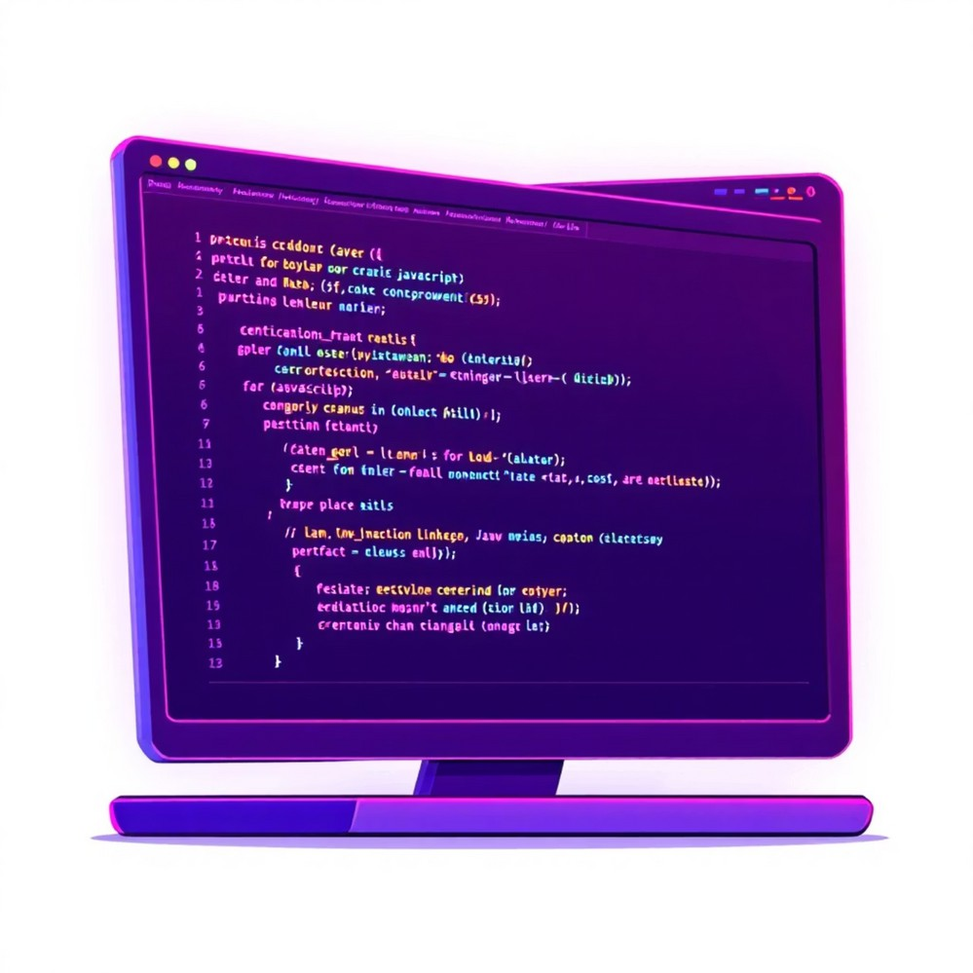
Technology Stack
Frontend Technologies
HTML5 for semantic structure
CSS3 with Grid and Flexbox layouts JavaScript ES6+ modules
Google Fonts (Outfit family)
System Requirements
Modern web browser (Chrome, Firefox, Safari, Edge) 2GB+ RAM recommended
1024x768 minimum display resolution

Slide 4
Five Scheduling Algorithms
1
First Come First Serve (FCFS)
Non-Preemptive - Processes execute in arrival order. Simple implementation but high average waiting time for short processes.
2
Shortest Job First (SJF)
Non-Preemptive - Shortest burst time executes first. Optimal average waiting time but risks starvation for long processes.
3
Shortest Remaining Time First (SRTF)
Preemptive - Shortest remaining time executes. Minimum average waiting time with context switching overhead.
4
Round Robin (RR)
Preemptive - Fixed time quantum in circular order. Fair CPU allocation with no starvation, better response time.
5
Priority Scheduling
Non-Preemptive - Executes by priority (lower number = higher priority). Flexible but starvation possible for low-priority processes.

Slide 5



Project Architecture
index.html (45 KB)
Complete HTML structure with input forms, algorithm selection, process queue table, and results visualization.
style.css (6.5 KB)
Modern dark theme with CSS custom properties, responsive grid layouts, and interactive hover effects.
script.js (7.2 KB)
DOM manipulation, event handling, process management, simulation execution, and results rendering.
algorithms.js (8.9 KB)
Implementation of all five algorithms with scheduling logic, Gantt chart generation, and metrics calculation.

Slide 6
Key Performance Metrics
3
Core Metrics
Completion Time, Turnaround Time, and Waiting Time calculated for each process.
5
Algorithms Compared
FCFS, SJF, SRTF, Round Robin, and Priority scheduling analyzed simultaneously.
100%
Accuracy
Precise calculations with proper handling of idle time and context switching.
Turnaround Time (TAT) = Completion Time - Arrival Time
Waiting Time (WT) = Turnaround Time - Burst Time

Slide 7
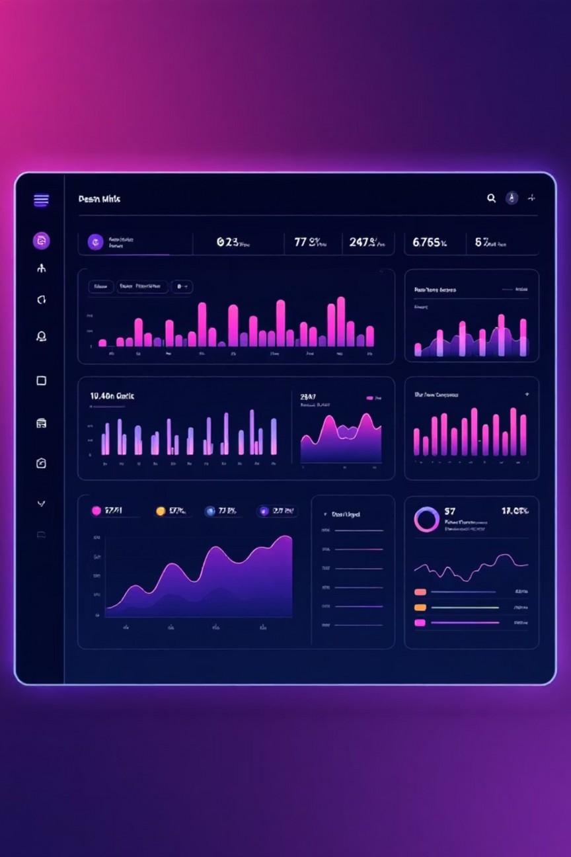

Core Features
Process Management
Visualization
Interactive Gantt charts
Color-coded process blocks
Hover tooltips with timing
Time ruler for reference
Analysis
Detailed metrics table
Average TAT and WT
CPU utilization
Algorithm comparison
Add processes with arrival time, burst time, priority
Delete individual processes
View all processes in table
Reset all data

Slide 8
How to Use the Simulator
Add Processes
Enter arrival time, burst time, and priority for each process. Click "Add Process" to build your queue.
Configure Algorithm
Select from five algorithms. For Round Robin, specify time quantum (e.g., 2).
Run Simulation
Click "Simulate" to execute. View Gantt chart and metrics table with TAT and WT.
Compare Results
Click "Compare & Recommend" to run all algorithms and see the optimal choice highlighted.

Slide 9
Learning Outcomes
Algorithm Mastery
Deep understanding of preemptive vs non-preemptive scheduling, trade-offs, and optimization strategies.
Programming Skills
JavaScript ES6+ features, modular code organization, DOM manipulation, and state management.
Web Development
Responsive design with CSS Grid and Flexbox, modern UI/UX principles, and data visualization techniques.

Slide 10

Project Success & Future Vision
This CPU Scheduler successfully demonstrates five major scheduling algorithms with accurate calculations, clear visualization, and professional interface design.
Achievements
All objectives met: correct algorithm implementation, accurate metrics, interactive Gantt charts, and optimal algorithm recommendation.
Future Enhancements
Preemptive Priority, Multilevel Queue Scheduling, step-by-step execution mode, and PDF export capabilities.
Educational Impact
Excellent tool for visualizing OS concepts, making complex scheduling algorithms accessible and interactive.

