Slide 1
Bank Credit Card Risk Analysis System
LOW
score 0-2
MEDIUM
score 3-5
Rule-based credit risk analytics: from raw repayment data to explainable risk bands and role-based dashboards
HIGH
score 6-11
Python | Pandas | MySQL | FastAPI | Streamlit
Notes:
Good morning. This project is a credit card risk analysis system. It takes 30,000 customers' repayment history, turns it into transparent risk scores, and serves them through secure APIs and dashboards. The three bands on the right are the final output: LOW, MEDIUM and HIGH.

Slide 2



Problem statement
Raw data, little insight
Six months of repayment status, bills and payments across 25 fields per customer are hard to read by hand.
22.12%
of customers in the dataset defaulted the following month
No consistent risk measure
Without one standard score, customers cannot be ranked or compared fairly.
30,000
Decisions that are hard to explain
Black-box scores are difficult to justify to auditors or to customers.
customers to assess, each with 25 raw fields
Notes:
The problem: a lender holds raw repayment, bill and payment data for thousands of customers. In this dataset about 22 percent of customers defaulted the next month. Reading 25 raw fields per customer by hand is not realistic, there is no standard score to compare customers, and a black-box score would be hard to justify.

Slide 3




Business need
Early warning
Explainable decisions
Spot customers likely to miss payments before they default, so action can start sooner.
Every score traces back to four visible rules, which makes it easy to audit and defend.
Portfolio visibility
Controlled access
KPIs, segments and default rates in one place instead of scattered spreadsheets.
Admins, analysts and viewers each see only what their role allows.
Notes:
Four business needs drive the design. Early warning, so risky customers are found sooner. Explainability, because lending decisions must be justified. Portfolio visibility, so managers see KPIs and default rates in one place. And controlled access, because customer data is sensitive.

Slide 4




Solution overview
1. Ingest
2. Store
3. Score
4. Serve
A validated, incremental ETL loads the dataset into MySQL.
MySQL holds customers, credit data, risk results and audit logs.
A rule engine turns four indicators into a 0-11 score and a band.
FastAPI and Streamlit give role-based dashboards and reports.
How risk is scored: four indicators add up to a score from 0 to 11
Delay frequency
Delay severity
Credit utilization
Payment behavior
LOW
score 0-2
MEDIUM
score 3-5
HIGH
score 6-11
Notes:
The solution has four steps: ingest, store, score, serve. The ETL loads and validates the data, MySQL stores it, a rule engine scores each customer on four indicators (how many months were late, how serious the worst delay was, how much of the credit limit is used, and how much of the bills were paid), and FastAPI plus Streamlit deliver it to users by role. The score runs from 0 to 11 and maps to LOW, MEDIUM or HIGH.

Slide 5
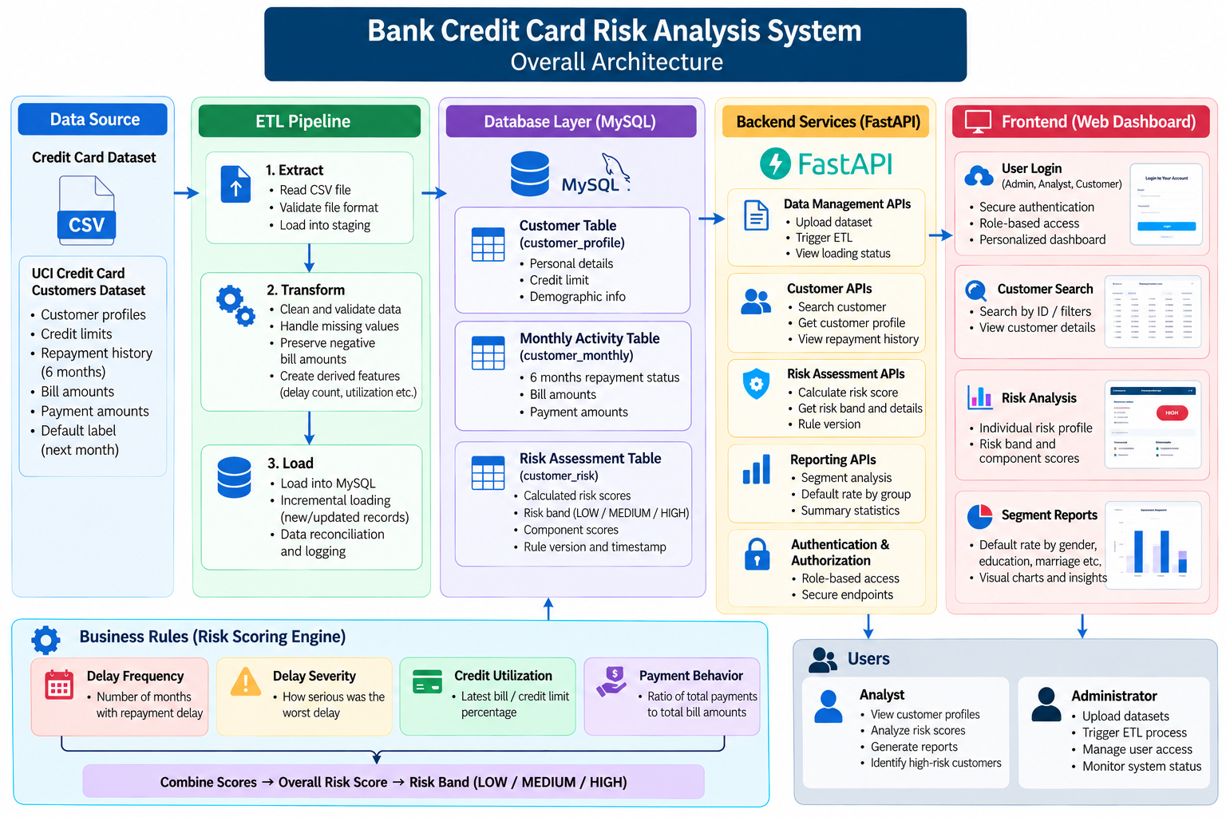
Architecture
1
Data flow
Source, ETL, MySQL, FastAPI, then the web dashboard.
2
Risk engine
Four rule-based indicators are combined into a score and a band, stored in MySQL.
3
Users
Analysts and administrators get role-based access.
Notes:
This is the overall architecture. Read it left to right: the credit card dataset goes through the ETL pipeline into MySQL. FastAPI serves data and risk assessments to the web dashboard. The business rules engine at the bottom scores each customer on four indicators and writes the result back to the database. Analysts and administrators are the two main user roles.

Slide 6
Data flow: end to end
A. Data loading (batch ETL)
Dataset
UCI .xls file
ETL
clean + derive
Incremental load
new + changed rows
MySQL
customers
credit data
risk results
users and audit
B. Risk scoring (batch job)
Batch job
load_risk.py
Features
extract, transform
Risk rules
score 0-11, band
on create or update
C. Runtime (user requests)
User
Admin, Analyst, Viewer
Streamlit
login, dashboards
FastAPI
JWT, roles, SQL
Batch
Runtime
Data store or source
Notes:
Three lanes, one database. Lane A loads the dataset through the ETL into MySQL. Lane B is a separate batch job that rebuilds the features, applies the risk rules and saves the score and band. Lane C is what the user sees: Streamlit calls FastAPI, which checks the token and role and runs SQL. The dashed arrow shows that when an admin creates or updates a customer, FastAPI calls the same risk rules immediately. MySQL is the single source of truth.

Slide 7
Data flow: ETL pipeline
UCI .xls dataset, six stages, then MySQL tables plus an audit log
1
Extract
2
Validate
3
Transform
extract.py
validate.py
transform.py
Reads the Excel dataset
Checks required columns
13 data quality checks
FAIL stops; WARNING passes
Renames and maps codes
Derives credit features
4
Detect changes
5
Prepare tables
6
Load
incremental.py
prepare_tables.py
load.py
Compares 15 columns to MySQL
Marks rows new, changed, same
Splits into 3 tables
Monthly rows = 6 x customers
One transaction + audit row
Error: rollback, FAILED log
Design guarantees
Incremental
Idempotent
Atomic
Auditable
Notes:
The ETL has six stages. Extract reads the Excel file. Validate runs 13 data quality checks; any FAIL stops the pipeline, warnings are logged. Transform renames columns, maps codes and derives delay, bill, payment and utilization features. Detect changes compares 15 columns with what is already in MySQL and classes each customer as new, changed or unchanged; the counts must reconcile with the source. Prepare tables splits the rows into customers, credit profiles and monthly activity. Load writes everything in one transaction with an audit row, and rolls back with a FAILED audit entry on any error. That makes the pipeline incremental, idempotent, atomic and auditable.

Slide 8







Technology stack
Language
Data processing
Database
Backend
Python
Pandas, NumPy
MySQL
FastAPI, Pydantic, Uvicorn
Frontend
Authentication
Testing
Version control
Streamlit, Plotly
JWT, Argon2 password hashing
Pytest, pytest-cov
Git, GitHub
Notes:
The stack is all Python and MySQL. Pandas and NumPy handle the data processing. FastAPI with Pydantic and Uvicorn is the backend. Streamlit with Plotly is the dashboard. Authentication uses JWT tokens and Argon2 password hashing. Pytest covers the testing, and Git with GitHub handles version control.

Slide 9
Demo
Suggested live walkthrough, about 5 minutes
1
Log in
2
Portfolio Overview
3
Risk Analysis
Sign in as an admin. The sidebar shows pages for that role.
Show KPIs, credit exposure and the historical default rate.
Show the three risk bands next to historical default outcomes.
4
Customer Explorer
5
Customer Management
6
Reports and access
Search a customer and open the profile and risk breakdown.
Create a customer: the risk score is calculated instantly.
Export a filtered CSV, then log in as a viewer to show limits.
Notes:
Suggested demo order. Log in as an admin. Open Portfolio Overview for KPIs. Open Risk Analysis to show the three bands against historical defaults. Use Customer Explorer to open one customer and show the risk breakdown. In Customer Management create a customer and show that the score appears immediately. Finish with a CSV export, then log in as a viewer to show that restricted pages are hidden and blocked by the backend. Have the database loaded and the API running before you start.

Slide 10
Evaluation results
30,000
customers scored: 13,966 LOW, 9,673 MEDIUM, 6,361 HIGH
370
automated tests passing
Historical observations on the source dataset, not predictions or guarantees of future defaults.
Notes:
On the initial 30,000 customers, the HIGH band had a 51.36% historical default rate against 12.61% for LOW, roughly four times higher. MEDIUM is 16.62% and the overall rate was 22.12%. These are observed historical outcomes on this dataset, not predictions, and the default flag was not used as an input to the score. The 672 tests are the automated test suite.

Slide 11
Challenges and learnings
Challenges
Learnings
Messy source codes. Undocumented education and marriage values and negative bills are flagged as warnings.
Safe incremental loads. New and changed rows are detected, counts reconciled, and loads are all-or-nothing.
Explainable scoring. Thresholds are proposed rules checked against historical defaults, not a trained model.
Consistent security. Roles are enforced in the backend, not only hidden in the UI.
Validate early. A data quality gate before transformation prevents bad data downstream.
Make reruns safe. Idempotent, audited pipelines can be repeated without side effects.
Separate layers. ETL, rules, API and UI stay small and testable, backed by 672 tests.
Simple rules work. Four indicators separate HIGH (51%) from LOW (13%) historical default rates.
Next: run risk scoring automatically after each ETL load, and validate the thresholds on other portfolios.
Notes:
Challenges: the source data has undocumented codes and negative bill amounts, which we handle as warnings; loading incrementally without ever leaving half-loaded data; keeping the scoring explainable instead of using a black-box model; and enforcing roles in the backend. Learnings: validate early, make pipelines safe to rerun, keep layers separate so they can be tested, and remember that simple rules can still separate risk well. Limitations to be upfront about: the scores are rule-based classifications, not probabilities of default, the dataset is historical, and risk scoring currently runs as a separate step after the ETL. The next step is to trigger it automatically.

