Slide 1
CUSTOMER INTELLIGENCE • RETENTION • ML
Customer Retention
Intelligence System
From raw customer data to actionable churn risk — with analytics, APIs, a dashboard and machine learning.
DATA
SQL
API
UI
ML
Prepared from the supplied project guide

Slide 2
CUSTOMER PITCH
Executive Story: Why This Matters
A retention workflow that turns customer data into prioritized action.
7,043
21
~26.5%
1
Business outcome
Give retention teams a single place to understand customers, identify high-risk segments, and act earlier.
customers in the reference dataset
customer attributes
historical churned share
integrated retention workflow
Move from reactive churn reporting to proactive risk identification.
Combine descriptive analytics, explainable rules and ML-based scoring.
Expose insights through APIs so the dashboard and downstream consumers use the same data.
Based on the Customer Retention Intelligence System project guide
2

Slide 3
CUSTOMER PITCH
The Business Problem
Retention teams often have data, but not a connected decision workflow.
Customer data is fragmented
Risk is hard to prioritize
Profile, services, contract and billing attributes must be brought together before risk can be understood.
A retention team needs a ranked, actionable list — not just an overall churn percentage.
Insights need context
Analysis must become repeatable
A score is more useful when the team can see the customer profile and why the customer is considered risky.
Daily/recurring data needs validation, cleaning, feature generation and scoring without manual rework.
Core idea: connect data → intelligence → action.
Based on the Customer Retention Intelligence System project guide
3

Slide 4
CUSTOMER PITCH
Proposed Solution
A layered Customer Retention Intelligence System.
1
Ingest
2
Clean & Curate
3
Analyze
4
Predict
5
Act
Validate incoming customer extract
Standardize and load trusted data
KPIs, segments and high-risk rules
Train, interpret and score churn risk
Dashboard + APIs for retention teams
Explainable first
ML when ready
One serving layer
Rule-based high-risk view provides an immediate, transparent decision layer.
ML scoring adds probability-based prioritization and captures patterns beyond fixed rules.
APIs expose customer profiles, summaries, features and risk lists to the UI.
Based on the Customer Retention Intelligence System project guide
4

Slide 5
CUSTOMER PITCH
What the Retention Team Can Do
A simple user journey from overview to individual action.
01
See the churn picture
Executive KPIs and churn breakdowns by contract and internet service.
02
Search a customer
Look up a customer profile during a support or retention conversation.
03
Prioritize outreach
Review a high-risk list with tenure, charges, contract and risk reason.
04
Estimate individual risk
Submit customer attributes and receive a churn risk prediction.
Based on the Customer Retention Intelligence System project guide
5

Slide 6
CUSTOMER PITCH
Reference Data & Business Signals
The supplied guide uses the IBM/Telco churn dataset as the common source.
Dataset profile
High-signal segmentation
7,043 customer snapshots • 21 columns • approximately 1 MB CSV • ~73.5% active / ~26.5% churned.
Contract, internet service, payment method, tenure and monthly charges are used to understand churn patterns.
Important data quality issue
Reference insight
TotalCharges arrives as text with about 11 blank values for tenure=0 customers; the pipeline converts and fills these appropriately.
The guide expects month-to-month customers — particularly the month-to-month + fiber optic segment — to be among the highest-risk segments.
Note: these are reference-dataset findings/expectations from the supplied guide, not claims about a live telecom population.
Based on the Customer Retention Intelligence System project guide
6

Slide 7
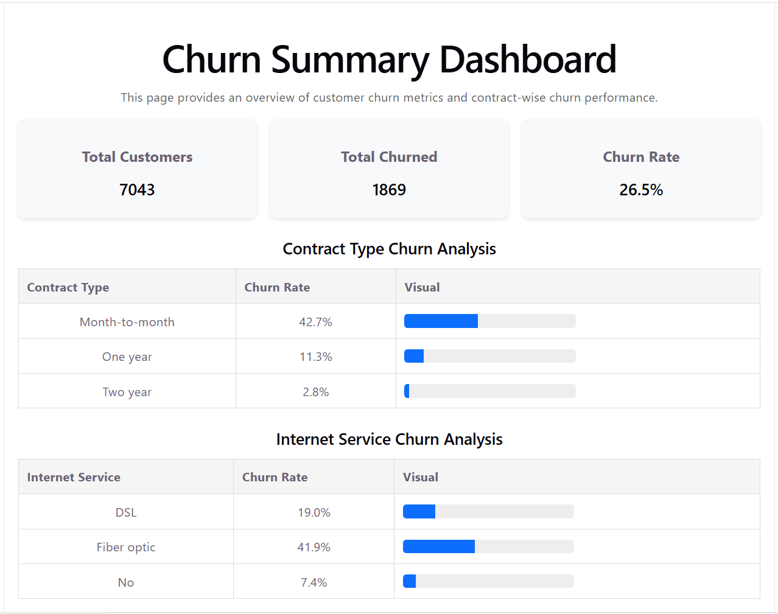
FRONTEND
Frontend Experience — Dashboard
Expected content
Total customers • churned • churn rate • breakdowns by contract and internet service.
API source
GET /churn/summary returns the structured KPI payload consumed by the React page.
Presentation tip
Replace this placeholder with your strongest dashboard screenshot.
Based on the Customer Retention Intelligence System project guide
7

Slide 8
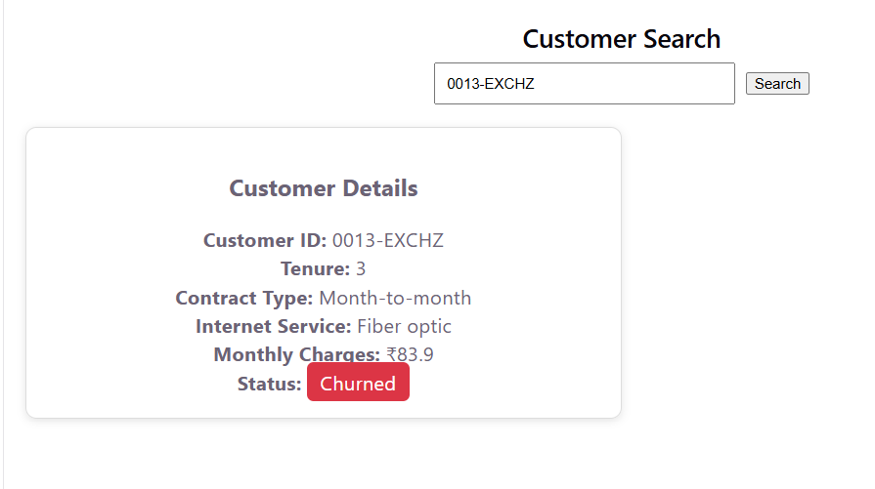
FRONTEND
Frontend Experience — Customer Search
User action
Enter customer ID and search for a profile.
Profile view
Tenure, contract, internet service, monthly charges and churn status.
API source
GET /customer/{customer_id}
Based on the Customer Retention Intelligence System project guide
8

Slide 9
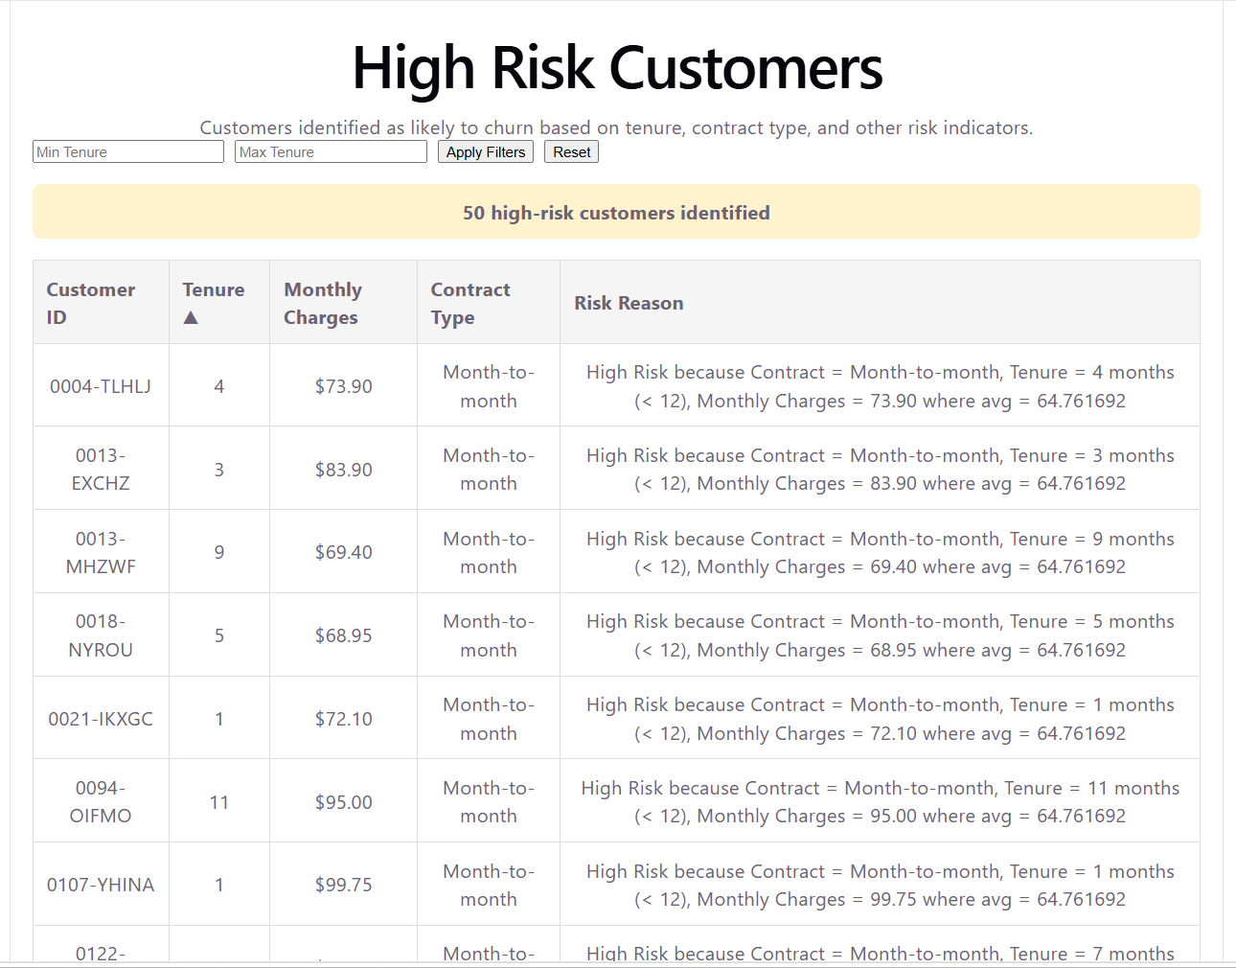
FRONTEND
Frontend Experience — High-Risk Customers
Actionable list
Customer ID, tenure, monthly charges, contract type and risk reason.
Interaction
Load more + tenure sorting + empty-state handling.
API source
GET /customers/high-risk
Based on the Customer Retention Intelligence System project guide
9

Slide 10
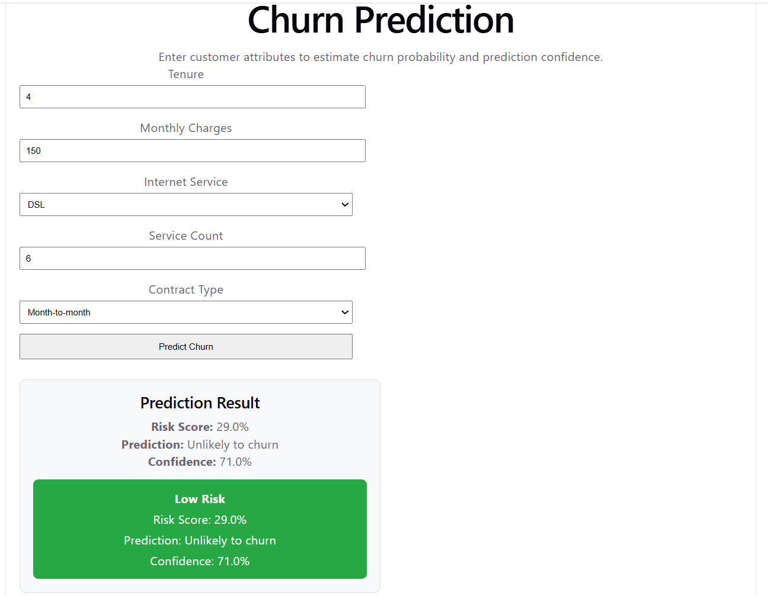
FRONTEND
Frontend Experience — Churn Prediction
Input
Tenure, monthly charges, contract type and service count.
Output
Risk score + prediction; designed to work with the real ML model after the API stub.
API source
POST /predict-churn
Based on the Customer Retention Intelligence System project guide
10

Slide 11
TECHNICAL ARCHITECTURE
Technical Architecture
Layered design separates ingestion, data, intelligence, serving and presentation.
FRONTEND
React • dashboard • customer search • high-risk list • prediction form
API / SERVICE
FastAPI • Pydantic validation • service layer • SQLAlchemy • error handling • API key stub
DATA / STORAGE
Staging table → curated tables → ML feature table → customer risk table
DATA ENGINEERING
Schema validation • cleaning • feature build • incremental upsert • quality gates • Airflow orchestration • PySpark path
MACHINE LEARNING
Feature matrix → Logistic Regression / Decision Tree → interpretation → prediction → batch scoring
Based on the Customer Retention Intelligence System project guide
11

Slide 12
TECHNICAL ARCHITECTURE
Data Engineering & Quality Flow
The pipeline is designed to be repeatable, auditable and safe for downstream ML.
Landing
Validate
Stage
Clean
Curate
Features
Quality Gate
Score
Incoming CSV
21-column schema
stg_customer_raw
CustomerCleaner
Trusted tables
6 engineered features
PASS / FAIL
Risk table
Idempotency
Data quality as code
Orchestration
Upsert logic handles new, updated and unchanged customers without duplicate creation.
Null, range, allowed-value, row-count and duplicate checks create a JSON quality report.
Airflow is used to turn the standalone pipeline stages into an automated flow.
Based on the Customer Retention Intelligence System project guide
12

Slide 13
TECHNICAL ARCHITECTURE
Data Model & API Surface
A curated relational model becomes the stable serving contract for the application.
customers
dim_contract
dim_payment
fact_customer_account
customer_ml_features
identity + profile
contract dimension
payment dimension
tenure + charges + churn
ML-ready feature table
GET /customer/{id}
GET /churn/summary
GET /customers/high-risk
Customer profile
Executive KPIs
Rule-based priority list
GET /customer/{id}/features
POST /predict-churn
ML feature vector
Prediction contract
Based on the Customer Retention Intelligence System project guide
13

Slide 14
TECHNICAL ARCHITECTURE
Machine Learning: From Baseline to Batch Risk
The ML layer is built for both prediction and explainability.
Feature engineering
Model comparison
Interpretability
Prediction API
Batch scoring
tenure_bucket
high_charge_flag
service_count
is_long_term_customer
has_streaming_bundle
auto_pay_flag
Logistic Regression
vs
Decision Tree
Select using churn-class F1
Coefficients / feature importance
+ top-risk customers
+ comparison with SQL rules
Load selected model
and return risk score
+ prediction
Score all customers
→ customer_risk_table
→ dashboard / API / future AI
Key design principle: a churn model is not the endpoint — the scored risk table is what makes predictions operational.
Based on the Customer Retention Intelligence System project guide
14

Slide 15
TECHNICAL ARCHITECTURE
Explainability, Validation & Operational Discipline
Trust is built into the workflow rather than added after deployment.
Explainability
Validation
Auditability
Rule-based high-risk view includes a risk_reason. ML interpretation surfaces influential features and high-risk customers.
Pydantic validates API payloads; database failures return consistent errors; data quality gates can stop the pipeline.
Ingestion and pipeline logs capture status, counts, timestamps and reasons; quality reports are persisted as JSON.
Observability
Security baseline
Failure behavior
Logging is included across cleaning, pipeline stages and API routes, giving visibility into processing and requests.
The API phase adds an environment-based API key check and consistent 401 handling as a basic authentication layer.
Critical quality failures raise errors and stop downstream processing instead of silently propagating bad data.
Based on the Customer Retention Intelligence System project guide
15

Slide 16
TECHNICAL
Technology Stack
Practical components mapped to clear responsibilities.
Python
Pandas
SQL + SQLAlchemy
FastAPI + Pydantic
Cleaning, feature engineering, pipeline utilities
Profiling, transformation and batch feature logic
Relational storage, queries, ORM and upserts
REST APIs, validation and service layer
React + Axios
Airflow
PySpark
scikit-learn + joblib
Dashboard and API-consuming UI
Pipeline orchestration
Scalable DataFrame processing path
Churn models, evaluation and model persistence
Based on the Customer Retention Intelligence System project guide
16

Slide 17
TECHNICAL
End-to-End Technical Flow
How a customer record travels from source data to a business decision.
Customer Extract
Data Quality
Trusted Data
ML Features
Risk Score
CSV snapshot
schema + checks
curated SQL
6 derived features
batch / API
Operational outputs
Retention dashboard
Customer support
Prediction API
Future AI assistant
KPIs + high-risk customers
Profile lookup
Individual churn probability
customer_risk_table as a data source
Based on the Customer Retention Intelligence System project guide
17

Slide 18
CUSTOMER PITCH
Business Value & Future Expansion
A foundation for a more proactive retention operating model.
Today: Visibility
Today: Prediction
Today: Trust
Centralized churn KPIs, customer lookup and prioritized high-risk lists.
Individual and batch churn risk scoring creates a repeatable prioritization mechanism.
Explainable rules, feature interpretation, validation and logging support responsible adoption.
Next: Real-time signals
Next: Smarter actions
Next: AI assistant
Extend the customer-state model with event or usage data when available.
Move from risk identification to next-best retention action and offer recommendation.
Use the customer risk table as a grounded source for a conversational retention assistant.
Goal: reduce the gap between “we know who is at risk” and “we know what to do next.”
Based on the Customer Retention Intelligence System project guide
18

Slide 19
CUSTOMER PITCH
Closing: From Churn Data to Retention Action
A complete foundation for customer retention intelligence.
One platform.
One customer view.
One actionable risk workflow.
DATA
Validated + curated customer data
Understand the customer
Identify the highest-risk segments
Explain why a customer is risky
Prioritize the next conversation
Continuously refresh the intelligence
INTELLIGENCE
Analytics + explainable rules + ML risk
ACTION
APIs + React dashboard for retention teams
Thank you
Based on the Customer Retention Intelligence System project guide
19

