Slide 1
JUnit Java Testing Framework

Slide 2
Introduction
JUnit is the most popular unit testing framework for Java programming language
Junit 5 is the latest version and main goal is to leverage features of Java 8 like Lambda expression and Streams
Junit modules
Junit Platform : The foundation for launching testing frameworks on the JVM. Allows tests to be run form a console launcher or build tools such as Maven or Gradle.
Unit Jupiter : Programming model for writing tests and extensions to Junit
Junit Vintage : Provides a test engine for running Junit 3 and Junit 4 tests.

Slide 3
Junit setup in Maven Project
Add Junit-5 dependency in the pom.xml file
<dependency> <groupId>org.junit.jupiter</groupId> <artifactId>junit-jupiter-engine</artifactId> <version>5.7.2</version> <scope>test</scope> </dependency>
Add below plugins in the pom.xml file
<plugin> <groupId>org.apache.maven.plugins</groupId> <artifactId>maven-surefire-plugin</artifactId> <version>3.0.0-M5</version> </plugin> <plugin> <groupId>org.apache.maven.plugins</groupId> <artifactId>maven-failsafe-plugin</artifactId> <version>3.0.0-M5</version> </plugin>

Slide 4
Junit Test case
A unit test is a test of a single class
A test case is a single test of a single method.
Test Class
For each class in the project create separate Test class with the same package name in test directory
Test class name should be Test*.java, *Test.java, *Tests.java, *TestCase.java
Structure of Test Method
Test method does below activities
Create required objects of the classes and data for testing.
Invoking the method to be tested and capture results
Validate the result using Assertions
A test method doesn’t return anything (void return type)
If tests run correctly, a test method does nothing.
If a test fails it throws an AssertFailuedError.

Slide 5
Junit Annotations
@Test
@BeforeAll
@AfterAll
@BeforeEach
@AfterEach
@ParameterizedTest
@RepeatedTest
@Disabled
@DisplayName
@Tag
@ExtendWith

Slide 6
Examples
Sample Junit Test Cases
Junit test cases with Mockito
Junit test cases with Springboot

Slide 7
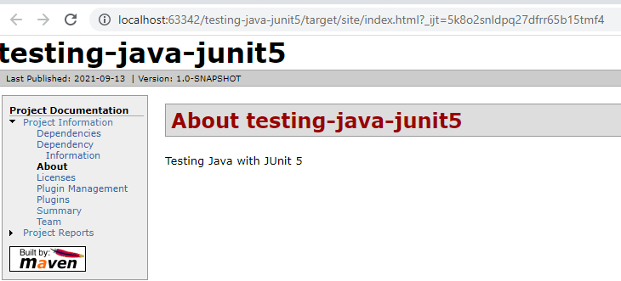
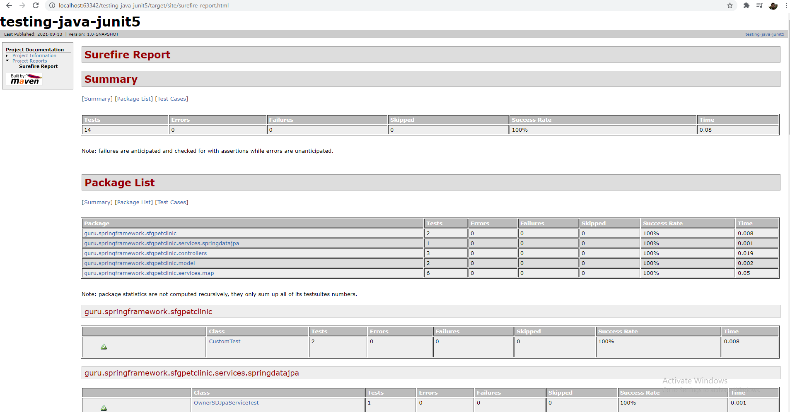
Maven Surefire Test Reporting
Maven generates report summary in xml format. Readable HTML format can be generated by using ‘maven-surefire-report-plugin’
Steps to generate report
1. Add ‘maven-surefire-report-plugin’ and ‘maven-jxr-plugin’ plugins under reporting in pom.xml
<reporting> <plugins> <plugin> <groupId>org.apache.maven.plugins</groupId> <artifactId>maven-surefire-report-plugin</artifactId> <version>2.22.0</version> </plugin> </plugins> </reporting>
2. Execute maven site lifecycle to generate report.

