Slide 1
Wind Energy
Git Hub Link:-
https://github.com/hari-i123/Wind_Energy/upload/main
College name: GASC
Students names: N.HARISH,V.KUMAR,A.VIJAY KUMAR, K.N.SESHADRI

Slide 2
Problem statement
The Problem:
As global energy demands continue to rise, the reliance on fossil fuels leads to severe environmental consequences including climate change, air pollution, and depletion of natural resources. Despite the availability of renewable alternatives, many regions underutilize wind energy due to:
High initial infrastructure costs
Intermittent power generation
Lack of real-time optimization systems
Insufficient public and government awareness
Limited access to localized wind data

Slide 3
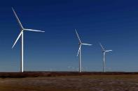
Introduction
To solve climate change, society needs to rapidly decarbonize
Incorporation of greater amounts of renewable wind power will be one of many essential strategies for decarburization
But the wind does not always blow!
To incorporate high amounts of wind power, the future smart grid will require accurate forecasts to operate effectively and efficiently

Slide 4
Project Client and Objective
Client: vertically-integrated electric utility company seeking to incorporate higher amounts of wind power generation into its electricity portfolio
Objective: employ machine learning to accurately predict hourly wind power generation at 7 wind farms, based on historical wind speeds and wind directions.

Slide 5
Data
Data provided by Institute of Electrical and Electronics Engineers (IEEE)
Retrieved from Kaggle database
Time series dataset with wind speed, wind direction and wind power production data
Data for 7 separate wind farms
Unitless for anonymity

Slide 6
Forecast Categories
Data is split into 4 Forecast Categories:
Category 1: 1-hour to 12-hour ahead data
Category 2: 13-hour to 24-hour ahead data
Category 3: 25-hour to 36-hour ahead data
Category 4: 37-hour to 48-hour ahead data

Slide 7
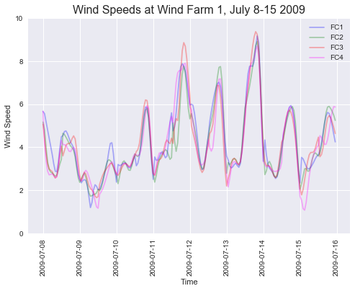
Example Wind Speeds

Slide 8
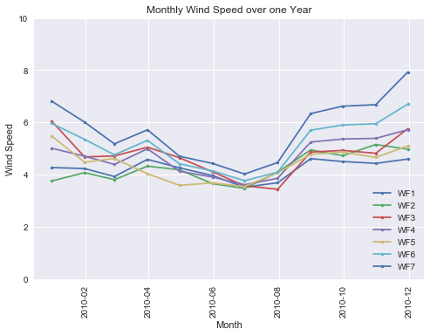
Wind Speed over 1 Year

Slide 9
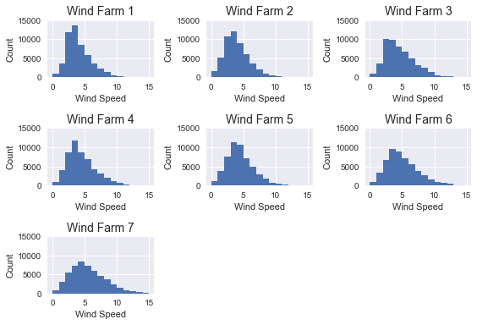
Wind Speed Distribution

Slide 10
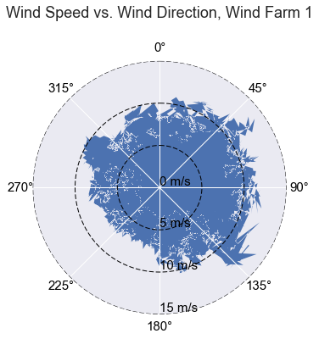
Wind Speed vs. Direction

Slide 11
Machine Learning Models
Models:
Linear Regression
Lasso Regression
Ridge Regression
Decision Tree
Neural Networks
Evaluation:
Root Mean Square Error (RMSE): a value of 0 indicates a perfect fit. The lower the RMSE value, the more accurate the predictive capability of the model

Slide 12
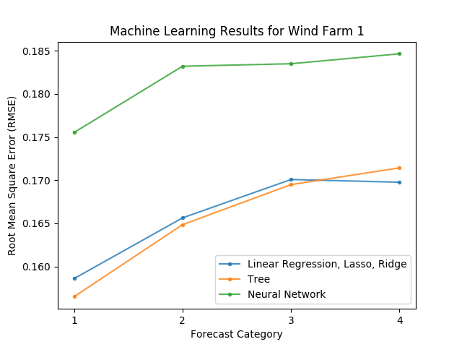
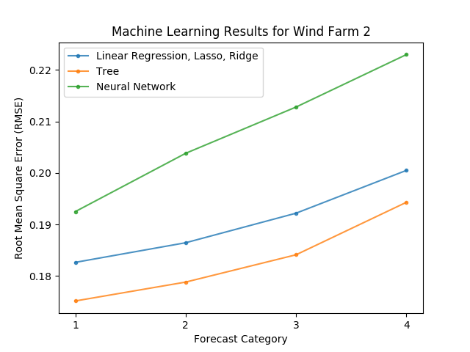
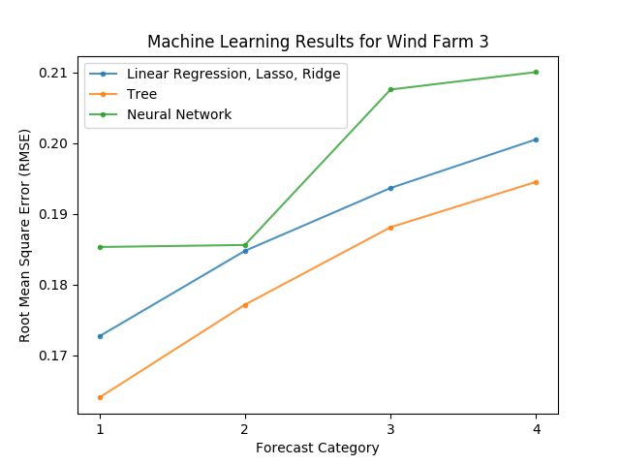
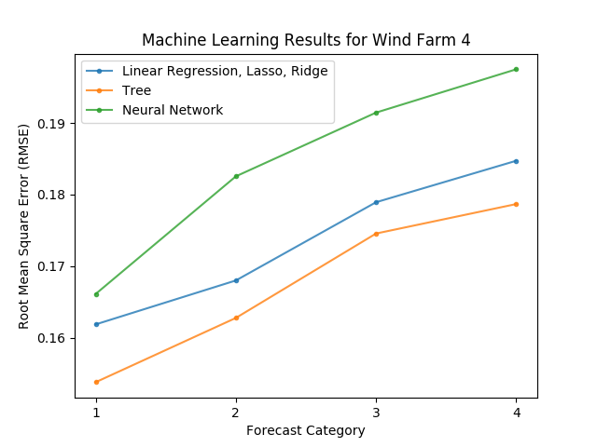
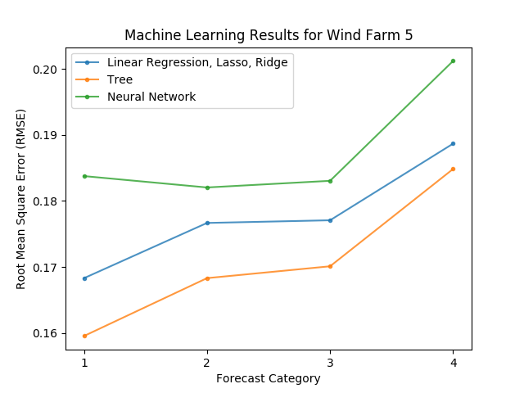
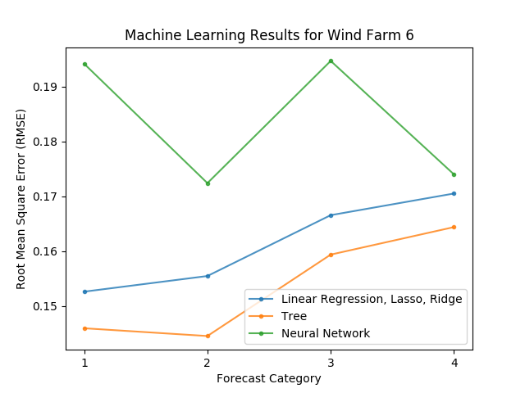
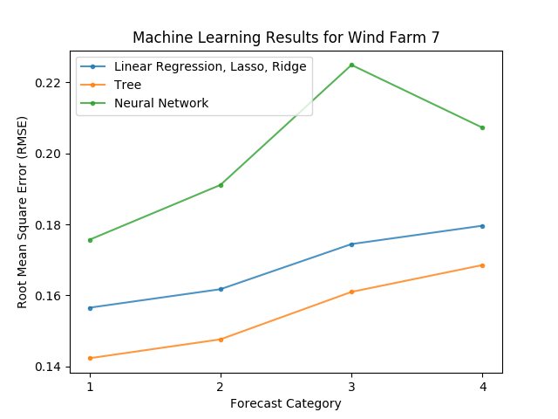
Machine Learning Results

Slide 13
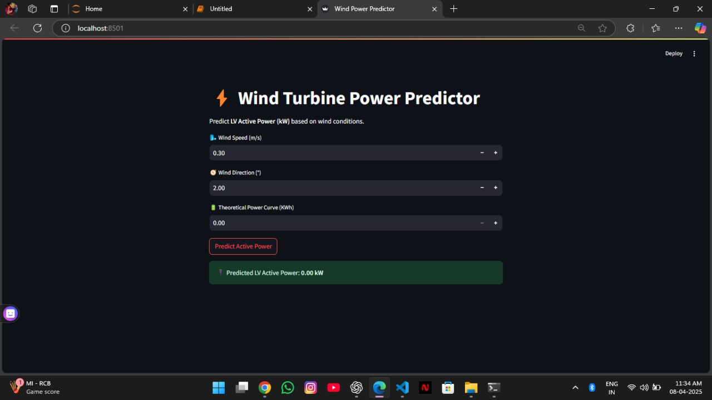
Sample Output

Slide 14
Conclusion
Decision Trees perform best, producing the lowest RMSE values
Thus, Decision Tree Models are recommended to the electric utility to be applied future wind data to predict power generation
More accurate forecasts can be used to make better informed decisions with regards to electricity transmission sizing, sizing of nearby distributed energy resources (DERs), sizing of energy storage systems, and other issues related to renewable energy integration in a smart grid or microgrid

Slide 15
THANK YOU

