Slide 1

Day 2
Binding (Event, Property, One-way, Two-way)
Building a Basic Shopping Cart Application
Dependency Injection with Services
Deploying CLI Project
Single Page Application Development
Creating a REST Web Service

Slide 2
Hands On Exercise
Create a data member count and initialize with 0 in CounterComponent
  Display count value in template
Define a method incrementCounter() in CounterComponent
incrementCounter():void {
this.count++;
}

Slide 3
Event Binding
Create a button in template to increase the counter.
<button>Increase</button>
To bind an event, use the parentheses syntax, (eventname)
To bind a click event for button, use (click)
<button (click)="incrementCounter()"> Increase </button>

Slide 4
Property Binding
Display count data in a text box.
The [] square bracket notation here signifies a property binding.
Bind the count to textbox
The value is a property on the DOM object
To think about property binding in a simpler way, take element.value for example.
Applying Property Binding
<input type="number" [value]="count">

Slide 5
Two-way Data Binding
Data-binding is an automatic synchronization of data between a View (HTML) and Model (data).
Angular Supports
  One-way data binding: Model to View
  Two-way Data Binding: Model to View and Vice-versa
Apply two way binding with HTML form elements.
Two-Way Data Binding is applied by using both property binding and event binding [(ngModel)]
<input [(ngModel)]=‘property name’>
The [(ngModel)] is available in FormsModule.
To use ngModel, our module is depends on FormsModule.
<input type="number" [(ngModel)]="count“>

Slide 6
Working with Child Components
Angular2 allows nesting a component inside another component.
The outer component is RootComponent / Parent Component and inner component is a Child Component.
We will create another component (Child Component) and we will see how to nest the child component inside the parent component.

Slide 7
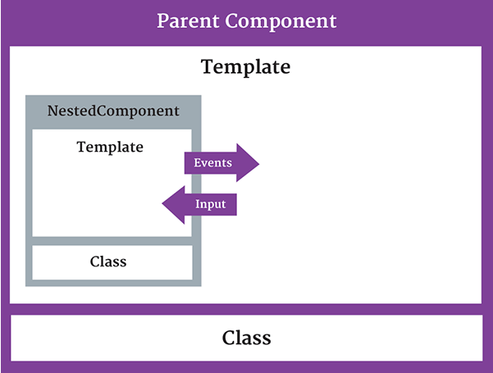
Passing data into Angular2 Components
In AppComponent, Declare a data member myCount with value as 100 and display in template.
export class AppComponent {
myCount:number = 100;
}
Initialize the myCount data
for count property
We need to tell Angular
what is coming into our
component.
@Input decorator is used to
recieve input details from
parent component.

Slide 8
Hands On Example
Decorate count property with Input decorator
@Input()
count:number = 0;
We have to tell Angular the name of the property binding
<counter [count]=“myCount"></counter>
Use another <counter> tag in App Component Template
<hr>
<counter count="15"></counter>

Slide 9
Passing Data from Child Component
Changes applied for count property when a button clicked, it should apply myCount in parent.
If the nested component wants to send information back to its container, it can raise an event.
Event is raised through an EventEmitter Object
The nested component should expose an event data member with @Output decorator to pass output to its parent.
The event object uses emit() method to send data as an argument.
$event is used to access details of an event

Slide 10
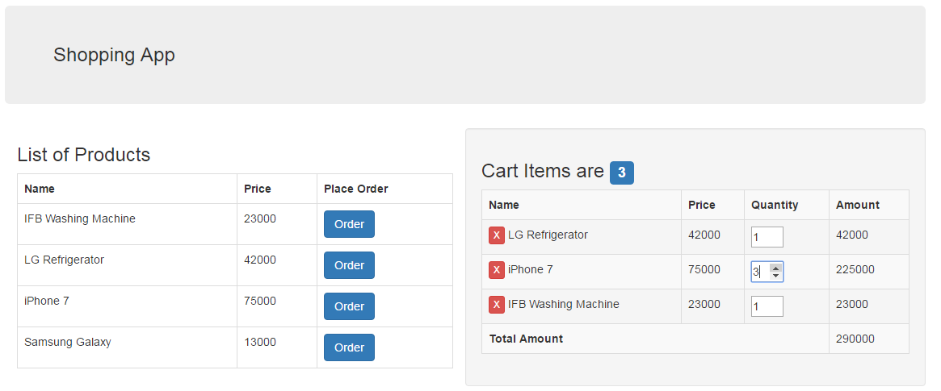
What are we building?
We are going to build a basic Shopping Cart Application, to understand the features of Angular.

Slide 11
Hands On Exercise
Create a new Angular Project ngcartapp
Open the Project in IDE (WebStorm)
Execute the Project and verify the output.
CLI Project File Name Conventions
Observe the CLI project folder structure
  Important folders are src and app folders
app.module.ts → Application Module
app.component.ts → Application Component Class
app.component.html → Application Template
app.component.css → Application Component Styles
app.component.spec.ts → Application Component Unit Testing File

Slide 12
Application Style
Bootstrap is a HTML, CSS and JS framework aims to ease web development.
  It is a collection of CSS classes, add style to your pages, enhancing and improving the presentation of your content.
Using Bootstrap Framework in Angular CLI project
Install bootstrap in project: npm install bootstrap
Modify styles.css file to use bootstrap.css file
@import url("../node_modules/bootstrap/dist/css/bootstrap.css");
Verify the Output

Slide 13
Hands On Exercise - Component
In App Component Template, we need to use a web component as :
<app-header></app-header>
As per convention, each component will have .component.ts file header.component.ts for the tag <app-header>
template: `<nav class='navbar navbar-default'>
<div class="navbar-header">
<a href="#" class="navbar-brand"> Shopping App</a>
</div>
</nav>`

Slide 14
Hands On Exercise – Angular Modules
Create a new folder shopping in app folder
Create a new module in shopping.module.ts file
Create a web Component “<product-list>”
  Create an external template product-list.component.html in shopping folder
  Create a file product-list.component.ts in shopping folder
  Define a class ProductListComponent
  Register in Shopping Module
  Use <product-list> in App Component Template
Create a web component <cart-items> component with external template in Shopping Module.
Use the Web Component within AppComponent Template.

Slide 15
Bootstrap Grid System
Bootstrap 3 includes predefined grid classes for quickly making grid layouts.
Creating Two Column Layout:
Bootstrap grid system is based on 12 columns, so to keep the columns in a one line (i.e. side by side), the sum of the grid column numbers in each row should be equal to 12.
<app-header></app-header>
<div class="col-sm-6“>
<product-list></product-list>
</div>
<div class="col-sm-6 well“>
<cart-items></cart-items>
</div>

Slide 16
Hands On - Bootstrap
  Presenting list of products in tabular format
<table>
<tr><th>Name</th><th>Price</th><th>Action</tr>
</table>
  The table class improve the appearance of table in a simple way.
  <table class=“table">
  The table-bordered class add borders to the all table cells.
  <table class=“table table-bordered">
  The table-striped class used for alternate background like zebra-stripes.
  <table class=“table table-bordered
  table-striped">

Slide 17
Hands On Exercise
Display Cart Items with Name, Price, Quantity, Amount and Total Amount in tabular format.

Slide 18
Exercise - Passing Data to Template
Define a data member in Component Class
export class HeaderComponent {
cmpHeading:string = “My Shopping Cart App"
}
Bind the data member to View (Template) using {{ }}
<a href="#" class="navbar-brand"> {{cmpHeading}}</a>

Slide 19
Model Class
Model represents data of our application.
  Each Model instance maps to a Row in the data source.
Create a folder models in app folder and create a file product.model.ts
export class Product {
constructor(public id:number,
public name:string,
public price:number,
public description: string) {}
}

Slide 20
Using Model in Component
Define data member products of type Product Array in ProductList Component.
products: Product[] = [];
Populate sample data in ProductList Component constructor
constructor(){
this.products = [new Product(1, "IFB Washing Machine", 23000, "Automatic Washing Machine"),
new Product(2, "LG Refrigerator", 42000, "Double Door Refrigerator"),
new Product(3, "iPhone 7", 75000, "Next Gen Smart Phone"),
new Product(4, "Samsung Galaxy", 13000, "Android Smart Phone")]
}

Slide 21
Directives
Directive is an custom element, attribute, or a class that allows we to attach behavior to DOM elements.
There are three kinds of directives:
Components – using @Component():
Directives with templates known as Components.
Structural Directives – using @Directive:
Directives that creates and destroys DOM elements known as Structural Directives such as NgFor, NgIf.
Attribute Directives – using @Directive:
doesn’t change the DOM but can change the appearance or behavior of an element such as hidden.

Slide 22
Built In Structural Directives
Structural directives allow us to add, remove, or replace a part of the DOM depending on the expression given as parameter.
*ngFor directive
This directive is used to repeat collection of data items.
  This is an attribute directive
  * represents structural directive
  Structural directives update the content of a page
Syntax: <HTMLTag *ngFor=“elem of collection”>

Slide 23
Hands On Example
Bind the data in template using *ngFor structural directive
<h3>List of Products</h3>
<table class="table table-bordered">
<tr>
<th>Name</th><th>Price</th><th>Action</th>
</tr>
<tr *ngFor="let product of products">
<td>{{product.name}}</td>
<td>{{product.price}}</td>
</tr>
</table>
Throws an error regarding ngFor. This directive is available in CommonModule, so import in ShoppingModule
imports: [CommonModule]

Slide 24
*ngIf Directive
If the expression is evaluated to a true the NgIf shows the elements else it removes this element from DOM.
Modify ProductList Component constructor, comment this.products statement.
<tr *ngIf=“products.length == 0">
<td colspan="4">No Data Found...</td>
</tr>

Slide 25
Hands On Exercise
Develop a model class for cartitems with public members.
Use in Component
Present the data in Template

Slide 26
Angular2 Services
The Best Practice to organize our source code is to divide our application source code into different layers.
  Presentation Layer
  Business Layer
  Data Layer
Components are responsible for displaying stuff.
Need of Service:
  If the logic or data isn’t view specific OR
  Needs to be used globally across number of different components
Service is basically just a class

Slide 27
Hands On Example
Create services folder in app folder. And Create ProductService in product.service.ts file
  Move the data from Component to Service
export class ProductService {
private productsData:Product[];
constructor(){
this.productsData = [new Product(1, "IFB Washing Machine", 23000, "Automatic Washing Machine"),
new Product(2, "LG Refrigerator", 42000, "Double Door Refrigerator"),
}
getProducts(){
return this.productsData;
}
}

Slide 28
Using Service
Create an object of Service
Invoke the method of a service.
export class ProductListComponent {
products: Product[] = [];
constructor(){
let ps:ProductService = new ProductService();
this.products = ps.getProducts();
}
}

Slide 29
Hands On Exercise
Create CartService to handle
  Cart Items Data
Define Data Operation logic in Cart Service
  Retrieve Cart Items
  Add New Item in Cart
  Delete an existing Item in Cart

Slide 30
Dependency Injection
Features of Services:
  Are independent from any particular component
  Provide shared data or logic across components
Dependency Injection is a pattern in which a class receives the instances of objects it needs (called dependencies) from an external source rather than creating them itself.
Angular is designed to manage all these dependencies between components and services for us.
Alternatively, we can register our service with Angular2 and Angular creates single instance of that class called Singleton
Angular2 provides an built-in Injector, which maintains a container of the created service instances.

Slide 31
Working with Service
1) A class with @Injectable to tell angular 2 that its to be injected – DataService
2) A class with a constructor that accepts a type to be injected
import {Component, Injectable} from “@angular/core“
@Injectable()
export class CartService {
}

Slide 32
Using and Registering a Service
Inject the dependency object in any component as argument.
Modify Product List Component Constructor
constructor(private cartSvc: CartService){
}
Register the Service in our application module by using providers metadata attribute.
providers: [CartService],
Exercise
Modify Cart Items Component to use CartService

Slide 33
Event Binding
To bind a click event for button, use the parentheses syntax, (click)
<button (click)=“addToCart(product)">Add To Cart </button>
Define a method addToCart() in ProductListComponent
addToCart(selectedProduct:Product){
let cartItem:CartItem = new CartItem(selectedProduct.getName(), selectedProduct.getPrice(), 1);
this.cartSvc.addCartItem(cartItem);
}

Slide 34
Hands On Exercise
Implement cancelItem()
To acquire index position of an element in template:
<tr *ngFor="let item of cartItems; let i = index">
Implement Total Amount

Slide 35
Single Page Application
In SPA we load a single HTML page and based on the user request/interaction, we load the other HTML views in the same page, hence the name Single Page Application.
  The Web Site is divided into Component Views
  The Layout Component is common for all views in our application.
The router is the mechanism for navigating from one component view to another component view.
  Router uses a path to navigate to a specific component.
  http://localhost:3000/about Now the router navigate us to About Component
Partial Component Views
  Partial views are loaded into the layout whenever required.
  Partials doesn’t have <html><head><body> Tags.

Slide 36
Getting Started
Make our AppComponent as our layout component that only handles navigation and loading partials.
The routerLink directive allows us to bind the anchor tag to a string that tells the router where to navigate to the specifed path when the user clicks the link.
  Modify HeaderComponent to add links to the navbar, add an unordered list with the classes of .nav, .navbar-nav.
  Add an anchor tag to the template, when clicked, activates the navigation to a specific Component.
<ul class="nav navbar-nav">
<li><a routerLink="/">Home</a></li>
<li><a routerLink="/list">ShoppingList</a></li>
</ul> </nav>`

Slide 37
Hands on Example - Routing
Adding a <router-outlet> element to the layout template displays each component that matches to router link.
<router-outlet></router-outlet>
Create routes.components.ts file, and define Home Component and List Component
@Component({
template:"<h3>Welcome to My Shopping App</h3>"
})
export class HomeComponent {}
Register the Components in App Module

Slide 38
Configuring Routes – Add Routing
Routing is Navigation between different views.
The Angular router is an external, optional Angular Module called RouterModule.
  The router is a combination of multiple provided services (RouterModule), multiple directives (RouterOutlet, RouterLink, RouterLinkActive), and a configuration (Routes).
Make the RouterModule available for our Application i.e. our Module is depends on RouterModule
Import the RouterModule in App Module
Declare the dependencies in imports array of @NgModule decorator

Slide 39
Hands On Example
In Application Module, Use the forRoot method for configuring routes.
  It is a collection of pathnames mapped with components.
@NgModule({
imports: [BrowserModule, . . , RouterModule.forRoot([
{path:"", component: HomeComponent}, {path:“list", component: ListComponent}
])
],
Run the Application and verify all the Links

Slide 40
Hands On Example
Create NotFoundComponent in routes.components.ts file for any other unmatched routes.
Route Mapping:
{path:"", component: HomeComponent},
{path:“list", component: ListComponent},
{path:"**", component: NotfoundComponent}

