Slide 1
Pose Estimation with Deep Learning Framework
Core Course Project
SHREEHARI S 23AM103

Slide 2
Human Pose Estimation:
Detects and tracks key human body points (joints) from images or videos.
Recognizes body posture and movements.
Keypoints Used in Pose Estimation:
Common body points: eyes, nose, shoulders, elbows, wrists, hips, knees, and ankles.
COCO Keypoints:
The COCO dataset provides 17 keypoints for pose estimation.
Includes specific points like left/right eyes, ears, shoulders, elbows, wrists, hips, knees, ankles, and nose.

Slide 3
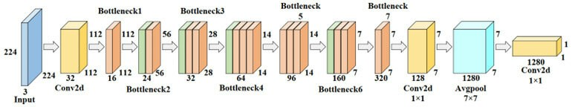
MobileNetV2 Architecture
Lightweight and Efficient
Designed for mobile and embedded devices
Fewer parameters, high accuracy
Depth-wise Separable Convolutions
Splits convolutions into depthwise and pointwise steps
Inverted Residuals with Linear Bottlenecks
Residual connections maintain performance
Fewer parameters, efficient representation
Reduces computation, improves speed

Slide 4
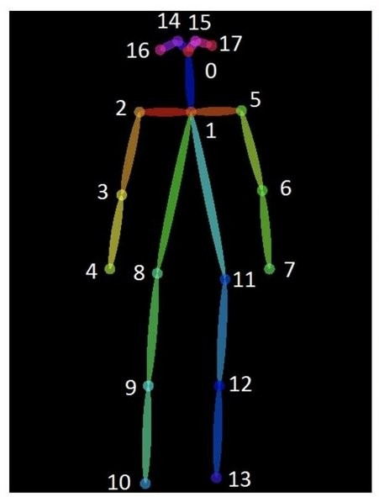

Nose
Left Eye
Right Eye
Left Ear
Right Ear
Left Shoulder
Right Shoulder
Left Elbow
Right Elbow
Left Wrist
Right Wrist
Left Hip
Right Hip
Left Knee
Right Knee
Left Ankle
Right Ankle

Slide 5
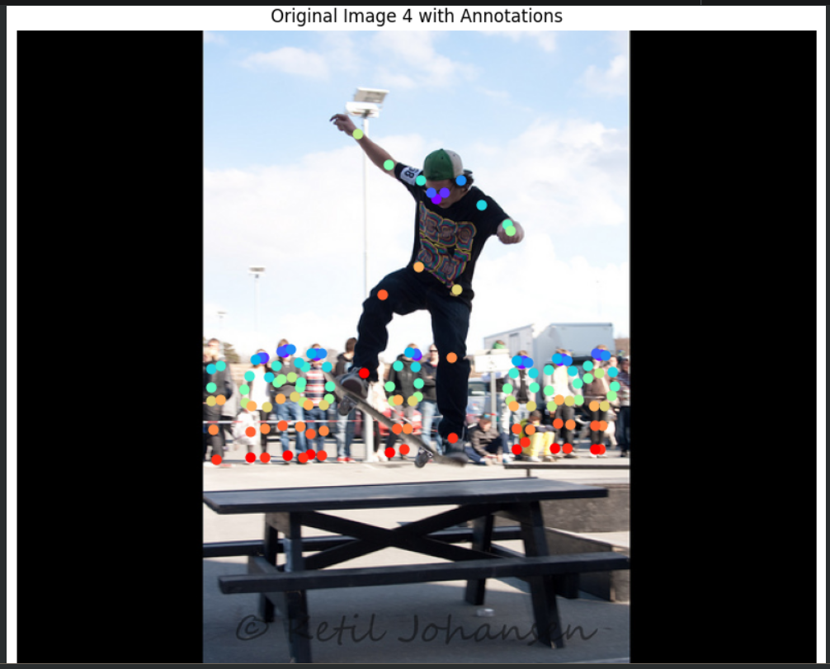
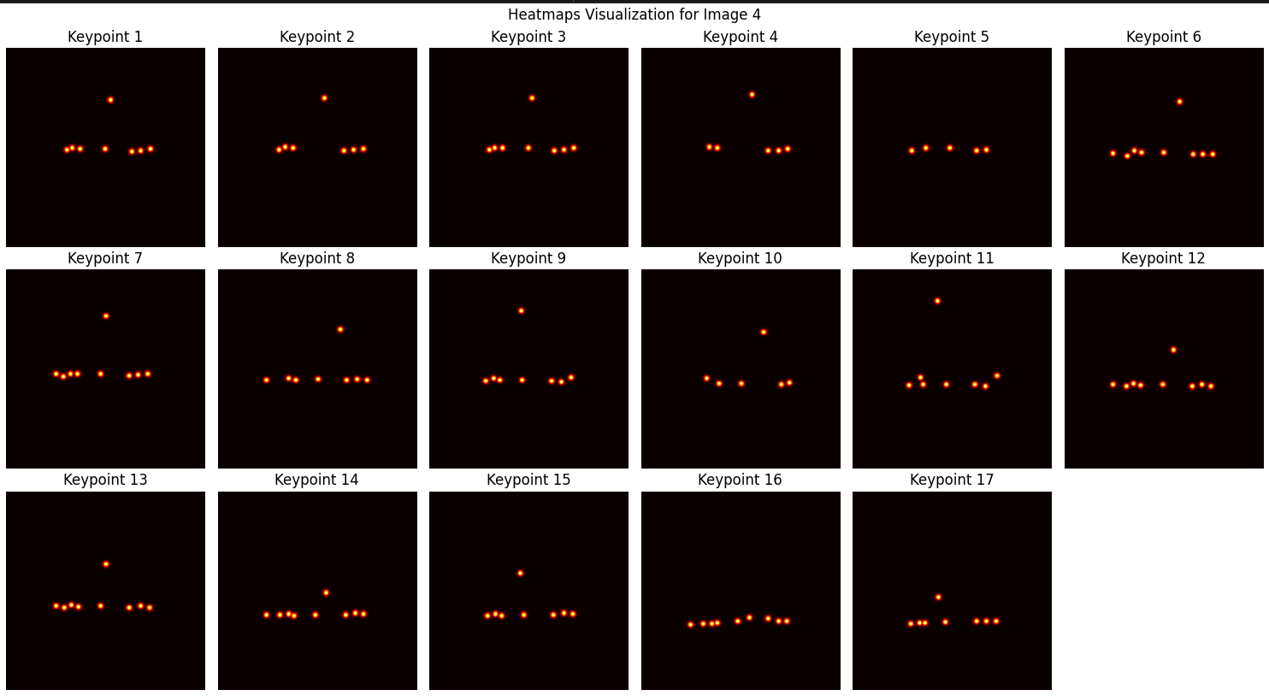
Dataset Loading
Data Preprocessing
Model Initialization
Training Loop
Loss Calculation
Backpropagation
Weight Update
Validation
Model Saving
Keypoint Detection

Slide 6
Lightweight
MobileNetV2 uses fewer parameters, which reduces the model size and allows for faster inference compared to RCNN or YOLO.
Real-Time Performance
MobileNetV2 offers real-time performance on devices with limited resources, while RCNN is typically slower due to its two-stage detection process.
Efficiency on Edge Devices
MobileNetV2 is designed specifically for edge devices (like smartphones), which need high speed and low power consumption, unlike RCNN and YOLO, which are generally more resource-intensive.
Pose Estimation Task-Specific Advantage
MobileNetV2's architecture is well-suited for pose estimation due to its depthwise separable convolutions, which handle keypoint detection efficiently, while RCNN and YOLO are more geared toward object detection.
Simplified Deployment
MobileNetV2 is easier to deploy on devices with lower computational power compared to RCNN and YOLO, which often require higher-end hardware.
Tradeoff Between Accuracy and Speed
While RCNN and YOLO may offer higher accuracy in object detection, MobileNetV2 provides a balanced tradeoff between speed and acceptable accuracy, particularly in real-time applications like pose estimation.
Mobile and Embedded Use Cases
The primary advantage of MobileNetV2 is its design for mobile and embedded systems, which are increasingly the target platforms for pose estimation applications.
MobileNetV2 is optimized for efficiency, making it ideal for mobile and embedded devices, unlike heavier models like RCNN and YOLO.
Fewer Parameters

Slide 7
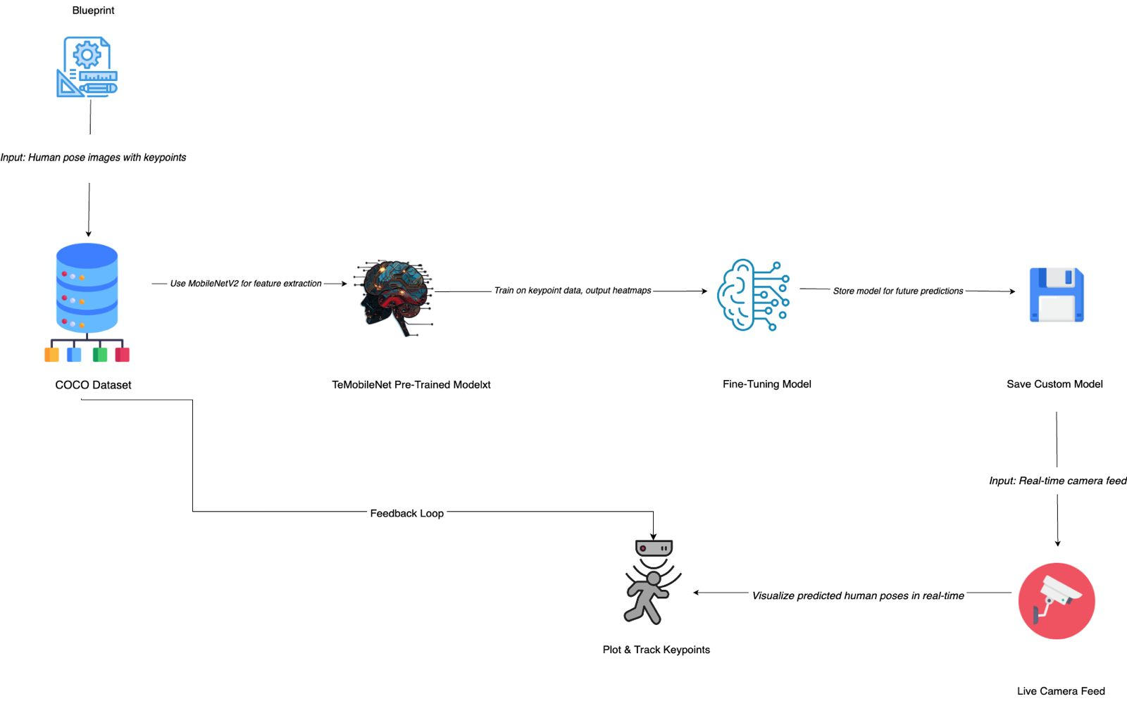
Flow Of Control

Slide 8
Human Pose Estimation is Crucial
Widely used in real-time applications (sports, healthcare, etc.).
Efficient Real-Time Performance Needed
Many devices require fast, accurate pose estimation for user experiences.
MobileNetV2 Fits Resource Constraints
Lightweight architecture ideal for mobile and embedded devices.
High Accuracy with Fewer Parameters
Balances between computational efficiency and accuracy.
Scalable for Edge Devices
Can run efficiently on devices with limited processing power.
Expanding Use Cases
From AR/VR to surveillance, pose estimation is a growing field.
COCO Dataset Provides a Rich Benchmark
Well-established dataset with 17 keypoints and diverse images.
Improves Human-Computer Interaction
Enhances the ability to understand and respond to human movements.
Potential for Further Innovation
Allows for more advanced research in areas like gesture recognition, robotics, etc.
Bridges the Gap between Research and Application
Combines state-of-the-art deep learning with practical real-world deployment.

Slide 9
Feature | MobileNetV2 | RCNN (e.g., Faster RCNN) | YOLO (e.g., YOLOv3)
Architecture Type | Lightweight, efficient for mobile | Two-stage detection (region proposal + classification) | Single-stage detection
Model Size | Small, optimized for low resources | Large, heavy model | Moderate model size
Inference Speed | Fast (real-time on edge devices) | Slower (due to two-stage approach) | Fast, but heavier than MobileNetV2
Use Case | Real-time applications, mobile/embedded | High accuracy object detection | Fast object detection (tradeoff with accuracy)
Computational Resources | Low (optimized for low power devices) | High (requires more processing power) | Moderate to high depending on version
Accuracy | Good for real-time pose estimation | High for object detection tasks | High, but faster than RCNN
Training Complexity | Easier to train and fine-tune | More complex due to region proposals | Moderate complexity
Suitability for Pose Estimation | Excellent for pose estimation tasks | Primarily for object detection | Primarily for object detection, adaptable
Deployment | Ideal for mobile and edge deployment | More suited for server/cloud environments | Can be deployed on edge but resource-intensive
Key Feature | Depthwise separable convolutions for efficiency | High accuracy object detection | Real-time detection, fast

Slide 10



References
MobileNetV2: Inverted Residuals and Linear Bottlenecks Sandler, M., Howard, A., Zhu, M., Zhmoginov, A., & Chen, L. (2018).
Proceedings of the IEEE Conference on Computer Vision and Pattern Recognition (CVPR). URL: https://arxiv.org/abs/1801.04381
COCO Dataset: Common Objects in Context Lin, T.-Y., Maire, M., Belongie, S., Hays, J., Perona, P., Ramanan, D., Dollár, P., & Zitnick, C. L. (2014).
European Conference on Computer Vision (ECCV). URL: https://cocodataset.org
Pose Estimation Using Deep Learning Cao, Z., Simon, T., Wei, S.-E., & Sheikh, Y. (2017).
Real-time Multi-person 2D Pose Estimation Using Part Affinity Fields.
IEEE Conference on Computer Vision and Pattern Recognition (CVPR). URL: https://arxiv.org/abs/1611.08050
Faster R-CNN: Towards Real-Time Object Detection Ren, S., He, K., Girshick, R., & Sun, J. (2015).
IEEE Transactions on Pattern Analysis and Machine Intelligence. URL: https://arxiv.org/abs/1506.01497
You Only Look Once (YOLO) Object Detection Redmon, J., Divvala, S., Girshick, R., & Farhadi, A. (2016).
Proceedings of the IEEE Conference on Computer Vision and Pattern Recognition (CVPR).
URL: https://arxiv.org/abs/1506.02640
TensorFlow and Keras for Pose Estimation TensorFlow Documentation.
URL: https://www.tensorflow.org/lite/models/pose_estimation/overview
OpenCV for Real-Time Video Processing OpenCV Documentation.
URL: https://docs.opencv.org/

Slide 11
Thank you

