Slide 1
Implementing a Network Protocol using Sockets: A Modular Approach
March 08, 2018

Slide 2
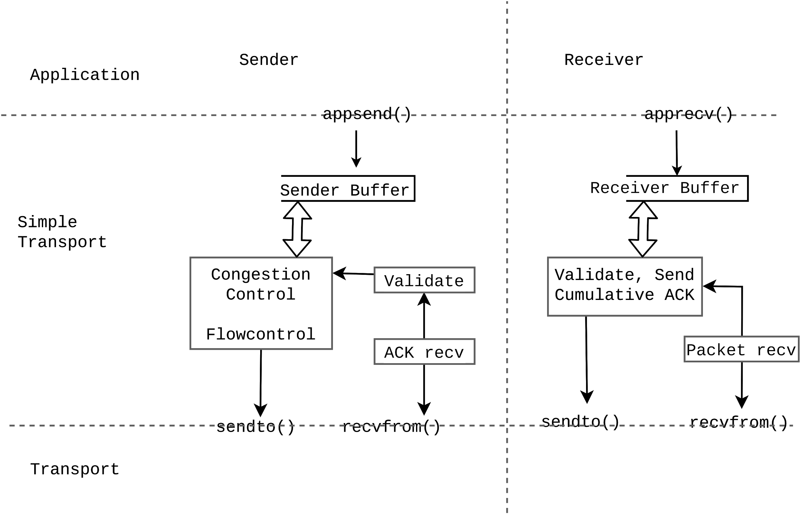
Implementing a Transport Wrapper at the Application Layer
Independent process

Slide 3
Sender Modules
Buffer Handler Handles sender buffer. appSend call will send data directly to Buffer Handler which maintains a queue to store the data coming from the application. This call is a blocking call, where the call may get blocked if enough space is not available at the sender buffer
Flow and Congestion Control Handler - runs in a separate process, constructs the packets from the application data based on flow and congestion control algorithm, and sends the data to transport layer (UDP) through kernel system call
Timeout Handler - handles timeout, updates window size
ACK handler
Triple duplicate Handler - Trigger congestion control (reduce congestion window and restart)
New ACK Handler - Trigger flow and congestion control (adjust window size based on congestion window and receiver advertised window size)
Transport (UDP) Sender: Send the data packet
Transport (UDP) Receiver: Receive an ACK packet

Slide 4
Sender Module
Application
appSend()
Send_Queue
Buffer Handler - sendbuffer_handle()
Flow and Congestion Handler - rate_control()
Update window
update_window()
Construct Packets
create_packet()
Parse ACK Packets
parse_packets()
Send UDP Packets
udp_send()
Receive UDP Packets
udp_receive()
Kernel System Calls

Slide 5
Receiver Module
Buffer Handler Handles sender buffer. appRecv call will try to fetch data from Buffer Handler. This call may be block if no data is available.
Receiver:
ACK generator
Sender:
Send ACK packets

Slide 6
Receiver Module
Application
appReccv()
Recv_Queue
Buffer Handler - recvbuffer_handle()
Parse DATA Packets
parse_packets()
Send ACK
send_ack()
Receive UDP Packets
udp_receive()
Send UDP Packets
udp_send()
Kernel System Calls

Slide 7
Assignment: Sender Side
Need to implement full congestion control algorithm including Slow-Start and Congestion Avoidance states (TCP Tahoe). Use Byte sequence number. Set MSS=1024 bytes - You need to change the header - try to design it.
There will be a special parameter ssthresh which will determine the state
cnwd < ssthresh: Slow Start
Otherwise: Congestion Avoidance (AIMD)
Congestion window (cwnd) will increase by 1 MSS per successful ACK during Slow-Start and MSS/cwnd bytes during Congestion avoidance (AIMD)
ssthresh will set to half of current window size in case of triple duplicate ACK as well as timeout event. However cwnd will start from ssthresh in case of triple duplicate ACK and will start from 1 MSS in case of timeout event
Sender can send packet only if number of outstanding packets is less than min(cwnd,rwnd)
This entire things have to run from a different process (congestion controller) other than the parent process. Also, parent process send data to congestion controller via appSend function only.

Slide 8
Assignment: Receiver Side
Receiver have to maintain a buffer for incoming packets
Receiver may accept out of order packets, but it will generate ACK with acknowledgement number of the last consecutive packets (use cumulative acknowledgements)
Receiver has to send ACK containing current available space in the receiver buffer which is receiver’s advertised window size
Receiver has to run through a separate process, and the parent process (the application) will communicate through appRecv call only.
appRecv call may get blocked if receiver buffer is empty

Slide 9
Combine Everything Together
appSend()
Application
appRecv()
Send_Queue
sendbuffer_handle()
recvbuffer_handle()
Recv_Queue
rate_control()
update_window()
send_ack()
ACK
create_packet()
DATA
parse_packets()
create_packet()
udp_send()
udp_receive()
udp_send()
Kernel System Calls

