Slide 1
Project Name Blinkit Grocery Sales Data Dashboard
Developed By
HARI YOGESH RAM B

Slide 2
Introduction & History of Blinkit
Blinkit (formerly Grofers) is a quick-commerce grocery delivery platform in India.
Offers delivery of groceries, fruits, vegetables, and essentials within minutes.
Founded: 2013 as Grofers
Rebranded: Blinkit in 2021 after Zomato acquisition
Presence: Operates across multiple Indian cities

Slide 3
Project Objective & Summary
Objective:
Analyze Blinkit's grocery sales to identify trends & insights
Create an interactive Excel dashboard for decision-making
Summary:
Collected and cleaned raw sales data
Used pivot tables, charts, slicers
Designed dashboard to visualize sales, ratings, outlet performance

Slide 4
Use Cases & Goals of the Dashboard
Uses:
Track sales performance
Identify strong/weak products and outlets
Aid supply chain and inventory planning
Main Goals:
Monitor trends
Compare outlet types and regions
Evaluate product categories
Identify improvement areas

Slide 5
Dataset Overview
File Name:
Grocery Sales Data ( Blinkit ).xlsx
Sheet Name:
Raw Data
Cleaned Data
Pivot Table Analysis
Dashboard
Total Records: 8,523

Slide 6
Dataset Columns
Item Fat Content, Item Identifier, Item Type
Outlet Establishment Year, Outlet Location Type
Outlet Identifier, Outlet Size, Outlet Type
Item Visibility, Item Weight
Sales($), Rating(1-5)

Slide 7
DATASET COLUMNS WITH DESCRIPTION
S.No | Column Name | Description | Example / Values | Purpose
1 | S.No | Serial number for each record | 1 to 8,523 | Used for indexing records
2 | Item Fat Content | Fat content of food items | "Low Fat", "Regular" | Segment by health preference
3 | Item Identifier | Unique code for each product | FDX32, NCU05, DRJ11 | Track items uniquely
4 | Item Type | Product category | Breads, Dairy, Frozen Foods, Snack Foods, etc. (15 categories total) | Analyze by category
5 | Outlet Establishment Year | Year outlet was opened | 2011, 2012, 2014, ..., 2022 | Compare new vs old outlets
6 | Outlet Identifier | Unique code for each outlet | OUT049, OUT013, OUT027 | Analyze at outlet level
7 | Outlet Location Type | Tier classification of city | Tier 1: MetrosTier 2: Large CitiesTier 3: Small Cities | Compare city-level performance
8 | Outlet Size | Physical store size | Small, Medium, High | Compare formats
9 | Outlet Type | Classification by store model | Supermarket Type 1/2/3, Grocery Store | Evaluate by outlet type
10 | Item Visibility | Shelf space allocated to item (%) | Numeric percentage | Study placement impact on sales
11 | Item Weight | Product weight or volume | In kg or ml depending on category | Analyze by package size
12 | Sales | Total revenue generated by item | Numeric ($) | Identify top/bottom revenue items
13 | Rating | Customer satisfaction score | 1 (Very Poor) to 5 (Excellent) | Assess product quality

Slide 8
Excel Features & Techniques Used
Data Cleaning
Conditional Formatting
Pivot Tables & Pivot Charts
Slicers for Interactivity
Dashboard Design Principles

Slide 9
Pivot Table
KPI:
Total Sales | Average Sales | Average Rating | No. of Items |
Max Sales | Min Sales
Find -> Total Sales
By Fat Content
By Outlet Location
By Item Type
By Outlet Establishment Year
By Outlet Type
By Outlet Size

Slide 10
Pivot Chart
Clustered Column Chart: Compare values across categories vertically (e.g., sales by product type).
Clustered Bar Chart: Compare values across categories horizontally (e.g., sales by outlet).
Line Chart: Show trends or changes over time (e.g., monthly sales growth).
Area Chart: Visualize cumulative data trends over time (e.g., total sales contribution).
Pie Chart: Show percentage share of a whole (e.g., sales share by region).
Doughnut Chart: Display proportional data with space for labels (e.g., product category share).

Slide 11
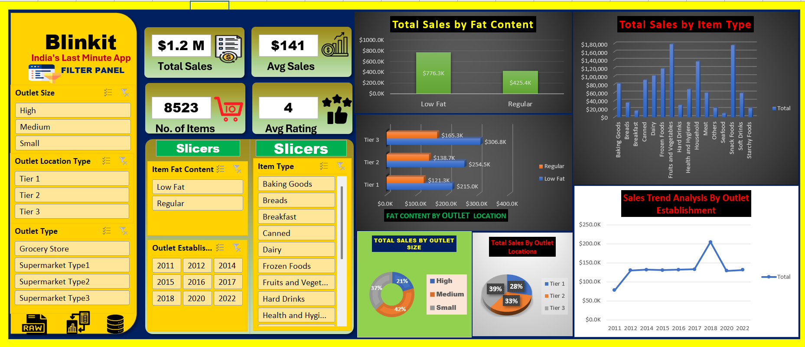
Dashboard Overview

Slide 12
Future Enhancements
Integrate real-time data updates
Add predictive analytics for forecasting
Track outlet-level profit margins

Slide 13
Business Performance Improvement
Identify and maintain top-selling items
Optimize shelf visibility for better sales
Focus marketing on growing city tiers
Improve or replace low-rated products

Slide 14
Final Results
Insights on sales, outlet performance, and ratings
Enhanced understanding of customer and product behavior
Dashboard enables data-driven decision making

Slide 15
THANK YOU!...

