Slide 1
HEALTHCARE PERFORMANCE SNAPSHOT
Healthcare performance is balanced
with one sharp exception.
Across volume, admission mix, outcomes, billing, and payer revenue, the portfolio is remarkably even. The final admissions point is the outlier to validate.

Slide 2
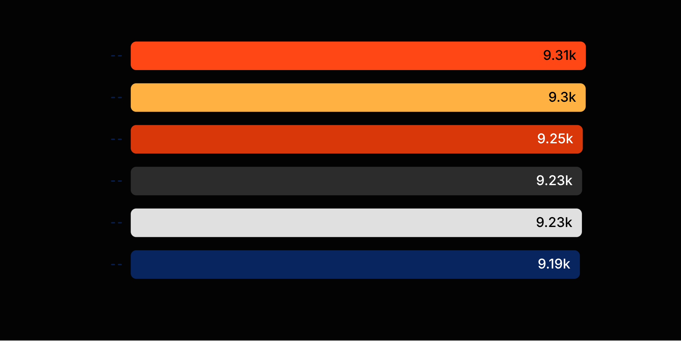
PATIENT VOLUME
Patient volume is nearly even across six conditions
TOP TO BOTTOM
123
patients separate Arthritis from Asthma.
Highest: Arthritis at 9,308
Lowest: Asthma at 9,185

Slide 3
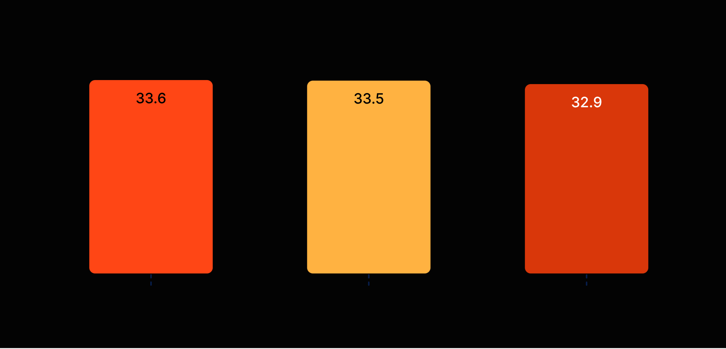
ADMISSION MIX
Admission type is a three-way split
THE GAP
0.7 pp
The largest-to-smallest difference is just 0.7 percentage points.
33.6% Elective
33.5% Urgent
32.9% Emergency

Slide 4
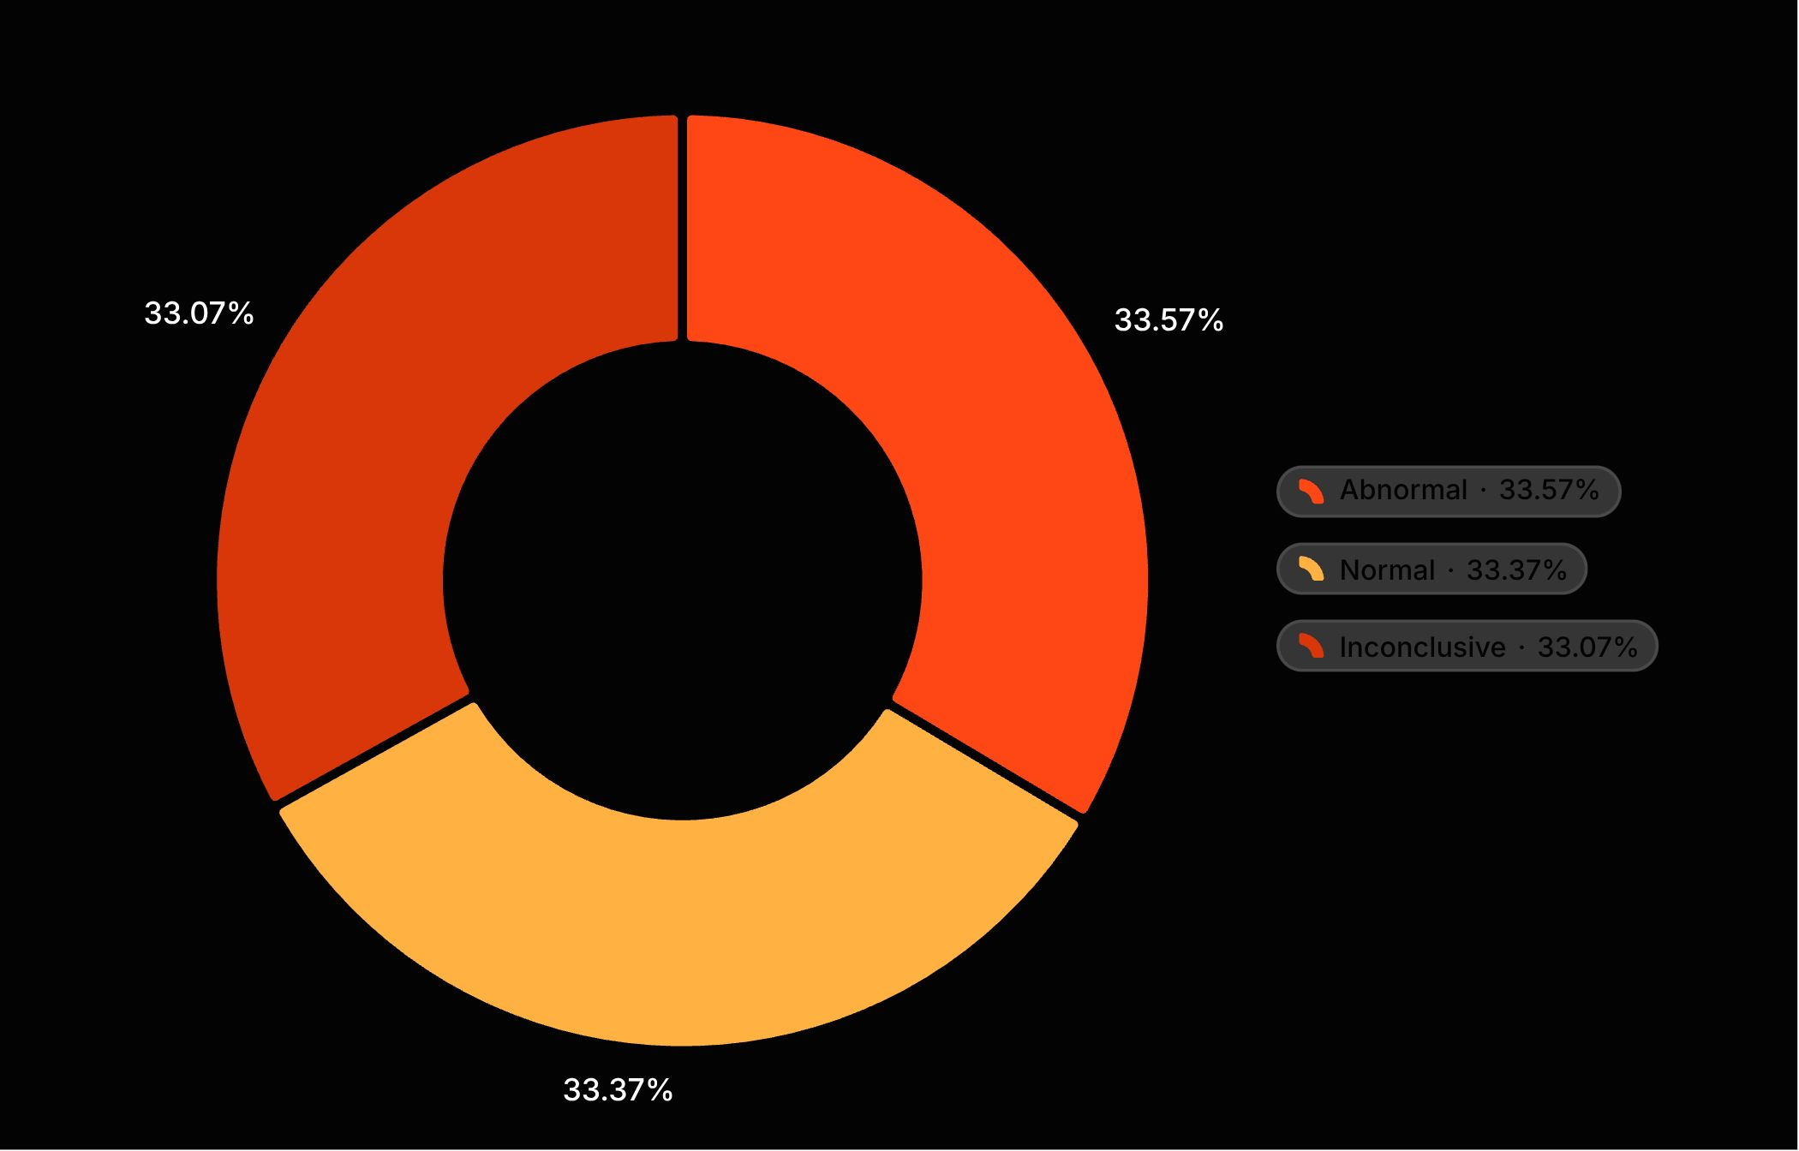
TEST OUTCOMES
Test outcomes are equally mixed
~⅓
No category dominates.
Abnormal, normal, and inconclusive results each represent about one-third of the mix.
Read this as a balanced mix, not a single-outcome story.

Slide 5
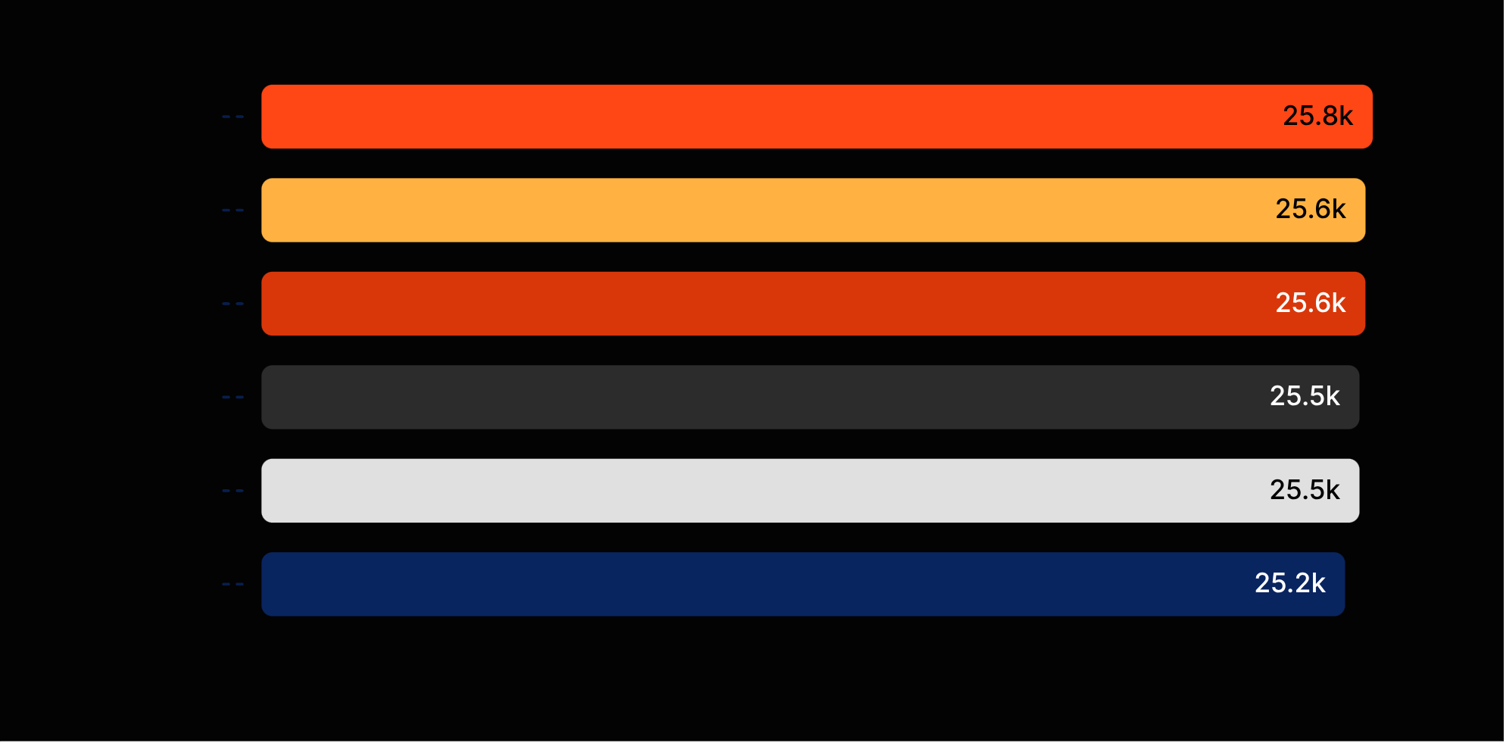
AVERAGE BILLING
Average billing is clustered within a $644 band
BAND
$644
from highest to lowest average billing.
Highest: Obesity at $25,806
Lowest: Cancer at $25,162
Tie: Arthritis and Hypertension at $25,497

Slide 6
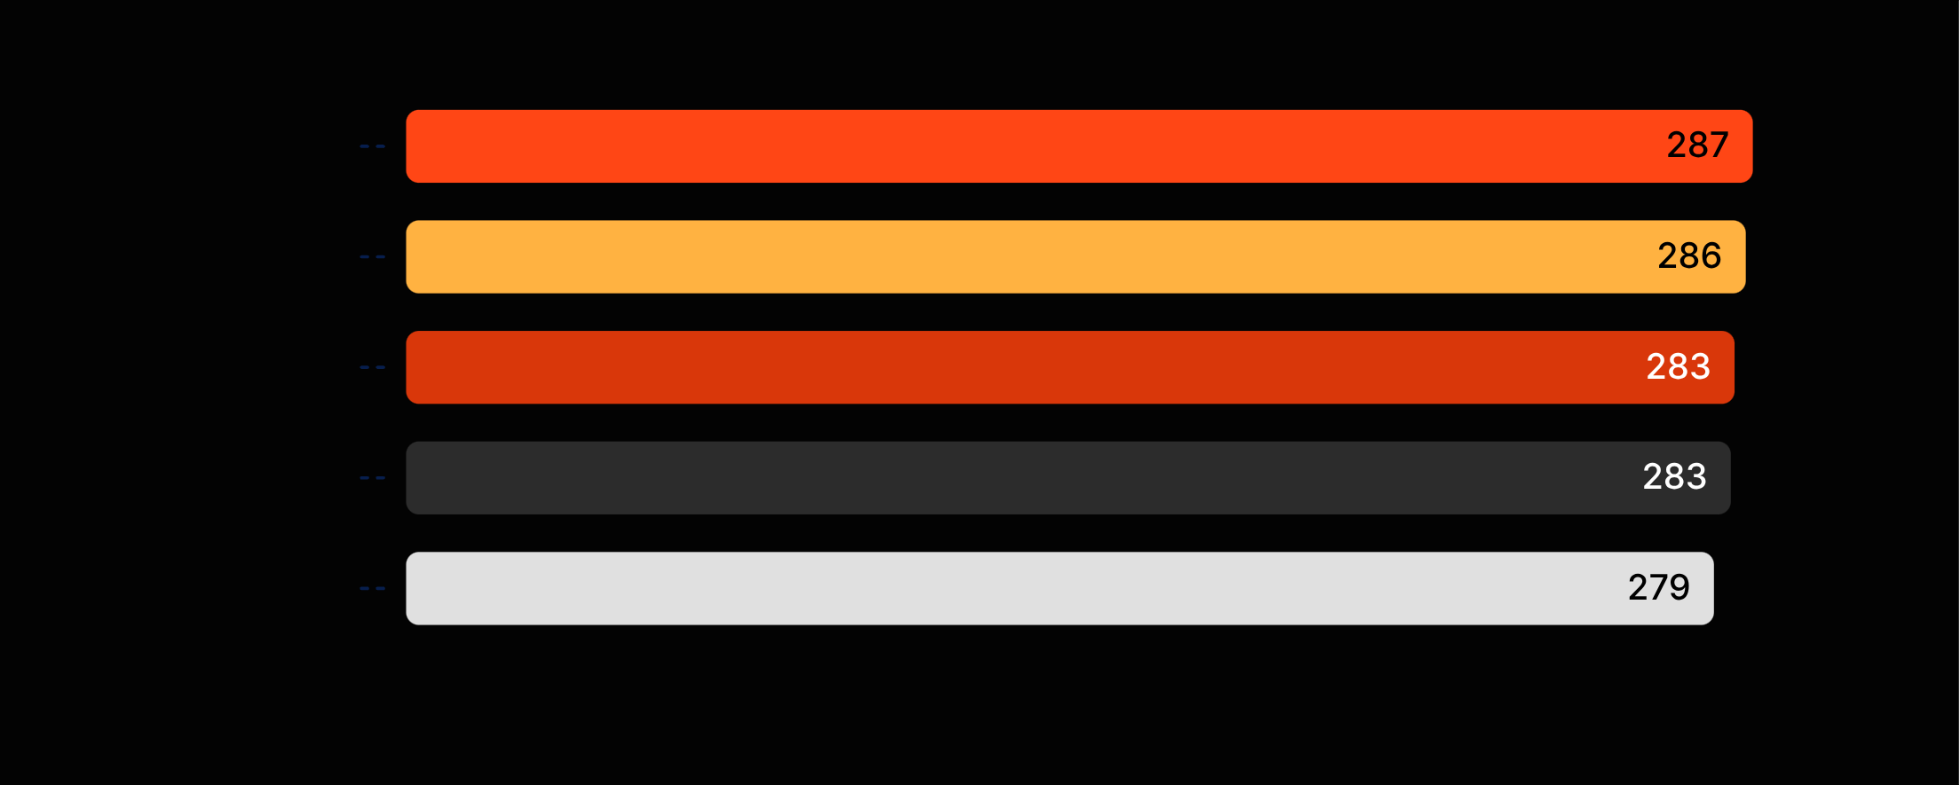
PAYER REVENUE
Payer revenue is similarly concentrated — and tightly grouped
FIVE-PROVIDER RANGE
$8.3M
separates the highest and lowest payer revenue.
Leader: Cigna at $287.2M
Lowest: Aetna at $278.9M

Slide 7
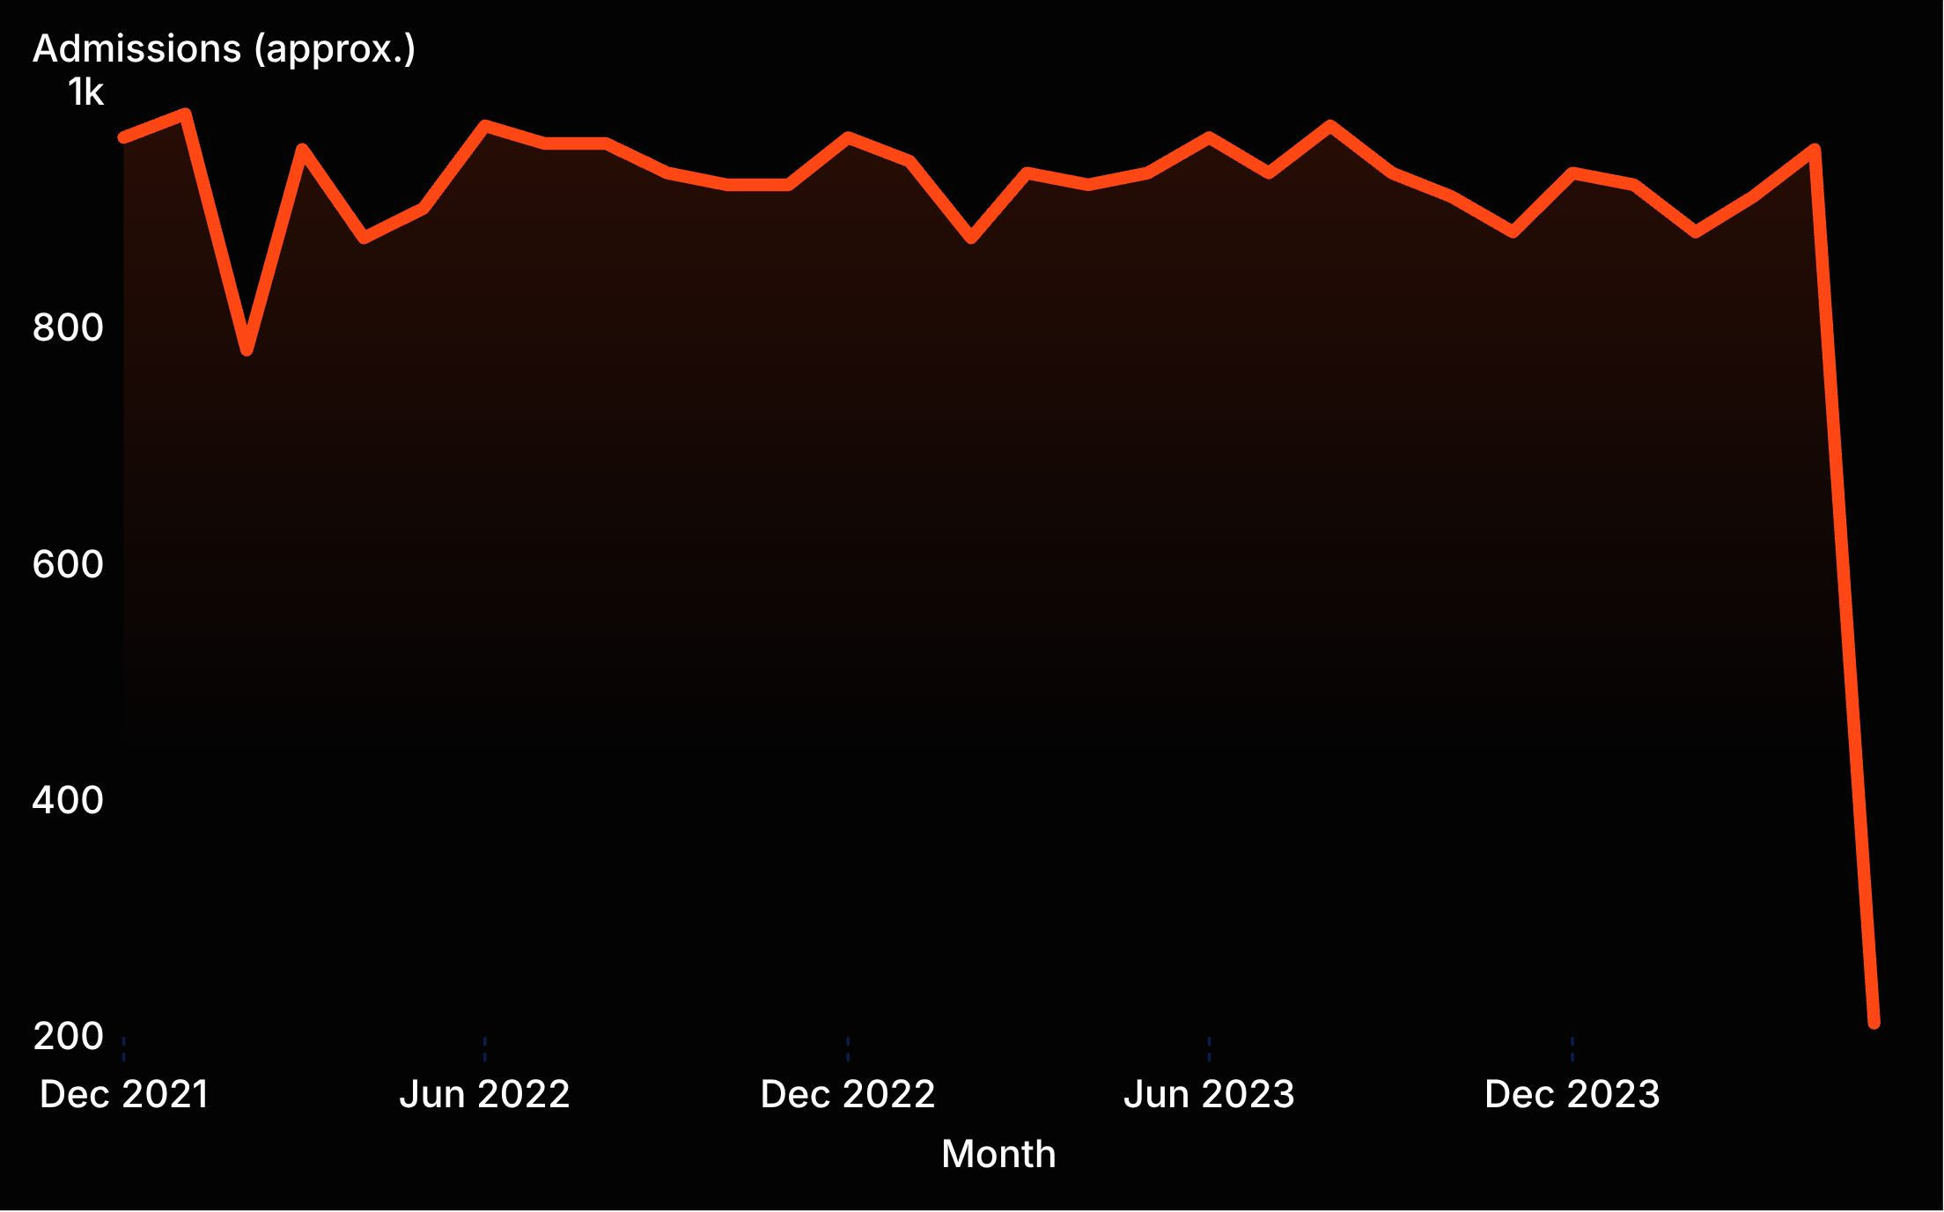
THE ONE SHARP EXCEPTION
The admissions trend is stable until the final data point
~210
Final plotted point
From late 2021 through spring 2024, monthly admissions generally sit around 780–980.
The chart provides no printed point labels, so values are approximate.
Validate before action.

Slide 8
The snapshot points to validation, not a portfolio imbalance
Patient volume
Admissions + tests
Balanced across all six conditions.
Admission types and test outcomes are balanced across categories.
Billing + payer revenue
VALIDATE
The final admissions point
Tightly clustered across the portfolio.
The one signal that materially breaks the pattern.

