Slide 1


MACHINE LEARNING
MASTER CLASS
DAY – 3/30
Advertisement Sale prediction

Slide 2

01
Advertisement Sale prediction
Concept

Slide 3
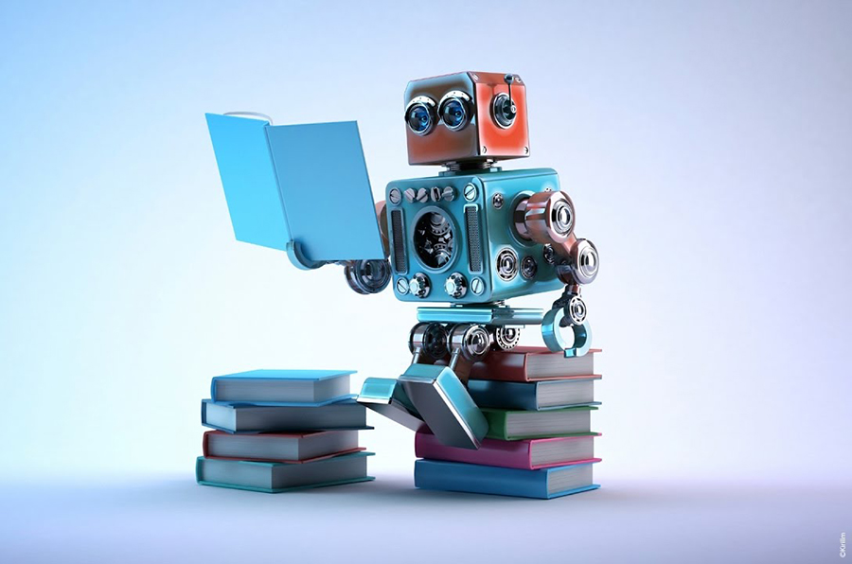
02
Advertisement Sale prediction
Project

Slide 4
Watch Strangest Secret
🧠Mindset task of the Day💡

Slide 5
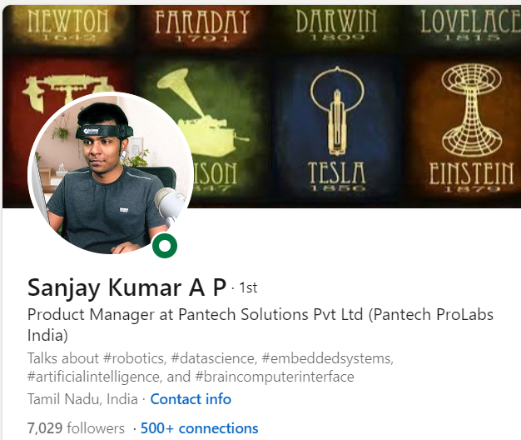
THANKS!
DO YOU HAVE ANY QUESTIONS?
Follow Me on the LinkedIn

