Slide 1

20AM6203 - DESIGN PROJECT - II
BATCH-15
TRADEBOT AI : PREDICTING STOCK VALUE WITH LLM AND DEEP LEARNING
Presented by :
Guided by :
HARI BASKAR L - 811722001012
MOHAMED FARHAN M - 811722001031
MUGESH D - 811722001033
Mr. C. MUTHUKUMARAN M.E., (Ph. D)
Assistant Professor / AI

Slide 2
OBJECTIVE
Develop an LSTM-based model to forecast stock prices using historical data, financial indicators, and trading volume. Integrate an interactive chatbot powered by NLP and RNNs to deliver real-time stock insights and assist users in investment decisions.

Slide 3
EXISTING SYSTEM
Traditional methods like moving averages and linear regression help smooth trends but struggle with market volatility.
Machine learning models handle complex patterns and adapt better to dynamic stock data.
Deep learning techniques like LSTM and ANN capture long-term dependencies for more accurate predictions.
Demerits
Requires large datasets and longer training time.
May overfit if not properly tuned or regularized.
Less effective in highly unpredictable market scenarios.

Slide 4
PROPOSED SYSTEM
The system uses an LSTM-based model trained on historical stock data to forecast future prices by learning time-based trends and patterns.
Data is preprocessed through normalization and enhanced with technical indicators like moving averages to improve prediction quality.
A chatbot interface is integrated to let users interact in real time, ask queries, and receive insightful stock forecasts and investment guidance.
Merits
Performs well with large datasets and captures long-term patterns.
Reduces overfitting through proper feature selection and tuning.
More reliable in dynamic and volatile market conditions.

Slide 5
LITERATURE SURVEY

Slide 6
S.no | Year | Authors | Title of the Paper | Algorithm/ Methodologies/ Techniques | Demerits
1 | 2025 | Aino Heino | New Product Demand Forecasting In Retail Applying Machine Learning Techniques To Forecast Demand For New Product Purchasing Decisions | XGBoost model | Handling the missing Values It requires high memory spaces.
2 | 2023 | Gone Neelakantam | Fog Computing Enabled Locality Based Product Demand Prediction and Decision Making Using Reinforcement Learning | K-Means | More rapid computational timing. Hard to forecast the K value
3 | 2022 | Matthias Ulrich | Distributional regression for demand forecasting in e-grocery | Random Forest | It provides high accuracy It requires more computational power
4 | 2020 | Osayi Victor Agbonlahor | A Comparative Study On Machine Learning And Deep Learning Techniques For Predicting Big Mart Output Sales | Support Vector Regression (SVR) | It works well with in the high dimensional dataset It doesn’t perform when the dataset get noisy
5 | 2019 | Pahul Preet Singh Kohli | Stock Prediction Using Machine Learning Algorithms | Support Vector Machine(SVM) | Cost-Effective It’ not suitable for large dataset.

Slide 7
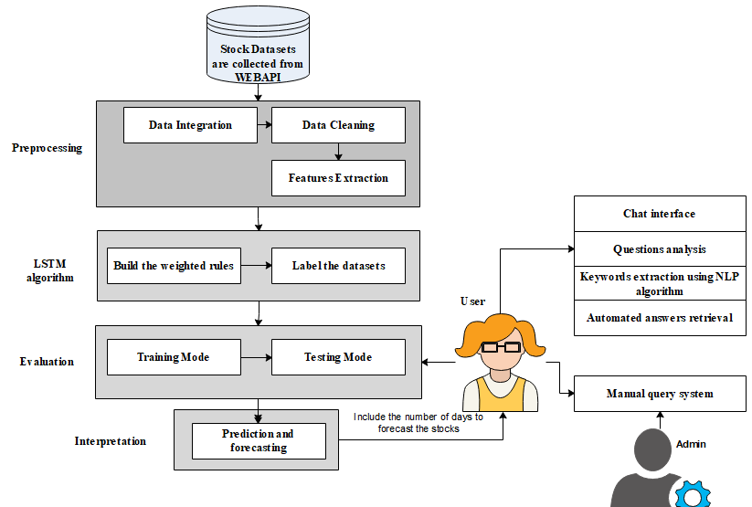
ARCHITECTURE

Slide 8
SYSTEM DESCRIPTION
HARDWARE REQUIREMENTS
Processor : Intel processor
RAM : 1GB
Hard disk : 160 GB
Compact Disk : 650 Mb
Keyboard : Standard keyboard
Monitor : 15 inch color monitor

Slide 9
SYSTEM DESCRIPTION
SOFTWARE REQUIREMENTS
Server Side : Python 3.7.4(64-bit) or (32-bit)
Client Side : HTML, CSS, Bootstrap
IDE : Flask 1.1.1
Back end : MySQL 5.
Server : WampServer 2i
OS : Windows 10 64 –bit

Slide 10
MODULES
DATASETS ACQUISITION
PREPROCESSING MODULE
FEATURES EXTRACTION
LSTM BASED MODEL CONSTRUCTION
PRICE PREDICTION
FORECASTING AND BOT CONSTRUCTION

Slide 11
DATASET ACQUISITION
Purpose
To collect comprehensive historical stock data essential for training and evaluating the prediction model.
Functionality
Retrieves stock prices, trading volumes, and dates from sources like Yahoo Finance or Alpha Vantage API.
Gathers technical indicators to enhance prediction features.
Ensures a wide time range of data for long-term pattern analysis.
Formats and stores the dataset as structured CSV files or DataFrames for processing.

Slide 12
Algorithms Used
yfinance and pandas_datareader.
Explanation
Accurate and sufficient data enables better model training and generalization.
Reliable sources ensure the integrity and consistency of financial data.
Large historical windows help LSTM identify trends across time.
Clean data storage makes preprocessing and analysis efficient.

Slide 13
PREPROCESSING MODULE
Purpose
To clean, format, and normalize raw stock data to make it suitable for model input.
Functionality
Handles missing values through interpolation or removal to avoid biased learning.
Applies normalization to bring all features to the same scale for efficient learning.
Converts date columns into datetime objects and sets proper indexing.
Splits the dataset into training and testing sets while preserving the time sequence.

Slide 14
Algorithms Used
Min-Max Normalization, Time-Series Split, Pandas operations.
Explanation
Preprocessing reduces noise and enhances learning quality.
Scaling prevents dominance of large-range variables over smaller ones.
Proper sequencing maintains temporal integrity for LSTM inputs.
Data splitting enables fair evaluation of model performance.

Slide 15
FEATURES EXTRACTION
Purpose
To enhance raw data with informative financial features for improved model accuracy.
Functionality
Computes moving averages, RSI, MACD, and Bollinger Bands to represent trends and momentum.
Extracts volatility indicators that reflect market risk and activity.
Includes volume-based features to capture investor behavior.
Selects the most relevant technical indicators based on correlation and predictive power.

Slide 16
Algorithms Used
ta-lib and pandas-ta.
Explanation
Feature engineering adds context to raw price movements.
Helps LSTM learn complex relationships beyond basic data.
Enhances the model’s predictive capability under real-world conditions.
Reduces irrelevant noise by focusing on high-impact indicators

Slide 17
LSTM BASED MODEL CONSTRUCTION
Purpose
To design a neural network model that understands temporal patterns in stock data for accurate forecasting.
Functionality
Constructs sequential LSTM layers to model the flow of time-based data.
Incorporates dropout layers to prevent overfitting on training data.
Configures model with appropriate loss functions (e.g., MSE) and optimizers (e.g., Adam).
Trains the model over multiple epochs using historical sequences as input-output pairs.

Slide 18
Algorithms Used
TensorFlow and Keras
Explanation
LSTM is ideal for capturing dependencies across long time steps.
Unlike traditional models, it retains memory of previous inputs while learning new ones.
Robust architecture allows for handling noisy or irregular data.
Enables learning complex nonlinear relationships present in stock data.

Slide 19
PRICE PREDICTION
Purpose
To generate future stock prices based on learned patterns from historical data using the trained LSTM model.
Functionality
Feeds recent and test sequences into the model to obtain future price outputs.
Visualizes predicted prices against actual data for validation.
Evaluates accuracy using metrics like RMSE or MAE.
Saves and exports predictions for chatbot integration and report generation.

Slide 20
Algorithms Used
LSTM-based Time Series Forecasting.
Explanation
Helps investors identify likely future trends in the market.
Visualization builds trust and clarity in model outputs.
Performance metrics ensure the reliability of the model.
Acts as the decision-support backbone of the system.

Slide 21
FORECASTING AND BOT CONSTRUCTION
Purpose
To build an interactive chatbot that delivers predictions and answers stock-related queries in real time.
Functionality
Integrates the trained LSTM model’s output to respond to user questions.
Uses NLP to understand and interpret user queries on stock performance.
Offers personalized stock insights, summaries, and trend-based suggestions.
Maintains real-time interaction through a web interface or messaging API.

Slide 22
Algorithms Used
NLP techniques with RNN Transformer
Explanation
Makes financial forecasting more accessible and user-friendly.
Empowers users with on-demand analysis without technical expertise.
Acts as a virtual assistant for investors, aiding smarter decisions.
Enhances usability and engagement of the forecasting model.

Slide 23
ADVANTAGES
Predict the stock price accurately
Time complexity can be reduced
Future price can be analysed
Computational complexity can be reduced.

Slide 24
APPLICATION
Stock Forecasting
Investment Advisory
Market Trend Analysis
Chatbot Integration
Financial Automation

Slide 25
CONCLUSION
The proposed system uses LSTM networks to accurately predict stock prices by analyzing long-term trends in historical data. Integrated with a chatbot, it delivers real-time insights and personalized responses, helping users make smarter investment decisions.

Slide 26
REFERENCES
1. Singh, R., Varshney, S., Kumar, V., "Stock Price Prediction Using LSTM and
Sentiment Analysis with News Headlines", Journal of Artificial Intelligence and
Data Science, 23(2), 456–472, 2025.
2. Wang, H., Zhou, Y., Liu, M., "An LSTM-based Financial Forecasting Model with
Attention Mechanism", IEEE Access, 22(4), 2331–2345, 2024.
3. Patel, D., Agarwal, R., Jain, N., "Hybrid Deep Learning Framework for Stock
Market Forecasting", International Journal of Intelligent Computing, 21(3), 1120–
1136, 2024.
4. Nguyen, T.H., Pham, K., Vo, B., "Combining NLP and LSTM for Real-time Stock
Movement Prediction", Expert Systems with Applications, 20(5), 789–803, 2023.
5. Li, Z., Huang, J., Yang, Q., "Temporal Deep Learning for Financial Time-Series
Forecasting", Journal of Computational Finance and Analytics, 19(1), 345–362,
2023.

Slide 27
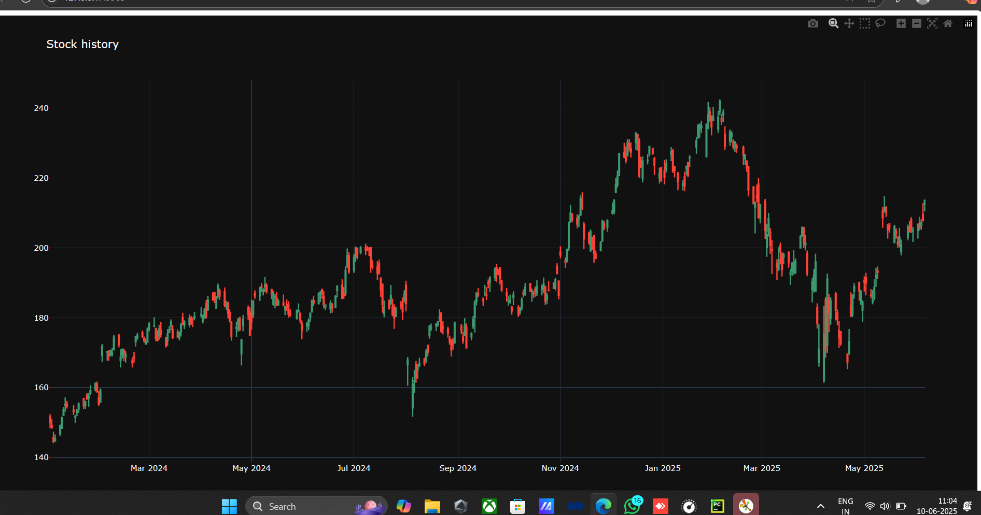
SCREENSHOTS

Slide 28
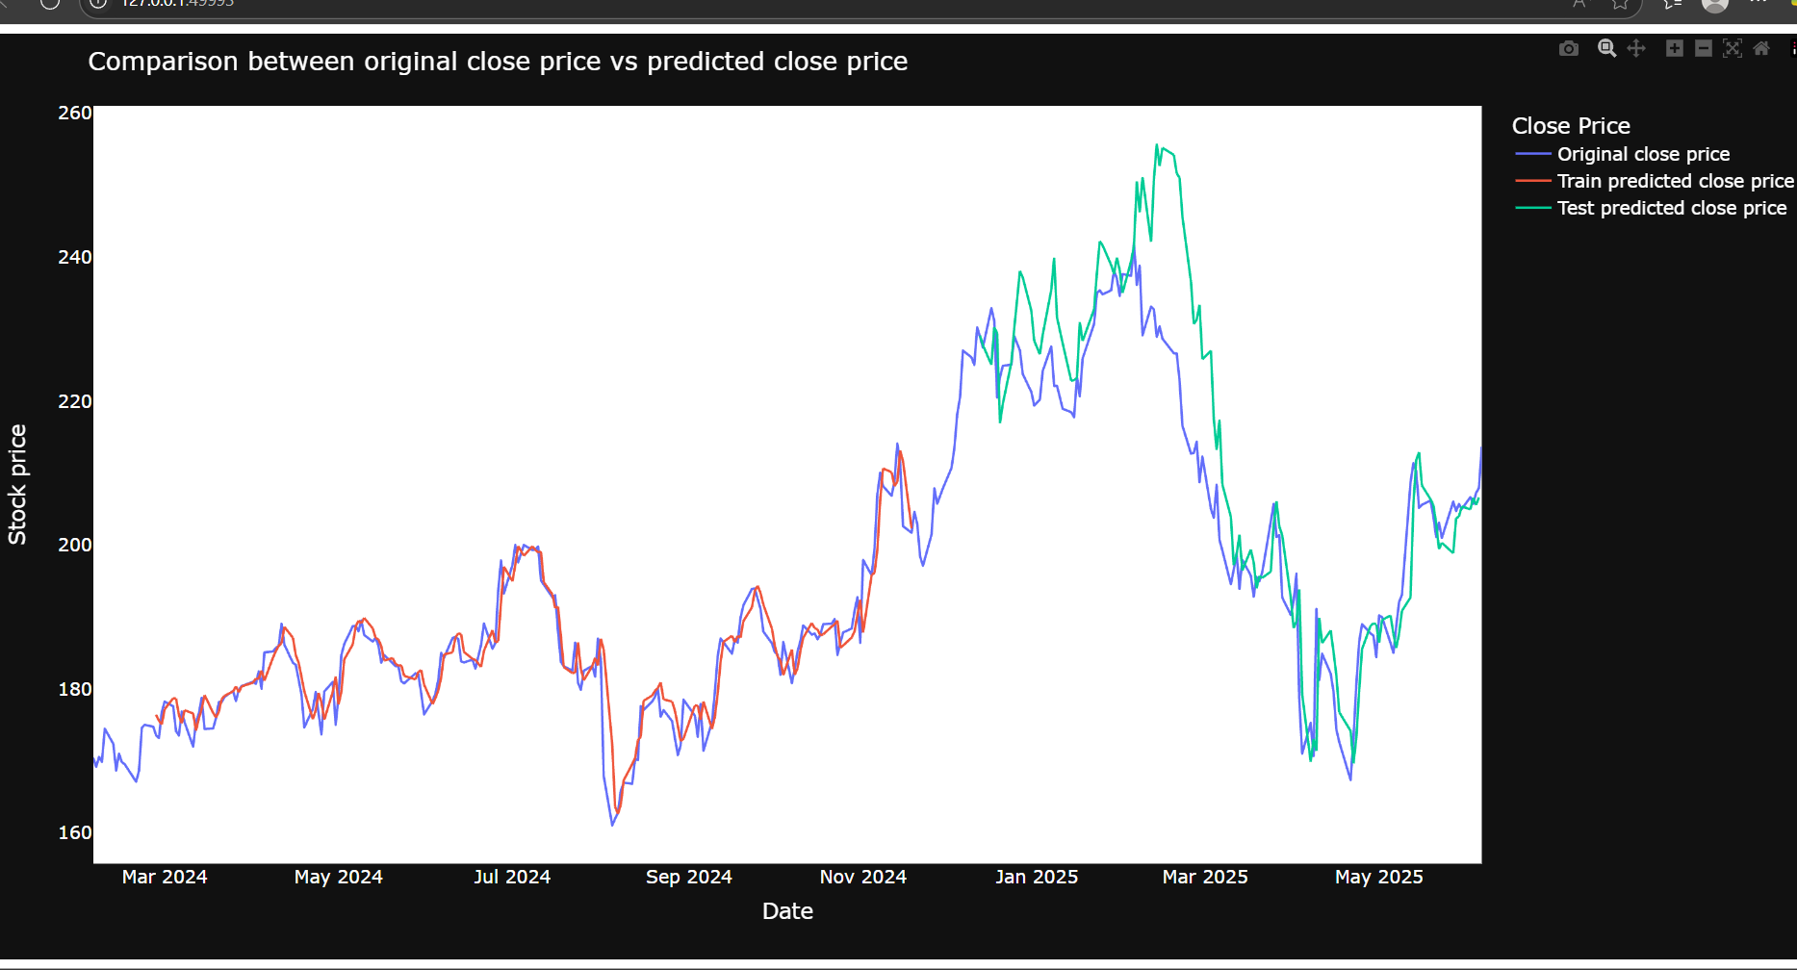

Slide 29
