Slide 1
BUSINESS ANALYSIS OF CYCL-OFO
TEAM MEMBERS
HARI PRASATH NARESH 19BCE1436

Slide 2
ABSTRACT
Society is developing at an unprecedented rate. Air pollution and environmental problems are causing detrimental effects on people’s health, both mentally and physically. The emergence of the sharing bicycles makes environment and citizen’s health condition better. Cyclofo is one of the bike sharing aiming to reduce the pollution.
The business goal is to design marketing strategies aimed at converting casual riders into annual members. In order to do that, however, the marketing analyst team needs to better understand how annual members and casual riders differ, why casual riders would buy a membership, and how digital media could affect their marketing tactics.
time.
Notes:
As an initial hypothesis we can guess that casual riders have not such a habit as members, that is because they don’t use the service in a daily basis. It can be deduced that they don’t ride to work but use it in their leisure time.
This hypothesis must be supported by the results of the analysis, though.

Slide 3
INTRODUCTIONask
Company
Context
Business Task
Cycl-ofo is a bike-share program world wide with flexible pricing plans: casual use and annual memberships.
Annual members are more profitable than casual riders.
Key business goal: converting casual users to annual members.
Find out how casual riders and annual members use the service differently to design marketing strategies aimed at converting casual riders into annual members.
Notes:
Company
Cycl-ofo is a bike-share program that features more than 5,800 bicycles and 600 docking stations. Cyclistic sets itself apart by also offering reclining bikes, hand tricycles, and cargo bikes, making bike-share more inclusive to people with disabilities and riders who can’t use a standard two-wheeled bike. The majority of riders opt for traditional bikes; about 8% of riders use the assistive options. Cyclistic users are more likely to ride for leisure, but about 30% use them to commute to work each day.
Context
Until now, Cyclistic’s marketing strategy relied on building general awareness and appealing to broad consumer segments. One approach that helped make these things possible was the flexibility of its pricing plans: single-ride passes, full-day passes, and annual memberships. Customers who purchase single-ride or full-day passes are referred to as casual riders. Customers who purchase annual memberships are Cyclistic members.
Business Task
Cyclistic’s finance analysts have concluded that annual members are much more profitable than casual riders. Although the pricing flexibility helps Cyclistic attract more customers, Moreno believes that maximizing the number of annual members will be key to future growth. Rather than creating a marketing campaign that targets all-new customers, Moreno believes there is a very good chance to convert casual riders into members. She notes that casual riders are already aware of the Cyclistic program and have chosen Cyclistic for their mobility needs.
The business goal is to design marketing strategies aimed at converting casual riders into annual members. In order to do that, however, the marketing analyst team needs to better understand how annual members and casual riders differ, why casual riders would buy a membership, and how digital media could affect their marketing tactics.
With this goal in mind, the business task is answer a question: **How do annual members and casual riders use Cyclistic bikes differently?**

Slide 4
Initial hypothesis
Casual riders have not such a habit as members, it can be deduced that they As an initial hypothesis we can guess that casual riders have not such a habit as members, that is because they don’t use the service in a daily basis. It can be deduced that they don’t ride to work but use it in their leisure time.
time.
Notes:
As an initial hypothesis we can guess that casual riders have not such a habit as members, that is because they don’t use the service in a daily basis. It can be deduced that they don’t ride to work but use it in their leisure time.
This hypothesis must be supported by the results of the analysis, though.

Slide 5
Data sources
From 2020 to June 2021
Trips information
From 2018 to 2019
Trips information (different format)
From 2013 to 2018
Trips and stations information
Assumptions
Current is better
One year and a half is enough
COVID 19 situation may continue
Notes:
The data used for this analysis is kept in csv files in the next location: Data source location
Here we can find different kind of csv files depending on the year of the information:
It expands from 2013 to June 2021
From 2020 to June 2021:
There is no metadata, although its content can be easily deduced by its column names.
Column names:
ride_id
rideable_type
started_at
ended_at
start_station_name
start_station_id
end_station_name
end_station_id
start_lat
start_lng
end_lat
end_lng
member_casual
From 2018 to 2019:
There is no metadata, but its the same information than in previous years, and those have metadata.
Column names:
trip_id
start_time
end_time
bikeid
tripduration
from_station_id
from_station_name
to_station_id
to_station_name
usertype
gender
birthyear
From 2013 to 2018:
There is metadata for two kinds of information: trips and stations:
ASSUMPTIONS
1. There is more than enough information to analyse trends in the files that go from 2020 to June 2021.
2. Older files have not the same information and are not as current as the last group of files.
3. Although older files have some useful information about the users, such as gender or birthday it is only available for subscribers, such is, members. As our target group is casual riders, we cannot take any important insight of this extra data.
4. Even though the time spans in the period of the COVID-19 epidemics and, as everybody knows, it has been a major trigger for a change of habits, the results of the analysis will considered extended to the future months. Previous years habits are not likely to be going back, anyway.

Slide 6
Data sources
From 2020 to June 2021
16 csv files
~5.5 million rows (rides)
With the same 13 columns
Columns
ride_id
rideable_type
started_at
ended_at
start_station_name
start_station_id
end_station_name
end_station_id
start_lat
start_lng
end_lat
end_lng
member_casual
Notes:
The data used for this analysis is kept in csv files in the next location: Data source location
Here we can find different kind of csv files depending on the year of the information:
It expands from 2013 to June 2021
From 2020 to June 2021:
There is no metadata, although its content can be easily deduced by its column names.
Column names:
ride_id
rideable_type
started_at
ended_at
start_station_name
start_station_id
end_station_name
end_station_id
start_lat
start_lng
end_lat
end_lng
member_casual
From 2018 to 2019:
There is no metadata, but its the same information than in previous years, and those have metadata.
Column names:
trip_id
start_time
end_time
bikeid
tripduration
from_station_id
from_station_name
to_station_id
to_station_name
usertype
gender
birthyear
From 2013 to 2018:
There is metadata for two kinds of information: trips and stations:
ASSUMPTIONS
1. There is more than enough information to analyse trends in the files that go from 2020 to June 2021.
2. Older files have not the same information and are not as current as the last group of files.
3. Although older files have some useful information about the users, such as gender or birthday it is only available for subscribers, such is, members. As our target group is casual riders, we cannot take any important insight of this extra data.
4. Even though the time spans in the period of the COVID-19 epidemics and, as everybody knows, it has been a major trigger for a change of habits, the results of the analysis will considered extended to the future months. Previous years habits are not likely to be going back, anyway.

Slide 7
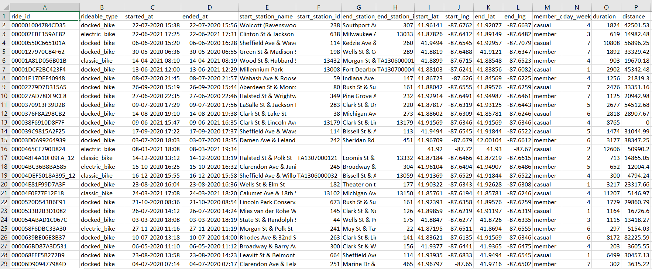
DATA

Slide 8
Import previous csv to RStudio
Filter out wrong durations and distances (only a few registers)
Select only final 11 useful fields
Import to R
Check
Filter
Add Fields
Select
2nd check with R tools
Add new calculated fields:
Time of day
Date and hour

Slide 9
LITERATURE SURVEY
https://www.researchgate.net/publication/347400513_Analysis_of_the_Failure_of_Ofo_Sharing_Bicycle_Company_and_Possible_Solutions
https://www.researchgate.net/publication/346759489_Analysis_of_OFO's_Financing_Problems
TOOLS
R (PROGRAMMING LANGUAGE)
TABLEAU
R STUDIO
WEKA

