Slide 1

DEPARTMENT OF COMPUTER SCIENCE AND ENGINEERING
Project name : Flood Monitoring System
Team name : Proj_224785_Team_4
Team members:
ASHOK KUMAR A(113321104005)
GIRISH KUMAR VV(113321104023)
HARI KRISHNAN R(113321104026)
MOHAMED FAIZ M(113321104060)

Slide 2
Project Definition:
The "Flood Monitoring System using IoT" project aims to develop a robust and proactive solution to address the growing challenge of floods. By integrating IoT sensors, this system will continuously collect data on water levels, rainfall, and weather conditions in flood-prone areas. The data will be transmitted in real-time to a central server for analysis and decision-making.
When critical thresholds are reached, the system will trigger automated alerts, enabling authorities and residents to take timely preventive measures. This project seeks to enhance disaster preparedness, minimize property damage, and ensure the safety of lives in flood-affected regions through cutting-edge technology and data-driven insights.

Slide 3
Objectives:
Real-time Data Collection: Gather accurate and timely data on water levels, rainfall, and weather conditions in flood-prone areas through IoT sensors.
Early Warning System: Develop an early warning system that triggers alerts when critical thresholds are met, enabling rapid response and evacuation procedures.
Remote Monitoring: Enable remote monitoring and control of the system, allowing authorities to make informed decisions and adjustments in real time.
Integration with Existing Systems: Ensure compatibility and integration with existing disaster management and communication systems for a seamless response to flood events.

Slide 4
IoT Sensor Design:
There are several IoT sensors and components that are used in flood monitoring system using IoT. Some of them are as follows.
ESP8266 NodeMCU or ESP32 (Microcontroller Board).
Water Level Sensors.
Weather Sensors.
GSM/GPRS Module.
Arduino IDE and Relevant Libraries.
LoRaWAN Module.
Power Adapter or Battery Pack (Power Supply)

Slide 5
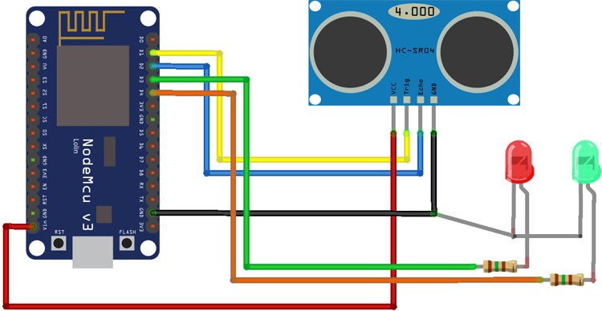
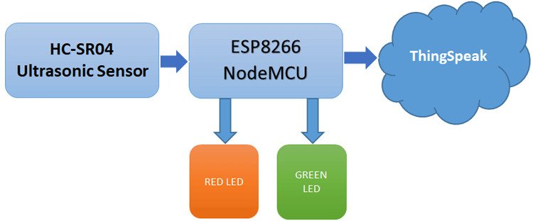
IoT Sensor Design:

Slide 6
Real-Time Transit Information Platform:
Flood Alerts: Providing real-time alerts and notifications about flood conditions, including severity levels and affected areas.
Interactive Maps: Displaying live maps with flood data, evacuation routes, and the status of transportation infrastructure.
Traffic and Transportation Updates: Offering information on road closures, delays, and public transportation services impacted by flooding.
Weather Updates: Providing current weather conditions and forecasts to enhance understanding of the situation.
Historical Data: Archiving past flood events and their impacts for analysis and future planning.

Slide 7
Integration Approach:
Real-Time Data Integration: Integrate the app with the central flood monitoring system's data sources, enabling real-time access to flood data, alerts, and maps.
User Authentication and Data Security: Implement secure user authentication to protect user data. Ensure data security by using encryption techniques and secure APIs for data transmission.
Geospatial Mapping and Visualization: Incorporate interactive maps that display flood-prone areas, water levels, evacuation routes, and shelters.
Offline Functionality: Include offline capabilities, allowing users to access critical information even when they have limited or no internet connectivity.

Slide 8
THANK YOU

