Slide 1

DEPARTMENT OF COMPUTER SCIENCE AND ENGINEERING
Project name : Flood Monitoring and Early Warning
Team name : Proj_224785_Team_4
Team members:
ASHOK KUMAR A(113321104005)
GIRISH KUMAR VV(113321104023)
HARI KRISHNAN R(113321104026)
MOHAMED FAIZ M(113321104060)

Slide 2
Innovation
Real-time Data Collection: Implement sensors and data collection devices in flood-prone areas to continuously monitor water levels and weather conditions. This data should be collected in real-time and transmitted to a central database.
Automated Alerts: Develop an automated alert system that can send notifications to local authorities and residents when water levels rise above safe thresholds. Alerts can be delivered via SMS, mobile apps, or email to ensure timely response.
Predictive Analytics: Use historical data and advanced analytics to create predictive models that can forecast flood events. This can help in proactive planning and resource allocation for flood mitigation and response.
User-Friendly Interface: Create a user-friendly interface for accessing flood information. This could be a website or a mobile app that provides real-time updates, flood maps, and safety tips to help residents make informed decisions during floods.

Slide 3
Project Objectives:
Early Warning and Alert System: Developing an effective early warning and alert system is crucial as it directly contributes to public safety by providing timely notifications of potential flood events.
Accuracy and Reliability: Ensuring the accuracy and reliability of collected data is fundamental to minimizing false alarms and errors, which in turn helps build trust in the monitoring system.
Data Analysis and Reporting: Implement data analysis tools to generate reports and insights from the flood monitoring data, aiding in decision-making and post-flood analysis.
Collaboration: Foster collaboration with relevant government agencies, local communities, and technology partners to ensure the success and effectiveness of the flood monitoring system.

Slide 4
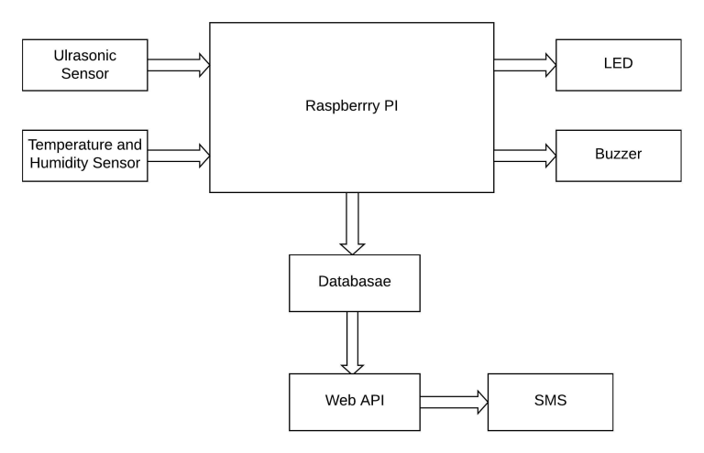
IoT based Virtualization

Slide 5
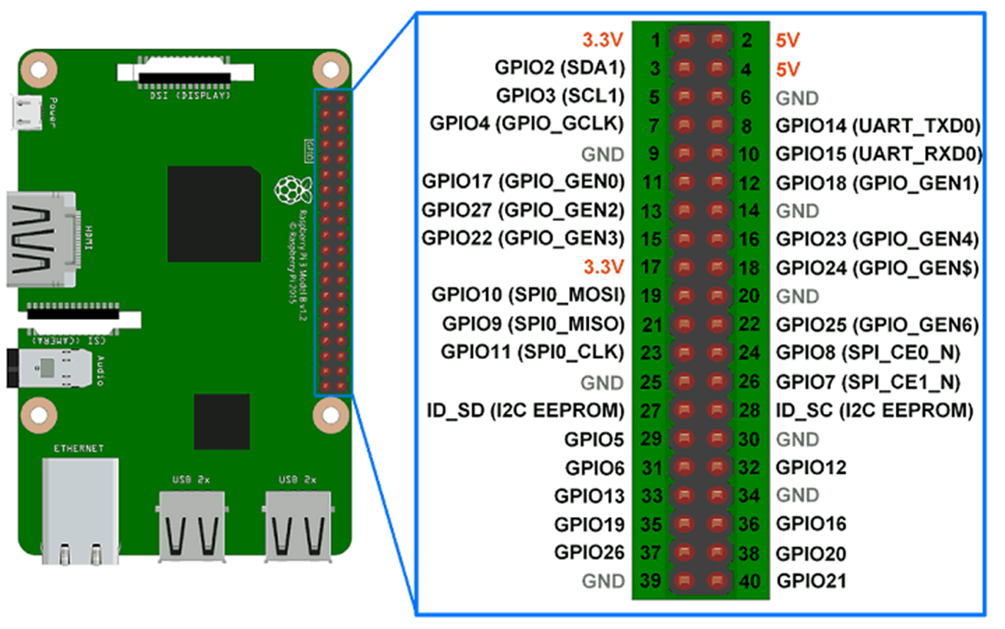
Raspberry Pi Integration :

Slide 6
Code Implementation:
Hardware:
Raspberry Pi (with Raspbian OS installed)
Water level sensor (e.g., ultrasonic sensor)
Breadboard and jumper wires
Power supply for Raspberry Pi
Software:
Python (to write the monitoring code)
RPi.GPIO library (to interface with GPIO pins on Raspberry Pi)

Slide 7
Conclusion
In conclusion, the flood monitoring system is a vital innovation prioritizing public safety through real-time data, early warnings, and community engagement. It minimizes flood risks, fosters collaboration, and enhances disaster preparedness with user-friendly interfaces and predictive features. Leveraging IoT virtualization ensures reliability, cost-efficiency, scalability, and security, marking a pivotal step in safeguarding flood-prone areas.
With its user-friendly interface and predictive capabilities, this system empowers communities to make informed decisions during flood events. Moreover, by utilizing IoT virtualization for testing and validation, it ensures reliability and cost-efficiency while promoting scalability and security. In essence, the flood monitoring system represents a pivotal step towards safeguarding lives and property in flood-prone areas.

Slide 8
THANK YOU

