Slide 1
Iris Recognition-Based Authentication System Using Daugman's Algorithm
Biometrics & Security · Group project
Hari Sankar A · Abhinav Dileep · Ayyappadas M T
Ajith Ashok · Pranav Pradeep
Notes:
Open (30 s). Say: passwords can be shared, stolen or guessed. We built an iris-based authentication system: Daugman's pipeline from scratch, a hardened template store around it, and an evaluation on subjects we never tuned on. Introduce the team and who will answer which topic.

Slide 2
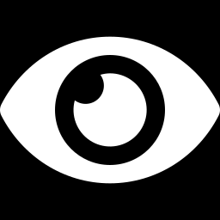
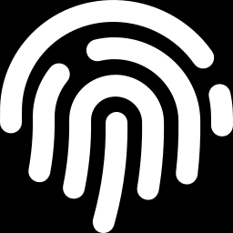
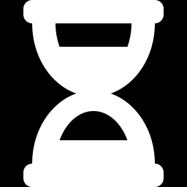

Why authenticate with the iris
Passwords can be shared, stolen or guessed. A biometric checks who you are, so the template that proves it needs protecting as carefully as a password hash.
Distinctive
Codes from different eyes behave like independent random bits, so strict thresholds are possible.
Stable
0.48
0.25
Iris texture is considered stable for most of adulthood and is protected inside the eye.
average distance, different eyes
average distance, same eye
Measurable
One number, the Hamming distance, separates the same eye from a different eye.
Notes:
Context (40 s). The two numbers on the left are measured on our test subjects: same-eye comparisons average about 0.25 Hamming distance, different eyes about 0.48. That gap is the whole idea. Trade-off to mention if asked: iris needs near-infrared capture and some cooperation from the user.

Slide 3
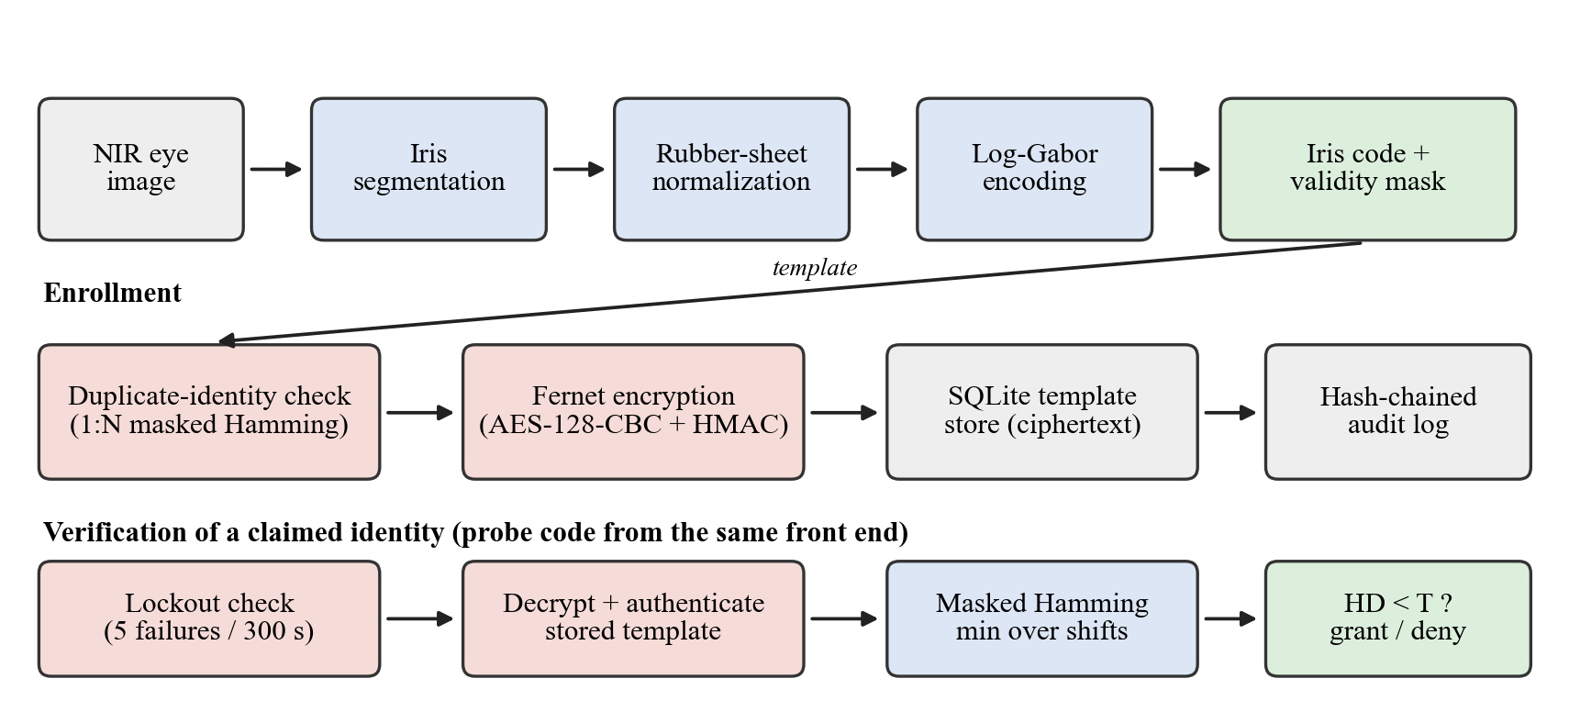
System overview
Blue: biometric front end shared by both paths. Red: security controls.
Notes:
Walk the figure top to bottom (45 s). Top row: image to iris code. Middle: enrollment, where the new template is first compared with everyone enrolled, then encrypted and stored with an audit entry. Bottom: verification, where lockout is checked first, the stored template is decrypted and authenticated, then compared and the decision is made. Everything in red is a security control we added around the biometric core.

Slide 4
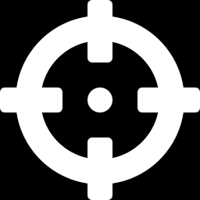
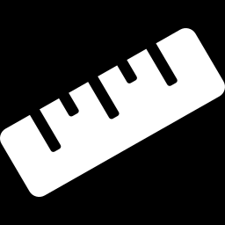
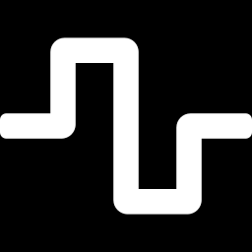
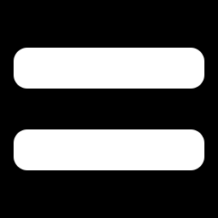
From photo to decision in four stages
1
2
3
4
Segment
Normalize
Encode
Match
Find the pupil and iris circles with Daugman's integro-differential operator.
Unwrap the ring with the rubber-sheet model into a fixed rectangle.
Log-Gabor filters, keep the sign of each response, mask eyelashes and glare.
Masked Hamming distance, best of 13 rotations (±8.4°).
pupil + iris radius
64 × 512 strip
16,384-bit code
distance 0 to 1
Decision: accept when the distance is below the threshold, a server setting (default 0.423, high security).
Notes:
The four stages (60 s). Segment: pupil first by removing the corneal reflections and thresholding, then both boundaries refined with the integro-differential operator, which finds the sharpest circular edge. Normalize: rubber sheet, so pupil dilation and eye size stop mattering. Encode: two Log-Gabor wavelengths, keep only the sign of the real and imaginary parts, giving 16 by 256 by 4 bits, and a mask for unreliable bits. Match: fraction of differing bits over bits valid in both, minimized over 13 rotations. The decision threshold is server policy, never chosen by the user.

Slide 5
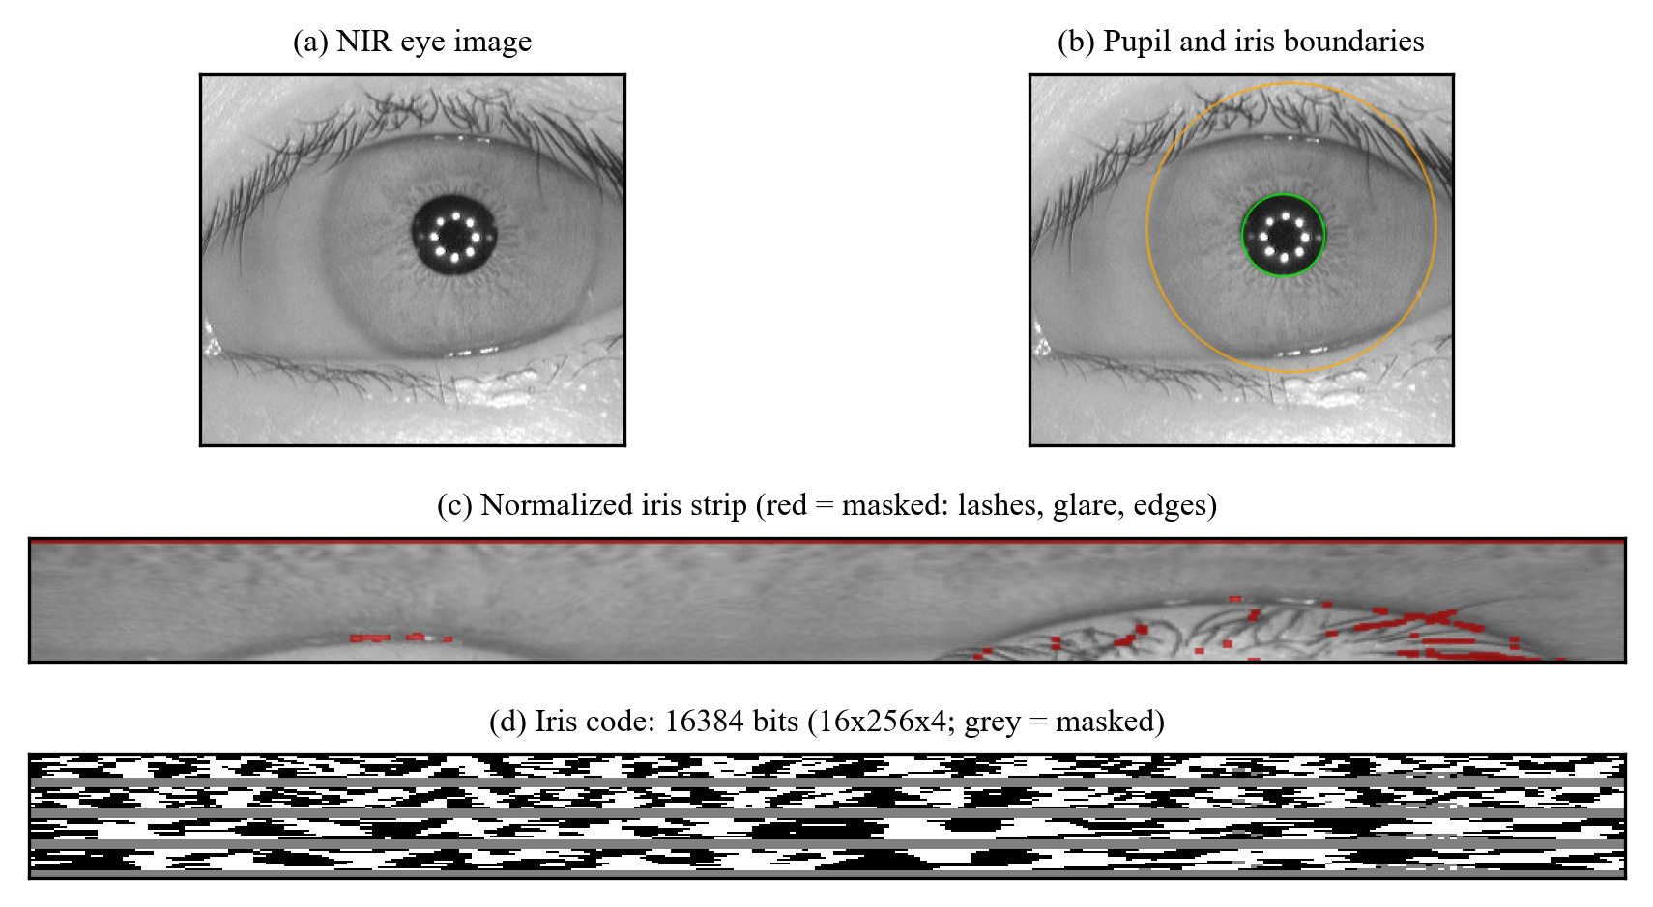
The pipeline on a real image
Green and orange circles
Pupil and iris boundaries found by the operator.
Red patches in the strip
Eyelashes and glare, masked so they never count.
Grey bands in the code
Outer quarter of the iris is always ignored.
Notes:
One real test image (30 s). (a) the input, (b) detected circles, (c) the unwrapped strip with eyelash and glare pixels marked red, (d) the iris code as a bitmap. Grey bands are bits we never use because the outer iris is most often occluded. The live demo's Pipeline view shows this same sequence.

Slide 6
How we tested it
Tuning
subjects 001–060
81 eyes · 553 images
Held-out test
subjects 061–249 · 314 eyes · 2,066 images · never used for tuning
Dataset: CASIA-Iris-Interval, 2,639 near-infrared images of 395 eyes from 249 subjects. Thresholds were chosen on the tuning set only, then frozen.
6,632
2.1 M
0.76%
genuine comparisons (same eye)
impostor comparisons (different eyes)
images not segmented (20 of 2,639)
Genuine pair: Two different images of the same eye.
Impostor pair: Images of two different eyes. Left and right eyes of one person count as different eyes.
Notes:
Protocol (40 s). We split by subject, not by image: tuning on subjects 001 to 060, final numbers on 061 to 249, so no person appears on both sides. A genuine pair is two different images of the same eye; an impostor pair is two different eyes. The 0.76 percent of images that fail segmentation are reported, not hidden. Be ready to volunteer: during development we inspected segmentation outliers from the whole dataset, so the test set is not strictly blind; numeric tuning used only the tuning subjects.

Slide 7
1.94% error rate on unseen subjects
1.94%
equal error rate (FAR = FRR)
4.24
decidability d′ (separation in standard deviations)
96.5%
rank-1 identification (1,752 probes, 314 eyes)
Notes:
Headline result (45 s). On subjects never used for tuning: equal error rate 1.94%, d-prime 4.24, and 96.5% rank-1 identification. The chart shows why: genuine distances peak near 0.21, impostor distances near 0.47 and are very narrow, so there is little overlap. Caveat to say out loud: it is one dataset and 314 eyes, so treat the numbers as indicative.

Slide 8
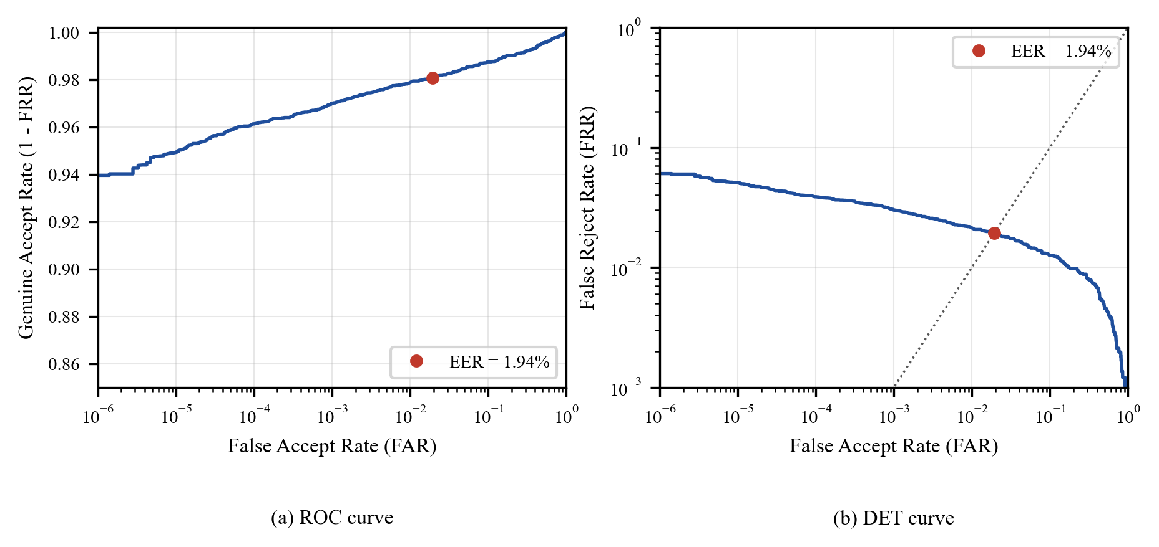
ROC and DET curves
Genuine-accept rate falls only gradually as false accepts are pushed down: a few badly segmented images set the floor.
Notes:
Standard biometric view (30 s). Left: ROC. Right: DET on log axes with the equal error point marked. The curve flattens at about 3 to 4 percent false rejects even at very strict thresholds. That floor comes from a few genuine pairs where one image is badly segmented, which is why better pupil localization is our first piece of future work.

Slide 9
Security is a dial, not a number
Security level | Threshold | False accept | False reject | Attacker in 5 tries
Balanced | 0.442 | 1.73% | 1.96% | ≈ 8.3%
High security (server default) | 0.423 | 0.13% | 2.91% | ≈ 0.6%
Maximum security | 0.406 | 0.011% | 3.81% | ≈ 0.06%
Thresholds were chosen on the tuning subjects and the rates measured on the test subjects, so they transfer. Maximum security cuts false accepts about 150-fold; the price is two extra false rejects per 100 genuine tries.
Notes:
Three settings (40 s). The balanced setting is the equal-error point; high and maximum security are the points where the tuning-set false-accept rate is 0.1 percent and 0.01 percent. The test-set rates agree closely, which is the evidence that the thresholds generalize. The last column assumes five independent attempts with different impostors, which is what the lockout allows per five minutes. The server default is the high-security level.

Slide 10
What each design choice is worth
4.0×
higher error without rotation compensation
Rotation shifts matter most: a tilted head misaligns the code.
The radius prior and inner-band restriction each help by about 0.3 to 0.6 points.
The mask helps least, because invalid pixels are already filled before filtering.
Notes:
Ablations (40 s). We removed one design element at a time and re-evaluated on the test set. Rotation compensation is the biggest: 1.94 to 7.85 percent. The iris-radius prior is a property of the fixed-distance camera, so it ties us to this kind of image. The mask has the smallest effect, and we say so rather than overselling it.

Slide 11
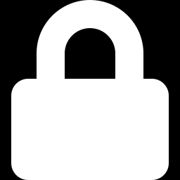

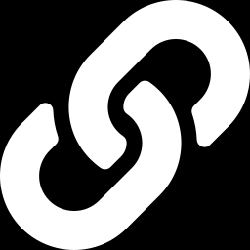
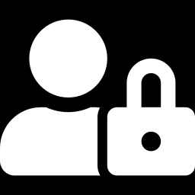
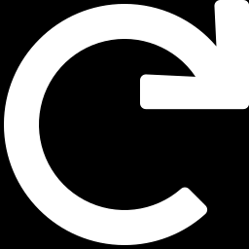

Defences around the biometric core
Encrypted, account-bound templates
Keys kept apart
Tamper-evident audit log
Fernet encryption; a template copied to another account is rejected.
Outside the data folder, owner-only, passphrase option, rotatable.
HMAC hash chain: edits, deletions and reordering are flagged.
Rate limits, no enumeration
Replay rejection
Hardened input and access
Per account and per client; unknown users look like wrong users.
Exact copies of the enrollment or an accepted image are refused.
Header-checked 5 MB uploads, hidden scores, localhost, admin mode.
Plus: duplicate-iris refusal that does not name the other account, and secure deletion.
Notes:
Security layer (60 s). Biometrics can't be revoked, so the stored template matters as much as the matcher. Walk the six cards. Templates are encrypted and bound to the account name, so swapping ciphertexts fails. The audit log is a keyed hash chain; the Audit tab shows whether it is intact and we will tamper with it live. Unknown usernames get the same denial as wrong ones. Replay: two different captures of the same eye were never closer than 0.052 in our data, so an identical copy is rejected. Uploads are checked from the header, never written to disk, and match scores are hidden by default because a visible score enables hill-climbing.

Slide 12
Live demo
1
Pipeline view
4
Genuine login granted
2
Enroll alice
5
Replayed photo denied
3
Same eye refused as a duplicate
6
Lockout, audit log, tamper alarm
Notes:
Demo (8 min). Follow the Demo and Viva Kit. Before this slide: scores switched on (IRIS_DEMO_SCORES=1), data\store reset, server running at 127.0.0.1:8501, sidebar on High security 0.423. Sequence: Pipeline view with S1088L01; enroll alice with S1088L01; try mallory with S1088L02 (refused); enroll bob with S1193L01; verify alice with S1088L03 (granted, about 0.217); replay alice with S1088L01 (denied, 0.000); repeat failures to trigger the lockout; open the Audit log and show the integrity banner. Optional: edit one log row and refresh to show the tamper alarm. Tip: if the Audit log table looks squashed when the tab first opens, click another tab and back.

Slide 13

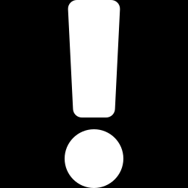
Threat model: covered and not covered
Covered
Open risks
Stolen database file
Fake irises: print, lens, screen
Swapped or edited templates
Fresh recapture of a genuine image
Username probing and guessing
Compromised host (key and data together)
Replayed image files
Rollback to an old database snapshot
Malicious uploads
Lockout used to block a victim
Edited audit log
Each covered item has an automated test; five were also disabled one at a time to confirm their tests fail.
Notes:
Threat model (45 s). Be explicit about what we do not stop: presentation attacks such as a printed iris, a fresh recapture of a genuine image, a compromised host, rollback of the whole database, and the fact that the lockout can be abused to lock out a victim. A per-client limit can also be dodged by opening new sessions, so a real deployment needs network-level limits. Saying this first is stronger than being asked.

Slide 14
Privacy: strong on storage, weak on revocation
Principle | Status | In this system
Data minimization | Provided | Only the code and mask are stored; eye images stay in memory.
Confidentiality | Provided | Encrypted, authenticated and bound to the account.
Disclosure to others | Provided | Refusals do not name who holds an iris.
Erasure | Partial | Deleted templates are overwritten; no self-service button.
Irreversibility | Not provided | Images resembling the eye can be rebuilt from binary codes.
Unlinkability | Not provided | One iris gives comparable codes in every system.
Renewability | Not provided | A compromised iris cannot be replaced.
Principles from ISO/IEC 24745; GDPR Article 9 and India's DPDP Act 2023 inform the analysis. We do not claim legal compliance.
Notes:
Privacy (40 s). The rubric asks for security and privacy analysis. Good on data minimization and confidentiality. Weak on the three template properties of ISO 24745: irreversibility, unlinkability and renewability. Binary iris templates are lossy, but images resembling the original eye have been reconstructed from them in the literature, and the same iris yields comparable codes in every system. Encryption lowers the chance of a leak but does not remove the consequence if the key is also stolen. The remedy is cancelable templates, which is future work. We map to GDPR and DPDP principles but do not claim compliance.

Slide 15

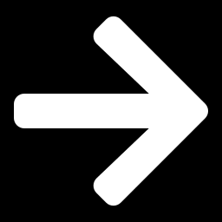
Limitations and next steps
Limitations
Next steps
One dataset and one sensor; the radius prior is tied to a fixed-distance camera.
Test subjects were not strictly blind: segmentation was debugged on outliers from the whole dataset.
Poorly segmented, occluded eyes set the error floor.
No liveness detection, and no confidence intervals yet.
Learned segmentation for occluded eyes.
Presentation-attack detection: pupil response, texture analysis.
Cancelable templates so a leak can be revoked.
Bootstrap confidence intervals; other sensors and cross-session data.
Notes:
Limitations and next steps (30 s). We state the limitations first because they are real: one dataset, not strictly blind, segmentation floor, no liveness. Next steps follow directly from the evidence: better pupil localization lowers the error floor, liveness detection closes the biggest open attack, and cancelable templates fix the privacy gap.

Slide 16
Conclusion
A complete iris authentication system, evaluated on subjects it never tuned on: 1.94% equal error rate and 96.5% rank-1 identification.
A security layer that was tested and attacked, with its open risks stated: no liveness detection, host compromise, non-revocable templates.
Next steps: learned segmentation, liveness detection and cancelable templates.
Notes:
Close (30 s). Three takeaways, then invite questions. One: a complete iris authentication system evaluated on subjects we never tuned on, 1.94 percent equal error rate. Two: a security layer that we tested and attacked, with the open risks stated rather than hidden. Three: the next steps follow from the evidence: better segmentation, liveness detection, cancelable templates. Then say: we are happy to take questions, and we can show any part of the demo again.

