Slide 1
Introduction to K2E Devices
KeyStone Training
Multicore Applications
Ran Katzur, Senior Applications Engineer, Training Lead

Slide 2
Agenda
KeyStone Device Overview
Introducing K2E (Edison)
K2E Software
For More Information

Slide 3
KeyStone Device Overview

Slide 4
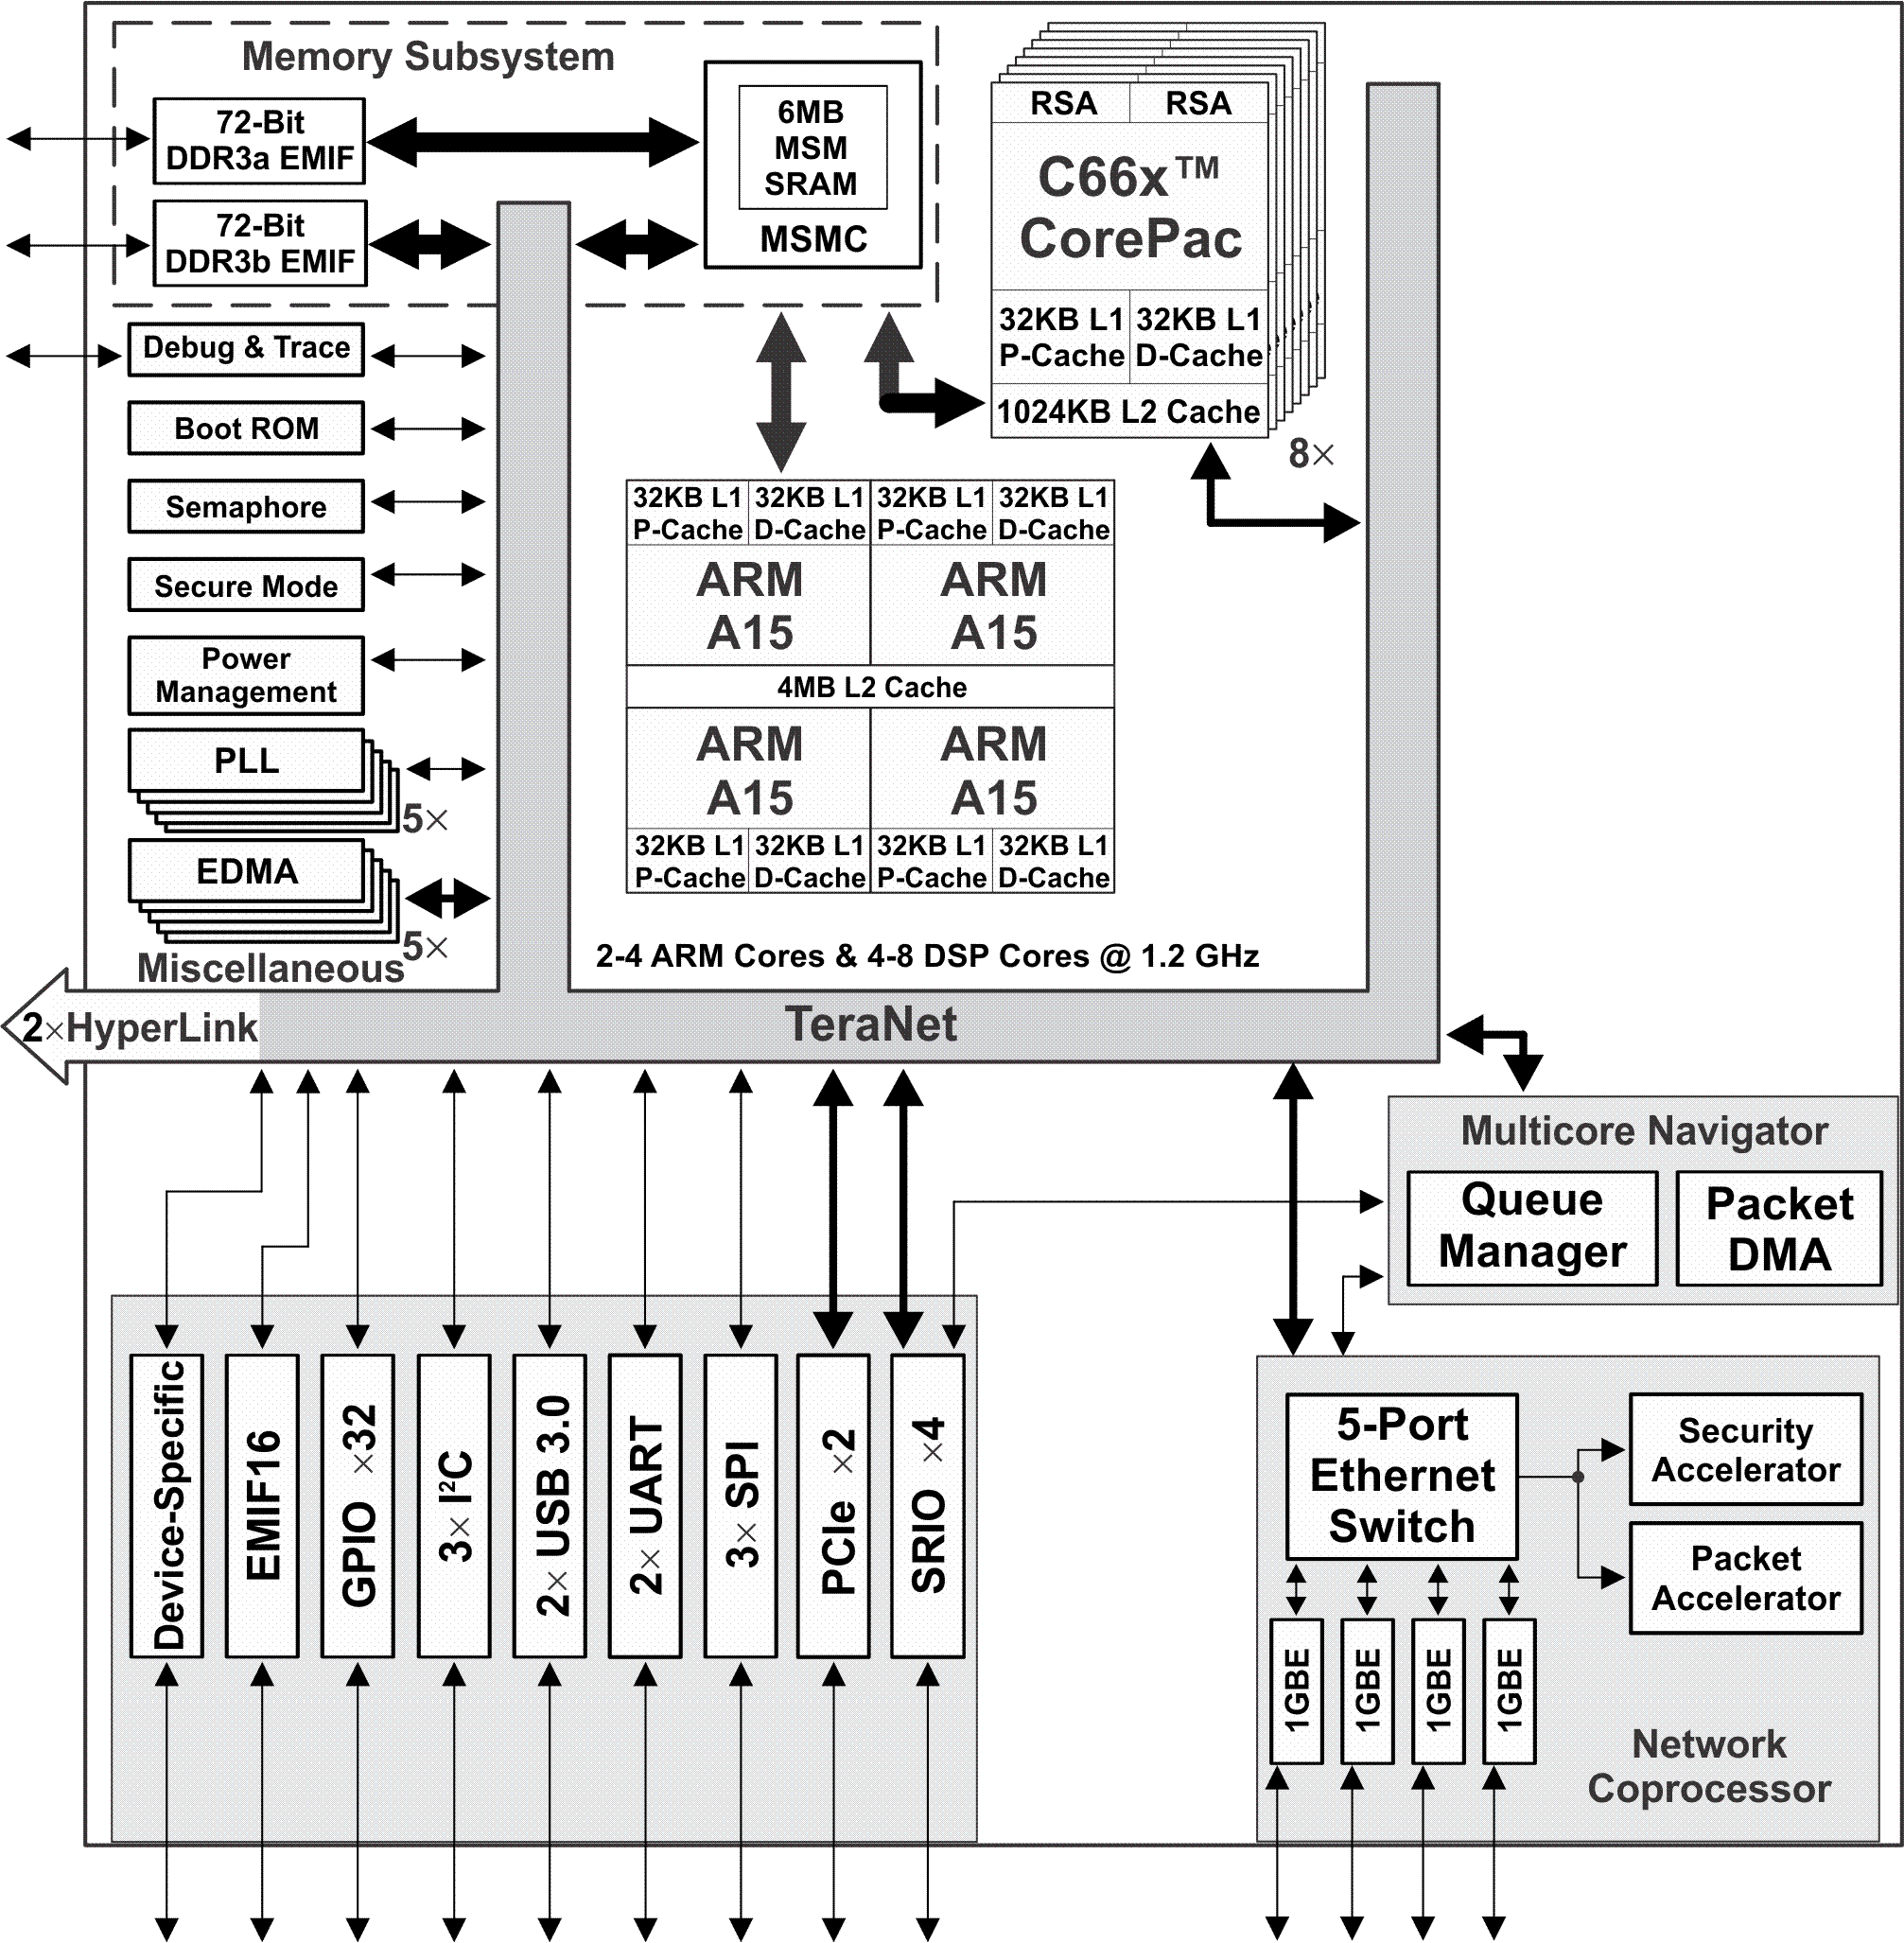
Keystone II: K2H/K2K Devices
High-performance ARM + DSP
Memory Subsystem:
Multi-bank shared memory
32- to 36- (40) bit translation
Smart access arbitration
Error detect/protect/correct
Multicore Navigator: HW routing
NETCP: HW acceleration
Lots of connectivity:
High bit-rate peripherals: SRIO, PCIe, Ethernet
Device-specific: TSIP
HyperLink: Seamless interface
TeraNet:
Non-blocking
Smart arbitration
Fast and wide

Slide 5
Keystone I: C667x Devices
Memory Subsystem
High end of the market for signal processing:
Amazing performance
Great SOC features
Challenges for broad market:
Power consumption 10-15W
Prices reflect performance
DDR3 EMIF
MSM
SRAM
MSMC
Debug/Trace
Boot ROM
Semaphore
C66x™
Power
CorePac
Management
PLL
L1P
L1D
x3
Cache/RAM
Cache/RAM
EDMA
L2 Memory Cache/RAM
x3
1 to 8 Cores @ up to 1.25 GHz
HyperLink
TeraNet
Multicore Navigator
Queue
Packet
Manager
DMA
x2
x4
t
T
e
h
C
R
I
n
c
Security
e
P
O
r
t
h
Device Specific I/O
A
Device Specific I/O
e
i
c
GPIO
2
I
S
I
C
U
I
h
w
t
Accelerator
P
R
t
S
i
S
E
w
S
Packet
I
Accelerator
I
M
x2
G
S
Network Coprocessor
Notes:
5
NEW

Slide 6
Keystone I: C665x Devices (Gauss)
Memory Subsystem
C6654
Signal Processing Engine
Maintains most advantages of KeyStone, except:
Few, more generic, accelerators
No NETCP
No TSIP, but McBSP
Smaller, slower DDR, less pins
32-Bit
MSMC
DDR3 EMIF
Debug/Trace
Boot ROM
Semaphore
Timers
C66x™
Security /
CorePac
Key Manager
Power
Management
32KB L1P
32KB L1D
PLL
Cache/RAM
Cache/RAM
x2
1024KB L2 Cache
EDMA
1 Cores @ 850 MHz
Typical applications:
Power limitations (sealed box)
Performance requirements that can be achieved with 1-2 DSP cores
No requirement for accelerators or TSIP
Smaller DDR requirements
TeraNet
Multicore Navigator
Queue
Packet
Manager
DMA
x2
x2
x2
O
P
T
I
P
Ethernet
I
P
S
MAC
EMIF16
P
I²C
R
P
e
G
U
A
S
B
I
U
c
C
M
P
SGMII
Notes:
6
NEW

Slide 7
Embedded Processing Domain

Slide 8
TI Embedded Processing Devices

Slide 9
Introducing K2E (Edison)

Slide 10
K2E Features Summary
Powerful Quad-ARM A15 CorePac with 0-1 DSP CorePac support, as needed
Robust Ethernet options:
Up to 2 ports 10G and 8 ports 1G
Multiple MDIOs support multiple physical Ethernet interfaces
Optimized external data movement:
Standard high-bit rate interfaces: Ethernet and PCIe (No SRIO)
EDMA and Multicore Navigator
Optimized internal traffic, priorities, arbitrations
TeraNet bus
MSMC
Fast (1600 MHz), wide (72 bits), and large (8G) external memory; DDRA only

Slide 11
Comparing K2H and K2E Architecture
 | K2H | K2E
ARM CorePacs | 2 or 4 | 1, 2, or 4
DSP CorePacs | 4 or 8 | 0 or 1
DSP Maximum Clock | 1.2 GHz | 1.4 GHz
External Memory | DDRA and DDRB | DDRA only
MSMC Memory (Shared L2) | 6 MB | 2 MB
PLL | 5x | 3x
SRIO | 4x (20 Gbaud) | NA
Multicore Navigator | 2 QMSS (16K queues) | Single QMSS (8K queues)
Hyperlink | 2x | 1x
5-Port 1GB Switch | 1x | 1-2x
3-Port 10GB Switch | NA | 1x
USIM (Universal Subscriber Identity Module) | NA | 1x
TSIP | NA | 1x
USB 3.0 | 1x | 2x
Secure Mode | No | Yes
MDIO | 1x | 3x

Slide 12
Typical K2E Application Requirements
Small, medium, or large I/O bandwidth
Efficient signal-processing calculations; Fixed-point or floating-point or both
Efficient power and performance:
ARM A15 has high processing-to-power ratio
NETCP offloads network processing
Communication and networking interfaces
2x 10G and 8x 1G
2x PCIe and 3x USB

Slide 13
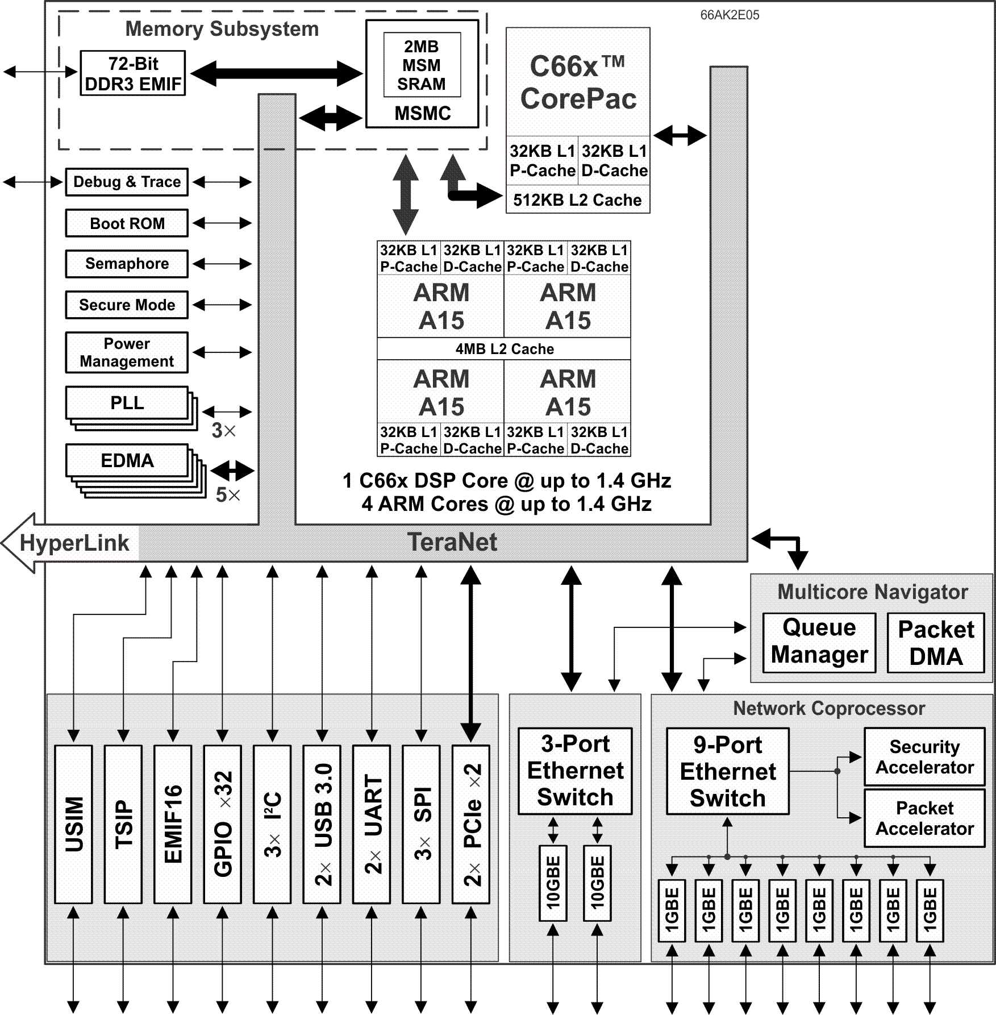
66AK2E05 Key Features
Powerful microcomputer with DSP coprocessor
Quad-ARM A15 CorePac
1x Queue Manager supports up to 8K queues
1x Network Coprocessor (NETCP)
1x 3-port 10GBE Switch Subsystem
10 Ethernet ports:
2x 10G
8x 1G
Telecommunications Serial Port (TSIP)
2x PCIe and 2x USB 3.0 to support solid-state drive
Notes:
13
NEW

Slide 14
66AK2E05 Applications
Communication and networking
Fast hard-disk storage (PCIe, USB)
Imaging, including analytics
Example: Defense communication systems
Advantages
Integrated SOC solution
High-speed communication and disk bandwidth for data storage
DSP enables on-the-fly data processing
Ability to scale up using HyperLink, or scale down using 66AK2E02
Low power (compared to other solutions)
Notes:
14
NEW

Slide 15
TI Embedded Processing Devices

Slide 16
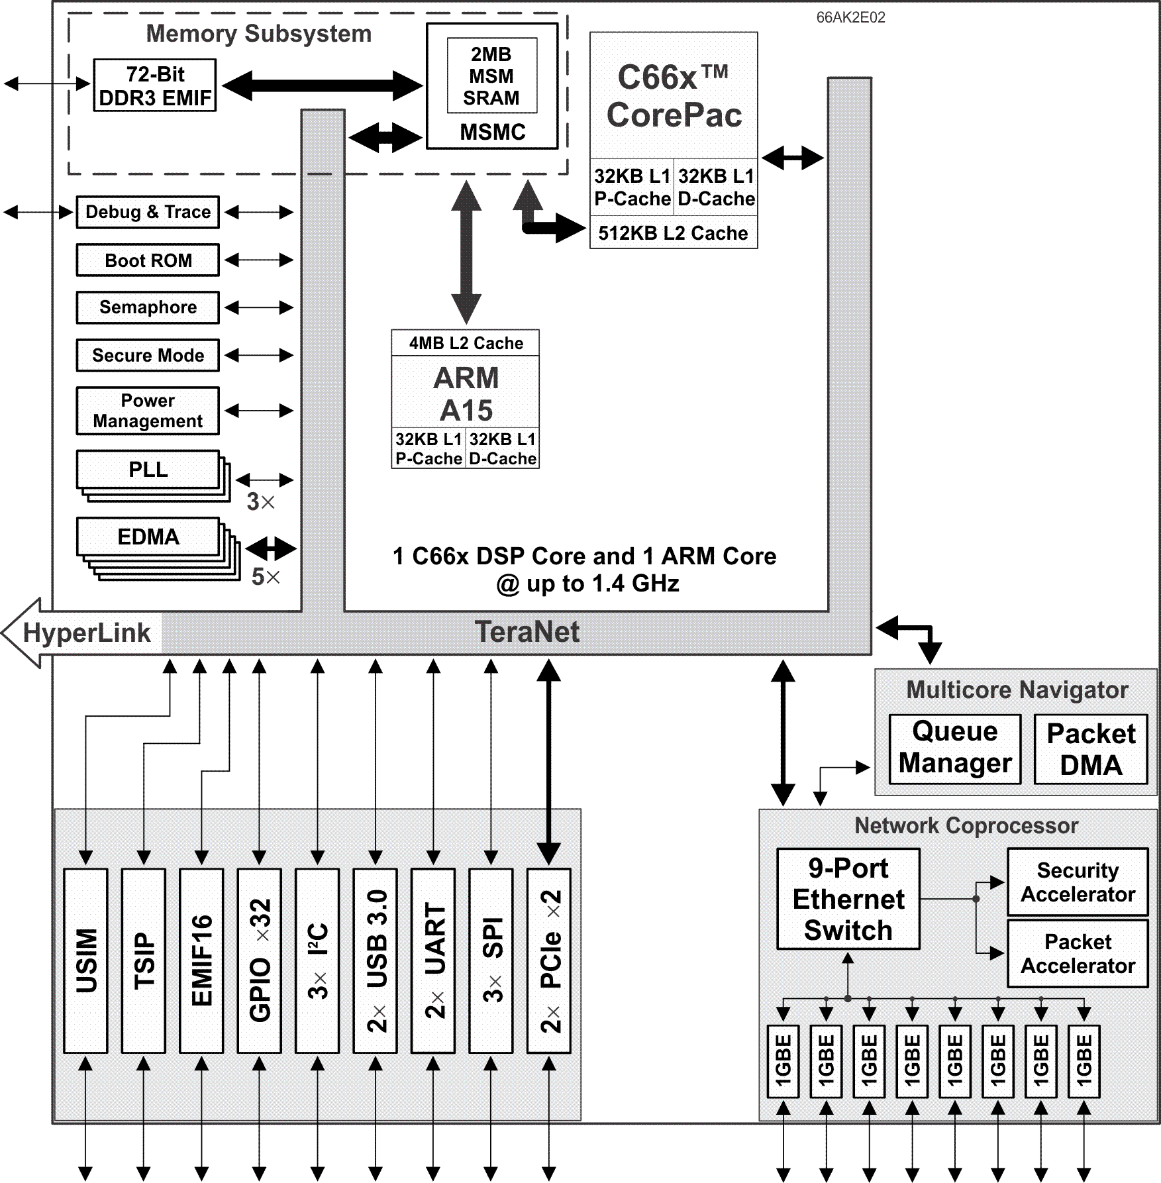
66AK2E02 Key Features
Scaled-down version of 66AK2E05
High connectivity, but does not have 10GBE
2x PCIe and 2x USB 3.0 enables fast disk storage
Communication, storage with some analytics
Notes:
16
NEW

Slide 17
66AK2E02 Applications
Smart Grid and Smart Metering
Factory automation
Building control
Aerospace and defense
Industrial networking and Fieldbus protocols (IEC 61158)
Medical imaging
Notes:
17
NEW

Slide 18
TI Embedded Processing Devices

Slide 19
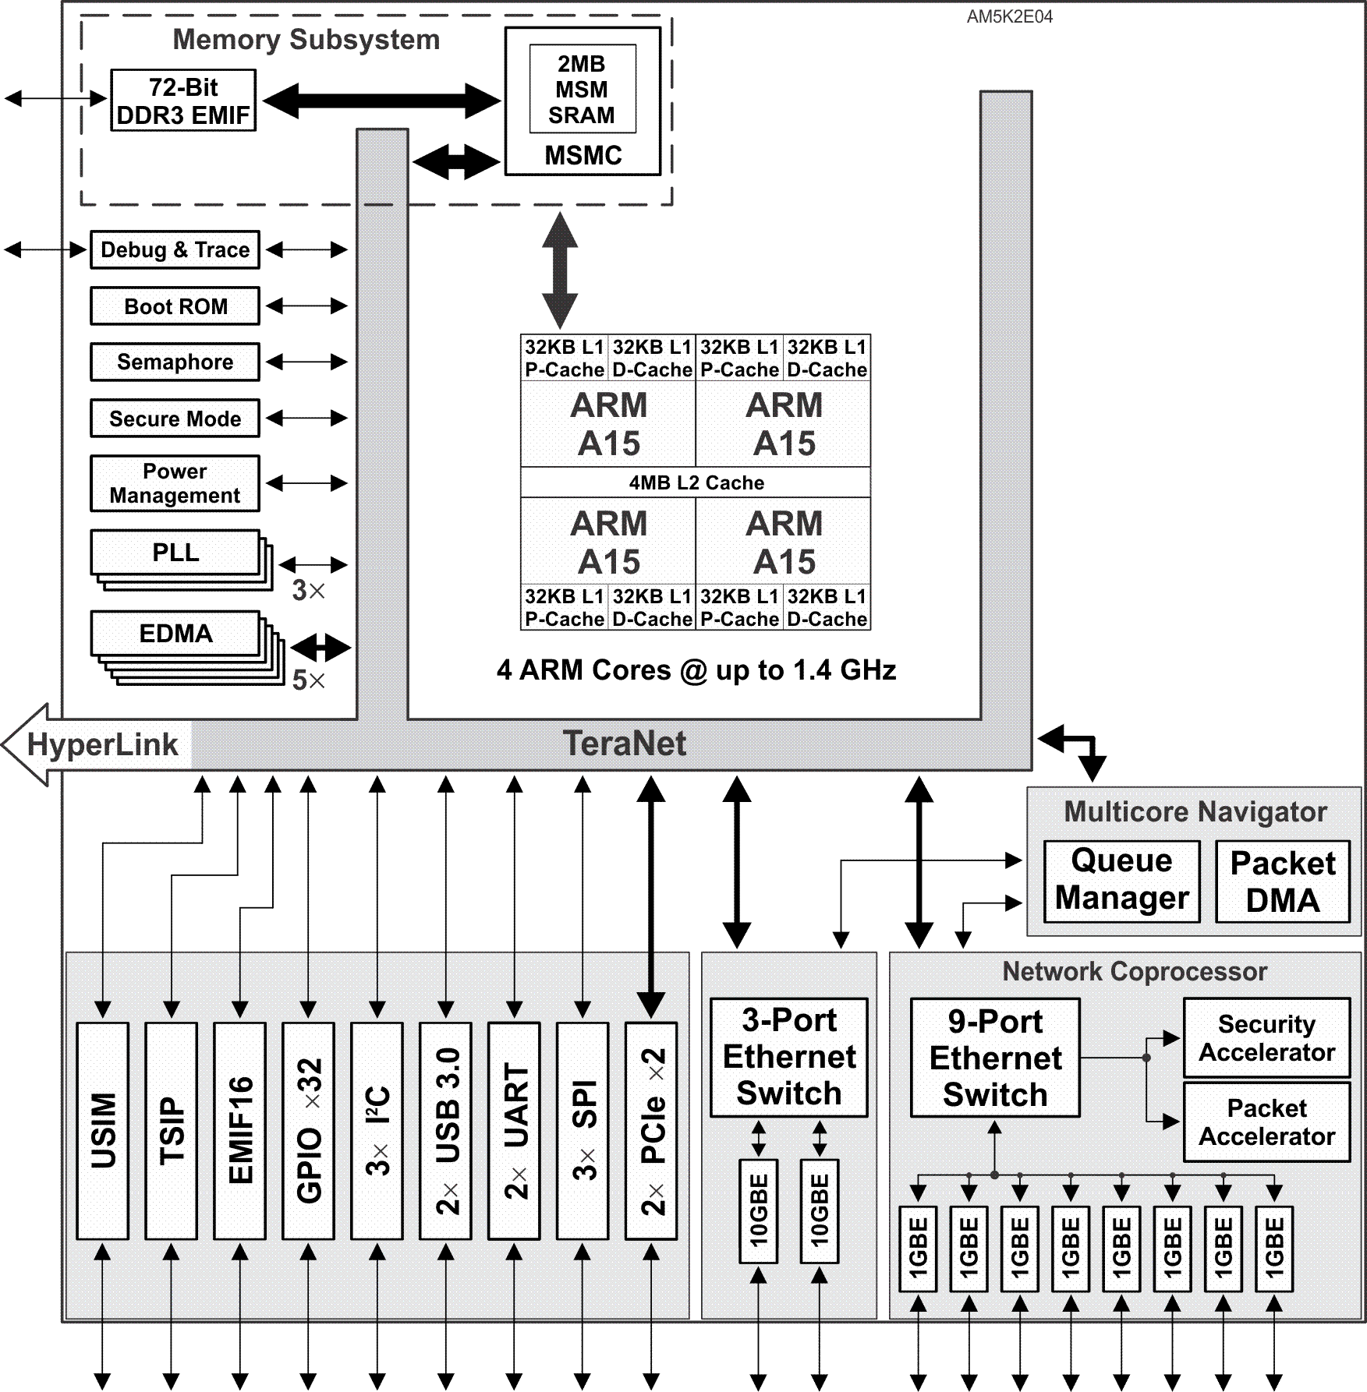
AM5K2E04 Key Features
ARM-only TI multicore device (First in the KeyStone architecture)
Quad-ARM A15 CorePac
1x Queue Manager supports up to 8K queues
1x Network Coprocessor (NETCP)
1x 3-port 10GBE Switch Subsystem
Telecommunications Serial Port (TSIP)
2x PCIe and 2x USB 3.0 to support solid-state drive
Notes:
19
NEW

Slide 20
AM5K2E04 Applications
Networking:
Enterprise
Service Provider
Data Center/Cloud
Industrial network and Fieldbus protocols (IEC 61158)
Other industrial applications that do not require DSP
Notes:
20
NEW

Slide 21
AM5K2E04 Wins
Defense Munitions
Power efficiency
High-performance processing
Large amount of internal memory
Efficient ARM instructions
Flight Control Panel
High-performance, Linux-based processor
Open-source applications available
Efficient memory and internal bus utilization (MSMC, TeraNet)
Support for big Endian
Notes:
21
NEW

Slide 22
TI Embedded Processing Devices

Slide 23
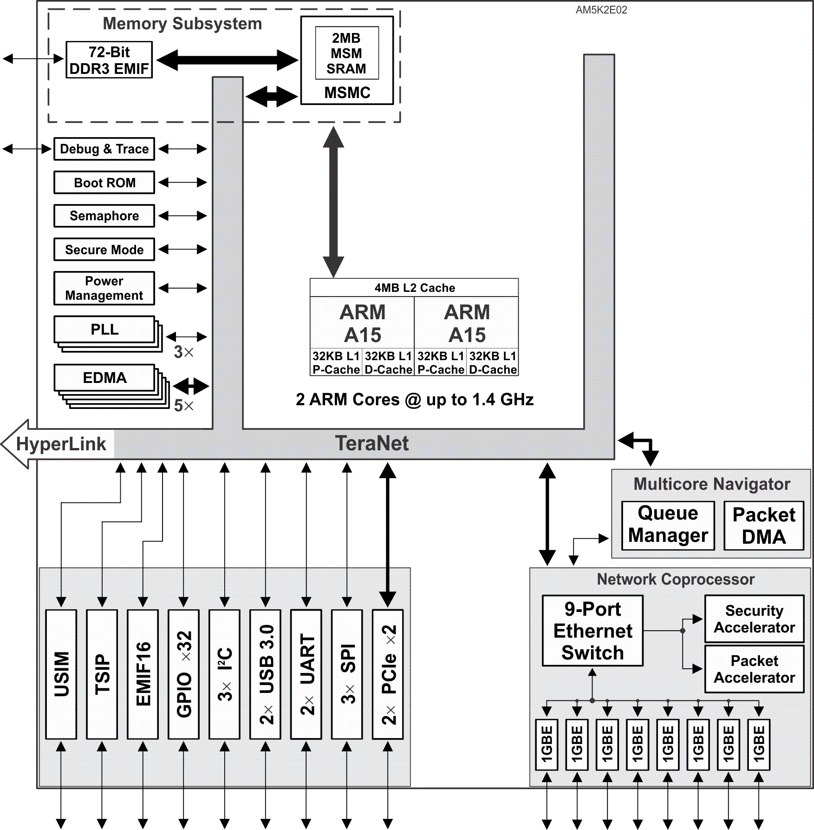
AM5K2E02 Key Features/Applications
Scaled-down version of AM5K2E04
Dual-ARM A15 CorePac
1x NETCP
10GBE not included
Supports low-end applications of AM5K2E04
Notes:
23
NEW

Slide 24
TI Embedded Processing Devices

Slide 25
K2E Software

Slide 26
K2E Software Support
MCSDK _03_01_XX supports K2E and K2L (also, K2K and K2H):
Contiguous memory (cmem) allocation for ARM User Space enables internal and external DMA-based communication.
User Space IO (UIO) driver support for mmap interface, interrupt handling, and chip power control
TSIP LLD: MCSDK_3_1_0_2\pdk_keystone2_3_01_00_02\packages\ti\drv\tsip
mmap LLD: MCSDK_3_1_0_2\pdk_keystone2_3_01_00_02\packages\ti\runtime\mmap
Automatic setting of EVM frequency based on the chip EFUSE value instead of environment variable in Uboot

Slide 27
For More Information
Datasheets:
66AK2E05/02: http://www.ti.com/lit/SPRS865
AM5K2E04/02: http://www.ti.com/lit/SPRS864
Product Folders:
66AK2E05: http://www.ti.com/product/66ak2e05
66AK2E02: http://www.ti.com/product/66ak2e02
AM5K2E04: http://www.ti.com/product/am5k2e04
AM5K2E02: http://www.ti.com/product/am5k2e02
For questions regarding topics covered in this training, visit the support forums at the TI E2E Community website.

