Slide 1
Introduction to Linaro Toolchain
Embedded Processors Training
Multicore Software Applications
Literature Number: SPRPXXX

Slide 2
Agenda
Topic 1
Topic 2
Topic 3
Topic 4

Slide 3
Topic 1
Linaro Toolchain

Slide 4
Toolchain for Sitara Devices (but it is true for other ARM based devices as well)
A tool chain is a collection of programs used to compile and build applications or libraries and generally includes several additional tools useful for debugging or troubleshooting issues.
Starting with SDK 6.0 we have switched from using a GCC based tool chain built by TI and moved to a GCC based tool chain built by Linaro.
Notes:
Usually when someone is referring to a toolchain they are referring to the gcc compiler since that is the only program people use. However, the gcc application actually invokes other tools within the toolchain but provides a single interface for users to make their lives easier.

Slide 5


Cross Compiling
Whenever you are compiling an application or library for a platform other than the one it will be ran or used on then you are “cross compiling”
Is this considered cross compiling?
Compiling an application on your Linux laptop to run on your Linux desktop.
Compiling a Windows application on a Macintosh
Compiling a Linux application on your PC for your Sitara EVM or Beaglebone.
Notes:
http://en.wikipedia.org/wiki/Cross_compiler

Slide 6
Compiling a Simple Program

Slide 7
Compiling a Simple Program
To use your tool chain you need to add it to your environment’s PATH variable. This allows you to invoke your tool chain by simply calling it by its name instead of having to specify the entire path.
Adding your tool chain’s path to your environment’s path
export PATH=<toolchain dir>:$PATH
The simplest way to build an application is by listing the sources and specifying the name of the binary to be generated
arm-linux-gnueabihf-gcc <C sources> -o <executable name>
You can add other flags such as the debug flag
arm-linux-gnueabihf-gcc <C sources> - g -o <executable name>
Sitara Tool Chain is part of “Linux Development Kit” or Linux-devkit

Slide 8
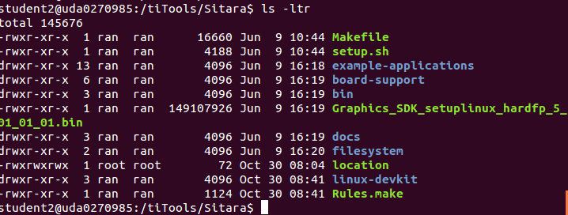
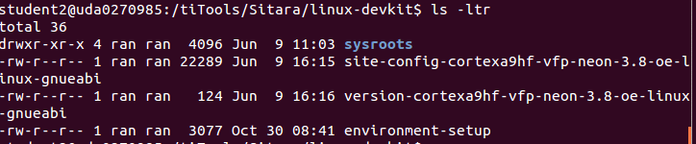
Linux-devkit part of Linux SDK
Notes:
PMU – Programming Multi-channel Unit (The ARM module)
LPDDR - Low Power Double Data Rate memory 266MHZ
DDR3 – 400MHZ
DDR3L – low voltage DDR3
OCMC – On chip memory controller

Slide 9
Understanding Linux-devkit
Linux-Devkit
Target Headers and Libraries
Host Tools Directory
Environment-setup
Toolchain
GDB
Qt compiler
Etc..
Common environment variables
that affects compiling
Target’s headers and
libraries

Slide 10
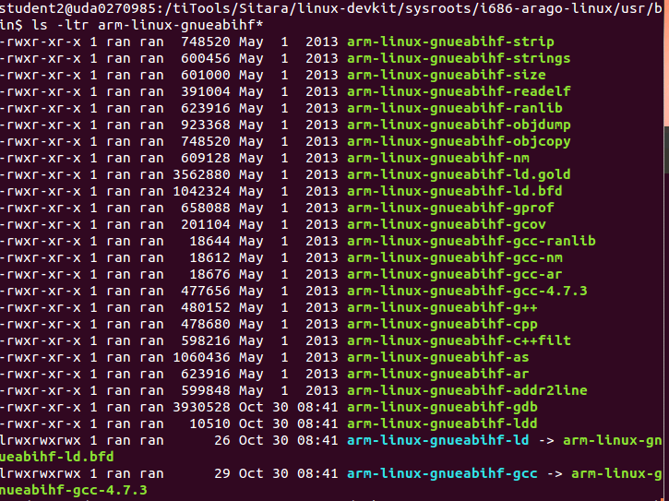
Code generation Location

Slide 11
Linking to External Libraries
When linking against non standard C libraries and headers the compiler needs to be told what library to link against
This is done by manually passing the library name to the compiler. (Usually make files already handle this for you)
Find the name of the library file that is needed. Remove lib from the front and remove the extension. Then add -l to the front.
Example:
Link against PNG library (libpng.so)
libpng.so -> png -> -lpng
arm-linux-gnueabihf-gcc <C sources> -lpng -o <executable name>
And don’t forget the Path
Notes:
http://www.cs.swarthmore.edu/~newhall/unixhelp/howto_C_libraries.html
http://stackoverflow.com/questions/5479584/compiling-or-using-libxml-using-c-on-osx

Slide 12

Environment-setup
Purposes:
Point the compiler to target’s headers and libraries
Automatically adds the tool chain binaries to your PATH.
Sets environment variables that affects cross compiling
Set compiler options specific to the SOC
Using environment-setup:
Go to SDK’s linux-devkit
Modify the file environment-setup if needed
source environment-setup

Slide 13
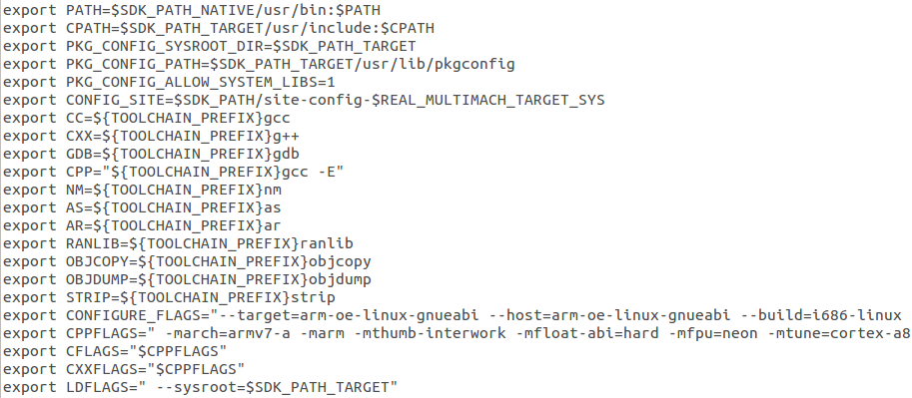
Environment-setup Example

Slide 14
Environment-setup Example
Setting tool chain path

Slide 15
Environment-setup Example
Setting environment variables that
point to common tool chain tools.

Slide 16
Environment-setup Example
SOC specific options, alters the compiler’s
default header and library search path

Slide 17
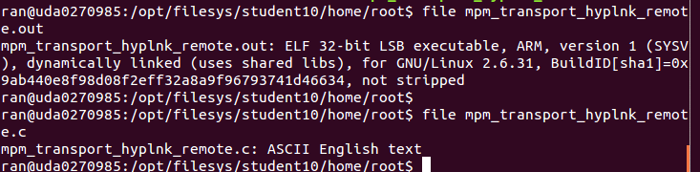
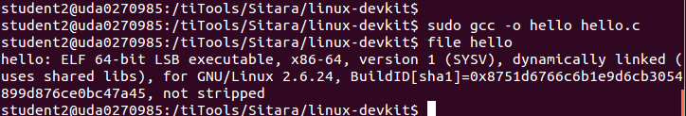
Compiler Path
If the compiler name and path are not explicitly given, the compiler may build the executable for the host architecture and not the target architecture
The file command can tell you what compiler built the file

Slide 18
Compiler Search Path
The compiler must know where to look for libraries and headers. If the user does not specify these paths explicitly, the compiler may find headers and libraries that do not belong to the desired target
Host Contamination – When cross compiling software/compiler finds and uses headers and libraries that belong to the host
Sysroot – Compiler option that set the compiler’s default search path.

Slide 19
Compiling User Space vs. Kernel Space
Example Kernel Space/BSP Software
U-boot, kernel and kernel device drivers
Example User Space Software
Qt, Gstreamer and Busybox
Kernel space software is protected thus it should not be exposed to the environment variables set by environment-setup for the user space
Kernel space software should be portable to support multiple platforms

Slide 20
Software Build Systems
For simple application, a “simple” Makefile and make utility was enough to build an executable
Difficulties:
Portable – the same code for multiple architectures
Cross compiling – find the right tools, headers and libraries
Build Systems – set of tools and scripts used to build and deploy/install applications or libraries on different architectures
GNU build system – Auto-tools is used by SDK
Automat the process of building portable executables
Config
Make install
Make
Notes:
It can be difficult to make a software program portable: the C compiler differs from system to system; certain library functions are missing on some systems; header files may have different names. One way to handle this is to write conditional code, with code blocks selected by means of preprocessor directives (#ifdef); but because of the wide variety of build environments this approach quickly becomes unmanageable. Autotools is designed to address this problem more manageably.

Slide 21
Building with Auto Tools
/configure – Used to determine what compiler your using, supported compiler options, available libraries and allows users to determine which features to use and which features not
make – Builds the application
make install – Install binaries, headers to either a default location or user specified location.

Slide 22
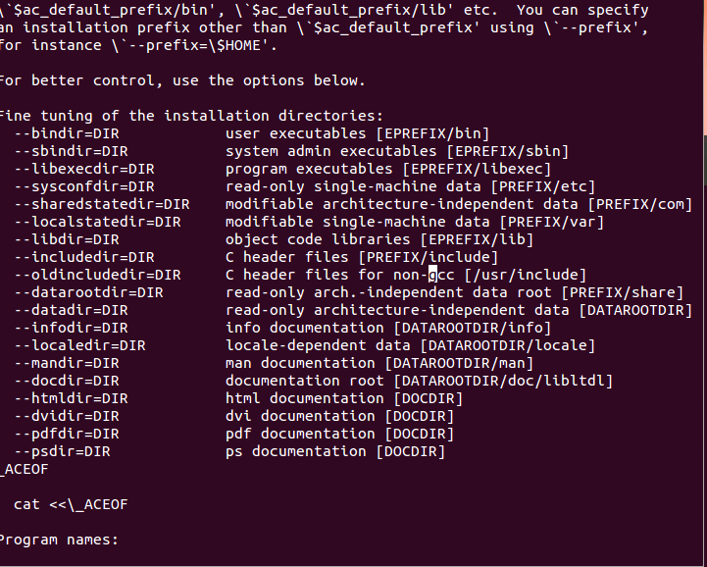
From the configure file

Slide 23
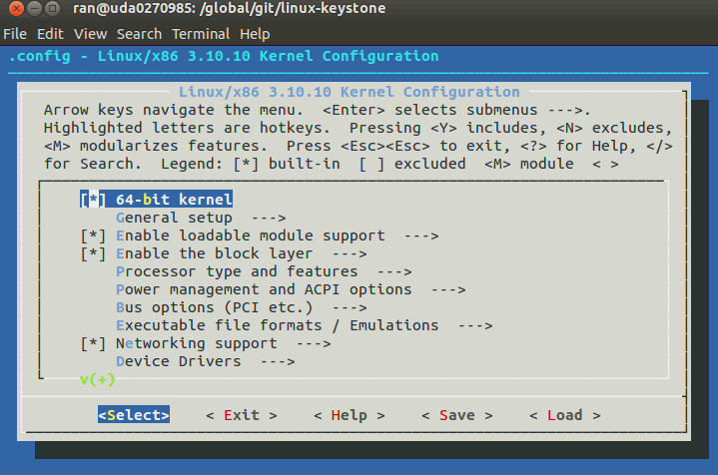
Configure GUI make menuconfig

Slide 24
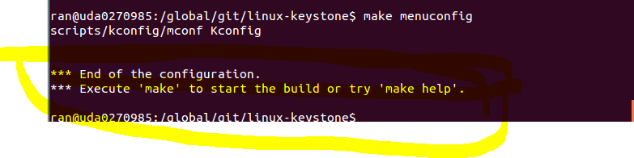
Configure GUI make menuconfig

Slide 25
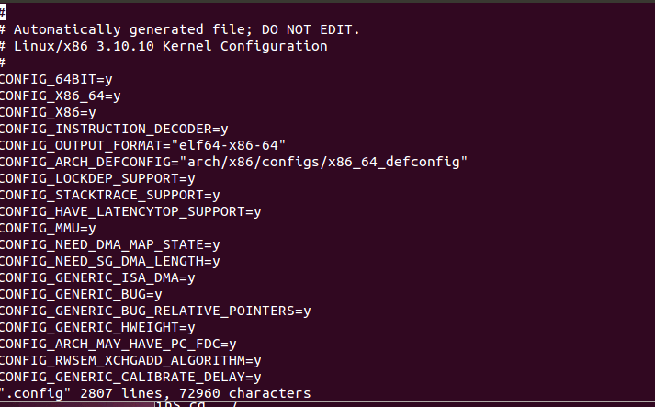
Configure using vi .config
Then you have to “make oldconfig” again

Slide 26
Configure – Cross Compile Options
Cross compiling software configure requires some options such as:
--build=build
The system on which the package is built.
--host=host
The system where built programs and libraries will run.
--target=target
When building compiler tools: the system for which the tools will create output.
Environment-setup creates a environment variable with all this information already filled!
And of course, the PATH must be defined (see next slide)
Notes:
http://www.gnu.org/software/automake/manual/html_node/Cross_002dCompilation.html

Slide 27
Configure without the right PATH

Slide 28
Configure Help
./configure –help
Display list of options that a user can use to influence the configuration and building of the piece of software.

Slide 29
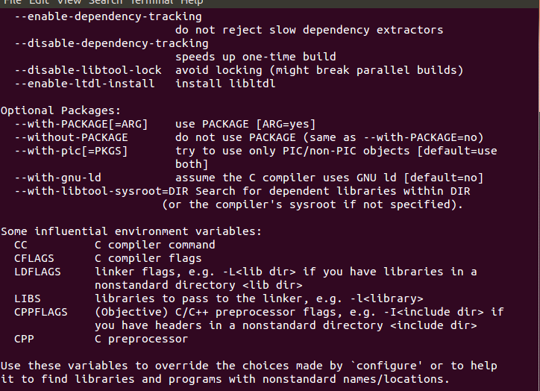
Configure Help

Slide 30
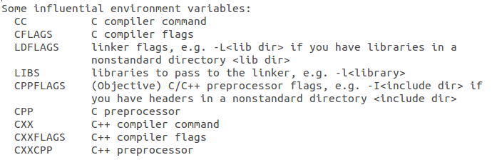
Configure – Important Environment Variables
Notes:
Going back at the configure help

Slide 31
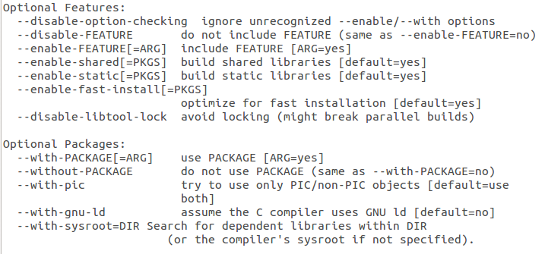
Configure – Feature Selection

Slide 32
Install Location
By default auto tools will install libraries and applications on the host in the local directory
The user may choose to change the install location, for example, to put it in a NFS directory
Easiest way to accomplish this is by setting the software’s default install location in the auto tools script

Slide 33
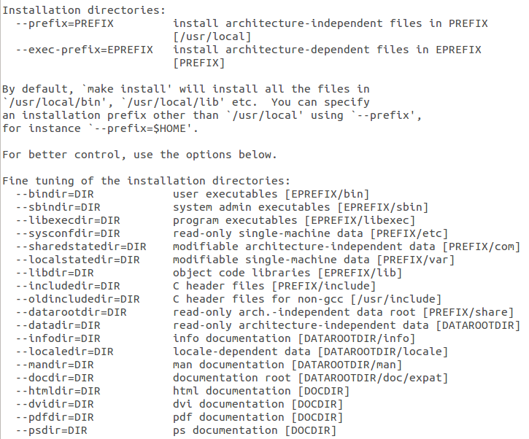
Configure Installation Options
Default root
Installation
directory
Usually don’t change

Slide 34
Configure Prefix Option
By using the configure prefix option you can alter the default location where configure installs libraries and applications.
The syntax is:
./configure --prefix=<new install location>

Slide 35
Deploying to the Target
Dynamically linked libraries and headers that are used by applications must be in the filesystem of the target
If the libraries (and the headers) are in the cross-compiler system they may not be visible to the target
The user must copy the contents of the directory where the libraries and headers are into the file system of the target (either ramfs, or mount or any other file system location)

Slide 36
Recap
What we learned?
How to manually compile simple software.
How to link to external libraries.
How to build an auto tools based program.
How to build with libraries not included in the SDK.
How to deploy cross compiled libraries to the target

Slide 37
Issues with Cross Compiling
Cross compiling problems are when:
Cross compiling is less common than natively compiling
Programs aren’t developed to be portable.
Programs may require host tools to be build before the actual application or library can be built:
Example: Qt and Python
Programs uses some build system that isn’t cross compiling friendly.
Developer doesn’t follow the proper standard for the build system to make things portable.
For each large application or library it may take different steps to compile successfully.

Slide 38
Native Compiling
Building the executable on the target (The same machine that the code will run on)
Benefits:
Don’t worry about host contamination
Native compiling is simpler and requires less configurations and settings
Draw Backs:
Building on an embedded device will be a lot slower than even building on a PC.
Building Qt on a PC takes about 3+ hours. Building it on the Beaglebone can take 14+ hrs
Compiling may fail due to a lack of memory.
Some distributions don’t provide the tool chain so it isn’t an option.

Slide 39
Different Approach – Build your own distribution
Open embedded/Yocto project is used to create distribution file system for any architecture
A ‘recipe” scripts contains all the information that is required to build applications and libraries.
There are Over 2000 for different systems
Benefits:
Open embedded makes handling dependencies simple.
Easy updating or Upgrading software
Reproducing the entire file system is easy.
Sitara provides a good starting point to use.
Handles licenses restrictions for you easily!
FREE!!!!!!!
Notes:
Add a halo

Slide 40
For More Information
Sitara Linux Software Developer's Guide: http://processors.wiki.ti.com/index.php/Sitara_Linux_Software_Developer’s_Guide
Sitara Linux SDK GCC Toolchain: http://processors.wiki.ti.com/index.php/Sitara_Linux_SDK_GCC_Toolchain
Linux EZ Software Development Kit (EZSDK) for Sitara Processors: http://www.ti.com/tool/linuxezsdk-sitara
For questions regarding topics covered in this training, visit the support forums at the TI E2E Community website.

