Slide 1
Introduction to Packet Accelerator (PA)
Notes:
Hello, and welcome to the keystone training for the network coprocessor – packet acelerator.

Slide 2
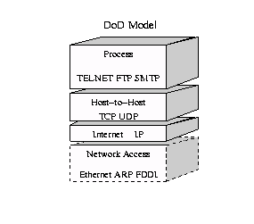

Slide 3
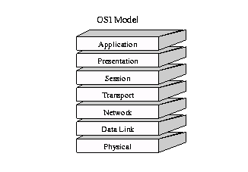

Slide 4
The 7 layers of OSI (Open Systems Interconnection)
7 Application Layer
6 Presentation Layer
5 Session Layer
4 Transport Layer
3 Network Layer
2 Data Link Layer
1 Physical Layer

Slide 5
Layer 4 - UDP, TCP, DCCP, SCTP
Some Common Ports
Port | Protocol | Usage
1 | TCP/UDP | TCPMUX (TCP port Service Multiplexer)
20 | TCP | FTP
25 | TCP | SMTP (simple mail transfer protocol)
67-68 | UDP | BOOTP (also used as DHCP)
69 | UDP | TFTP (Trivial FTP)
80 | TCP | HTTP (Hypertext Transfer Protocol)
109 | TCP | POPv2 (Post office protocol)
110 | TCP | POPv3
1023 | TCP/UDP | reserved
1024-49151 | TCP/UDP | Registered ports
49152-65535 | TCP/UDP | Dynamic or private ports

Slide 6
Layer 3 - Ipv4, Ipv6, ICMP, ICMPv6, ECN,IGMP
IpSec (tunneling) – encryption of the IP addresses and assign new IP addresses (virtual Private Network)
Same destination might have multiple new IP addresses

Slide 7
Layer 2 - Ethernet 802.3, Token Ring 802.5, PPP, X.25, FDDI, ISDN, Frame Relay
ECN,IGMP

Slide 8
Sending and receiving a packet

