Slide 1
KeyStone IPC For Internal Audience Only
Multicore Applications
Ran Katzur
Acknowledge the help of Ramsey Harris

Slide 2
Agenda
KeyStone Hardware Support for IPC
IPC Issues
KeyStone IPC Support
Shared Memory IPC
IPC Device-to-Device Using SRIO
Demonstrations & Examples

Slide 3
KeyStone Hardware Support for IPC
Memory
Semaphores
IPC Registers
Multicore Navigator

Slide 4
Memory Resources
Shared memory
DDR
MSMC memory
Local “private” L1D and L2 memory both use global addresses
Semaphores
Block of 32 hardware semaphores used to protect shared resources

Slide 5
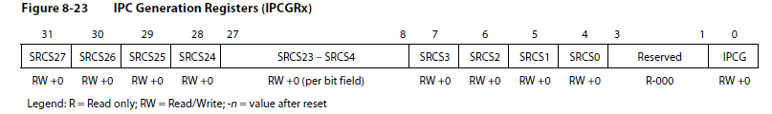
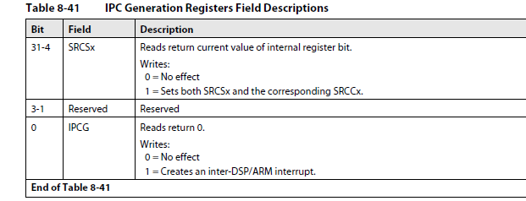
IPC Registers
Each CorePac has its own pair of IPC registers:
IPCGRx generating interrupt
IPCARx acknowledge interrupt (clearing)
28 bits can be used to define a protocol
28 concurrent sources are available for interrupt definition

Slide 6
Multicore Navigator
QMSS (Queue Manager Subsystem)
Descriptors carry messages between queues
Receive queues are associated with cores
Enables zero copy messaging
Infrastructure PKTDMA (Packet DMA) facilitates copying of messages between sender and receiver

Slide 7
IPC Issues
Memory
Coherency
Allocation and free
Race Condition
Linux Protection

Slide 8
Logical and Physical Memory
MPAX registers map the same logical memory to different physical memory
Must agree on the location and translation of the shared memory
Current solution: Use the default MPAX for shared memory
Proc 0
Shared Memory Region (DDR3)
Proc 1
0x90000000
0x90000000
Proc 0 Local Memory Region
Proc 1 Local Memory Region

Slide 9
Logical and Physical Memory: User Space ARM
MMU assigns (non-contiguous) physical locations for buffers.
Physical
Addresses
Memory
…
Page 1
CorePac
MMU
Page 2
Logical
Address
Page 3
Page 4
TLB
Page 5
Translation Lookaside Buffer (TLB)

Slide 10
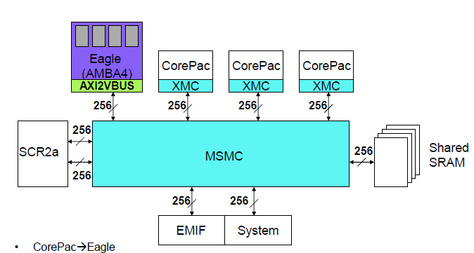
Coherency
ARM
A15
Write-invalidate
Read-snoop for MSMC SRAM
TeraNet
Write-invalidate
Read-snoop for
DDR3A
DSP L2 cache does not have coherency with the external world.
Q: What about ARM coherency?
A: It depends on which port interfaces with the MSMC:
Coherency from the TeraNet
Not coherent from DSP CorePac
Q: Can we use the MAR registers to disable cache?
A: Yes. But do we want to disable cache for a message? If the data in the message needs complex processing it is better to be cached.
Notes:
One still needs to do ensure consistency, with load and store exclusive instructions and data barriers (DMB); SIMPLIFY?
I think that the reason why there are two snoops is because there are two ways to get into the MSMC and from the MSMC to the memories, but the DSP to MSMC -

Slide 11
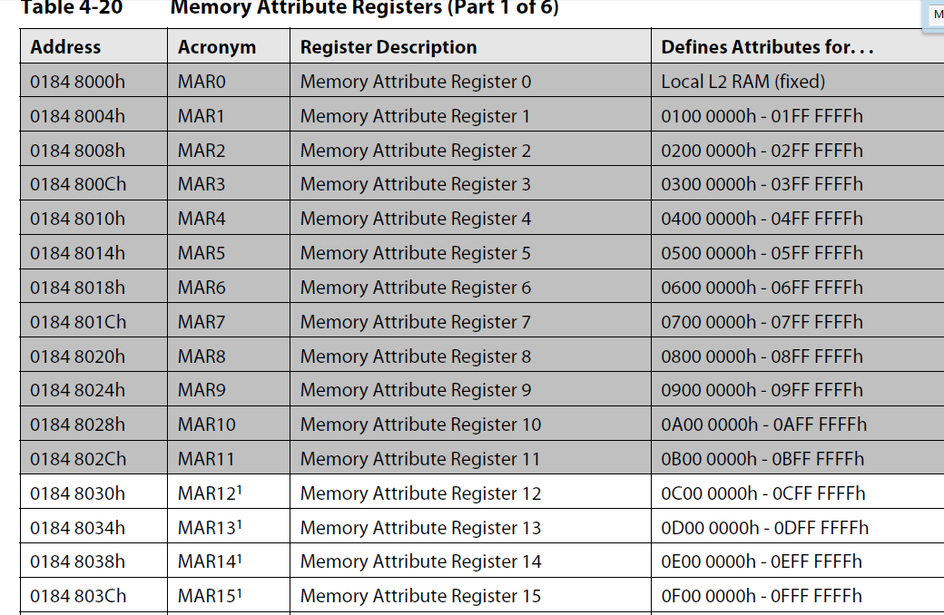
Coherency: MAR Registers
MAR0 is implemented as a read-only register. The PC of the MAR0 is always read as 1.
MAR1 through MAR11 correspond to internal and external configuration address spaces. Therefore, these registers are read-only, and their PC field reads as 0.
MAR12 through MAR15 correspond to MSMC memory. These are read-only registers, the PC always read as 1. This makes the MSMC memory always cacheable within L1D when accessed by its primary address range.
NOTE Using MPAX may
disable L1 cache for
MSMC memory.

Slide 12
Allocation and Free
Messages are not consumed in the same order that they are generated.
The core that allocates the memory is not the core that frees the memory. Thus, global (all cores) heap management is needed.
Race Condition
If multiple cores can access the same heap, protection against race condition is needed.
Semaphores can be used to protect resource(s) shared by multiple cores.

Slide 13
Linux Protection
In user space, MMU protects one process from another process, and protects the kernel space from any user space
Using physical pointer in the user space breaks the protection

Slide 14
Keystone IPC Support
Keystone I IPC solution
Appleton IPC
Keystone II initial release
Keystone II MCSDK_3_1 release

Slide 15
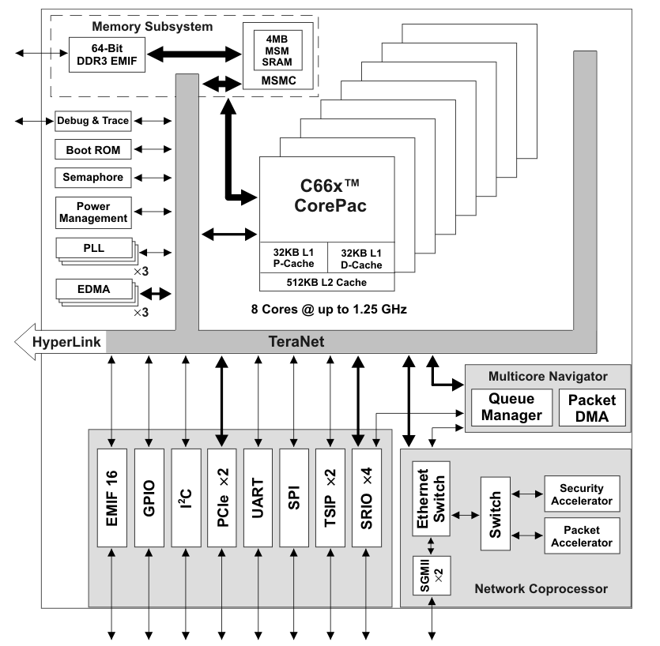
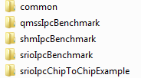
Keystone I IPC Solution
Based on the standard IPC API from legacy TI products
Same API for messages inside a core, between cores, or between devices.
Multiple transport mechanisms, all have the same run-time API:
Shared memory
Multicore Navigator
SRIO
Examples: MCSDK_2_01_6\pdk_C6678_1_1_2_6\packages\ti\transport\ipc\examples

Slide 16
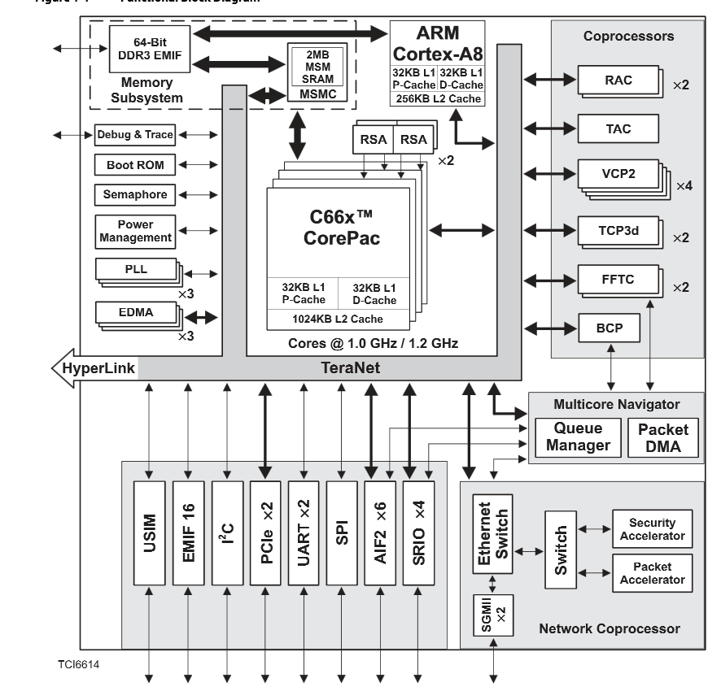
Appleton IPC: 6612 and 6614
Navigator-based msgCom package:
DSP to DSP
ARM to DSP
Developed for the vertical market, not easy to adapt to the broad market

Slide 17
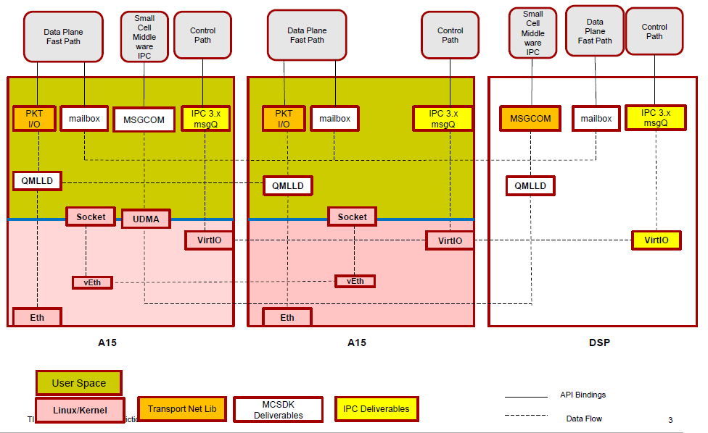
IPC Technologies in KeyStone II (MCSDK 3.0.3.15)

Slide 18
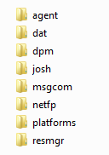
IPC Libraries: MCSDK Release 3_0_3_15

Slide 19
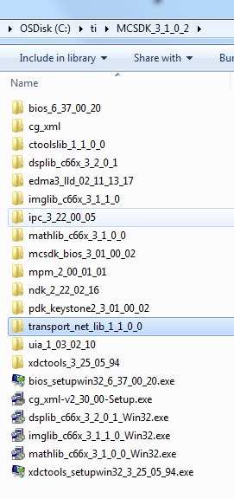
Keystone II: MCSDK_3_1
Dropped syslib from the release; No msgCom
IPC based on shared memory is still supported
transport_net_lib (also in release 3.0.4.18) is used for OpenCL/OpenMP type of communications

Slide 20
Shared Memory IPC Library
IPC library based on shared memory common to all releases:
DSP: Must build with BIOS
Designed for moving messages and “short” data
Compatible with legacy devices (same API)
Currently supported on all GA KeyStone devices

Slide 21
Shared Memory IPC
KeyStone IPC

Slide 22
IPC Library: Transports
Current IPC implementation uses several transports:
CorePac → CorePac (Shared Memory Model)
Device → Device (Serial Rapid I/O) – KeyStone I
Chosen at configuration; Same code regardless of thread location.
Device 1
Device 2
CorePac 1
CorePac 2
CorePac 1
Thread 1
Thread 2
Thread 1
Thread 2
Thread 1
Thread 2
IPC
IPC
IPC
MEM
SRIO
SRIO

Slide 23
IPC Services
The IPC package is a set of APIs.
MessageQ uses the modules below.
Each module can also be used independently.
Application

Slide 24
IPC Services in the Release
Top-level modules, used by application
MCSDK_3_0_4_18\ipc_3_00_04_29\packages\ti.sdo.ipc
MCSDK_3_0_4_18\ipc_3_00_04_29\packages\ti\sdo\util
Ipc
Notify
MessageQ
SharedRegion
MultiProc
HeapMemMP
HeapBufMP
NameServer
GateMP

Slide 25
Ipc Module
Ipc = IPC Manager is used to initialize IPC and synchronize with other processors
API summary:
Ipc_start reserves memory, create default gate and heap
Ipc_stop releases all resources
Ipc_attach sets up transport between two processors
Ipc_detach finalizes transport

Slide 26
NameServer Module
NameServer = Distributed Name/Value Database
Manages name/value pairs
Used for registering data that can be looked up by other processors
API summary:
NameServer_create creates a new database instance
NameServer_add adds a name/value entry into database
NameServer_get retrieves the value for given name

Slide 27
MultiProc Module
MultiProc = Processor Identification
Stores processor ID of all processors in the multi-core application. Processor ID is a number from 0 – (n-1).
Stores processor name as defined by IPC:
See ti.sdo.utils.MultiProc > Configuration Settings, MultiProc.setConfig
Click on Table of Valid Names for Each Device
API summary:
MultiProc_getSelf returns your own processor ID
MultiProc_getId returns processor ID for given name
MultiProc_getName returns processor name

Slide 28
SharedRegion Module
SharedRegion - Shared Memory Address Translation
Manages shared memory and its cache configuration
Manages shared memory using a memory allocator
Multiple shared regions are supported
Each shared region has optional HeapMemMP instance:
Memory is allocated and freed using this HeapMemMP instance.
HeapMemMP_create/open manages internally at IPC initialization
SharedRegion_getHeap API is used to get this heap handle

Slide 29
HeapMemMP HeapBufMP Modules
HeapMemMP & HeapBufMP = Multi-Processor Memory and Buffer Allocator
Shared memory allocators can be used by multiple processors
HeapMemMP uses variable size allocations
HeapBufMP uses fixed size allocations, deterministic, ideal for MessageQ
All allocations are aligned on cache line size. WARNING: Small allocations occupy a full cache line.
Uses GateMP to protect shared state across cores.
Every SharedRegion uses a HeapMemMP instance to manage the shared memory

Slide 30
GateMP Module
GateMP = Multiple Processor Gate
Protects critical sections
Provides context protection against threads on both local and remote processors
Device-specific gate delegates offer hardware locking to GateMP
GateHWSem for C6474, C66x
API summary:
GateMP_create create a new instance
GateMP_open opens an existing instance
GateMP_enter acquires the gate
GateMP_leave releases the gate

Slide 31
Notify: Basic Communication
Simpler form of IPC communication
Send and receive event notifications
Device 1
CorePac 1
CorePac 2
Thread 1
Thread 2
Thread 1
Thread 2
IPC
IPC
MEM

Slide 32
Notify Model
Comprised of SENDER and RECEIVER.
The SENDER API requires the following information:
Destination (SENDER ID is implicit)
16-bit Line ID
32-bit Event ID
32-bit payload (For example, a pointer to message handle)
The SENDER API generates an interrupt (an event) in the destination.
Based on Line ID and Event ID, the RECEIVER schedules a pre-defined call-back function.

Slide 33
Notify Model

Slide 34
Notify Implementation
How are interrupts generated for shared memory transport?
The IPC hardware registers are a set of 32-bit registers that generate interrupts. There is one register for each core.
How are the notify parameters stored?
The allocation of the memory is done by HeapMP and SharedRegion
How does the notify know to send the message to the correct destination?
MultiProc and name server keep track of the core ID.
Does the application need to configure all these modules?
No. Most of the configuration is done by the system. They are all “under the hood”

Slide 35
Example Callback Function
/*
* ======== cbFxn ========
* This fxn was registered with Notify. It is called when any event is sent to this CPU.
*/
Uint32 recvProcId ;
Uint32 seq ;
void cbFxn(UInt16 procId, UInt16 lineId, UInt32 eventId, UArg arg, UInt32 payload)
{
/* The payload is a sequence number. */
recvProcId = procId;
seq = payload;
Semaphore_post(semHandle);
}

Slide 36
Data Passing Using Shared Memory (1/2)
When there is a need to allocate memory that is accessible by multiple cores, shared memory is used.
However, the MPAX register for each DSP core might assign a different logical address to the same physical shared memory address.
Solution: Maintain a shared memory area in the default mapping (Until future release, when the shared memory module will do the translation automatically)
Proc 0
Shared Memory Region (DDR2)
Proc 1
0x90000000
0x90000000
Proc 0 Local Memory Region
Proc 1 Local Memory Region

Slide 37
Data Passing Using Shared Memory (2/2)
Communication between DSP core and ARM core requires knowledge of the DSP memory map by the MMU.
To provide this knowledge, the MPM (Multiprocessor management unit on the ARM) must load the DSP code.
Other DSP code load methods will not support IPC between ARM and DSP.

Slide 38
MessageQ: Highest Layer API
Single READER, multiple WRITERS model (READER owns queue/mailbox)
Supports structured sending/receiving of variable-length messages, which can include (pointers to) data.
Uses all of the IPC services layers along with IPC Configuration & Initialization
APIs do not change if the message is between two threads:
On the same core
On two different cores
On two different devices
APIs do NOT change based on transport; only the CFG (init) code
Shared memory
SRIO

Slide 39
MessageQ and Messages
How does the writer connect with the reader queue?
MultiProc and name server keep track of queue names and core IDs. Each MessageQ has a unique name known to all elements of the system
What do we mean when we refer to structured messages with variable size?
Each message has a standard header and data. The header specifies the size of payload.
If there are multiple writers, how does the system prevent race conditions (e.g., two writers attempting to allocate the same memory)?
GateMP provides hardware semaphore API to prevent race conditions.
What facilitates the moving of a message to the receiver queue?
This is done by Notify API using the transport layer.
Does the application need to configure all these modules?
No. Most of the configuration is done by the system. More details later.

Slide 40
Using MessageQ (1/3)
CorePac 2 - READER
MessageQ_create(“myQ”, *synchronizer);
MessageQ_get(“myQ”, &msg, timeout);
“myQ”
Step I: MessageQ creation during initialization:
MessageQ transactions begin with READER creating a MessageQ.
Step 2: During run-time
READER’s attempt to get a message results in a block (unless timeout was specified), since no messages are in the queue yet.

Slide 41
Using MessageQ (2/3)
CorePac 1 - WRITER
CorePac 2 - READER
MessageQ_open (“myQ”, …);
msg = MessageQ_alloc (heap, size,…);
MessageQ_put(“myQ”, msg, …);
MessageQ_create(“myQ”, …);
MessageQ_get(“myQ”, &msg…);
“myQ”
Heap
WRITER begins by opening MessageQ created by READER.
WRITER gets a message block from a heap and fills it, as desired.
WRITER puts the message into the MessageQ.

Slide 42
Using MessageQ (3/3)
CorePac 1 - WRITER
CorePac 2 - READER
MessageQ_open (“myQ”, …);
msg = MessageQ_alloc (heap, size,…);
MessageQ_put(“myQ”, msg, …);
MessageQ_close(“myQ”, …);
MessageQ_create(“myQ”, …);
MessageQ_get(“myQ”, &msg…);
*** PROCESS MSG ***
MessageQ_free(“myQ”, …);
MessageQ_delete(“myQ”, …);
“myQ”
Heap
Once WRITER puts msg in MessageQ, READER is unblocked.
READER can now read/process the received message.
READER frees message back to Heap.
READER can optionally delete the created MessageQ, if desired.

Slide 43
MessageQ: Configuration
All API calls use the MessageQ module in IPC.
User must also configure MultiProc and SharedRegion modules.
All other configuration/setup is performed automatically by MessageQ.
User APIs
MessageQ
Notify
HeapMemMP +
Uses
MultiProc
Uses
Shared Region
Uses
Cfg
GateMP
NameServer

Slide 44
More Information About MessageQ
For the DSP, all structures and function descriptions are exposed to the user and can be found within the release:
\ipc_U_ZZ_YY_XX\docs\doxygen\html\_message_q_8h.html
IPC User Guide \MCSDK_3_00_XX\ipc_3_XX_XX_XX\docs\IPC_Users_Guide.pdf
Notes:
NEW

Slide 45
IPC Device-to-Device Using SRIO
Currently available only on KeyStone I devices

Slide 46
IPC Transports: SRIO (1/3) KeyStone I Only
The SRIO (Type 11) transport enables MessageQ to send data between tasks, cores and devices via the SRIO IP block.
Refer to the MCSDK examples for setup code required to use MessageQ over this transport.
Writer CorePac W
Reader CorePac Y
msg = MessageQ_alloc
“get Msg from queue”
MessageQ_put(queueId, msg)
MessageQ_get(queueHndl,rxMsg)
TransportSrio_put
MessageQ_put(queueId, rxMsg)
Srio_sockSend(pkt, dstAddr)
TransportSrio_isr
SRIO x4
SRIO x4

Slide 47
IPC Transports: SRIO (2/3) KeyStone I Only
From a messageQ standpoint, the SRIO transport works the same as the QMSS transport. At the transport level, it is also somewhat the same.
The SRIO transport copies the messageQ message into the SRIO data buffer.
It will then pop a SRIO descriptor and put a pointer to the SRIO data buffer into the descriptor.
Writer CorePac W
Reader CorePac Y
msg = MessageQ_alloc
“get Msg from queue”
MessageQ_put(queueId, msg)
MessageQ_get(queueHndl,rxMsg)
TransportSrio_put
MessageQ_put(queueId, rxMsg)
Srio_sockSend(pkt, dstAddr)
TransportSrio_isr
SRIO x4
SRIO x4

Slide 48
IPC Transports: SRIO (3/3) KeyStone I Only
The transport then passes the descriptor to the SRIO LLD via the Srio_sockSend API.
SRIO then sends and receives the buffer via the SRIO PKTDMA.
The message is then queued on the receive side.
Writer CorePac W
Reader CorePac Y
msg = MessageQ_alloc
“get Msg from queue”
MessageQ_put(queueId, msg)
MessageQ_get(queueHndl,rxMsg)
TransportSrio_put
MessageQ_put(queueId, rxMsg)
Srio_sockSend(pkt, dstAddr)
TransportSrio_isr
SRIO x4
SRIO x4
Notes:
Dotted line to show what the application is doing and what is done automatically

Slide 49
IPC Transport Details
Message Size | Shared Memory | SRIO
 | Throughput (Mb/second)
48 | 23.8 | 4.1
256 | 125.8 | 21.2
1024 | 503.2 | -
Benchmark Details
IPC benchmark examples from MCSDK
CPU Clock = 1 GHz
Header Size = 32 bytes
SRIO in loopback Mode
Messages allocated up front

Slide 50
Demonstrations & Examples
KeyStone IPC

Slide 51
Example Code
There are multiple IPC library example projects for KeyStone I in the MCSDK 2.x release: mcsdk_2_X_X_X\pdk_C6678_1_1_2_5\packages\ti\transport\ipc\examples
IPC example for communication: Instructions on how to build, run and modify this code example is part of KeyStone II Lab book.

Slide 52
For More Information
Device-specific Data Manuals for the KeyStone SoCs can be found at TI.com/multicore.
For articles related to IPC, refer to the Embedded Processors Wiki for the KeyStone Device Architecture.
For questions regarding topics covered in this training, visit the support forums at the TI E2E Community website.

Slide 53
BACKUP SLIDES

Slide 54
Configuration

Slide 55
Static Configuration
Open cfg file in CCS with XDCScript Editor
var Settings = xdc.module('ti.sdo.ipc.family.Settings');
var Cache = xdc.useModule('ti.sysbios.family.c66.Cache');
var MessageQ = xdc.useModule('ti.sdo.ipc.MessageQ');
var Notify = xdc.module('ti.sdo.ipc.Notify');
var Ipc = xdc.useModule('ti.sdo.ipc.Ipc');
Notify.SetupProxy = xdc.module(Settings.getNotifySetupDelegate());
MessageQ.SetupTransportProxy= xdc.module(Settings.getMessageQSetupDelegate());
Notes:
NEW

Slide 56
Static Configuration
Open cfg file in CCS with XDCScript Editor
switch (Program.platformName) {
case "ti.sdo.ipc.examples.platforms.evm6678.core0":
case "ti.platforms.evm6678":
Program.global.USING_C6678 = 1;
Program.global.maxNumCores = 8;
procNameList = ["CORE0", "CORE1", "CORE2", "CORE3", "CORE4", "CORE5", "CORE6", "CORE7"];
Program.global.shmBase = 0x0C000000;
Program.global.shmSize = 0x00200000;
break;
Notes:
NEW

Slide 57
Static Configuration
Open cfg file in CCS with XDCScript Editor
var MultiProc = xdc.useModule('ti.sdo.utils.MultiProc');
MultiProc.setConfig(procName, procNameList);
var SharedRegion = xdc.useModule('ti.sdo.ipc.SharedRegion');
SharedRegion.translate = false;
SharedRegion.setEntryMeta(0,
{ base: Program.global.shmBase,
len: Program.global.shmSize,
ownerProcId: 0,
isValid: true,
cacheEnable: cacheEnabled,
cacheLineSize: cacheLineSize, /* Aligns allocated messages to a cache line */
name: "internal_shared_mem",
});
Notes:
NEW

Slide 58
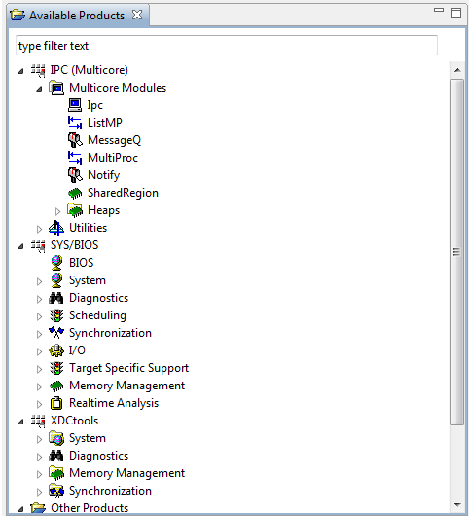
Static Configuration
Open cfg file in CCS with XGCONF
Notes:
NEW

Slide 59
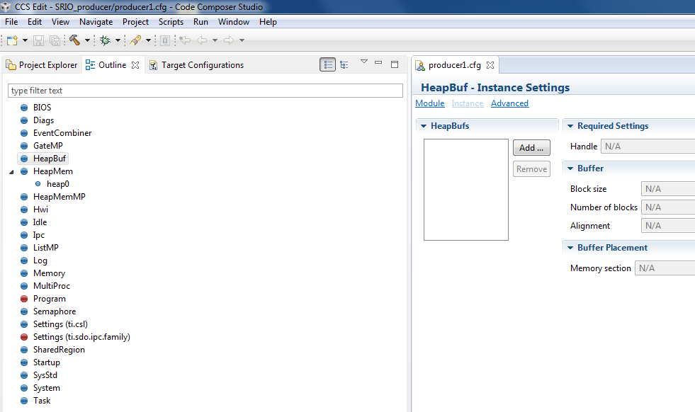
Static Configuration
Open cfg file in CCS with XGCONF
Notes:
NEW

