Slide 1
C6614/6612 Memory System
MPBU Application Team

Slide 2
Agenda
Overview of the 6614/6612 TeraNet
Memory System – DSP CorePac Point of View
Overview of Memory Map
MSMC and External Memory
Memory System – ARM Point of View
Overview of Memory Map
ARM Subsystem Access to Memory
ARM-DSP CorePac Communication
SysLib and its libraries
MSGCOM
Pktlib
Resource Manager

Slide 3
Agenda
Overview of the 6614/6612 TeraNet
Memory System – DSP CorePac Point of View
Overview of Memory Map
MSMC and External Memory
Memory System – ARM Point of View
Overview of Memory Map
ARM Subsystem Access to Memory
ARM-DSP CorePac Communication
SysLib and its libraries
MSGCOM
Pktlib
Resource Manager

Slide 4
TCI6614 Functional Architecture
64-Bit
ARM
Coprocessors
DDR3 EMIF
2MB
Cortex-A8
MSM
32KB L1
32KB L1
Memory
SRAM
P-Cache
D-Cache
RAC
x2
Subsystem
MSMC
256KB L2 Cache
Debug & Trace
RSA
RSA
TAC
Boot ROM
x2
VCP2
Semaphore
x4
Power
C66x™
Management
CorePac
TCP3d
x2
PLL
FFTC
x3
32KB L1
32KB L1
x2
EDMA
P-Cache
D-Cache
1024KB L2 Cache
BCP
x3
Cores @ 1.0 GHz / 1.2 GHz
HyperLink
TeraNet
Multicore Navigator
Queue
Packet
Manager
DMA
6
x2
x2
x6
x4
t
M
1
e
h
C
T
I
n
c
I
F
e
P
O
r
t
h
Security
S
I
2
I
R
S
2
e
i
c
Accelerator
U
M
I
C
A
F
I
h
w
t
E
P
I
R
t
S
i
U
A
S
E
w
S
Packet
I
Accelerator
I
M
x2
G
S
Network Coprocessor
TCI6614

Slide 5
C6614 TeraNet Data Connections
HyperLink
S
MSMC
DDR3
S
M
CPUCLK/2
256bit TeraNet 2A
Shared L2
S
HyperLink
M
S
S
S
S
M
TPCC
16ch QDMA
TC0
M
TC1
M
EDMA_0
DDR3
XMC
ARM
S
L2 0-3
M
SRIO
S
Core
M
CPUCLK/2
256bit TeraNet 2B
M
S
Core
M
M
S
Core
M
From ARM
Network
Coprocessor
To TeraNet
2B
M
SRIO
TPCC
64ch
QDMA
TC2
M
S
TC3
M
S
TPCC
64ch
QDMA
TC6
M
TCP3e_W/R
MPU
TC4
M
TC5
TC7
M
M
TC8
M
TC9
M
S
EDMA_1,2
TCP3d
S
CPUCLK/3
128bit TeraNet 3A
TCP3d
TAC_BE
DDR3
TAC_FE
S
M
RAC_FE
RAC_BE0,1
S
M
RAC_FE
RAC_BE0,1
S
M
FFTC / PktDMA
M
FFTC / PktDMA
M
VCP2 (x4)
S
VCP2 (x4)
S
VCP2 (x4)
AIF / PktDMA
S
M
VCP2 (x4)
S
QM_SS
M
QMSS
PCIe
S
M
S
PCIe
DebugSS
M
Notes:
CPT see physical addresses. In MSMC, one CPT per bank.

Slide 6
Agenda
Overview of the 6614/6612 TeraNet
Memory System – DSP CorePac Point of View
Overview of Memory Map
MSMC and External Memory
Memory System – ARM Point of View
Overview of Memory Map
ARM Subsystem Access to Memory
ARM-DSP CorePac Communication
SysLib and its libraries
MSGCOM
Pktlib
Resource Manager

Slide 7
SoC Memory Map 1/2
Start Address | End Address | Size | Description
0080 0000 | 0087 FFFF | 512K | L2 SRAM
00E0 0000 | 00E0 7FFF | 32K | L1P
00F0 0000 | 00F0 7FFF | 32K | L1D
0220 0000 | 0220 007F | 128K | Timer 0
0264 0000 | 0264 07FF | 2K | Semaphores
0270 0000 | 0270 7FFF | 32K | EDMA CC
027D 0000 | 027d 3FFF | 16K | TETB Core 0
0c00 0000 | 0C3F FFFF | 4M | Shared L2
1080 0000 | 1087 FFFF | 512K | L2 Core 0 Global
12E0 0000 | 12E0 7FFF | 32K | Core 2 L1P Global

Slide 8
SoC Memory Map 2/2
Start Address | End Address | Size | Description
2000 0000 | 200F FFFF | 1M | System Trace Mgmt Configuration
2180 0000 | 33FF FFFF | 296M+32K | Reserved
3400 0000 | 341F FFFF | 2M | QMSS Data
3420 0000 | 3FFF FFFF | 190M | Reserved
4000 0000 | 4FFF FFFF | 256M | HyperLink Data
5000 0000 | 5FFF FFFF | 256K | Reserved
6000 0000 | 6FFF FFFF | 256K | PCIe Data
7000 0000 | 73FF FFFF | 64M | EMIF16 Data NAND Memory (CS2)
8000 0000 | FFFF FFFF | 2G | DDR3 Data

Slide 9
KeyStone Memory Topology
L1D – 32KB Cache/SRAM
L1P – 32KB Cache/SRAM
L2 – 1MB Cache/SRAM
MSM – 2MB Shared SRAM
DDR3 – Up to 8GB
DDR3 (1x64b)
MSMC
MSMC SRAM
256
256
256
256
256
Peripherals
L1D
L1P
L1D
L1P
L1D
L1P
L1D
L1P
C66x CorePac
C66x CorePac
C66x CorePac
C66x CorePac
256
L2
L2
L2
L2
TeraNet
256
256
256
L1D & L1P Cache Options – 0KB, 4KB, 8KB, 16K, 32KB
L2 Cache Options – 0KB, 32KB, 64KB, 128KB, 256KB, 512KB

Slide 10
MSMC Block Diagram
CorePac
0
CorePac
1
CorePac
2
CorePac
3
XMC
XMC
XMC
XMC
MPAX
MPAX
MPAX
MPAX
256
256
256
256
CorePac
CorePac
CorePac
CorePac
Slave Port
Slave Port
Slave Port
Slave Port
System
Slave Port
for Shared SRAM
(SMS)
Memory
Protection &
Extension
Unit
(MPAX)
MSMC Datapath
Arbitration
TeraNet
256
256
Shared RAM
2048 KB
System Slave Port for External Memory
(SES)
Memory
Protection &
Extension
Unit
(MPAX)
Error Detection & Correction (EDC)
256
256
256
MSMC Core
MSMC System
MSMC EMIF
Master Port
Master Port
Events
256
256
TeraNet
To SCR_2_B
and the DDR

Slide 11
XMC – External Memory Controller
The XMC is responsible for the following:
Address extension/translation
Memory protection for addresses outside C66x
Shared memory access path
Cache and pre-fetch support
User Control of XMC:
MPAX (Memory Protection and Extension) Registers
MAR (Memory Attributes) Registers
Each core has its own set of MPAX and MAR registers!

Slide 12
The MPAX Registers
System
Physical 36-bit Memory Map
MPAX (Memory Protection and Extension) Registers:
Translate between physical and logical address
16 registers (64 bits each) control (up to) 16 memory segments.
Each register translates logical memory into physical memory for the segment.
F:FFFF_FFFF
8:8000_0000
8:7FFF_FFFF
8:0000_0000
7:FFFF_FFFF
C66x CorePac
Logical 32-bit Memory Map
MPAX Registers
1:0000_0000
0:FFFF_FFFF
FFFF_FFFF
8000_0000
7FFF_FFFF
0:8000_0000
0:7FFF_FFFF
0:0C00_0000
0:0BFF_FFFF
0C00_0000
0BFF_FFFF
Segment 1
Segment 0
0000_0000
0:0000_0000

Slide 13
The MAR Registers
MAR (Memory Attributes) Registers:
256 registers (32 bits each) control 256 memory segments:
Each segment size is 16MBytes, from logical address 0x0000 0000 to address 0xFFFF FFFF.
The first 16 registers are read only. They control the internal memory of the core.
Each register controls the cacheability of the segment (bit 0) and the prefetchability (bit 3). All other bits are reserved and set to 0.
All MAR bits are set to zero after reset.

Slide 14
XMC: Typical Use Cases
Speeds up processing by making shared L2 cached by private L2 (L3 shared).
Uses the same logical address in all cores; Each one points to a different physical memory.
Uses part of shared L2 to communicate between cores. So makes part of shared L2 non-cacheable, but leaves the rest of shared L2 cacheable.
Utilizes 8G of external memory; 2G for each core.

Slide 15
Agenda
Overview of the 6614/6612 TeraNet
Memory System – DSP CorePac Point of View
Overview of Memory Map
MSMC and External Memory
Memory System – ARM Point of View
Overview of Memory Map
ARM Subsystem Access to Memory
ARM-DSP CorePac Communication
SysLib and its libraries
MSGCOM
Pktlib
Resource Manager

Slide 16
ARM Core

Slide 17
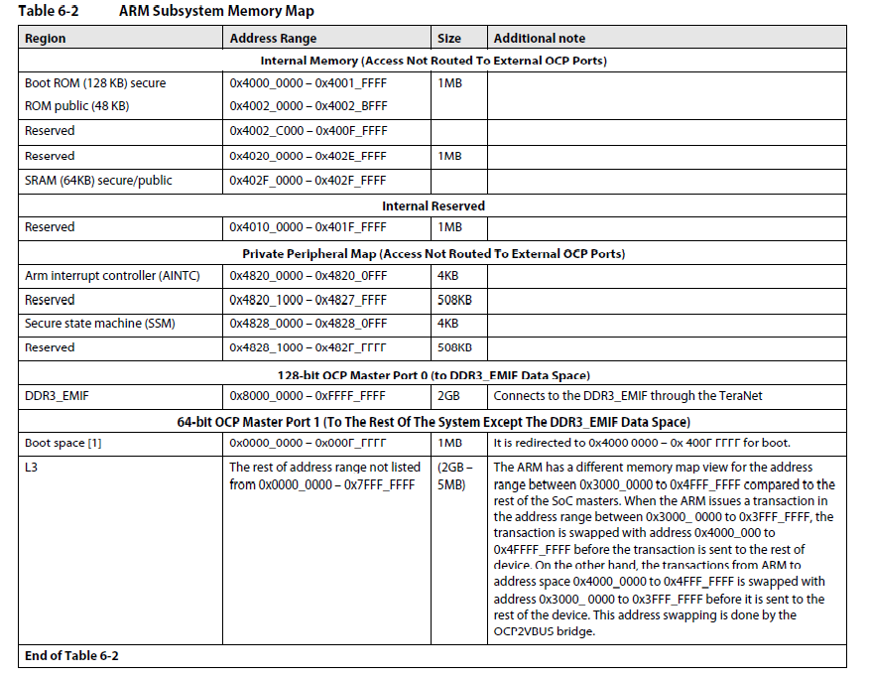
ARM Subsystem Memory Map

Slide 18
ARM Subsystem Ports
32-bit ARM addressing (MMU or Kernel)
31 bits addressing into the external memory
ARM can address ONLY 2GB of external DDR (No MPAX translation) 0x8000 0000 to 0xFFFF FFFF
31 bits are used to access SOC memory or to address internal memory (ROM)

Slide 19
ARM Visibility Through the TeraNet Connection
It can see the QMSS data at address 0x3400 0000
It can see HyperLink data at address 0x4000 0000
It can see PCIe data at address 0x6000 0000
It can see shared L2 at address 0x0C00 0000
It can see EMIF 16 data at address 0x7000 0000
NAND
NOR
Asynchronous SRAM

Slide 20
ARM Access SOC Memory
Do you see a problem with HyperLink access?
Addresses in the 0x4 range are part of the internal ARM memory map.
What about the cache and data from the Shared Memory and the Async EMIF16?
The next slide presents a page from the device errata.
Description | Virtual Address from Non-ARM Masters | Virtual Address from ARM
QMSS | 0x3400_0000 to 0x341F_FFFF | 0x4400_0000 to 0x441F_FFFF
HyperLink | 0x4000_0000 to 0x4FFF_FFFF | 0x3000_0000 to 0x3FFF_FFFF

Slide 21
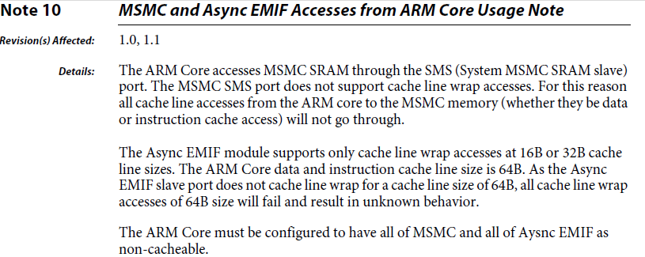
Errata User’s Note Number 10

Slide 22
ARM Endianess
ARM uses only Little Endian.
DSP CorePac can use Little Endian or Big Endian.
The User’s Guide shows how to mix ARM core Little Endian code with DSP CorePac Big Endian.

Slide 23
Agenda
Overview of the 6614/6612 TeraNet
Memory System – DSP CorePac Point of View
Overview of Memory Map
MSMC and External Memory
Memory System – ARM Point of View
Overview of Memory Map
ARM Subsystem Access to Memory
ARM-DSP CorePac Communication
SysLib and its libraries
MSGCOM
Pktlib
Resource Manager

Slide 24
MCSDK Software Layers
Demonstration Applications
HUA/OOB
IO Bmarks
Image
Processing
Software Framework Components
Communication Protocols
SYS/BIOS
RTOS
Inter-Processor
Communication (IPC)
Instrumentation
TCP/IP
Networking
(NDK)
Algorithm Libraries
Platform/EVM Software
DSPLIB
IMGLIB
MATHLIB
Platform
Library
Transports - IPC - NDK
Low-Level Drivers (LLDs)
Resource
Manager
Power On Self Test (POST)
EDMA3
PA
SRIO
FFTC
TSIP
OS Abstraction Layer
Bootloader
PCIe
QMSS
CPPI
HyperLink
…
Chip Support Library (CSL)
Hardware

Slide 25
SysLib Library – An IPC Element
Application
Resource
Management SAP
Packet SAP
Communication
SAP
FastPath SAP
System Library (SYSLIB)
Resource
Manager (ResMgr)
Packet Library
(PktLib)
MsgCom Library
NetFP Library
Low-Level Drivers (LLD)
CPPI LLD
PA LLD
SA LLD
Hardware Accelerators
Queue Manager Subsystem (QMSS)
Network
Coprocessor (NETCP)

Slide 26
MsgCom Library
Purpose: To exchange messages between a reader and writer.
Read/write applications can reside:
On the same DSP core
On different DSP cores
On both the ARM and DSP core
Channel and Interrupt-based communication:
Channel is defined by the reader (message destination) side
Supports multiple writers (message sources)

Slide 27
Channel Types
Simple Queue Channels: Messages are placed directly into a destination hardware queue that is associated with a reader.
Virtual Channels: Multiple virtual channels are associated with the same hardware queue.
Queue DMA Channels: Messages are copied using infrastructure PKTDMA between the writer and the reader.
Proxy Queue Channels – Indirect channels work over BSD sockets; Enable communications between writer and reader that are not connected to the same Navigator.

Slide 28
Interrupt Types
No interrupt: Reader polls until a message arrives.
Direct Interrupt: Low-delay system; Special queues must be used.
Accumulated Interrupts: Special queues are used; Reader receives an interrupt when the number of messages crosses a defined threshold.

Slide 29
Blocking and Non-Blocking
Blocking: The Reader can be blocked until message is available.
Non-blocking: The Reader polls for a message. If there is no message, it continues execution.

Slide 30
Case 1: Generic Channel Communication Zero Copy-based Constructions: Core-to-Core
NOTE: Logical function only
hCh=Find(“MyCh1”);
hCh = Create(“MyCh1”);
Reader
Writer
MyCh1
Tibuf *msg = PktLibAlloc(hHeap);
Put(hCh,msg);
Tibuf *msg =Get(hCh);
PktLibFree(msg);
Delete(hCh);
Reader creates a channel ahead of time with a given name (e.g., MyCh1).
When the Writer has information to write, it looks for the channel (find).
Writer asks for a buffer and writes the message into the buffer.
Writer does a “put” to the buffer. The Navigator does it – magic!
When the Reader calls “get,” it receives the message.
The Reader must “free” the message after it is done reading.
Notes:
Notes:
All naming is illustrative.
Open Items:
Recycling policies on Tx Completion queues
API Naming convention

Slide 31
Case 2: Low-Latency Channel Communication Single and Virtual Channel Zero Copy-based Construction: Core-to-Core
NOTE: Logical function only
Reader
Writer
hCh = Create(“MyCh2”);
MyCh2
Posts internal Sem and/or callback posts MySem;
hCh=Find(“MyCh2”);
chRx
(driver)
Get(hCh); or Pend(MySem);
Tibuf *msg = PktLibAlloc(hHeap);
Put(hCh,msg);
PktLibFree(msg);
hCh=Find(“MyCh3”);
MyCh3
hCh = Create(“MyCh3”);
Tibuf *msg = PktLibAlloc(hHeap);
Get(hCh); or Pend(MySem);
Put(hCh,msg);
PktLibFree(msg);
Reader creates a channel based on a pending queue. The channel is created ahead of time with a given name (e.g., MyCh2).
Reader waits for the message by pending on a (software) semaphore.
When Writer has information to write, it looks for the channel (find).
Writer asks for buffer and writes the message into the buffer.
Writer does a “put” to the buffer. The Navigator generates an interrupt . The ISR posts the semaphore to the correct channel.
The Reader starts processing the message.
Virtual channel structure enables usage of a single interrupt to post semaphore to one of many channels.
Notes:
Notes:
All naming is illustrative.
Open Items:
Recycling policies on Tx Completion queues
API Naming convention

Slide 32
Case 3: Reduce Context Switching Zero Copy-based Constructions: Core-to-Core
NOTE: Logical function only
Reader
Writer
hCh = Create(“MyCh4”);
hCh=Find(“MyCh4”);
MyCh4
Tibuf *msg =Get(hCh);
Tibuf *msg = PktLibAlloc(hHeap);
chRx
(driver)
Put(hCh,msg);
Accumulator
PktLibFree(msg);
Delete(hCh);
Reader creates a channel based on an accumulator queue. The channel is created ahead of time with a given name (e.g., MyCh4).
When Writer has information to write, it looks for the channel (find).
Writer asks for buffer and writes the message into the buffer.
The writer put the buffer. The Navigator adds the message to an accumulator queue.
When the number of messages reaches a water mark, or after a pre-defined time out, the accumulator sends an interrupt to the core.
Reader starts processing the message and makes it “free” after it is done.
Notes:
Notes:
All naming is illustrative.
Open Items:
Recycling policies on Tx Completion queues
API Naming convention

Slide 33
Case 4: Generic Channel Communication ARM-to-DSP Communications via Linux Kernel VirtQueue
NOTE: Logical function only
Reader
Writer
hCh = Create(“MyCh5”);
hCh=Find(“MyCh5”);
MyCh5
msg = PktLibAlloc(hHeap);
Tibuf *msg =Get(hCh);
Put(hCh,msg);
Tx
PKTDMA
Rx
PKTDMA
PktLibFree(msg);
Delete(hCh);
Reader creates a channel ahead of time with a given name (e.g., MyCh5).
When the Writer has information to write, it looks for the channel (find). The kernel is aware of the user space handle.
Writer asks for a buffer. The kernel dedicates a descriptor to the channel and provides the Writer with a pointer to a buffer that is associated with the descriptor. The Writer writes the message into the buffer.
Writer does a “put” to the buffer. The kernel pushes the descriptor into the right queue. The Navigator does a loopback (copies the descriptor data) and frees the Kernel queue. The Navigator loads the data into another descriptor and sends it to the appropriate core.
When the Reader calls “get,” it receives the message.
The Reader must “free” the message after it is done reading.
Notes:
Notes:
All naming is illustrative.
Open Items:
Recycling policies on Tx Completion queues
API Naming convention

Slide 34
Case 5: Low-Latency Channel Communication ARM-to-DSP Communications via Linux Kernel VirtQueue
NOTE: Logical function only
hCh = Create(“MyCh6”);
Reader
Writer
MyCh6
hCh=Find(“MyCh6”);
chIRx
(driver)
Get(hCh); or Pend(MySem);
msg = PktLibAlloc(hHeap);
Put(hCh,msg);
Tx
PKTDMA
Rx
PKTDMA
PktLibFree(msg);
Delete(hCh);
PktLibFree(msg);
Reader creates a channel based on a pending queue. The channel is created ahead of time with a given name (e.g., MyCh6).
Reader waits for the message by pending on a (software) semaphore.
When Writer has information to write, it looks for the channel (find). The kernel space is aware of the handle.
Writer asks for buffer. The kernel dedicates a descriptor to the channel and provides the Writer with a pointer to a buffer that is associated with the descriptor. The Writer writes the message into the buffer.
Writer does a “put” to the buffer. The kernel pushes the descriptor into the right queue. The Navigator does a loopback (copies the descriptor data) and frees the Kernel queue. The Navigator loads the data into another descriptor, moves it to the right queue, and generates an interrupt. The ISR posts the semaphore to the correct channel
Reader starts processing the message.
Virtual channel structure enables usage of a single interrupt to post semaphore to one of many channels.
Notes:
Notes:
All naming is illustrative.
Open Items:
Recycling policies on Tx Completion queues
API Naming convention

Slide 35
Case 6: Reduce Context Switching ARM-to-DSP Communications via Linux Kernel VirtQueue
NOTE: Logical function only
hCh=Find(“MyCh7”);
hCh = Create(“MyCh7”);
Reader
Writer
MyCh7
Msg = Get(hCh);
chRx
(driver)
msg = PktLibAlloc(hHeap);
Put(hCh,msg);
Tx
PKTDMA
Rx
PKTDMA
Accumulator
PktLibFree(msg);
Delete(hCh);
Reader creates a channel based on one of the accumulator queues. The channel is created ahead of time with a given name (e.g., MyCh7).
When Writer has information to write, it looks for the channel (find). The Kernel space is aware of the handle.
The Writer asks for a buffer. The kernel dedicates a descriptor to the channel and gives the Write a pointer to a buffer that is associated with the descriptor. The Writer writes the message into the buffer.
The Writer puts the buffer. The Kernel pushes the descriptor into the right queue. The Navigator does a loopback (copies the descriptor data) and frees the Kernel queue. Then the Navigator loads the data into another descriptor. Then the Navigator adds the message to an accumulator queue.
When the number of messages reaches a watermark, or after a pre-defined time out, the accumulator sends an interrupt to the core.
Reader starts processing the message and frees it after it is complete.
Notes:
Notes:
All naming is illustrative.
Open Items:
Recycling policies on Tx Completion queues
API Naming convention

Slide 36
Code Example
Reader
hCh = Create(“MyChannel”, ChannelType, struct *ChannelConfig); // Reader specifies what channel it wants to create
// For each message
Get(hCh, &msg) // Either Blocking or Non-blocking call,
pktLibFreeMsg(msg); // Not part of IPC API, the way reader frees the message can be application specific
Delete(hCh);
Writer:
hHeap = pktLibCreateHeap(“MyHeap); // Not part of IPC API, the way writer allocates the message can be application specific
hCh = Find(“MyChannel”);
//For each message
msg = pktLibAlloc(hHeap); // Not part of IPC API, the way reader frees the message can be application specific
Put(hCh, msg); // Note: if Copy=PacketDMA, msg is freed my Tx DMA.
…
msg = pktLibAlloc(hHeap); // Not part of IPC API, the way reader frees the message can be application specific
Put(hCh, msg);

Slide 37
Packet Library (PktLib)
Purpose: High-level library to allocate packets and manipulate packets used by different types of channels.
Enhance capabilities of packet manipulation
Enhance Heap manipulation

Slide 38
Heap Allocation
Heap creation supports shared heaps and private heaps.
Heap is identified by name. It contains Data buffer Packets or Zero Buffer Packets
Heap size is determined by application.
Typical pktlib functions:
Pktlib_createHeap
Pktlib_findHeapbyName
Pktlib_allocPacket

Slide 39
Packet Manipulations
Merge multiple packets into one (linked) packet
Clone packet
Split Packet into multiple packets
Typical pktlib functions:
Pktlib_packetMerge
Pktlib_clonePacket
Pktlib_splitPacket

Slide 40
PktLib: Additional Features
Clean up and garbage collection (especially for clone packets and split packets)
Heap statistics
Cache coherency

Slide 41
Resource Manager (ResMgr) Library
Purpose: Provides a set of utilities to manage and distribute system resources between multiple users and applications.
The application asks for a resource. If the resource is available, it gets it. Otherwise, an error is returned.

Slide 42
ResMgr Controls
General purpose queues
Accumulator channels
Hardware semaphores
Direct interrupt queues
Memory region request

