Slide 1
Introduction to Tool chains

Slide 2
Tool chain for the Sitara Family (but it is true for other ARM based devices as well)
A tool chain is a collection of programs used to compile and build applications or libraries and generally includes several additional tools useful for debugging or troubleshooting issues.
Starting with SDK 6.0 we have switched from using a GCC based tool chain built by TI and moved to a GCC based tool chain built by Linaro.
Notes:
Usually when someone is referring to a toolchain they are referring to the gcc compiler since that is the only program people use. However, the gcc application actually invokes other tools within the toolchain but provides a single interface for users to make their lives easier.

Slide 3


Cross Compiling
Whenever you are compiling an application or library for a platform other than the one it will be ran or used on then you are “cross compiling”
Is this considered cross compiling?
Compiling an application on your Linux laptop to run on your Linux desktop.
Compiling a Windows application on a Macintosh
Compiling a Linux application on your PC for your Sitara EVM or Beaglebone.
Notes:
http://en.wikipedia.org/wiki/Cross_compiler

Slide 4
Compiling a Simple Program

Slide 5
Compiling a Simple Program
To use your tool chain you need to add it to your environment’s PATH variable. This allows you to invoke your tool chain by simply calling it by its name instead of having to specify the entire path.
Adding your tool chain’s path to your environment’s path
export PATH=<toolchain dir>:$PATH
The simplest way to build an application is by listing the sources and specifying the name of the binary to be generated
arm-linux-gnueabihf-gcc <C sources> -o <executable name>
You can add other flags such as the debug flag
arm-linux-gnueabihf-gcc <C sources> - g -o <executable name>
Sitara Tool Chain is part of “Linux Development Kit” or Linux-devkit

Slide 6
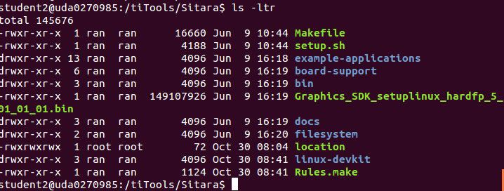
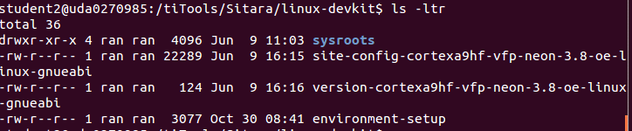
Linux-devkit part of Linux SDK
Notes:
PMU – Programming Multi-channel Unit (The ARM module)
LPDDR - Low Power Double Data Rate memory 266MHZ
DDR3 – 400MHZ
DDR3L – low voltage DDR3
OCMC – On chip memory controller

Slide 7
Understanding Linux-devkit
Linux-Devkit
Target Headers and Libraries
Host Tools Directory
Environment-setup
Toolchain
GDB
Qt compiler
Etc..
Common environment variables
that affects compiling
Target’s headers and
libraries

Slide 8
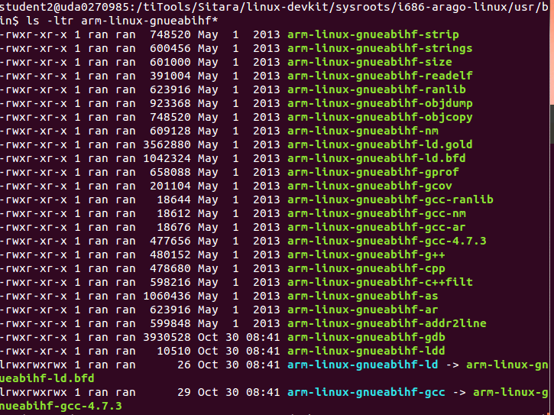
Code generation Location

Slide 9
Linking to External Libraries
When linking against non standard C libraries and headers the compiler needs to be told what library to link against
This is done by manually passing the library name to the compiler. (Usually make files already handle this for you)
Find the name of the library file that you need to link against. Remove lib from the front and remove the extension. Then add -l to the front.
Example:
Link against PNG library (libpng.so)
libpng.so -> png -> -lpng
arm-linux-gnueabihf-gcc <C sources> -lpng -o <executable name>
And don’t forget the Path
Notes:
http://www.cs.swarthmore.edu/~newhall/unixhelp/howto_C_libraries.html
http://stackoverflow.com/questions/5479584/compiling-or-using-libxml-using-c-on-osx

Slide 10

Environment-setup
Purposes:
Point the compiler to target’s headers and libraries
Automatically adds the tool chain binaries to your PATH.
Sets environment variables that affects cross compiling
Set compiler options specific to the SOC
Using environment-setup:
Open a terminal
Go to SDK’s linux-devkit
source environment-setup

Slide 11
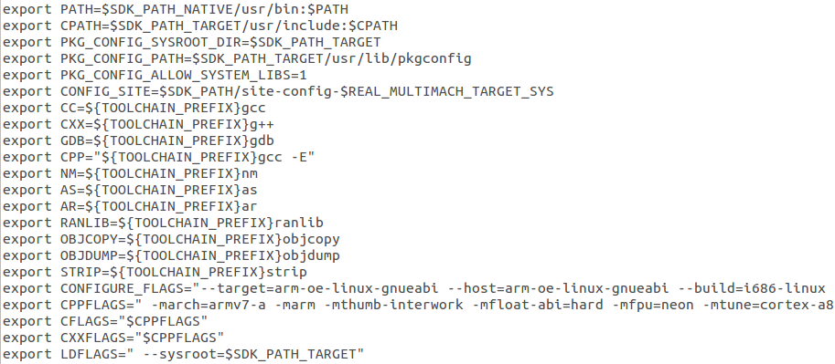
Environment-setup Example

Slide 12
Environment-setup Example
Setting tool chain path

Slide 13
Environment-setup Example
Setting environment variables that
point to common tool chain tools.

Slide 14
Environment-setup Example
SOC specific options, alters the compiler’s
default header and library search path

Slide 15
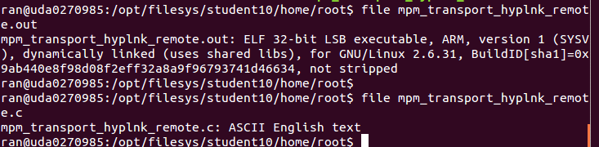
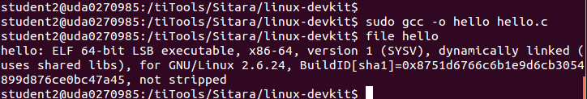
Compiler Path
If the compiler name and path are not explicitly given, the compiler may build the executable for the host architecture and not the target architecture
The file command can tell you what compiler built the file

Slide 16
Compiler Search Path
The compiler must know where to look for libraries and headers. If the user does not specifies these paths explicitly, the compiler may find headers and libraries that do not belong to the desired target
Host Contamination – When cross compiling software and the compiler find and use headers and libraries that belong to the host
Sysroot – Compiler option that alters the compiler’s default search path.

Slide 17
Compiling User Space vs. Kernel Space Software
Example Kernel Space/BSP Software
U-boot, kernel and kernel device drivers
Example User Space Software
Qt, Gstreamer and Busybox
Kernel space software is protected thus it should not be exposed to the environment variables set by environment-setup for the user space
Kernel space software should be portable to support multiple platforms

Slide 18
Software Build Systems
For simple application, a “simple” Makefile and make utility was enough to build an executable
Difficulties:
Portable – the same code for multiple architecture
Cross compiling – find the right tools, headers and libraries
Build Systems – set of tools or scripts used to build and deploy/install applications or libraries.
GNU build system – Auto-tools is used by SDK
Automat the process of building portable executables
Config
Make install
Make
Notes:
It can be difficult to make a software program portable: the C compiler differs from system to system; certain library functions are missing on some systems; header files may have different names. One way to handle this is to write conditional code, with code blocks selected by means of preprocessor directives (#ifdef); but because of the wide variety of build environments this approach quickly becomes unmanageable. Autotools is designed to address this problem more manageably.

Slide 19
Building with Auto Tools
configure – Used to determine what compiler your using, supported compiler options, available libraries and at times allows users to determine which features to used or not use.
make – Builds the application
make install – Install binaries, headers to either a default location or user specified location.

Slide 20
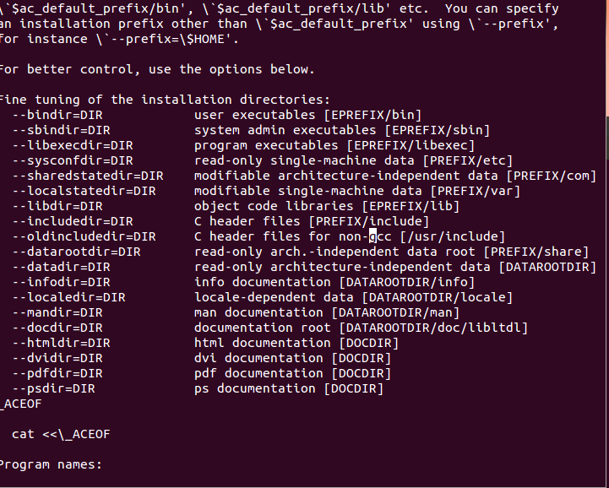
From the configure file

Slide 21
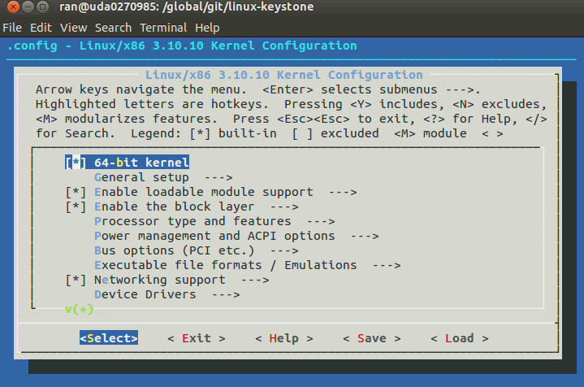
Configure GUI make menuconfig

Slide 22
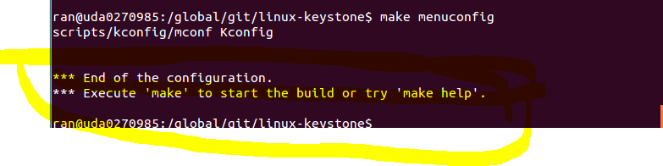
Configure GUI make menuconfig

Slide 23
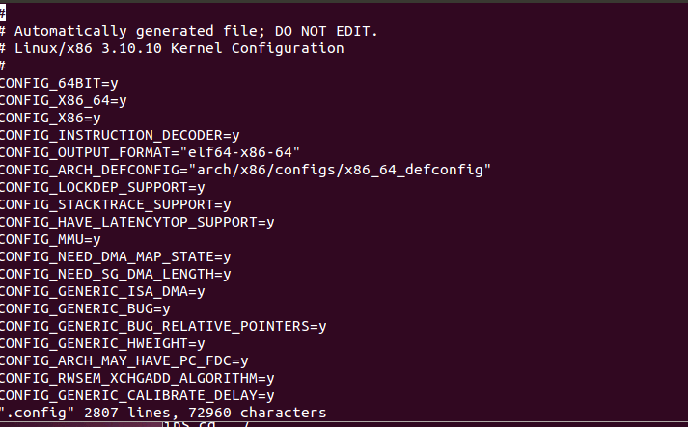
Configure using vi .config
Themn you have to “make oldconfig” again

Slide 24
Configure – Cross Compile Options
When cross compiling software configure requires a few options passed to it
--build=build
The system on which the package is built.
--host=host
The system where built programs and libraries will run.
--target=target
When building compiler tools: the system for which the tools will create output.
Environment-setup creates a environment variable with all this information already filled!
When cross compiling auto tools based software always use:
./configure $CONFIGURE_FLAGS
If not, see the next slide
Notes:
http://www.gnu.org/software/automake/manual/html_node/Cross_002dCompilation.html

Slide 25
Configure without the right PATH

Slide 26
Configure Help
./configure –help
Display list of options that a user can use to influence the configuration and building of the piece of software.

Slide 27
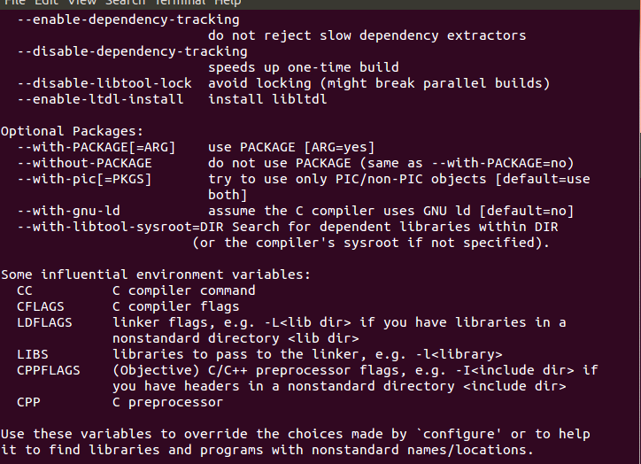
Configure Help

Slide 28
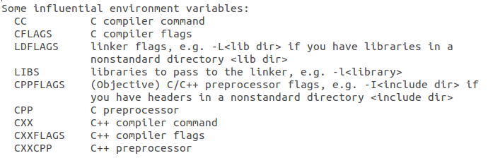
Configure – Important Environment Variables
These variables are important not just to configure/autotools
but for many other build systems
Notes:
Going back at the configure help

Slide 29
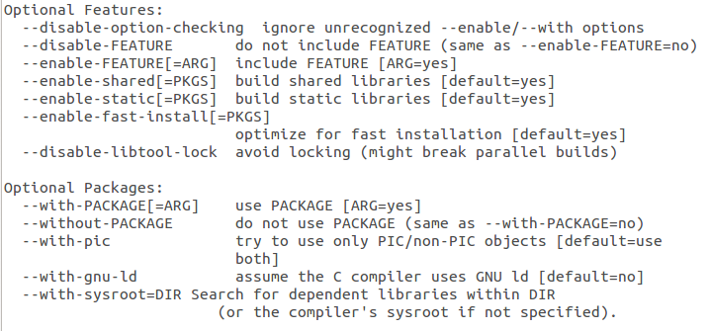
Configure – Feature Selection
Example Enable PIC:
./configure --with-pic
Example Disable PIC:
./configure --without-pic

Slide 30
Install Location
By default auto tools will assume you want to install your library or application on the host.
When cross compiling this is not what you want to do so how do you change this?
Easiest way to accomplish this is by altering the software’s default install location
Auto tools based software makes this fairly easy

Slide 31
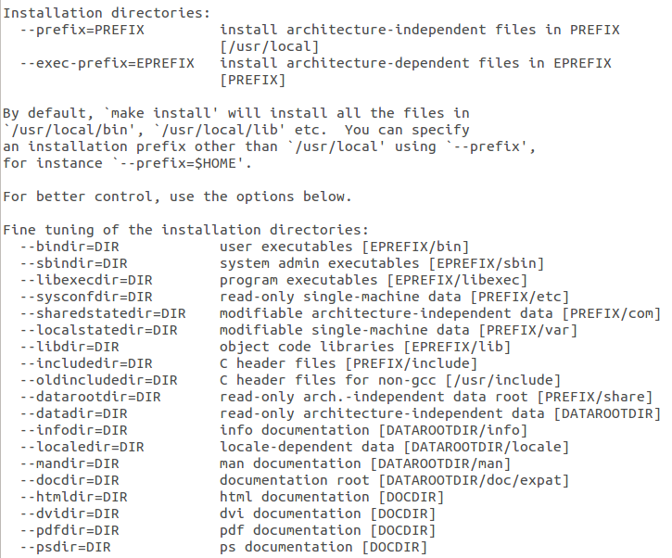
Configure Installation Options
Default root
Installation
directory
Usually don’t change

Slide 32
Configure Prefix Option
By using the configure prefix option you can alter the default location configure wants to install your libraries and application.
The syntax is:
./configure --prefix=<new install location>

Slide 33
Deploying to the Target
Having the headers and libraries in the custom directory isn’t enough if the application requires them.
When applications are running on the target they will need access to the manually compiled libraries.
Simply copy the contents of the custom dir and copy it to your filesystem’s root directory.

Slide 34
Recap
What we learned?
How to manually compile simple software.
How to link to external libraries.
How to build an auto tools based program.
How to build with libraries not included in the SDK.
How to deploy cross compiled libraries to the target
Cross compiling is easy!!
Well it depends ☹

Slide 35
When Cross Compiling Sucks
Cross compiling sucks when:
Cross compiling is less common than natively compiling
Programs aren’t developed to be portable.
Programs may require host tools to be build before the actual application or library can be built:
Example: Qt and Python
Programs uses some build system that isn’t cross compiling friendly.
Developer doesn’t follow the proper standard for the build system to make things portable.
For each large application or library it may take different steps to compile successfully.

Slide 36
Native Compiling
When every your building software to be ran on the same machine that it is being built on then your natively compiling your program.
Benefits:
Don’t worry about host contamination
Since your not cross compiling then compiling should be as simple as it would be on a PC.
Draw Backs:
Building on an embedded device will be a lot slower than even building on a PC.
Building Qt on a PC takes about 3+ hours. Building it on the Beaglebone can take 14+ hrs
Compiling may fail due to a lack of memory.
Some distributions don’t provide the tool chain so it isn’t an option.
Sharing what you have built is trickier since it is now already apart of your file system.

Slide 37
Better Approach
So if cross compiling can be tricky and natively compiling has its own problems what is a better solution.
Open embedded/Yocto
Open embedded/Yocto is used to create your own distribution file system quickly and easily from scratch.
Benefits:
A scripts called ‘recipe’ contains all the information required to build applications or libraries.
Over 2000+ recipes exist.
Only 1 thing to learn.
Open embedded makes handling dependencies simple.
Upgrading versions of a piece of software is easy
Don’t want to ship your product with a critical vulnerability included right?
Reproducing your entire file system is easy.
Sitara provides a good starting point to use.
Handles licenses restrictions for you easily!
FREE!!!!!!!
Notes:
Add a halo

