Slide 1
KeyStone Interrupts
KeyStone Training
Multicore Applications
Literature Number: SPRPXXX

Slide 2
Agenda
Interrupt Scheme
Example 1: SPI Transmit Interrupt
Example 2: HyperLink Interrupt
ARM Interrupt Scheme

Slide 3
Interrupt Scheme
KeyStone Interrupts

Slide 4
Link Events to ISR (Interrupt Service Routine)

Slide 5
Link Events to ISR (Interrupt Service Routine)

Slide 6
Link Events to ISR (Interrupt Service Routine)
To connect an event to ISR:
Connect primary event to one of the 124 maskable interrupt lines
Connect interrupt line to ISR
CSL or BIOS API are used to connect events to interrupt lines and interrupt lines to ISR (Interrupt Service Routine).

Slide 7

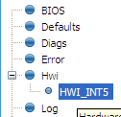
Configuring an Hwi (Hardware Interrupt) Using BIOS Statically via GUI
Example:
Event 94 to the CPU HWI₅
Use Hwi module (Available Products), insert new Hwi (Outline View)
NOTE: BIOS objects can be created via the GUI, script code, or C code (dynamic).
By the way, Event 94 is not connected to anything. It is reserved.

Slide 8
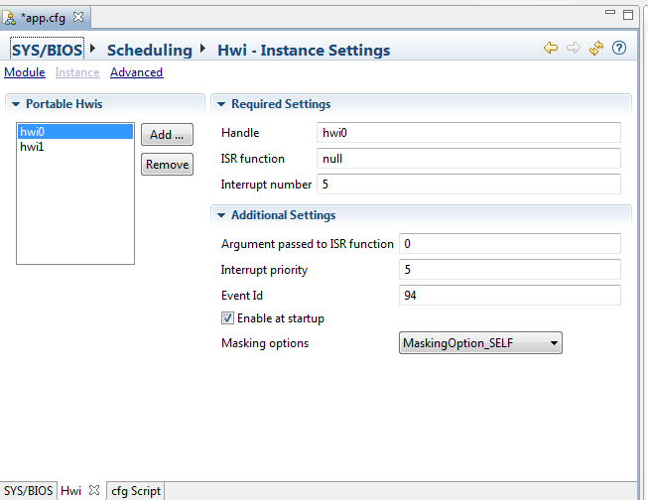
Configuring an Hwi Using BIOS Statically via GUI

Slide 9
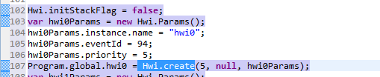
Configuring an Hwi with BIOS Using Run-Time Functions
The include file Hwi.h in the release MCSDK_3_0_4_18\bios_6_37_00_20\packages\ti\sysbios\family\c64p\Hwi.h
Has the definition of the Hwi class
Where do you find the Event Id #?

Slide 10
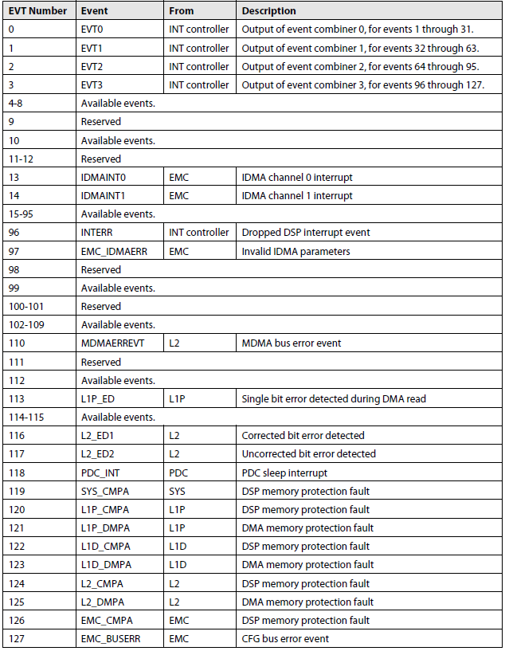
C66x CorePac Input Events (CorePac Events Only)
From the System Event Mapping table in the C66x DSP CorePac User Guide:
128 CorePac events
22 assigned events NOTE: 4 used for event combining
7 reserved events
99 available events; The available events are connected to the device (mostly via CIC).
Total of 124 “unique” Corepac input events
-

Slide 11
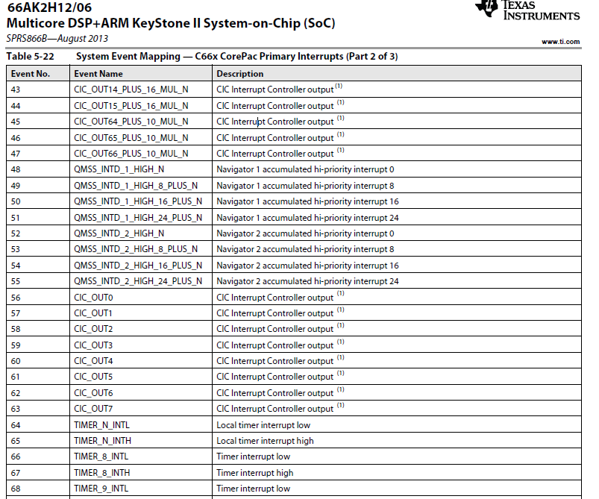
C66x CorePac Events (CIC Output) for KeyStone II Devices

Slide 12
Configure HWI Using CSL
CSL interrupt files are in the release: MCSDK_3_0_4_18\pdk_keystone2_3_00_04_18\packages\ti\csl\src\intc
Include files: csl_intc.h csl_intcAux.h
Source files in src/intc directory
CSL_intcPlugEventHandler()
CSL_intcInit()
CSL_intcGlobalNmiEnable
CSL_intcGlobalEnable()
CSL_intcHwControl()
CSL_intcOpen
And many more
NOTE: In addition to the mapping, the interrupt must be enabled:
Global Enable activates the global interrupt register.
Then enable specific interrupt can be activated.
This presentation will not get into details of enabling the interrupts.

Slide 13
KeyStone II Interrupt Topology
CIC0
C66x CorePac0
All events from all IP come to the interrupt controllers.
Some are connected directly to C66x or other masters (EDMA, ARM, Hyperlink)
Some are mapped by the interrupt controllers
C66x CorePac1
C66x CorePac2
C66x CorePac3
CIC1
C66x CorePac4
C66x CorePac5
Events
C66x CorePac6
C66x CorePac7
CIC2
HyperLink
EDMA CC0
EDMA CC1
EDMA CC2
EDMA CC3
EDMA CC4
Peripherals
ARM A15
CorePac

Slide 14
C66x CorePac Secondary Events

Slide 15
CIC to C66x CorePac Connections Event Number: CorePac Input Event Event Name: CIC Output Line

Slide 16
Connecting System Events
Mapping (Connecting) System Events (Input to CIC)
to Channels (Output of CIC)

Slide 17
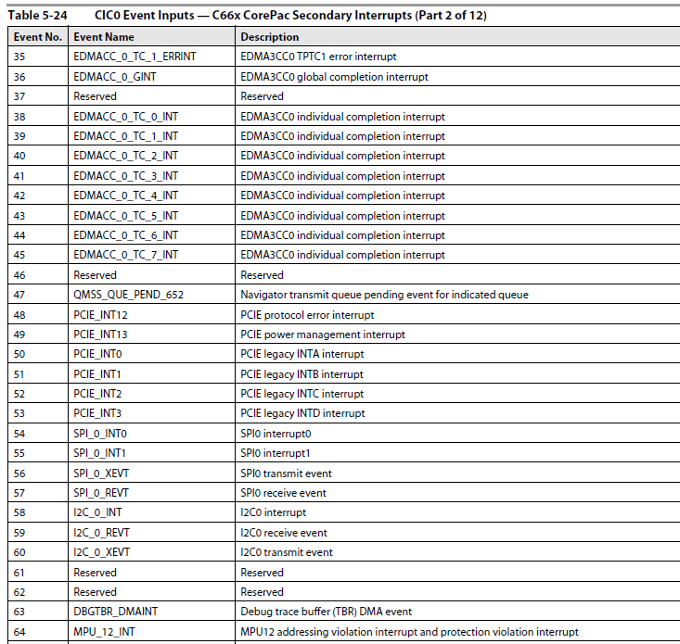
KeyStone II CIC Input System Events

Slide 18
CIC Mapping API
Read the following Wiki: http://processors.wiki.ti.com/index.php/Configuring_Interrupts_on_Keystone_Devices
CSL APIs: For KeyStone II (MCSDK 3.x), there are two include files:
csl_cpIntc.h
csl_cpIntCAux.h
SysBios APIs: MCSDK_Y_XX\bios_6_BB_AA_ZZ\packages\ti\sysbios\family\c66\tci66xx
cpInitc.h
cpInitc.c

Slide 19
Example 1: SPI Transmit Interrupt
KeyStone Interrupts

Slide 20
Example 1: Connect SPIXEVT to CorePac ISR
66AK2H12 has multiple instances of SPI; We will look at SPI 0.
SPIXEVT is NOT a primary event so it should be mapped via CIC.
The next slide shows the system events that are associated with SPIXEVT.

Slide 21
KeyStone II CIC Input Events

Slide 22
Connect SPIXEVT to CorePac ISR
SPI_0_XEVT is input event number 56 to CIC.
What channel should be used?
Table 5-22 shows the C66x CorePac Input Events. There are multiple CIC output events that are connected to C66x CorePac.
Some of these events are broadcast events (e.g, connected to all 4 CorePacs that CIC supports)
Some are individual CorePac events.

Slide 23
Connect SPIXEVT to CorePac ISR
Eight events (56 to 63) coming out of the interrupt controller are broadcast events.
They are connected to CIC output channels 0 to 7 respectively.
This example uses C66x input event 63, which is connected to CIC_OUT7.

Slide 24
Connect SPIXEVT to CorePac ISR
They are other events from the interrupt controller that could be considered (Both broadcast and single core)
The ARM GIC has 480 input events and 12 of them are connected to SPI.

Slide 25
Connect SPI 0 Transmit Event to CorePac 3 ISR

Slide 26
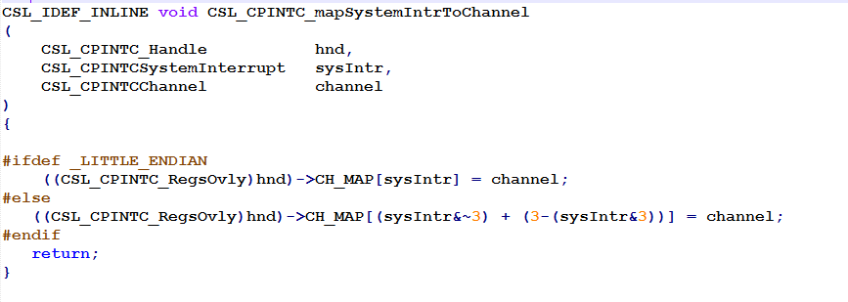
CSL Map System Event (CIC Input) to Output
csl_cpIntCAux.h shows the APIs that connect system events to channels (e.g., the output of the CIC).
Connecting channel events to interrupt queues is done using CSL or SYSBIOS, as described previously.
Error = CSL_CPINTC_mapSystemToChannel(hnd, 56,7) ;//CSL
Error = CpIntc_mapSysIntToHostInt(0, UInt 56, 7); // BIOS

Slide 27
Example 2: HyperLink Interrupt
KeyStone Interrupts

Slide 28
Example 2: HyperLink Interrupt
MCSDK includes examples of interrupts originating from peripherals: MCSDK_3_01_12\pdk_keystone2_3_00_01_12\packages\ti\drv
Consider an example using HyperLink, where an interrupt is sent from Hyperlink 0 to a C66x Corepac.

Slide 29
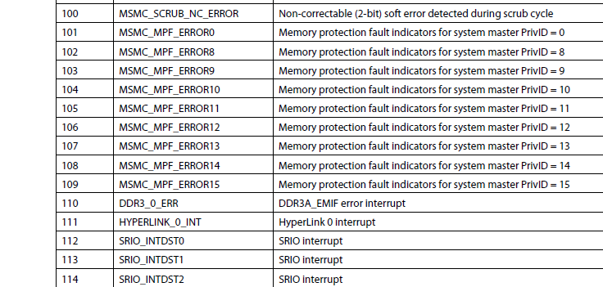
Hyperlink Interrupt 0 Table 5-24 of 66AK2H12- CIC0 Input Events
Event number 111 (ox6F) is HyperLink 0 interrupt.
Next, this interrupt is connected to a CorePac …

Slide 30
Hyperlink Interrupt 0 to CIC Input
static int hyplnkExampleInitChipIntc (void)
{
CSL_CPINTC_Handle hnd;
// I some functions hidden here (enable/disable interrupts, etc.)
CSL_CPINTC_mapSystemIntrToChannel (hnd, CSL_CIC0_HYPERLINK_0_INT, hyplnk_EXAMPLE_INTC_OUTPUT);
// I some functions hidden here (enable/disable interrupts, etc.)
return 0;
}
CSL_CIC0_HYPERLINK_0_INT = 111
What about hyplnk_EXAMPLE_INTC_OUTPUT?

Slide 31
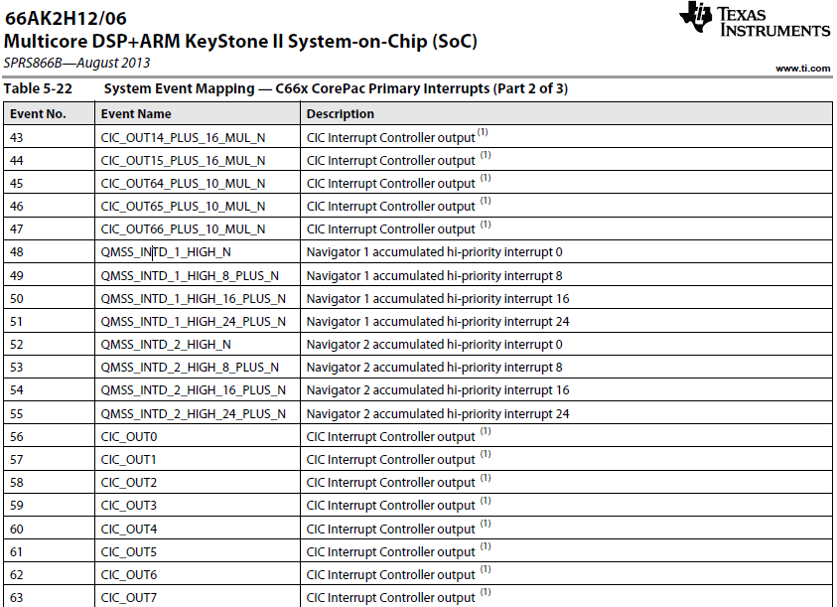
Hyperlink Interrupt 0: CIC Output to CorePac
Use CorePac input event 45
It could be any one of other CIC_OUT lines (look at the complete table for even more)

Slide 32
Hyperlink Interrupt 0: CIC Output to CorePac
Event 45 on C66x CorePac N is connected to CIC output 64 + 10 x N:
Core 0 event 45 is connected to CIC output event 64
Core 1 event 45 is connected to CIC output event 74
Core 2 event 45 is connected to CIC output event 84
Core 3 event 45 is connected to CIC output event 94
The code from the previous slide will map CIC 0 input event 111 to output event 64 (or 74, 84, … depending on which core is used).

Slide 33
ARM Interrupt Scheme
KeyStone Interrupts

Slide 34
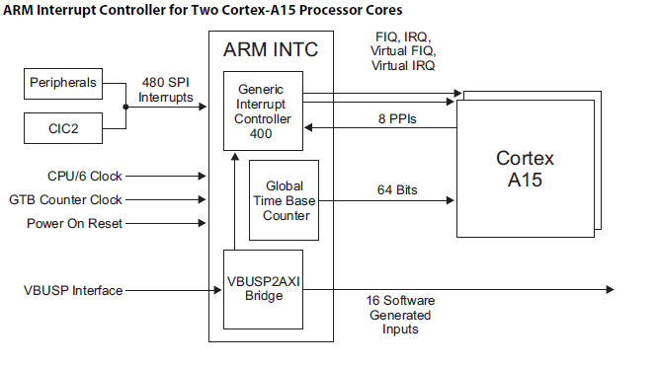
ARM A15 Interrupt Scheme

Slide 35
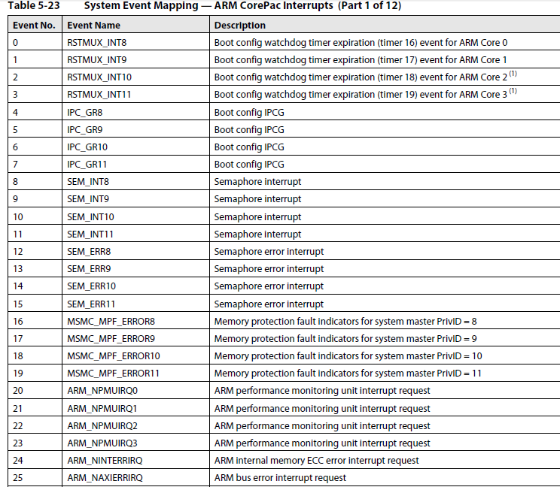
System Event Mapping to GIC

Slide 36
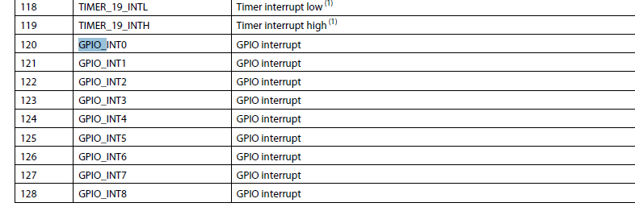
Following GPIO 0 From Table 5-23 of 66AK2H12: ARM CorePac Interrupts

Slide 37
From the File gpio-keystone.c /git/linux-keystone/drivers/gpio
static int keystone_gpio_irq_map(struct irq_domain *h, unsigned int virq, irq_hw_number_t hw)
{
struct gpio_bank *bank = h->host_data;
irq_set_chip_data(virq, bank);
irq_set_chip_and_handler(virq, &keystone_gpio_irqchip,
handle_simple_irq);
set_irq_flags(virq, IRQF_VALID | IRQF_PROBE);
irq_set_irq_type(virq, IRQ_TYPE_NONE);
return 0;
}

Slide 38
From the File gpio-keystone.c /git/linux-keystone/drivers/gpio
static void gpio_irq_enable(struct irq_data *d)
{
struct gpio_bank *bank = irq_data_get_irq_chip_data(d);
u32 mask, status = irqd_get_trigger_type(d);
struct gpio_regs *regs = bank->regs;
int gpio;
gpio = d->hwirq - bank->base;
mask = 1 << gpio;
if (status & IRQ_TYPE_EDGE_FALLING)
__raw_writel(mask, bank->reg_base + regs->set_fal_trig);
if (status & IRQ_TYPE_EDGE_RISING)
__raw_writel(mask, bank->reg_base + regs->set_rise_trig);
}

Slide 39
For More Information
C66x DSP CorePac User Guide http://www.ti.com/lit/SPRUGW0C
KeyStone Architecture Chip Interrupt Controller (CIC) User Guide http://www.ti.com/lit/SPRUGW4A
For questions regarding topics covered in this training, visit the support forums at the TI E2E Community website.

