Slide 1
ARM DSP working together
Multicore Training

Slide 2
Agenda
Managing the peripherals and IP in hydrogenous device
Linux Device Tree
Resource Management

Slide 3
Challenges
How to use peripherals and other Ip in ARM and DSP KeyStone devices?
Configuration
Run-time usage
Solution: Chip Support Library (CSL) and Low Level Drivers (LLD) on DSP, LINUX drivers on the ARM
How to share resources’ configuration, control and usage between different cores?
Protect resources from conflict usage
ARM runs Linux, C66x runs BIOS
Solution: Resource Management

Slide 4
DSP view of peripherals and IP
Chip support Library (CSL) provide access to the peripherals and other IP
CSL translates physical MMR locations into symbols, and provides functions to manipulate the MMR
Low level drivers (LLD) is an abstraction layer that simplified the usage of peripherals
Some peripherals have high layer libraries (on the top of LLD) to further abstract peripherals usage details from the application

Slide 5
DSP: Interface via LLD and CSL Layers

Slide 6
LLD Overview
Low Level Drivers (LLD) hide the details of CSL from the application.
Simple IP and peripherals do not have LLD. The application uses CSL directly.
Most of the IPs use LLD.
Drivers for Linux system will be discussed later.

Slide 7
Linux Control peripherals and IP
MMU controls memory access for user mode in Linux. Application does not see physical address
Device drivers can be called by the applications, they can access physical memory
Linux Device Drivers provide
Modularity
Standard interface
Standard structure

Slide 8
What are Linux Device Drivers?
Link between standard interface and the hardware
Hides the complexity of device operation from the user
Provides standard API to use the device
Maps the API to one or more functions that manipulate the specific hardware device.
Linux kernel modularity scheme enables easy plugging of new device drivers to a kernel.

Slide 9
Linux Application API
Device drivers can be loaded during boot time or loaded (as modules) during run time
Driver classification:
Character device
Block device
Network interface
Each type of drivers have standard API, for example, character devices will have open and close, read and write functions.

Slide 10
KeyStone Drivers Structure Example - SRIO

Slide 11
Linux Drivers mcsdk_03_00_00_09/linux-keystone/drivers
GIC IRQ chip driver
Keystone IPC IRQ chip driver
AEMIF driver
NAND driver
SPI and SPI NOR flash drivers
I2C and EEPROM drivers
Keystone GPIO driver
Keystone IPC GPIO driver
Network driver (NetCP), PktDMA, Packet Accelerator
SGMII driver
QoS driver
USB driver
10Gig Ethernet driver (not validated due to test hardware)
PCIe driver

Slide 12
Agenda
Managing the peripherals and IP in hydrogenous device
Linux Device Tree
Resource Management

Slide 13
Linux Device Tree
How do Linux drivers know what resources are available and what are the physical attributes of the resources?
The device tree
Linux Device tree is an ASCII file *.dts that describes the resources available to Linux. A compiled version of the file *.dtb is used by the linux system
Device tree source code has a well defined syntax.

Slide 14
The device tree file k2hk-evm.dts is from the public git server
/dts-v1/;
/include/ "skeleton.dtsi“
/ { model = "Texas Instruments Keystone 2 SoC“
; compatible = "ti,tci6638-evm“
; #address-cells = <2>;
#size-cells = <2>;
interrupt-parent = <&gic>;
aliases {
serial0 = &uart0; gpio0 = &gpio0;
ethernet1 = &interface1;
};
chosen { };

Slide 15
Device tree defines the CPU that are available
cpus
{ interrupt-parent = <&gic>;
cpu@0 {
compatible = "arm,cortex-a15";
};
cpu@1 {
compatible = "arm,cortex-a15";
};
cpu@2 {
compatible = "arm,cortex-a15";
};
cpu@3 {
compatible = "arm,cortex-a15";
};
};

Slide 16
Device tree defines the clocks that are available
chipclk12: chipclk12 {
#clock-cells = <0>;
compatible = "fixed-clock-factor";
clocks = <&chipclk1>;
mult = <1>;
div = <2>;
};

Slide 17
Device tree defines the interrupts that are available
ipcirq0: ipcirq0@26202bc
{ /* ipc irq chip */
compatible = "ti,keystone-ipc-irq";
reg = <0x026202a0 4 /* host ack register */
0x02620260 4>; /* ipc host interrupt generation register */
interrupts = <0 4 0x101>;/* it should match the value in irqs.h */
/* following is the source id to irq mapping SRCS0 <-> ipc hw irq 0 ... SRCS27 <-> ipc hw irq 27 note that SRCS0 is bit 4 in ipc register */
interrupt-controller;
#interrupt-cells = <2>;
};

Slide 18
Device tree defines the interrupt queues that are in the system
queues {
qpend-arm-low {
values = <652 20>;
interrupts = <0 40 0xf04 0 41 0xf04 0 42 0xf04 0 43 0xf04 0 44 0xf04 0 45 0xf04 0 46 0xf04 0 47 0xf04>;
reserved;
};
qpend-arm-hi {
values = <8704 32>;

Slide 19
Device tree defines the region that are used by the Linux
regions {
#address-cells = <1>;
#size-cells = <1>
; ranges;
region-12 {
id = <12>;
values = <2048 128>; /* num_desc desc_size */
link-index = <0x4000>;
};

Slide 20
Device tree defines channels of communications that are used by the Linux
channels {
nettx0
{ transmit;
label = "nettx0";
pool = "pool-net";
submit-queue = <648>;
/* complete-queue = <xx>;
*/ /* debug;
*/ /* channel = <0>;
*/ /* priority = <1>;
*/ };

Slide 21
A word about ARM – DSP resource Management
When ARM and DSP co-exist, some resources are managed by the resource manager server
Memories are managed differently. The next few slides describe how memories are managed in DSP-Linux system

Slide 22
Memory defined in the Device Tree
In the device tree we define what memories will be used by the Linux and what by the DSP*
During boot time (U-BOOT) builds a device tree table and updates it based on U-BOOT environment
Device Tree for the EVM is tci6638-evm.dts. It defines several memories. It defines the total logical memory and what part of it will be used by the kernel, and it defines what memories will be reserved for the DSP

Slide 23
DSP memory definition in Device Tree
For each C66 CorePac, 7 memory allocations:
Address of Core control registers (boot address, power)
L1 P global memory address
L1 D global memory address
L2 global memory address
In addition, the MSM memory address and DDR addresses that are dedicated to DSP usage are defined.
DSP code that uses DDR must use ONLY the DDR addresses that are assigned to it

Slide 24
Memory definitions from TCI6638-evm Device tree
memory
{
reg = <0x00000000 0x80000000 0x00000000 0x20000000>;
};
dspmem: dspmem
{
compatible = "linux,rproc-user";
mem = <0x0c000000 0x00060000 0xa0000000 0x20000000>;
label = "dspmem";
};
Note – We will see later how the start address of the DSP DDR is determined by the U-BOOT parameters.
When build DSP code, one must be aware what is the start DDR address for DSP

Slide 25
DSP core memory definitions TCI6638-evm Device tree
dsp7: dsp7
{
compatible = "linux,rproc-user";
reg = <0x0262005C 4
0x02350858 4
0x02350a58 4
0x0262025C 4
0x17e00000 0x00008000
0x17f00000 0x00008000
0x17800000 0x00100000>;
reg-names = "boot-address", "psc-mdstat", "psc-mdctl", "ipcgr", "l1pram", "l1dram", "l2ram";

Slide 26
Agenda
Managing the peripherals and IP in hydrogenous device
Linux Device Tree
Resource Management

Slide 27
Keystone II RM: Major Requirements
Dynamically manage resources
Enable management of resources at all levels within system software architecture.
Core, task, application component (LLD)
Pre/post-main execution
Runtime modification of resource permissions.
Automate reservation of resources taken by Linux kernel.
Generic, processor-independent transport interface that allows RM instances to communicate regardless of device hardware architecture.
Transport glue logic provided by application
Easy to port RM to new devices

Slide 28
Keystone II RM – Overview (1)
Instance-based Client/Server Architecture:
Three instance hierarchy:
RM Server – Global management of resources and permission policies
RM Client – Provide resource services to system software elements
RM Client Delegate (CD)
Offloads management of resource subsets from Server.
Provides singular data path to Server
Resource services provided via instance service API
RM Instances Communication Over Generic Transport Interface
Application must setup data paths between RM instances
Allows RM to run on any device architecture without modification to RM source

Slide 29
Keystone II RM – Overview (2)
RM server is a Linux process

Slide 30
Keystone II RM – Overview (2/2)
Resources Tracked by RM Defined in Global Resource List (GRL)
GRL captures all resources that will be tracked for a given device
Facilitates automatic extraction of resources used by ARM Linux from Linux DTB
Policies Specify RM Instance Resource Privileges
Resource initialization, usage, and exclusive right privileges assigned to RM instances
Resource assignment to RM instances allows resource management at all software system levels.
Runtime modification of policy privileges
APIs and Linux CLI (Planned)
Resources Stored within Balanced Search Tree Allocators
Reduce memory usage and resource lookup times
Allocators facilitated by NameServer

Slide 31
Keystone II RM: Overview
ARM/DSP n
ARM/DSP n+1
User Mode (ARM)
Resource Policies
Global Resource List (GRL)
Linux DTB
Available resources are inverse of Linux DTB
Memory Allocator
QMSS
CPPI
RM Server Instance
RM CD Instance
QMSS
Allocation policies
Resource Allocators
PA
Resources Allocated from Server
CD Service Transaction Handler
CPPI
CD Service Transaction Handler
Service
Port
Etc
Transport API
PA
Service
Port
ARM ⬄ DSP Transport
DSP ⬄ DSP Transport
Etc
Transport API
Transport-Specific Data Path
ARM ⬄ DSP Transport
ARM/DSP n+2
DSP ⬄ DSP Transport
ARM/DSP n+3
QMSS
QMSS
DSP ⬄ DSP Transport
RM Client Instance
Transport API
RM Client Instance
CPPI
CPPI
Transport API
Client Service Transaction Handler
Client Service Transaction Handler
PA
PA
Mem Alloc
Service
Port
Mem Alloc
Service
Port
Etc
Etc

Slide 32
Keystone II RM: Instances
Server | Client Delegate (CD) | Client
Assigned resource permissions in policy based on instance name given at instance instantiation Can satisfy standard service requests via service API Can satisfy pre-main service requests Manages all system resources Multiple Servers within system must manage mutually exclusive sets of resources Manages all system policies Maintains NameServer Manages resource recovery in case of fault in CD or Client instance (Planned) Can register with any number of CDs and Clients | Assigned resource permissions in policy based on instance name given at instance instantiation Can satisfy standard service requests via service API Can satisfy pre-main service requests Manages subset of system resources provided by Server (Planned) Provided a sub-policy that is sync’d with Server level policy (Planned) Can register with any number of Clients Can register with at most one Server | Assigned resource permissions in policy based on instance name given at instance instantiation Can satisfy standard service requests via service API Can register with at most one CD or Server

Slide 33
Keystone II RM: Instance Topology Example
DSP Multicore Application
IPC
BIOS
Linux User-Space
LLD
Etc
LLD
Etc
LLD
Etc
RM Server
RM Client Delegate
RM Client
ARM
DSP 1
DSP 2

Slide 34
Keystone II RM - Services
RM Services:
Allocate (initialization, usage)
Free
Map resource(s) to NameServer name
Get resource(s) tied to existing NameServer name
Unmap resource(s) from existing NameServer name
Non-blocking service requests directly return result
Blocking service requests return ID to system

Slide 35
Keystone II RM: Global Resource List (GRL)
Specified in Device Tree Source (DTS) format
Open source, dual GPL/BSD-licensed LIBFDT used for parsing GRL
Input to Server on initialization
Server instantiates allocator for each resource specified in GRL
A GRL specification for a resource includes:
Resource name
Resource range (base + length)
Linux DTB alias path (if applicable)
Resource NameServer assignments (if applicable)
Permissions not specified in GRL - In the polices

Slide 36
Keystone II RM: Policy Example
/* RM Server global policy */
/ {
/* All RM instances expected to be resource assignees within the policy.
/* RM will fail at init if
* it finds a resource assignee that is not in the user-instances list */
valid-instances = "RM_Server",
"RM_Client_Delegate",
"RM_Client";
/* RM will deny any resource requests for resources not defined in the policy. */
/* Format for assigning resources to specific RM instances */
qmss {
gp-queue {
assignments = <2000 1000>, "iu=(RM_Server RM_Client_Delegate RM_Client)",
<3000 1>, "iux=(RM_Server) & iu=(RM_Client_Delegate RM_Client)";
<4000 1>, “s=(RM_Client_Delegate RM_Client)”;
};
};
cppi {
pass-rx-flow-id {
assignments = <0 20>, "iux=(*)";
};
};

Slide 37
KeyStone II Peripherals and Coprocessors
KeyStone II Peripherals and Coprocessors
Resource Management
DSP CorePac CSL Layer
DSP CorePac LLD Layer
LLD Functions
LLD Support in MCSDK 3.x
LLD Usage
NWAL
ARM Kernel Drivers
ARM-DSP Inter-Processor Communications

Slide 38
KeyStone I Device Architecture
Memory Subsystem
Application-Specific
Coprocessors
C66x™
CorePac
Miscellaneous
HyperLink
TeraNet
Multicore Navigator
External Interfaces
Network Coprocessor
Notes:
38
NEW

Slide 39
Peripherals and Coprocessors (1/3)
High Bit Rate Interfaces
HyperLink
SRIO
PCIe
10/100/1G SGMII
10G SGMII
USB3
AIF2
TSIP

Slide 40
Peripherals and Coprocessors (2/3)
Low Bit-Rate Interfaces
UART
I2C
SPI
GPIO
IP that support multicore co-operation
Multicore Navigator
EDMA
Semaphore
Timers

Slide 41
Peripherals and Coprocessors (3/3)
Coprocessors
VCP
TCPE
TCPD
FFTC
BCP

Slide 42
CSL Overview
(Almost) All peripherals are controlled by Memory Mapped Registers (MMR).
MMR may have different address in different (future) devices.
CSL has two layers:
The first layer assigns a standard name to MMR.
The second layer is a set of functions to manipulate these registers.
Application needs only to know the API of the CSL functions.

Slide 43
CSL Registers #define
MMR address depends on the device family. Currently there are two families.
The include file and device-specific CSL files are located here:
pdk_keystone2_X_XX_XX_XX\packages\ti\csl\device\k2H
pdk_keystone2_X_XX_XX_XX\packages\ti\csl\device\k2E
The include file cslr_device.h contains the address definitions of the MMR**
** In KeyStone 1 releases, the file cslr_device.h is here: pdk_c6678_X_XX_XX_XX\packages\ti\csl

Slide 44
cslr_device.h
#define CSL_TAC_BEI_CFG_REGS (0x02580000 + 0x8000)
#define CSL_TAC_SGCCP_0_CFG_REGS (0x02580000 + 0x10000)
#define CSL_TAC_SGCCP_1_CFG_REGS (0x02580000 + 0x20000)
#define CSL_TAC_SGCCP_2_CFG_REGS (0x02580000 + 0x30000)
#define CSL_TAC_SGCCP_3_CFG_REGS (0x02580000 + 0x40000)
#define CSL_CIC_0_REGS (0x02600000)
#define CSL_CIC_1_REGS (0x02604000)
#define CSL_CIC_2_REGS (0x02608000)
#define CSL_GPIO_CFG_REGS (0x0260BF00)
#define CSL_BOOT_CFG_REGS (0x02620000)
#define CSL_USB_SERDES_CFG_REGS (0x02630000)
#define CSL_SEMAPHORE_REGS (0x02640000)
#define CSL_USB_CFG_REGS (0x02680000)
#define CSL_EDMACC_0_REGS (0x02700000)
#define CSL_EDMACC_4_REGS (0x02708000)
#define CSL_EDMACC_1_REGS (0x02720000)

Slide 45
Registers Definition: cslr_XXX.h
Use the semaphore as an example
As we saw, the base address of the semaphore registers is defined at cslr_device.h
The include file cslr_sem.h is here: pdk_keystone2_X_XX_XX_XX\packages\ti\csl directory
This include file defines all the semaphore register values and structures. The following slide shows part of the cslr_sem.h file

Slide 46
cslr_sem.h
typedef struct {
volatile Uint32 SEM_PID;
volatile Uint32 SEM_SCRATCH;
volatile Uint32 SEM_RST_RUN;
volatile Uint32 SEM_EOI;
volatile Uint8 RSVD0[240];
volatile Uint32 SEM[64];
volatile Uint32 ISEM[64];
volatile Uint32 QSEM[64];
volatile Uint32 SEMFLAGL_CLEAR[16];
volatile Uint32 SEMFLAGH_CLEAR[16];
volatile Uint32 SEMFLAGL_SET[16];
volatile Uint32 SEMFLAGH_SET[16];
volatile Uint32 SEMERR;
volatile Uint32 SEMERR_CLEAR;
volatile Uint32 SEMERR_SET;
} CSL_SemRegs;
//* SEM_PID */
#define CSL_SEM_SEM_PID_SCHEME_MASK (0xC0000000u)

Slide 47
CSL Function Layer: csl_XXX.h and CSL_XXXAux.h
Each IP has at least two csl include file for interfacing with higher layer:
csl_XXX.h defines the objects that are used in the APIs
CSL_XXXAux.h defines the inline functions to manipulate and configure the IP. Functions that are not inline are defined in source files.
The next two slides show part of csl_sem.h and csl_semAux.h

Slide 48
csl_sem.h
/**@defgroup CSL_SEM_FUNCTION SEM Functions@ingroup CSL_SEM_API*/
/**@addtogroup CSL_SEM_SYMBOL@{*/
/** * Handle to access SEM registers. */
#define hSEM ((CSL_SemRegs*)CSL_SEMAPHORE_REGS)
/**@}*/

Slide 49
csl_semAux.h
CSL_IDEF_INLINE Uint8 CSL_semAcquireDirect (Uint8 semNum)
{
/* Direct Access Request: Read from the SEMn register */
return CSL_FEXT (hSEM->SEM[semNum], SEM_SEM_FREE0);
}
CSL_IDEF_INLINE void CSL_semReleaseSemaphore (Uint8 semNum)
{
/* Semaphore is released up by writing a 1 to the SEMn register */
hSEM->SEM[semNum] = CSL_FMK (SEM_SEM_FREE0, 1);
}

Slide 50
CSL Layer Summary
Defines MMR and API to manipulate IP
Keeps application compatible with new devices
Each IP has at least one cslr file and two csl files
A partial list of CSL include files are shown on the next slide
Most of the IP have higher layer LLDs based on the CSL. So the CSL layer is transparent to the application.

Slide 51
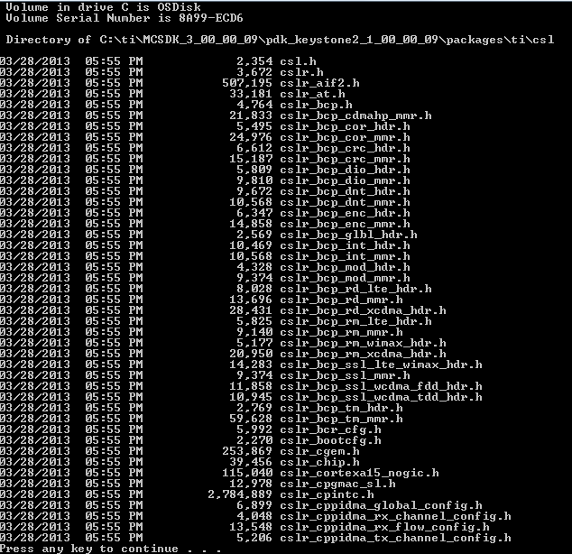
Partial List of CSL Include Files

Slide 52
DSP CorePac LLD Layer: Functions
KeyStone II Peripherals and Coprocessors
Resource Management
DSP CorePac CSL Layer
DSP CorePac LLD Layer
LLD Functions
LLD Support in MCSDK 3.x
LLD Usage
NWAL
ARM Kernel Drivers
ARM-DSP Inter-Processor Communications

Slide 53
Understanding the LLD
Almost all LLDs are part of the Platform Development Kit (PDK), which is part of MCSDK.
EDMA LLD is not part of PDK
The Real Time Software Component (RTSC) system enforces a fix structure to all the LLD modules.
The lowest level of PDK functionality is CSL.
LLD drivers are the next layer above.
The next section addresses the LLDs that are part of the PDK for MCSDK release 3.x
Almost all LLD drivers are used the same way.

Slide 54
DSP CorePac LLD Layer: Support in MCSDK 3.x
KeyStone II Peripherals and Coprocessors
Resource Management
DSP CorePac CSL Layer
DSP CorePac LLD Layer
LLD Functions
LLD Support in MCSDK 3.x
LLD Usage
NWAL
ARM Kernel Drivers
ARM-DSP Inter-Processor Communications

Slide 55
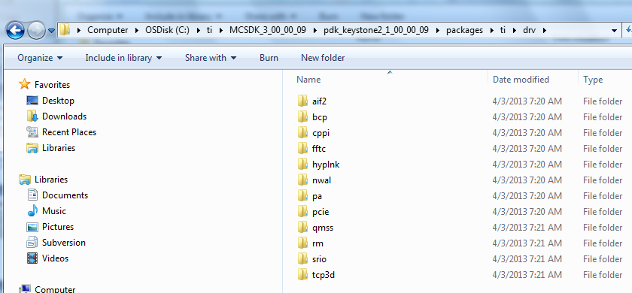
Supported LLD Drivers: MCSDK 3.0

Slide 56
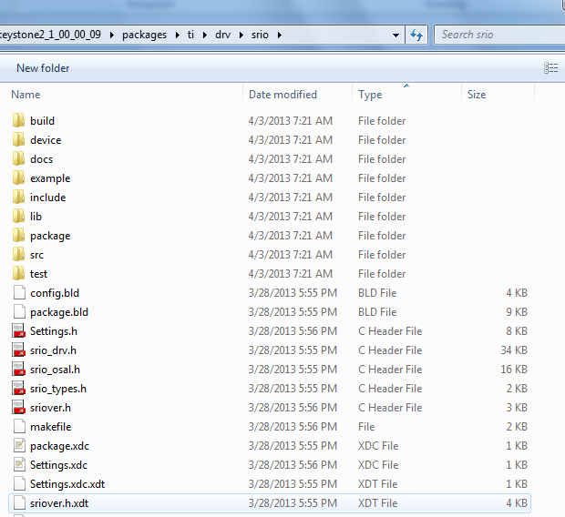
Directory
Structure of
LLD Drivers
(1/3)

Slide 57
Directory Structure of LLD Drivers (2/3)
Top directory
Include files that are visible to the application
XDC files that help with building projects
Subdirectories:
Build: Make files to build the generic libraries
Device: Device specific source code, usually definition and device specific functions
Docs: The most important subdirectory, will be discussed later.
Example: Code to support the example project
Include: Include files that are needed for internal module build

Slide 58
Directory Structure of LLD Drivers (3/3)
Additional Subdirectories:
Lib: Contains two generic libraries; little endian or big endian version (the additional e means big endian)
Package: Files that are used during the automatic building of the module
SRC: Contains the source files that are not device dependent
Test: Contains files that are part of the example test

Slide 59
Docs Directory
In the top directory
Software manifest (licensing, export control, etc.)
Release notes
User Guide*
Other module-specific documents
Doxygen Subdirectory
Collection of linked HTML files generated from the source code that describe the module objects and functions
Easy navigation between different types of information
The main tool to understand how to use the module
* not all modules have a user guide

Slide 60
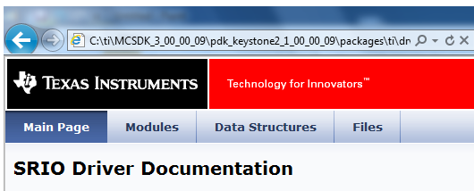
HTML Documents: Main Page

Slide 61
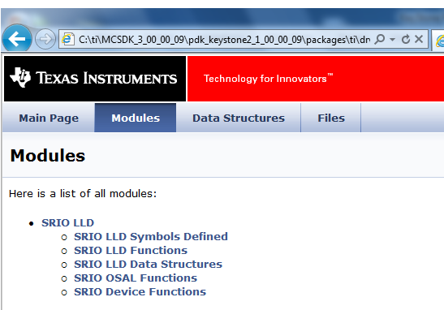
HTML Documents: Modules

Slide 62
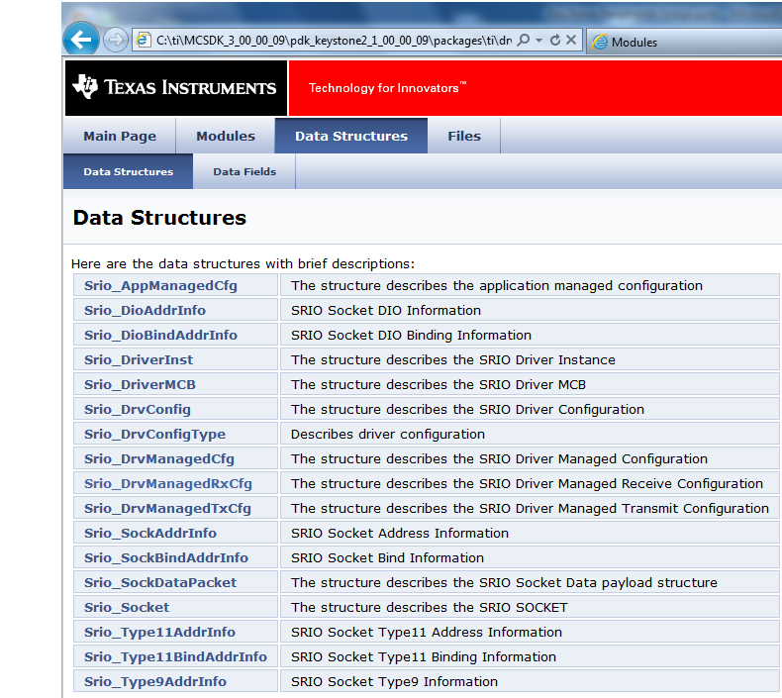
HTML Documents: Data Structures

Slide 63
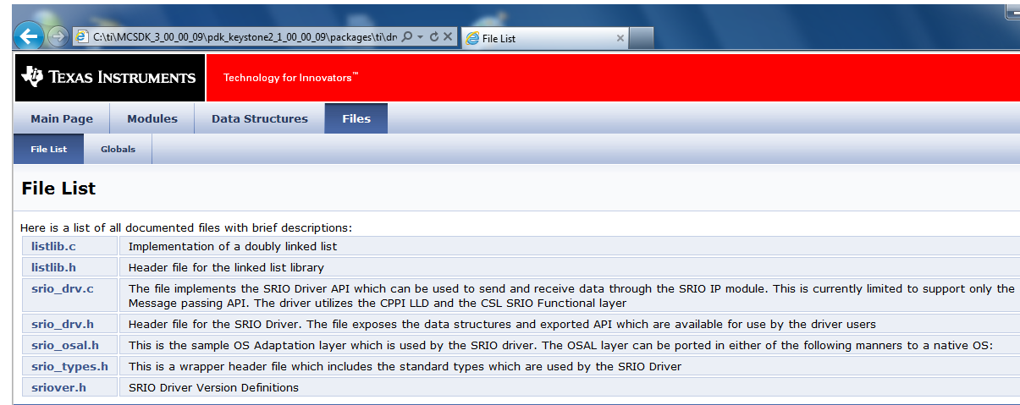
HTML Documents: Files

Slide 64
DSP CorePac LLD Layer: Usage
KeyStone II Peripherals and Coprocessors
Resource Management
DSP CorePac CSL Layer
DSP CorePac LLD Layer
LLD Functions
LLD Support in MCSDK 3.x
LLD Usage
NWAL
ARM Kernel Drivers
ARM-DSP Inter-Processor Communications

Slide 65
Developing LLD Code
Get a resource (open, create).
Resource management
Configure the resource (one core, each core).
Understand the structure of the parameters of the configuration function (example to follow)
Configure dependencies (Multicore Navigator).
Use in run time.
Follow the MCSDK example to understand what needs to be done (reverse engineer the C code).

Slide 66
PDK Example: Using SRIO Direct IO
if (coreNum == CORE_SYS_INIT)
{
System_printf ("Debug(Core %d): System Initialization for CPPI & QMSS\n", coreNum);
/* System Initialization */
if (system_init() < 0)
return;
/* Power on SRIO peripheral before using it */
if (enable_srio () < 0)
{
System_printf ("Error: SRIO PSC Initialization Failed\n");
return;
}
/* Device Specific SRIO Initializations: This should always be called before
* initializing the SRIO Driver. */
if (SrioDevice_init() < 0)
return;
/* Initialize the SRIO Driver */
if (Srio_init () < 0)
{
System_printf ("Error: SRIO Driver Initialization Failed\n");
return;
}

Slide 67
QMSS Example: Inside qmss_init
/* Initialize Queue Manager Sub System */
result = Qmss_init (&qmssInitConfig, &qmssGblCfgParams);
if (result != QMSS_SOK)
{
System_printf ("Error initializing Queue Manager SubSystem error code : %d\n", result);
return -1;
}
/* Start the QMSS. */
if (Qmss_start() != QMSS_SOK)
{
System_printf ("Error: Unable to start the QMSS\n");
return -1;
}
/* Memory Region 0 Configuration */
memRegInfo.descBase = (UInt32 *)l2_global_address((UInt32)host_region);
memRegInfo.descSize = SIZE_HOST_DESC;
memRegInfo.descNum = NUM_HOST_DESC;
memRegInfo.manageDescFlag = Qmss_ManageDesc_MANAGE_DESCRIPTOR;
memRegInfo.memRegion = Qmss_MemRegion_MEMORY_REGION_NOT_SPECIFIED;
/* Initialize and inset the memory region. */
result = Qmss_insertMemoryRegion (&memRegInfo);

Slide 68
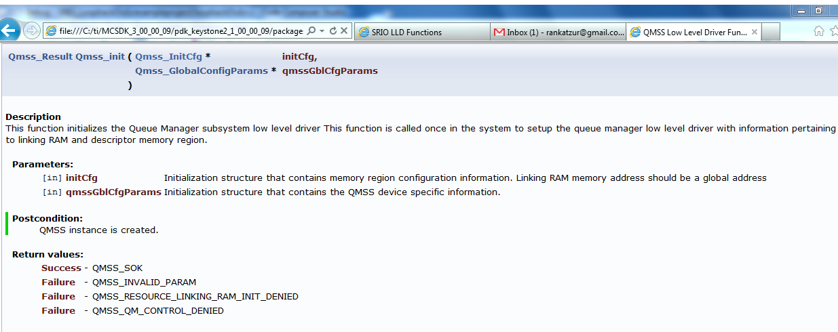
Locate qmss_init in Doc Directory (QMSS)

Slide 69
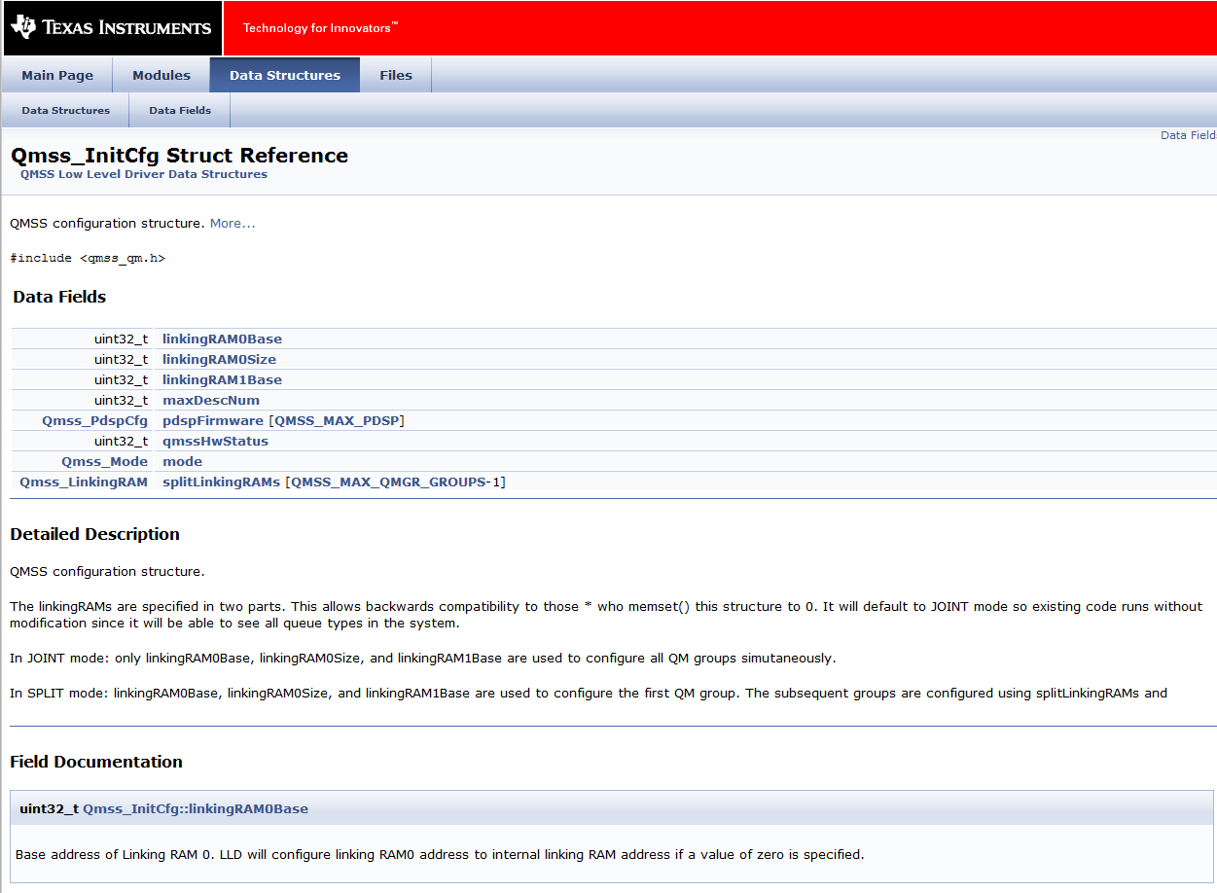
Qmss_InitCfg Struc Reference

Slide 70
Enable SRIO
static Int32 enable_srio (void)
{
/* SRIO power domain is turned OFF by default. It needs to be turned on before doing any
* SRIO device register access. This not required for the simulator. */
/* Set SRIO Power domain to ON */
CSL_PSC_enablePowerDomain (CSL_PSC_PD_SRIO);
/* Enable the clocks too for SRIO */
CSL_PSC_setModuleNextState (CSL_PSC_LPSC_SRIO, PSC_MODSTATE_ENABLE);
/* Start the state transition */
CSL_PSC_startStateTransition (CSL_PSC_PD_SRIO);
/* Wait until the state transition process is completed. */

Slide 71
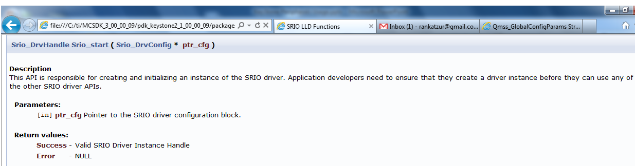
SRIO Handle to the Instance
hDrvManagedSrioDrv = Srio_start(&drvCfg);

Slide 72
DSP CorePac LLD Layer: NWAL
KeyStone II Peripherals and Coprocessors
Resource Management
DSP CorePac CSL Layer
DSP CorePac LLD Layer
LLD Functions
LLD Support in MCSDK 3.x
LLD Usage
NWAL
ARM Kernel Drivers
ARM-DSP Inter-Processor Communications

Slide 73
NETCP Configuration
NETCP is very sophisticated device that can offload all networking processing from CPU, but requires (of course) configuration.
The DSP LLD does not hide all implementation details from the application; They require multiple LLD calls and explicit usage of Multicore Navigator to configure the NETCP.
NWAL (Network Adaptation Layer) is higher layer driver library for easy configuration of the NETCP device.
NETAPI is a user’s space library that supports networking.

Slide 74
NWAL
The Network Adaptation Layer (NWAL) provides high-level driver functionality abstracting NETCP LLD for PA and SA.
NWAL supports NETCP functionality:
Classification and routing of ingress packages based on L2 (MAC), L3 (IP) and L4 (UDP - port) or L5 (GTPU ID)
MAC/IPSec/IP/UDP header generation for outgoing packets
NWAL APIs provide both blocking/synchronous and non-blocking/asynchronous support for the NETCP configuration.
NWAL is part of PDK release.

Slide 75
NWAL: NETCP Security Accelerator (SA) Configuration
Unidirectional IPSec SA creation and deletion
Unidirectional IPSec Security Policy creation and deletion

Slide 76
NWAL Dependencies
Initialization of Queue Manager Subsystem (QMSS)
Initialization of memory buffer pool with packet DMA resources including descriptors

Slide 77
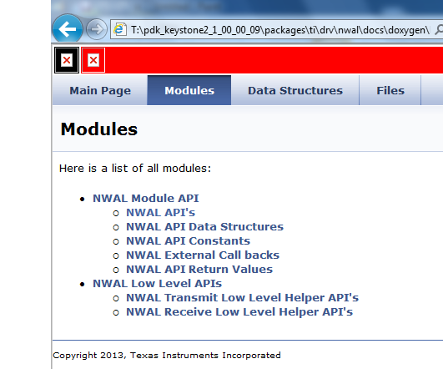
NWAL Documentation - T:\pdk_keystone2_1_00_00_09\packages\ti\drv\nwal\docs\doxygen\html

Slide 78
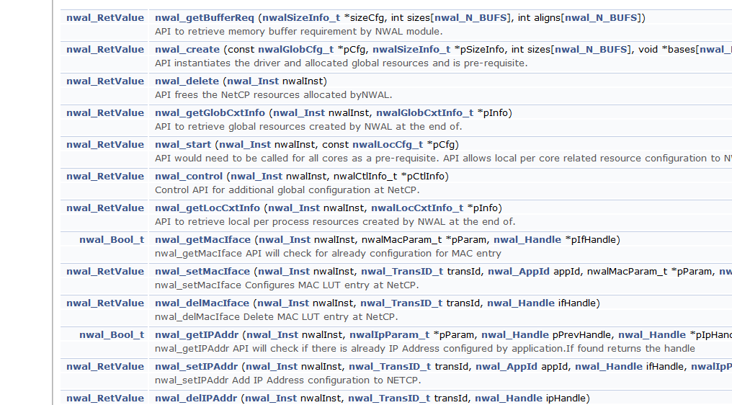
NWAL Functions (Partial List)

Slide 79
ARM Kernel Drivers
KeyStone II Peripherals and Coprocessors
Resource Management
DSP CorePac CSL Layer
DSP CorePac LLD Layer
LLD Functions
LLD Support in MCSDK 3.x
LLD Usage
NWAL
ARM Kernel Drivers
ARM-DSP Inter-Processor Communications

Slide 80
Backup – PktLib Utility Libraries

Slide 81
Packet Library (PktLib)
Purpose: High-level library to allocate packets and manipulate packets used by different types of channels.
Enhance capabilities of packet manipulation
Enhance Heap manipulation

Slide 82
Heap Allocation
Heap creation supports shared heaps and private heaps.
Heap is identified by name. It contains Data buffer Packets or Zero Buffer Packets
Heap size is determined by application.
Typical pktlib functions:
Pktlib_createHeap
Pktlib_findHeapbyName
Pktlib_allocPacket

Slide 83
Packet Manipulations
Merge multiple packets into one (linked) packet
Clone packet
Split Packet into multiple packets
Typical pktlib functions:
Pktlib_packetMerge
Pktlib_clonePacket
Pktlib_splitPacket

Slide 84
PktLib: Additional Features
Clean up and garbage collection (especially for clone packets and split packets)
Heap statistics
Cache coherency

Slide 85
For More Information
Software downloads and device-specific Data Manuals for the KeyStone II SoCs can be found at TI.com/multicore.
For articles related to multicore software and tools, refer to the Embedded Processors Wiki for the KeyStone Device Architecture.
For questions regarding topics covered in this training, visit the support forums at the TI E2E Community website.

