Slide 1
Sitara AM437x Overview
Embedded Processors Training
Multicore Applications
Literature Number: SPRPXXX

Slide 2
Agenda
AM437x Silicon Overview
Processors
Peripherals
Buses and Memory
Quick look at the system
Software Overview
AM437x Development Boards
AM437x Documentation and Tools

Slide 3
AM437x Silicon Overview
Processors
Peripherals
Buses and Memory
Quick Look at the System

Slide 4
AM437X Applications
Patient Monitoring
Security Applications
Bar Code Scanners
Navigation Equipment
Point of Service
Industrial Automation
Portable Mobile Radio
Portable Data Terminals
Test And Measure
Any other broad market EP applications
Notes:
EPOS - Electronic point of sale
SK – Software Kit
IDK – Industrial Development Kit
HS- High Security

Slide 5

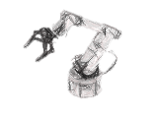


AM437x Cortex™-A9 based processors
Benefits
Performance
High performance Cortex-A9 up to 1GHz
display system
Security Engine
PRU-ICSS
Multiple system services
Peripherals and Connectivity
Variety of peripherals
Multiple high bit rate interfaces for data IO
Multiple interfaces for boot and control/monitor
Power Targets
Total Power: <1000mW
Deep sleep: ~4mW
RTC-only mode: <0.03mW
Software and development tools
Free Linux SDK directly from TI
RTOS (QNX, Nucleus, Green Hills, etc) from partners
Full featured and low cost development board options (EVM, SK, IDK)
Schedule and packaging
Samples and Dev. Tools: 2Q 2014
Production: 4Q 2014
Package: 17x17mm, 0.65 VCA, 0.8mm-pitch effective routing
ARM®
Cortex A9
Up to 1 GHz
Graphics Acceleration
SGX530
PRU
Industrial
Communication Subsystem EtherCAT®,PROFINET®, EtherNET/IP™ + Motor Feedback
Protocols +
Sigma Delta
32K/32K L1
Display
Subsystem
256K L2 / L3
64K RAM
24bit LCD
Touch Screen Controller⁽¹⁾
Security AccelerationPac
Crypto, Secure boot
Processing
Overlay, Resizing, Color Space Conversion, etc.
256KB L3 Shared RAM
32-bit LPDDR2/DDR3/DDR3L⁽²⁾
System Services
Simple Pwr Seq
EDMA
Debug
12 Timers
SyncTimer32K
WDT
RTC
2 12-bit ADCs⁽¹⁾
Connectivity and IOs
EMAC
2-port switch 10/100/1G w/1588
Camera I/F (2x Parallel)
CAN x2
PWM x6
McASP x2
NAND
/NOR (16bit ECC)
eCAP/
eQEP x3
SPI x5
GPIO
USB2 OTG +PHY x2
3 MMC/ SD/SDIO
QSPI
HDQ
I2C x3
UART x6

Slide 6
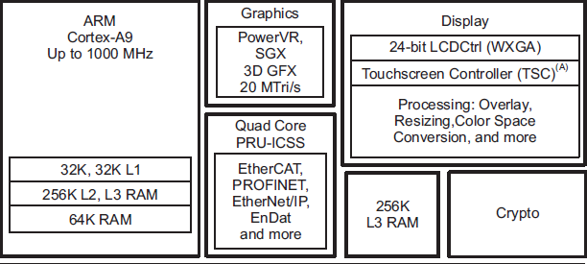
AM437x Silicon Overview Processors and Co-processors
Notes:
SGX530 – graphics Accelerator - features pixel, vertex, and geometry shader hardware, supporting OpenGL ES - 7M Triangles and 200M Pixels 1.6GFLOPS
OpenGL for Embedded Systems (OpenGL ES or GLES) is a subset of the OpenGL computer graphics rendering application programming interface (API) for rendering 2D and 3D computer graphics such as those used by video games, typically hardware-accelerated using a graphics processing unit (GPU).
Crypto

Slide 7
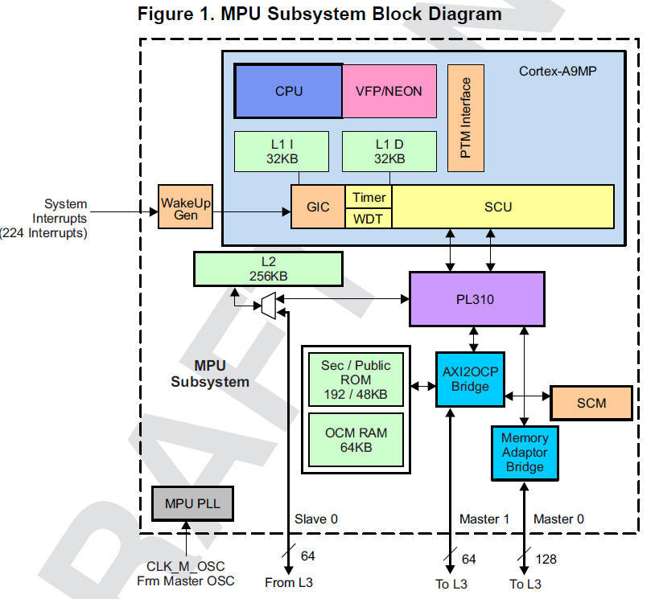
Cortex-A9 (AM437x) vs Cortex-A8 (AM335x)
VFP Fully Pipelined ~10x floating point speed up
Out of order processing and other performance improvements giving 2.5 DMIPS/MHz (~16% in actual tests
External PL310 cache controller
L2 Cache can be used as generic SRAM (SRAM or Cache - no mixing)
Interrupts (more interrupts, 224)
Generic Interrupt Controller
Wakeup Gen
local counter, watchdog timer
Up to 1GHz MPU clock

Slide 8
Cortex A-19 Features
Superscalar architecture:
2 ALU, 2 shifts, branch unit, multiply and divide, load store
2 concurrent decoded
Full implementation of ARMv7-A architecture instruction set:
More MAC instructions (normalization and rounding)
Integer divide
Pipeline optimization:
Speculating dynamic pipeline, 8-11 stages to issue
Out-of-order pipeline (8-11 stages) execution
Notes:
8 issues:
2 for Neon- VFP
2 for load and store
4 for the other (ALU, Shift, multiply)

Slide 9
Cortex A-9 Features
Dynamic branch prediction – Loop prediction and indirect branch predictor
Branch Target Address cache (BTAC)
Global History Buffer (GHB) has three arrays:
Taken array
Not taken array
Selector array
Return Stack

Slide 10
SIMD Engine NEON
64/128-bit data instructions
Fully integrated into the main pipeline
32x 64-bit registers that can be arranged as 128-bit registers
Data can be interpreted as follows:
Byte
Half-word (16-bit)
Word
Long

Slide 11
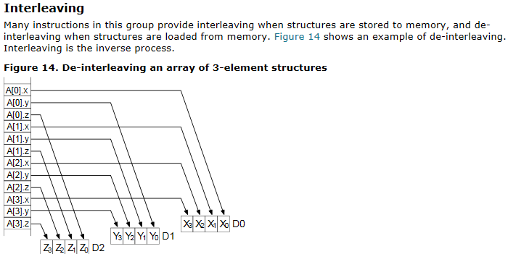
NEON Registers
NEON registers load and store data into 64-bit registers from memory with on-the-fly interleave, as shown in this diagram.
Source: ARM Compiler Toolchain Assembler Reference; DUI0489C

Slide 12
Vector Floating Point (VFP)
Fully integrated into the main pipeline
32 DP registers for FP operations
Native (hardware) support for all IEEE-defined floating-point operations and rounding modes; Single- and double-precision
Supports fused MAC operation (e.g., rounding after the addition or after the multiplication)
Supports half-precision (IEEE754-2008); 1-bit sign, 5-bit exponent, 10-bit mantissa

Slide 13
Memory Management Unit (MMU)
Logical-to-physical memory translation:
User protected
Hardware manages the actual memory
Page size – 16MB to 4KB
Memory
…
Page 1
CorePac
MMU
Logical
Address
Physical
Address
Page 2
Page 3
Page 4
TLB
Page 5
Notes:
The translation between virtual address to physical address is done via two or three steps
32 L1 Instructions
2 by 32 data L1
4 ways 512-entry L2 TLB (for each processor)

Slide 14
Programmable Real-Time Unit (PRU) Subsystem
Programmable Real-Time Unit (PRU) is a low-latency microcontroller subsystem
Two independent PRU execution units
32-Bit RISC architecture
200MHz – 5ns per instruction
Single cycle execution - No pipeline
Dedicated instruction and data RAM per core
Shared RAM
Includes Interrupt Controller for system event handling
Fast I/O interface
Up to 30 inputs and 32 outputs on external pins per PRU unit
AM335x PRU Subsystem Block Diagram
Industrial Ethernet
MII0 RX/TX
DRAM0
(8K Bytes)
32 GPO
PRU0 Core
(8KB IRAM)
30 GPI
DRAM1
(8K Bytes)
Scratchpad
shared
(12K Bytes)
32 GPO
PRU1 Core
(8KB IRAM)
32-bit Interconnect bus
30 GPI
Master I/F (to SoC interconnect)
Industrial Ethernet
MII1 RX/TX
Slave I/F (from SoC interconnect)
MDIO
IEP (Timer)
UART
Events to ARM INTC
eCAP
Interrupt Controller (INTC)
Events from Peripherals + PRUs
MPY/MAC
Notes:
Notes:
AM335x:
- 8K Byte instruction RAM (2K instructions) per core
- 8K Bytes data RAM per core
- 12K Bytes shared RAM
Although PRU can only run from IRAM, it can be reset and new code can be loaded. This allows you to use the PRU for multiple functions.
Each PRU has a total of 32 output pins and 30 input pins. Pins are multiplexed with other peripherals at the system level so there are pin muxing considerations to be kept in mind.
Main point:
The PRU subsystem has key features and dedicated resources that help solve real-time problems.
Key features:
2 PRU cores – each with dedicated instruction RAM
- RISC processors

Slide 15
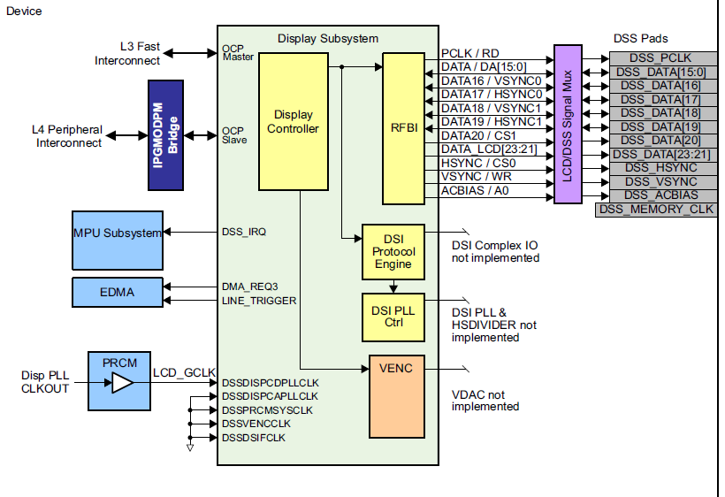
Display Subsystem (DSS)
Getting input data from frame buffer, sending output image or video to external display
Notes:
VENC -

Slide 16
Display Subsystem (DSS)
Display Subsystem
Up to 100MHz pixel clock
Up to 2048x2048 resolution, highly dependent on frame rate, bpp, etc.
Display Controller :
Input modes :
Programmable pixel display modes (1, 2, 4, 8, 12, 16, 18 and 24 bit-per-pixel modes, YUV and 24 bits RGB)
256 x 24-bit entry palette in RGB
Display support :
Passive & Active Matrix panel.
Remote Frame Buffer support through the RFBI module.
Signal processing :
Overlay support for Graphics,Video1 and Video2
Video resizer : upsampling (up to x8) downsampling (down to 1/4)
Transparency color key (source and destination)
Programmable video color space conversion YcbCr 4:2:2 into RGB
Gamma curve support
Programmable Color Phase Rotation (CPR)
Notes:
VENC - Composite Video, S-Video
Passive active Matrix Panel – supply the voltage to the LCD
Transparency color key - mixing multiple colors
Gamma curve support - compensate for the way the eye sees things
Programmable Color Phase Rotation – changing the phase of presentation of color (2 values, radius and phase)

Slide 17
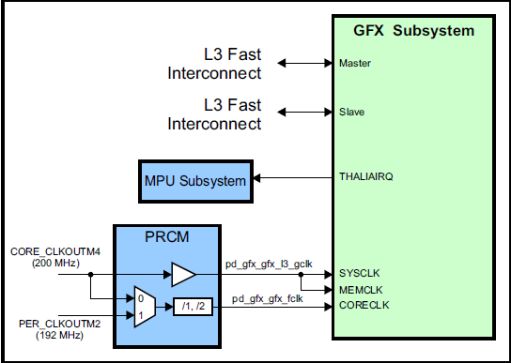
Graphic Accelerator SGX530 (Imagination Technologies)
2D and 3D graphics
Tile-based architecture
Universal scalable shader engine (USSE™) – multithreaded engine incorporating pixel and vertex shader functionality
Industry-standard API support: OpenGL ES 1.1 and 2.0, OpenVG v1.0.1
Advanced geometry direct memory access (DMA)
Programmable high-quality image anti-aliasing

Slide 18
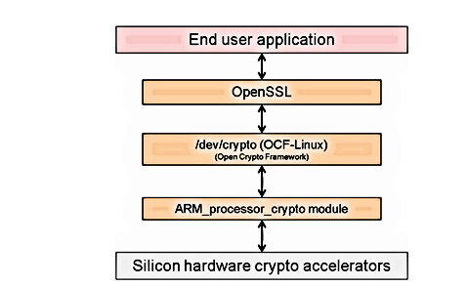
Crypto Hardware Accelerator
offload cryptographic processing from the ARM core
OpenSSL
Crypto
Secure Boot
Notes:
OpenSSL is an open-source implementation of the SSL and TLS protocols.
The core library, written in the C programming language, implements basic cryptographic functions and provides various utility functions.

Slide 19
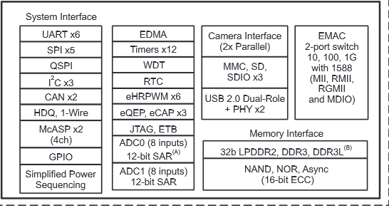
AM437x Silicon Overview Peripherals

Slide 20
Camera Subsystem (2x)
Camera clock
and
synchronization signal
Parallel camera
Timing control
VPFE
Dual Port 8/10bit BT656 interface
Single port 12-bit interface
YUV422/RGB422, BT656, RAW input formats
Up to 75MHz input pixel clock
Bar code scanner
processing sub module
C C D C
PREVIEW
L3
MMU
REGISTERS
L4
Notes:
VPFE – Video Port Front End
BT 656 – digital video Protocol for streaming uncompressed PAL or NTSC
CCD – Charged Couple device (digital camera)
CCDC – Charge Couple device controller
75MHZ input pixel clock (2Kx1Kx30fps)

Slide 21
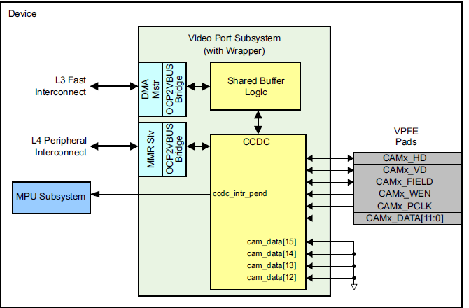
Camera Subsystem
Notes:
VPFE – Video Port Front End
BT 656 – digital video Protocol for streaming uncompressed PAL or NTSC
CCD – Charged Couple device (digital camera)
CCDC – Charge Couple device controller
For 16 bits interface, two VPFE are connected together
Row data - color filter array (CFA or RGB color space Foveon X3 sensors

Slide 22
EMAC – Ethernet Media Access Controller switch
New feature vs. AM335x
AM437x
AM437x
Port2
Port2
Port0
Port1
Port0
Port1
Dual MAC mode
Switch mode
Two 10/100/1000Mb external ports, 3 port Ethernet switch
Supports standard Media Independent Interface (MII), Reduced Media Independent Interface (RMII), Gig Reduced Media Independent Interface (RGMII) to physical layer device (PHY)
Layer 2 switch (1024 addresses LUT)
Includes MDIO interface to control/communicate with PHY
Reset Isolation
EXTDEV PLL to provide clock to external PHY
Notes:
(Ipv4, Ipv6, 802.3x) - software support
MDIO – Management Data Input-Output serial link to talk to the physical front end

Slide 23
Ethernet: changes from AM335x
Added capability to derive REFCLK for Ethernet PHY from AM437x
Added Low Jitter EXTDEV PLL
Saves cost of external crystal or oscillator for PHY
25MHz REFCLK for other PHYs
50MHz REFCLK for RMII PHY clock (default for ROM for boot)
Separated voltage domains of MDIO clk/data and Ethernet I/F in all I/O sets
Compliant to IEEE Ethernet Vmin=2.0V spec
Expanded pinmux options
NAND + Dual Ethernet supported
IEEE1588 TimeStamp
Provides accurate time based control over Ethernet
Ability to provide separate PLL (reusing Display PLL) with Fractional M multiplier for time stamping
IPV6 time stamping. Now supporting Annex D, E , F
Added support for Ethernet operation in CORE OPP50
Internal TX Delay mode supported by default to enable RGMII boot
New feature vs. AM335x
AM437x
Ethernet
PHY
CLKOUTx

Slide 24
USB 2.0 – Universal Serial Bus
New feature vs. AM335x
Benefit: 2x xHCI DRD (dual role device) USB controllers with embedded DMA and integrated PHYs provide a mechanism that complies with the USB2.0 standard for data transfer between USB devices up to 480 Mbps. Its dual-role feature allows the capability to operate as a host or peripheral.
20+% performance improvement
AM335x
Mentor OTG controller
AM437x
xHCI controller
New generation xHCI provides industry standard register definition for USB host controllers supported by open-source drivers
AM437x adds capabilities to xHCI for peripheral mode
2 ports (USB0 and USB1)
Both ports bootable
USB0 as peripheral,
USB1 as host. Can boot off of a MSD (ie, flash drive)
Swappable DP/DM to facilitate clock routing
Notes:
eXtensible Host Controller Interface (xHCI) is a computer interface specification
DM/DP differential physical interface, data plus data minus
Super Speed – 5G not supported
Internal DMA controller
– Descriptor caching and data pre-fetching ensures high performance
– Dynamic FIFO memory allocation for all endpoints
OCP – open Core Protocol

Slide 25
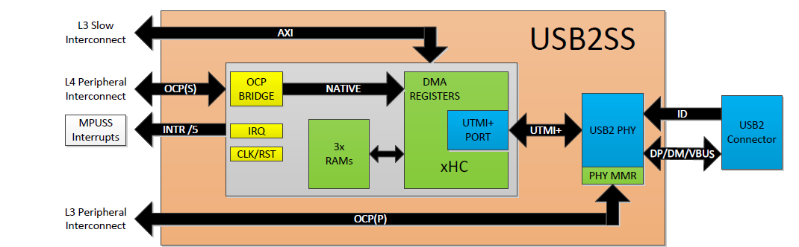
USB 2.0 – Universal Serial Bus
Operating as a host, it compiles with USB2.0 standard for high-speed, full-speed and low-speed operation with a peripheral
Operating as a peripheral, it compiles with USB2.0 standard for high-speed and full-speed operation with a host
SuperSpeed is not supported! (Did not integrate SuperSpeed PHY)
Supports all modes of transfers (control, bulk, interrupt, and isochronous)
Supports 15 simultaneous Transmit (TX) and 15 Receive (RX) endpoints, in addition to endpoint 0
All new devices (Keystone, Vayu, etc.) going forward will be using xHCI controller (driver compatibility)
Notes:
eXtensible Host Controller Interface (xHCI) is a computer interface specification
DM/DP differential physical interface, data plus data minus
Super Speed – 5G not supported
Internal DMA controller
– Descriptor caching and data pre-fetching ensures high performance
– Dynamic FIFO memory allocation for all endpoints
OCP – open Core Protocol )additional P – Presence - assertions and constraints
UTMI, USB 2.0 Transceiver Macrocell Interface

Slide 26
External memory interfaces
New feature vs. AM335x
Features of the GPMC include:
8-bit and 16-bit wide data bus
Programmable cycle timings for each chip select
Up to 16-bit ECC support for NAND Flash using BCH code (t=4, 8 or 16) or Hamming code for 8-bit or 16-bit NAND-flash
Integrated ELM (Error Locator Module) to provide ECC calculation (up to 16b) for NAND support. Supports 4-bit, 8-bit and 16-bit per 512byte block error location based on BCH algorithms
used to connect NAND, NOR (async and sync), FPGAs, etc
Features of the MMC/SD include support for:
3 MMC/SD ports
Multimedia card (MMC v4.3/ SD 2.0 ), supports >2GB capacity on eMMC boot on MMC0
Card detect and write protect on each MMCSD port
48 MHz maximum I/O clock rate (up to SDR25 speeds)
Features of the QSPI:
Supports up to 4bit read, 1bit write
Up to 48MHz clock, Master only
Supports eXecute-In-Place (XIP) from serial NOR flash
Primarily intended for fast boot from quad-SPI flash devices

Slide 27
AM437x has numerous serial peripherals…
New feature vs. AM335x
12 GP Timers & 1 watchdog timer
Free-running 32-bit upward counter. Runs off 32KHz or 19.2, 24, 25, 26 MHz system clock.
WDT: MPU Watchdog (runs off of 32KHz system clock)
1 Sync Timer (32KHz)
Special always on 32K timer for OS
I2C (3)
3 I2C ports compliant with Philips I2C specification version 2.1
Support for standard (up to 100K bits/s) and fast (up to 400K bits/s) modes
General-Purpose I/O (GPIO) Interface (6 banks, each 32 GPIO)
Synchronous interrupt requests in active mode from each channel are processed by GIC (General Interrupt Controller) in MPUSS.
Asynchronous wake-up request
192 total GPIOs muxed with other signals
Multichannel Audio Serial Port Interface (2)
Data Clock 50 MHz ,
Two Clock Zones and up to 4 Serial Data Pins per McASP port
Supports TDM, I2S and Similar Formats
Supports DIT mode
48K, 96K and 192K sample rate, 8 to 32 bits per sample, 384 time slots
Universal Asynchronous Receiver Transmitters (UART) (6)
UART1 will support full Modem Control (CTS,RTS,DTR, DSR, DCD, RIN)
All UARTs support IrDA, CIR and RTS, CTS flow control.
Supports baud rate up-to 3.6M bits/s.
Notes:
WDT – Watchdog Timer
MPU – Microprocessor Unit
McASP - general-purpose audio serial port optimized for the needs of multichannel audio applications. The McASP is useful for time-division multiplexed (TDM) stream, Inter-Integrated Sound (I2S) protocols, and intercomponent digital audio interface transmission (DIT). 384 time slots, each 8,12,16,20,24,28,32 bit, 2 to 32 streams
CTS RTS DTR DSR DCD RIN -RTS / CTS Flow Control is another flow control mechanism that is part of the RS232 standard Transmission Initialization bit (TIN) and
the Receive Initialization bit (RIN)
Sync Timer -32 bits on 32KHZ (falling edge). Go from zero to pre-define value and continue from zero

Slide 28
AM437x has numerous serial peripherals (cont.)…
New feature vs. AM335x
PWM Subsystem
eCAP (3)
Up to Three 32-bit enhanced Capture Modules – configurable as 3 capture inputs or 3 auxiliary PWM outputs
eHRPWM (6)
Up to Six Enhanced High Resolution PWM modules (eHRPWM) – with dedicated 16-bit time base counter with time and frequency controls.
eQEP (3)
Up to Three 32-bit enhanced Quadrature Pulse Encoder modules
HDQ/1-wire
For connection to battery gauges
DCAN (2)
Same as AM335x
McSPI (5)
Master/Slave operation, 48MHz clock
Up to 4 channels for each McSPI0,1, two channels on McSPI2,3
Notes:
PWM - Pulse Width Modulation
The Pulse-Width Modulation Subsystem (PWMSS) consists of an instance of Enhanced High Resolution Pulse Width Modulator (eHRPWM),
Enhanced Capture (eCAP), and Enhanced Quadrature Encoded Pulse (eQEP) modules.
1-Wire is a device communications bus system designed by Dallas Semiconductor Corp. that provides low-speed data, signaling, and power over a single signal.^{[1]} 1-Wire is similar in concept to I²C, but with lower data rates and longer range.
HDQ –HDQ communication between host and slave single wire open-drain, The protocol is asynchronous
DCAN Control Area Network - The Controller Area Network is a serial communications protocol which efficiently supports distributed
realtime control with a high level of security. The DCAN module supports bitrates up to 1 Mbit/s and is
compliant to the CAN 2.0B protocol specification. The core IP within DCAN is provided by Bosch.
This device includes two instantiations of the DCAN controller: DCAN0 and DCAN1
McSPI – Multichannel Serial Interface

Slide 29
AM437x: Two ADCs
New feature vs. AM335x
AM437x
AM335x
ADC0
ADC0
ADC1
ADC0 (Touchscreen)
12-bit Successive Approximation Register (SAR) ADC
867KSPS
8 analog inputs
Can be configured as a Touchscreen Controller. When configured as TSC, it takes away pins/channels for general purpose ADC use.
ADC1
12-bit Successive Approximation Register (SAR) ADC with preamp
867KSPS
8 analog inputs
ADC0
8inputs
AFE
Simultaneous mode
ADC1 controls ADC0 AFE
2 16bit results can be read from one 32bit register inputs converted to 32bit value
ADC1
16bits
FIFO1
32bits
8inputs
AFE
FIFO0
16bits
Notes:
Successive Approximation register
KSPS – k signals per second?
AFE-

Slide 30
Memories and Buses
L3 Interconnect
ARM Subsystem
Programmable Real-Time Unit (PRU) Subsystem
Interconnect
PRU0 (200MHz)
PRU1 (200MHz)
PRU0 I/O
Cortex-A8
L3 Interconnect
PRU1 I/O
Shared RAM
Inst. RAM
DataRAM
Inst. RAM
DataRAM
L1 Instruction Cache
L1 Data Cache
L2 Data Cache
L4 Interconnect
INTC
Peripherals
Shared
Memory
Peripherals
Peripherals
GP I/O
Notes:
ARM + PRU + memories + peripherals = SoC
PRU works as a co-processor in system-level implementation, or
- PRU works independently

Slide 31

Buses and Memories
PMU Internal memories
32K L1P, 32K L1D, 256K L2/L3, 64K RAM
PRU Internal memory
Data and Instruction RAM per PRU, Shared RAM
L3 Shared RAM (OCMC)
256KB shared memory
External Memory
32-bit LPDDR2/DDR3/DDR3L
Notes:
PMU – Programming Multi-channel Unit (The ARM module)
LPDDR - Low Power Double Data Rate memory 266MHZ
DDR3 – 400MHZ
DDR3L – low voltage DDR3
OCMC – On chip memory controller

Slide 32
AM437x Memory interface (LPDDR2/DDR3)
Features of the EMIF4D include:
Frequency Targets
LPDDR2: 266 MHz Clock (532 MHz Data Rate)
DDR3 (1.5V) /DDR3L (1.35V): 400 MHz Clock (800 MHz Data Rate)
16 or 32 bit data bus
2GB total addressable space
Supported Memory configurations
1 load (x32 device)
2 loads (x16 devices)
4 loads (x8 devices)
Supports a maximum of 4 address loads DDR3, 2 data loads for LPDDR2 and 1 data load for DDR3
New feature vs. AM335x
T topology
DDR3
(x16)
AM437x
DDR3
(x16)
Fly-by topology
Point to point
D[31:16]
AM437x
LPDDR2 (x32)
AM437x
D[15:0]
DDR3
(x16)
DDR3
(x16)
AM437x
DDR3
(x16)
Addr/Ctrl
VTT
Notes:
Fly-by Topology – interleaving between the two memories (time delay)

Slide 33
AM437x DDR3 Low Power
New feature vs. AM335x
DeepSleep
AM437x
VDDS_DDR
DDR3
VDDS_DDR
DDR_RESET
Low power enhancements for DDR3
Fail Safe I/O for DDR_RESET: Facilitates external pull-up to keep DDR in self-refresh during RTC+DDR.
PMIC: Load Switch facilitates separation of DDR voltage to AM437x and DDR memory
Added extra signaling in hardware to facilitate suspend/resume sequencing
DDR_CKE
WKUP
RTC + DDR
VDDS_DDR
AM437x
VDDS_DDR
DDR3
DDR_RESET
DDR_CKE
Notes:
PMIC – Power Management integrated circuit

Slide 34
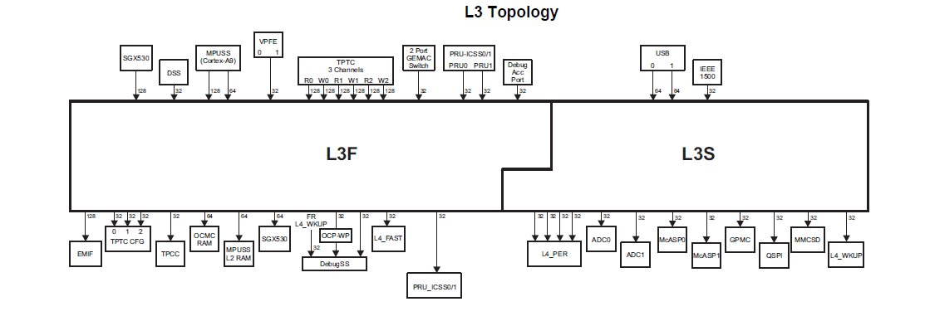
Buses and Memories- Inter-Connect
L3 – High performance Interconnect
Packet based protocol based on a Network-On-Chip (NoC) interconnect infrastructure
Connect all high bit rate peripherals and IP

Slide 35
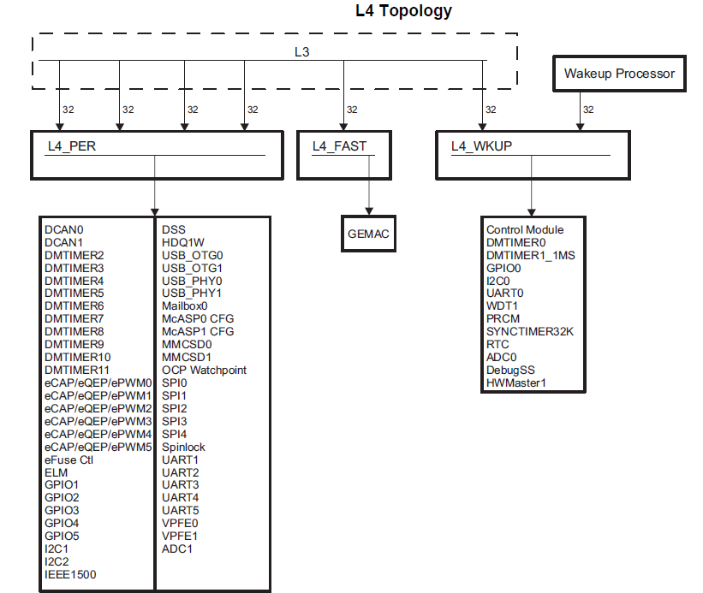
Buses and Memories-Inter-Connect
L4 - low latency low bandwidth access inter-connect
non-blocking peripheral interconnect
Up to 4 Masters (Initiators) and up to 63 slave (targets)

Slide 36
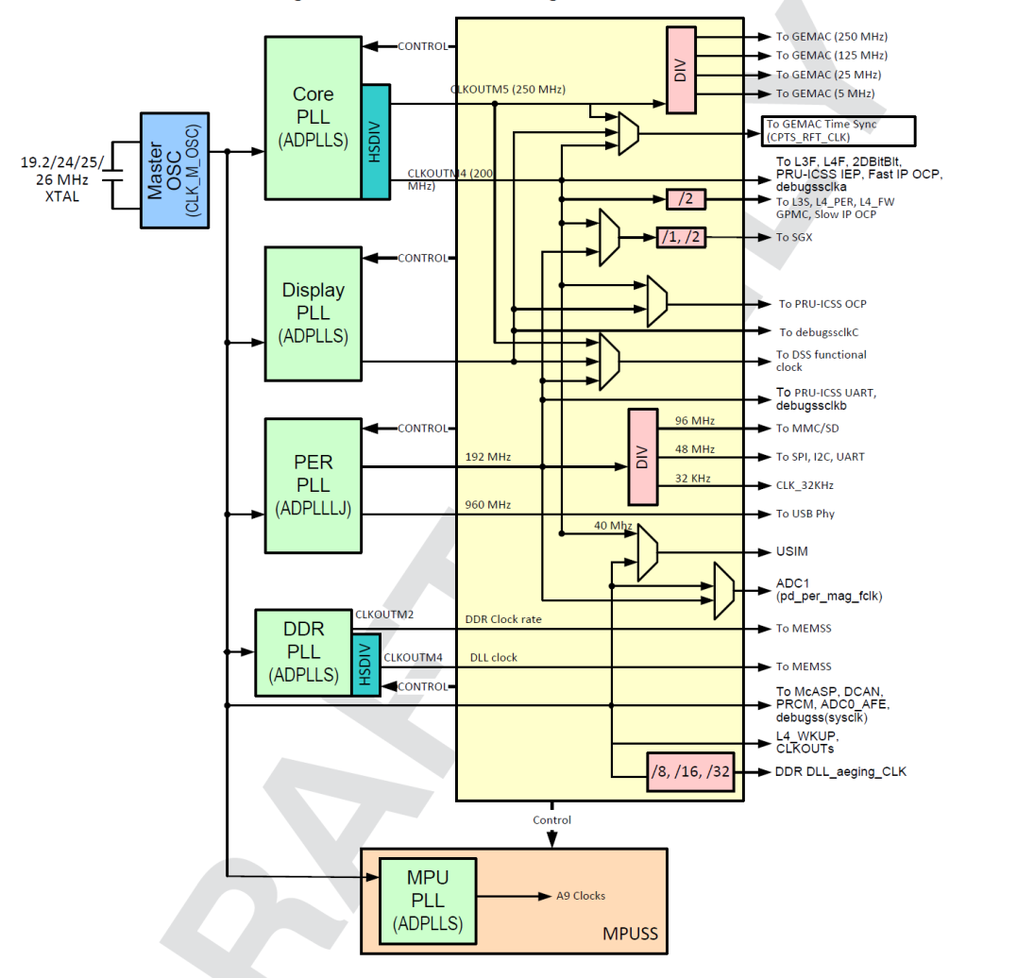
Clocks
Input Clocks to device
19.2, 24, 25, 26 MHz system clock
RTC Clock - 32kHz clock. From Crystal or PER PLL
6 PLLs to generate various system clocks:
MPU PLL - ARM MPU subsystem
DDR PLL – for DDR interface
PER low jitter PLL - USB & Peripherals (MMC/SD, UART, SPI, I2C, etc.)
CORE PLL - L3, L4, Ethernet, SGX
Display PLL – DSS Pixel Clock and IEEE1588
EXT low jitter PLL – drives external devices through CLKOUTx
New feature vs. AM335x

Slide 37
AM437x ROM (Boot ROM)
New feature vs. AM335x
Boot from a number of sources, selectable with SYSBOOT pins
Memory boot
SD cards
eMMC – support for >2GB on either MMC0 or MMC1
NOR flash – support for muxed and non-muxed XIP boot
NAND flash - 8 or 16 bit
SPI EEPROMs
QSPI - XIP boot from serial flash
USB Host (USB1) – USB mass storage devices, USB thumb drives, great for product upgrades
Peripheral boot
Ethernet – support for MII, RMII, and RGMII boot.
USB client (USB0)
UART
Boot occurs in MPU and CORE OPP50 in all modes
Notes:
Memory Booting: booting the device by executing firmware stored on permanent memories like flashmemory
or memory cards. This process usually occurs after a cold or warm reset of the device.
• Peripheral Booting: booting the device by downloading the executable code over a communication
interface such as UART, USB, or Ethernet. This process is can also be used to flash a device.
eMMC – e Multi Media card
Opp50 – certain voltage

Slide 38




AM437x: A scalable platform with 4 pin-to-pin compatible devices
ARM Cortex-A9
(MHz)
Graphics
Programmable Real-time Unit & Industrial Communication Sub-System (PRU-ICSS)∆
Package
AM4379
800/1000*
3D graphics
PRU-ICSS + EtherCAT® slave
17x17/0.65mm †
Pin-to-Pin Compatible
Software Compatible
AM4378
800/1000*
3D graphics
PRU-ICSS
17x17/0.65mm †
AM4377
800/1000*
PRU-ICSS + EtherCAT® slave
17x17/0.65mm †
AM4376
800/1000*
PRU-ICSS
17x17/0.65mm †
∆ PRU-ICSS is commonly used for slave industrial communication protocols such as PROFIBUS, PROFINET®, Powerlink, Ethernet/IP™ and EnDat
† Via Channel Array technology provides 0.8mm-pitch effective layout routing rules.
*pending silicon characterization

Slide 39
AM437x – Differentiation vs. AM335x
Improved vs.
AM335x
Cortex-A9 delivers up to 2500 DMIPs
20% higher than Cortex-A8
VFP unit 10 times faster than Cortex-A8
45nm
ICSS for industrial protocol acceleration - enables simultaneous industrial Ethernet protocols and motor feedback protocols.
ARM®
Cortex A9
Up to 1 GHz
Graphics Acceleration
SGX530
PRU-ICSS
Industrial
Communications + Motor Feedback
Protocols +
Sigma Delta
256KB RAM configurable as either L2 cache or L3 SRAM, providing up to 512KB of internal L3 RAM
32K/32K L1
Display
Subsystem
Display processing off-loads CPU from tasks such as overlay, etc.
Contributes to higher performance than AM335x
256K L2 / L3
24bit LCD
64K RAM
Touch Screen Controller
Increased L3 RAM (AM335x has 64KB)
32b DDR memory interface increases bandwidth (vs 16b in AM335x)
Security AccelerationPac
Crypto, Secure boot
Processing:
Overlay, Resizing, Color Space Conversion, etc.
256KB L3 Shared RAM
32-bit LPDDR2/DDR3/DDR3L
Secure boot enables IP protection, anti-cloning, and take-over protection
System Services
Simplified power sequencing for flexible power design
System cost savings
Simple Pwr Seq
EDMA
Debug
12 Timers
SyncTimer32K
WDT
RTC
2x 12-bit ADCs
Connectivity and IOs
EMAC
2-port switch 10/100/1G w/1588
Camera I/F (2x Parallel)
CAN x2
PWM x6
McASP x2
NAND
/NOR (16bit ECC)
QSPI interface enables execute-in-place (XIP) from low-cost NOR flash
Enables DDR-less applications
eCAP/
eQEP x3
SPI x5
GPIO
Single/Dual camera port
For apps such as data terminals, barcode scanners, etc.
USB2 OTG +PHY x2
3 MMC/ SD/SDIO
QSPI
HDQ
I2C x3
UART x6
Increased SPI, Timers, PWMs, and ADC inputs
New HDQ/1-Wire interface for sensors and battery monitor

Slide 40
System enhancements over AM335x
New feature vs. AM335x
I/O Cell Power Management
I/O Daisy chaining - Allows for wakeup from any GPIO, not just wakeup domain GPIO0
I/O Isolation – more control with low power pad configuration
MPU auto clock gating
MPU will automatically be clock gated in WFI
Wakeup via interrupts
Simplified power sequencing
Provide 1.8V bias voltage from 3.3V rail.
Simplifies power up/down sequencing for discrete power solutions

Slide 41
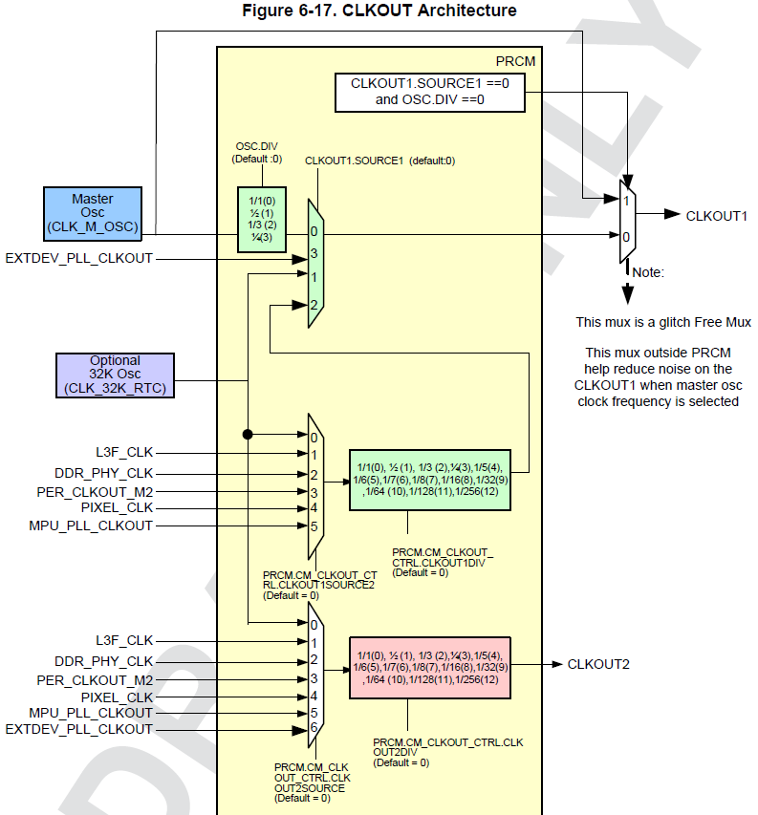
System enhancements over AM335x
New feature vs. AM335x
Improved CLKOUT performance
Output buffers are on separate voltage domain to reduce noise
Provided low jitter PLL for Ethernet, modem applications
Added different input options (MPU clock, EXT PLL)
CLKOUT1 path is optimized

Slide 42
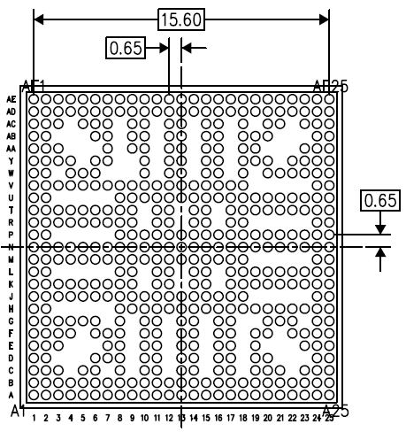
Package
ZDN Package:
17x17 mm 0.65 pitch via channel array [0.8 routable] package
Separate VDD_MPU and VDD_CORE

Slide 43
Tools and Software Overview

Slide 44
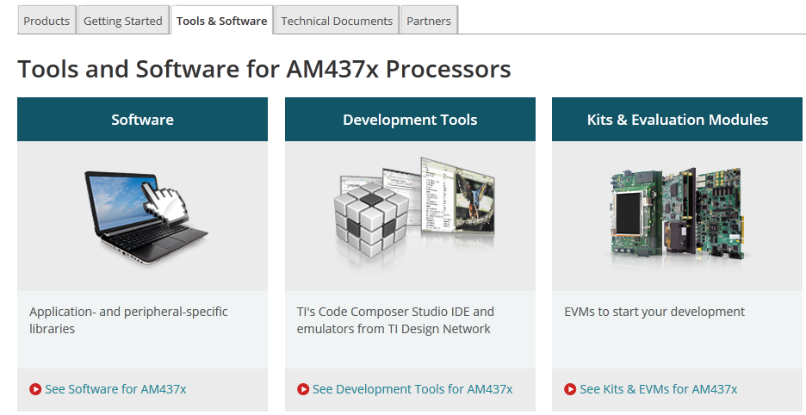
Software and tools Page http://www.ti.com/lsds/ti/arm/sitara_arm_cortex_a_processor/arm_cortex_a9_core/am437x_arm_cortex_a9/tools_software.page

Slide 45
Software Product page http://software-dl.ti.com/sitara_linux/esd/AM437xSDK/latest/index_FDS.html

Slide 46
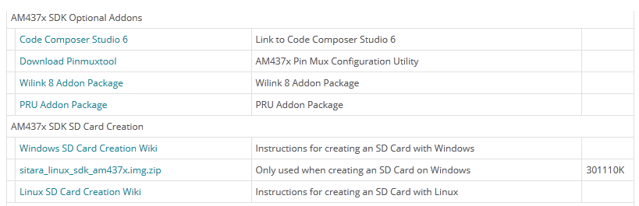
Software Product page (2) http://software-dl.ti.com/sitara_linux/esd/AM437xSDK/latest/index_FDS.html

Slide 47
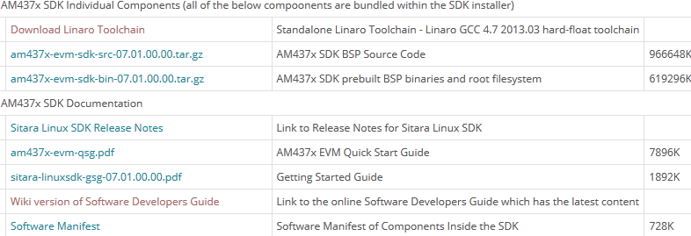
Software Product page (3) http://software-dl.ti.com/sitara_linux/esd/AM437xSDK/latest/index_FDS.html

Slide 48
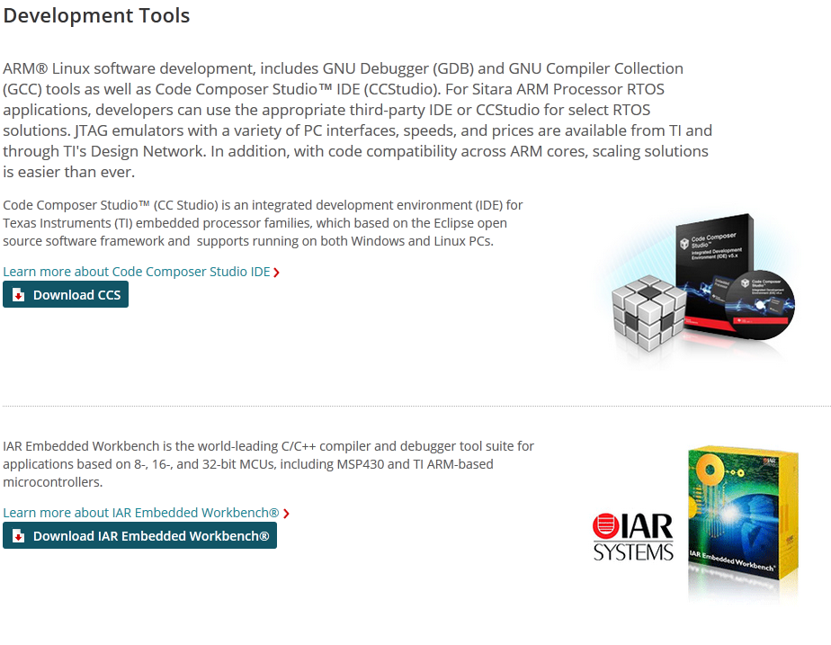
Development Tools http://www.ti.com/lsds/ti/arm/sitara_arm_cortex_a_processor/arm_cortex_a9_core/am437x_arm_cortex_a9/tools_software.page#tools

Slide 49
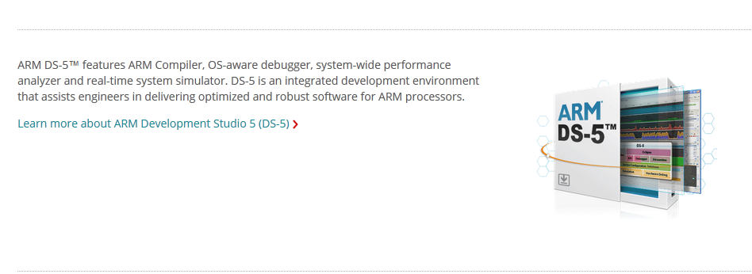
Development Tools (2) http://www.ti.com/lsds/ti/arm/sitara_arm_cortex_a_processor/arm_cortex_a9_core/am437x_arm_cortex_a9/tools_software.page#tools

Slide 50
CCS Functional Overview
Compiler
Asm Opto
Standard Runtime Libraries
Linux and
Application
Libraries
SIM
.asm
.c
.lib
DSK
Edit
.asm
Asm
.obj
Link
Debug
EMU
.out
EVM
.map
Third
Party
Code Composer Studio Includes:
Integrated Edit / Debug GUI
EMU
Simulator
Code Generation Tools
Integrated Code generation Tools
PRU C compiler
Target Board

Slide 51

TI Reference designs – make your life easy

Slide 52
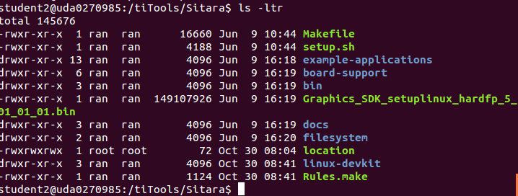
Linux SDK
Notes:
PMU – Programming Multi-channel Unit (The ARM module)
LPDDR - Low Power Double Data Rate memory 266MHZ
DDR3 – 400MHZ
DDR3L – low voltage DDR3
OCMC – On chip memory controller

Slide 53
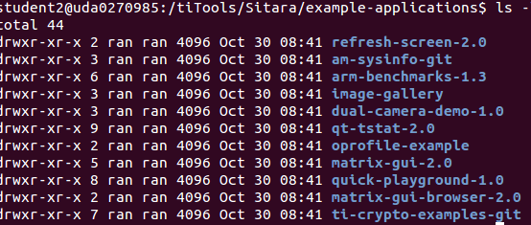
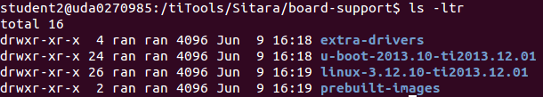
Linux SDK directories (1)
Notes:
PMU – Programming Multi-channel Unit (The ARM module)
LPDDR - Low Power Double Data Rate memory 266MHZ
DDR3 – 400MHZ
DDR3L – low voltage DDR3
OCMC – On chip memory controller

Slide 54
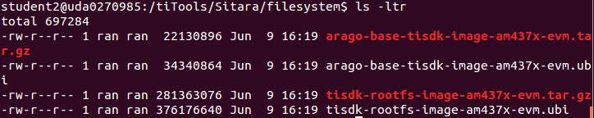
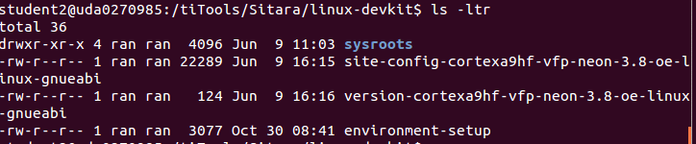
Linux SDK directories (2)
Notes:
PMU – Programming Multi-channel Unit (The ARM module)
LPDDR - Low Power Double Data Rate memory 266MHZ
DDR3 – 400MHZ
DDR3L – low voltage DDR3
OCMC – On chip memory controller

Slide 55
AM437x Development Platforms

Slide 56
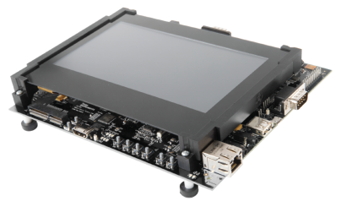
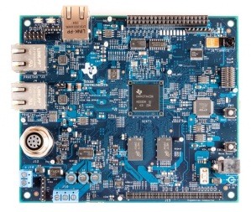
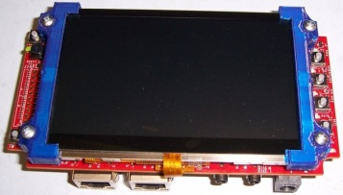
AM437x EVMs and Development Tools
TMDXEVM437X
TMDXSK437X
TMDXIDK437X
CPU-Freq
AM4378 – Up to 1GHz
AM4378 – Up to 1GHz
AM4379 – Up to 1GHz
Memory
2GB DDR3
1GB DDR3L
1GB DDR3
Display
7” Cap Touch / LCD
4.3” Cap Touch / LCD
None
PMIC
TPS65218
TPS65218
Discrete solution
WLAN/BT
Connector for WiLink8
Connector for WiLink8
N/A
Key Features
2x Camera modules
1x Gb Ethernet port
NAND/eMMC
2x DCAN
HDMI/LCD
In/Out audio
1x Camera module
2x Gb Ethernet ports
QSPI-NOR Flash
No DCAN
LCD only
In/Out audio
1x Camera module
QSPI-NOR Flash
1x Gb Ethernet
PWM & ADC
No display
2x Industrial Ethernet
Software
Linux
Linux
SYS/BIOS
Available
2Q 2014
4Q 2014
3Q 2014
Target: $599
Target: $299
Target: $329

Slide 57
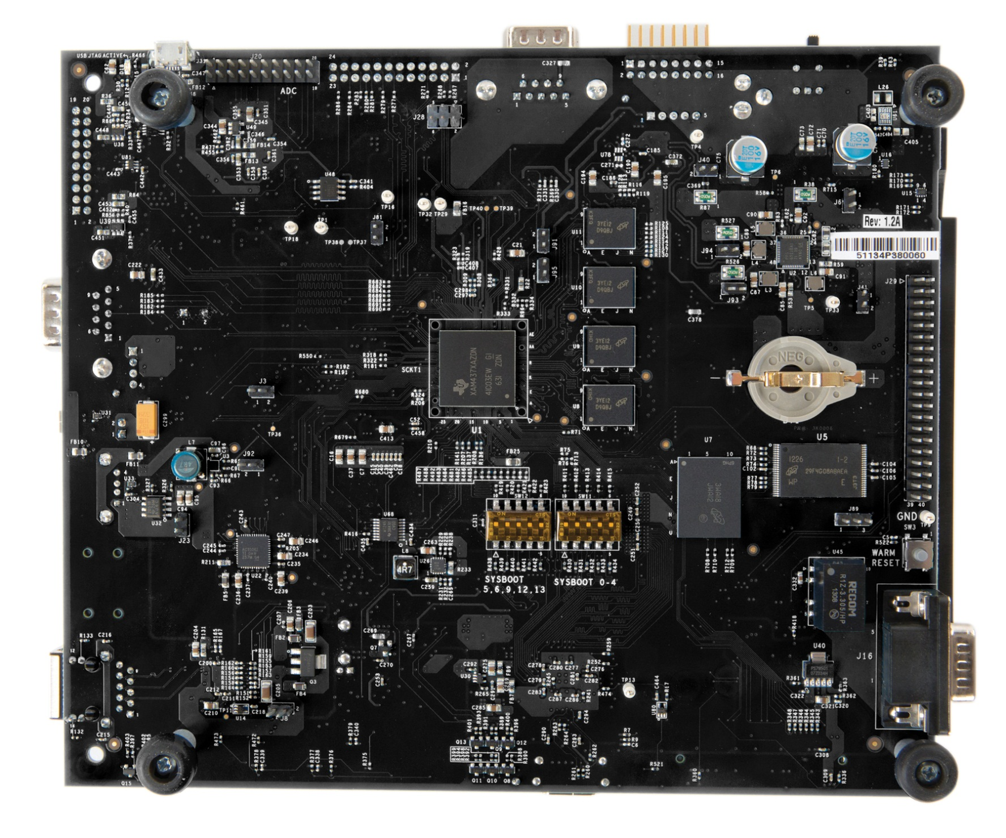
Peripheral support on AM437x GP EVM
USB JTAG
ADC header
4 x8 Fly-by DDR3
uSD
PMIC
AM437x
NAND (4Gb)
Audio codec
SYSBOOT
eMMC (4GB)
DCAN #1

Slide 58
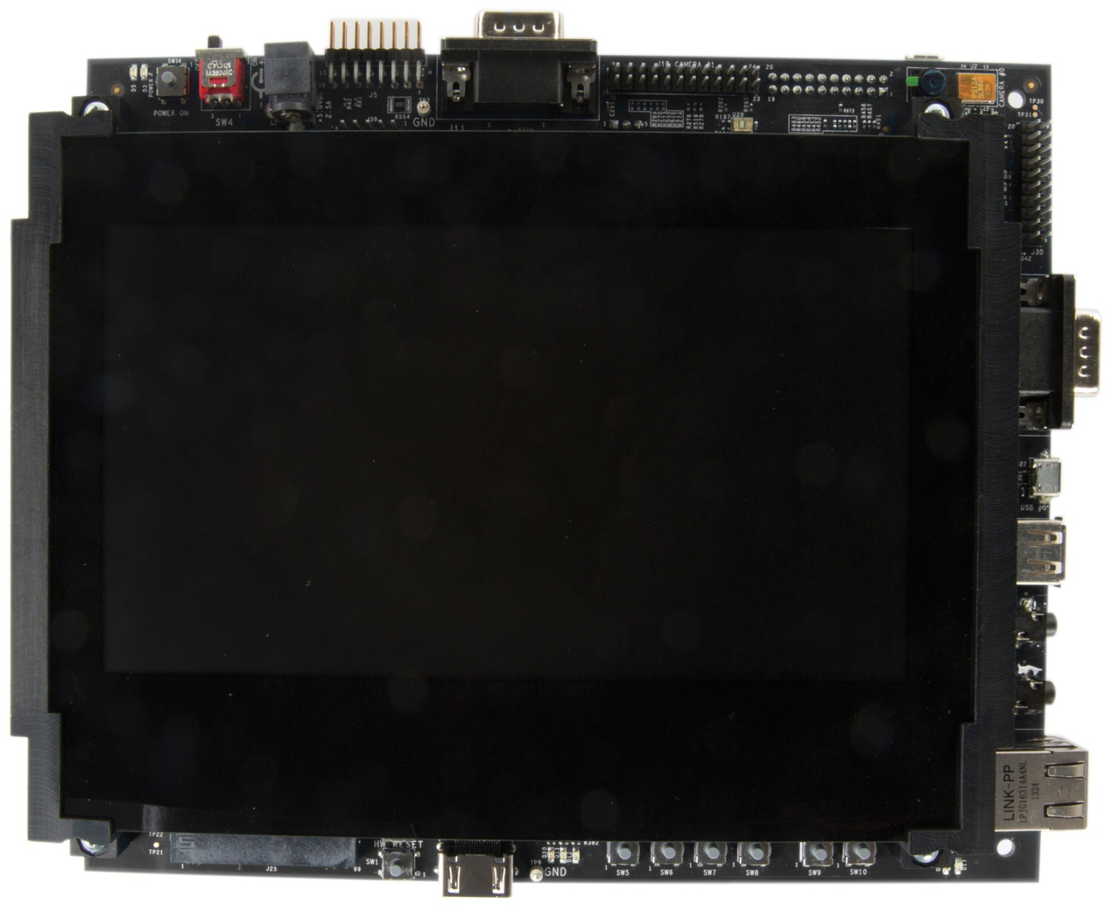
Power switch
DCAN #0
Camera #1
connector
+5V
Camera 2Mp
Power LEDs
20-pin ARM
JTAG Connector
UART #0
7” LCD
800x480
Touchscreen
Micro USB 2.0
USB 2.0
Audio in
Audio out
Gigabit
Ethernet
WLAN/BT COM
connector
User LEDs
User Buttons
HDMI

Slide 59
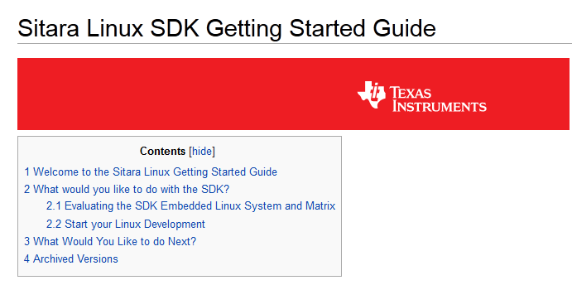
Getting Start Guide http://processors.wiki.ti.com/index.php/Sitara_Linux_SDK_Getting_Started_Guide

Slide 60
For More Information
C66x DSP CorePac User Guide http://www.ti.com/lit/SPRUGW0C
KeyStone Architecture Chip Interrupt Controller (CIC) User Guide http://www.ti.com/lit/SPRUGW4A
For questions regarding topics covered in this training, visit the support forums at the TI E2E Community website.

