Slide 1
Implementation of ProDrive Model
Ran Katzur 10-8-2014

Slide 2
Demo Goals
Demonstrate the ability of DSP core to copy data from 66AK2H12 DDR into its own DDR
Demonstrate the ability of DSP core to copy data from its own DDR into 66AK2H12 DDR
Demonstrate the ability of a DSP core to process data and return results to the ARM
Demonstrate the IPC model that is described in this presentation

Slide 3
Agenda
Demo Model
Shannon Copy Implementation details
66AK2H12 Messages Implementation Details
Building the Demo

Slide 4
Basic Card

Slide 5
Management Communication
Message Types:
Data Address for the next load
Finish Loading
Message Media:
SRIO type 11
SRIO DirectIO
Ethernet

Slide 6
SRIO
Short messages – less than 256 bytes
Message type (2 Bytes)
Sender ID (2 bytes)
Destination ID (2 bytes)
Destination address (4 bytes)
Other information needed
Type 11
up to 64 mailboxes and 4 letters (single packet model)
Hardware protected messages- each message has acknowledgment
Access through sockets
Each ARM thread can have its own mailbox - socket
Direct IO
Need to define protocol structure

Slide 7
IPC Control Communication
From ARM thread to DSP core:
Copy my memory to your memory
Copy your memory to my memory
Execute a function
From DSP core to ARM:
Finish Copying
Finish processing with results

Slide 8
IPC over Hyperlink - Simple Model
Each thread is associated with one DSP core
Simple “messageQ” type model, single writer
No interrupts, messages are always pulled
Multiple buffers for messages, simple state machine for the write side and the read side
Each side of the transection keeps score what buffer it should read next and what buffer it should write next
Each side takes care of cache coherency
Communicating with the DSP that are on 66AK2H12
Same algorithm, uses direct read and write with cache coherency

Slide 9
ARM Thread – DSP Core Messages
Thread sends a message to DSP Core
DSP reads and executes the message
DSP sends acknowledgment to thread
Buffer 0 is released
Thread sends the next message to DSP
Can be before step 3
DSP reads and processes the message
DSP sends acknowledgment to thread
Buffer 1 is released
Note:
The number of message buffers is the depth of processing queue. The Arm thread keeps track on number of available (free) messages
Thread checks Message Number to detect if DSP message was overwritten (No DSP release of ARM message Buffer)

Slide 10
Copy Data From Thread to DSP Core
DSP core gets a message from the thread with source logical address, destination logical address, and size
DSP initiates EDMA transfer via the Hyperlink and waits for the EDMA completion
At the completion of the transfer the DSP send a message to the thread
MPAX and Hyperlink configuration will be discuss later

Slide 11
Copy Data From DSP Core to Thread
DSP core gets a message from the thread with source logical address, destination logical address, and size
DSP initiates EDMA transfer via the Hyperlink and waits for the EDMA completion
At the completion of the transfer the DSP send a message to the thread
MPAX and Hyperlink configuration will be discuss later

Slide 12
DSP Core Real-time State Machine
DSP waits for a new message to arrive
When message arrives the DSP executes the function that is associated with the message
Upon completion of execution the DSP sends message back to the thread, and updates the buffer number for the next message
DSP returns to the waiting state. If there is a message waiting it continue with step 2, otherwise continue waiting

Slide 13
The Thread Real-time Algorithm Assume ARM manages DSP Data Memory
Thread checks if a new message from FPGA arrived
If a message arrived, it processes the message and then checks for new message from the DSP core
If no message arrive, checks to see if a new message arrived from the DSP
Thread checks if a new message from DSP arrived
If a message arrived, it processes the message and then checks for new message from the FPGA core
If no message arrive, checks to see if a new message arrived from the FPGA

Slide 14
Processing FPGA message Assume ARM manages DSP Data Memory
Messages to DSP includes source and destination logical address and scratch logical address if needed
Logical scratch address or destination address are managed by the ARM thread and can be used for post processing (post mortem) and to load new tables and constants

Slide 15
Processing DSP Message Assume ARM manages DSP Data Memory

Slide 16
Thread Post-Processing Assume ARM manages DSP Data Memory

Slide 17
Agenda
Demo Model
Shannon Copy Implementation details
66AK2H12 Messages Implementation Details
Building the Demo

Slide 18
C6678 Memory Management

Slide 19
C6678 Memory Segment
Physical Address | Size | description | Logical address for the core | Comment
0x0 0c00 0000 | 4MB | MSMC shared memory | 0x0c00 0000 | Use for IPC, all DSP cores can see this memory
0x8 8000 0000 | 384MB | DSP 0 private memory | 0x8000 0000 | Access only by DSP 0
0x8 9800 0000 | 384MB | DSP 1 Private memory | 0x8000 0000 | Access only by DSP 1
0x8 b000 0000 | 384MB | DSP 2 private memory | 0x8000 0000 | Access only by DSP 2
0x8 c800 0000 | 384MB | DSP 3 Private memory | 0x8000 0000 | Access only by DSP 3
0x8 e000 0000 | 384MB | DSP 4 private memory | 0x8000 0000 | Access only by DSP 4
0x8 f800 0000 | 384MB | DSP 5 Private memory | 0x8000 0000 | Access only by DSP 5
0x9 1000 0000 | 384MB | DSP 6 private memory | 0x8000 0000 | Access only by DSP 6
0x9 2800 0000 | 384MB | DSP 7 Private memory | 0x8000 0000 | Access only by DSP 7
0x9 4000 0000 | 1GB | Shared Memory for all cores | 0xc000 0000 | Accessed by all cores, will have code, constants and so on
0x8 8000 0000** (For each core the start address will be different, the implementation will be describe in the MPAX implementation section) | 1GB – 384M = 0x3F40 0000 | No core has access except to its own region | 0x9800 0000 | This segment will have no permission to read, write or execute for any core. This is done to prevent one core overwrite the data of another core

Slide 20
MPAX registers – Shannon side
Each DSP core has its own set of MPAX registers
Teranet has multiple sets of SES and SMS MPAX registers
Since EDMA inherent the PriviID of the DSP core that initiates the transfer, each core will configure its own MPAX registers and the SES and SMS MPAX registers that are associated with its PriviID.
Multiple MPAX registers may map the same Logical address, each one to a different physical address. It that case the actual translation is done based on the MPAX register with the higher ID number. This feature will be used to prevent DSP core from accessing private memory of another core.
The default setting of the MPAX registers uses MPAX register 0 to map all internal device addresses (logical memory MSB is 0x0) to internal memory ), just add 4 bits of zero as the MSB, and maps 2G of external memory (MSB is 0x1) to 2G physical addresses starting with address 0x8 8000 0000. The SES and SMS default registers are similar. These registers will not be modified.

Slide 21
C6678 MPAX Registers
The setting of MPAX registers for DSP core I, i=0. 7 (C6678 only)
Value | MPAX2 | MPAX3 | MPAX4 | MPAX5
Logical | 0x80000 | 0x80000 | 0x90000 | 0xc0000
Physical | 0x8800000 | 0x880000 + I * 0x18000 where I is the core number | 0x890000 + I * 0x18000 where I is the core number | 0x940000
Size | 0x1E (1G) | 0x1c (256M) | 0xb (128MB) | 0x1E (1G)
Permission | 0x00 | 0x3f | 0x3f | 0x3f
Comment | Permission are all zero, cannot read, write or execute | Configure the private memory, Overwrite MPAX 2 | Configure the private memory, Overwrite MPAX 2 | For the shared memory

Slide 22
C6678 MPAX Registers
The setting of SES registers for PriviID I, i=0. 7 (C6678 only)
Value | SES 1 for PrivID i | SES 2 for PrivID i | SES 3 for PrivID i | SES 4 for PrivID i
Logical | 0x80000 | 0x80000 | 0x90000 | 0xc0000
Physical | 0x880000 | 0x880000 + I * 0x18000 where I is the PrivID number | 0x890000 + I * 0x18000 where I is the PrivID number | 0x940000
Size | 0x1E (1G) | 0x1c (256M) | 0xb (128MB) | 0x1E (1G)
Permission | 0x00 | 0x3f | 0x3f | 0x3f
Comment | Permission are all zero, cannot read, write or execute | Configure the private memory, Overwrite MPAX 2 | Configure the private memory, Overwrite MPAX 2 | For the shared memory

Slide 23
C6678 MPAX Registers
The setting of SMS registers for PriviID I, i=0.7 stays as the default

Slide 24
Hyperlink Considerations
Each CorePac can access up to 256MB of memory (128M Hyperlink 1 on 66AK2H12)
Using ARM thread to move data to and from Shannon limits the data to 256MB (128MB) for all the 8 cores (No run-time re-configure of Hyperlink please)
When the system uses Shannon cores to move data to and from the 66AK2H12, each core can address up to 256MB
If two Shannons use Hyperlink to access remote memory, DDR accessible memory is limited to 2G (31 bits address, the MSB is always 1) in addition to internal-device MMR and memories (MSMC, L2, L1, MMR)

Slide 25
Hyperlink Considerations (2)
To increase efficiency and reduce complexity it is very important to allow parallel data movements to and from 66AK2H12 DDR
8 ARM threads may exchange data between the ARM and DSP cores within 66AK2H12. This work does not cover internal data move
16 threads move data via the Hyperlink, thus the size limit of Hyperlink is very important

Slide 26
Hyperlink Considerations (3)
Message buffers are located on the MSMC memory. All MSMC memory can be accessed by Hyperlink
2G of DDR memory can be access by Hyperlink
Each DSP core can access up to 128M (2G/16)
In the following slides we analyze the Hyperlink configuration that is needed to support Shannon access to 66AK2H12 memories
66AK2H12 access into Shannon (for messages) will be discussed later

Slide 27
Hyperlink Considerations (4)
We assume that messages reside in MSMC memory
In order to get 128MB DDR for each core, PriviID must be overlay on the look-up table index
On the remote side, the look-up table has the base address of memory segment. The index to the look-up table is part of the address value that is sent from the local to the remote
The following figure shows the structure of the address value for 1G total access from Shannon( Each core – 128MB. 4 buffers, 32MB each for each DSP core)

Slide 28
C6678 Hyperlink Address structure This is the address that the Shannon sends to 66AK2H12 Hyperlink

Slide 29
Address Manipulation: Tx Side Registers
Tx Address Overlay Control Register
User configures PrivID / Security bit overload in this register
Register is at address HyperLinkCfgBase + 0x1c. For 6678 that is 0x2140_001c
If using HyperLink LLD, hyplnkTXAddrOvlyReg_s represents this register
31 | 20 | 19 | 16 | 15 | 12 | 11 | 8 | 7 | 4 | 3 | 0
Reserved |  | txsecovl |  | Reserved |  | txprividovl |  | Reserved |  | txigmask
R |  | R/W |  | R |  | R/W |  | R |  | R/W
Register Configuration
txsecovl = o – security bit not overlay
txprividovl = 12 (bit 31 to 28)
txigmask = 11 (mask = 0x0fff ffff)

Slide 30
Address Translation: Rx Side Registers
Rx Address Selector Control Register
Register is at address HyperLinkCfgBase + 0x2c. For 6678, that is 0x2140_002c
If using HyperLink LLD, hyplnkRXAddrSelReg_s represents this register
31 | 26 | 25 | 24 | 23 | 20 | 19 | 16 | 15 | 12 | 11 | 8 | 7 | 4 | 3 | 0
Reserved |  | rxsechi | rxseclo | Reserved |  | rxsecsel |  | Reserved |  | rxprividsel |  | Reserved |  | rxsegsel
R |  | R/W | R/W | R |  | R/W |  | R |  | R/W |  | R |  | R/W
Register Configuration
rxsechi, rxseclo, and rxsecsel are all zero
rxprividsel = 12 (Bits 31 to 28)
rxsegsel = 9 (bits 30 to 25)

Slide 31
Hyperlink Look-up Table
Each Shannon core will have 8 lines in the look-up table (there are 64 lines in each Hyperlink, and 8 cores)
4 lines point to 4 segment of remote memory, 32MB memory each, fifth segment is the MSMC memory
The last 3 lines are empty (can configure to non-existing memory to prevent access to memory that is not accessible to Shannon)
Translation from logical addresses to physical addresses will be done by the 66AK2H12 Hyperlink MPAX registers (set E)

Slide 32
Hyperlink Look-up Table Shannon 0 DSP internal addresses - from 0x4000 000 to 0x47ff ffff
Line (index) (Binary) | CorePac | Logical base Address | Size | Purpose
000000 to line 000111 | 0 | 0x8000 0000, 0x8200 0000 0x8400 0000 0x8600 0000 0x0c00 0000 | 24 (32MB) for the first 4 segments, 21 (4MB) for the last segment dedicated to IPC | First 4 segment are for data copy and will be mapped to DDR physical memory by SES MPAX, last segment
001000 to line 001111 | 1 | 0x8800 0000, 0x8b00 0000 0x8d00 0000 0x8e00 0000 0x0c00 0000 | 24 (32MB) for the first 4 segments, 21 (4MB) for the last segment dedicated to IPC | First 4 segment are for data copy and will be mapped to DDR physical memory by SES MPAX, last segment
010000 to line 010111 | 2 | 0x9000 0000, 0x9200 0000 0x9400 0000 0x9600 0000 0x0c00 0000 | 24 (32MB) for the first 4 segments, 21 (4MB) for the last segment dedicated to IPC | First 4 segment are for data copy and will be mapped to DDR physical memory by SES MPAX, last segment
011000 to line 011111 | 3 | 0x9800 0000, 0x9b00 0000 0x9d00 0000 0x9e00 0000 0x0c00 0000 | 24 (32MB) for the first 4 segments, 21 (4MB) for the last segment dedicated to IPC | First 4 segment are for data copy and will be mapped to DDR physical memory by SES MPAX, last segment

Slide 33
Hyperlink Look-up Table Shannon 0 DSP internal addresses - from 0x4000 000 to 0x47ff ffff
100000 to line 100111 | 4 | 0xa000 0000, 0xa200 0000 0xa400 0000 0xa600 0000 0x0c00 0000 | 24 (32MB) for the first 4 segments, 21 (4MB) for the last segment dedicated to IPC | First 4 segment are for data copy and will be mapped to DDR physical memory by SES MPAX, last segment
101000 to line 101111 | 5 | 0xa800 0000, 0xab00 0000 0xad00 0000 0x8e00 0000 0x0c00 0000 | 24 (32MB) for the first 4 segments, 21 (4MB) for the last segment dedicated to IPC | First 4 segment are for data copy and will be mapped to DDR physical memory by SES MPAX, last segment
110000 to line 110111 | 6 | 0xb000 0000, 0xb200 0000 0xb400 0000 0xb600 0000 0x0c00 0000 | 24 (32MB) for the first 4 segments, 21 (4MB) for the last segment dedicated to IPC | First 4 segment are for data copy and will be mapped to DDR physical memory by SES MPAX, last segment
111000 to line 111111 | 7 | 0xb800 0000, 0xbb00 0000 0xbd00 0000 0xbe00 0000 0x0c00 0000 | 24 (32MB) for the first 4 segments, 21 (4MB) for the last segment dedicated to IPC | First 4 segment are for data copy and will be mapped to DDR physical memory by SES MPAX, last segment

Slide 34
Hyperlink Look-up Table Shannon 1 DSP internal addresses - from 0x4000 000 to 0x47ff ffff
Line (index) (Binary) ) | CorePac | Logical base Address | Size | Purpose
000000 to line 000111 | 0 | 0xc000 0000, 0xc200 0000 0xc400 0000 0xc600 0000 0x0c00 0000 | 24 (32MB) for the first 4 segments, 21 (4MB) for the last segment dedicated to IPC | First 4 segment are for data copy and will be mapped to DDR physical memory by SES MPAX, last segment
001000 to line 001111 | 1 | 0xc800 0000, 0xca00 0000 0xcc00 0000 0xcd00 0000 0x0c00 0000 | 24 (32MB) for the first 4 segments, 21 (4MB) for the last segment dedicated to IPC | First 4 segment are for data copy and will be mapped to DDR physical memory by SES MPAX, last segment
010000 to line 010111 | 2 | 0xd000 0000, 0xd200 0000 0xd400 0000 0xd600 0000 0x0c00 0000 | 24 (32MB) for the first 4 segments, 21 (4MB) for the last segment dedicated to IPC | First 4 segment are for data copy and will be mapped to DDR physical memory by SES MPAX, last segment
011000 to line 011111 | 3 | 0xd800 0000, 0xda00 0000 0xdc00 0000 0xdd00 0000 0x0c00 0000 | 24 (32MB) for the first 4 segments, 21 (4MB) for the last segment dedicated to IPC | First 4 segment are for data copy and will be mapped to DDR physical memory by SES MPAX, last segment

Slide 35
Hyperlink Look-up Table Shannon 1 DSP internal addresses - from 0x4000 000 to 0x47ff ffff
100000 to line 100111 | 4 | 0xec000 0000, 0xe200 0000 0xe400 0000 0xe600 0000 0x0c00 0000 | 24 (32MB) for the first 4 segments, 21 (4MB) for the last segment dedicated to IPC | First 4 segment are for data copy and will be mapped to DDR physical memory by SES MPAX, last segment
101000 to line 101111 | 5 | 0xe800 0000, 0xea00 0000 0xec00 0000 0xed00 0000 0x0c00 0000 | 24 (32MB) for the first 4 segments, 21 (4MB) for the last segment dedicated to IPC | First 4 segment are for data copy and will be mapped to DDR physical memory by SES MPAX, last segment
110000 to line 110111 | 6 | 0xf000 0000, 0xf200 0000 0xf400 0000 0xf600 0000 0x0c00 0000 | 24 (32MB) for the first 4 segments, 21 (4MB) for the last segment dedicated to IPC | First 4 segment are for data copy and will be mapped to DDR physical memory by SES MPAX, last segment
111000 to line 111111 | 7 | 0xf800 0000, 0xfa00 0000 0xfc00 0000 0xfd00 0000 0x0c00 0000 | 24 (32MB) for the first 4 segments, 21 (4MB) for the last segment dedicated to IPC | First 4 segment are for data copy and will be mapped to DDR physical memory by SES MPAX, last segment

Slide 36
Agenda
Demo Model
Shannon Copy Implementation details
66AK2H12 Implementation Details
Building the Demo

Slide 37
66AK2H12 Physical Addresses
66AK2H12 dedicates 1G of DDR memory to facilitate data move (read and write) between each Shannon and the ARM using Hyperlink
Assume that Shannon 0 has a dedicated physical addresses 0x9 0000 0000 to 0x9 3fff ffff
Assume that Shannon 1 has a dedicated physical addresses 0x9 c000 0000 to 0x9 ffff ffff
Accessing the memory for IPC (messages) will be described later

Slide 40
MPAX registers – Hyperlink on 66AK2H12
The hyperlink configuration on the 66AK2H12
Shannon 0 logical memory 0x8000 0000 to 0xbfff ffff
Shannon 1 logical memory 0xc000 0000 to 0xffff ffff
The physical memory configuration of 66AK2H12
Shannon 0 - 0x9 0000 0000 to 0x9 3fff ffff
Shannon 1 - 0x9 C000 0000 to 0x9 ffff ffff

Slide 41
66AK2H12 Hyperlink MPAX Registers
Value | SES 1 for PriviID 0xE | SES 2 for PriviID 0xE
Logical | 0x80000 | 0xc0000
Physical | 0x900000 | 0x9c0000
Size | 0x1E (1G) | 0x1E (1G)
Permission | 0x3f | 0x3f
Comment | First Shannon starts at address 0x9 0000 0000 | Second Shannon starts at address 0x9 C000 0000

Slide 42
66AK2H12 Hyperlink MPAX Registers
The setting of SMS registers for PriviID 0xE stays as the default

Slide 43
66AK2H12 to Shannon Communication Considerations
In the model that is described here, the only read or write that the 66AK2H12 does with respect to the Shannon devices is sending messages
66AK2H12 messages area (from Shannon to 66AK2H12) is chosen to be the MSMC
If the messages are in DDR, it reduces the size of buffer that is dedicated to each DSP
The hyperlink and MPAX setting was covered already
The Shannon’s messages memory is chosen to be in the MSMC memory
Otherwise it reduces the size of the DDR buffers that are currently used by a DSP core

Slide 44
Configuration Considerations
The messages memory is statically divide between DSP cores in the application. In terms of the Hyperlink configuration and MPAX registers all cores in all Shannons can access the entire messages memory. (again, limitations are in the application)
The next few slides shows the proposed messages’ structure

Slide 45
Messages structure size 128 Bytes

Slide 46
Messages Control

Slide 47
Shannon MSMC Messages structure
Each DSP can keep track on its address using DNUM, or we can use the MPAX registers to have the same logical address to all DSPs

Slide 48
66AK2H12 Hyperlink Address structure This is the address that the 66AK2H12 send to Hyperlink Shannon

Slide 49
Address Manipulation: Tx Side Registers
Tx Address Overlay Control Register
User configures PrivID / Security bit overload in this register
Register is at address HyperLinkCfgBase + 0x1c. For 6678 that is 0x2140_001c
If using HyperLink LLD, hyplnkTXAddrOvlyReg_s represents this register
31 | 20 | 19 | 16 | 15 | 12 | 11 | 8 | 7 | 4 | 3 | 0
Reserved |  | txsecovl |  | Reserved |  | txprividovl |  | Reserved |  | txigmask
R |  | R/W |  | R |  | R/W |  | R |  | R/W
Register Configuration
txsecovl = o – security bit not overlay
txprividovl = 12 (bit 31 to 28)
txigmask = 11 (mask = 0x0fff ffff)

Slide 50
Address Translation: Rx Side Registers
Rx Address Selector Control Register
Register is at address HyperLinkCfgBase + 0x2c. For 6678, that is 0x2140_002c
If using HyperLink LLD, hyplnkRXAddrSelReg_s represents this register
31 | 26 | 25 | 24 | 23 | 20 | 19 | 16 | 15 | 12 | 11 | 8 | 7 | 4 | 3 | 0
Reserved |  | rxsechi | rxseclo | Reserved |  | rxsecsel |  | Reserved |  | rxprividsel |  | Reserved |  | rxsegsel
R |  | R/W | R/W | R |  | R/W |  | R |  | R/W |  | R |  | R/W
Register Configuration
rxsechi, rxseclo, and rxsecsel are all zero
rxprividsel = 12 (Bits 31 to 28)
rxsegsel = 6 (bits 27 to 22)

Slide 51
Hyperlink Look-up Table
Since there is no overlay between PriviID and the index to the look-up table, only one line in the look-up table is needed
If the model is changed, and more Shannon memory is visible to the 66AK2H12, then more lines will be added (and the configuration might be changed)
The SMS MPAX registers on the 66AK2H12 for Hyperlink are the default

Slide 52
Hyperlink Look-up Table
Line (index) (Binary) | CorePac | Logical base Address | Size | Purpose
000000 | ARM CorePack | 0x0c00 0000, | 21 (4MB) for the MSMC | Having the messages buffers. All together 8K for each Shannon. Base address can be anywhere in the 4MB area

Slide 53
Agenda
Demo Model
Shannon Copy Implementation details
66AK2H12 Messages Implementation Details
Building the Demo

Slide 54
Demo Goals
Demonstrate the ability of DSP core to copy data from 66AK2H12 DDR into its own DDR
Demonstrate the ability of DSP core to copy data from its own DDR into 66AK2H12 DDR
Demonstrate the ability of a DSP core to process data and return results to the ARM
Demonstrate the IPC model that is described in this presentation
Usage of the 66AK2H12 DSP cores is not covered in the demo
Hyperlink boot of the Shannon device is not covered by the demo
Hyperlink speed is not an issue in the demo

Slide 55
Demo Flow

Slide 56
ARM Initialization
Flag Index | State
0 | TRUE
1 | FALSE
2 | FALSE
3 | FALSE
4 | FALSE
5 | FALSE
6 | FALSE
7 | FALSE
Initializes all global variables
Reboot the Shannon device
Initial the global Flag array
Span 8 threads

Slide 57
Thread (i) Initialization
Initializes all sets of buffers that are associated with the DSP that is controlled by this thread
Row Data Buffers
Output buffers
Scratch area buffers
Mailbox buffers
Other initialization, thread variables, etc.
Wait on the flag
Buffer Index | Logical Address | State
0 | 0x | 0
1 | 0x | 0
2 | 0x | 0
3 | 0x | 0

Slide 58
Thread (i) Flow

Slide 59
DSP Flow

Slide 60
Questions?

Slide 61
Back up

Slide 62
Example memory Allocation for DSP 7
4 x 32MB row data buffers | Logical Address (first 128MB starting in logical address 0x8000 0000 | Physical Address (DSP 7) Physical address starts at 0x9 2800 0000
0 | 0x8000 0000 | 0x9 2800 0000
1 | 0x8200 0000 | 0x9 2A00 0000
2 | 0x8400 0000 | 0x9 2C00 0000
3 | 0x8600 0000 | 0x9 2E00 0000
Note – each buffer will be loaded before the program starts with 1024 values
Each value is 0x1000 0000 * DSP number + 0x0010 0000 * buffer Number + I
Where I goes from 0 to 1023

Slide 63
Example memory Allocation for DSP 7
4 x 32MB output data buffers | Logical Address (next 128MB starting in logical address 0x8800 0000 | Physical Address (DSP 7) Physical address starts at 0x9 2800 0000
0 | 0x8800 0000 | 0x9 3000 0000
1 | 0x8A00 0000 | 0x9 3200 0000
2 | 0x8C00 0000 | 0x9 3400 0000
3 | 0x8E00 0000 | 0x9 3600 0000
Note – These buffers will be used to move data back to the 66AK2H12
One of the DSP functions will multiply the row data values by constant and write it to these buffers

Slide 64
Example memory Allocation for DSP 7
4 x 32MB scratch data buffers | Logical Address (next 128MB starting in logical address 0x9000 0000 | Physical Address (DSP 7) Physical address starts at 0x9 2800 0000
0 | 0x9000 0000 | 0x9 3800 0000
1 | 0x9200 0000 | 0x9 3A00 0000
2 | 0x9400 0000 | 0x9 3C00 0000
3 | 0x9600 0000 | 0x9 3E00 0000
Note – These buffers will be used as private scratch area if needed

Slide 65
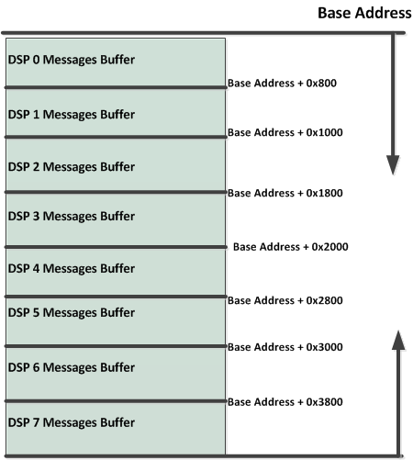
Mailbox Allocation in Shannon Assume base Address 0x0c00 0000 (logical) 0x0 0c00 0000 (Physical)
Message Number | Logical Address
0 | 0x0C00 0000
1 | 0x0C00 0080
2 | 0x0C00 0100
3 | 0x0C00 0180
4 | 0x0C00 0200
5 | 0x0C00 0280
6 | 0x0C00 0300
7 | 0x0C00 0480
Note – These buffers will be used as private scratch area if needed

Slide 66
Shannon MSMC Messages structure
Each DSP can keep track on its address using DNUM, or we can use the MPAX registers to have the same logical address to all DSPs

Slide 67
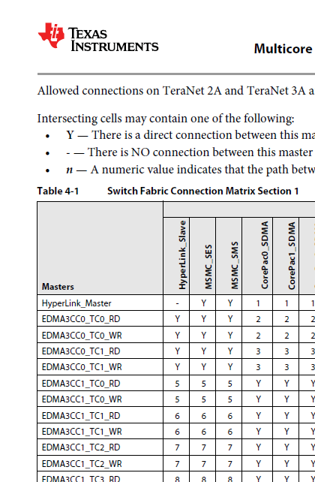
C6678 Hyperlink and Memory – EDMA

Slide 68
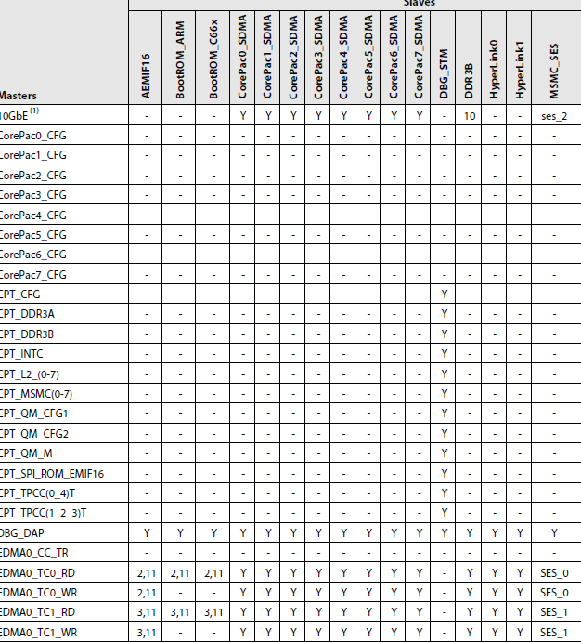
66AK2H12 Hyperlink and Memory – EDMA

Slide 69
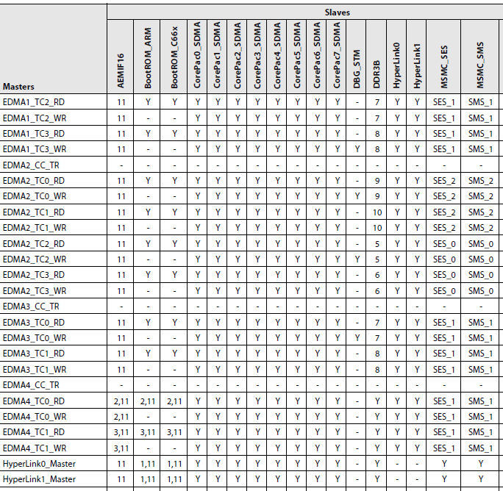
66AK2H12 Hyperlink and Memory – EDMA

