Slide 1
Keystone Connectivity and Priorities
Internal presentation October 2013
Acknowledgements:
This presentation is could not be developed without the major help of Piyush Patel and Rolando Asmat

Slide 2
Agenda
Description of internal connectivity
Teranet bridges
DSP Internal access priorities and delays
DSP Master access to MSMC memory and DDR and delays
Teranet priorities for other masters and delays
EDMA priorities and delays

Slide 3
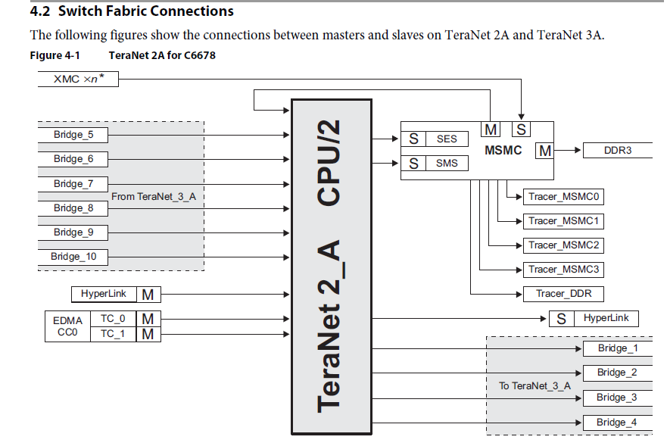
Teranet Masters and Slaves
Main switched Fabric Bus, connect Masters and Slaves
Masters can initiate transfer (put address on the address bus)
No contention on a master
Slaves respond to master requests
Slaves may have multiple requests from multiple masters

Slide 4
Some Observation about the Teranet
Multiple sections of the Data Teranet connected by bridges
Limiting the number of concurrent transfers between sections
KeyStone I has CPU/2 section and CPU/3 sections
KeyStone II all sections are CPU/3
Configuration Teranet is slower – CPU/6

Slide 5
6678 Data Manual (SPRS691D—April 2013)

Slide 6
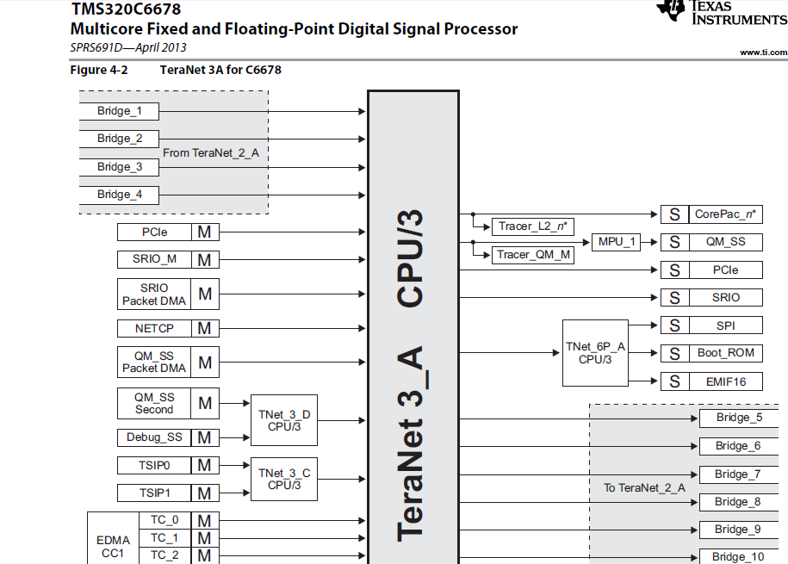

Slide 7
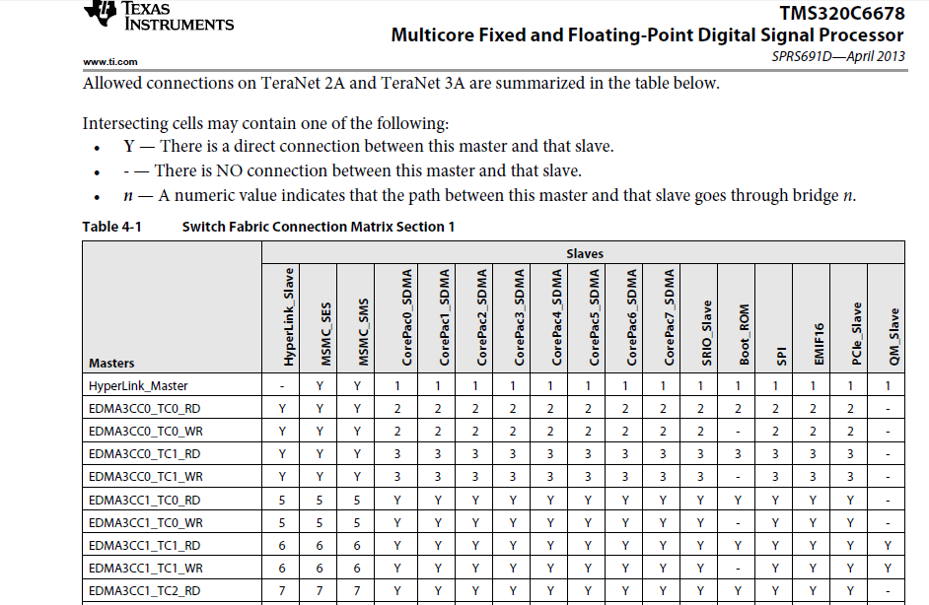

Slide 8
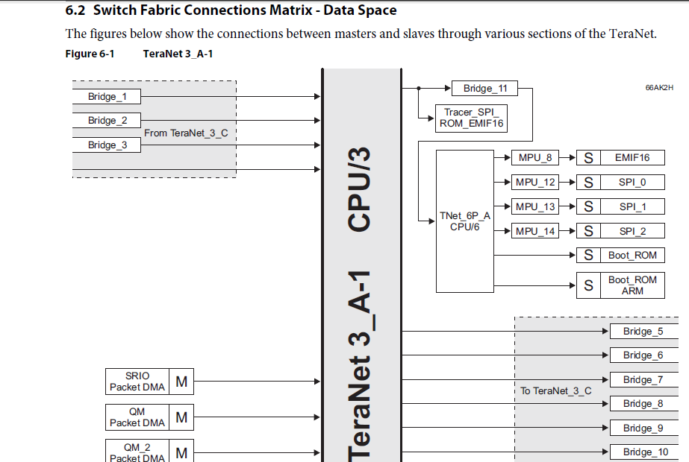
6638 Data Manual (SPRS691D—April 2013)

Slide 9
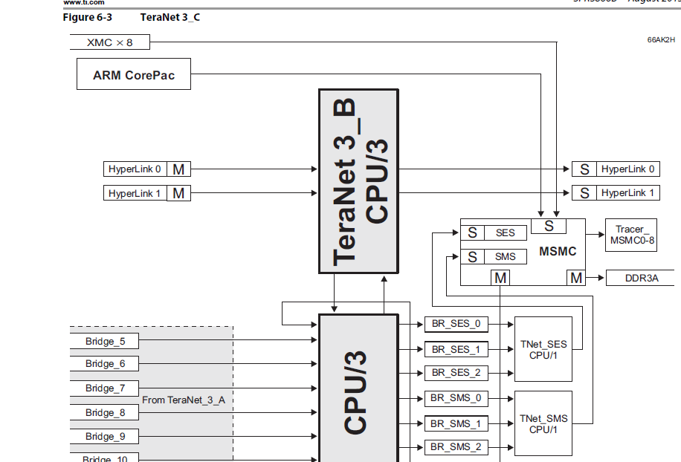

Slide 10
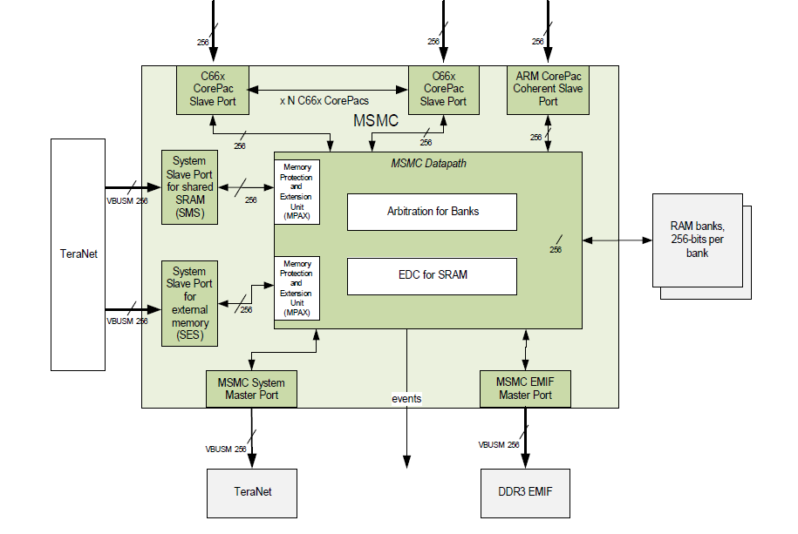
KeyStone II MSMC interfaces

Slide 11
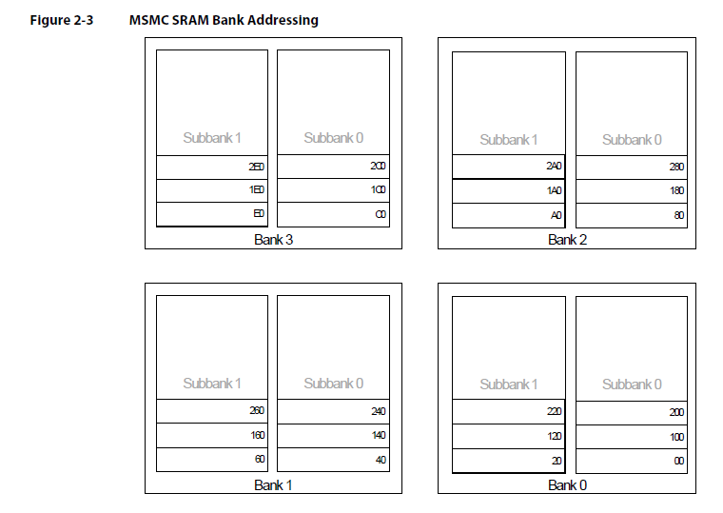
KeyStone I MSMC SRAM Banks (2x32 bytes) 64 Bytes aligned

Slide 12
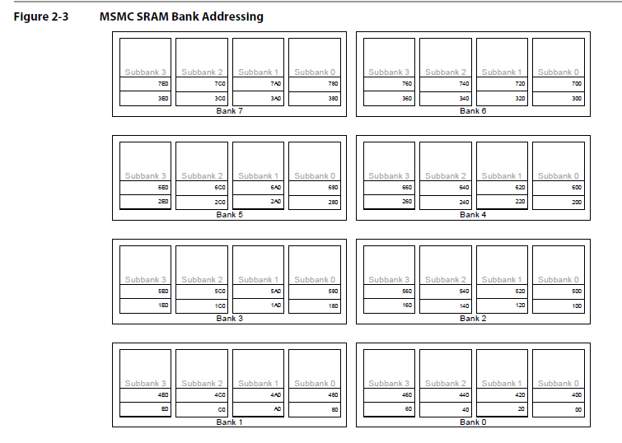
KeyStone II MSMC SRAM Banks (4x32 bytes) 128 Bytes aligned

Slide 13
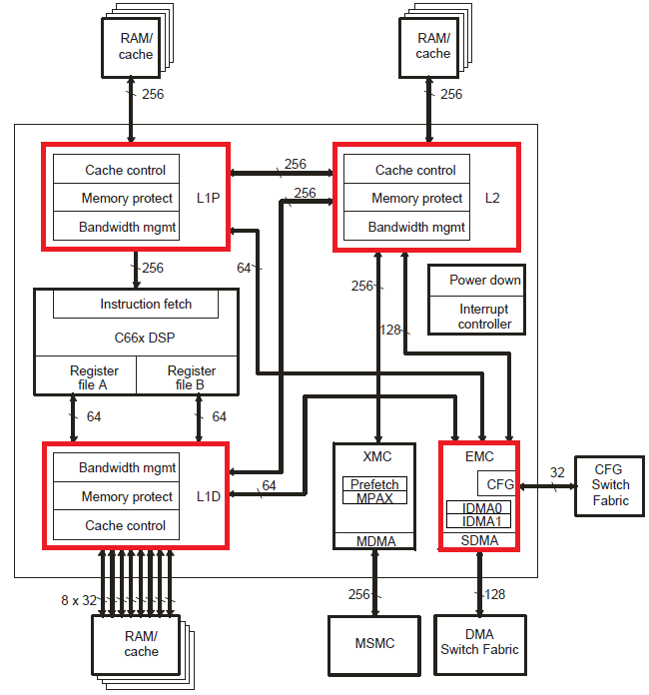
CorePac Bandwidth Management
Purpose
To set priorities for resources, and at the same time, to ensure that a requester doesn’t use a resource of the C66x CorePac for too long.
Resources
L1P
L1D
L2
Memory-mapped registers configuration bus.
Figure 1. CorePac Block Diagram

Slide 14
CorePac Bandwidth Management Cont.
Potential Requestors of resources
DSP-initiated transfers
Data access
Program access
Cache Coherency Operations
Block-based (operations on a range of addresses)
Global (operations on the entire cache)
IDMA (Internal DMA)
Local memory to memory DMA
SDMA (Slave DMA)
External initiated
Masters outside the CorePac requesting access a resource

Slide 15
CorePac Bandwidth Management Cont.
A word about Cache
L1 cache is read only allocated (no cache line is allocated when write)
L2 cache is read and write allocation (unless configured otherwise)
Cache is configured using CSL functions. API are defined in csl_cache.h and csl_cachAux.h . These files are located in C:\ti\MCSDK_3_01_12\pdk_keystone2_3_00_01_12\packages\ti\csl
L2 Cache write-through is supported by the MAR registers – the configuration is visible in the BIOS API
static inline Void BCACHE_setMar(Ptr baseAddr, size_t byteSize, UInt32 val)
{
ti_sysbios_family_c66_Cache_setMar(baseAddr, byteSize, val);
}

Slide 16
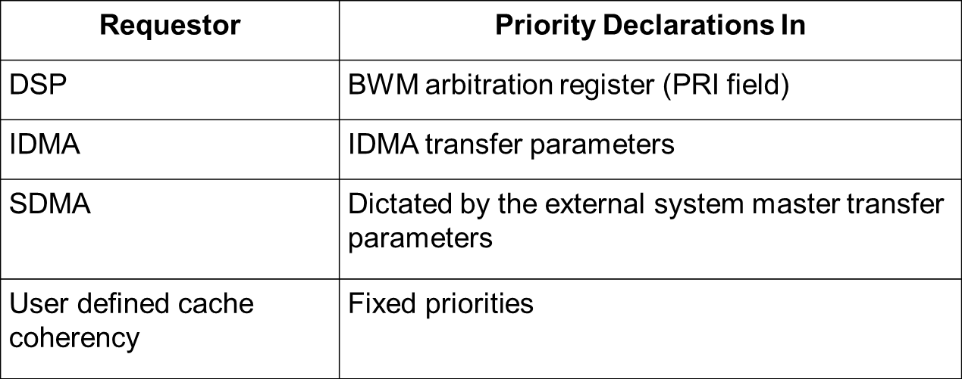
CorePac Bandwidth Management Cont.
The table below shows where the priority declaration for each requestor is declared.
Table 1. Priority Declaration

Slide 17
CorePac Bandwidth Management Cont.
BWM Scheme
Bandwidth management is implemented locally through registers called “Arbitration Registers”
Each resource has a set of arbitration registers, different registers for each requester.
Each register defines either PRI or MAXWAIT or both. The PRI field will declare the priority for that requestor. MAXWAIT is explained below. A register may or may not have a PRI field but it will always have the MAXWAIT field.
Priorities
Requestors are assigned priorities on a per-transfer basis
Highest: Priority 0
…..
Lowest: Priority 8
When contention occurs for many successive cycles, a counter is increased. Once the counter reaches the value in the MAXWAIT field, the lower priority requestor gets access. Done by setting its priority to -1 for that cycle, the counter then resets to 0.

Slide 18
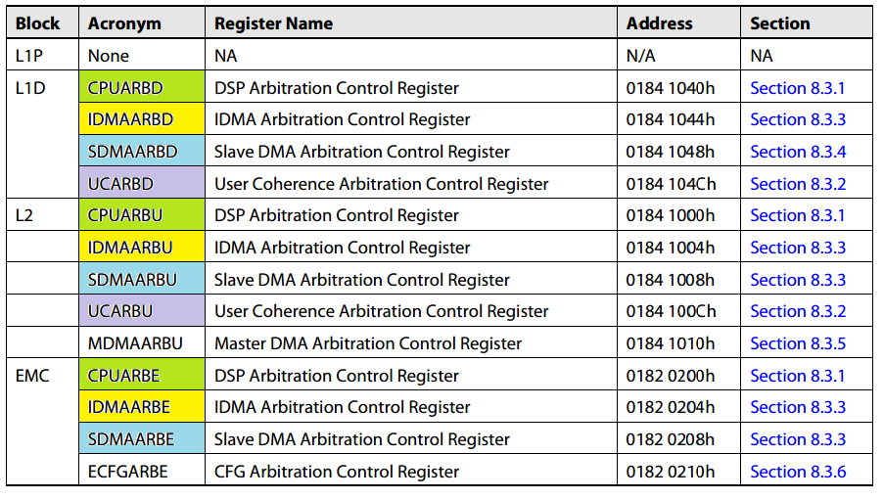
CorePac Bandwidth Management Cont.
Arbitration Registers
Table 2. Arbitration Registers
Notes:
Note: Look into ARM.
Update: Couldn’t find anything on arbitration. Here is a link to the ARM Corepac User Guide.
http://www.ti.com/lit/ug/spruhj4/spruhj4.pdf

Slide 19
CorePac Bandwidth Management Cont.
Cache coherency operations:
Fixed priorities, global has the highest priority, block has the lowest priority
The WAITMAX is only for block transfer

Slide 20
CorePac Bandwidth Management Cont.
IDMA
IDMA channel 0 is always the highest priority.
IDMA channel 0 is intended for quick programming of configuration registers located in the external configuration space (CFG). It transfers data from a local memory (L1P, L1D, and L2) to the external configuration space.
IDMA channel 1 has a programmable priority using the PRI field in the IDMA channel 1 count register (IDMA1_COUNT).
IDMA channel 1 is intended for transferring data between local memories. It moves data and program sections in the background without DSP operation to set up processing from fast memory.
Address: 0182 0112h

Slide 21
CorePac Bandwidth Management Cont.
External master
Priorities are configured by each master
But MAXWAIT is controlled by CorePac

Slide 22
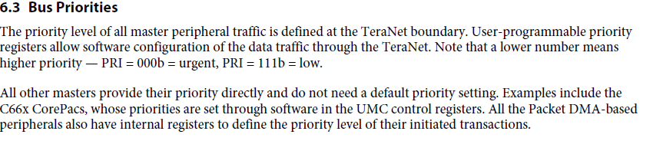
TeraNet Bus Priorities
From the User’s Guide:

Slide 23
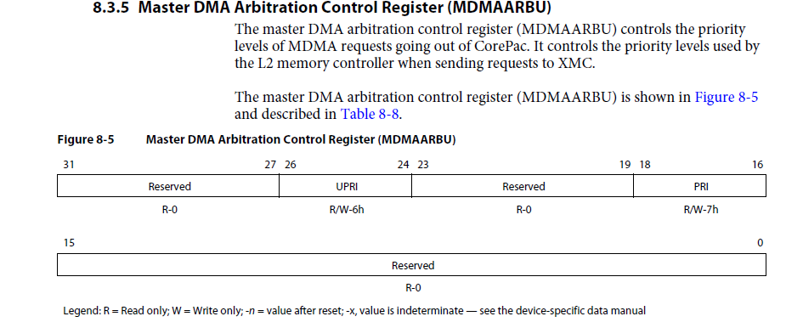
DSP Priorities

Slide 24
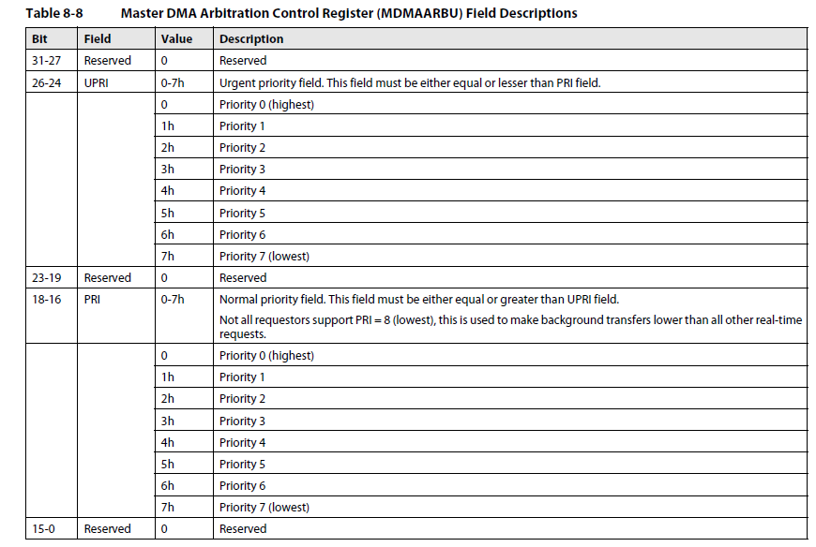
DSP Priorities

Slide 25
EDMA Priority scheme
Priorities on the bus – Each TC has priority
Set by queue Priority Register (QUEPRI)
EDMA UG section 4.2.1.8 in SPRUGS5A—December 2011
Look at csl_edma3.h and csl_edmaAux.h
Priorities inside EDMA controller – fixed scheme
Look at the next two slides

Slide 26
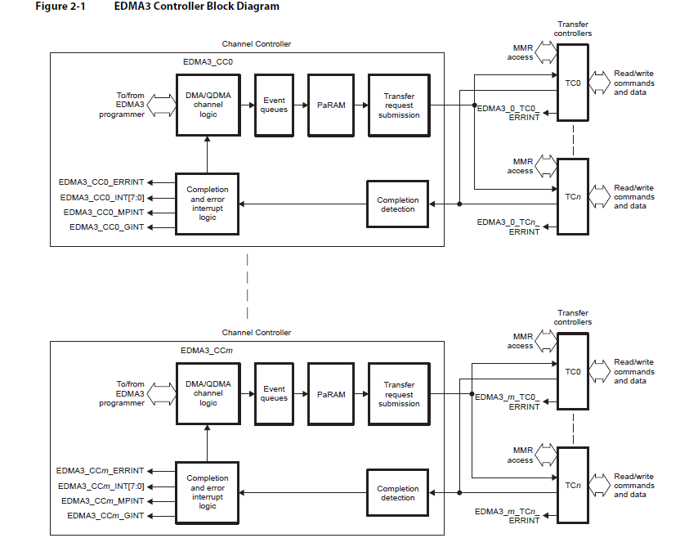

Slide 27
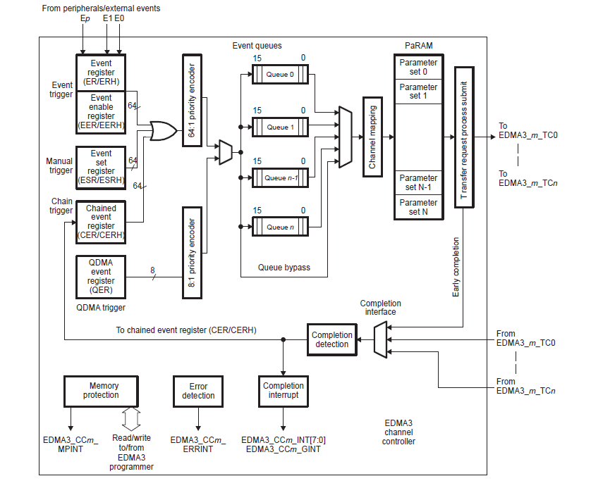
Channel Controller

Slide 28
EDMA Priorities
Channel Priorities when more than one event occurs
Lower channel number = higher priority
DMA has higher priority compare with QDMA
De-queue priority (from the queues to TC)
Lower number TC gets channel from the queue before higher TC number
Out-of-order queuing
Smart algorithm can modify the order of channels in a queue to minimize overhead associated with multiple similar requests
Burst size – each TC has burst size
CC0 TC0 and TC1 16 bytes default
All other TC – 8 bytes default

Slide 29
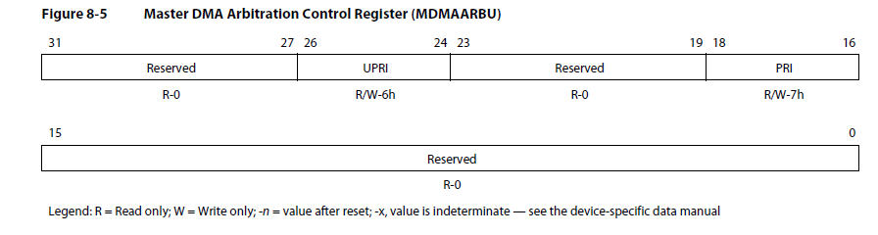
Core MSMC and DDR priorities
From CORES to MSMC there are two priorities PRI (for pre-fetch) and Urgent priority UPRI for all other requests
Default priorities for CorePack – 6 for UPRI and 7 for PRI
Register MDMAARBU described in 8.3.9 of the CorePack UG enable the user to change the priorities
CSL API

Slide 30
MSMC Starvation Control
Starvation Control limits the waiting time of a low priority requester by temporary increasing the priority to 0 – the highest priority
8 registers, one for each core, and 2 (one for SMS and one for SES) from the Teranet
Register SBNDCn described in 3.4.1 of the MSMC UG describes the Starvation register for core n
CSL API

Slide 31
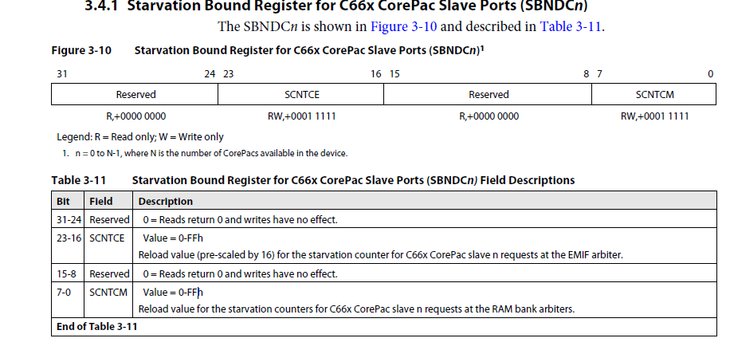
MSMC Starvation Control

Slide 32
DDR EMIF Bandwidth Management – Level 1 – Arbitration at MSMC controller
DDR is not SRAM, the overhead of moving from one address to another is high. Thus starvation mechanism is different than MSMC memory
Use the same registers as before, different bit field
8 registers, one for each core, one for SES from the Teranet. Values are multiply by 16 for the DDR
DDR starvation range from 0 to 255 X 16 = 4080 MSMC cycles = 8160 DSP cycles
Register SBNDCn described in 3.4.1 of the MSMC UG describes the Starvation register for core n
CSL API

Slide 33
Level 2 DDR Arbitration
The DDR3 memory controller performs command reordering and scheduling. Command reordering takes place within the command FIFO.
The DDR3 memory controller examines all the commands stored in the command FIFO to schedule commands to the external memory.
For each master, the DDR3 memory controller reorders the commands based on the following rules:
The DDR3 controller will advance a read command before an older write command from the same master if the read is to a different block address (2048 bytes) and the read priority is equal to or greater than the write priority.
The DDR3 controller will block a read command, regardless of the master or priority if that read command is to the same block address (2048 bytes) as an older write command.

Slide 34
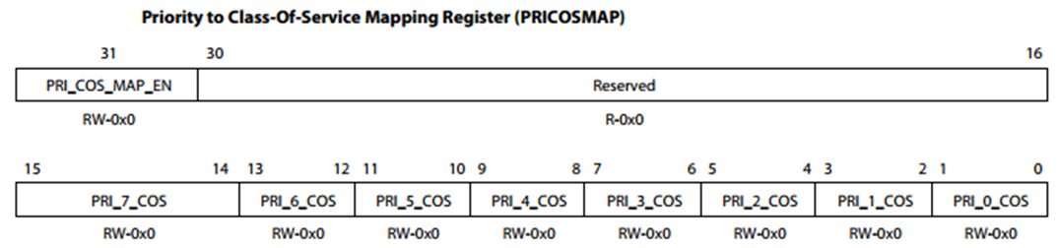
DDR3 Memory Controller Interface Cont.
Class of Service
The commands in the Command FIFO can be mapped to two classes of service: 1 and 2.
The mapping of commands to a particular class of service can be done based on the priority or the master ID.
The mapping based on priority can be done by setting the appropriate values in the Priority to Class of Service Mapping register (offset: 100h).

Slide 35
DDR3 Memory Controller Interface Cont.
The mapping based on master ID can be done by setting the appropriate values of master ID and the masks in the Master ID to Class of Service Mapping registers:
Master ID to Class-Of-Service Mapping 1 Register (offset: 104h)
Master ID to Class-Of-Service Mapping 2 Register (offset: 108h)
There are 3 master ID and mask values that can be set for each class of service. In conjunction with the masks, each class of service can have a maximum of 144 master IDs mapped to it. For example, a master ID value of 0xFF along with a mask value of 0x3 will map all master IDs from 0xF8 to 0xFF to that particular class of service. By default all commands will be mapped to class of service 2.
Registers description is in the next slide

Slide 36


DDR3 Memory Controller Interface Cont.

Slide 37
DDR3 Memory Controller Interface Cont.
Each class of service has an associated latency counter. The value of this counter can be set in the Latency Configuration register (offset: 0x54h). When the latency counter for a command expires, i.e., reaches the value programmed for the class of service that the command belongs to, that command will be the one that is executed next. If there is more that one command that has expired latency counters, the command with the highest priority will be executed first. One exception to this rule is as follows: if any of the commands with the expired latency counters is also the oldest command in the queue, that command will be executed first irrespective of priority.
Description of the register is in the next slide

Slide 38
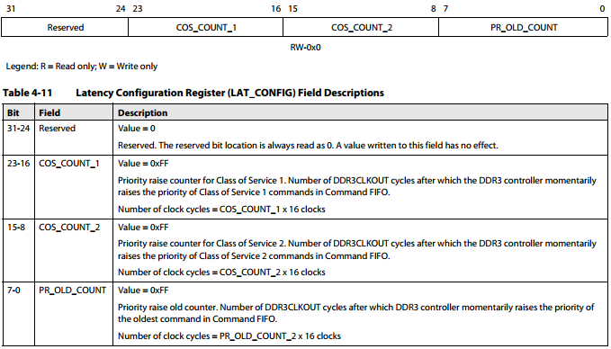
DDR3 Memory Controller Interface Cont.

Slide 39
Priority of other Masters
Other masters configure the bus priority internally to the master
The next few slides shows where to set the priority of each master

Slide 40
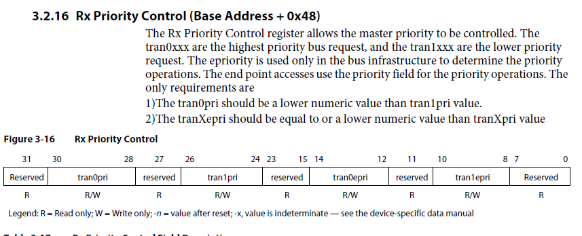
Hyperlink Priority Register

Slide 41
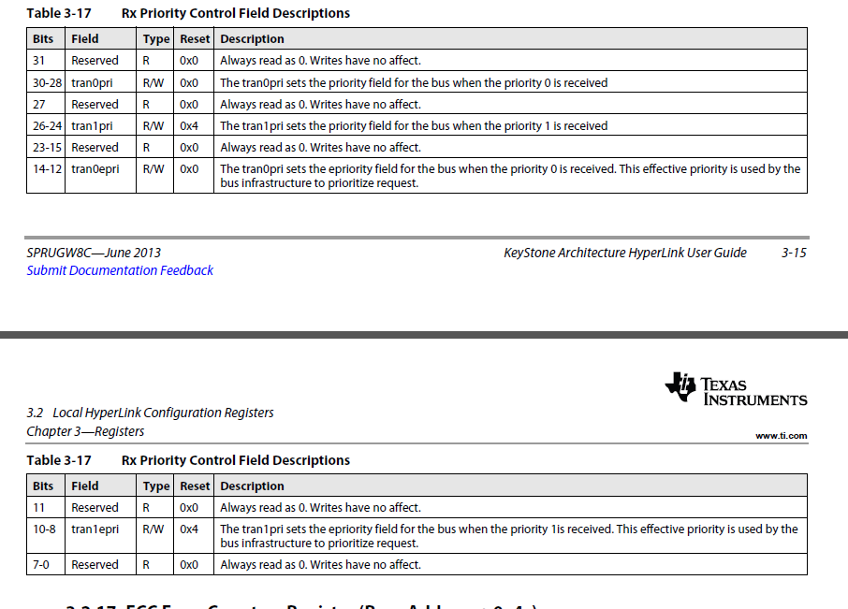
Hyperlink Priority Register

Slide 42
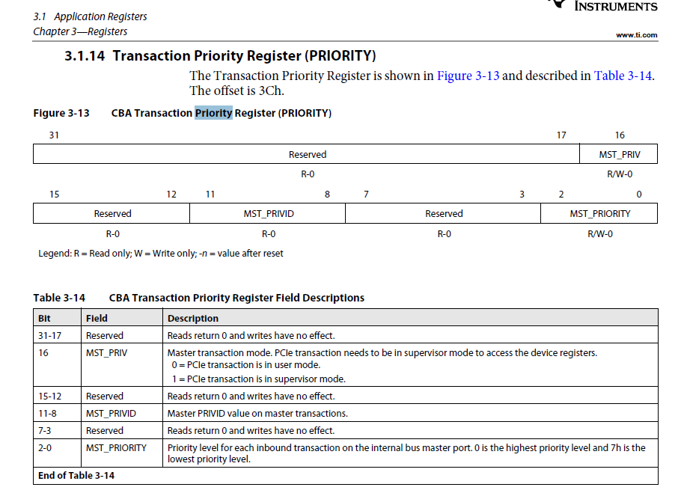
PCIe Priority Register

Slide 43
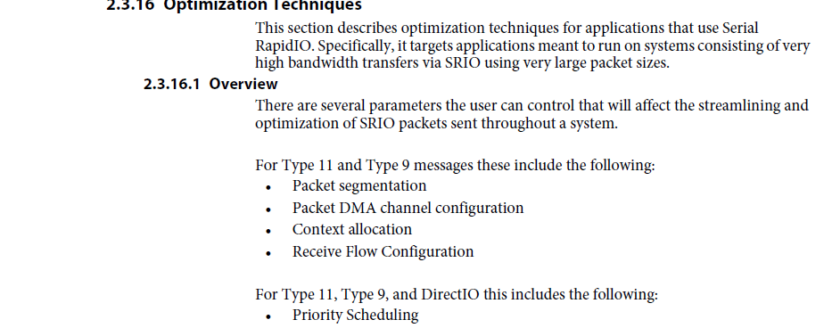
SRIO Priority Register (1/3)

Slide 44
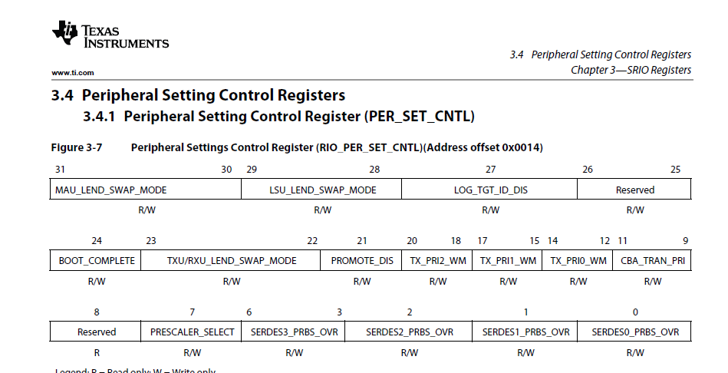
SRIO Priority Register (2/3)

Slide 45
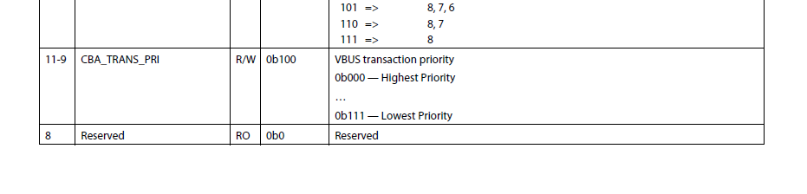
SRIO Priority Register (3/3)

Slide 46
Questions and Final Statement
Almost all information is extracted from KeyStone I (Shannon) User Guides (Data manual, EDMA UG, MSMC UG, DDR UG)
I did not go through KeyStone II documents. I believe they are similar

