Slide 1
KeyStone 1 + ARM device memory System
MPBU Application team

Slide 2
KeyStone 1 External memory System
MPBU Application team

Slide 3
Agenda
Over View of the 6614 TeraNet
Memory System – DSP core point of view
Overview of memory map
MSMC and external Memory
Memory System – ARM point of view
Overview of memory map
ARM subsystem access to memory
ARM-DSP communication

Slide 4
Agenda
Overview of memory map
MSMC and external Memory
Examples
Software layer

Slide 5
Agenda
Over View of the 6614 TeraNet
Memory System – DSP core point of view
Overview of memory map
MSMC and external Memory
Memory System – ARM point of view
Overview of memory map
ARM subsystem access to memory
ARM-DSP communication

Slide 6
Agenda
Overview of memory map
MSMC and external Memory
Examples
Software layer

Slide 7
TCI6614 Functional Architecture
64-Bit
ARM
Coprocessors
DDR3 EMIF
2MB
Cortex-A8
MSM
32KB L1
32KB L1
Memory
SRAM
P-Cache
D-Cache
RAC
x2
Subsystem
MSMC
256KB L2 Cache
Debug & Trace
RSA
RSA
TAC
Boot ROM
x2
VCP2
Semaphore
x4
Power
C66x™
Management
CorePac
TCP3d
x2
PLL
FFTC
x3
32KB L1
32KB L1
x2
EDMA
P-Cache
D-Cache
1024KB L2 Cache
BCP
x3
Cores @ 1.0 GHz / 1.2 GHz
HyperLink
TeraNet
Multicore Navigator
Queue
Packet
Manager
DMA
6
x2
x2
x6
x4
t
M
1
e
h
C
T
I
n
c
I
F
e
P
O
r
t
h
Security
S
I
2
I
R
S
2
e
i
c
Accelerator
U
M
I
C
A
F
I
h
w
t
E
P
I
R
t
S
i
U
A
S
E
w
S
Packet
I
Accelerator
I
M
x2
G
S
Network Coprocessor
TCI6614

Slide 8
C6616 TeraNet Data Connections
HyperLink
S
MSMC
DDR3
S
M
CPUCLK/2
256bit TeraNet
Shared L2
S
HyperLink
DDR3
M
S
S
S
S
M
TPCC
16ch QDMA
TC0
M
EDMA_0
TC1
M
C6616 TeraNet facilitates high Bandwidth communication links between DSP cores, subsystems, peripherals, and memories.
TeraNet supports parallel orthogonal communication links
In order to evaluate the potential communication link throughput, consider the peripheral bit-width and the speed of TeraNet
Please note that while most of the communication links are possible, some of them are not, or are supported by particular Transfer Controllers. Details are provided in the C6616 Data Manual
XMC
S
L2 0-3
M
SRIO
S
Core
M
M
S
Core
M
M
S
Core
M
Network
Coprocessor
M
SRIO
TPCC
64ch
QDMA
TC2
M
S
TC3
M
S
TPCC
64ch
QDMA
TC6
M
TCP3e_W/R
TC4
M
TC5
TC7
M
M
TC8
M
TC9
M
S
EDMA_1,2
TCP3d
S
CPUCLK/3
128bit TeraNet
TCP3d
TAC_BE
TAC_FE
S
M
RAC_FE
RAC_BE0,1
S
M
RAC_FE
RAC_BE0,1
S
M
FFTC / PktDMA
M
FFTC / PktDMA
M
VCP2 (x4)
S
VCP2 (x4)
S
VCP2 (x4)
AIF / PktDMA
S
M
VCP2 (x4)
S
QM_SS
M
QMSS
PCIe
S
M
S
PCIe
DebugSS
M
…
Notes:
CPT see physical addresses. In MSMC, one CPT per bank.

Slide 9
C6614 TeraNet Data Connections
HyperLink
S
MSMC
DDR3
S
M
CPUCLK/2
256bit TeraNet 2A
Shared L2
S
HyperLink
M
S
S
S
S
M
TPCC
16ch QDMA
TC0
M
EDMA_0
TC1
M
XMC x2
DDR3
XMC
ARM
S
L2 0-3
M
SRIO
S
Core
M
CPUCLK/2
256bit TeraNet 2B
M
S
Core
M
M
S
Core
M
From ARM
Network
Coprocessor
To TeraNet
2B
M
SRIO
TPCC
64ch
QDMA
TC2
M
S
TC3
M
S
TPCC
64ch
QDMA
TC6
M
TCP3e_W/R
MPU
TC4
M
TC5
TC7
M
M
TC8
M
TC9
M
S
EDMA_1,2
TCP3d
S
CPUCLK/3
128bit TeraNet 3A
TCP3d
TAC_BE
DDR3
TAC_FE
S
M
RAC_FE
RAC_BE0,1
S
M
RAC_FE
RAC_BE0,1
S
M
FFTC / PktDMA
M
FFTC / PktDMA
M
VCP2 (x4)
S
VCP2 (x4)
S
VCP2 (x4)
AIF / PktDMA
S
M
VCP2 (x4)
S
QM_SS
M
QMSS
PCIe
S
M
S
PCIe
DebugSS
M
Notes:
CPT see physical addresses. In MSMC, one CPT per bank.

Slide 10
Agenda
Over View of the 6614 TeraNet
Memory System – DSP core point of view
Overview of memory map
MSMC and external Memory
Memory System – ARM point of view
Overview of memory map
ARM subsystem access to memory
ARM-DSP communication

Slide 11
Agenda
Overview of memory map
MSMC and external Memory
Examples
Software layer

Slide 12
Soc memory Map - 1
00800 0000 | 0087 ffff | 512k | L2 SRAM
00e0 0000 | 00e0 7fff | 32k | L1P
00f0 0000 | 00f0 7fff | 32k | L1D
0220 0000 | 0220 007f | 128 | Timer 0
0264 0000 | 0264 07ff | 2k | Semaphores
0270 0000 | 0270 7fff | 32k | EDMA CC
027d 0000 | 027d 3fff | 16k | TETB core 0
0c00 0000 | 0c3f ffff | 4M | Shared L2
1080 0000 | 1087 ffff | 512k | L2 core 0 global
12e0 0000 | 12e0 7fff | 32k | Core2 l1p global

Slide 13
Soc memory Map - 2
2000 0000 | 200f ffff | 1M | System trace management configuration
3400 0000 | 341f ffff | 2M | QMSS data
4000 0000 | 4fff ffff | 256M | HyperLink data
5000 0000 | 5fff ffff | 256K | Reserve
6000 0000 | 6fff ffff | 256K | PCIe Data
7000 0000 | 73ff ffff | 64M | EMIF16 data NAND memory (CS2)
8000 0000 | Ffff ffff | 2G | DDR3 Data

Slide 14
KeyStone Memory Topology
L1D – 32KB Cache/SRAM
L1P – 32KB Cache/SRAM
L2 - Cache/SRAM – 0.5MB
MSM – Shared SRAM 4MB
DDR3 – Up to 8GB
DDR3 (1x64b)
MSMC
MSMC SRAM
256
256
256
256
256
IP1
L1D
L1P
L1D
L1P
L1D
L1P
L1D
L1P
New C66x CorePac
New C66x CorePac
IP2
New C66x CorePac
New C66x CorePac
L2
L2
256
L2
L2
TeraNet
256
256
256
IPn
L1D & L1P Cache Options – 0KB, 4KB, 8KB, 16K or 32KB
L2 Cache Options – 0KB, 32KB, 64KB, 128KB, 256KB, 512KB

Slide 15
MSMC Block Diagram
CorePac
0
CorePac
1
CorePac
2
CorePac
3
XMC
XMC
XMC
XMC
MPAX
MPAX
MPAX
MPAX
256
256
256
256
CorePac
CorePac
CorePac
CorePac
Slave Port
Slave Port
Slave Port
Slave Port
System
Memory
MSMC Datapath
Teranet
Slave Port
Protection
Arbitration
for shared
and
256
SRAM
256
Extension
(
SMS
)
(
Unit
MPAX
)
Shared RAM
,
System Slave Port for external memory
Memory
256
2048
KB
Protection
EDC
and
256
Extension
256
(
Unit
(
SES
)
MPAX
)
MSMC Core
MSMC System
MSMC EMIF
Master Port
events
Master Port
256
256
To SCR_2_B
And the DDR
TeraNet
–

Slide 16
XMC – External Memory Controller
The XMC responsible for:
Address extension/translation
Memory protection for addresses outside C66x
Shared memory access path
Cache and pre-fetch support
User Control of XMC:
MPAX registers – Memory Protection and Extension Registers
MAR registers – Memory Attributes Registers
Each core has its own set of MPAX and MAR registers!

Slide 17
The MPAX Registers
Translate between physical and logical address
16 registers (64 bits each) control (up to) 16 memory segments
Each register translates logical memory into physical memory for the segment.
Segment definition in the MPAX registers:
Segment size = 5 bits; power of 2; smallest segment size 4K, up to 4GB
Logical base address (up to 20 bits) is the upper bits of the logical segment base address. The lower N bits are zero where N is determined by the segment size:
For segment size 4K, N = 12 and the base address uses 20 bits.
For segment size 8k, N=13 and the base address uses only 19 bits.
For segment size 1G, N=20 and the base address uses only 2 bits.

Slide 18
The MPAX Registers
Segment definition in the MPAX registers (continue):
Physical (replacement address) base address (up to 24 bits) is the upper bits of the physical (replacement) segment base address. The lower N bits are zero where N is determined by the segment size:
For segment size 4K, N = 12 and the base address uses up to 24 bits.
For segment size 8k, N=13 and the base address uses up to 23 bits.
For segment size 1G, N=20 and the base address uses up to 6 bits.
Permission types allowed in this address range:
Three bits are dedicated for supervisor mode (write, read, execute)
Three bits are dedicated for user mode (write, read, execute)

Slide 19
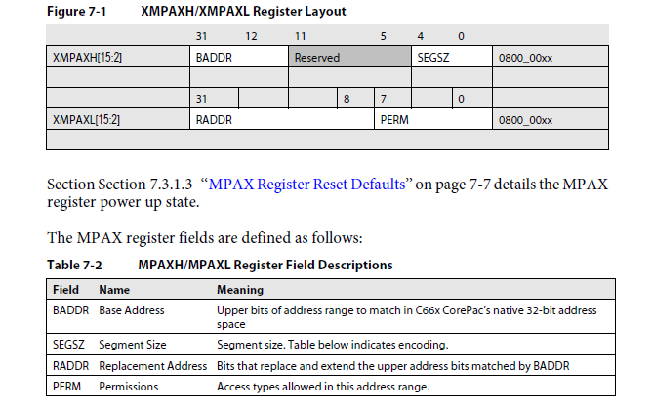
MPAX Registers Layout

Slide 20
The MPAX Registers
The following table summarizes the names and addresses of the MPAX registers:
MPAX description | Name | Address
Segment 0 lower 32 bits | XMPAXL0 | 0800_0000
Segment 0 upper 32 bits | XMPAXH0 | 0800_0004
Segment 1 lower 32 bits | XMPAXL1 | 0800_0008
Segment 1 upper 32 bits | XMPAXH1 | 0800_000c
Segment N lower 32 bits (N between 0 and 15) | XMPAXLN | 0800_0000 + N * 8
Segment N upper 32 bits(N between 0 and 15) | XMPAXHN | 0800_0004 + N * 8
Segment 15 lower 32 bits | XMPAXL15 | 0800_0078
Segment 15 upper 32 bits | XMPAXH15 | 0800_007c

Slide 21
The MAR Registers
MAR = Memory Attributes Registers
256 registers (32 bits each) control 256 memory segment
Each segment size is 4MBytes, from logical address 0x00000000 to address 0xffffffff
The first 16 registers are read only. They control the core’s internal memories.
Each register controls the cache-ability of the segment (bit 0) and the pre-fetch-ability (bit 3). All other bits are reserved and set to 0
All MAR bits are set to zero after reset

Slide 22
The MAR Registers
The following table gives names, segments and addresses some of the MAR registers:
Address | Name | Description | Defines attributes for
0x0184 8000 | MAR0 | MAR register 0 | Local L2 (Ram)
0x0184 8004 | MAR1 | MAR register 1 | 0100 0000h-01ff ffffh
0x0184 803c | MAR15 | MAR register 15 | 0f00 0000h-0fff ffffh
0x0184 8040 | MAR16 | MAR register 16 | 1000 0000h-10ff ffffh
0x0184 8044 | MAR17 | MAR register 17 | 1100 0000h-11ff ffffh
0x0184 8048 | MAR18 | MAR register 18 | 1200 0000h-12ff ffffh
0x0184 8200 | MAR128 | MAR register 128 | 8000 0000h-80ff ffffh
0x0184 8204 | MAR129 | MAR register 129 | 8100 0000h-81ff ffffh
0x0184 83fc | MAR255 | MAR register 255 | ff00 0000h-ffff ffffh

Slide 23
Example 1: Enable L2 Cache for MC Shared Memory Assumptions
Shared memory (MCMS RAM address 0c0000000 to 0c3f ffff) is L1 cacheable, but not L2 cacheable.
User assumptions:
Make the first 1M of it L2 cacheable (and thus make it L3 memory).
Protect this memory so that user and supervisor can read and write but not execute from this memory
The user must configure the MPAX and the MAR registers.

Slide 24
Example 1: Enable L2 Cache for MC Shared Memory Configuring MPAX
Configuring the MPAX register:
Use any MPAX register that is available (e.g., Register 3)..
Configure segment size to be 1M.
Give a different logical address to the first 1Mbytes of shared L2.
The logical address will present a memory that does not exist on the board. For example: If there is 512M bytes of external memory (from address 0xc000 0000 to address 0xdfff ffff), choose the logical address to start at address 0xe000 0000
The protection bits are 00110110 (two reserved bits, Supervisor read, write, execute, user read, write, execute)
Segment 3 registers are at addresses 0x0800 0018 (low register) and 0x0800 001c (high register).
Segment 3 has the following values:
Size = 1M = 10011b = 0x13 - 5 LSB of low register
7 bits reserved, written as zeros 0000000b
Logical base address 0x00E00 (12 bits with the 20 zero bits from the size of the logical base address are 0xE0000000). So the low register at address 0x08000018 is: 0000 0000 1110 0000 0000 0000 0001 0011
Physical (replacement) base address 0x000c0 (16 bits, with the 20 bits from the size the physical base address is 0x0c000000). So the high register at address 0x0800001C is: 0000 0000 0000 1110 0000 0011 0110

Slide 25
Example 1: Enable L2 Cache for MC Shared Memory Configuring MAR
Configuring the MAR register:
The MAR register that corresponds to logical address 0xe000 0000 is MAR 224 at address 0x01848380.
This register controls 4M of memory, from 0xe000 0000 to 0xe0ff ffff – even though only 1M of this memory is mapped into a “real” physical memory.
Assume that the user wants to enable both, the cache and the pre-fetch. So the value of the MAR register is set to: 0000 0000 0000 0000 0000 0000 0000 1001

Slide 26
Example 2: Disable L1 Cache from MC Shared Memory
Shared memory (MCMS RAM address 0c0000000 to 0c3f ffff) is L1 cacheable. The coherency is not guaranteed between L1 cache and shared memory.
If the user wants to use the shared memory to communicate between cores, they must manually manage the L1 coherency or disable the “cache-ability” of the shared memory.
This example uses the same MPAX registers as in Example 1. However, the value of the correspondent MAR register (MAR 224 at address 0x01848380 ) is changed to disable cache and pre-fetch.
Thus, the MAR register is set to the value 0x0000 0000.

Slide 27
Example 3: Sharing Very Large DDR for Different Cores
The DDR controller supports up to 8GB of external memory.
Each core logical address is limited to 32 bits, where the external memory starts at address 0x8000 0000.
So the maximum external addressable external memory from each core is 2G.
If the user needs to use more external memory, each core can be provided a separate area in the external memory. For example, four cores can use 8G of memory.
The following example shows how each of the eight cores configures 1G of logical external memory to different parts of the 8G physical external memory. This configuration can be for multi-channel applications where the same code runs on all cores on different channels.
To configure the MPAX register for each core:
Use any MPAX register that is available, say register 1
Configure segment size to be 1G
The logical address will start at 0x8000 0000 to 0xbfff ffff
The physical address depends on the core number
Assume full permission of the memory (R/W/E)

Slide 28
Example 3: Sharing Very Large DDR for Different Cores
Core 0 physical address will be from address 0x0 0000 0000 to address 0x0 3fff ffff
Core 1 physical address will be from address 0x0 4000 0000 to address 0x0 7fff ffff
Core 2 physical address will be from address 0x0 8000 0000 to address 0x0 bfff ffff
Core 3 physical address will be from address 0x0 C000 0000 to address 0x0 ffff ffff
Core 4 physical address will be from address 0x1 0000 0000 to address 0x1 3fff ffff
Core 5 physical address will be from address 0x1 4000 0000 to address 0x1 7fff ffff
Core 6 physical address will be from address 0x1 8000 0000 to address 0x1 bfff ffff
Core 7 physical address will be from address 0x1 c000 0000 to address 0x1 ffff ffff

Slide 29
Example 3: Sharing Very Large DDR for Different Cores
Segment 1 registers are at addresses 0x0800 0008 (low register) and 0x0800 000c (high register).
Segment 1 has the following values:
Size = 1G = 11101b = 0x1D; 5 LSB of low register
7 bits reserved, written as zeros 0000000b
Logical base address 0x00002 (2 bits, with the 30 zero bits from the size the logical base address is 0x80000000)
So the low register at address 0x08000008 for ALL the cores is 0000 0000 0000 0000 0010 0000 0001 1101
The higher register is a function of the core number:
Core 0, Physical (replacement) base address 0x00000 (16 bits, with the 30 bits from the size the physical base address is 0x0 0000 0000)
So the high register at address 0x0800001C for Core 0 is: 0000 0000 0000 0000 0000 0011 1111

Slide 30
Example 3: Sharing Very Large DDR for Different Cores
Core 1, Physical (replacement) base address 0x00001 (16 bits, with the 30 bits from the size the physical base address is 0x0 4000 0000)
So the high register at address 0x0800001C for Core 1 is 0000 0000 0000 0000 0001 0011 1111
Core 2, Physical (replacement) base address 0x00002 (16 bits, with the 30 bits from the size the physical base address is 0x0 8000 0000)
So the high register at address 0x0800001C for Core 2 is 0000 0000 0000 0000 0010 0011 1111
Core 7, Physical (replacement) base address 0x00007 (16 bits, with the 30 bits from the size the physical base address is 0x1 c000 0000)
So the high register at address 0x0800001C for Core 7 is 0000 0000 0000 0000 0111 0011 1111

Slide 31
Using Software to Configure XMC
Verify that the following path exists in your project (if not, add it):
PDK_INSTALL\packages
Where PDK_INSTALL is the path to the directory where the latest PDK was installed.
A typical path looks like:
C:\Program Files\Texas Instruments\pdk_C6678_1_0_0_11\packages
Include the CSL Auxiliary include file: #include <ti/csl/csl_cacheAux.h>

Slide 32
Using Software to Configure XMC
Manipulate the MAR registers:
Defined in csl_cacheAux.h
CSL_IDEF_INLINE void CACHE_enableCaching ( Uint8 mar )
CSL_IDEF_INLINE void CACHE_disableCaching ( Uint8 mar )
CSL_IDEF_INLINE void CACHE_setMemRegionInfo (Uint8 mar, Uint8 pcx, Uint8 pfx)
Where Mar is 8 bits (0 to 255) number of the MAR register
Interestingly enough, this is the base address shifted 24 places to the right
PCX controls cache-ability
PFX controls pre-fetching
Example 1: Enable cache for DDR3 memory 0x8000 0000 to 0x80ff ffff
#define MAPPED_VIRTUAL_ADDRESS0 0x80000000
CACHE_enableCaching ((MAPPED_VIRTUAL_ADDRESS0) >> 24);
Example 2: Disable cache for DDR3 memory 0x8100 0000 to 0x81ff ffff
#define MAPPED_VIRTUAL_ADDRESS1 0x81000000
CACHE_disableCaching ((MAPPED_VIRTUAL_ADDRESS1) >> 24);
Example 3: Disable cache and enable prefetch for DDR3 memory 0x8100 0000 to 0x81ff ffff
#define MAPPED_VIRTUAL_ADDRESS1 0x81000000
CACHE_setMemRegionInfo (((MAPPED_VIRTUAL_ADDRESS1) >> 24,0,1);
Note 1: If CACHE_setMemRegionInfo is used, no need to use CACHE_disableCaching or CACHE_enableCaching
Note 2: Reset values (Mar 15 to 255) pre-fetch enable, cache disabled

Slide 33
Using Software to Configure XMC
Manipulate the MPAX registers:
Defined in csl_xmcAux.h
CSL_IDEF_INLINE void
CSL_XMC_setXMPAXL ( Uint32 index, CSL_XMC_XMPAXHL * mpaxh )
Where index is one of the MPAX registers, 0 to 15 and CSL_XMC_XMPAXHL is a structure that is defined in the next slide:

Slide 34
Definition: CSL_XMC_XMPAXL
typedef struct CSL_XMC_XMPAXL
{
/** Replacement Address */
Uint32 rAddr;
/** When set, supervisor may read from segment */
Uint32 sr;
/** When set, supervisor may write to segment */
Uint32 sw;
/** When set, supervisor may execute from segment */
Uint32 sx;
/** When set, user may read from segment */
Uint32 ur;
/** When set, user may write to segment */
Uint32 uw;
/** When set, user may execute from segment */
Uint32 ux;
}CSL_XMC_XMPAXL;

Slide 35
Using Software to Configure XMC
Manipulate the MPAX registers: Defined in csl_xmcAux.h
CSL_IDEF_INLINE void
CSL_XMC_setXMPAXH ( Uint32 index, CSL_XMC_XMPAXH * mpaxh )
Where index is one of the MPAX registers, 0 to 15 and CSL_XMC_XMPAXH is a structure that is defined as follows:
typedef struct CSL_XMC_XMPAXH
{
/** Base Address */
Uint32 bAddr;
/** Encoded Segment Size */
Uint8 segSize;
}CSL_XMC_XMPAXH;

Slide 36
Implementation of Example 1 using CSL API
MPAX registers from the beginning of the presentation:
Use MPAX register 3
Segment size 1M (0x13 = 10011b)
Logical address 0xe0000000 (0x00e00)
Protection for supervisor and user, read, write, no execution (00110110)
Physical memory starts at 0x0c000000 (0x000c0)

Slide 37
Implementation of Example 1 using CSL API
Load CSl structures (there are APIs to load it with the appropriate values):
struct CSL_XMC_XMPAXL lowerStructure
{
rAddr = 0x00e00
sr = 1;
sw= 1;
sx = 0 ;
ur = 1;
uw= 1;
ux = 0 ;
};
struct CSL_XMC_XMPAXH higherStructure
{
bAddr = 0X000C0;
segSize= 0x13 ;
};

Slide 38
Implementation of Example 1 using CSL API
Call CSl functions to set the MPAX registers:
CSL_XMC_setXMPAXH (3, higherStructure) ;
CSL_XMC_setXMPAXL (3, owerStructure) ;

Slide 39
Agenda
Over View of the 6614 TeraNet
Memory System – DSP core point of view
Overview of memory map
MSMC and external Memory
Memory System – ARM point of view
Overview of memory map
ARM subsystem access to memory
ARM-DSP communication

Slide 40
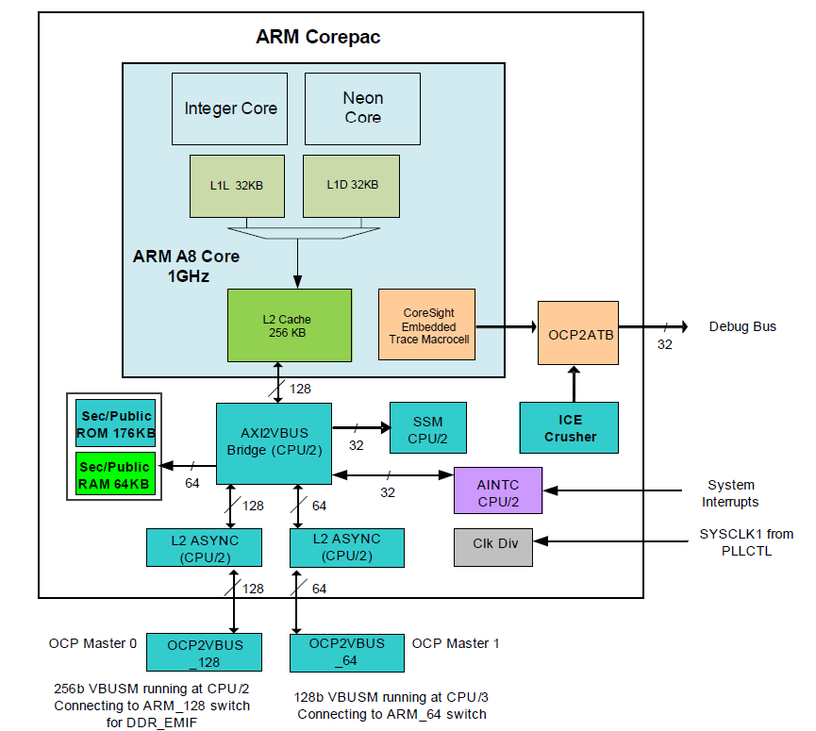
ARM CorePac

Slide 41
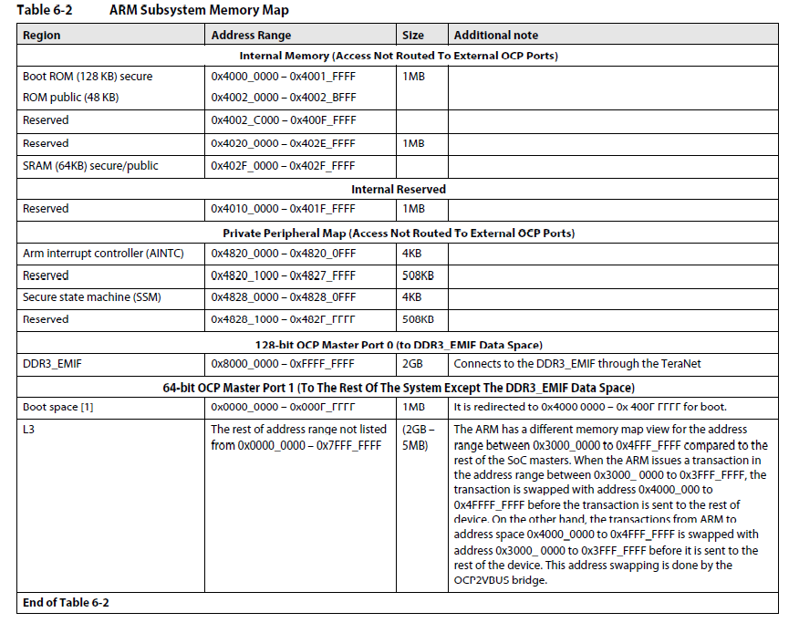
ARM subsystem memory Map

Slide 42
ARM subsystem Ports
32-bit ARM addressing (MMU or Kernel)
31 bits addressing into the external memory
ARM can address ONLY 2GB of external DDR (No MPAX translation) 0x8000 0000 to 0xffff ffff
The other 31 bits are used to access SOC memories or to address internal memories (ROM)

Slide 43
So what the ARM can see through the VBUS connection?
It can see the QMSS data at address 0x3400 0000
It can see HyperLink data at address 0x4000 0000
It can see PCIe data at address 0x6000 0000
It can see shared L2 at address0x0c00 0000
It can see EMIF 16 data at address 0x7000 0000
NAND
NOR
Asynchronous SRAM

Slide 44
ARM access SOC memory
Do you see a problem with HyperLink access?
Addresses in the 0x4 range are part of the internal ARM memory map
What about the cache and data from the Shared Memory and the Async EMIF16?
The next slide presents a page from the device errata

Slide 45
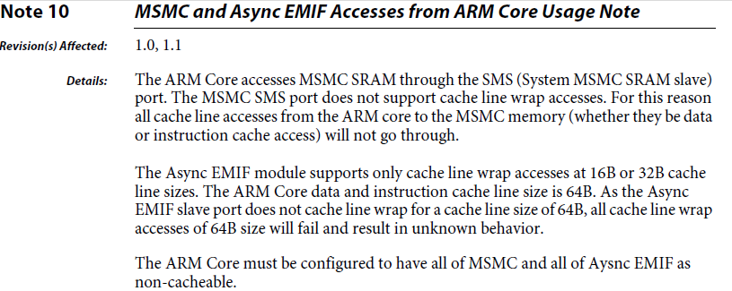
Errata User’s Note number 10

Slide 46
Read the Errata
Introduction. . . . . . . . . . . . . . . . . . . . . . . . . . . . . . . . . . . . . . . . . . . . . . . . . . . . . . . . . . . . . . . . . . . . . . . . . . . . . . . . . . . . . . . . . . . . . . . . . . . . . . 5
Device and Development Support Tool Nomenclature. . . . . . . . . . . . . . . . . . . . . . . . . . . . . . . . . . . . . . . . . . . . . . . . . . . . . . . . . . . . . 5
Package Symbolization and Revision Identification . . . . . . . . . . . . . . . . . . . . . . . . . . . . . . . . . . . . . . . . . . . . . . . . . . . . . . . . . . . . . . . . 6
Silicon Updates. . . . . . . . . . . . . . . . . . . . . . . . . . . . . . . . . . . . . . . . . . . . . . . . . . . . . . . . . . . . . . . . . . . . . . . . . . . . . . . . . . . . . . . . . . . . . . . . . . . 8
Advisory 1— HyperLink Temporary Blocking Issue . . . . . . . . . . . . . . . . . . . . . . . . . . . . . . . . . . . . . . . . . . . . . . . . . . . . . . . . . . . . . . . . . . . . . . . . .9
Advisory 2— BCP DNT Support for HSUPA 10ms TTI With Spreading Factor Two Issue . . . . . . . . . . . . . . . . . . . . . . . . . . . . . . . . . . . . . .10
Advisory 3— BCP DIO Reading From DDR Memory Issue . . . . . . . . . . . . . . . . . . . . . . . . . . . . . . . . . . . . . . . . . . . . . . . . . . . . . . . . . . . . . . . . . .11
Advisory 4— DDR3 Excessive Refresh Issue . . . . . . . . . . . . . . . . . . . . . . . . . . . . . . . . . . . . . . . . . . . . . . . . . . . . . . . . . . . . . . . . . . . . . . . . . . . . . . .12
Advisory 5— TAC P-CCPCH QPSK Symbol Data Mode with STTD Issue . . . . . . . . . . . . . . . . . . . . . . . . . . . . . . . . . . . . . . . . . . . . . . . . . . . . .13
Advisory 6— SRIO Control Symbols Are Sent More Often Than Required Issue . . . . . . . . . . . . . . . . . . . . . . . . . . . . . . . . . . . . . . . . . . . . .14
Advisory 7— Corruption of Control Characters In SRIO Line Loopback Mode Issue . . . . . . . . . . . . . . . . . . . . . . . . . . . . . . . . . . . . . . . . .15
Advisory 8— SerDes Transit Signals Pass ESD-CDM up to ±150 V Issue . . . . . . . . . . . . . . . . . . . . . . . . . . . . . . . . . . . . . . . . . . . . . . . . . . . . .16
Advisory 9— AIF2 CPRI 8x UL Peak BW Issue . . . . . . . . . . . . . . . . . . . . . . . . . . . . . . . . . . . . . . . . . . . . . . . . . . . . . . . . . . . . . . . . . . . . . . . . . . . . . .18
Advisory 10— AIF2 SERDES Lane Aggregation Issue. . . . . . . . . . . . . . . . . . . . . . . . . . . . . . . . . . . . . . . . . . . . . . . . . . . . . . . . . . . . . . . . . . . . . . .19
Advisory 11— ARM L2 Cache Content Corruption Issue . . . . . . . . . . . . . . . . . . . . . . . . . . . . . . . . . . . . . . . . . . . . . . . . . . . . . . . . . . . . . . . . . . .20
Advisory 12— L2 Cache Corruption During Block and Global Coherence Operations Issue. . . . . . . . . . . . . . . . . . . . . . . . . . . . . . . . . .21
Advisory 13— System Reset Operation Disconnects the SoC from CCS Issue . . . . . . . . . . . . . . . . . . . . . . . . . . . . . . . . . . . . . . . . . . . . . . .23
Advisory 14— Power Domains Hang When Powered Up Simultaneously with RESET (Hard Reset) Issue . . . . . . . . . . . . . . . . . . . . .24
Usage Note 1— TAC DL TPC Timing Usage Note . . . . . . . . . . . . . . . . . . . . . . . . . . . . . . . . . . . . . . . . . . . . . . . . . . . . . . . . . . . . . . . . . . . . . . . . . .25
Usage Note 2— Packet DMA Clock-Gating for AIF2 and Packet Accelerator Subsystem Usage Note . . . . . . . . . . . . . . . . . . . . . . . . .26
Usage Note 3— VCP2 Back-to-Back Debug Read Usage Note . . . . . . . . . . . . . . . . . . . . . . . . . . . . . . . . . . . . . . . . . . . . . . . . . . . . . . . . . . . . . .27
Usage Note 4— DDR3 ZQ Calibration Usage Note . . . . . . . . . . . . . . . . . . . . . . . . . . . . . . . . . . . . . . . . . . . . . . . . . . . . . . . . . . . . . . . . . . . . . . . . .28
Usage Note 5— I2C Bus Hang After Master Reset Usage Note . . . . . . . . . . . . . . . . . . . . . . . . . . . . . . . . . . . . . . . . . . . . . . . . . . . . . . . . . . . . . .29
Usage Note 6— MPU Read Permissions for Queue Manager Subsystem Usage Note. . . . . . . . . . . . . . . . . . . . . . . . . . . . . . . . . . . . . . . .30
Usage Note 7— Queue Proxy Access Usage Note . . . . . . . . . . . . . . . . . . . . . . . . . . . . . . . . . . . . . . . . . . . . . . . . . . . . . . . . . . . . . . . . . . . . . . . . .31
Usage Note 8— TAC E-AGCH Diversity Mode Usage Note. . . . . . . . . . . . . . . . . . . . . . . . . . . . . . . . . . . . . . . . . . . . . . . . . . . . . . . . . . . . . . . . . .32
Usage Note 9— Minimizing Main PLL Jitter Usage Note . . . . . . . . . . . . . . . . . . . . . . . . . . . . . . . . . . . . . . . . . . . . . . . . . . . . . . . . . . . . . . . . . . .33
Usage Note 10— MSMC and Async EMIF Accesses from ARM Core Usage Note. . . . . . . . . . . . . . . . . . . . . . . . . . . . . . . . . . . . . . . . . . . . .34
Usage Note 11— OTP Efuse Controller Does Not Operate at Full Speed Usage Note . . . . . . . . . . . . . . . . . . . . . . . . . . . . . . . . . . . . . . . .35

Slide 47
One more comments about the ARM
ARM uses only Little Endian
DSP can use Little Endian or Big Endian
Using Big Endian on the DSP requires a little extra attention to details

Slide 48
Agenda
Over View of the 6614 TeraNet
Memory System – DSP core point of view
Overview of memory map
MSMC and external Memory
Memory System – ARM point of view
Overview of memory map
ARM subsystem access to memory
ARM-DSP communication

Slide 49
Moving Messages/Data between DSP cores and ARM
Data to exchange can reside in the DDR, shared L2 or others
Only DDR data is cacheable
Send/Receive messages via two one-direction buffers with interrupts or polling
Using the Navigator to communicate. The navigator was designed for such used case
Communication between the ARM and DSP
Standard interface to and from DSP core regardless if the message arrives from another core or from the ARM
Kernel space does physical addressing, User’s space applications call kernel space driver

Slide 50
Introducing msgcom Messages exchange System

Slide 51
Requirements
Runs directly on KeyStone Navigator
Shall support communications between Application processes on the same core, different cores, and deferent devices
Note: inter QMSS over Ethernet/SRIO - can be done later
Shall provide the options to minimize either:
Application level latency (from writer’s context PUT to reader’s context GET including message cache operations). The goal is <300cycles for inter core.
Number of interrupt context switching (e.g. through message accumulation)
Shall support Management and Abstraction of hardware resources
SoC resources are managed by distributed resource manager.
Writer/Reader are generally unaware of the details of communication channel that is being set up. No changes in application SW required when underlying plumbing has been replaced (assuming the same blocking/non-blocking method is used).
Shall support both zero copy and CPPI DMA copy (for scattering/gathering and memory management) operations
Shall support both blocking/non-blocking operations
Shall support PDSP-based accumulation/interrupt pacing
Shall support following options for callback-based notification
None (assuming reader will read/poll at it’s convenience)
Implicit (each channel has dedicated non-empty interrupt line - e.g. QPEND) and
Explicit (out of band method, writer explicitly notifies reader that there are messages pending)

Slide 52
Types of Channel communications
Examples of the Zero-Copy constructions
Used for Core to Core communication
Channel | Type | Reading Mode | Interrupt Mode
MyCh1 | Queue | Non-Blocking | No Interrupt
MyCh2 | Queue | Blocking | Direct Interrupt
MyCh3 | Queue-Virtual | Blocking | Direct Interrupt
MyCh4 | Queue | Blocking | Accumulated Interrupt
Examples of the DMA-Copy constructions
Used for ARM (user’s Space) to Core communication
Channel | Type | Reading Mode | Interrupt Mode
MyCh5 | Queue | Non-Blocking | No Interrupt
MyCh6 | Queue | Blocking | Direct Interrupt
MyCh7 | Queue-Virtual | Blocking | Direct Interrupt

Slide 53
Case 1 – Generic Channel communication Zero Copy based Constructions Core to Core
Note – logical function only
hCh=Find(“MyCh1”);
hCh = Create(“MyCh1”);
READER
WRITER
MyCh1
Tibuf *msg = PktLibAlloc(hHeap);
Tibuf *msg =Get(hCh);
Put(hCh,msg);
PktLibFree(msg);
Delete(hCh);
Reader create a channel ahead of time with a given name
When writer has information to write it looks for the channel (find)
The write asks for buffer and writes the message into the buffer
The writer put the buffer. The navigator does it magic
When the reader calls get, it gets the message
The reader responsibility is to free the message after it is done reading
Notes:
Notes:
All naming is illustrative.
Open Items:
Recycling policies on Tx Completion queues
API Naming convention

Slide 54
Case 2 – Low-Latency Channel communication Zero Copy based Constructions Core to Core
Note – logical function only
READER
WRITER
hCh = Create(“MyCh2”);
MyCh2
Posts internal Sem and/or callback posts MySem;
hCh=Find(“MyCh2”);
chRx
(driver)
Get(hCh); or Pend(MySem);
Tibuf *msg = PktLibAlloc(hHeap);
Put(hCh,msg);
PktLibFree(msg);
hCh=Find(“MyCh3”);
MyCh3
hCh = Create(“MyCh3”);
Tibuf *msg = PktLibAlloc(hHeap);
Get(hCh); or Pend(MySem);
Put(hCh,msg);
PktLibFree(msg);
Reader create a channel based on one of the pending queues ahead of time with a given name.
The reader waits for the message by pending on a (software) semaphore
When writer has information to write it looks for the channel (find)
The write asks for buffer and writes the message into the buffer
The writer put the buffer. The navigator generate an interrupt . The ISR post the semaphore to the correct channel
The reader start processing the message
Virtual channel structure enables usage of a single interrupt to post semaphore to one of many channels
Notes:
Notes:
All naming is illustrative.
Open Items:
Recycling policies on Tx Completion queues
API Naming convention

Slide 55
Case 3 – Reduce context Switching Zero Copy based Constructions Core to Core
Note – logical function only
READER
WRITER
hCh = Create(“MyCh4”);
hCh=Find(“MyCh4”);
MyCh4
Tibuf *msg =Get(hCh);
Tibuf *msg = PktLibAlloc(hHeap);
chRx
(driver)
Put(hCh,msg);
Accumulator
PktLibFree(msg);
Delete(hCh);
Reader create a channel based on one of the accumulator queues ahead of time with a given name.
When writer has information to write it looks for the channel (find)
The write asks for buffer and writes the message into the buffer
The writer put the buffer. The Navigator adds the message to an accumulator queue
When the number of messages reaches a water mark, or after a pre-defined time out, the accumulator sends an interrupt to the core
The reader start processing the message and free after it is done
Notes:
Notes:
All naming is illustrative.
Open Items:
Recycling policies on Tx Completion queues
API Naming convention

Slide 56
ARM to Core Communication
For protection, User’s space does not involved with physical memory. All queues and descriptors manipulations are done by Kernel Space
A set of user’s space to Kernel space APIs hides the kernel space operation and the hardware from application code (part of the User’s space)
Kernel’s virtual queue module (VirtQueue) provides the application with pointers to buffers
Note – Similar APIs can support device to device communication using SRIO or other navigator based peripherals. This code is not implemented yet

Slide 57
Case 4 – Generic Channel communication ARM to DSP communications via Linux Kernel VirtQueue
Note – logical function only
READER
WRITER
hCh = Create(“MyCh5”);
hCh=Find(“MyCh5”);
MyCh5
msg = PktLibAlloc(hHeap);
Tibuf *msg =Get(hCh);
Put(hCh,msg);
Tx CPPI
DMA
Rx CPPI
DMA
PktLibFree(msg);
Delete(hCh);
Reader create a channel ahead of time with a given name
When writer has information to write it looks for the channel (find). The kernel is aware of the user’s space handle
The write asks for buffer. The kernel dedicate a descriptor to the channel and gives the write a pointer to a buffer that is associated with the descriptor. The write writes the message into the buffer.
The writer put the buffer. The kernel push the descriptor into the right queue. The navigator does loopback (copy the descriptor data) and free the Kernel queue. Then the navigator load the data into another descriptor and sends it to the appropriate core.
When the reader calls get, it gets the message
The reader responsibility is to free the message after it is done reading
Notes:
Notes:
All naming is illustrative.
Open Items:
Recycling policies on Tx Completion queues
API Naming convention

Slide 58
Case 5 – Low-Latency Channel communication ARM to DSP communications via Linux Kernel VirtQueue
Note – logical function only
hCh = Create(“MyCh6”);
READER
WRITER
MyCh6
hCh=Find(“MyCh6”);
chIRx
(driver)
Get(hCh); or Pend(MySem);
msg = PktLibAlloc(hHeap);
Put(hCh,msg);
Tx CPPI
DMA
Rx CPPI
DMA
PktLibFree(msg);
Delete(hCh);
PktLibFree(msg);
Reader create a channel based on one of the pending queues ahead of time with a given name.
The reader waits for the message by pending on a (software) semaphore
When writer has information to write it looks for the channel (find). The Kernel space is aware of the handle
The write asks for buffer. The kernel dedicate a descriptor to the channel and gives the write a pointer to a buffer that is associated with the descriptor. The write writes the message into the buffer.
The writer put the buffer. The kernel push the descriptor into the right queue. The navigator does loopback (copy the descriptor data) and free the Kernel queue. Then the navigator load the data into another descriptor , move it to the right queue and generate an interrupt . The ISR post the semaphore to the correct channel
The reader start processing the message
Virtual channel structure enables usage of a single interrupt to post semaphore to one of many channels
Notes:
Notes:
All naming is illustrative.
Open Items:
Recycling policies on Tx Completion queues
API Naming convention

Slide 59
Case 6 – Reduce context Switching ARM to DSP communications via Linux Kernel VirtQueue
Note – logical function only
hCh=Find(“MyCh7”);
hCh = Create(“MyCh7”);
READER
WRITER
MyCh7
Msg = Get(hCh);
chRx
(driver)
msg = PktLibAlloc(hHeap);
Put(hCh,msg);
Tx CPPI
DMA
Rx CPPI
DMA
Accumulator
PktLibFree(msg);
Delete(hCh);
Reader create a channel based on one of the accumulator queues ahead of time with a given name.
When writer has information to write it looks for the channel (find). The Kernel space is aware of the handle
The write asks for buffer. The kernel dedicate a descriptor to the channel and gives the write a pointer to a buffer that is associated with the descriptor. The write writes the message into the buffer.
The writer put the buffer. The kernel push the descriptor into the right queue. The navigator does loopback (copy the descriptor data) and free the Kernel queue. Then the navigator load the data into another descriptor . Then the Navigator adds the message to an accumulator queue
When the number of messages reaches a water mark, or after a pre-defined time out, the accumulator sends an interrupt to the core
The reader start processing the message and free after it is done
Notes:
Notes:
All naming is illustrative.
Open Items:
Recycling policies on Tx Completion queues
API Naming convention

Slide 60
Real Time Communication Resources
pktlib
Provides Navigator-based shared heaps
Created by one entity, found by others (using string name)
Provides optimized ways to implement Zero Copy based packet operations
Support Packet Merging, Splitting and Cloning
Maintains Reference Counts
Simplifies recycling policies

Slide 61
Real time Communication Resources
msgcom
Provides Navigator-based communication channels
DSP to DSP and ARM to DSP
Created by reader, found by writer (using string name)
Channel properties:
Zero Copy or DMA-copied
Polled and/or Interrupt driven
Block or non-blocking
With or without accumulation
Conceptually independent on allocation/freeing policies
Reader
hCh = Create(“MyChannel”, ChannelType, struct *ChannelConfig); // Reader specifies what channel it wants to create
// For each message
Get(hCh, &msg) // Either Blocking or Non-blocking call,
pktLibFreeMsg(msg); // Not part of IPC API, the way reader frees the message can be application specific
Delete(hCh);
Writer:
hHeap = pktLibCreateHeap(“MyHeap); // Not part of IPC API, the way writer allocates the message can be application specific
hCh = Find(“MyChannel”);
//For each message
msg = pktLibAlloc(hHeap); // Not part of IPC API, the way reader frees the message can be application specific
Put(hCh, msg); // Note: if Copy=PacketDMA, msg is freed my Tx DMA.
…
msg = pktLibAlloc(hHeap); // Not part of IPC API, the way reader frees the message can be application specific
Put(hCh, msg);

Slide 62
User Space Packet Processing
MsgCom SAP
Pktlib
SAP
Application
KeyStone Msgcom Library
KeyStone Packet Library
vRing API
bMan API
User
KeyStone Channel Adaptation
Kernel
TX DMA Channel
RX DMA Channel
TX DMA Channel
RX DMA Channel
TX DMA Channel
RX DMA Channel
Filter
Channel
Filter
Channel
TX
RX
TX
RX
TX
RX
TX/RX
Infrastructure DMA
CPPI DMA
CPPI DMA
TX DMA
RX DMA
TX
RX
HW Accelerator
HW Accelerator
TX DMA
RX DMA
HW Accelerator
SW
SW
SW
SW
SW
Usage Cases
1
2
3
4

