Slide 1
KeyStone Connectivity and Priorities
KeyStone Training
Multicore Applications
Literature Number: SPRPxxx

Slide 2
Agenda
TeraNet Bridges
Multicore Shared Memory Controller (MSMC)
C66x CorePac Bandwidth Management
Priorities
DSP Internal Access
DSP Master Access
TeraNet
EDMA

Slide 3
TeraNet Bridges
KeyStone Connectivity & Priorities

Slide 4
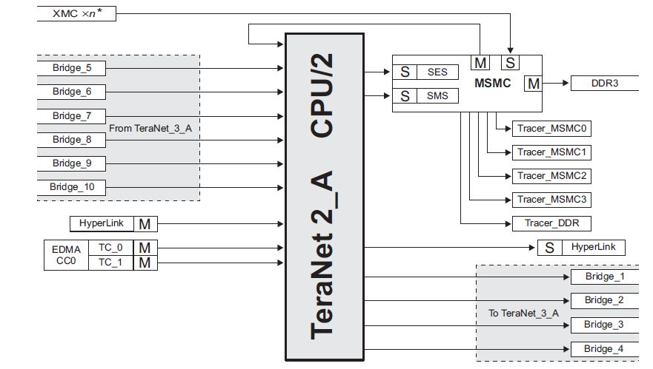
Teranet Masters and Slaves
Main switched fabric bus connects Masters and Slaves
Masters can initiate transfer (put address on the address bus)
No contention on a master
Slaves respond to master requests
Slaves may have multiple requests from multiple masters

Slide 5
TeraNet Observations
Multiple sections of the data Teranet are connected by bridges
Limiting the number of concurrent transfers between sections
KeyStone I has CPU/2 section and CPU/3 sections
KeyStone II: All sections are CPU/3
Configuration TeraNet is slower at CPU/6

Slide 6
KeyStone I: CPU/2 Bridge
Source: 6678 Data Manual (SPRS691D—April 2013)

Slide 7
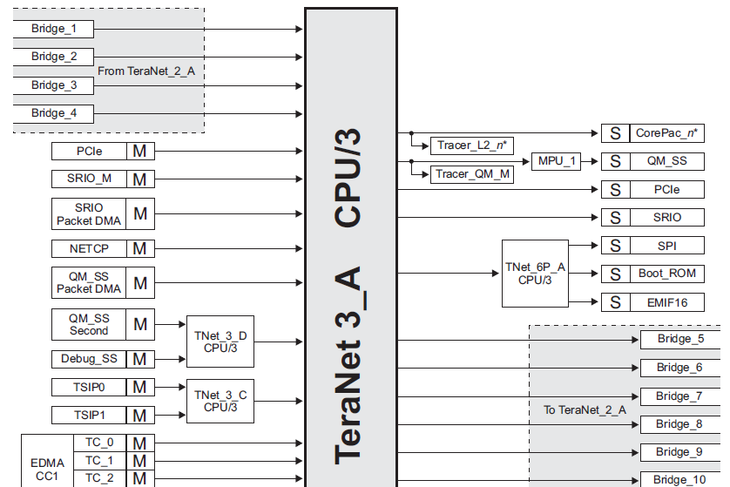
KeyStone I: CPU/3 Bridge
Source: 6678 Data Manual (SPRS691D—April 2013)

Slide 8
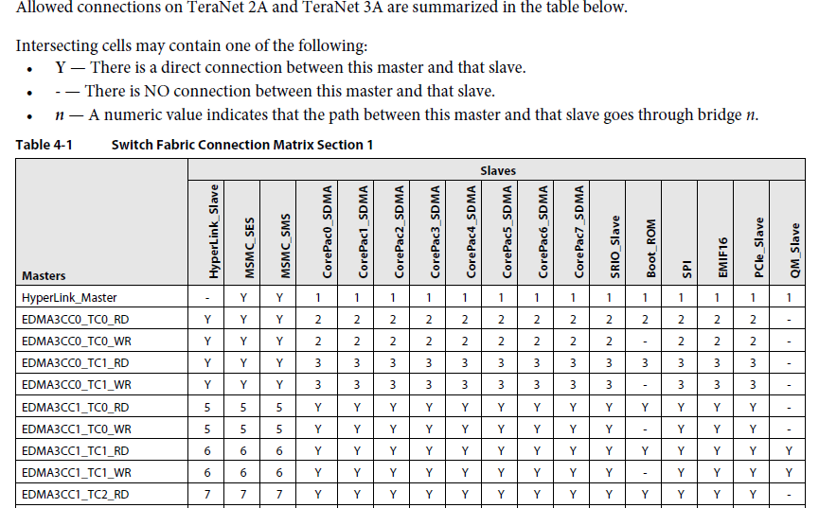
KeyStone I: TeraNet Connection Matrix
Source: 6678 Data Manual (SPRS691D—April 2013)

Slide 9
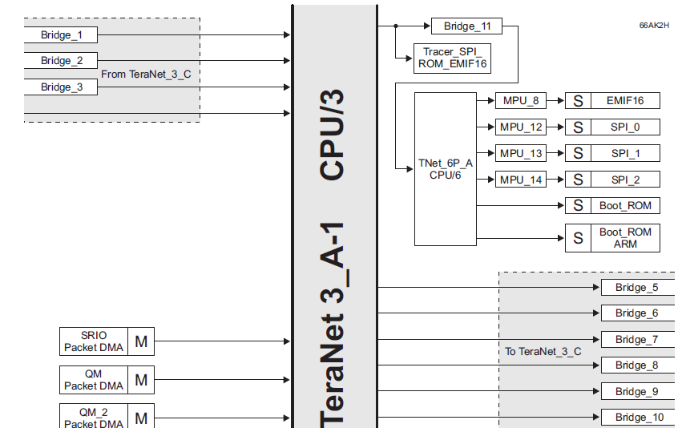
KeyStone II: CPU/3 Bridge
Source: 6638 Data Manual (SPRS691D—April 2013)

Slide 10
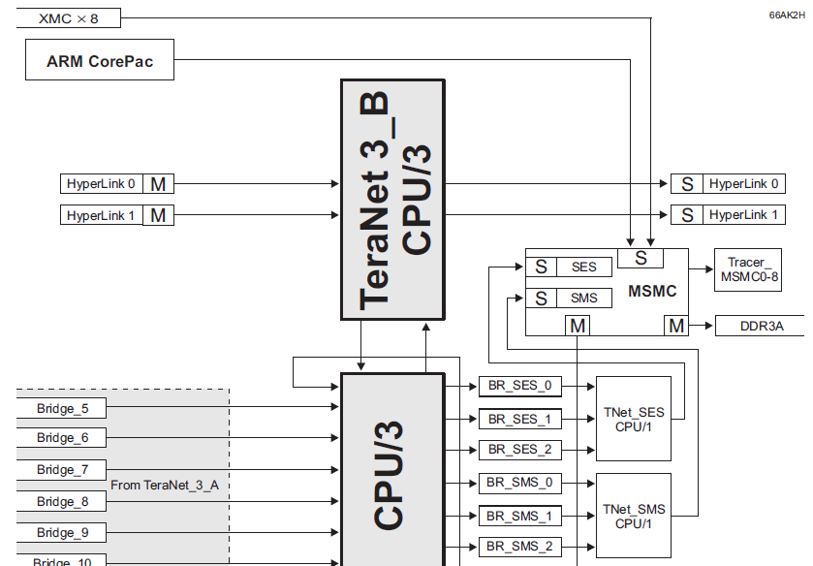
KeyStone II: CPU/3 Bridge
Source: 6638 Data Manual (SPRS691D—April 2013)

Slide 11
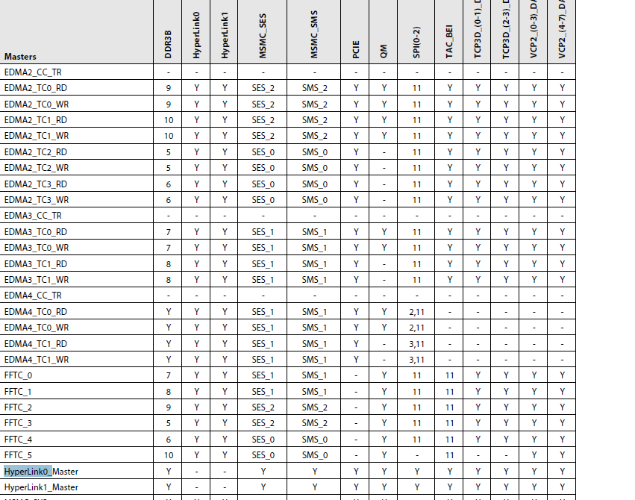
KeyStone II: TeraNet Connection Matrix

Slide 12
Multicore Shared Memory Controller (MSMC)
KeyStone Connectivity & Priorities

Slide 13
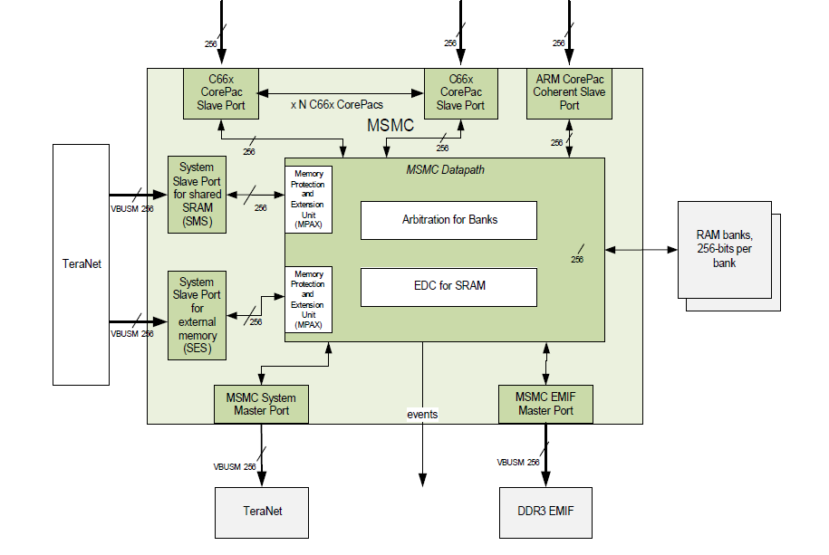
KeyStone II: MSMC Interfaces

Slide 14
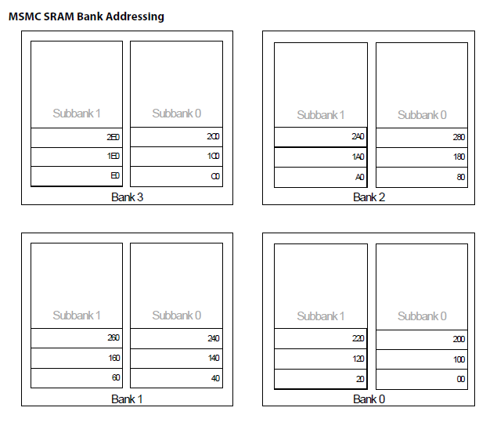
KeyStone I: MSMC SRAM Banks (2x32 bytes) 64 Bytes Aligned

Slide 15
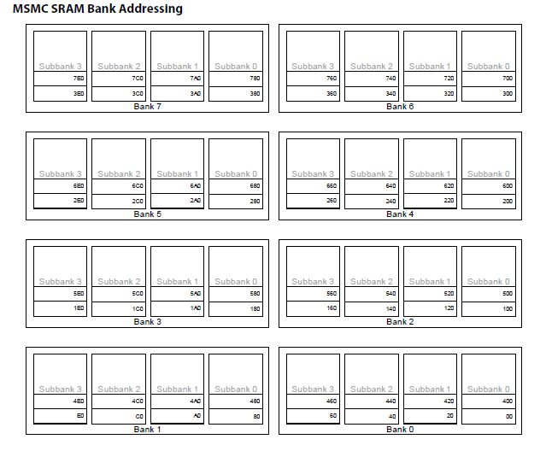
KeyStone II: MSMC SRAM Banks (4x32 bytes) 128 Bytes Aligned

Slide 16
C66x CorePac Bandwidth Management
KeyStone Connectivity & Priorities

Slide 17
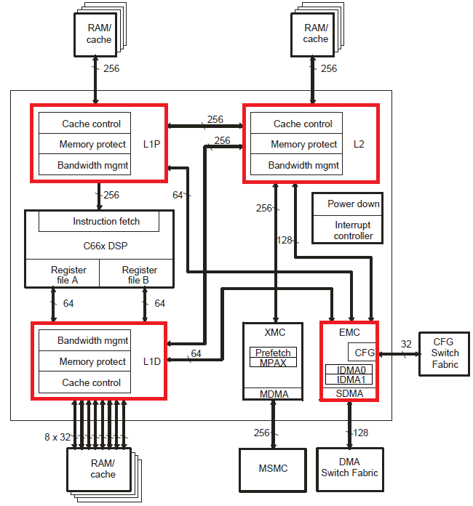
C66x CorePac Bandwidth Management: Overview
Purpose
To set priorities for resources
Ensure that requester does not use C66x CorePac resource(s) for too long
Resources
L1P
L1D
L2
Memory-mapped registers configuration bus
C66x CorePac Block Diagram

Slide 18
C66x CorePac Bandwidth Management: Requestors
Potential requestors of resources
DSP-initiated transfers
Data access
Program access
Cache Coherency Operations
Block-based (operations on a range of addresses)
Global (operations on the entire cache)
IDMA (Internal DMA)
Local memory to memory DMA
SDMA (Slave DMA)
External initiated
Masters outside the CorePac requesting access to a resource

Slide 19
C66x CorePac Bandwidth Management: Cache
A Word about Cache
L1 cache is read only allocated (no cache line is allocated when write)
L2 cache is read and write allocation (unless configured otherwise)
Cache is configured using CSL functions. API are defined in csl_cache.h and csl_cachAux.h . These files are located in C:\ti\MCSDK_3_01_12\pdk_keystone2_3_00_01_12\packages\ti\csl
L2 Cache write-through is supported by the MAR registers – the configuration is visible in the BIOS API
static inline Void BCACHE_setMar(Ptr baseAddr, size_t byteSize, UInt32 val)
{
ti_sysbios_family_c66_Cache_setMar(baseAddr, byteSize, val);
}

Slide 20
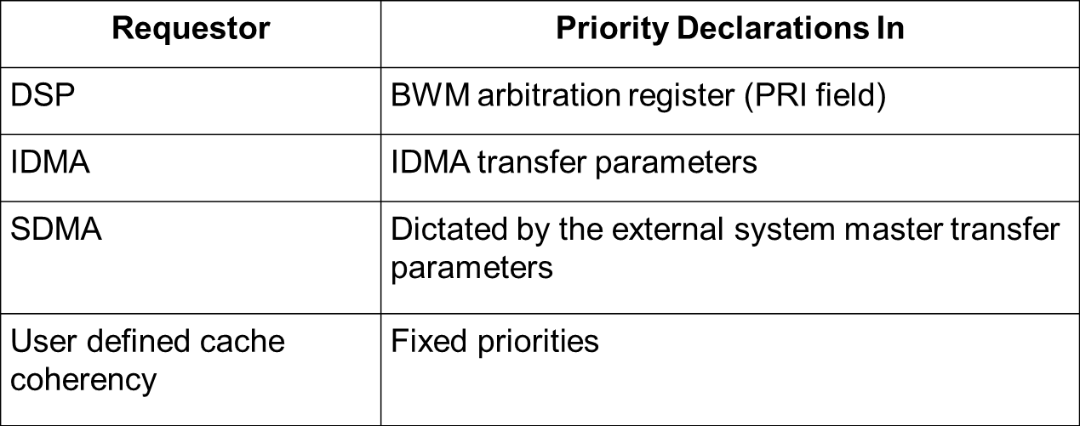
C66x CorePac Bandwidth Management: Priority Declarations
The table below shows where the priority declaration for each requestor is declared.

Slide 21
C66x CorePac Bandwidth Management: Arbitration Registers
BWM Scheme
Bandwidth management is implemented locally through registers called “Arbitration Registers.”
Each resource has a set of arbitration registers; Different registers for each requester.
Each register defines MAXWAIT and PRI. The PRI field will declare the priority for that requestor. MAXWAIT is explained below. A register may or may not have a PRI field, but it will always have the MAXWAIT field.
Priorities
Requestors are assigned priorities on a per-transfer basis:
Highest: Priority 0
…..
Lowest: Priority 8
When contention occurs for many successive cycles, a counter is increased. Once the counter reaches the value in the MAXWAIT field, the lower priority requestor gets access. This is enabled by setting its priority to -1 for that cycle. The counter then resets to 0.

Slide 22
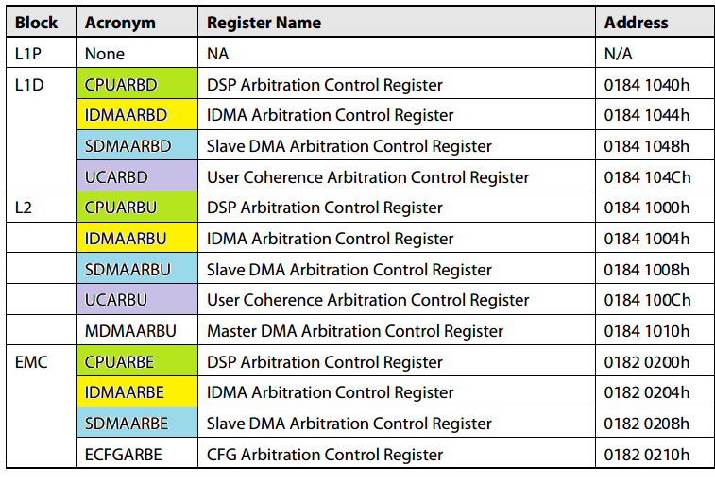
C66x CorePac Bandwidth Management: Arbitration Registers Per Resource
Notes:
Note: Look into ARM.
Update: Couldn’t find anything on arbitration. Here is a link to the ARM Corepac User Guide.
http://www.ti.com/lit/ug/spruhj4/spruhj4.pdf

Slide 23
C66x CorePac Bandwidth Management Cache Coherency
Cache coherency operations:
Fixed priorities:
Global has the highest priority
Block has the lowest priority
MAXWAIT is only for block transfers

Slide 24
C66x CorePac Bandwidth Management: IDMA
IDMA channel 0 is always the highest priority.
IDMA channel 0 is intended for quick programming of configuration registers located in the external configuration space (CFG).
It transfers data from a local memory (L1P, L1D, and L2) to the external configuration space.
IDMA channel 1 has a programmable priority using the PRI field in the IDMA channel 1 count register (IDMA1_COUNT).
IDMA channel 1 is intended for transferring data between local memories.
It moves data and program sections in the background without DSP operation to set up processing from fast memory.
Address: 0182 0112h

Slide 25
C66x CorePac Bandwidth Management: External Master
External Master priorities are configured by each master.
MAXWAIT is controlled by CorePac.

Slide 26
Priorities
KeyStone Connectivity & Priorities

Slide 27
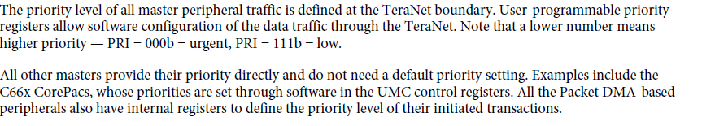
TeraNet Bus Priorities
From the User’s Guide:

Slide 28
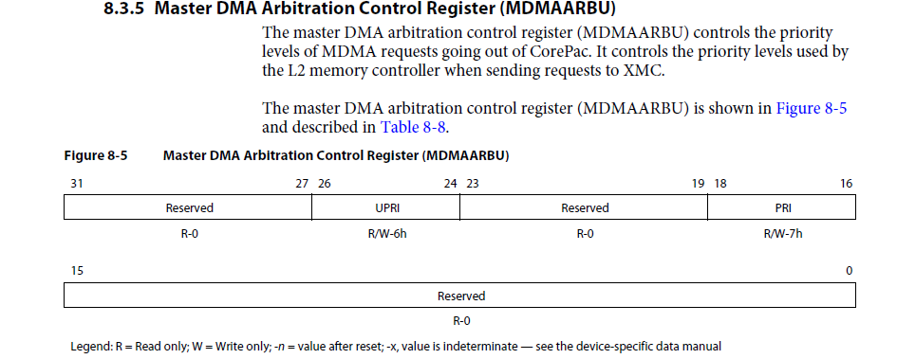
DSP Priorities

Slide 29
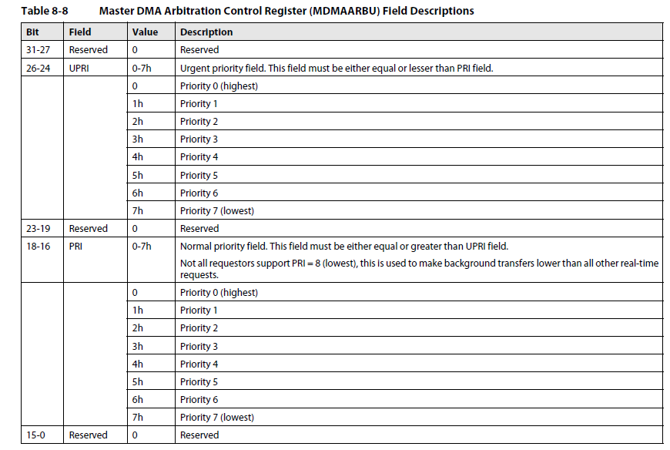
DSP Priorities

Slide 30
EDMA Priority Scheme
Priorities on the bus: Each Transfer Controller (TC) has priority
Set by queue Priority Register (QUEPRI)
EDMA UG section 4.2.1.8 in SPRUGS5A—December 2011
Look at csl_edma3.h and csl_edmaAux.h
Priorities inside EDMA controller: Fixed scheme
See the next two slides and then the third one…

Slide 31
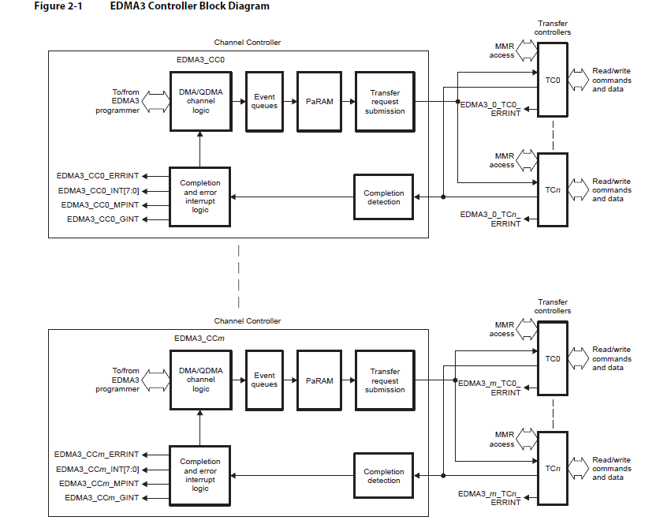
EDMA3 Controller

Slide 32
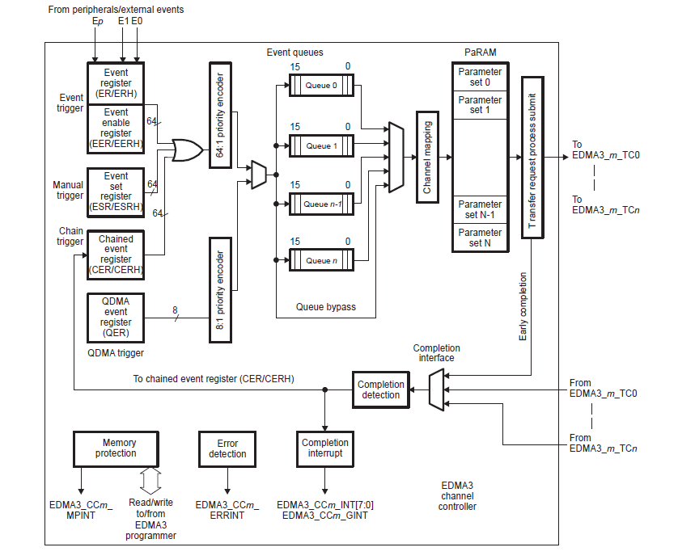
EDMA3 Channel Controller

Slide 33
EDMA Priorities
Channel priorities when more than one event occurs:
Lower channel number = higher priority
DMA has higher priority compared with QDMA
De-queue priority (from the queues to TC)
Lower TC number gets channel from the queue before higher TC number
Out-of-order queuing
Smart algorithm can modify the order of channels in a queue to minimize overhead associated with multiple similar requests
Each TC has a burst size
CC0 TC0 and TC1: 16 bytes default
All other TC: 8 bytes default

Slide 34
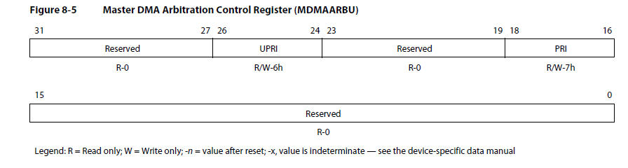
Core MSMC and DDR Priorities
From Cores to MSMC, there are two priorities:
PRI (Priority) for pre-fetch
UPRI (Urgent Priority) for all other requests
Default priorities for CorePac:
6 for UPRI
7 for PRI
Register MDMAARBU enables the user to change the priorities
NOTE: Details in the CorePac UG
CSL API

Slide 35
MSMC Starvation Control
Starvation Control limits the waiting time of a low priority requester by temporary increasing the priority to 0, which is the highest priority.
10 registers, one for each core, and two (one for SMS and one for SES) from the Teranet
Register SBNDCn describes the starvation register for Core n (see MSMC UG for more details).
CSL API

Slide 36
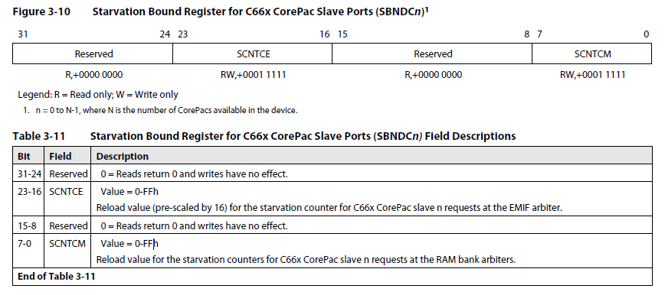
MSMC Starvation Bound Register (SBNDCn)

Slide 37
DDR EMIF Bandwidth Management: Level 1 – Arbitration at MSMC Controller
DDR is not SRAM. The overhead of moving from one DDR address to another is high. Thus, the starvation mechanism is different than MSMC memory,
Uses the same registers as before; Different bit field
9 registers, one for each core, one for SES from the Teranet. Values are multiplied by 16 for the DDR.
DDR starvation range from 0 to 255 X 16 = 4080 MSMC cycles = 8160 DSP cycles (for KeyStone II – 4080)
Register SBNDCn describes the starvation register for Core n (see MSMC UG for more details).
CSL API

Slide 38
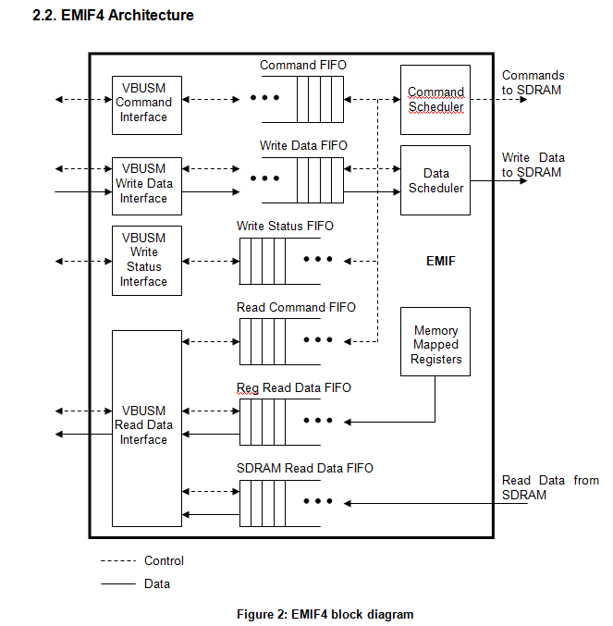
Level 2 - DDR Arbitration Algorithm (1)

Slide 39
DDR Arbitration Algorithm (2)
All commands are in the command FIFO
Data read into Register Read FIFO and Data Read FIFO
Write Data FIFO stores the data to be written
Write Status FIFO – write status information
Read Command FIFO – stores the read transactions to be issued to the VBUSM interface

Slide 40
DDR Arbitration Algorithm (3)
EMIF looks at all the commands in the command FIFO and can change the order of issuing commands regardless of priority
All commands with the same CMSTID will complete in order
Read command before write command if they are not to the same block (2kB) and the read priority is not lower than the write priority
Command with different CMSTID can be reorder
Block read command if there is a write command to the same block (regardless of priority or CMSTID)
Thus for each CMSTID there may be one pending read and one pending write
The EMIF select first the once that have open banks

Slide 41
DDR Arbitration Algorithm (4)
Switch between READ and Write depends on the READ WRITE EXECUTION THRESHOLD REGISTER
During Read session, counters counts how many reads were executed and when it reaches the threshold the EMIF switches to write
During write – the same process
Reg_pr_old_count is a counter that counts how long the Oldest command in the FIFO is waiting. When this counter expires, the EMIF raises the priority of the oldest command over all other commands

Slide 42
DDR Arbitration Algorithm (5) Class of Service
Two classes of services – class 1 and class 2
Mapping is done based on Priority or master ID
Each class has an associated Latency Counter (reg_cos_count)
When the latency for a command reaches the latency register for its class, the command will be execute next
Multiple commands expire – the higher priority will be executed
Exception to the role – the oldest command in the FIFO

Slide 43
Summary -DDR EMIF Bandwidth Management: Level 2 - DDR Arbitration
The DDR3 memory controller performs command reordering and scheduling. Command reordering takes place within the command FIFO.
The DDR3 memory controller examines all the commands stored in the command FIFO to schedule commands to the external memory.
For each master, the DDR3 memory controller reorders the commands based on the following rules:
The DDR3 controller will advance a read command before an older write command from the same master if the read is to a different block address (2048 bytes) and the read priority is equal to or greater than the write priority.
The DDR3 controller will block a read command, regardless of the master or priority if that read command is to the same block address (2048 bytes) as an older write command.

Slide 44
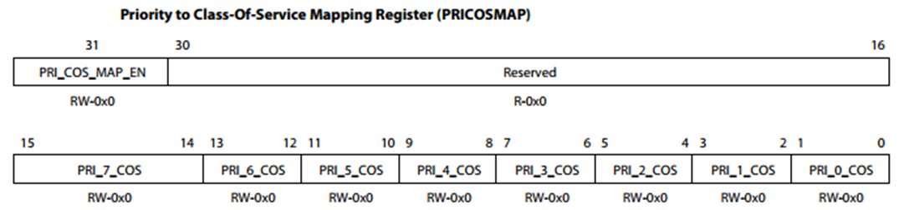
DDR3 Memory Controller Interface: Class of Service (CoS)
The commands in the Command FIFO can be mapped to two classes of service: 1 and 2.
The mapping of commands to a particular class of service can be done based on the priority or the master ID.
The mapping based on priority can be done by setting the appropriate values in the Priority to Class of Service Mapping register (offset: 100h).

Slide 45
DDR3 Memory Controller Interface: Mapping Master IDs to CoS
The mapping based on master ID can be done by setting the appropriate values of master ID and the masks in the Master ID to Class of Service Mapping registers:
Master ID to Class-Of-Service Mapping 1 Register (offset: 104h)
Master ID to Class-Of-Service Mapping 2 Register (offset: 108h)
There are three master ID and mask values that can be set for each class of service. In conjunction with the masks, each class of service can have a maximum of 144 master IDs mapped to it.
For example, a master ID value of 0xFF along with a mask value of 0x3 will map all master IDs from 0xF8 to 0xFF to that particular class of service.
By default all commands will be mapped to class of service 2.
Registers description is in the next slide

Slide 46


DDR3 Memory Controller Interface: CoS Mapping Registers

Slide 47
DDR3 Memory Controller Interface: CoS Latency
Each class of service has an associated latency counter. The value of this counter can be set in the Latency Configuration register (offset: 0x54h).
When the latency counter for a command expires, i.e., reaches the value programmed for the class of service that the command belongs to, that command will be the one that is executed next.
If there is more that one command that has expired latency counters, the command with the highest priority will be executed first.
One exception to this rule is as follows: if any of the commands with the expired latency counters is also the oldest command in the queue, that command will be executed first irrespective of priority.
Description of the register is in the next slide

Slide 48
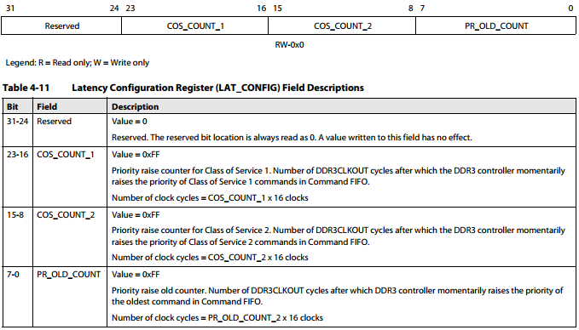
DDR3 Memory Controller Interface: CoS Latency Register

Slide 49
Bus Priority of Other Masters
Other masters configure the bus priority internally to the master
The next few slides shows where to set the priority of each master:
HyperLink
PCIe
SRIO

Slide 50
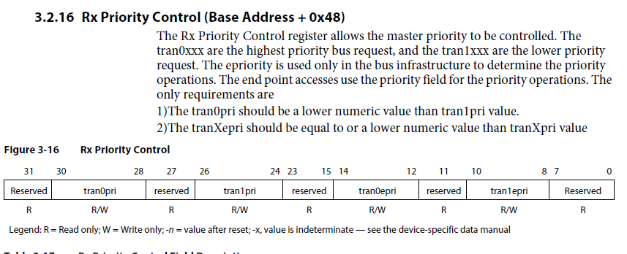
Hyperlink Priority Register

Slide 51
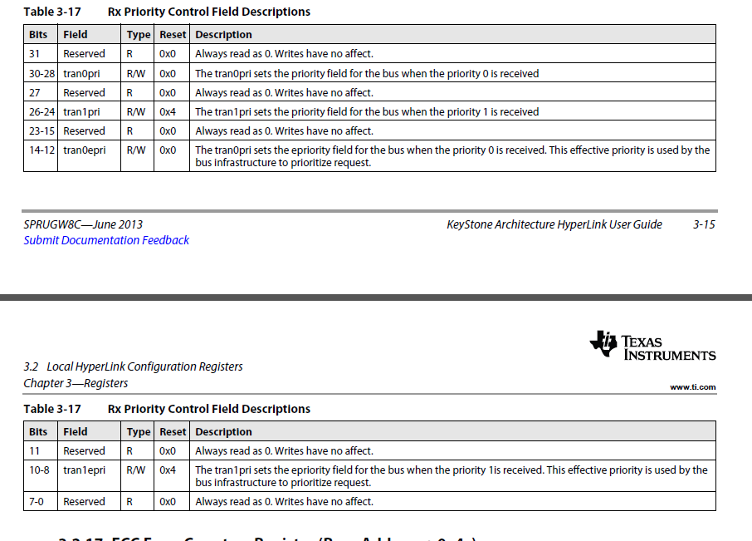
Hyperlink Priority Register

Slide 52
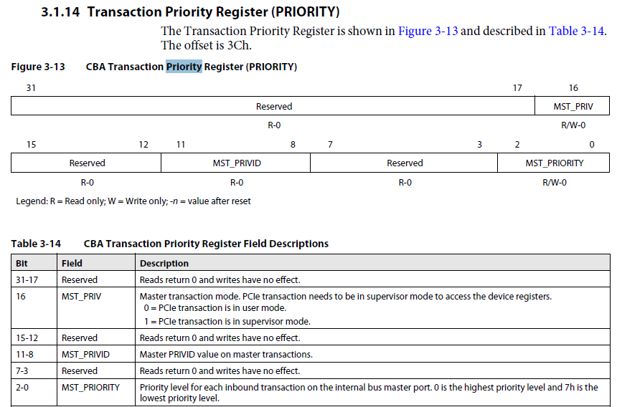
PCIe Priority Register

Slide 53
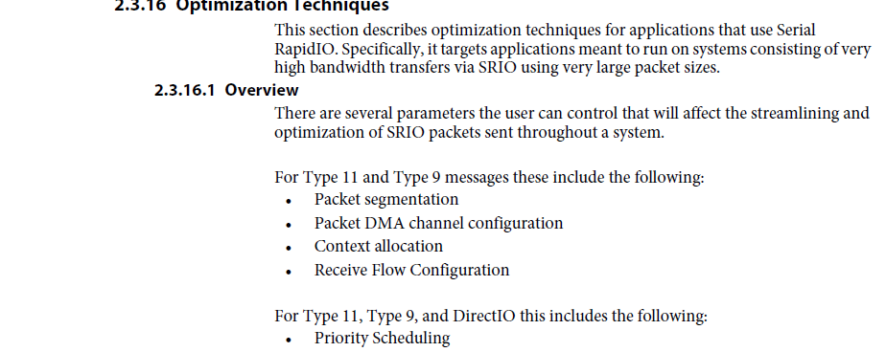
SRIO Priority Register (1/3)

Slide 54
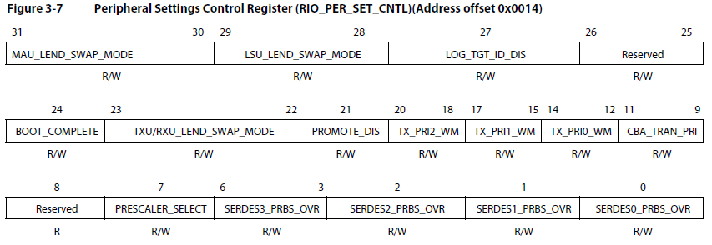
SRIO Priority Register (2/3)

Slide 55
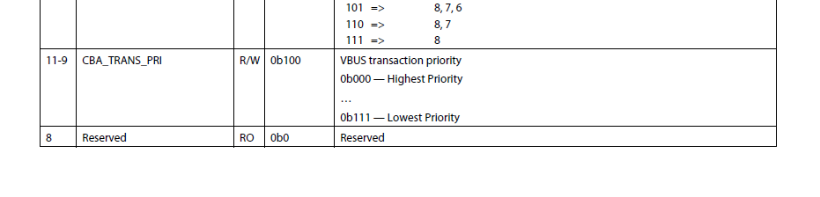
SRIO Priority Register (3/3)

Slide 56
Questions and Final Statement
Almost all information is extracted from KeyStone I (Shannon) User Guides (Data manual, EDMA UG, MSMC UG, DDR UG)
I did not go through KeyStone II documents. I believe they are similar.

