Slide 1
Introduction to The Linaro Toolchain
Embedded Processors Training
Multicore Software Applications
Literature Number: SPRPXXX

Slide 2
Toolchain for ARM of Sitara Devices Applicable to other ARM-based devices, as well
A tool chain is a collection of programs used to compile and build applications or libraries and generally includes several additional tools useful for debugging or troubleshooting issues.
Starting with SDK 6.0, TI switched from a proprietary code generation tool to the Linaro cross compiler tool chain.
Notes:
Usually when someone is referring to a toolchain they are referring to the gcc compiler since that is the only program people use. However, the gcc application actually invokes other tools within the toolchain but provides a single interface for users to make their lives easier.

Slide 3


Cross Compiling
Cross Compiler definition: A compiler that can convert instructions into machine code for a computer other than that on which it is run.
Which of the following are examples of cross compiling?
Compiling an application on your Linux laptop to run on your Linux desktop.
Compiling a Windows application on a Macintosh.
Compiling a Linux application on your PC for your Sitara EVM or Beaglebone.
Notes:
http://en.wikipedia.org/wiki/Cross_compiler

Slide 4
Compiling a Simple Program

Slide 5
Compiling a Simple Program
Adding the path to the environment allows simpler use of the tool chain by calling the commands directly instead of having to specify the entire path.
Adding the toolchain path to the environment path: export PATH=<toolchain dir>:$PATH
The simplest way to build an application is by listing the sources and specifying the name of the binary to be generated: arm-linux-gnueabihf-gcc <C sources> -o <executable name>
Other flags such as the debug can be added: arm-linux-gnueabihf-gcc <C sources> -g -o <executable name>

Slide 6
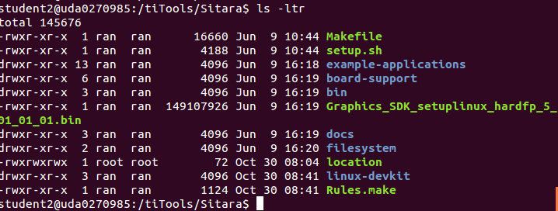
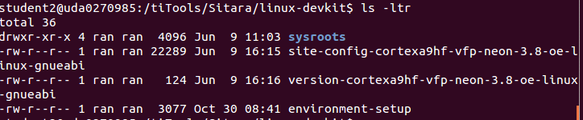
Linux SDK: linux-devkit
The Sitara toolchain is found in the Linux SDK in the linux-devkit directory.
Notes:
PMU – Programming Multi-channel Unit (The ARM module)
LPDDR - Low Power Double Data Rate memory 266MHZ
DDR3 – 400MHZ
DDR3L – low voltage DDR3
OCMC – On chip memory controller

Slide 7
Understanding Linux-devkit
Linux-Devkit
Target Headers & Libraries
Host Tools Directory
Environment-setup
Toolchain,
GDB,
Qt compiler,
and more
Common environment variables that affect compiling

Slide 8
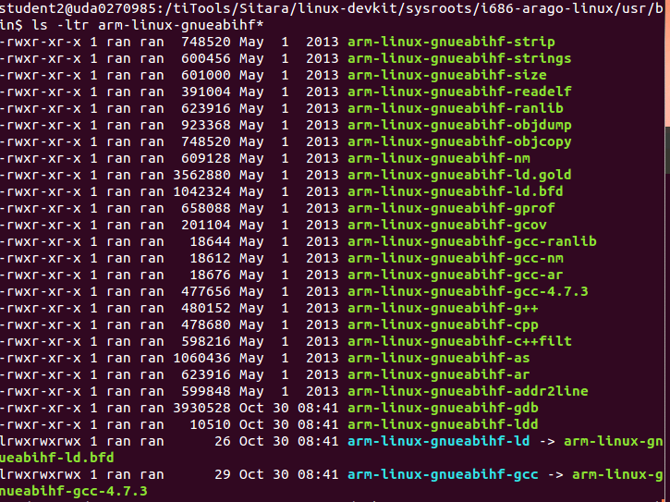
Code Generation Location

Slide 9
Linking to External Libraries
The code generation tool should know the non-standard libraries and headers with which it compiles and links.
This is done by passing the library name to the compiler in the command line or inside a make file.
Find the name of the library file that is needed. Remove lib from the front and remove the extension. Then add -l to the front.
Example:
Link against PNG library (libpng.so)
libpng.so -> png -> -lpng
arm-linux-gnueabihf-gcc <C sources> -lpng -o <executable name>
And don’t forget the Path
Notes:
http://www.cs.swarthmore.edu/~newhall/unixhelp/howto_C_libraries.html
http://stackoverflow.com/questions/5479584/compiling-or-using-libxml-using-c-on-osx

Slide 10

Environment-setup
Purposes:
Point the compiler to the target’s headers and libraries
Automatically adds the tool chain binaries to your PATH.
Sets environment variables that affect cross compiling
Set compiler options specific to the SoC
Using environment-setup:
Go to SDK linux-devkit directory
Modify the file environment-setup, as needed
source environment-setup

Slide 11
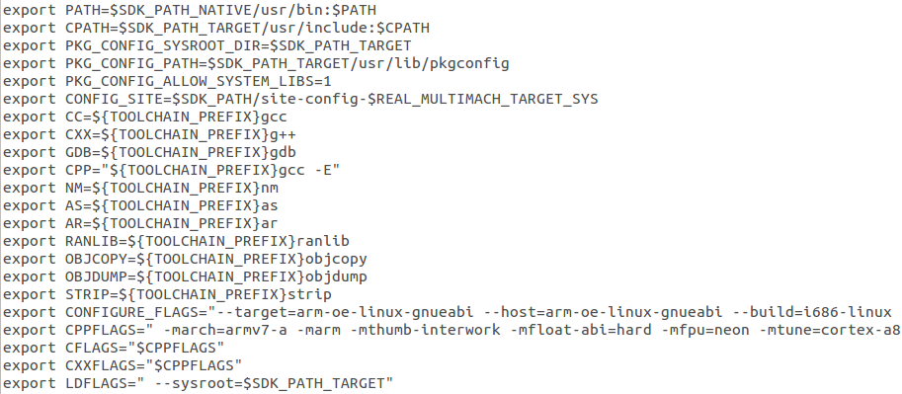
Environment-setup Example
Setting toolchain path
Setting environment variables that
point to common toolchain tools.
SoC-specific options alter the compiler’s
default header and library search path

Slide 12
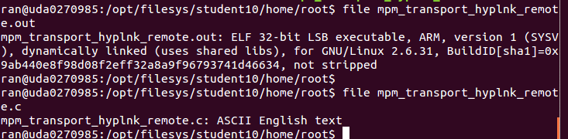
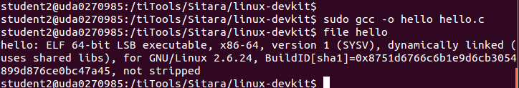
Compiler Path
If the compiler name and path are not explicitly given, the compiler may build the executable for the host architecture and not the target architecture.
The “file” command can tell you what compiler built the executable.

Slide 13
Compiler Search Path
The compiler must know where to look for libraries and headers. If the user does not specify these paths explicitly, the compiler may find headers and libraries that do not belong to the desired target.
Host Contamination occurs when the cross compiler finds and uses headers and libraries that belong to the host.
Sysroot is the compiler option that sets the compiler’s default search path.

Slide 14
Compiling User Space vs. Kernel Space
Example Kernel Space/BSP Software:
U-boot
Kernel
Kernel device drivers
Example User Space Software
Qt
GStreamer
Busybox
Environment-setup for the user space does not directly expose kernel space software. Kernel space software is protected from user space applications and can be access indirectly using APIs.
Kernel space software should be portable to support multiple platforms.

Slide 15
Software Build Systems
For simple application, a “simple” Makefile and make utility is sufficient to build an executable.
Difficulties:
Portable – the same code for multiple architectures
Cross compiling – find the right tools, headers and libraries
Build Systems is a set of tools and scripts used to build and deploy/install applications or libraries on different architectures.
GNU build system, a.k.a. Autotools, is used by SDK to automate the process of building portable executables:
Config
Make install
Make
Notes:
It can be difficult to make a software program portable: the C compiler differs from system to system; certain library functions are missing on some systems; header files may have different names. One way to handle this is to write conditional code, with code blocks selected by means of preprocessor directives (#ifdef); but because of the wide variety of build environments this approach quickly becomes unmanageable. Autotools is designed to address this problem more manageably.

Slide 16
Building with Autotools
/configure is used to determine the compiler, supported compiler options, available libraries and to allow users to determine which features to utilize
make builds the application
make install installs binaries and headers to either a default location or a user-specified location.

Slide 17
Configure Cross Compile Options
Cross compiling software configure requires some options such as:
--build=build The system on which the package is built.
--host=host The system where built programs and libraries will run.
--target=target The system for which the tools will create output when building compiler tools
Environment-setup creates a environment variable with all this information already filled!
And of course, the PATH must be defined.
Notes:
http://www.gnu.org/software/automake/manual/html_node/Cross_002dCompilation.html

Slide 18
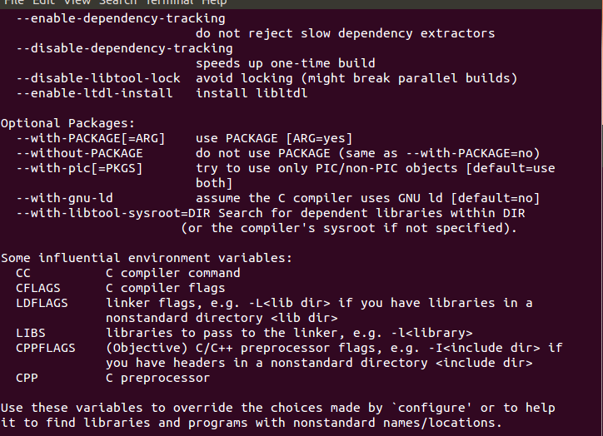
Configure Help
./configure –help displays a list of options that a user can use to influence the configuration and building of the piece of software.

Slide 19
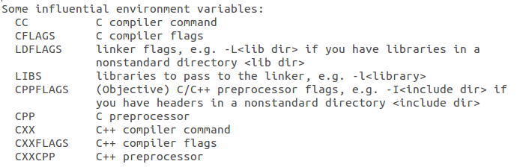
Configure: Important Environment Variables
Notes:
Going back at the configure help

Slide 20
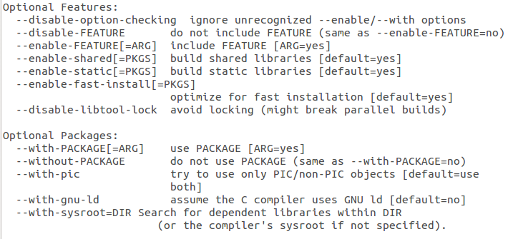
Configure: Feature Selection

Slide 21
Install Location
By default, autotools installs libraries and applications on the host in the local directory.
The user may choose to change the install location; For example, to put it in an NFS directory.
The easiest way to accomplish this is by setting the software’s default install location in the autotools script

Slide 22
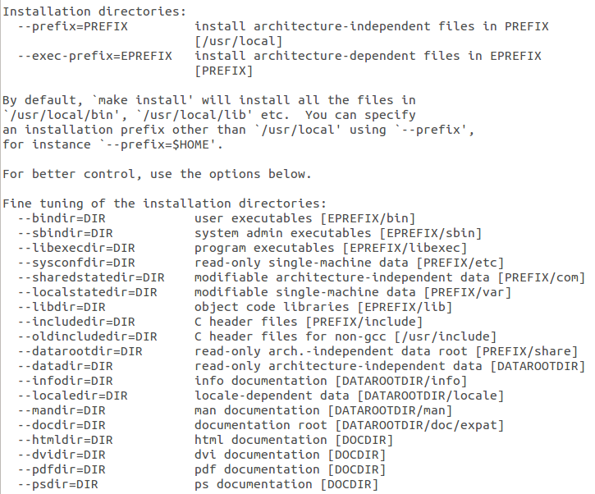
Configure Installation Options
Default root
Installation
directory
Usually don’t change

Slide 23
Configure Prefix Option
By using the configure prefix option you can alter the default location where configure installs libraries and applications.
The syntax is ./configure --prefix=<new install location>

Slide 24
Deploying to the Target
Dynamically-linked libraries and headers that are used by applications must be in the filesystem of the target.
If the libraries (and the headers) are in the cross-compiler system, they may not be visible to the target.
The user must copy the contents of the directory that includes the libraries and headers into the file system of the target (either ramfs, or mount, or any other file system location).

Slide 25
Native Compiling
Native compiling refers to building the executable on the target (e.g., the same machine on which the code will run).
Benefits:
NO host contamination
Native compiling is simpler and requires less configuration and settings.
Draw Backs:
Building on the target can be slower than building on a PC.
Building Qt on a PC takes about 3+ hours.
Building it on the Beaglebone can take 14+ hrs
Compiling may fail due to a lack of memory.
Some distributions do not provide the toolchain, so native compiling is not an option.

Slide 26
Different Approach: Yocto
Open embedded/Yocto project is used to create a distribution file system for any architecture:
Recipe scripts contain all the information that is required to build applications and libraries.
There are over 2000 recipes for different systems
Benefits:
Open embedded makes handling dependencies simple.
Easy updating or upgrading software
Reproducing the entire file system is easy.
Sitara provides a good starting point to use.
Handles license restrictions for you easily!
FREE
Notes:
Add a halo

Slide 27

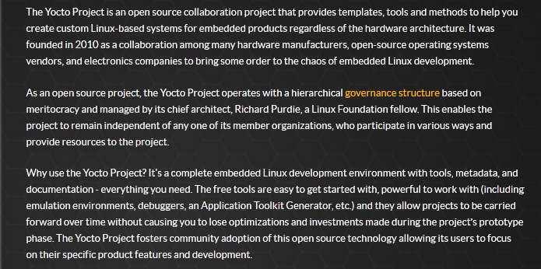
Different Approach: Yocto
http://www.yoctoproject.org
Notes:
Add a halo

Slide 28
For More Information
Sitara Linux Software Developer's Guide: http://processors.wiki.ti.com/index.php/Sitara_Linux_Software_Developer’s_Guide
Sitara Linux SDK GCC Toolchain: http://processors.wiki.ti.com/index.php/Sitara_Linux_SDK_GCC_Toolchain
Linux EZ Software Development Kit (EZSDK) for Sitara Processors: http://www.ti.com/tool/linuxezsdk-sitara
For questions regarding topics covered in this training, visit the support forums at the TI E2E Community website.

Slide 29
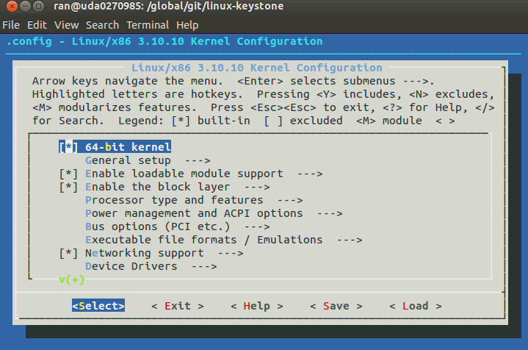
Configure GUI make menuconfig

Slide 30
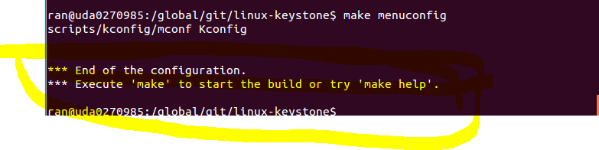
Configure GUI make menuconfig

Slide 31
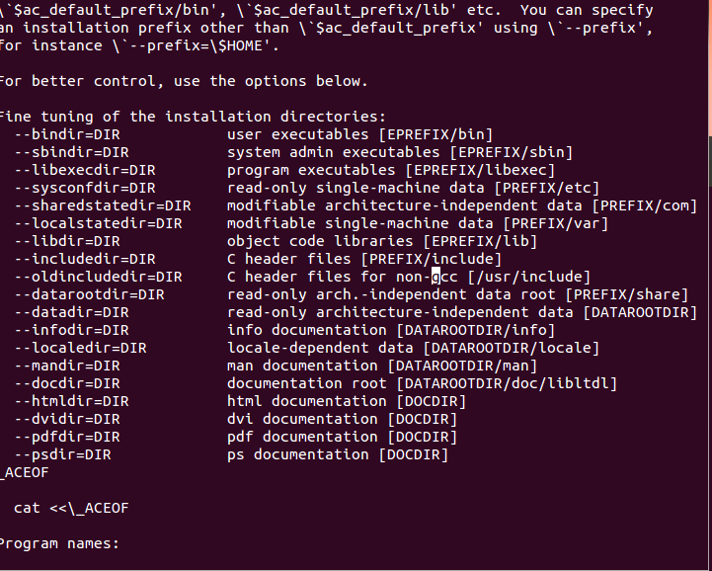
From the configure file

Slide 32
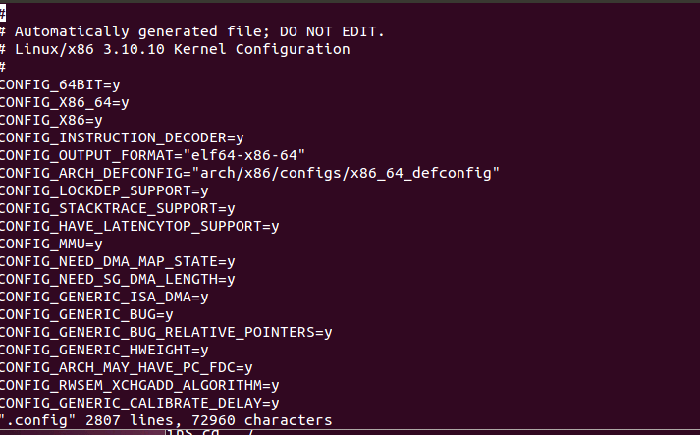
Configure using vi .config
Then you have to “make oldconfig” again

Slide 33
Configure without the right PATH

Slide 34
Issues with Cross Compiling
Cross compiling problems are when:
Cross compiling is less common than natively compiling
Programs aren’t developed to be portable.
Programs may require host tools to be build before the actual application or library can be built:
Example: Qt and Python
Programs uses some build system that isn’t cross compiling friendly.
Developer doesn’t follow the proper standard for the build system to make things portable.
For each large application or library it may take different steps to compile successfully.

