Slide 1
Introduction to The Linaro Toolchain
Embedded Processors Training
Multicore Software Applications
Literature Number: SPRPXXX

Slide 2
Agenda
Topic 1
Topic 2
Topic 3
Topic 4

Slide 3
Toolchain for ARM of Sitara Devices (but it is true for other ARM based devices as well)
A tool chain is a collection of programs used to compile and build applications or libraries and generally includes several additional tools useful for debugging or troubleshooting issues.
Starting with SDK 6.0 TI switched from a proprietary code generation tool to the Linaro cross compiler tool chain
Notes:
Usually when someone is referring to a toolchain they are referring to the gcc compiler since that is the only program people use. However, the gcc application actually invokes other tools within the toolchain but provides a single interface for users to make their lives easier.

Slide 4


Cross Compiling
Cross Compiler definition:
A compiler that can convert instructions into machine code for a computer other than that on which it is run
Is this considered cross compiling?
Compiling an application on your Linux laptop to run on your Linux desktop.
Compiling a Windows application on a Macintosh
Compiling a Linux application on your PC for your Sitara EVM or Beaglebone.
Notes:
http://en.wikipedia.org/wiki/Cross_compiler

Slide 5
Compiling a Simple Program

Slide 6
Compiling a Simple Program
Adding the path to the environment allows simpler use of the tool chain by calling the commands directly instead of having to specify the entire path.
Adding the tool chain’s path to the environment’s path
export PATH=<toolchain dir>:$PATH
The simplest way to build an application is by listing the sources and specifying the name of the binary to be generated
arm-linux-gnueabihf-gcc <C sources> -o <executable name>
Other flags such as the debug can be added
arm-linux-gnueabihf-gcc <C sources> - g -o <executable name>
Sitara Tool Chain is part of “Linux Development Kit” or Linux-devkit

Slide 7
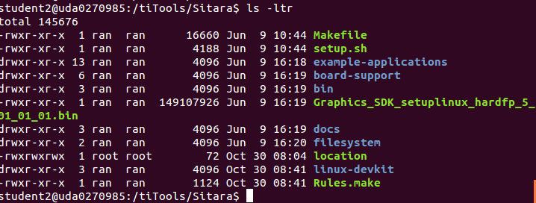
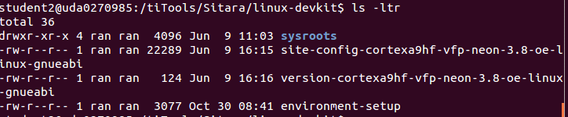
Linux-devkit part of Linux SDK
Notes:
PMU – Programming Multi-channel Unit (The ARM module)
LPDDR - Low Power Double Data Rate memory 266MHZ
DDR3 – 400MHZ
DDR3L – low voltage DDR3
OCMC – On chip memory controller

Slide 8
Understanding Linux-devkit
Linux-Devkit
Target Headers and Libraries
Host Tools Directory
Environment-setup
Toolchain
GDB
Qt compiler
Etc..
Common environment variables
that affects compiling
Target’s headers and
libraries

Slide 9
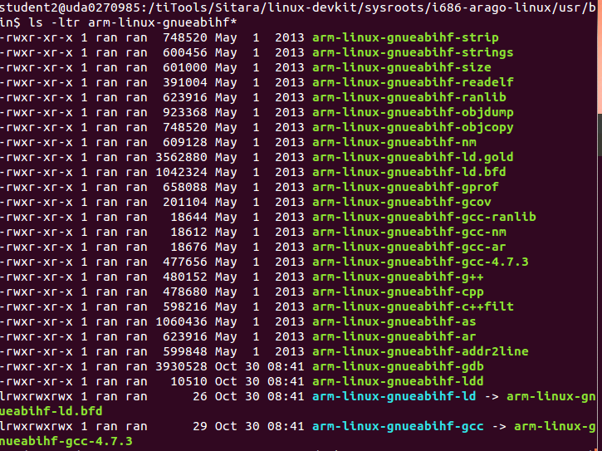
Code generation Location

Slide 10
Linking to External Libraries
The code generation tool should know the non-standard libraries and headers it compiles and links with
This is done by passing the library name to the compiler in the command line or inside a make file
Find the name of the library file that is needed. Remove lib from the front and remove the extension. Then add -l to the front.
Example:
Link against PNG library (libpng.so)
libpng.so -> png -> -lpng
arm-linux-gnueabihf-gcc <C sources> -lpng -o <executable name>
And don’t forget the Path
Notes:
http://www.cs.swarthmore.edu/~newhall/unixhelp/howto_C_libraries.html
http://stackoverflow.com/questions/5479584/compiling-or-using-libxml-using-c-on-osx

Slide 11

Environment-setup
Purposes:
Point the compiler to the target’s headers and libraries
Automatically adds the tool chain binaries to your PATH.
Sets environment variables that affects cross compiling
Set compiler options specific to the SOC
Using environment-setup:
Go to SDK’s linux-devkit
Modify the file environment-setup if needed
source environment-setup

Slide 12
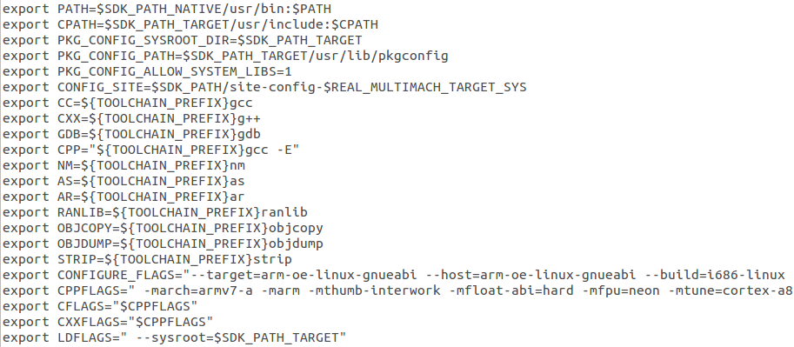
Environment-setup Example

Slide 13
Environment-setup Example
Setting tool chain path

Slide 14
Environment-setup Example
Setting environment variables that
point to common tool chain tools.

Slide 15
Environment-setup Example
SOC specific options, alters the compiler’s
default header and library search path

Slide 16
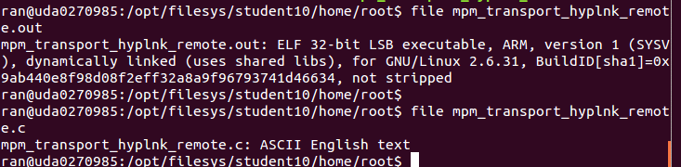
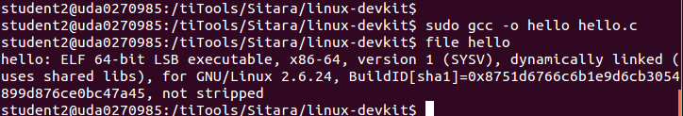
Compiler Path
If the compiler name and path are not explicitly given, the compiler may build the executable for the host architecture and not the target architecture
The “file” command can tell you what compiler built the executable

Slide 17
Compiler Search Path
The compiler must know where to look for libraries and headers. If the user does not specify these paths explicitly, the compiler may find headers and libraries that do not belong to the desired target
Host Contamination – When the cross compiler finds and uses headers and libraries that belong to the host
Sysroot – Compiler option that set the compiler’s default search path.

Slide 18
Compiling User Space vs. Kernel Space
Example Kernel Space/BSP Software
U-boot, kernel and kernel device drivers
Example User Space Software
Qt, Gstreamer and Busybox, applications
Environment-setup for the user space does not directly expose kernel space software. Kernel space software is protected from User space applications and can be access indirectly using APIs
Kernel space software should be portable to support multiple platforms

Slide 19
Software Build Systems
For simple application, a “simple” Makefile and make utility is sufficient to build an executable
Difficulties:
Portable – the same code for multiple architectures
Cross compiling – find the right tools, headers and libraries
Build Systems – set of tools and scripts used to build and deploy/install applications or libraries on different architectures
GNU build system – Auto-tools is used by SDK
Automate the process of building portable executables
Config
Make install
Make
Notes:
It can be difficult to make a software program portable: the C compiler differs from system to system; certain library functions are missing on some systems; header files may have different names. One way to handle this is to write conditional code, with code blocks selected by means of preprocessor directives (#ifdef); but because of the wide variety of build environments this approach quickly becomes unmanageable. Autotools is designed to address this problem more manageably.

Slide 20
Building with Auto Tools
/configure – Used to determine the compiler, supported compiler options, available libraries and allows users to determine which features to utilize
make – Builds the application
make install – Install binaries, headers to either a default location or user specified location.

Slide 21
Configure – Cross Compile Options
Cross compiling software configure requires some options such as:
--build=build
The system on which the package is built.
--host=host
The system where built programs and libraries will run.
--target=target
When building compiler tools: the system for which the tools will create output.
Environment-setup creates a environment variable with all this information already filled!
And of course, the PATH must be defined
Notes:
http://www.gnu.org/software/automake/manual/html_node/Cross_002dCompilation.html

Slide 22
Configure Help
./configure –help
Display list of options that a user can use to influence the configuration and building of the piece of software.

Slide 23
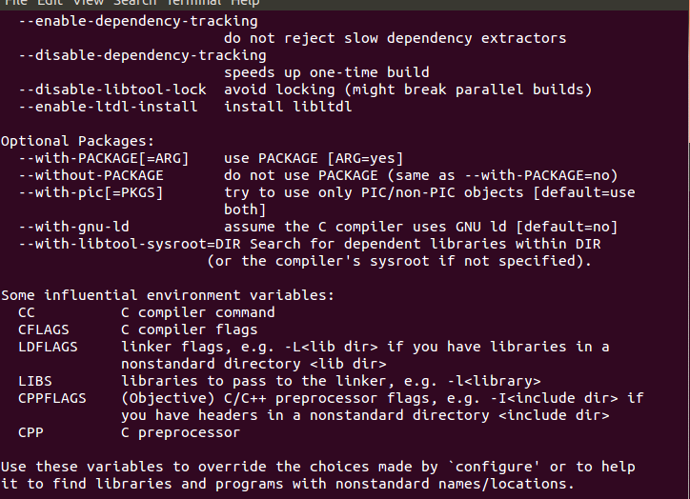
Configure Help

Slide 24
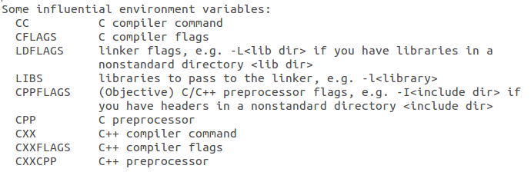
Configure – Important Environment Variables
Notes:
Going back at the configure help

Slide 25
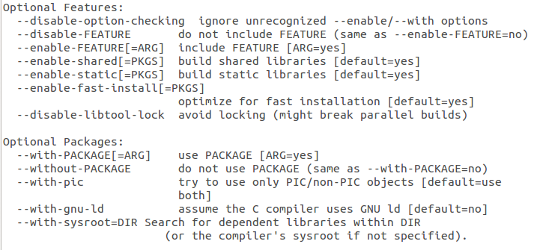
Configure – Feature Selection

Slide 26
Install Location
By default auto tools will install libraries and applications on the host in the local directory
The user may choose to change the install location, for example, to put it in a NFS directory
Easiest way to accomplish this is by setting the software’s default install location in the auto tools script

Slide 27
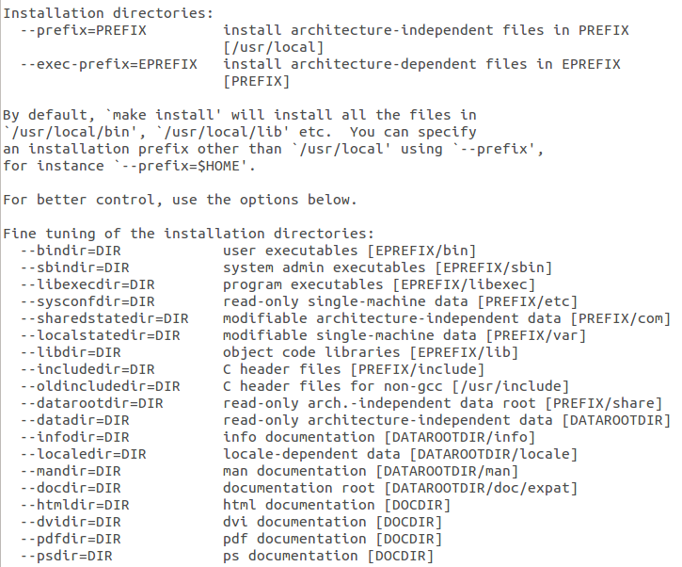
Configure Installation Options
Default root
Installation
directory
Usually don’t change

Slide 28
Configure Prefix Option
By using the configure prefix option you can alter the default location where configure installs libraries and applications.
The syntax is:
./configure --prefix=<new install location>

Slide 29
Deploying to the Target
Dynamically linked libraries and headers that are used by applications must be in the filesystem of the target
If the libraries (and the headers) are in the cross-compiler system they may not be visible to the target
The user must copy the contents of the directory where the libraries and headers are into the file system of the target (either ramfs, or mount or any other file system location)

Slide 30
Native Compiling
Building the executable on the target (The same machine that the code will run on)
Benefits:
NO host contamination
Native compiling is simpler and requires less configuration and settings
Draw Backs:
Building on the target can be slower than building on a PC.
Building Qt on a PC takes about 3+ hours. Building it on the Beaglebone can take 14+ hrs
Compiling may fail due to a lack of memory.
Some distributions don’t provide the tool chain so it isn’t an option.

Slide 31
Different Approach – Yocto
Open embedded/Yocto project is used to create distribution file system for any architecture
A ‘recipe” scripts contains all the information that is required to build applications and libraries.
There are Over 2000 for different systems
Benefits:
Open embedded makes handling dependencies simple.
Easy updating or Upgrading software
Reproducing the entire file system is easy.
Sitara provides a good starting point to use.
Handles licenses restrictions for you easily!
FREE
Notes:
Add a halo

Slide 32
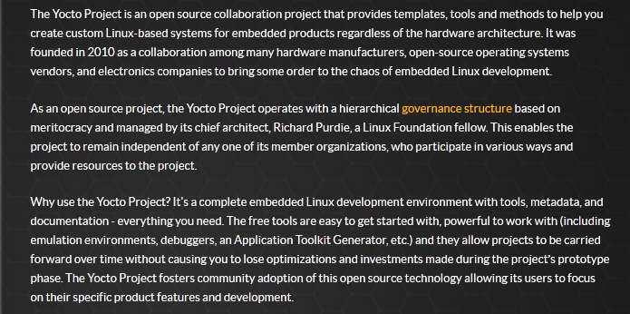
Different Approach – Yocto
https://www.yoctoproject.org
Notes:
Add a halo

Slide 33
For More Information
Sitara Linux Software Developer's Guide: http://processors.wiki.ti.com/index.php/Sitara_Linux_Software_Developer’s_Guide
Sitara Linux SDK GCC Toolchain: http://processors.wiki.ti.com/index.php/Sitara_Linux_SDK_GCC_Toolchain
Linux EZ Software Development Kit (EZSDK) for Sitara Processors: http://www.ti.com/tool/linuxezsdk-sitara
For questions regarding topics covered in this training, visit the support forums at the TI E2E Community website.

Slide 34
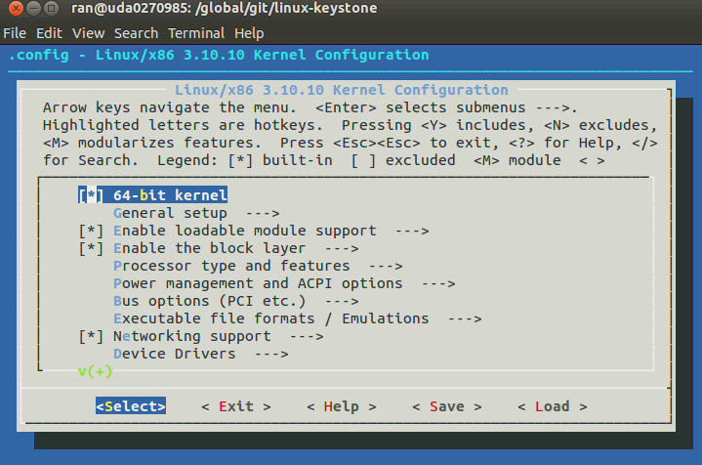
Configure GUI make menuconfig

Slide 35
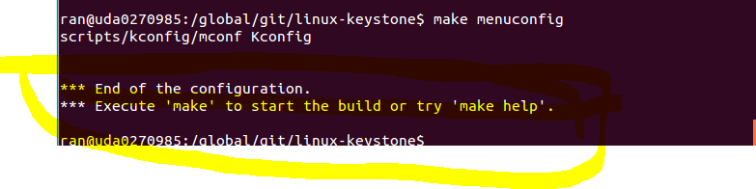
Configure GUI make menuconfig

Slide 36
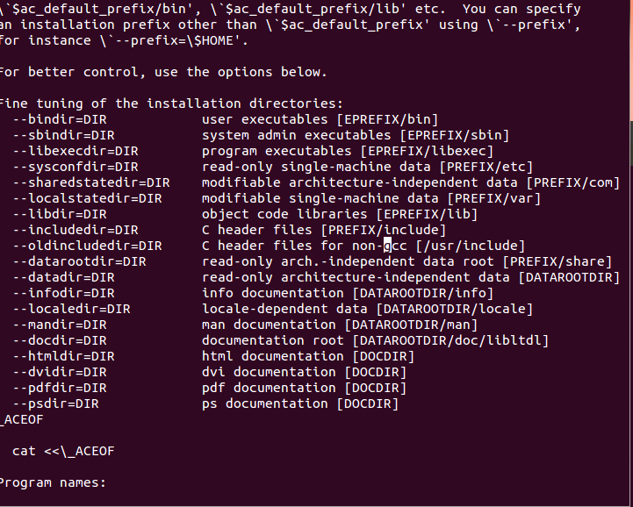
From the configure file

Slide 37
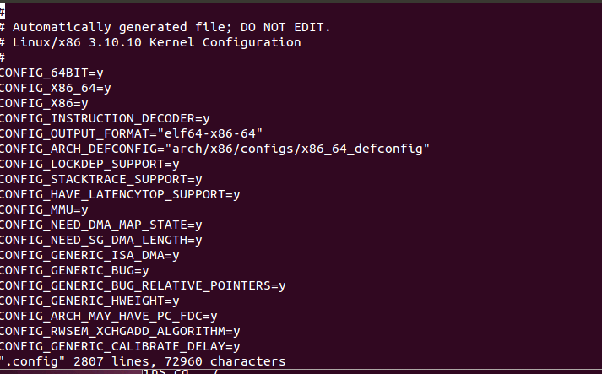
Configure using vi .config
Then you have to “make oldconfig” again

Slide 38
Configure without the right PATH

Slide 39
Issues with Cross Compiling
Cross compiling problems are when:
Cross compiling is less common than natively compiling
Programs aren’t developed to be portable.
Programs may require host tools to be build before the actual application or library can be built:
Example: Qt and Python
Programs uses some build system that isn’t cross compiling friendly.
Developer doesn’t follow the proper standard for the build system to make things portable.
For each large application or library it may take different steps to compile successfully.

