Slide 1
KeyStone Interrupts
KeyStone Training
Multicore Applications
Literature Number: SPRPXXX

Slide 2
Agenda
Interrupt Scheme (SPI 0 Example)
Configuring Interrupts (Hyperlink Example)

Slide 3
Interrupt Scheme
KeyStone Interrupts

Slide 4
Link Events to ISR

Slide 5
C66 core input events

Slide 6
C66 core Primary events
To connect event to ISR:
Connect Primary event to one of the 12 maskable interrupt lines
Connect interrupt line to ISR
CSL OR BIOS API are used to connect event to interrupt line and interrupt to ISR
List of Primary event – table 6-22 in 66AK2H14/12/06 Data Sheet

Slide 7

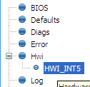
Configuring an Hwi Using BIOS Statically via GUI
Example:
event 94 to the CPU HWI₅
Use Hwi module (Available Products), insert new Hwi (Outline View)
NOTE: BIOS objects can be created via the GUI, script code, or C code (dynamic).
By the way, event 94 is not connected to anything – it is reserved

Slide 8
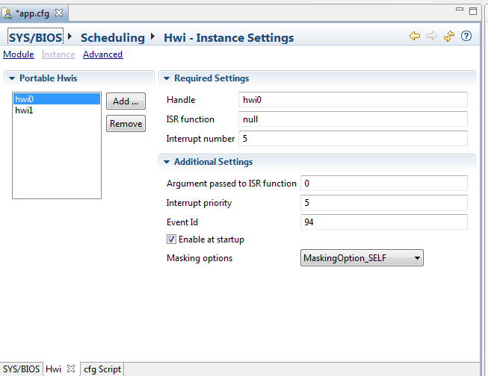
Configuring an Hwi Using BIOS Statically via GUI

Slide 9
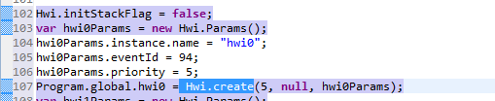
Configuring an Hwi Using BIOS using run-time functions
The include file Hwi.h in the release MCSDK_3_0_4_18\bios_6_37_00_20\packages\ti\sysbios\family\c64p\Hwi.h
Has the definition of the Hwi class
Where do you find the Event Id #?

Slide 10
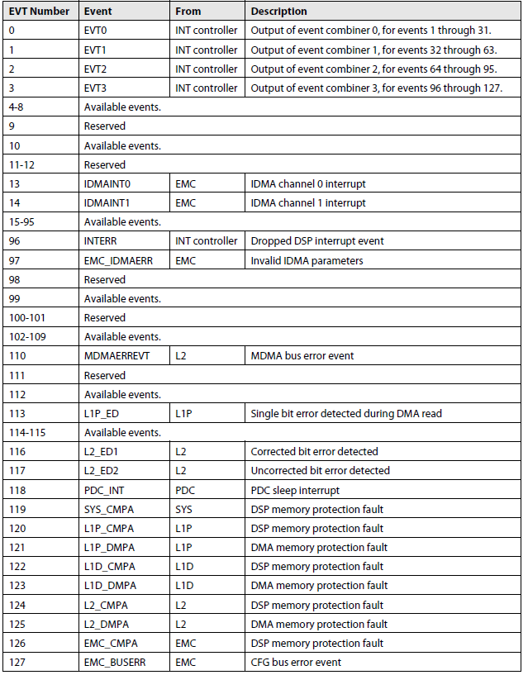
C66 Core Prime Event IDs (Core Events Only)
From the C66x User’s Guide:
22 assigned events
5 reserve primary events
17 secondary events
7 reserved events
99 Available events
The available events are connected to the device.

Slide 11
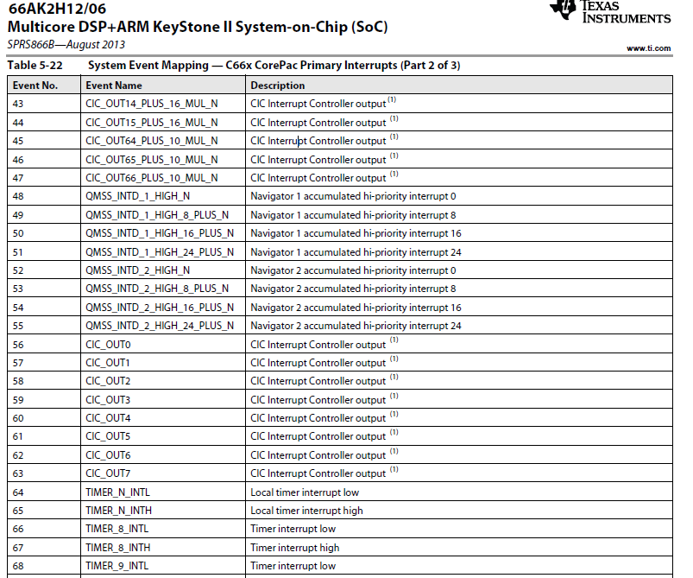
C66 Core Prime Event IDs When it is part of KeyStone 2 Device

Slide 12
Configure HWI using csl
CSL interrupt files are in the release
MCSDK_3_0_4_18\pdk_keystone2_3_00_04_18\packages\ti\csl\src\intc
Include files – csl_intc.h csl_intcAux.h
Source files in src/intc directory
CSL_intcPlugEventHandler()
CSL_intcInit()
CSL_intcGlobalNmiEnable
CSL_intcGlobalEnable()
CSL_intcHwControl()
CSL_intcOpen
And more
Note – In addition to the mapping, the interrupt must be enabled
Global enable – enable the global interrupt register
Enable the particular interrupt

Slide 13
KeyStone II Interrupt Topology
CIC0
C66x CorePac0
All events from all IP come to the interrupt controllers.
Some are connected directly to C66x or other masters (EDMA, ARM, Hyperlink)
Some are mapped by the interrupt controllers
C66x CorePac1
C66x CorePac2
C66x CorePac3
CIC1
C66x CorePac4
C66x CorePac5
Events
C66x CorePac6
C66x CorePac7
CIC2
HyperLink
EDMA CC0
EDMA CC1
EDMA CC2
EDMA CC3
EDMA CC4
Peripherals
ARM A15
CorePac

Slide 14
C66 core Secondary events

Slide 15
CIC to C66 core connections Event No – the core input event Event name – the CIC output line

Slide 16
Where is SPIXEVT?
Not on the above page
Not on any of the other two pages in the table
But we see that there are eight events (56 to 63) that come out of the interrupt controller. We can connect SPIXEVT through the interrupt controller to one of these events (broadcast events). We will connect to broadcast event 63
They are other events from the interrupt controller that could be considered (Both, broadcast and single core)
The ARM GIC has 480 input events and 12 of them are connected to SPI

Slide 17
Connecting SPIXEVT to Core 3
66AK2H12 has multiple instances of SPI; We will look at SPI 0
The next slide shows one page from the input table for CIC0. The same events are connected to CIC1 as well.

Slide 18
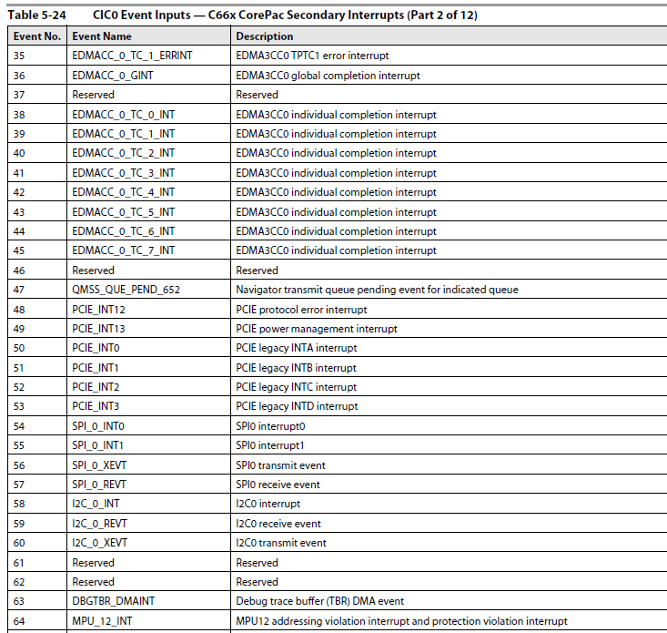
KeyStone II CIC input events

Slide 19
Connecting SPI 0 Transmit event to core 3 ISR

Slide 20
Configuring Interrupts
KeyStone Interrupts

Slide 21
Configuration API
Read the following Wiki: http://processors.wiki.ti.com/index.php/Configuring_Interrupts_on_Keystone_Devices
csl APIs- For KeyStone II (MCSDK 3.x), look at the two include files to see all the API that are needed:
csl_cpIntc.h
csl_cpIntCAux.h
SysBios APIs – look at cpInitc.h and cpInitc.c in directory MCSDK_Y_XX\bios_6_BB_AA_ZZ\packages\ti\sysbios\family\c66\tci66xx

Slide 22
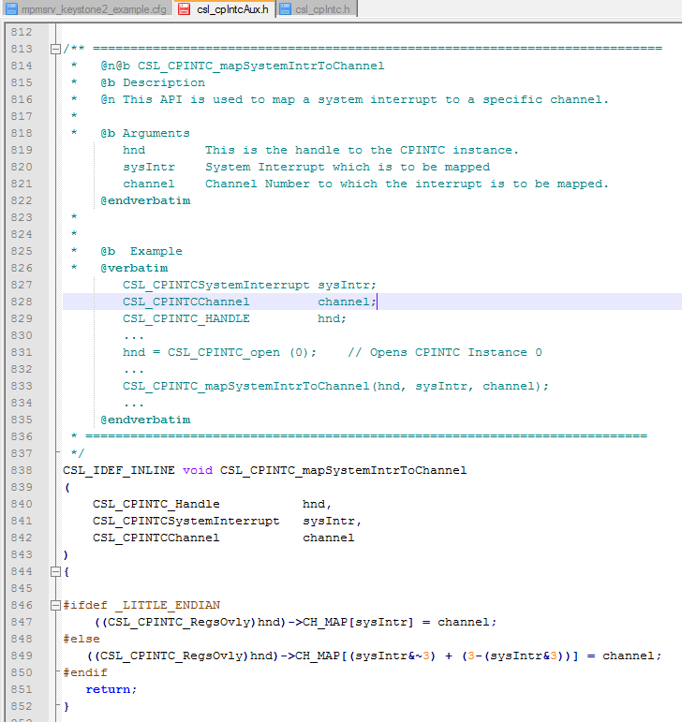
csl map system event (input) to output
csl_cpIntCAux.h shows the APIs that connect system events to channels (e.g., the output of the CIC).
Connecting channel events to interrupt queues is done using CSL or SYSBIOS, as described previously.

Slide 23
Code Examples
MCSDK includes examples of interrupts originating from peripherals: MCSDK_3_01_12\pdk_keystone2_3_00_01_12\packages\ti\drv
Consider an example using HyperLink, where an interrupt is sent from Hyperlink 0 to a DSP core.

Slide 24
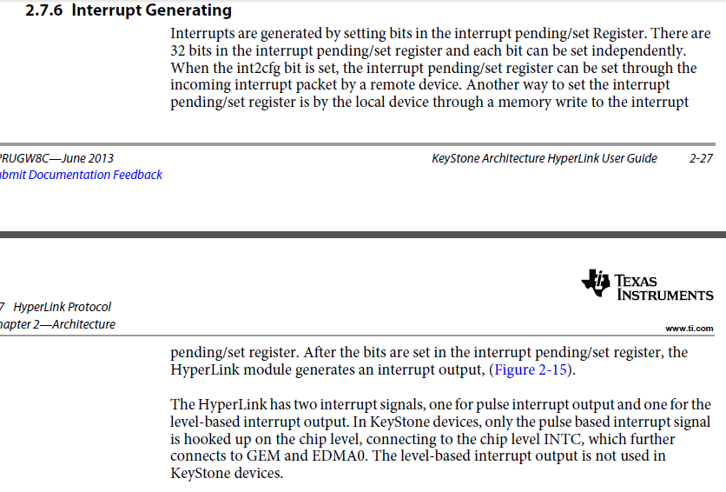
Hyperlink Interrupt

Slide 25
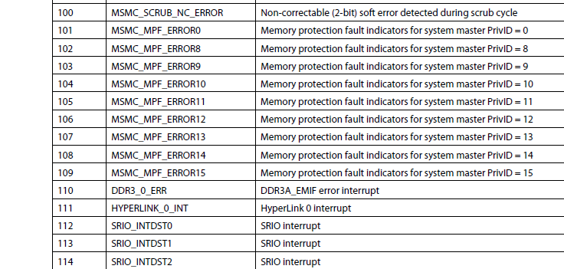
Following Hyperlink Interrupt 0 From Table 5-24 of 66AK2H12- CIC0 input events
Event number 111 (ox6F) is HyperLink 0 interrupt.
Next, this interrupt is connected to a core …

Slide 26
static int hyplnkExampleInitChipIntc (void)
{
CSL_CPINTC_Handle hnd;
// I drop some of the functions here (enable/disable interrupts etc.
CSL_CPINTC_mapSystemIntrToChannel (hnd, CSL_CIC0_HYPERLINK_0_INT, hyplnk_EXAMPLE_INTC_OUTPUT);
// I drop some of the functions here (enable/disable interrupts etc.
return 0;
}
CSL_CIC0_HYPERLINK_0_INT = 111
What about hyplnk_EXAMPLE_INTC_OUTPUT?

Slide 27
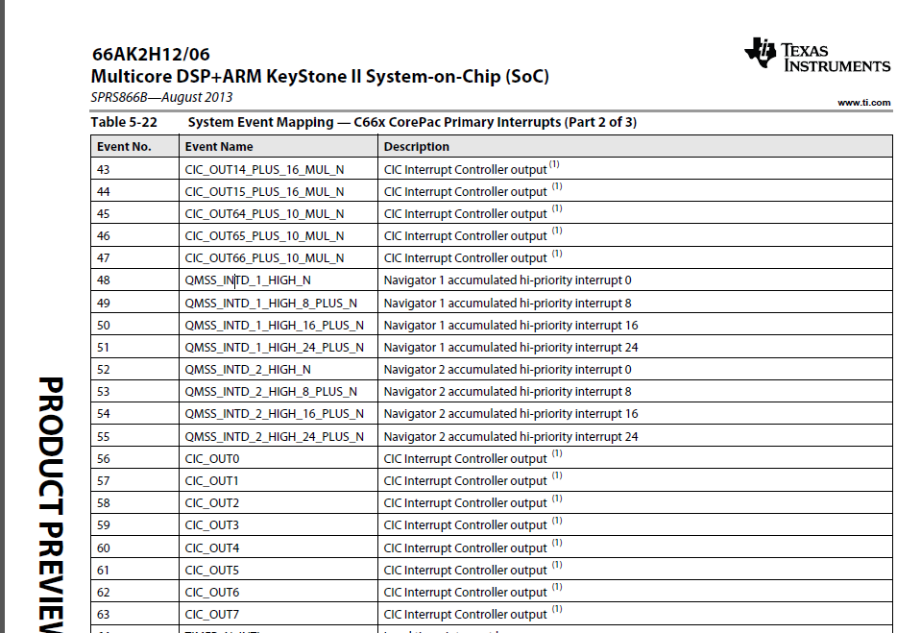
Choose to use event 45 of the core
It could be any one of other CIC_OUT lines (look at the complete table for even more)

Slide 28
Following Hyperlink Interrupt 0 - Continue
Event 45 on the C66 core is connected to CIC out 64 + 10 x N, that is
Core 0 event 45 is connected to CIC output event 64
Core 1 event 45 is connected to CIC output event 74
Core 2 event 45 is connected to CIC output event 84
You got the point
CIC0 should map input event 111 to output event 64 (or 74, or 84 or … depends on what core is used)

Slide 29

Screen Shot from CCS
The value of hyplnk_EXAMPLE_INTC_OUTPUT is (64 + 10 * DNUM)

Slide 30
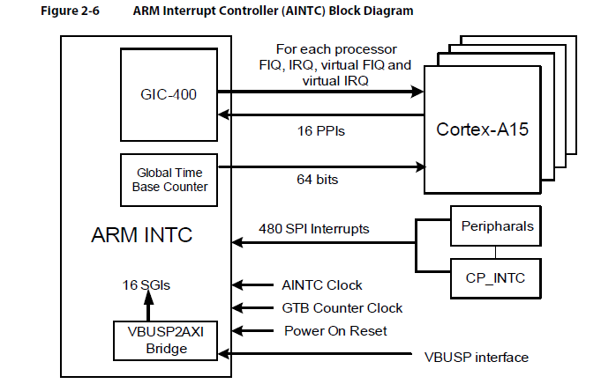
ARM A15 Interrupt Scheme

Slide 31
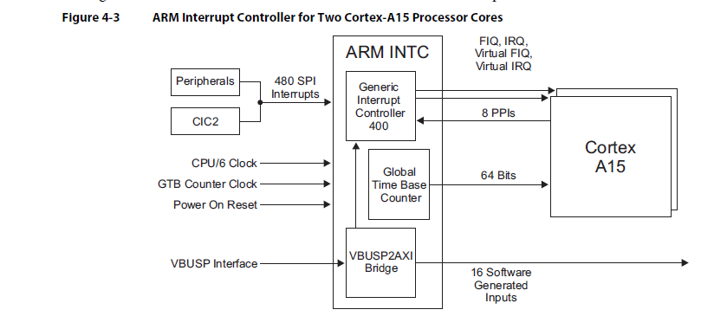
ARM A15 Interrupt Scheme

Slide 32
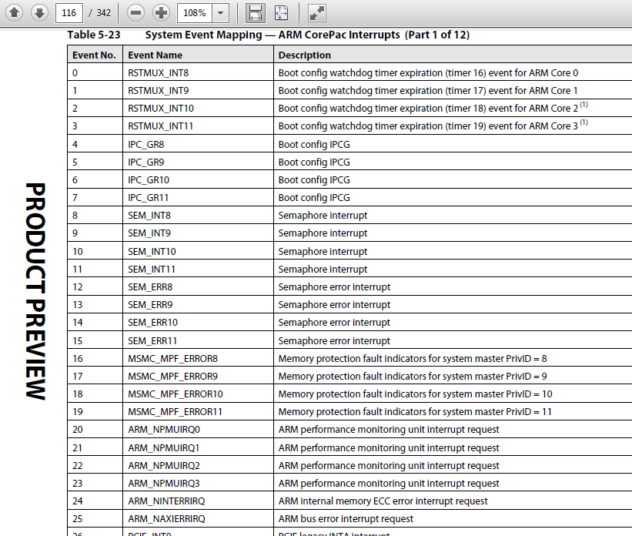
System Events Mapping to GIC

Slide 33
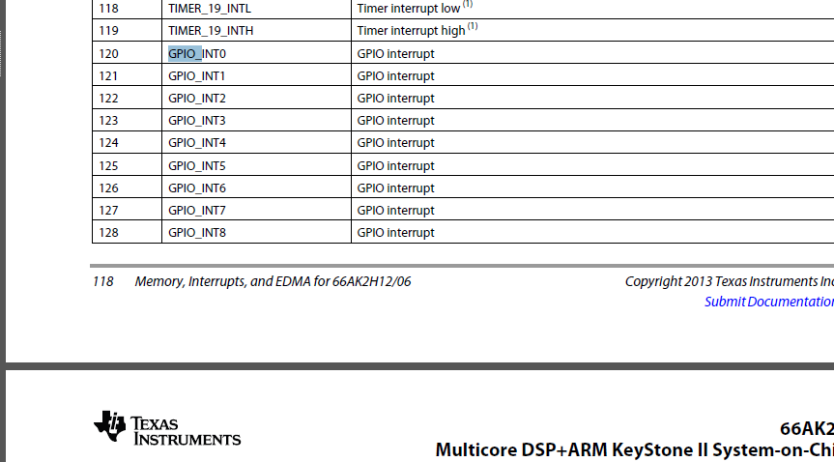
Following GPIO 0 From Table 5-23 of 66AK2H12- ARM CorePac Interrupts

Slide 34
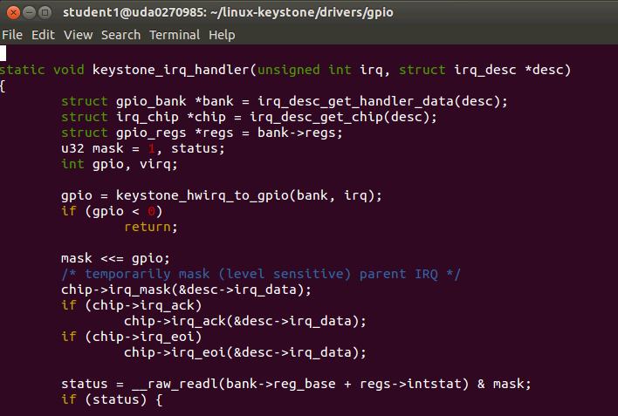
From the file gpio-keystone.c

Slide 35
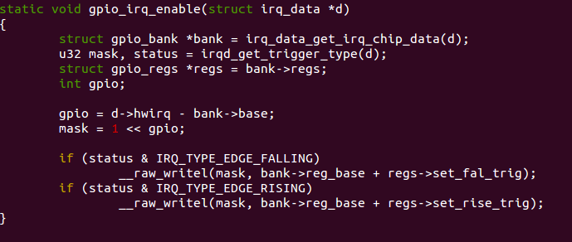
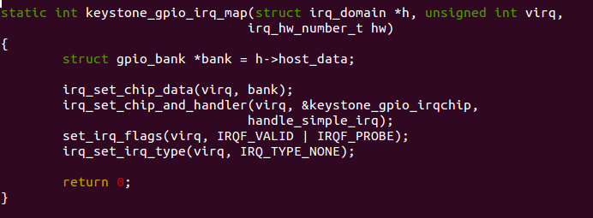
From the file gpio-keystone.c

Slide 36
Questions?

