Slide 1
Keystone IPC For Internal Audience Only
Multicore Applications
Ran Katzur
Acknowledge the help of Ramsey Harris

Slide 2
Agenda
Keystone Hardware Support for IPC
IPC Issues
Progress of IPC Support for KeyStone
Shared Memory IPC
Demo

Slide 3
Keystone Hardware Support for IPC
Memory
IPC Registers
Multicore Navigator
Semaphores

Slide 4
Memory Resources
Shared memory
DDR
MSMC memory
Local “private” memory
L1D and L2 memory use global addresses

Slide 5
IPC Registers
Each CorePac has its own set of registers:
IPCGRx generating interrupt
IPCARx acknowledge interrupt (clearing)
28 bits can be used for a protocol
28 concurrent sources for interrupt can be defined
8 registers for C6678, 12 for 66AK2H12

Slide 6
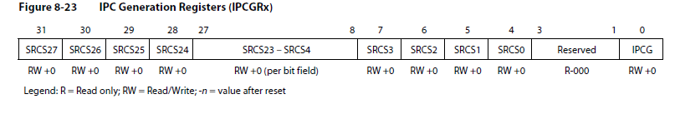
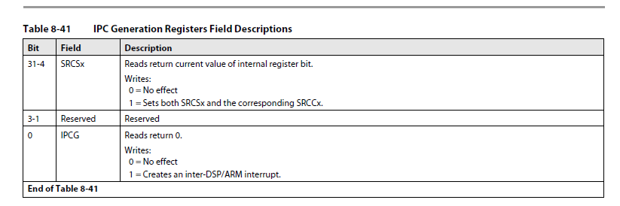
IPC Registers

Slide 7
Multicore Navigator
QMSS (Queue Manager Subsystem)
Descriptors carry messages between queues
Receive queues are associated with cores
Enable zero copy messaging
Infrastructure PKTDMA (Packet DMA) facilitates copy messages between sender and receiver

Slide 8
Semaphores
Block of 32 hardware semaphores
Used to protect shared resources

Slide 9
Agenda
Keystone Hardware support for IPC
IPC issues
Progress of IPC support for Keystone
Shared memory IPC
Demo

Slide 10
IPC Issues
Memory
Coherency
Allocation and free
Race Condition
Linux Protection

Slide 11
Logical and Physical Memory
MPAX registers map the same logical memory to different physical memory
Must agree on the location and translation of the shared memory
Current solution: Use the default MPAX for shared memory
Proc 0
Shared Memory Region (DDR3)
Proc 1
0x90000000
0x90000000
Proc 0 Local Memory Region
Proc 1 Local Memory Region

Slide 12
Logical and Physical Memory: User Space ARM
MMU assigns (non-continuous) physical location for buffers
Physical
Addresses
Memory
…
Page 1
CorePac
MMU
Page 2
Logical
Address
Page 3
Page 4
TLB
Page 5

Slide 13
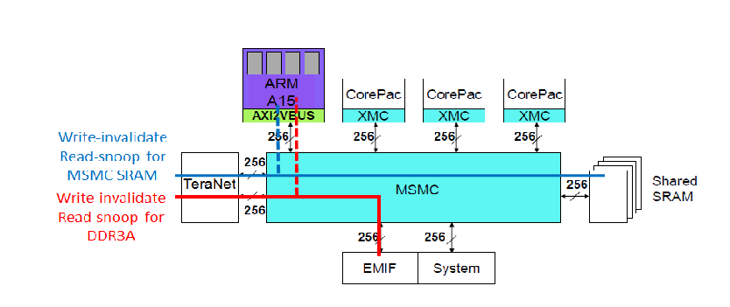
Coherency
DSP cores L2 does not have coherency with the external world
What about ARM? - Depends what port is used into the MSMC
Coherency from the Teranet
Not coherent from DSP CorePac

Slide 14
Coherency
Can we use the MAR registers to disable cache? Yes, but
Do we want to disable cache for a message? -
If the data in the message needs complex processing it is better to be cached
MSMC memory MAR register is given in the next slide

Slide 15
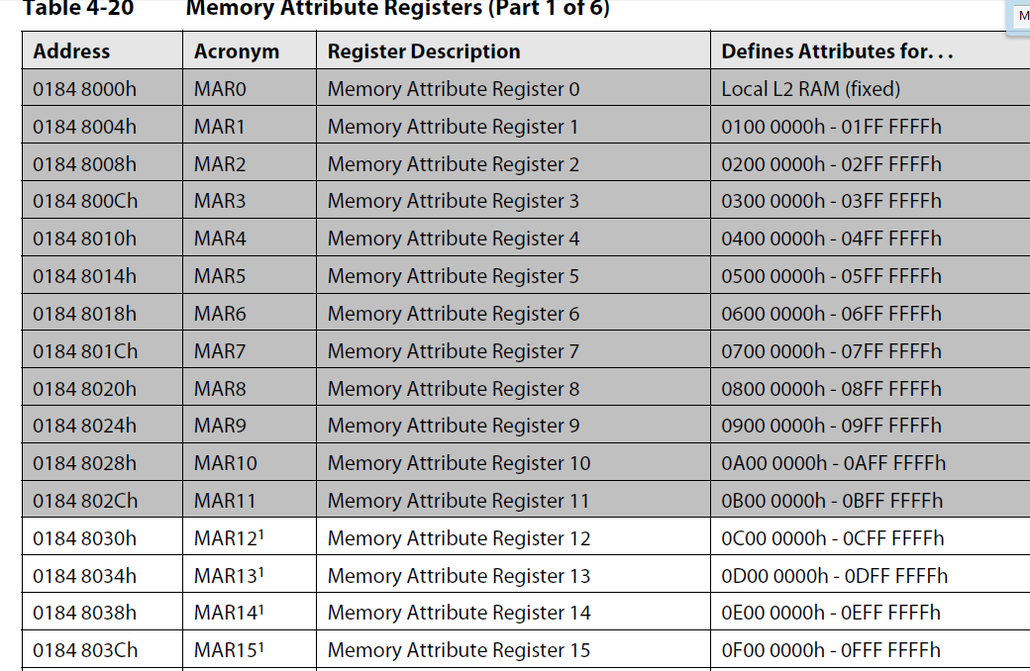
MAR0 is implemented as a read-only register. The PC of the MAR0 is always read
as 1.
2. MAR1 through MAR11 correspond to internal and external configuration
address spaces. Therefore, these registers are read-only, and their PC field reads
as 0.
3. MAR12 through MAR15 correspond to MSMC memory. These are read-only
registers, the PC always read as 1. This makes the MSMC memory always
cacheable within L1D when accessed by its primary address range
*****Using MPAX may disable L1 cache for MSMC memory *****

Slide 16
Allocation and Free
Messages are not consumed in the same order that they are generated
There is a need for Heap management
The core that allocates the memory is not the core that frees the memory, thus general heap management is needed

Slide 17
Race Condition
If multiple cores can access the same heap, protection against race condition is needed
Semaphores can protect resource that is shared by multiple cores

Slide 18
Linux Protection
In user space, MMU protects one process from another process, and protects the kernel space from any user space
Using physical pointer in the user space breaks the protection

Slide 19
Agenda
Keystone Hardware support for IPC
IPC issues
Progress of IPC support for Keystone
Shared memory IPC
Demo

Slide 20
Keystone IPC Support
Keystone I IPC solution
Appleton IPC
Keystone II initial release
Keystone II MCSDK_3_1 release

Slide 21
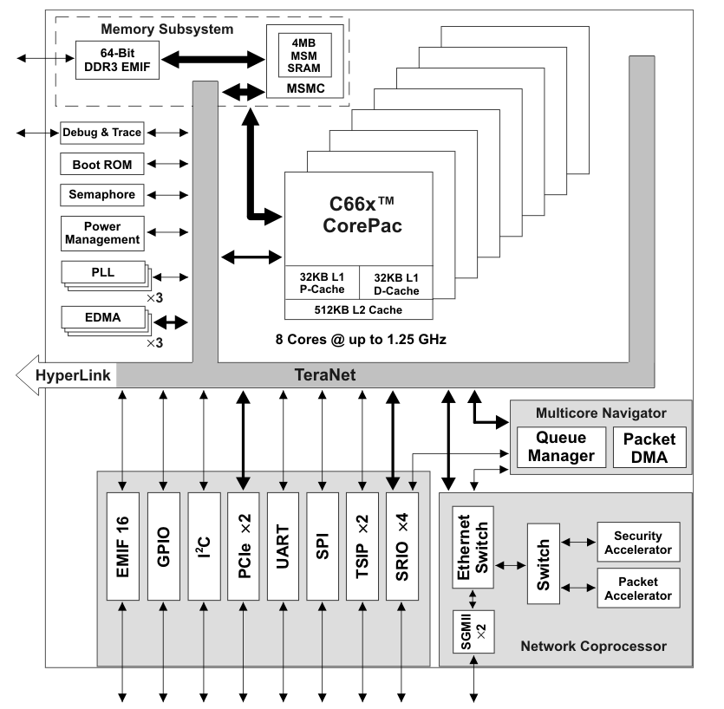
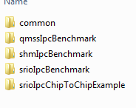
Keystone I IPC solution
Based on the standard IPC API from other TI product
Same API for messages inside a core, between cores or between devices
Multiple transport mechanism, all have the same run time API
Shared memory
multicore navigator
SRIO
MCSDK_2_01_6\pdk_C6678_1_1_2_6\packages\ti\transport\ipc\examples

Slide 22
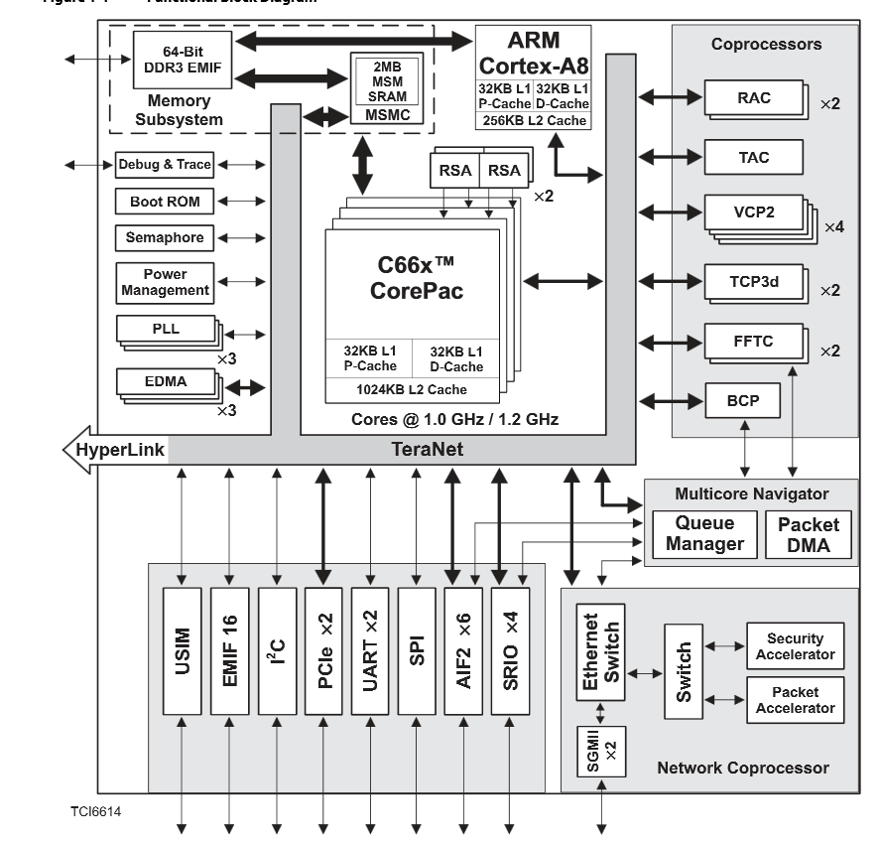
Appleton IPC 6612 and 6614
Navigator based msgCom package
DSP to DSP
ARM-DSP
Developed for the vertical market, not easy to adapt to the broad market

Slide 23
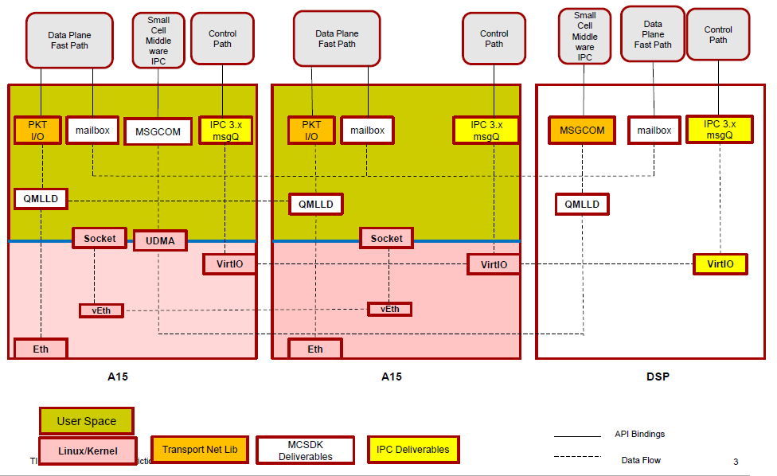
IPC Technologies in KeyStone II MCSDK 3.0.3.15

Slide 24
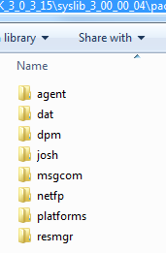
IPC Libraries MCSDK release 3_0_3_15

Slide 25
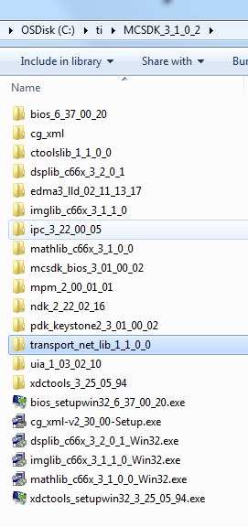
Keystone II MCSDK_3_1
Dropped syslib from the release, no msgCom
IPC based on shared memory is still supported
Transport_net_lib (appeared in release 3.0.4.18 as well) is used for openCL/ openMP type of communications

Slide 26
Common to all releases – Shared memory IPC library
IPC library based on shared memory
DSP: Must build with BIOS
Designed for moving messages and “short” data
Compatible with legacy devices (same API)
Supported by all Keystone generation (2014)

Slide 27
Agenda
Keystone Hardware support for IPC
IPC issues
Progress of IPC support for Keystone
Shared memory IPC
Demo

Slide 28
IPC Library
KeyStone IPC

Slide 29
IPC Library: Transports
Current IPC implementation uses several transports:
CorePac → CorePac (Shared Memory Model)
Device → Device (Serial Rapid I/O) – KeyStone I
Chosen at configuration; Same code regardless of thread location.
Device 1
Device 2
CorePac 1
CorePac 2
CorePac 1
Thread 1
Thread 2
Thread 1
Thread 2
Thread 1
Thread 2
IPC
IPC
IPC
MEM
SRIO
SRIO

Slide 30
IPC Services
The IPC package is a set of APIs.
MessageQ uses the modules below.
But each module can also be used independently.
Application

Slide 31
IPC Services In the release
Top-level modules, used by application
MCSDK_3_0_4_18\ipc_3_00_04_29\packages\ti.sdo.ipc
MCSDK_3_0_4_18\ipc_3_00_04_29\packages\ti\sdo\util
Ipc
Notify
MessageQ
SharedRegion
MultiProc
HeapMemMP
HeapBufMP
NameServer
GateMP

Slide 32
Ipc Module
Ipc – IPC Manager
Used to initialize IPC and synchronize with other processors.
Ipc_start – reserve memory, create default gate and heap
Ipc_stop – release all resources
Ipc_attach – setup transport between two processors
Ipc_detach – finalize transport

Slide 33
NameServer Module
NameServer – distributed name/value database
Manages name/value pairs
Used for registering data which can be looked up by other processors
API Summary
NameServer_create – create a new database instance
NameServer_add – add a name/value entry into database
NameServer_get – retrieve value for given name

Slide 34
MultiProc Module
MultiProc – processor identification
Stores processor ID of all processors in the multi-core application.
Stores processor name
Processor ID is a number from 0 – (n-1)
Processor name is defined by IPC
See ti.sdo.utils.MultiProc > Configuration Settings, MultiProc.setConfig Click on Table of Valid Names for Each Device
API Summary
MultiProc_getSelf – return your own processor ID
MultiProc_getId – return processor ID for given name
MultiProc_getName – return processor name

Slide 35
SharedRegion Module
SharedRegion – shared memory address translation
Manages shared memory and its cache configuration
Manages shared memory using a memory allocator
Multiple shared regions are supported
Each shared region has optional HeapMemMP instance
Memory is allocated and freed using this HeapMemMP instance
HeapMemMP_create/open and managed internally at IPC initialization
SharedRegion_getHeap API to get this heap handle

Slide 36
GateMP Module
GateMP – protect a critical section
Multiple processor gate that provides context protection against threads on both local and remote processors
Device-specific gate delegates offer hardware locking to GateMP
GateHWSem for C6474, C66x
API Summary
GateMP_create – create a new instance
GateMP_open – open an existing instance
GateMP_enter – acquire the gate
GateMP_leave – release the gate

Slide 37
HeapMemMP HeapBufMP Modules
HeapMemMP, HeapBufMP – multi-processor memory allocator
Shared memory allocators that can be used by multiple processors
HeapMemMP – variable size allocations
HeapBufMP – fixed size allocations, deterministic, ideal for MessageQ
All allocations are aligned on cache line size.
Warning: Small allocations will occupy full cache line.
Uses GateMP to protect shared state across cores.
Every SharedRegion uses a HeapMemMP instance to manage the shared memory

Slide 38
Notify – Basic Communication
Simpler form of IPC communication
Send and receive event notifications
Device 1
CorePac 1
CorePac 2
Thread 1
Thread 2
Thread 1
Thread 2
IPC
IPC
MEM

Slide 39
Notify Model
Comprised of SENDER and RECEIVER.
The SENDER API requires the following information:
Destination (SENDER ID is implicit)
16-bit Line ID
32-bit Event ID
32-bit payload (For example, a pointer to message handle)
The SENDER API generates an interrupt (an event) in the destination.
Based on Line ID and Event ID, the RECEIVER schedules a pre-defined call-back function.

Slide 40
Notify Model

Slide 41
Notify Implementation
How are interrupts generated for shared memory transport?
The IPC hardware registers are a set of 32-bit registers that generate interrupts. There is one register for each core.
How are the notify parameters stored?
The allocation of the memory is done by HeapMP and SharedRegion
How does the notify know to send the message to the correct destination?
MultiProc and name server keep track of the core ID.
Does the application need to configure all these modules?
No. Most of the configuration is done by the system. They are all “under the hood”

Slide 42
Example Callback Function
/*
* ======== cbFxn ========
* This fxn was registered with Notify. It is called when any event is sent to this CPU.
*/
Uint32 recvProcId ;
Uint32 seq ;
void cbFxn(UInt16 procId, UInt16 lineId, UInt32 eventId, UArg arg, UInt32 payload)
{
/* The payload is a sequence number. */
recvProcId = procId;
seq = payload;
Semaphore_post(semHandle);
}

Slide 43
Data Passing Using Shared Memory (1/2)
When there is a need to allocate memory that is accessible by multiple cores, shared memory is used.
However, the MPAX register for each DSP core might assign a different logical address to the same physical shared memory address.
Solution: Maintain a shared memory area in the default mapping (Until future release, when the shared memory module will do the translation automatically)
Proc 0
Shared Memory Region (DDR2)
Proc 1
0x90000000
0x90000000
Proc 0 Local Memory Region
Proc 1 Local Memory Region

Slide 44
Data Passing Using Shared Memory (2/2)
Communication between DSP core and ARM core requires knowledge of the DSP memory map by the MMU. To provide this knowledge, the MPM (Multiprocessor management unit on the ARM) must load the DSP code. Other DSP code load method will not support IPC between ARM and DSP

Slide 45
MessageQ – Highest Layer API
SINGLE reader, multiple WRITERS model (READER owns queue/mailbox)
Supports structured sending/receiving of variable-length messages, which can include (pointers to) data
Uses all of the IPC services layers along with IPC Configuration & Initialization
APIs do not change if the message is between two threads:
On the same core
On two different cores
On two different devices
APIs do NOT change based on transport; only the CFG (init) code
Shared memory
SRIO

Slide 46
MessageQ and Messages
How does the writer connect with the reader queue?
MultiProc and name server keep track of queue names and core IDs. Each MessageQ has a unique name known to all elements of the system
What do we mean when we refer to structured messages with variable size?
Each message has a standard header and data. The header specifies the size of payload.
If there are multiple writers, how does the system prevent race conditions (e.g., two writers attempting to allocate the same memory)?
GateMP provides hardware semaphore API to prevent race conditions.
What facilitates the moving of a message to the receiver queue?
This is done by Notify API using the transport layer.
Does the application need to configure all these modules?
No. Most of the configuration is done by the system. More details later.

Slide 47
Using MessageQ (1/3)
CorePac 2 - READER
MessageQ_create(“myQ”, *synchronizer);
MessageQ_get(“myQ”, &msg, timeout);
“myQ”
Step I - MessageQ creation during initialization:
MessageQ transactions begin with READER creating a MessageQ.
Step 2 – During run-time
READER’s attempt to get a message results in a block (unless timeout was specified), since no messages are in the queue yet.

Slide 48
Using MessageQ (2/3)
CorePac 1 - WRITER
CorePac 2 - READER
MessageQ_open (“myQ”, …);
msg = MessageQ_alloc (heap, size,…);
MessageQ_put(“myQ”, msg, …);
MessageQ_create(“myQ”, …);
MessageQ_get(“myQ”, &msg…);
“myQ”
Heap
WRITER begins by opening MessageQ created by READER.
WRITER gets a message block from a heap and fills it, as desired.
WRITER puts the message into the MessageQ.

Slide 49
Using MessageQ (3/3)
CorePac 1 - WRITER
CorePac 2 - READER
MessageQ_open (“myQ”, …);
msg = MessageQ_alloc (heap, size,…);
MessageQ_put(“myQ”, msg, …);
MessageQ_close(“myQ”, …);
MessageQ_create(“myQ”, …);
MessageQ_get(“myQ”, &msg…);
*** PROCESS MSG ***
MessageQ_free(“myQ”, …);
MessageQ_delete(“myQ”, …);
“myQ”
Heap
Once WRITER puts msg in MessageQ, READER is unblocked.
READER can now read/process the received message.
READER frees message back to Heap.
READER can optionally delete the created MessageQ, if desired.

Slide 50
MessageQ – Configuration
All API calls use the MessageQ module in IPC.
User must also configure MultiProc and SharedRegion modules.
All other configuration/setup is performed automatically by MessageQ.
User APIs
MessageQ
Notify
HeapMemMP +
Uses
MultiProc
Uses
Shared Region
Uses
Cfg
GateMP
NameServer

Slide 51
More Information About MessageQ
For the DSP, all structures and function descriptions are exposed to the user and can be found within the release:
\ipc_U_ZZ_YY_XX\docs\doxygen\html\_message_q_8h.html
IPC User Guide \MCSDK_3_00_XX\ipc_3_XX_XX_XX\docs\IPC_Users_Guide.pdf
Notes:
NEW

Slide 52
IPC Device-to-Device Using SRIO
Currently available only on KeyStone I devices

Slide 53
IPC Transports: SRIO (1/3) KeyStone I Only
The SRIO (Type 11) transport enables MessageQ to send data between tasks, cores and devices via the SRIO IP block.
Refer to the MCSDK examples for setup code required to use MessageQ over this transport.
Chip V CorePac W
Chip X CorePac Y
msg = MessageQ_alloc
“get Msg from queue”
MessageQ_put(queueId, msg)
MessageQ_get(queueHndl,rxMsg)
TransportSrio_put
MessageQ_put(queueId, rxMsg)
Srio_sockSend(pkt, dstAddr)
TransportSrio_isr
SRIO x4
SRIO x4

Slide 54
IPC Transports: SRIO (2/3) KeyStone I Only
From a messageQ standpoint, the SRIO transport works the same as the QMSS transport. At the transport level, it is also somewhat the same.
The SRIO transport copies the messageQ message into the SRIO data buffer.
It will then pop a SRIO descriptor and put a pointer to the SRIO data buffer into the descriptor.
Chip V CorePac W
Chip X CorePac Y
msg = MessageQ_alloc
“get Msg from queue”
MessageQ_put(queueId, msg)
MessageQ_get(queueHndl,rxMsg)
TransportSrio_put
MessageQ_put(queueId, rxMsg)
Srio_sockSend(pkt, dstAddr)
TransportSrio_isr
SRIO x4
SRIO x4

Slide 55
IPC Transports: SRIO (3/3) KeyStone I Only
The transport then passes the descriptor to the SRIO LLD via the Srio_sockSend API.
SRIO then sends and receives the buffer via the SRIO PKTDMA.
The message is then queued on the Receiver side.
Chip V CorePac W
Chip X CorePac Y
msg = MessageQ_alloc
“get Msg from queue”
MessageQ_put(queueId, msg)
MessageQ_get(queueHndl,rxMsg)
TransportSrio_put
MessageQ_put(queueId, rxMsg)
Srio_sockSend(pkt, dstAddr)
TransportSrio_isr
SRIO x4
SRIO x4
Notes:
Dotted line to show what the application is doing and what is done automatically

Slide 56
IPC Transport Details
Message Size | Shared Memory | SRIO
 | Throughput (Mb/second)
48 | 23.8 | 4.1
256 | 125.8 | 21.2
1024 | 503.2 | -
Benchmark Details
IPC benchmark examples from MCSDK
CPU Clock = 1 GHz
Header Size = 32 bytes
SRIO in loopback Mode
Messages allocated up front

Slide 57
Demonstrations & Examples
KeyStone IPC

Slide 58
Examples and Demos
There are multiple IPC library example projects for KeyStone I in the MCSDK 2.x release at mcsdk_2_X_X_X\pdk_C6678_1_1_2_5\packages\ti\transport\ipc\examples
IPC example for communication part of the Lab. Instructions how to build, run and modify this example is part of KeyStone Lab book

Slide 59
For More Information
Device-specific Data Manuals for the KeyStone SoCs can be found at TI.com/multicore.
For articles related to IPC, refer to the Embedded Processors Wiki for the KeyStone Device Architecture.
For questions regarding topics covered in this training, visit the support forums at the TI E2E Community website.

Slide 60
ti

Slide 61
Backup - configuration

Slide 62
Configuration

Slide 63
Static Configuration
Open cfg file in CCF with XDCScript Editor
var Settings = xdc.module('ti.sdo.ipc.family.Settings');
var Cache = xdc.useModule('ti.sysbios.family.c66.Cache');
var MessageQ = xdc.useModule('ti.sdo.ipc.MessageQ');
var Notify = xdc.module('ti.sdo.ipc.Notify');
var Ipc = xdc.useModule('ti.sdo.ipc.Ipc');
Notify.SetupProxy = xdc.module(Settings.getNotifySetupDelegate());
MessageQ.SetupTransportProxy= xdc.module(Settings.getMessageQSetupDelegate());
Notes:
NEW

Slide 64
Static Configuration
Open cfg file in CCS with XDCScript Editor
switch (Program.platformName) {
case "ti.sdo.ipc.examples.platforms.evm6678.core0":
case "ti.platforms.evm6678":
Program.global.USING_C6678 = 1;
Program.global.maxNumCores = 8;
procNameList = ["CORE0", "CORE1", "CORE2", "CORE3", "CORE4", "CORE5", "CORE6", "CORE7"];
Program.global.shmBase = 0x0C000000;
Program.global.shmSize = 0x00200000;
break;
Notes:
NEW

Slide 65
Static Configuration
Open cfg file in CCF with XDCScript Editor
var MultiProc = xdc.useModule('ti.sdo.utils.MultiProc');
MultiProc.setConfig(procName, procNameList);
var SharedRegion = xdc.useModule('ti.sdo.ipc.SharedRegion');
SharedRegion.translate = false;
SharedRegion.setEntryMeta(0,
{ base: Program.global.shmBase,
len: Program.global.shmSize,
ownerProcId: 0,
isValid: true,
cacheEnable: cacheEnabled,
cacheLineSize: cacheLineSize, /* Aligns allocated messages to a cache line */
name: "internal_shared_mem",
});
Notes:
NEW

Slide 66
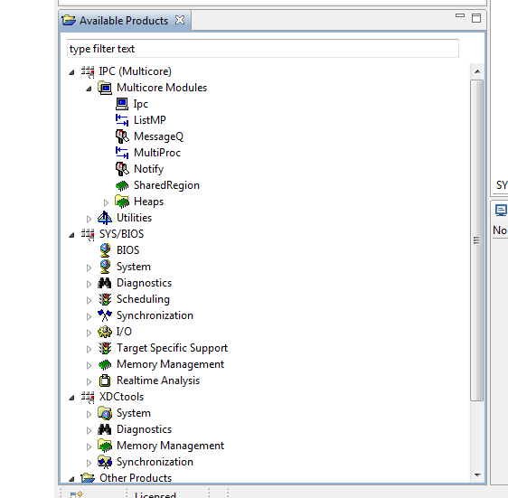
Static Configuration
Open cfg file in CCF with XGCONF
Notes:
NEW

Slide 67
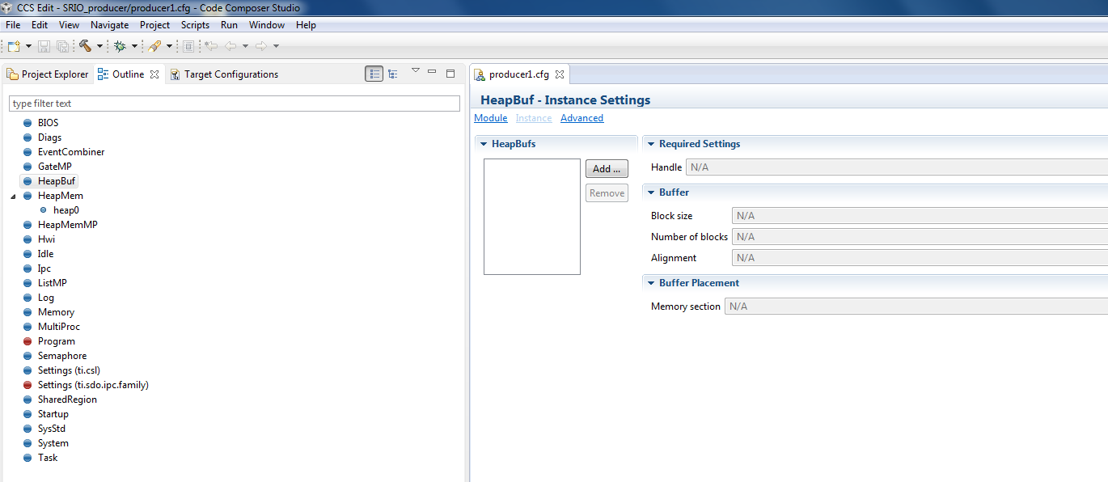
Static Configuration
Open cfg file in CCF with XGCONF
Notes:
NEW

