Slide 1
ARM-DSP Communication Architecture
KeyStone ARM-DSP Interaction

Slide 2
ARM-DSP Collaboration
MPM: Managing the DSP cores from the ARM
DSP executables are in the ARM file system
ARM can reset, load, run, and get messages and dump core out of a DSP core
IPC: Exchanging data and messages between ARM and DSP
User Space sends and receive Short Messages from DSP
MPM transport: exchange data between ARM and DSP
User Space exchange data
Inside the device and between devices using hyperlink

Slide 3
User Mode ARM and DSP Issues
Logical and physical Memory
Continuous Memory
Different translation types
Linux Protection
By-pass the MMU, get physical address from kernel space
Linux and DSP Coherency
There is not coherency between the ARM memory and the DSP direct access
Free messages and data
How does the ARM know when it can re-use the memory?

Slide 4
Type of Data Exchange
Data is in shared memory, no data move
Logical to physical address
Coherency
Data moves from a local memory (or global memory) to another local memory
DMA usage
Physical and logical memory
Coherency issues

Slide 5
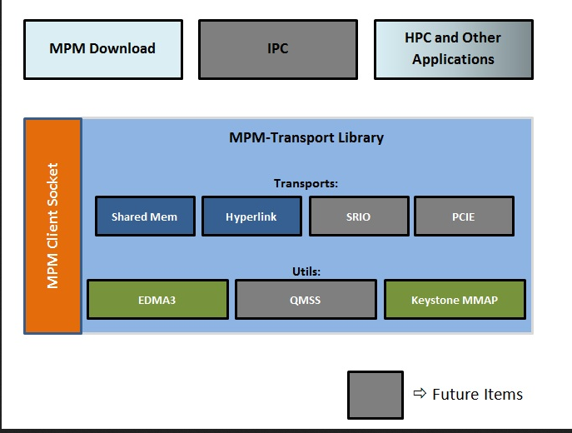
MPM Transport
The MPM transport is designed to provide access to memory associated with remote cores/nodes. The current supported transport modes are: shared memory transport and Hyperlink transport.

Slide 6
MPM Transport
Getting the MPM code, include and libraries
git://git.ti.com/keystone-linux/mpm-transport.git
Instructions how to get, build and use mpm_transport
http://processors.wiki.ti.com/index.php/MCSDK_UG_Chapter_Developing_Transports#MPM_Transport
After cloning the git, directory mpm-transport is generated. All the addresses are relative to mpm-transport

Slide 7
Getting the MPM Transport
The MPM transport is designed to provide access to memory associated with remote cores/nodes. The current supported transport modes are: shared memory transport and Hyperlink transport.
The API's to access transport and its static library are provided in linux-devkit
The APIs can be reviewed from mpm_transport.h
(mpm-transport/include/mpm_transport.h)
The parameters of transport can be configured from the JSON config file mpm_config.json. Currently the MPM downloader shares same config file, it is likely to change in future
(mpm-transport/scripts/mpm_config.json)
The static library to be linked for the transport is libmpmtransport.a
(mpm-transport/lib/libmpmtransport.a)
The link option should be -lmpmtransport
Multiple example applications of the transport components are provided in test.
mpm-transport/src/transport/test

Slide 8
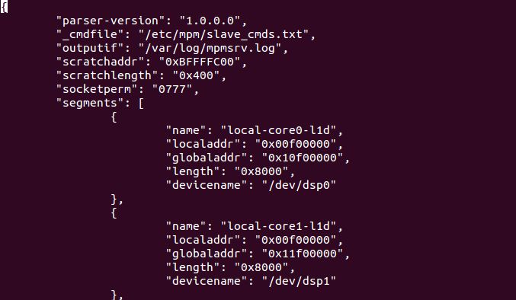
The mpm_config.json

Slide 9
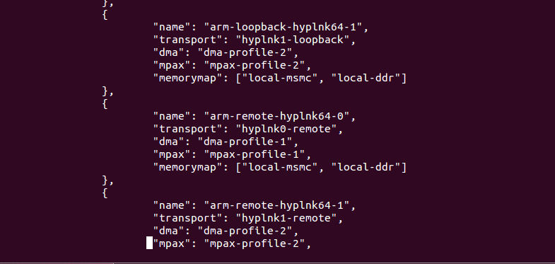
The mpm_config.json

Slide 10
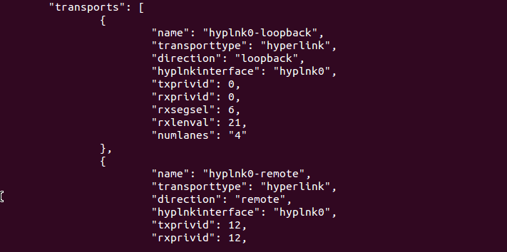
The mpm_config.json

Slide 11
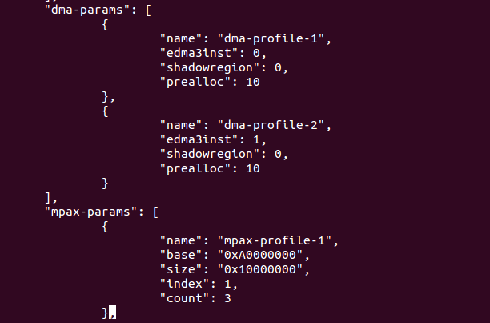
The mpm_config.json

Slide 12
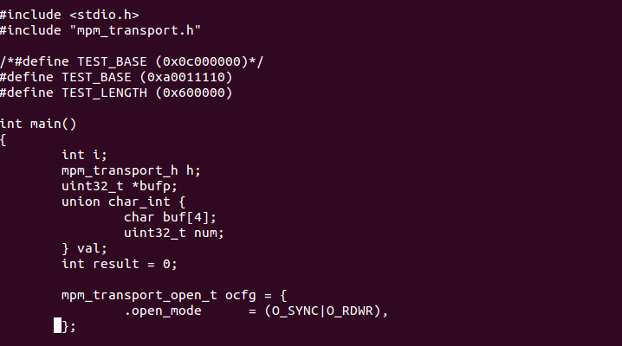
mpm_transport_test.c mpm-transport/src/transport/test/sharedmem

Slide 13
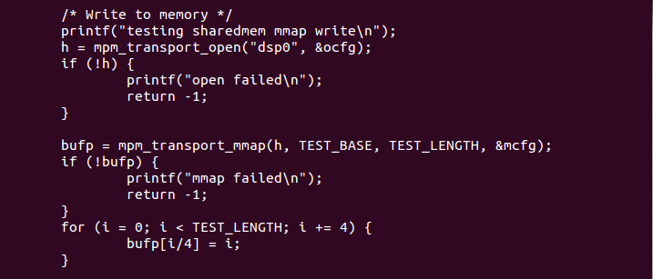
mpm_transport_test.c mpm-transport/src/transport/test/sharedmem

Slide 14
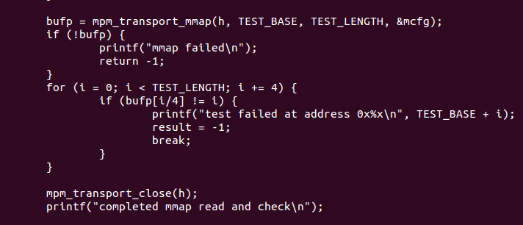
mpm_transport_hyplnk_remote.c mpm-transport/src/transport/test/sharedmem

Slide 15
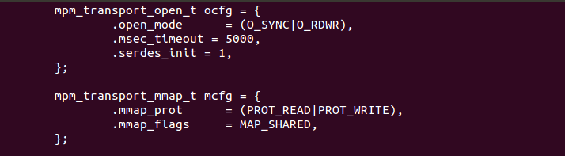
mpm_transport_test.c /mpm-transport/src/transport/test/hyplnk/hyplnk_remote

Slide 16
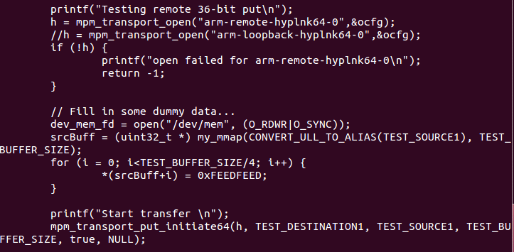
mpm_transport_hyplnk_remote.c /mpm-transport/src/transport/test/hyplnk/hyplnk_remote

Slide 17
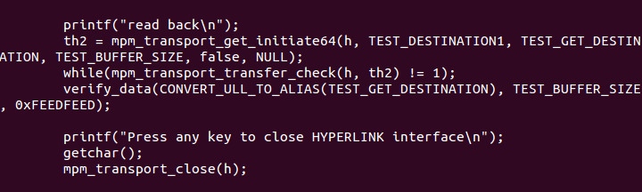
mpm_transport_hyplnk_remote.c /mpm-transport/src/transport/test/hyplnk/hyplnk_remote

Slide 18
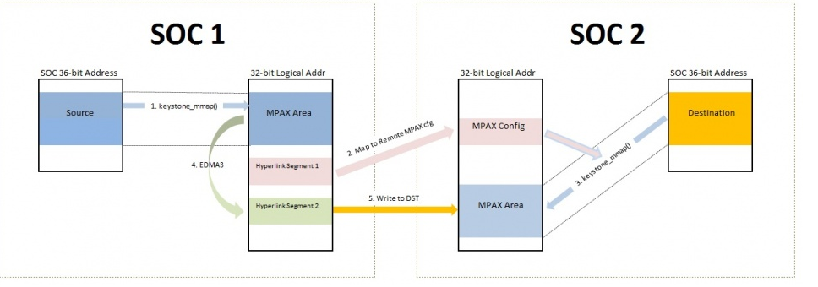
Hyperlink mpm_transport Physical memory to physical memory

Slide 19
EDMA – physical memory APIs
All from_addr and to_addr are physical addresses.
mpm_transport_get_initiate() - Get length data from remote from_addr and store it in local to_addr
mpm_transport_put_initiate() - Put length data from local from_addr to remote destination to_addr
mpm_transport_get_initiate_linked() - Same as mpm_transport_get_initiate(), except that this API accepts arrays of to_addr, from_addr, and length and complete all transfer with a single call. Parameter num_links must specify number of linked transfer and should equal the size of the three aforementioned arrays.
mpm_transport_put_initiate_linked() - Same as mpm_transport_put_initiate(), except that this API accepts arrays of to_addr, from_addr, and length and complete all transfer with a single call. Parameter num_links must specify number of linked transfer and should equal the size of the three aforementioned arrays.

Slide 20
For More Information
MPM transport Wiki http://processors.wiki.ti.com/index.php/MCSDK_UG_Chapter_Developing_Transports#MPM_Transport
Multicore articles, tools, and software are available at Embedded Processors Wiki for the KeyStone Device Architecture.
For questions regarding topics covered in this training, visit the support forums at the TI E2E Community website.

