Slide 1
KeyStone Interrupts
KeyStone Training
Multicore Applications
Literature Number: SPRPXXX

Slide 2
Agenda
Motivation
Interrupt Scheme (SPI 0 Example)
Configuring Interrupts (Hyperlink Example)

Slide 3
Motivation
KeyStone Interrupts

Slide 4

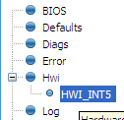
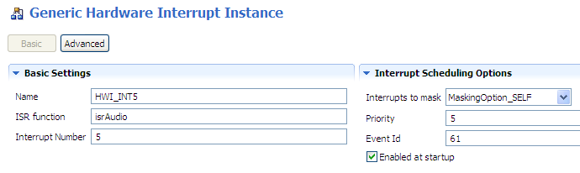
Configuring an Hwi: Statically via GUI
Example:
Tie SPI_INT to the CPU HWI₅
1
Use Hwi module (Available Products), insert new Hwi (Outline View)
NOTE: BIOS objects can be created via the GUI, script code, or C code (dynamic).
2
Configure Hwi: Event ID, CPU Int #, ISR vector:
To enable INT at startup, check the box
Where do you find the Event Id #?

Slide 5

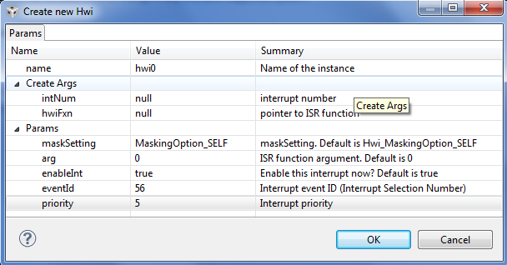
Hardware Event IDs
How do you know the names of the interrupt events and their corresponding event numbers?
Look it up in the datasheet.
Source: TMS320C6678 datasheet
As appropriate, refer to the datasheet for your target platform.

Slide 6
Interrupt Scheme
KeyStone Interrupts

Slide 7
System Events
Some events are connected directly to the cores; But not SPI.

Slide 8
System Events

Slide 9
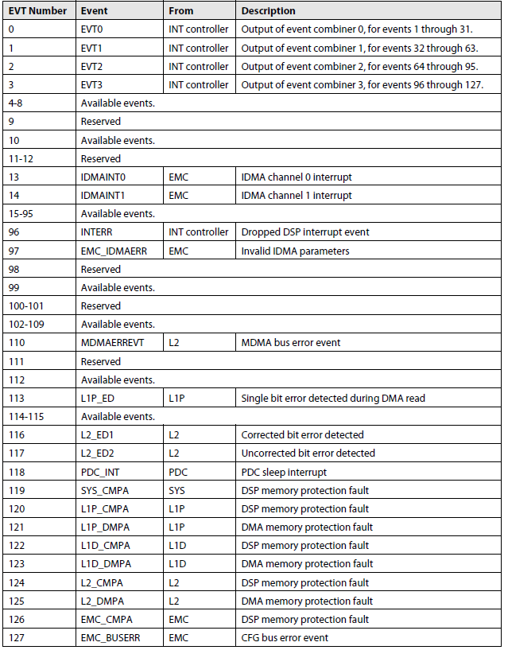
C66x Event Mapping
From the C66x User’s Guide:
22 assigned events
5 reserve primary events
17 secondary events
7 reserved events
99 Available events
The available events are connected to the device.
The next slides show how and what is connected to the available events within the C6638 device.

Slide 10
KeyStone II Interrupt Topology
CIC0
C66x CorePac0
All events from all IP come to the interrupt controllers.
Some are connected directly to C66x or other masters (EDMA, ARM, Hyperlink)
Some are mapped by the interrupt controllers
C66x CorePac1
C66x CorePac2
C66x CorePac3
CIC1
C66x CorePac4
C66x CorePac5
Events
C66x CorePac6
C66x CorePac7
CIC2
HyperLink
EDMA CC0
EDMA CC1
EDMA CC2
EDMA CC3
EDMA CC4
Peripherals
ARM A15
CorePac

Slide 11
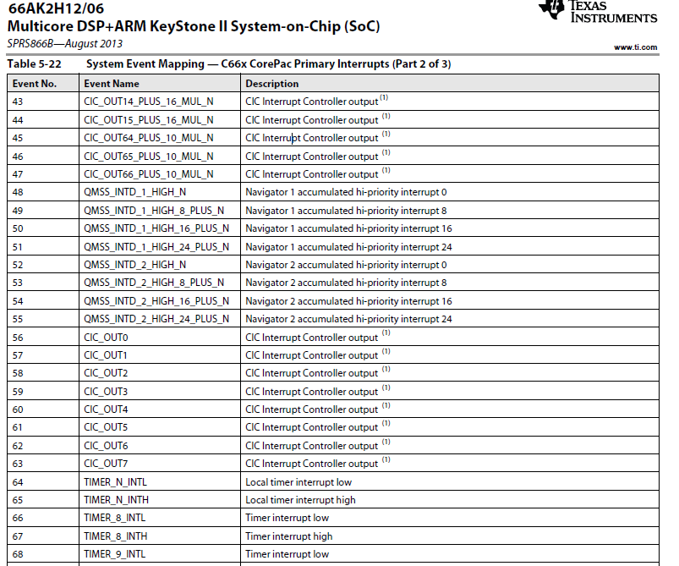

Slide 12
Where is SPIXEVT?
Not on the above page
Not on any of the other two pages in the table
But we see that there are eight events (56 to 63) that come out of the interrupt controller. We can connect SPIXEVT through the interrupt controller to one of these events (broadcast events). We will connect to broadcast event 63
They are other events from the interrupt controller that could be considered (Both, broadcast and single core)
The ARM GIC has 480 input events and 12 of them are connected to SPI

Slide 13
Connecting SPIXEVT to Core 3
66AK2H12 has multiple instances of SPI; We will look at SPI 0
The next slide shows one page from the input table for CIC0. The same events are connected to CIC1 as well.

Slide 14
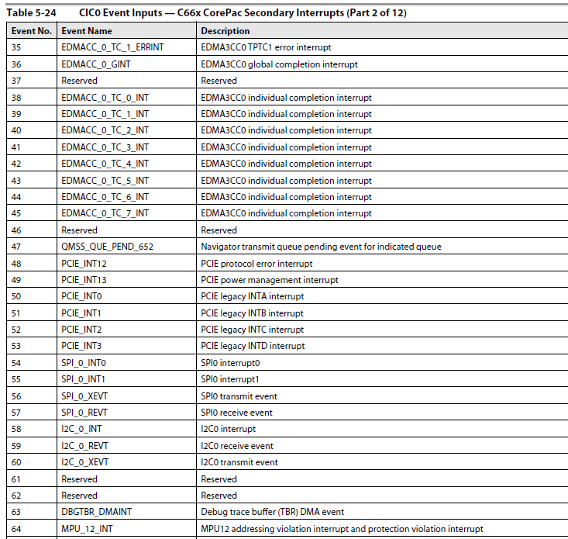

Slide 15
Connecting SPI 0 Transmit event to core 3 ISR

Slide 16
Configuring Interrupts
KeyStone Interrupts

Slide 17
Configuration API
Read the following Wiki: http://processors.wiki.ti.com/index.php/Configuring_Interrupts_on_Keystone_Devices
For KeyStone II (MCSDK 3.x), look at the two include files to see all the API that are needed:
csl_cpIntc.h
csl_cpIntCAux.h

Slide 18
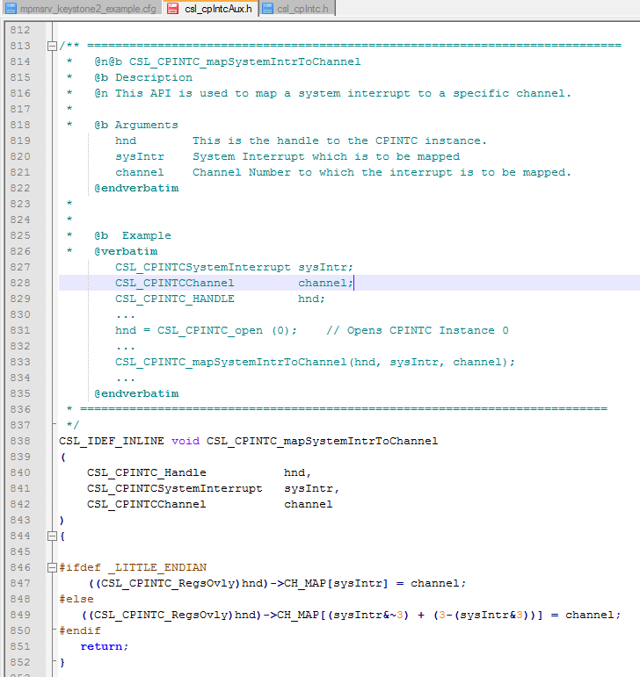
csl_cpIntCAux.h shows the APIs that connect system events to channels (e.g., the output of the CIC).
Connecting channel events to interrupt queues is done using CSL or SYSBIOS, as described previously.

Slide 19
Code Examples
MCSDK includes examples of interrupts originating from peripherals: MCSDK_3_01_12\pdk_keystone2_3_00_01_12\packages\ti\drv
Consider an example using HyperLink, where an interrupt is sent from Hyperlink 0 to a DSP core.

Slide 20
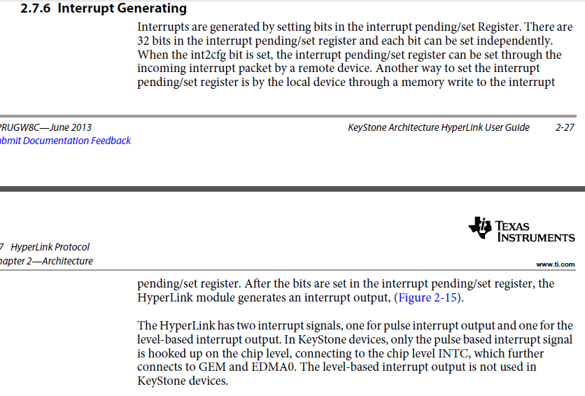
Hyperlink Interrupt

Slide 21
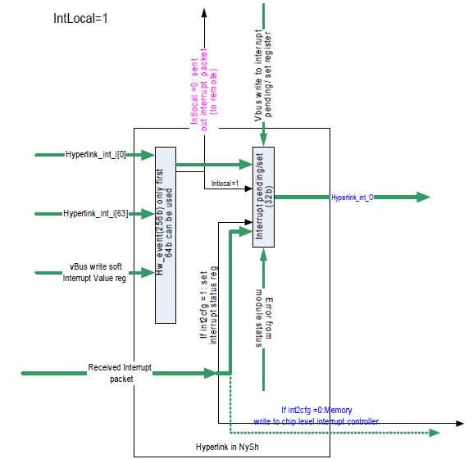
Hyperlink Interrupt
Overview

Slide 22
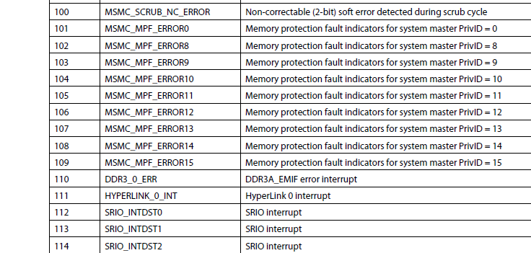
Following Hyperlink Interrupt 0 From Table 5-24 of 66AK2H12- CIC0 input events
Event number 111 (ox6F) is HyperLink 0 interrupt.
Next, this interrupt is connected to a core …

Slide 23
static int hyplnkExampleInitChipIntc (void)
{
CSL_CPINTC_Handle hnd;
// I drop some of the functions here (enable/disable interrupts etc.
CSL_CPINTC_mapSystemIntrToChannel (hnd, CSL_CIC0_HYPERLINK_0_INT, hyplnk_EXAMPLE_INTC_OUTPUT);
// I drop some of the functions here (enable/disable interrupts etc.
return 0;
}
CSL_CIC0_HYPERLINK_0_INT = 111
What about hyplnk_EXAMPLE_INTC_OUTPUT?

Slide 24
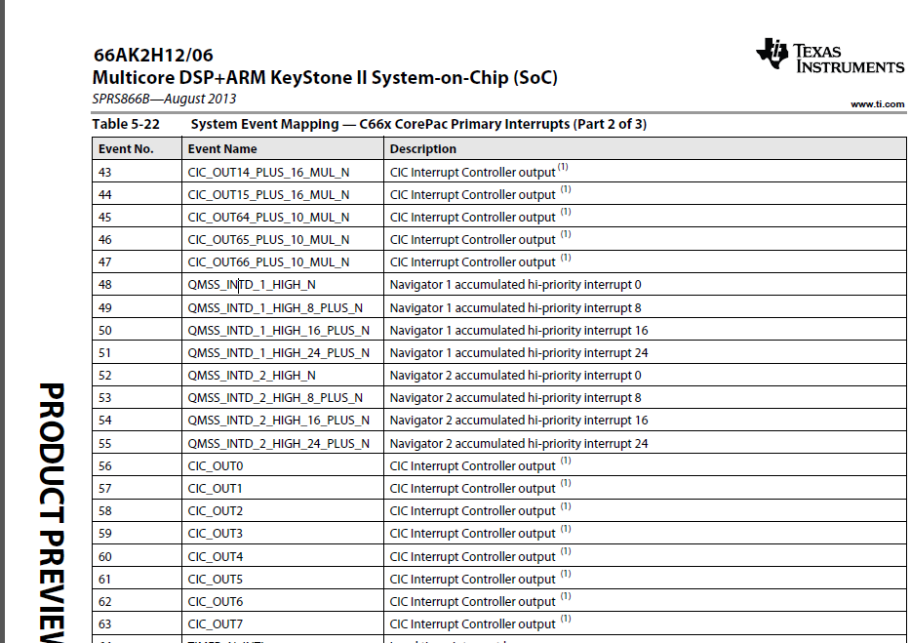
Choose to use event 45 of the core
It could be any one of other CIC_OUT lines (look at the complete table for even more)

Slide 25
Following Hyperlink Interrupt 0 - Continue
Event 45 on the C66 core is connected to CIC out 64 + 10 x N, that is
Core 0 event 45 is connected to CIC output event 64
Core 1 event 45 is connected to CIC output event 74
Core 2 event 45 is connected to CIC output event 84
You got the point
CIC0 should map input event 111 to output event 64 (or 74, or 84 or … depends on what core is used)

Slide 26

Screen Shot from CCS
The value of hyplnk_EXAMPLE_INTC_OUTPUT is (64 + 10 * DNUM)

Slide 27
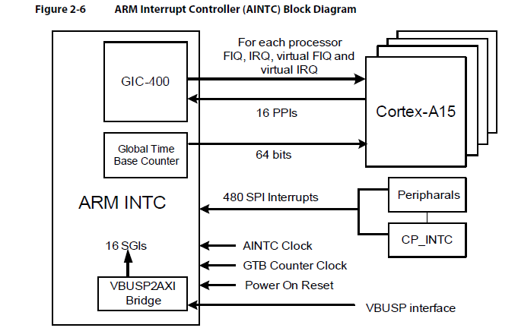
ARM A15 Interrupt Scheme

Slide 28
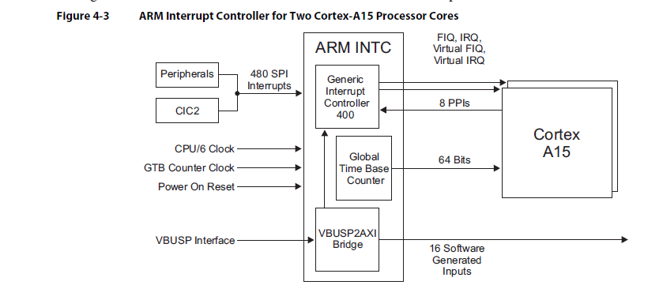
ARM A15 Interrupt Scheme

Slide 29
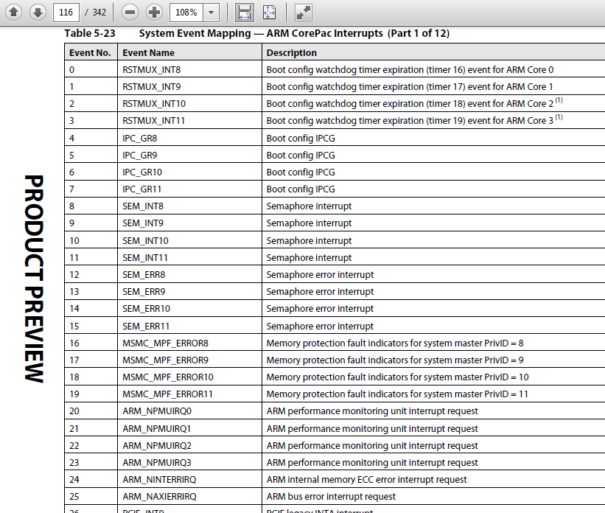
System Events Mapping to GIC

Slide 30
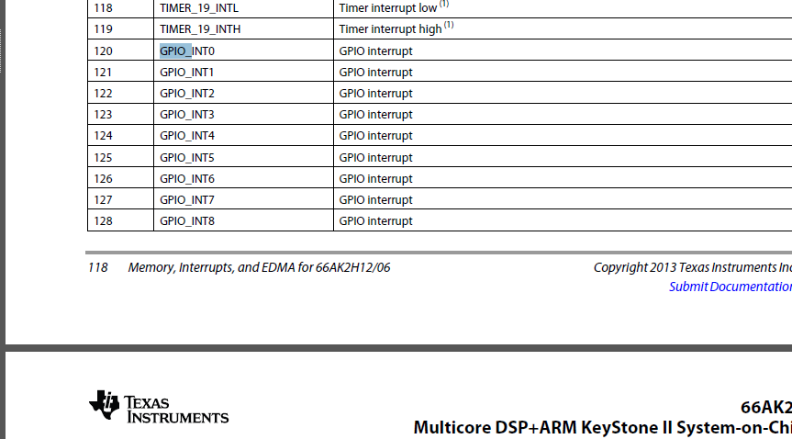
Following GPIO 0 From Table 5-23 of 66AK2H12- ARM CorePac Interrupts

Slide 31
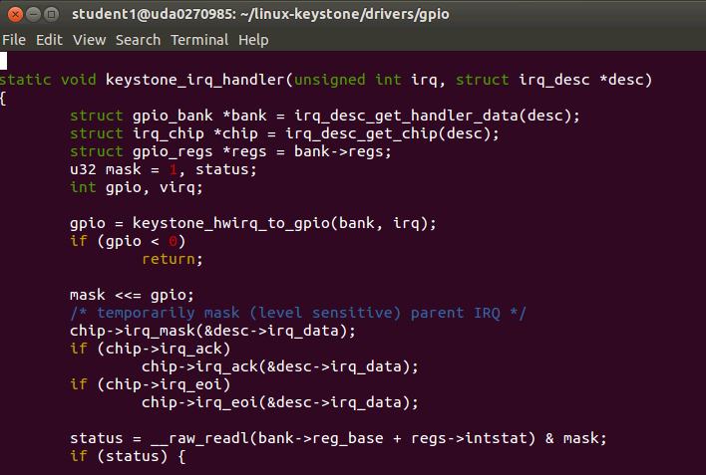
From the file gpio-keystone.c

Slide 32
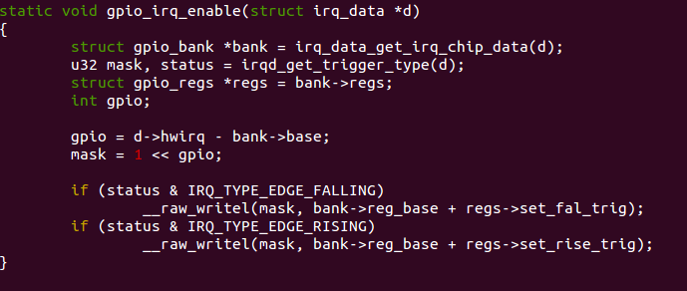
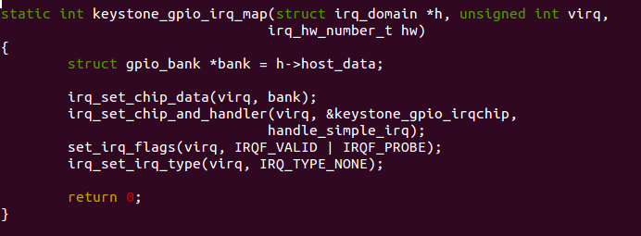
From the file gpio-keystone.c

Slide 33
Questions?

