Slide 1
Book1
File created on: 2022-06-10 4:44:17 PM

Slide 2
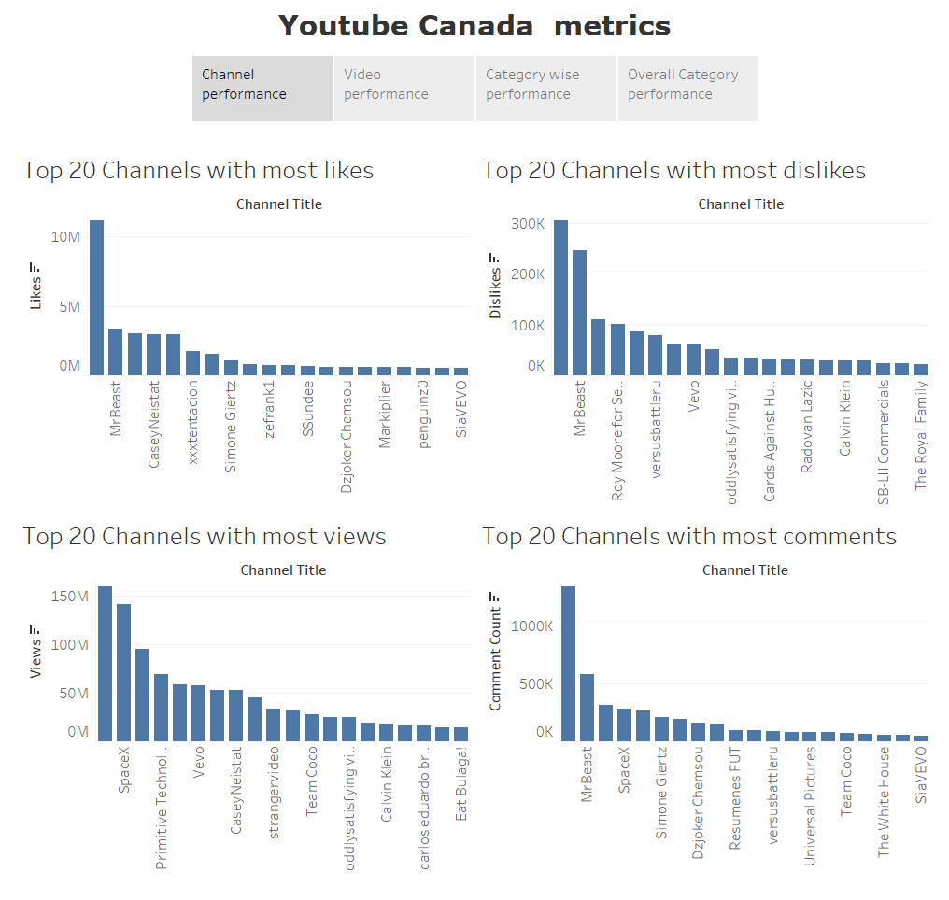

Slide 3
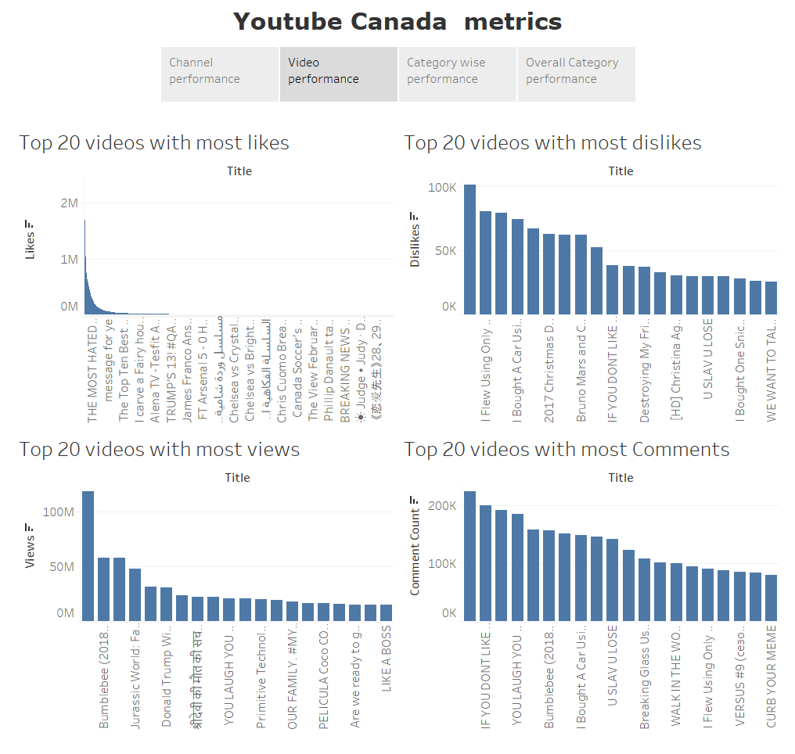

Slide 4
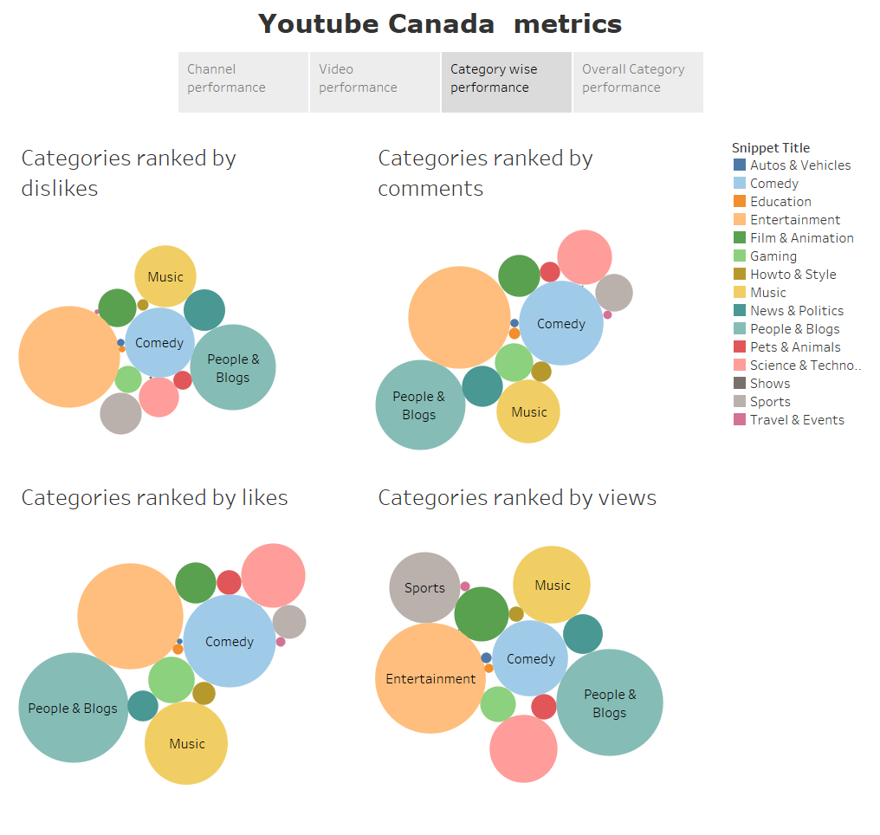

Slide 5
