Slide 1



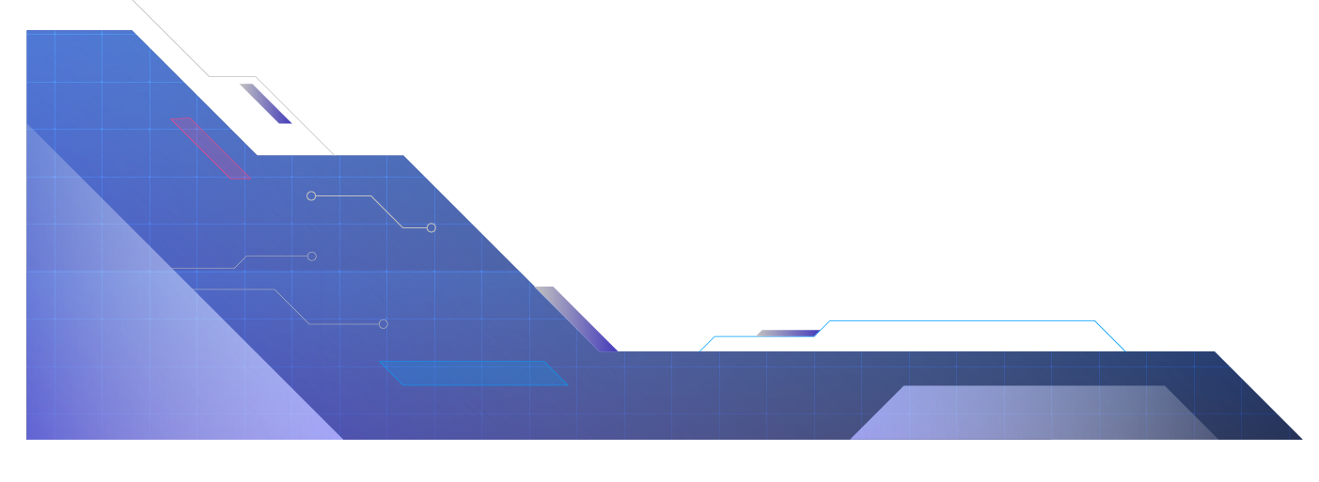
Adaptive Hybrid RAG Framework for Context-Aware Document Intelligence
An Adaptive Hybrid Retrieval Framework for Trustworthy AI-Powered Document Intelligence

Slide 2
Problem Statement?
Organizations and educational institutions manage thousands of digital documents such as research papers, reports, manuals, and policies. Finding specific information from these documents is often time-consuming, and traditional keyword search fails to understand the actual context or meaning of a user's query.
Large Language Models (LLMs) can generate natural language responses but may produce inaccurate or hallucinated answers for private documents. Therefore, there is a need for an intelligent document question-answering system that retrieves relevant information from uploaded documents and provides trustworthy, explainable answers with supporting evidence

Slide 3

Objectives
➔Develop an AI-powered document intelligence system for multiple document formats (PDF, DOCX, and TXT).
➔ Implement Adaptive Hybrid Retrieval by combining BM25 and Semantic Search for accurate information retrieval.
➔ Generate context-aware answers using a Large Language Model (Llama 3/Mistral) based on retrieved document content.
➔ Provide interactive evidence by highlighting the exact text in the original document used to generate the answer.
➔ Support conversation history and document summarization for an improved user experience.
➔ Build a reliable and explainable document question-answering platform that minimizes hallucinations and improves user trust.

Slide 4
Literature Survey
S.No | Research Paper | Key Contribution | Limitation
1 | Retrieval-Augmented Generation for Knowledge-Intensive NLP Tasks (Lewis et al., 2020) | Introduced the RAG framework by combining document retrieval with LLM-based answer generation. | Focuses mainly on retrieval and generation; limited explainability and enterprise-specific document intelligence. (arXiv)
2 | Dense Passage Retrieval for Open-Domain Question Answering (Karpukhin et al., 2020) | Introduced dense embedding-based semantic retrieval (DPR) for question answering. | Performs semantic retrieval only and may miss exact keyword matches. (ACL Anthology)
3 | REALM: Retrieval-Augmented Language Model Pre-Training (Guu et al., 2020) | Integrated retrieval directly into language model pre-training to improve factual knowledge access. | High computational complexity and difficult to adapt for enterprise document collections. (MIT Press Direct)
4 | Sentence-BERT: Sentence Embeddings using Siamese BERT-Networks (Reimers & Gurevych, 2019) | Generates high-quality sentence embeddings for semantic similarity and retrieval. | Does not perform retrieval by itself; requires an external vector index. (DOI)
5 | FAISS: A Library for Efficient Similarity Search and Clustering of Dense Vectors (Johnson et al., 2017) | Provides fast vector similarity search for millions of embeddings. | Handles semantic search only and does not perform keyword-based retrieval. (MIT Press Direct)

Slide 5
Literature Survey
S.No | Research Paper | Key Contribution | Limitation
6 | The Probabilistic Relevance Framework: BM25 and Beyond(Stephen Robertson, Hugo Zaragoza) | Introduced the probabilistic relevance framework that forms the foundation of the BM25 ranking algorithm for keyword-based information retrieval. | BM25 relies on exact keyword matching and cannot understand semantic relationships between different words or phrases
7 | BERT-based Dense Retrievers Require Interpolation with BM25 for Effective Passage Retrieval (Luan et al., 2021) | Demonstrates that combining BM25 with dense retrieval improves retrieval effectiveness. | Uses a fixed hybrid strategy without adaptive query-based retrieval. (DOI)
8 | Sparse, Dense, and Attentional Representations for Text Retrieval (Luan et al., 2021) | Compares sparse, dense, and hybrid retrieval methods for text search. | Primarily focuses on retrieval accuracy rather than explainability or document intelligence. (MIT Press Direct)
9 | Dense Text Retrieval Based on Pretrained Language Models: A Survey (2024) | Comprehensive survey of dense retrieval techniques, embedding models, and evaluation methods. | Survey paper; does not propose a unified adaptive retrieval framework. (DOI)
10 | Improving the Domain Adaptation of Retrieval-Augmented Generation Models for Open-Domain Question Answering (TACL) | Improves RAG performance on domain-specific knowledge bases. | Focuses on domain adaptation rather than explainability, contradiction detection, or evidence analysis. (MIT Press Direct)

Slide 6
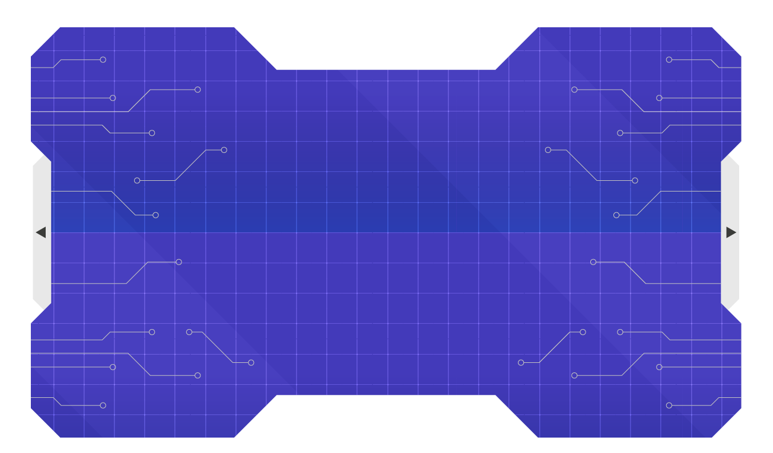
Research Gap Identification
Research Gap Identified from Literature | Our Proposed Solution
Most existing works use either keyword retrieval (BM25) or semantic retrieval (Dense Retrieval) independently. | Adaptive Hybrid Retrieval combines BM25 and FAISS to leverage both lexical and semantic search.
Existing RAG frameworks primarily focus on accurate answer generation rather than explaining how the answer was retrieved. | Explainable Evidence Navigation displays highlighted source passages used to generate the answer.
Current retrieval systems have limited support for adaptive retrieval strategy selection based on different query types. | Adaptive Retrieval Engine dynamically decides whether to use BM25, FAISS, or both depending on the query.
Existing document QA systems mainly retrieve information but perform limited cross-document reasoning. | Cross-Document Intelligence analyzes information across multiple uploaded documents.
Most research focuses on single-document retrieval or open-domain datasets rather than enterprise document collections. | Supports multiple enterprise documents including PDFs, DOCX, TXT, reports, manuals, and research papers.

Slide 7
Research Gap Identification
Research Gap Identified from Literature | Our Proposed Solution
Existing approaches rarely identify contradictory information across different documents. | Contradiction Detection Module highlights conflicting information from multiple sources.
Existing retrieval methods provide citations but do not estimate how strongly the evidence supports the answer. | Evidence Strength Estimation indicates whether an answer is supported by one or multiple sources.
Most RAG systems emphasize retrieval accuracy but provide limited transparency for users. | Context-Aware Explainable Document Intelligence improves transparency and user trust.
Existing solutions often require multiple independent components without a unified workflow. | A single integrated framework combining preprocessing, hybrid retrieval, LLM generation, explainability, and document intelligence.
Few studies target a complete enterprise-ready document intelligence workflow with secure internal document analysis. | A modular Adaptive Hybrid RAG Framework designed for secure organizational knowledge management.

Slide 8
Existing System Analysis (Case Study)
Existing System: ChatPDF (https://www.chatpdf.com/)
Description
ChatPDF is an AI-powered document question-answering platform that enables users to upload PDF documents and interact with them using natural language. It uses Retrieval-Augmented Generation (RAG) to retrieve relevant content from uploaded documents and generates contextual answers with source citations. It also supports document summarization and conversational interactions, making it useful for students, researchers, and professionals.

Slide 9
Existing System: ChatPDF (https://www.chatpdf.com/)
Note: ChatPDF was analyzed to understand how current AI-powered document question answering systems work in practice.
Existing Features
AI-powered document question answering.
Document summarization.
Source citations for generated responses.
Conversational interaction with uploaded documents.
Scope for Improvement
Primarily designed for single-document interaction.
Limited support for cross-document reasoning.
Does not analyze contradictory information across multiple documents.
Does not estimate evidence strength using multiple supporting documents.
Focuses on answering questions rather than providing cross-document document intelligence.

Slide 10
Research Gap Identification
Feature | ChatPDF | Proposed System
AI-powered Question Answering | ✅ | ✅
Document Summarization | ✅ | ✅
Source Citations | ✅ | ✅
Multiple Document Upload | Limited | ✅
Cross-Document Question Answering | ❌ | ✅
Contradiction Detection Across Documents | ❌ | ✅
Evidence Strength Analysis | ❌ | ✅
Adaptive Hybrid Retrieval | ❌ (User-facing) | ✅
Interactive Evidence Navigation | Basic Citation | ✅ Highlighted Source
Explainable Document Intelligence | Limited | ✅

Slide 11
Innovation
Our proposed framework introduces the following innovations:
Adaptive Hybrid Retrieval that dynamically selects the most suitable retrieval strategy based on the user's query.
Cross-Document Intelligence to retrieve and analyze information from multiple uploaded documents.
Contradiction Detection to identify conflicting information across different documents.
Evidence Strength Analysis to estimate the reliability of generated responses using supporting evidence from multiple documents.
Interactive Evidence Navigation, allowing users to view the exact highlighted text used to generate an answer.
Explainable AI Workflow that improves transparency and user trust.
class Robot:
def __init__(self, x, y):
self.x = x
self.y = y
def move_up(self):
self.y += 1
def move_down(self):
self.y -= 1
def move_left(self):
self.x -= 1
…………

Slide 12
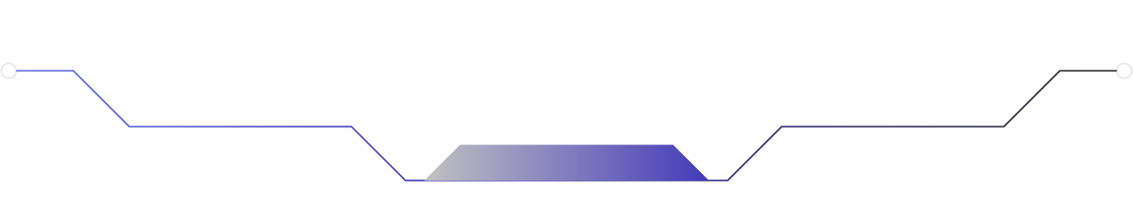



Creativity
Our project transforms traditional document question answering into an intelligent document analysis platform by integrating:
Multi-document understanding.
Explainable evidence tracing.
Cross-document comparison.
Intelligent contradiction detection.
Reliable evidence-based answer generation.
This enables users to not only receive answers but also understand how those answers were derived.

Slide 13
Novelty
Unlike conventional document QA systems, our proposed framework emphasizes transparency, reasoning, and explainability.
Key novel aspects include:
Combining Adaptive Hybrid Retrieval with Explainable AI.
Cross-document conflict and consensus analysis.
Evidence strength estimation based on multiple supporting sources.
Interactive highlighted evidence within original documents.
A unified platform for question answering, summarization, and document intelligence.

Slide 14
Feasibility
Technical Feasibility
Python
LangChain
Sentence Transformers
FAISS
BM25
Llama 3 / Mistral
FastAPI
Streamlit

Slide 15
Feasibility
Operational Feasibility
Supports common document formats (PDF, DOCX, TXT).
User-friendly interface requiring minimal technical knowledge.
Economic Feasibility
Built entirely using open-source frameworks and models.
No expensive commercial software required.
Implementation Feasibility
Modular architecture enables phased development within the B.Tech project timeline.

Slide 16
Project Plan

Slide 17
PHASE 1
Literature Survey & Requirement Analysis
PHASE 2
Document Processing & Text Extraction
PHASE 3
Embedding Generation & Hybrid Retrieval
PHASE 4
LLM Integration
PHASE 5
Cross-Document Intelligence Module
PHASE 6
Explainable Evidence Navigation
PHASE 7
Frontend & Backend Development
PHASE 8
Testing, Evaluation & Documentation

Slide 18
Project Workflow

Slide 19
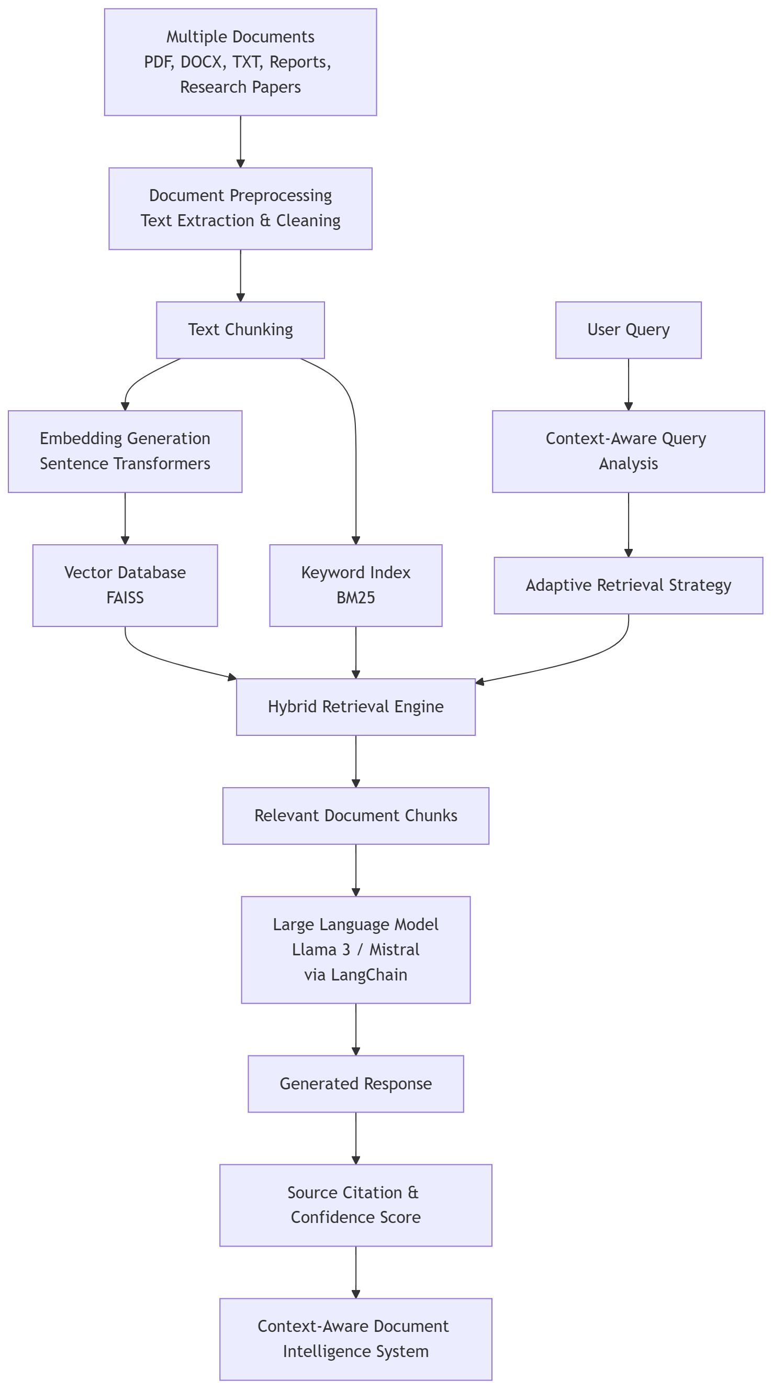

Slide 20
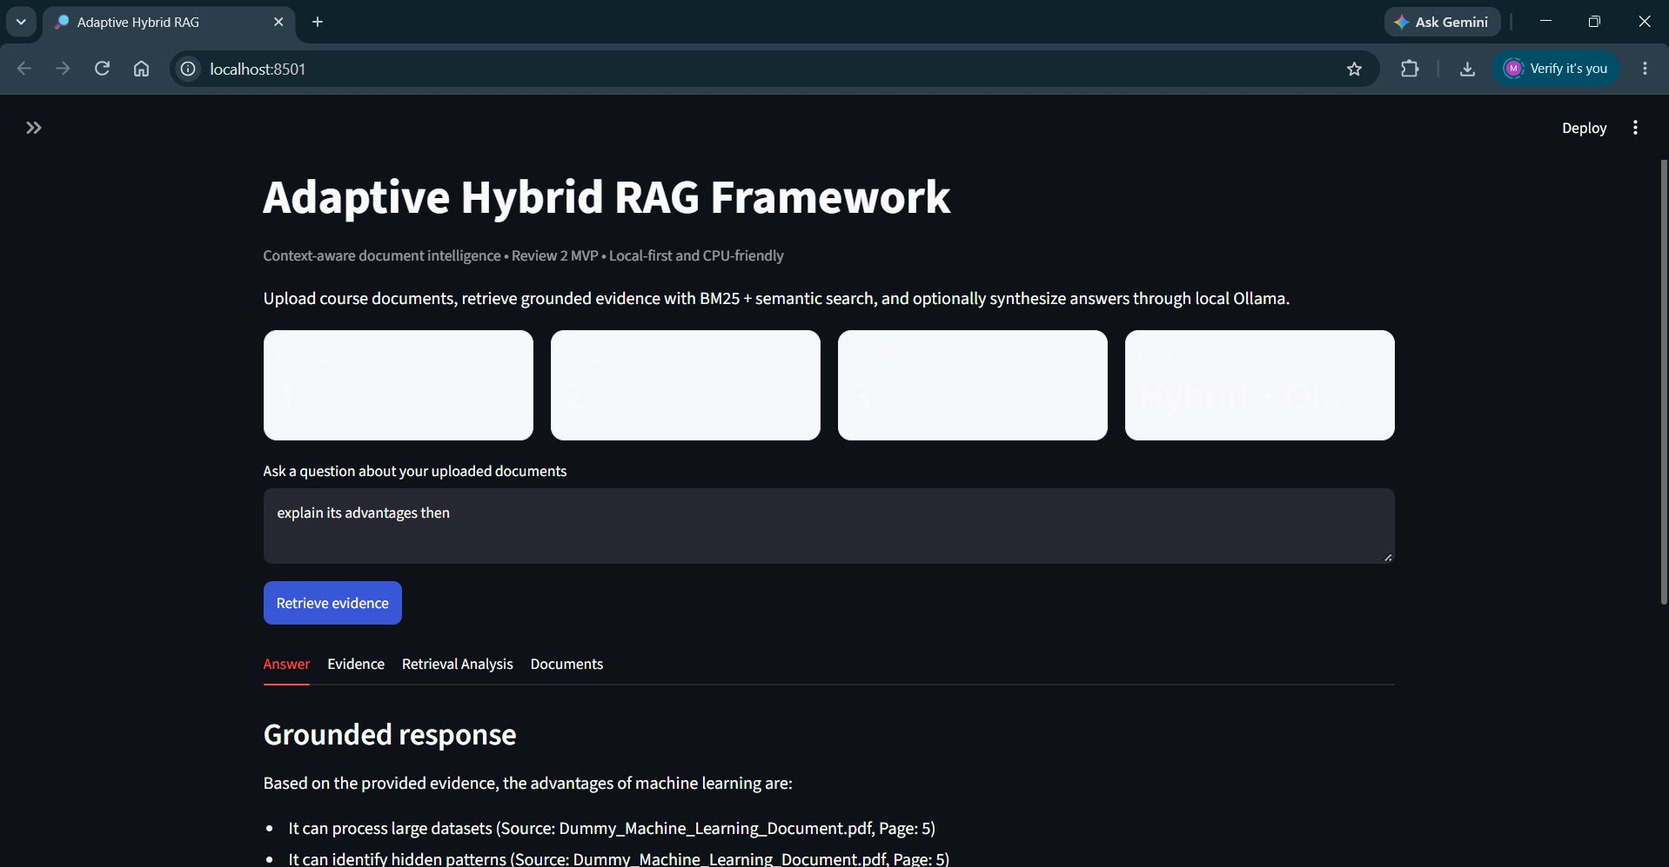
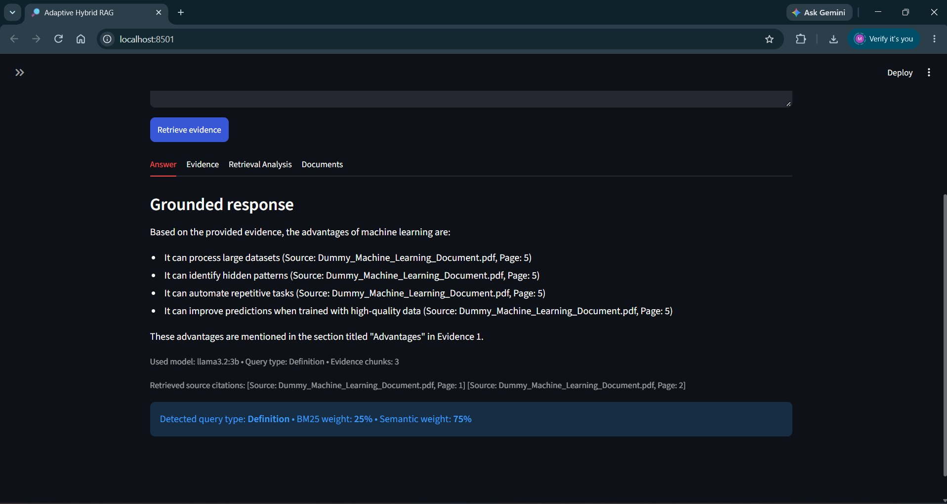
Output
Document Upload & Configuration
Grounded Answer Generation

Slide 21
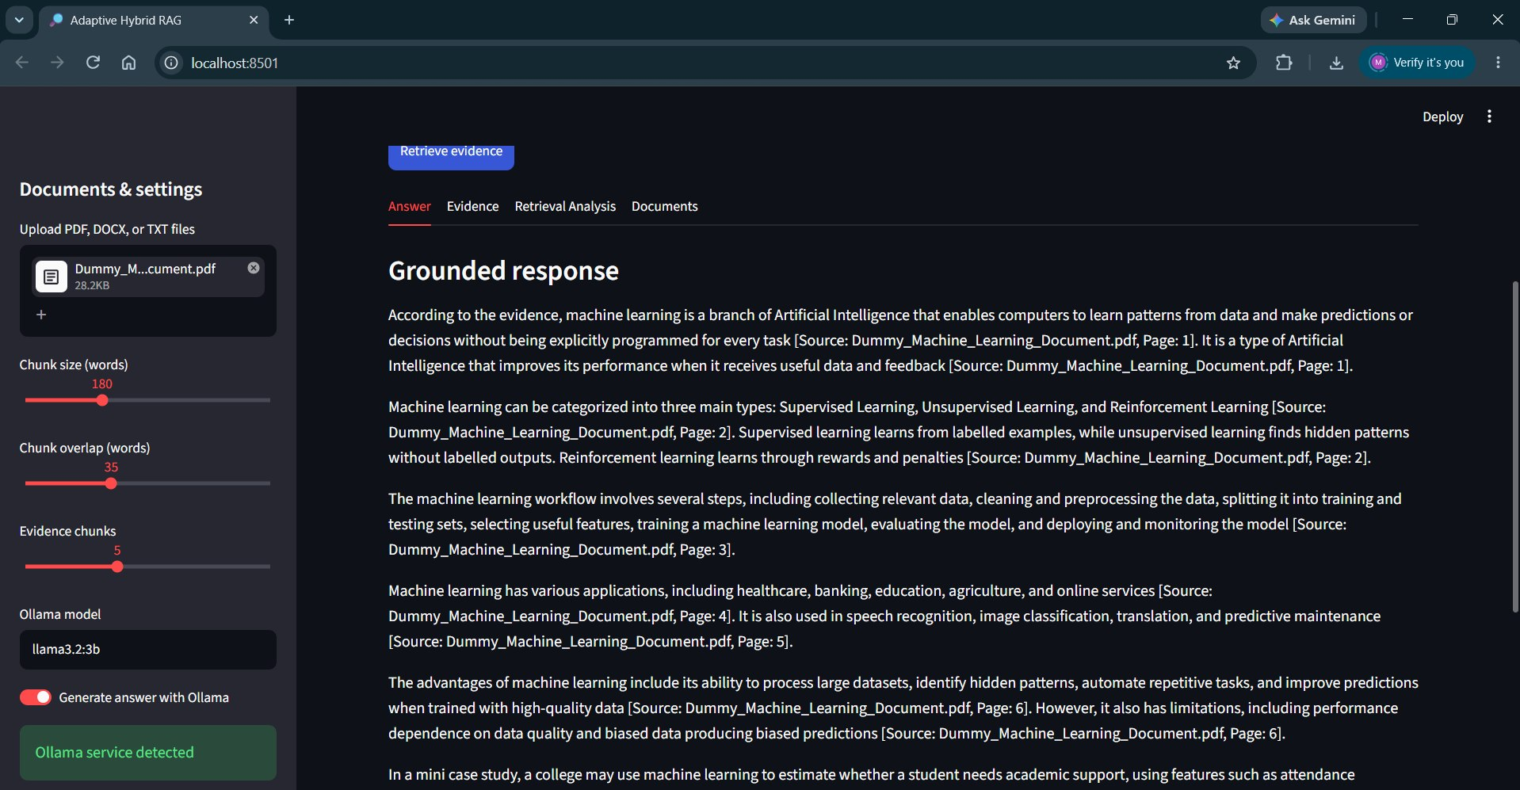
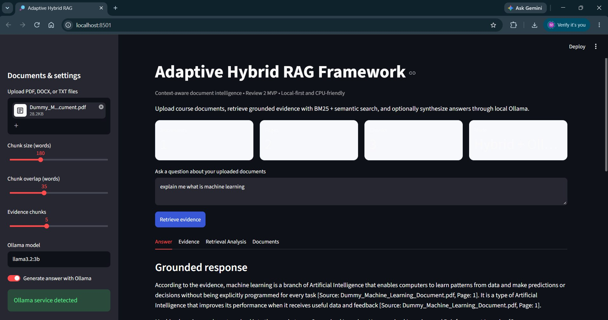
Output
Local LLM Integration
Document Processing & Indexing

Slide 22
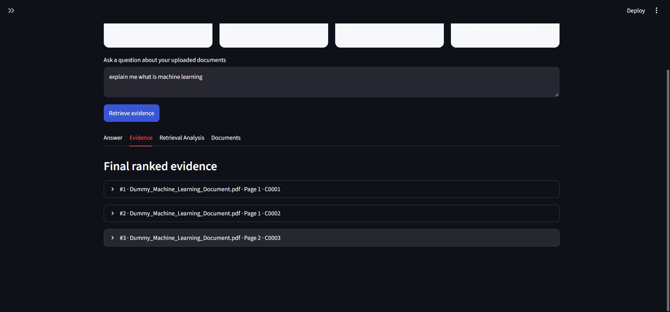
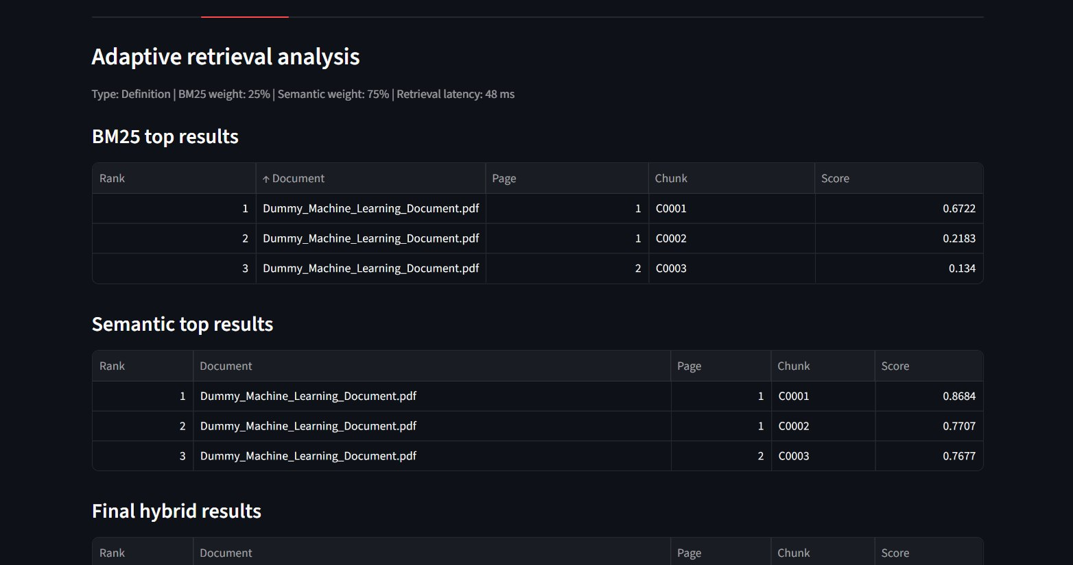
Output
Evidence Ranking & Source Traceability
Adaptive Hybrid Retrieval Analysis

Slide 23
System Architecture & Workflow
Document Upload
PDF • DOCX • TXT
Preprocessing
Extraction • Cleaning • Chunking
Indexing
BM25 + Sentence-BERT + FAISS
User Query
Query analysis
Adaptive Retrieval
BM25 / Semantic / Hybrid
Evidence Ranking
Relevant chunks + context
Explainable Output
Answer
Source evidence
Highlighted passages
Document context
LLM Generation
Llama 3 / Mistral

Slide 24
System Implementation
Document Processing
PDF/DOCX/TXT extraction,
cleaning and chunking
IMPLEMENTED PIPELINE
1. Upload
2. Parse
Semantic Retrieval
Sentence-BERT embeddings
stored in FAISS
3. Chunk
Keyword Retrieval
BM25 index for exact
term-based matching
4. Embed
5. Retrieve
LLM Integration
Llama 3 / Mistral receives
retrieved context
6. Generate
Streamlit provides the interactive interface for document upload, queries and outputs.

Slide 25
Testing, Results & Next Steps
FUNCTIONAL TESTING
INITIAL OUTPUT
✓ Document upload & text extraction
• Relevant document context is retrieved
✓ Chunking & embedding generation
• Answers are generated from retrieved context
✓ FAISS semantic retrieval
• Interactive Streamlit output is available
✓ LLM question answering
• Source/evidence information can be displayed
CURRENT LIMITATIONS
PDF layout/table extraction can vary.
Retrieval quality depends on chunking.
NEXT STEPS
Adaptive hybrid retrieval,
contradiction detection & evidence strength.

Slide 26
THANKYOU!
Presented By:
Agastya Singh
Sanchay Krishna G
Challa Saketh Kumar
M Hariharan

