Slide 1
Map Reduce: Simplified Data Processing On Large Clusters
Jeffery Dean and Sanjay Ghemawat
(Google Inc.)
OSDI 2004
(Operating Systems Design and Implementation)
Presented By: Hari Haran Venugopal

Slide 2
MapReduce: Introduction
MapReduce is a framework for processing huge datasets on distributable problems using a large number of computers (nodes, collectively referred to as a cluster or grid).
A new programming model for processing and generating large data sets
The framework is inspired by map and reduce functions, commonly used in functional programming such as LISP.
Functional programming is a programming paradigm that treats computation as the evaluation of mathematical functions and avoids state and mutable data.
Users specify a map function that process a key/value pair to generate a set of intermediate key/value pairs, and a reduce function that merge all intermediate values associated with the same intermediate key.
Some of the interesting programs that can be easily expressed as MapReduce computations are: Distributed Grep, Count of URL Access Frequency, Reverse Web-Link Graph, Term-Vector pre Host, Inverted Index, Distributed Sort.

Slide 3
MapReduce: Logical View
"Map" step: The master node takes the input, partitions it up into smaller sub-problems, and distributes those to worker nodes. A worker node may do this again in turn. The worker node processes that smaller problem, and passes the answer back to its master node.
"Reduce" step: The master node then takes the answers to all the sub-problems and combines them in some way to get the output — the answer to the problem it was originally trying to solve.
Map(k1,v1) → list(k2,v2)
Reduce(k2, list (v2)) → list(v3)

Slide 4
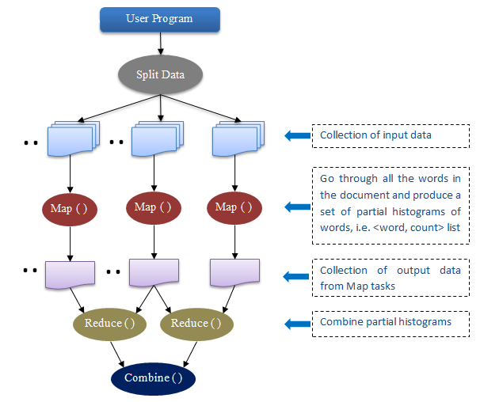
Word Count Problem
map(String key, String value):
// key: document name
// value: document contents
for each word w in value:
EmitIntermediate(w, "1");
reduce(String key, Iterator values):
// key: a word
// values: a list of counts
int result = 0;
for each v in values:
result += ParseInt(v);
Emit(AsString(result));

Slide 5
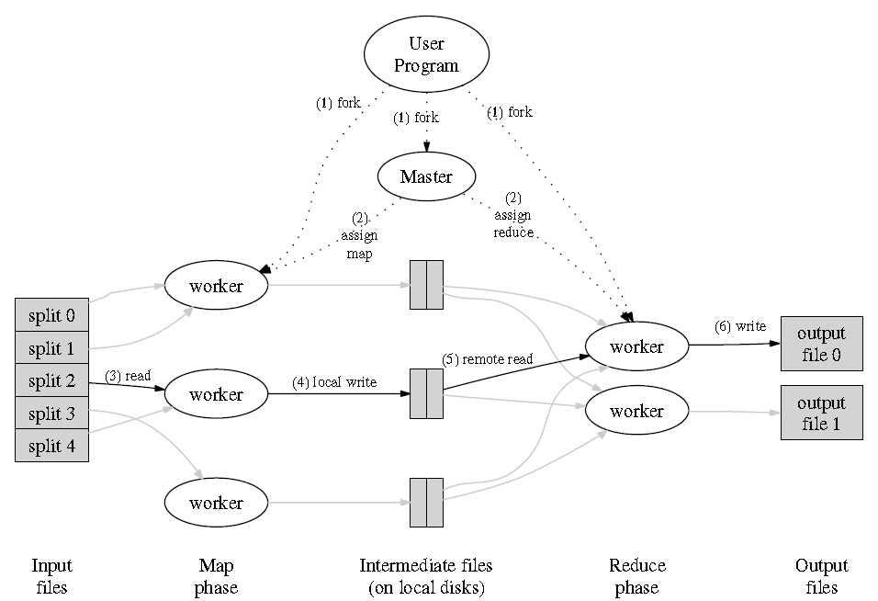
MapReduce: Execution View

Slide 6
MapReduce: Execution Steps
STEP 1: The MapReduce library in the user program splits the input file into M pieces (16 to 64MB) and starts up many copies of the program on a cluster of machines.
STEP 2: A Special Copy – Master and rest are workers which are assigned work by the master. The master picks idle workers and assigns each one a map task or reduce task.
STEP 3: Workers assigned with the map task parses the key/value pair from the corresponding input split and passes it to the Map function. The intermediate key/value pairs are generated and buffered in memory.
STEP 4: A partitioning function partitions these intermediate pairs into R regions and writes to local disk and the locations on the disk is passed to the master.

Slide 7
MapReduce: Execution Steps
STEP 5: Master notifies reduce worker about the locations , then the worker sorts intermediate keys so that all occurrence of the same key are grouped together.
STEP 6: The reduce worker passes each unique intermediate key and corresponding set of intermediate values to the user’s Reduce function.
STEP 7: The Master wakes up the user program once all map and reduce have been completed. At this point, the MapReduce call in the user program returns back to the user code.

Slide 8
Implementation
Many different implementations of the MapReduce interface are possible.
The right choice is depending on the environment.
Typical cluster: (Computing environment in wide use at Google, large clusters of PC’s connected via switched Ethernet.)
Hundreds to thousands of dual-processors x86, running on Linux, 2-4 GB of memory per machine.
Commodity networking Hardware is used – typically 100MB/S to 1 GB/S.
Storage is on local IDE disks (inexpensive) attached directly to individual machines.
GFS: Distributed File System that manages data stored on the disks by replication to provide availability and reliability on top of unreliable hardware.
Scheduling system to which user submits jobs. (Job consists of set of tasks mapped by scheduler to set of available machines within the cluster)
Implemented using C++ library and linked into user programs

Slide 9
Refinements
Partitioning Functions
Ordering Guarantees
Combiner Function
Input and Output Types
Skipping Bad Records
Local Execution
Status Information
Counters

Slide 10
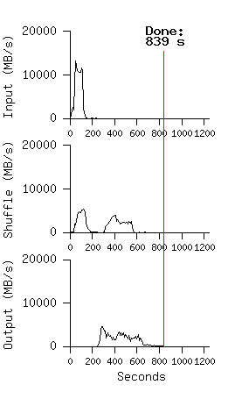
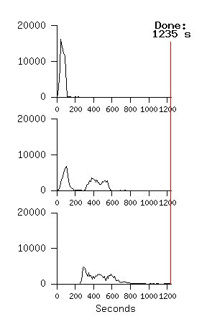
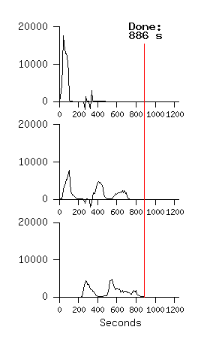
Performance
MapReduce Sort: Sort 10¹⁰ 100-byte records (modeled after TeraSort benchmark)
Normal Execution
No BackUp Tasks
200 Tasks Killed

Slide 11
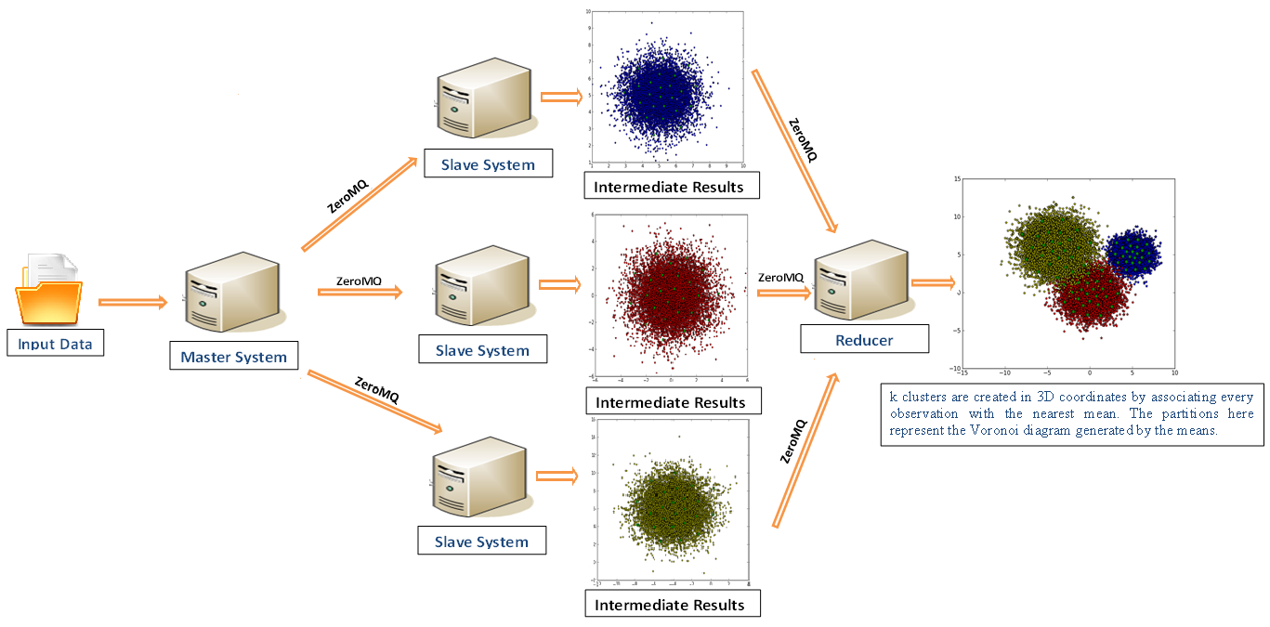
Use Case: MapReduce for Network Coverage Optimization Using
Kmeans Clustering

Slide 12
Conclusion
MapReduce provides a programming model that abstracts the problem from disk reads and writes, transforming into a computation over sets of keys and values.
It optimizes bandwidth of the network as the data is localized.
The run-time system takes care of the details of partitioning the input data, scheduling the program's execution across a set of machines, handling machine failures, and managing the required inter-machine communication.
The model is easy to use, even for programmers without experience with parallel and distributed systems, since it hides the details of parallelization, fault-tolerance, locality optimization, and load balancing.

Slide 13
References
https://hadoop.apache.org/docs/r1.2.1/mapred_tutorial.html
http://www.michael-noll.com/tutorials/writing-an-hadoop-mapreduce-program-in-python/
https://www.cloudera.com/content/cloudera-content/cloudera-docs/HadoopTutorial/CDH4/Hadoop-Tutorial.html
http://bigdatauniversity.com
Problem Solving on Large-Scale clusters - By Aaron Kimball: www.youtube.com/watch?v=yjPBkvYh-ss
Hadoop Mapreduce Fundamentals – By Lynn Langit http://www.youtube.com/watch?v=7FcMhTTG1Cs

