Slide 1

AdPortal Java Competency Development Scope and Objective

Slide 2
Scope of the Project
AdPortal provides a browser based platform for managing advertisements, the scope of the project is to demonstrate a very basic life cycle of an Advertisement.
As part of this project, the below components can be created :
User Interface to manage Advertisements :
This components will provide an user interface for the users to create advertisements. He should be able to create/modify and delete Advertisements.
The user interface also provides the control of displaying the advertisements.
The user interface also provides an admin privileges platform in which he can approve/reject an advertisements.
The user interface provides a preview for the users/admin for the created advertisements.
User Interface also provides an XML based metadata which can be uploaded to create the advertisement.
2. Metadata and data storage adapter :
This component provides a layer to manage data and a file server to store files.
3. User Interface to display Advertisements :
This component provides an user interface to display the advertisement.

Slide 3
Objective
With the current project execution, the team shall be able to apply the below concepts learned from the training, also they can explore/learn a domain which they see everyday.
From Java perspective
Core java.
Usage of Collection framework.
Database connectivity via JDBC.
Hibernate.
4. Exception Handling.
5. XML handling, JAXB.
J2EE.
HTML5.
JQuery, JSON.
From Domain perspective
1. Advertisement domain.

Slide 4
Team Details and Mentor Details
Team Details
Hari Haran Venugopal E2
Nandhini Chandran E2F
Mentor Details
Narendra Kumar (E4 TL)
Manager
Sujith Subramaniam

Slide 5
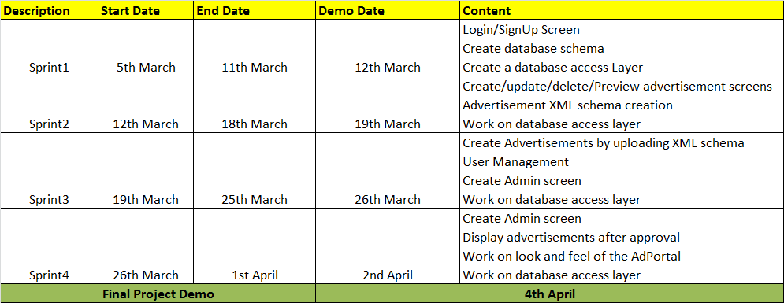
Project Execution Plan
Project shall be executed in Agile.
Duration of Sprint : 1 Weeks
One working demo shall be planned at the end of each Sprint.
Project Execution Plan

Slide 6
Thank You

