Slide 1
SQL - Basics

Slide 2
SQL
Structured Query Language
A programming language designed for managing data in relational database management systems (RDBMS).
File extension: sql.
Software : MS SQL server 2008 R2

Slide 3
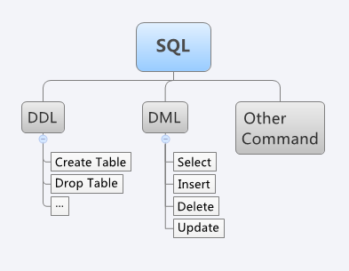

SQL DML and DDL
SQL can be divided into two parts: The Data Manipulation Language (DML) and the Data Definition Language (DDL).

Slide 4
Data Definition Language (DDL)
The DDL part of SQL permits database tables to be created or deleted. It also defines indexes (keys), specifies links between tables, and imposes constraints between tables.
Some DDL statements in SQL are:
  CREATE DATABASE - creates a new database
  ALTER DATABASE - modifies a database
  CREATE TABLE - creates a new table
  ALTER TABLE - modifies a table
  DROP TABLE - deletes a table
  CREATE INDEX - creates an index (search key)
  DROP INDEX - deletes an index

Slide 5
Data Manipulation Language (DML)
SQL can be divided into two parts: The Data Manipulation Language (DML) and the Data Definition Language (DDL).
Some DDL statements in SQL are:
  SELECT - extracts data from a database
  UPDATE - updates data in a database
  DELETE - deletes data from a database
  INSERT INTO - inserts new data into a database

Slide 6
Thank You
Notes:
Guidelines
The Program Review (PMR) is conducted monthly for all key functions to provide visibility to the Sr.Mgmt on the progress, performance, trends, risks and issues of the functions; the review is done against the function objectives, goals and plans; it helps the team and other stakeholders to take any course correction.
The Program review is held by the Function Head. Participants include the whole functional team.
The program review inputs (PPT/Report, support documents) to be circulated to all the participants in advance by the Function manager.
Participants are expected to come prepared for the meeting with specific queries/updates/resolution (for effective utilization of meeting time)
The recommended duration for program review is not more than 1 hour
The action item arising out of the Program review is recorded as part of the program review PPT and circulated to all the participants by the Function Manager
Function Manager tracks to closure the identified action items.
The Program review schedule will be published in the Intranet during the last week of every month and status updated periodically by QA.

