Slide 1


MapReduce Framework for Business Analytics <Hariharan Venugopal, Nikhita Bahuguna, Bekkem Praveen Kumar Reddy >
Paper Presentation

Slide 2
Introduction
We come from diverse teams handling different customers primarily working in the NMS and Mobile Enterprise Applications Group.
The interest into our presentation area i.e “MapReduce” began when we saw the recurring problems faced by our project teams in handling BigData across products that have lived for almost 7-8 years and today are crunched in scaling ahead due to the limitations the are presented by existing RDBMS.
Through this presentation we introduce MapReduce and present before you few use cases where MapReduce has been successfully implemented.
Today our customer too has put technologies like Hadoop within the roadmap of our project as they too now understand to leverage the strengths of Algorithms like MapReduce.

Slide 3
Problem Statement
What are the challenges in Large Scale Data Processing?
Indexing large amounts of unstructured data is a difficult task regardless of the technologies involved.
Traditional methods of applying dedicated algorithms and heuristics result in systems that are,
Hard to maintain.
Unwieldy.
Have degraded performance over time.
Although RDBMS are optimized for indexing and searching of large structured data sets they are inadequate for managing unstructured data.
What do we present here?
The MapReduce Programming Model
A use case around MapReduce Communication Architecture and its corresponding implementation
Implementation Case studies,
Kmeans Clustering
Image Segmentation Histogram
MapReduce in the Business Analytics Scenario

Slide 4
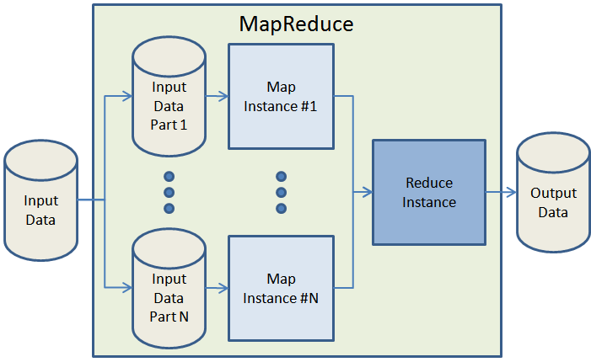
Programming Model - What is MapReduce?
MapReduce is a framework for processing huge datasets on distributable problems using a large number of computers (nodes, collectively referred to as a cluster or grid).
The algorithm comprises of two steps,
"Map" step: A master node takes the input data, partitions it up into smaller sub-problems, and distributes those to worker nodes. A worker node may again follow this iteration by acting as a master itself. The smaller problems are then processed by these individual worker nodes and the results are passed back to the master.
Map(k1,v1) → list(k2,v2)
"Reduce" step: Once the mapping is completed, the master node then takes the answers to all the sub-problems and combines them to get the required output i.e “The answer to the problem it was originally trying to solve.”
Reduce(k2, list (v2)) → list(v3)

Slide 5
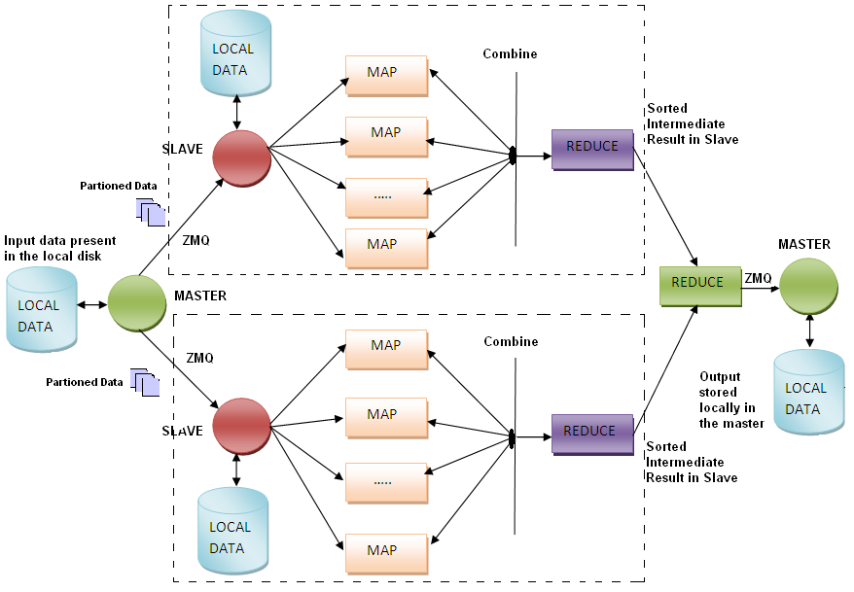
Programming Model - MapReduce In Detail…
The frozen part of the MapReduce Framework is a large distributed sort. The hot spots, which the application defines are:
An Input Reader
A Partition Function
A Map Function
A Combiner Function
A Comparison Function
A Reduce Function

Slide 6

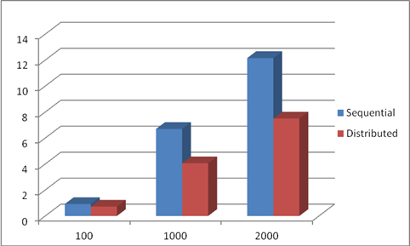
Use Case: MapReduce in the field of Biometrics
Biometrics are automated methods of recognizing a person based on a physiological or behavioral characteristics.
Over the next few years Biometric databases for the Federal Bureau of Investigations (FBI), Department of State (DoS), Department of Defense (DoD) and the Department of Homeland Security (DHS) are expected to grow to accommodate hundreds of millions, if not billions, of identities. As these biometric systems grow, distributed computing platforms such as MapReduce may be a feasible solution to this potential problem.
Using our framework we implemented image search using Histogram algorithm with significant performance compared to traditional sequential search.

Slide 7
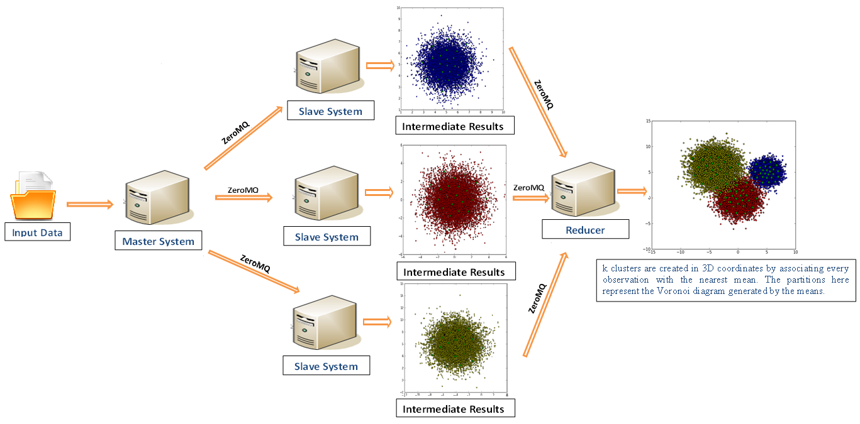
Use Case: MapReduce for Network coverage optimization using Kmeans clustering

Slide 8
Architecture used for Map-Reduce for KPI analytics
Network
Elements
KPI Reports & Analytics
Master Node
Task Balancer
Data Store
Network
Elements
Call Record
Stats Files
Control
Raw Data
Aggregated
KPI Data
Network
Elements
Cluster Machines
TaskTracker
TaskTracker
TaskTracker
TaskTracker
MR Node
MR Node
MR Node
MR Node
Distributed, Horizontally Scalable
Larger Network/More Call volume – More MR Nodes to scale out.
Seamless deployments for increased subscriber base

Slide 9
Conclusion
MapReduce provides a programming model that abstracts the problem from disk reads and writes, transforming into a computation over sets of keys and values.
It optimizes bandwidth of the network as the data is localized.
The run-time system takes care of the details of partitioning the input data, scheduling the program's execution across a set of machines, handling machine failures, and managing the required inter-machine communication.
The model is easy to use, even for programmers without experience with parallel and distributed systems, since it hides the details of parallelization, fault-tolerance, locality optimization, and load balancing.

Slide 10
Thank You!

