Slide 1
SEMI-PARAMETRIC DIFFERENTIAL GRAPH MODELS Kiran Teja Sarvamthota Hari Chandana Chintha

Slide 2
PROBLEM STATEMENT
Gene Network Analysis
To achieve accurate dependency relationships among genes.
Genes and their Interactions.
RNA and proteins are considered as group of variables and form genetic network which are modelled as graphical models.
In Gaussian graphical models,
Genes as nodes
Regulations as edges
Differential network analysis: Method of differential expression analysis of gene regulatory network

Slide 3
PROPOSED METHOD
Semi parametric graph models: To deal with gaussian distribution assumptions.
Latent Differential graph model:
Networks under two different conditions are represented by trans elliptical distributions.
Connectivity of individual network is encoded by latent precision matrix.
Ultimate goal is to estimate parameters and obtain a gene regulatory network.

Slide 4
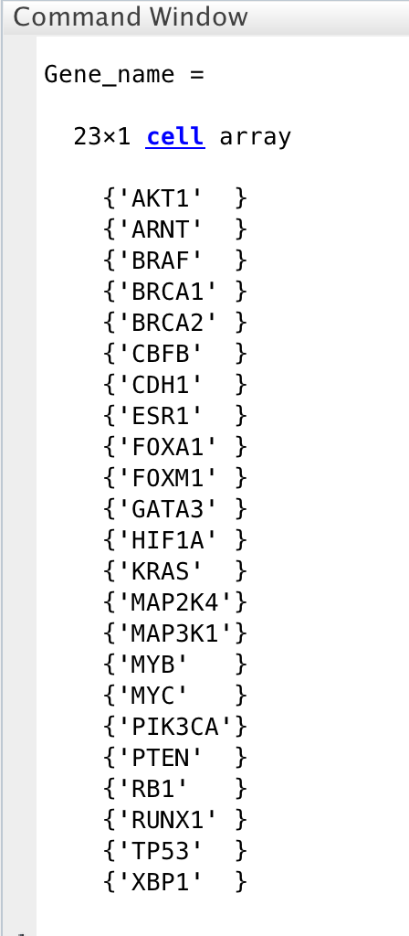
DATASET
Simulated Input DataSet:
hSigma_1.txt - Correlation values ( 23*23 matrix )
hSigma_2.txt - Correlation values ( 23*23 matrix )
TFs.txt – Gene Names ( 23 Genes )
Simulated Input DataSet:
hSigma_1.txt - Correlation values ( 50*50 matrix )
hSigma_2.txt - Correlation values ( 50*50 matrix )
TFs.txt – Gene Names ( 50 Genes )
Programming Envirornment: MATLAB

Slide 5
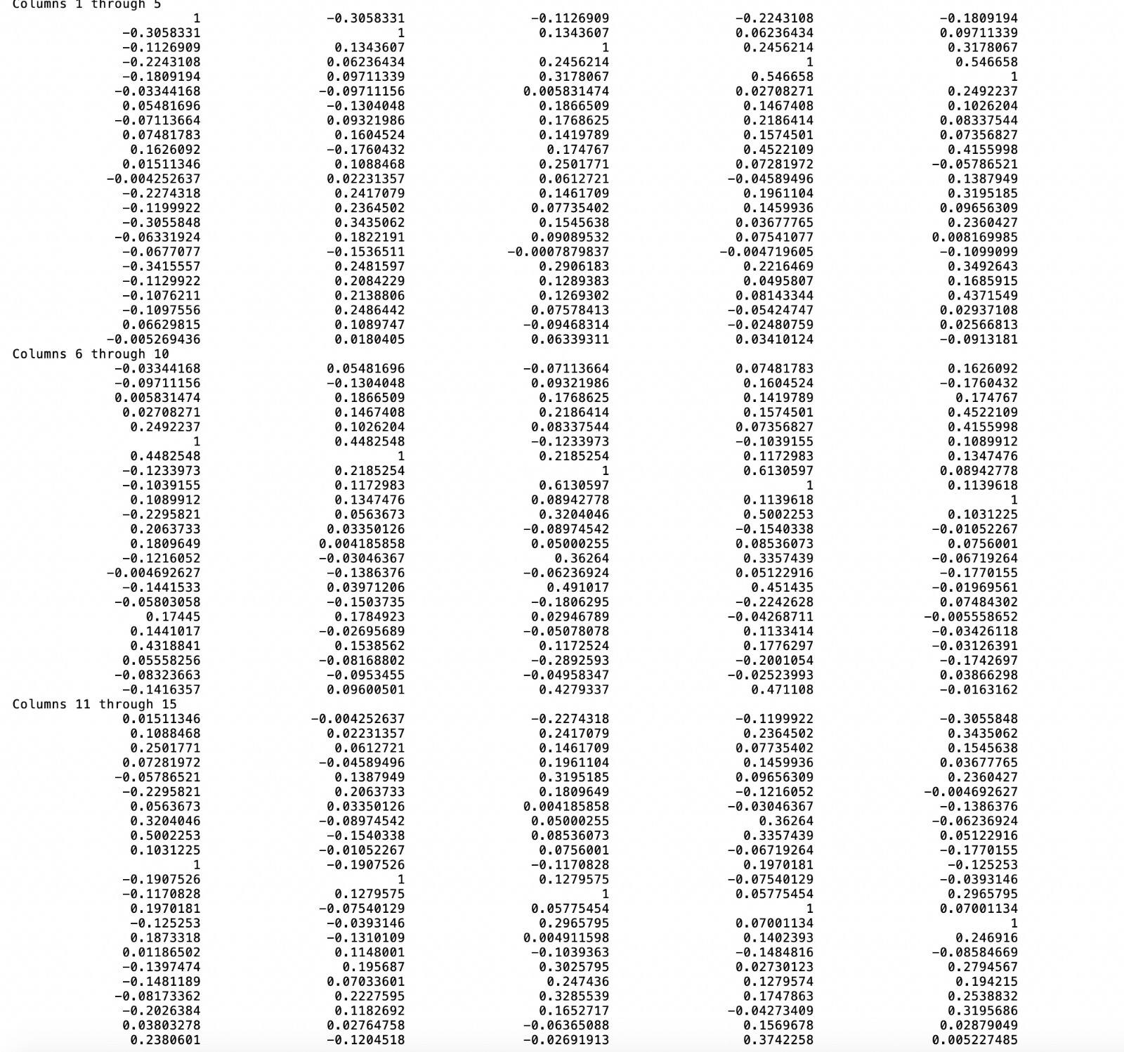
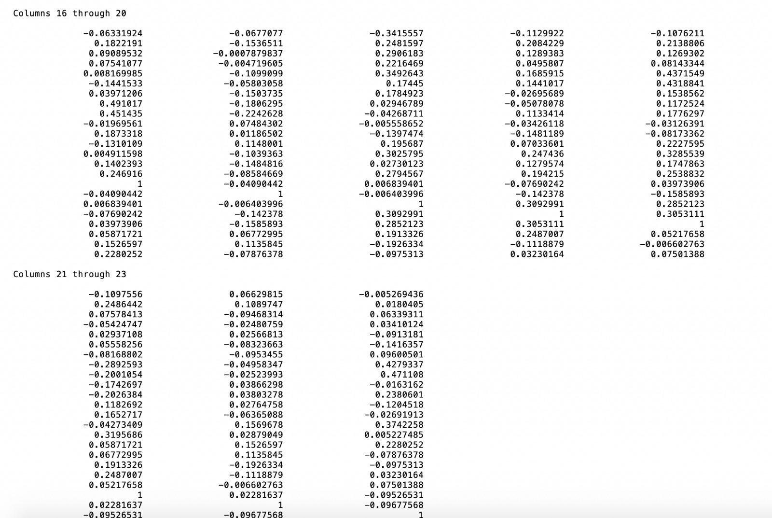
Input Data - Correlation Matrices

Slide 6
IMPLEMENTATION
Loaded the 3 input data files (hSigma_1.txt, hSigma_2.txt and TFs.txt )
Semi parametric graph models: To deal with gaussian distribution.
Multi variate Normal Distribution
Calculate covariance
Calculate Frobenius norm
Obtain a Covariance matrix

Slide 7
Latent Differential Graph Model
Differential Network analysis.
Calculate Q, Kronecker tensor product for all possible products of Sigma values.
Calculate b, difference of two latent precision matrices.
Calculate two trans elliptical distributions and obtain F and G values.
F = 1/2 *w'*Q*w - w'*b;
G = Q*w - b;

Slide 8
LDGM-L1:
Process Input: F & G values, W Initial matrix, Lambda.
Handle case insensitive for Gene Names.
Compute evaluate functions.
Outputs the W, Gene regulartory matrix.
On further refinement we obtain Thetha values.
Thetha values used to plot the gene regulatory network.

Slide 9
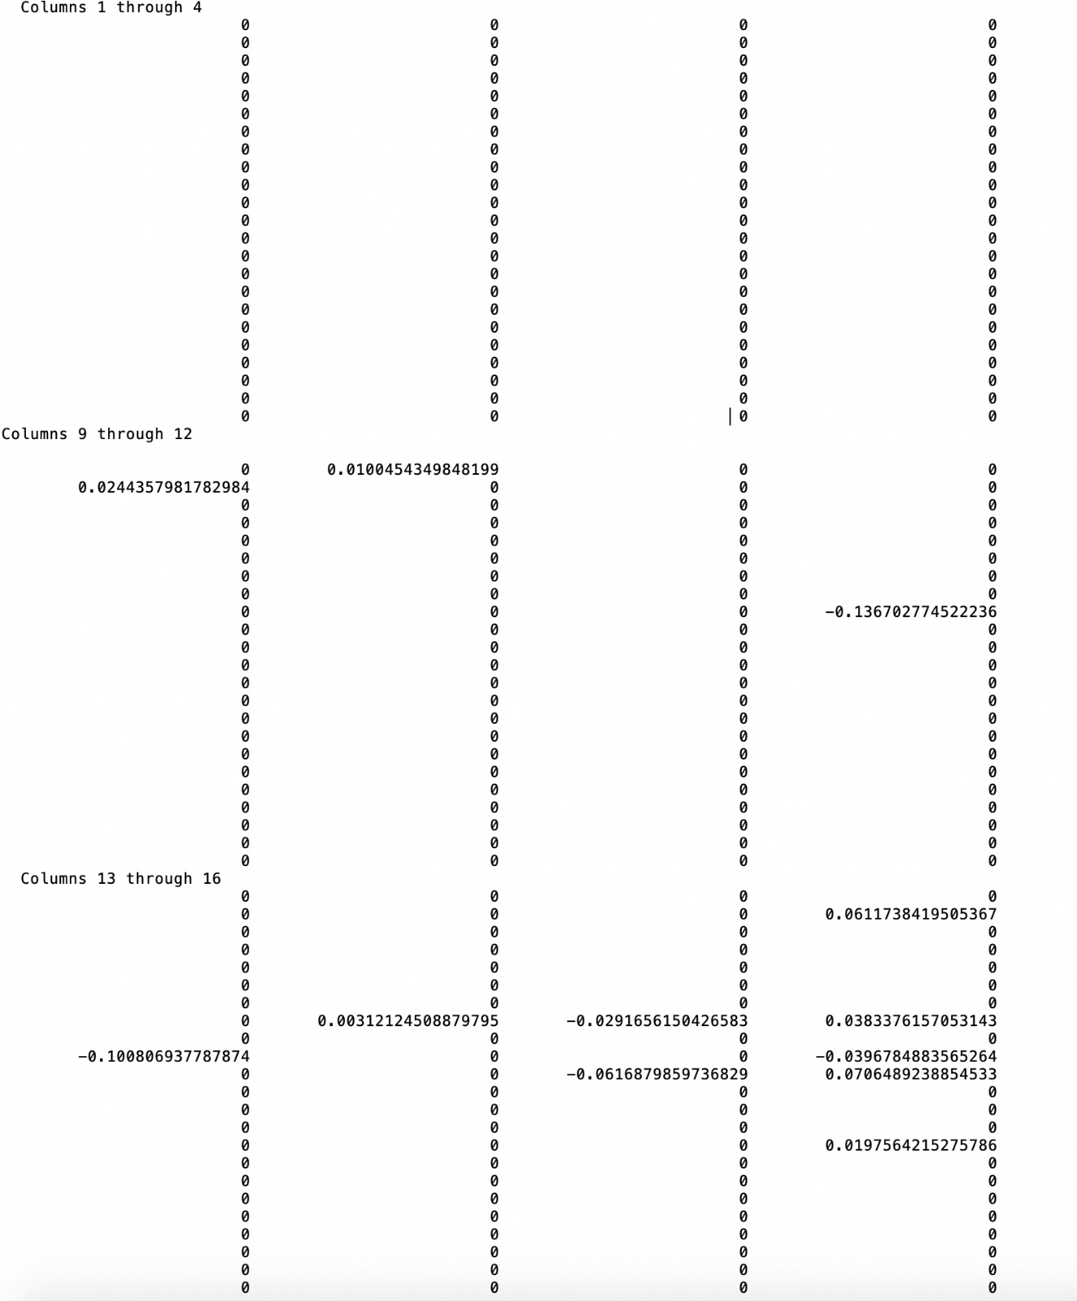
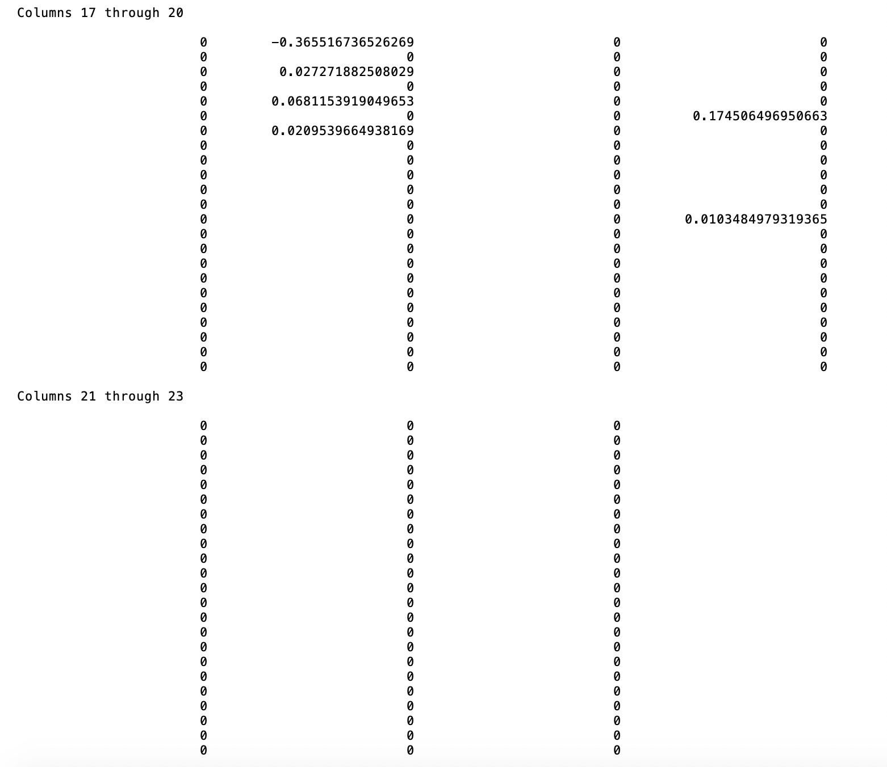
Obatained Matrix

Slide 10
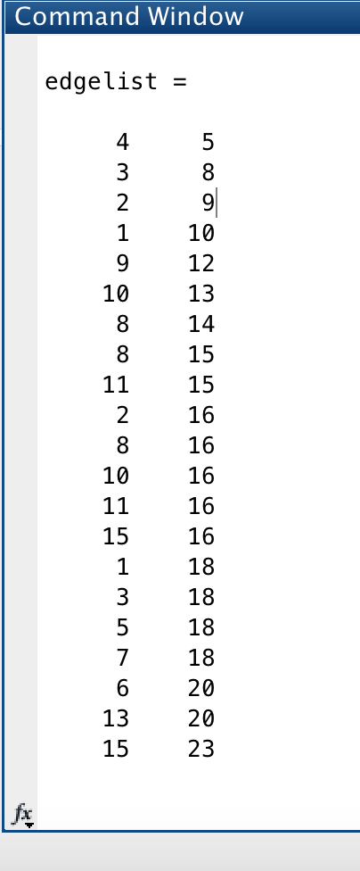
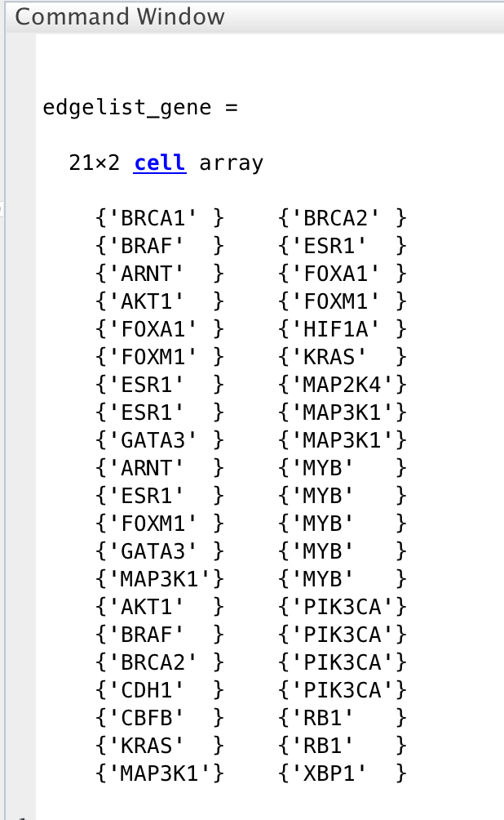
RESULTS
List of genes which have regulation.

Slide 11
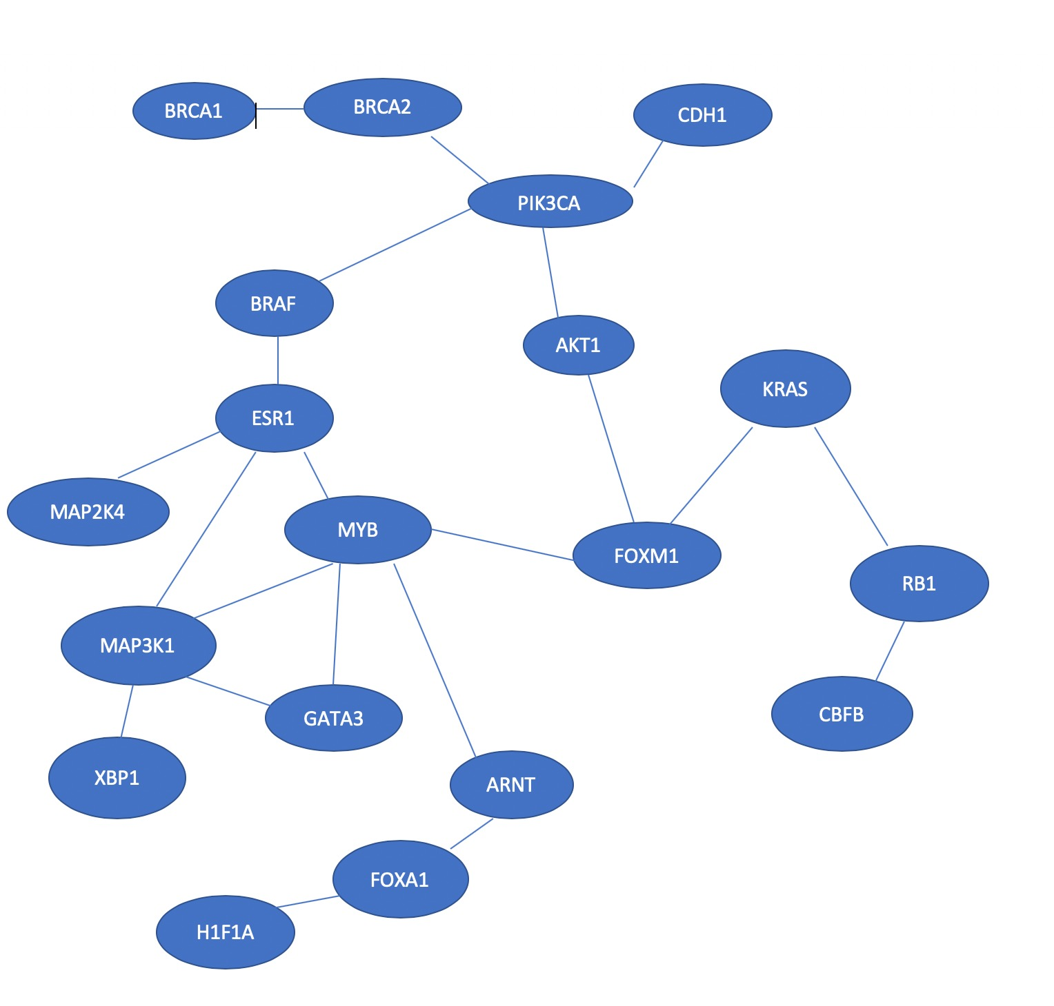
Gene Regulatory Network

Slide 12
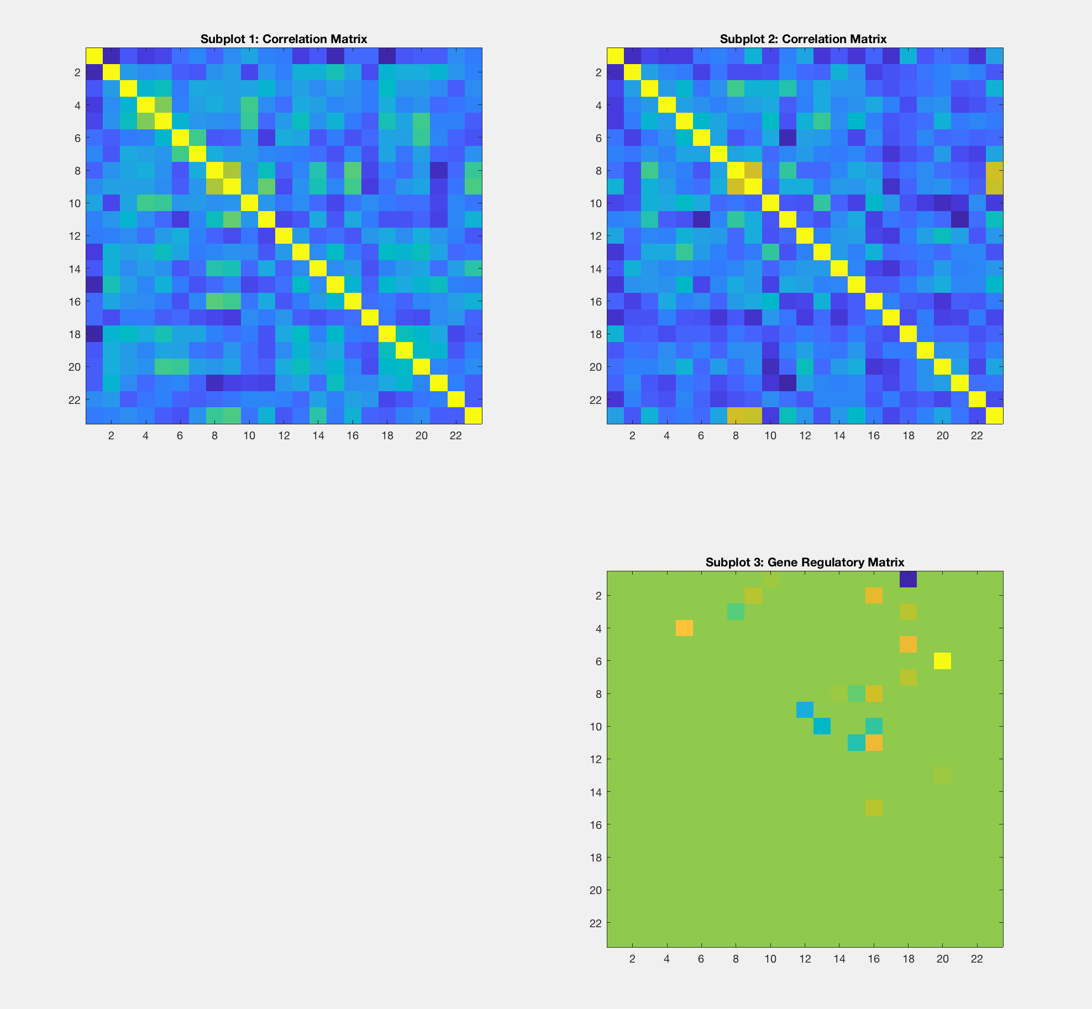
Visualization - Gene Regulation Matrix ( 23 Genes )

Slide 13
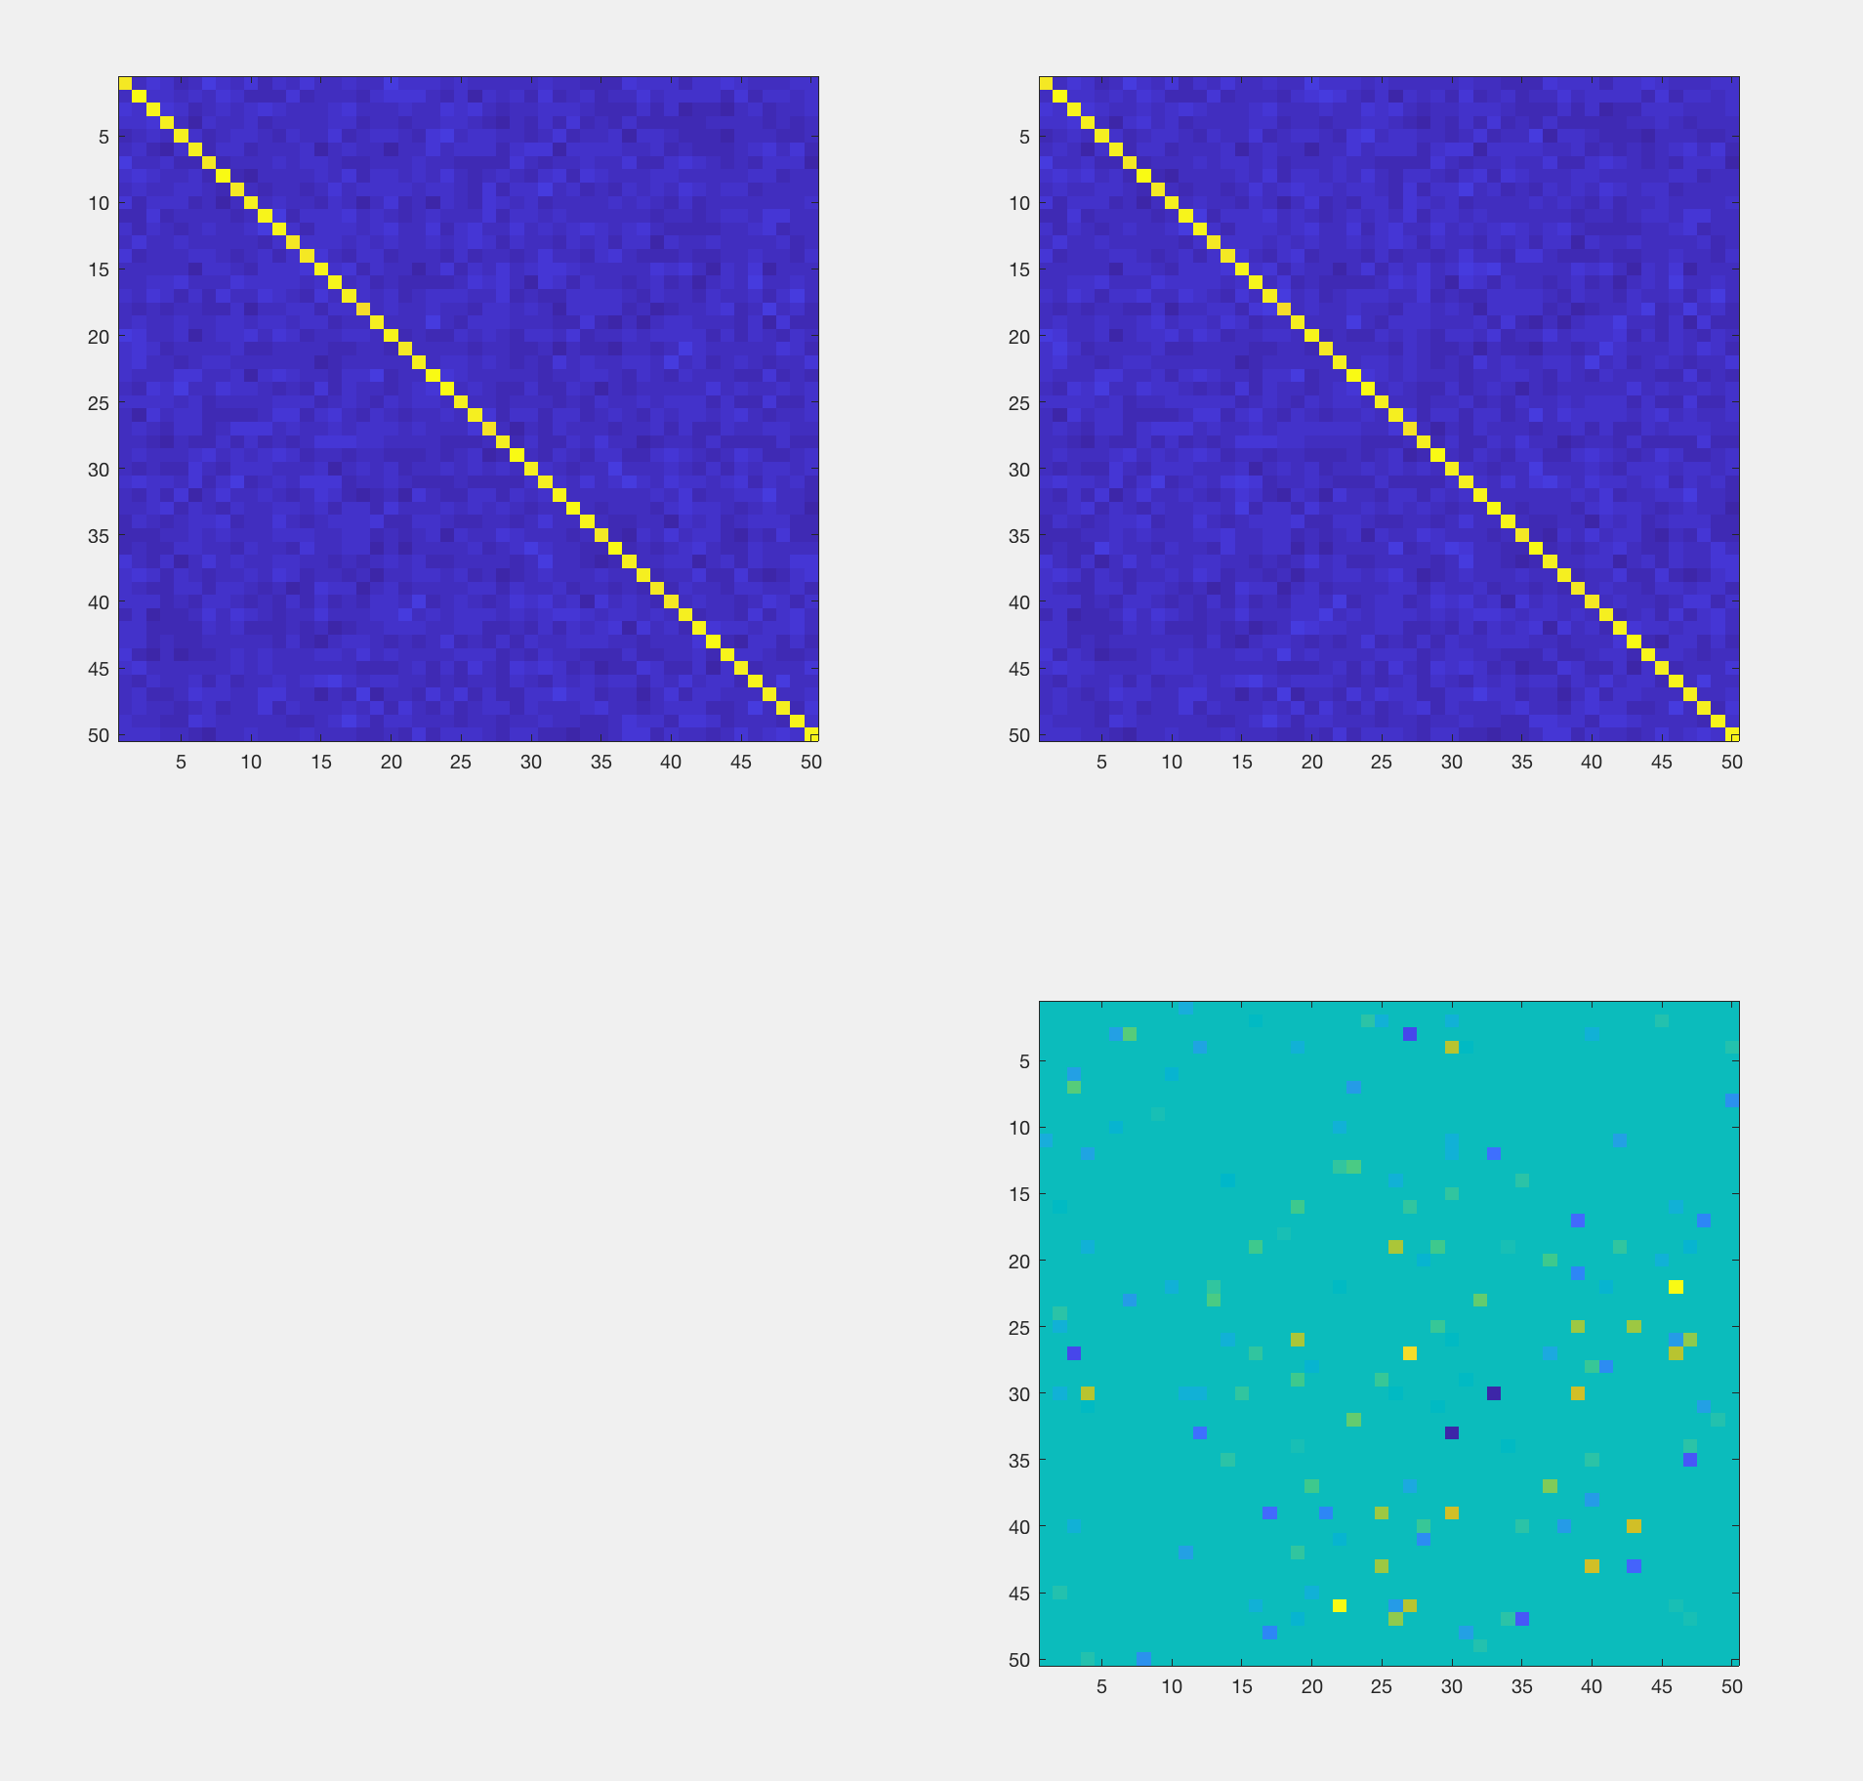
Visualization - Gene Regulation Matrix ( 50 Genes )

Slide 14
CITATIONS
PAPER: https://papers.nips.cc/paper/6529-semiparametric-differential-graph-models.pdf

Slide 15
THANK YOU
Thank you

