Slide 1
SECURE DATA HIDING IN IMAGES USING STEGANOGRAPHY
CAPSTONE PROJECT
Presented By :Hari Murugesan
Student Name : Hari Murugesan
College Name & Department : Vels University & Computer Science with Specialization Cybersecurity

Slide 2
OUTLINE
Problem Statement
Technology used
Wow factor
End users
Result
Conclusion
Git-hub Link
Future scope

Slide 3
PROBLEM STATEMENT
Traditional data encryption methods are easily detectable. We need a technique to hide messages in images securely without drawing attention.

Slide 4
TECHNOLOGY USED
Python (Main programming language)
Tkinter (GUI framework for the user interface)
OpenCV (cv2) (For image reading and writing)
Pillow (PIL) (For handling image formats)
OS Module (For file handling and opening images)

Slide 5
WOW FACTORS
Invisible Data Hiding: Messages are stored in image pixels, making detection difficult.
User-Friendly GUI: Easy-to-use interface for encoding and decoding messages.
Password Protection: Ensures only authorized users can decrypt messages.

Slide 6
END USERS
Journalists & Activists: Securely share sensitive information.
Defense & Intelligence: Covert communication without raising suspicion.
General Public: Private message sharing.
Military & government communication

Slide 7
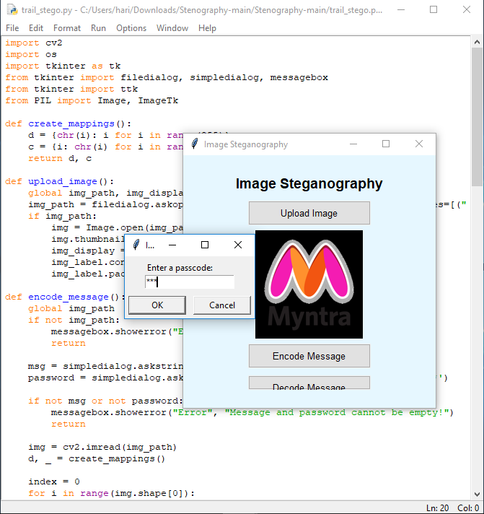
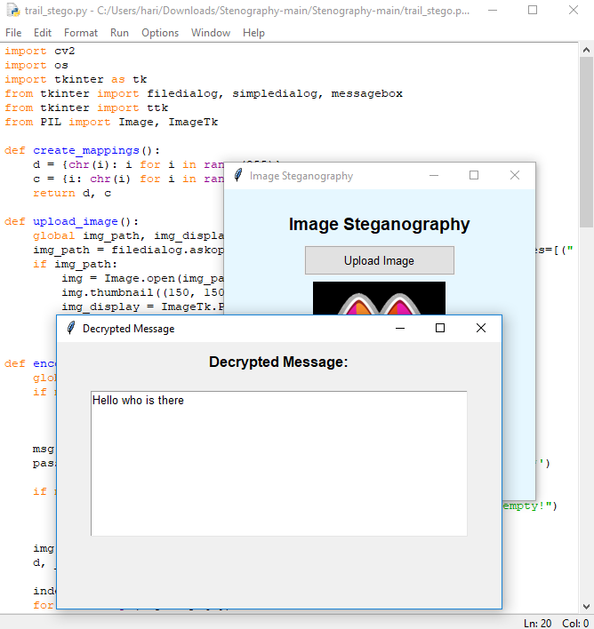
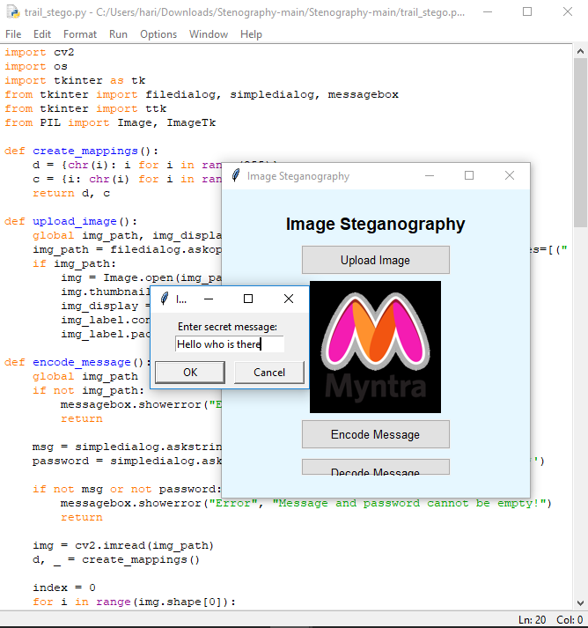
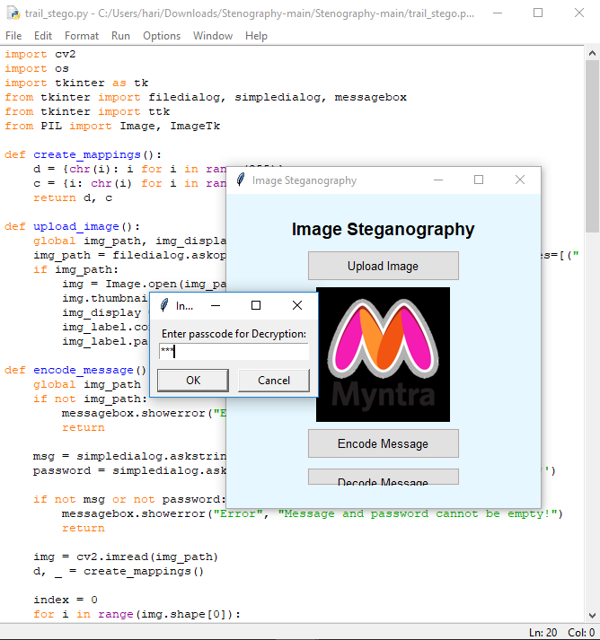
RESULTS

Slide 8
CONCLUSION
Steganography enhances security by hiding messages in images.
Our implementation ensures user-friendly encoding and decoding.
Password protection adds another layer of security.

Slide 9
GITHUB LINK
https://github.com/hari821-lap/stegno

Slide 10
FUTURE SCOPE(OPTIONAL)
Advanced Encryption: Combine steganography with encryption techniques.
Support for Multiple File Formats: Expand beyond PNG/BMP to JPEG and GIF.
Steganalysis Protection: Make detection even harder using noise reduction techniques.

Slide 11
THANK YOU

